Slide 1
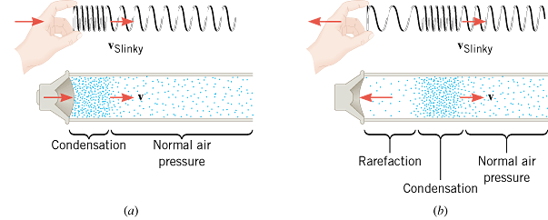
16.5 The Nature of Sound
Longitudinal Sound Waves
Sound in air is a longitudinal wave that is created by a vibrating object, such as a guitar string, the human vocal cords, or the diaphragm of a loudspeaker.

Slide 2
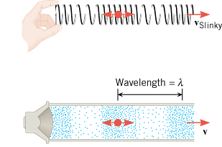
Sound cannot propagate in a vacuum
Bell in a vacuum

Slide 3
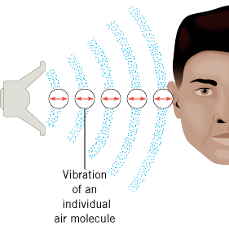
How do we hear?

Slide 4
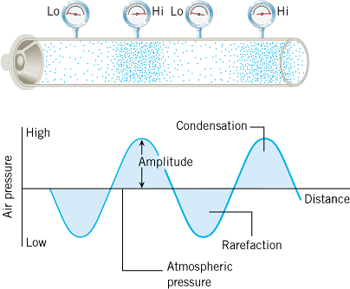
Wave Picture

Slide 5
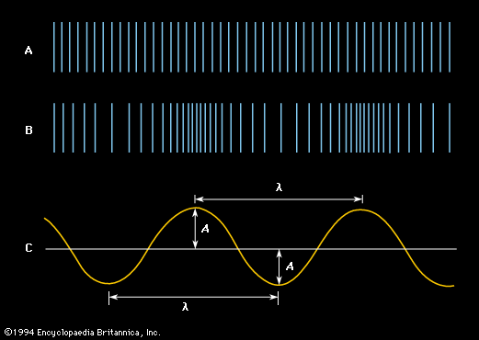
Graphic representations of a sound wave.
Air at equilibrium, in the absence of a sound wave; Compressions and rarefactions that constitute a sound wave;
Transverse representation of the wave, showing amplitude (A) and wavelength (λ).
Name the x axis?
What are the choices for the y-axis?
Draw a transverse representation of a wave, name the axes, and show period.

Slide 6
The Frequency of a Sound Wave
Audible Range: 20 Hz ----- 20,000 Hz.
Infrasonic waves: Sound waves with frequencies < 20 Hz.
Rhinoceroses use infrasonic frequencies as low as 5 Hz to call one another
Ultrasonic waves: Sound waves with frequencies > 20,000 Hz.
Bats use ultrasonic frequencies up to 100 kHz for locating their food sources and navigating.

Slide 7
Objective and Subjective properties of sound
Objective properties can be measured, used in physics.
Subjective properties are subjective to the person, used in music.
Objective property
Subjective quality
Frequency
Pitch
Intensity
Loudness
Waveform
Tymbre or Quality

Slide 8
Speed of Sound in an ideal gas
γ = 1.40 (ratio of specific heats for air) m = 4.8 x 10⁻²⁶ kg (average molecular mass of air) k = 1.38 x 10⁻²³ J/K (Boltzmann constant)
T= temperature in Kelvin
Gases Speed of Sound (m/s)
Air (0 °C) | 331
Air (20 °C) | 343
Carbon dioxide (0 °C) | 259
Oxygen (0 °C) | 316
Helium (0 °C) | 965
Liquids Speed of Sound (m/s)
Chloroform (20 °C) | 1004
Ethyl alcohol (20 °C) | 1162
Mercury (20 °C) | 1450
Fresh water (20 °C) | 1482
Seawater (20 °C) | 1522
Solids Speed of Sound (m/s)
Copper | 5010
Glass (Pyrex) | 5640
Lead | 1960
Steel | 5960

Slide 9
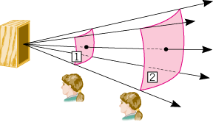
16.7 Sound Intensity
The sound intensity I is defined as the sound power P that passes perpendicularly through a surface divided by the area A of that surface:
The unit of sound intensity is power per unit area, or W/m².

Slide 10
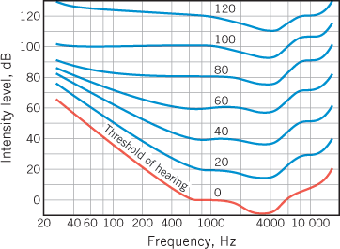
Human Ear and Sensitivity
Audible frequency range: 20 Hz – 20,000 Hz
Audible intensity range: 10^{–12} W/m² - 10 w/m²
10^{–12} W/m² = Threshold of hearing
10 W/m² = Threshold of pain

Slide 11
16.8 Decibels
The decibel (dB) is a measurement unit used when comparing two sound intensities.
The intensity level β (expressed in decibels) relative to the threshold of hearing, I_{o} is defined as follows:

Slide 12
TABLE 16.2 Typical Sound Intensities and Intensity Levels Relative to the Threshold of Hearing
Intensity I (W/m²)
Intensity Level β (dB)
Threshold of hearing
1.0 × 10⁻¹²
0
Rustling leaves
1.0 × 10⁻¹¹
10
Whisper
1.0 × 10⁻¹⁰
20
Normal conversation (1 meter)
3.2 × 10⁻⁶
65
Inside car in city traffic
1.0 × 10⁻⁴
80
Car without muffler
1.0 × 10⁻²
100
Live rock concert
1.0
120
Threshold of pain
10
130

