Slide 1
Ch3: Kinematics in Two Dimensions

Slide 2
3.1 Kinematics in Two Dimensions: An Introduction
Two-Dimensional Motion: Walking in a City

Slide 3
3.1 Kinematics in Two Dimensions: An Introduction
Two-Dimensional Motion: Walking in a City

Slide 4
3.1 Kinematics in Two Dimensions: An Introduction
Two-Dimensional Motion: Walking in a City

Slide 5
The Independence of Perpendicular Motions
The horizontal and vertical components of two-dimensional motion are independent of each other.

Slide 6
The Independence of Perpendicular Motions
The horizontal and vertical components of two-dimensional motion are independent of each other.
Any motion in the horizontal direction does not affect motion in the vertical direction, and vice versa.

Slide 7
The Independence of Perpendicular Motions
The horizontal and vertical components of two-dimensional motion are independent of each other.
Any motion in the horizontal direction does not affect motion in the vertical direction, and vice versa.

Slide 8
The Independence of Perpendicular Motions
The horizontal and vertical components of two-dimensional motion are independent of each other.
Any motion in the horizontal direction does not affect motion in the vertical direction, and vice versa.

Slide 9
Trigonometry
Right-Triangle | Pythagorean Theorem | sin θ | cos θ | tan θ
Starting from the base, a camper do the following walks and gets lost. First 3 miles north, then 4 miles east, and then 6 miles south. How will you direct a helicopter pilot to reach the stranded camper?

Slide 10
Trigonometry
A park ranger wanted to measure the height of a tall tree. The ranger stood 9.50 m from the base of the tree; and he observed that his line of sight made an angle of 65.2° above the horizontal as he looked at the top of the tree. The park ranger's eyes are 1.80 m above the ground. What is the height of the tree?

Slide 11
Vector Illustration
Consider the following displacement vector: 2 km @ 30⁰ North of East.

Slide 12
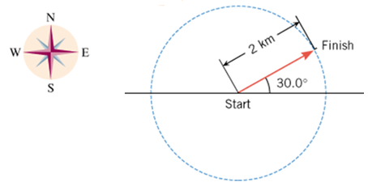
Vector Illustration
Consider the following displacement vector: 2 km @ 30⁰ North of East.

Slide 13
Vector Illustration
Consider the following displacement vector: 2 km @ 30⁰ North of East.
The length of the vector arrow is proportional to the magnitude of the vector and the arrow represents the direction.

Slide 14
Vector Illustration
Consider the following displacement vector: 2 km @ 30⁰ North of East.
The length of the vector arrow is proportional to the magnitude of the vector and the arrow represents the direction.
In the text, bold face is used for vectors and italics is used for scalars. When hand written an arrow is placed above the symbol.

Slide 15
Vector Illustration
Consider the following displacement vector: 2 km @ 30⁰ North of East.
The length of the vector arrow is proportional to the magnitude of the vector and the arrow represents the direction.
In the text, bold face is used for vectors and italics is used for scalars. When hand written an arrow is placed above the symbol.
A vector can be moved, keeping its magnitude and direction.

Slide 16
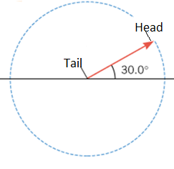
Vector Illustration
Consider the following displacement vector: 2 km @ 30⁰ North of East.
The length of the vector arrow is proportional to the magnitude of the vector and the arrow represents the direction.
In the text, bold face is used for vectors and italics is used for scalars. When hand written an arrow is placed above the symbol.
A vector can be moved, keeping its magnitude and direction.
Head and Tail of a vector are:

Slide 17
Components of a Vector
Consider the following vector, A:
How can we replace vector A by two perpendicular components?

Slide 18
Components of a Vector
A_{adj}=A∙Cos θ and A_{opp}=A∙Sin θ

Slide 19
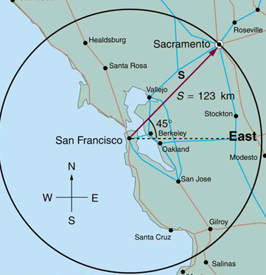
Chapter 3, Problem 15
15. Find the north and east components of the displacement from San Francisco to Sacramento shown in Figure 3.59.

