Slide 1
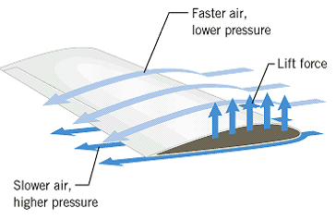

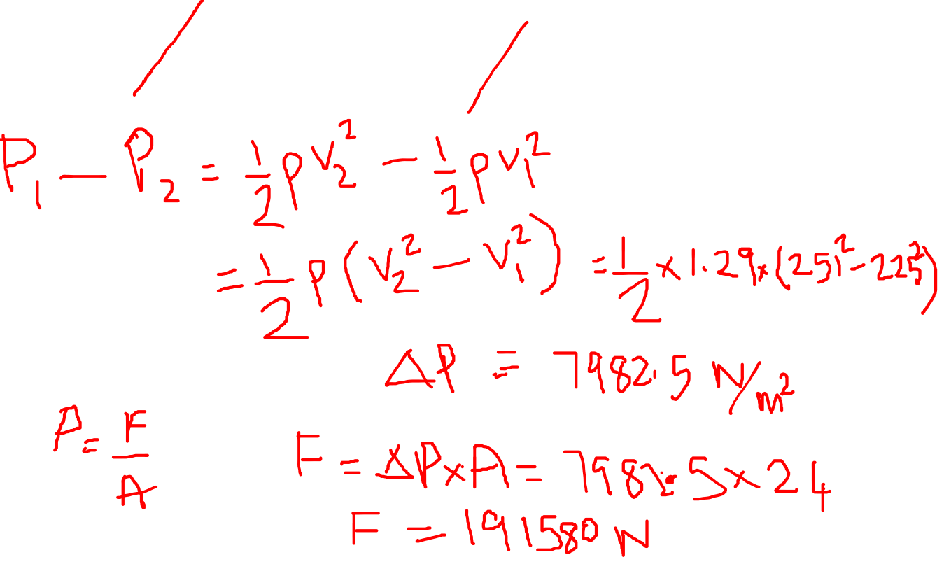
P63 CJ10. An airplane wing is designed so that the speed of the air across the top of the wing is 251 m/s when the speed of the air below the wing is 225 m/s. The density of the air is 1.29 kg/m³. What is the lifting force on a wing of area 24.0 m²?

Slide 2
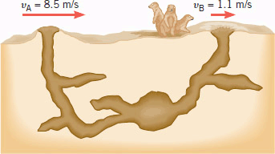
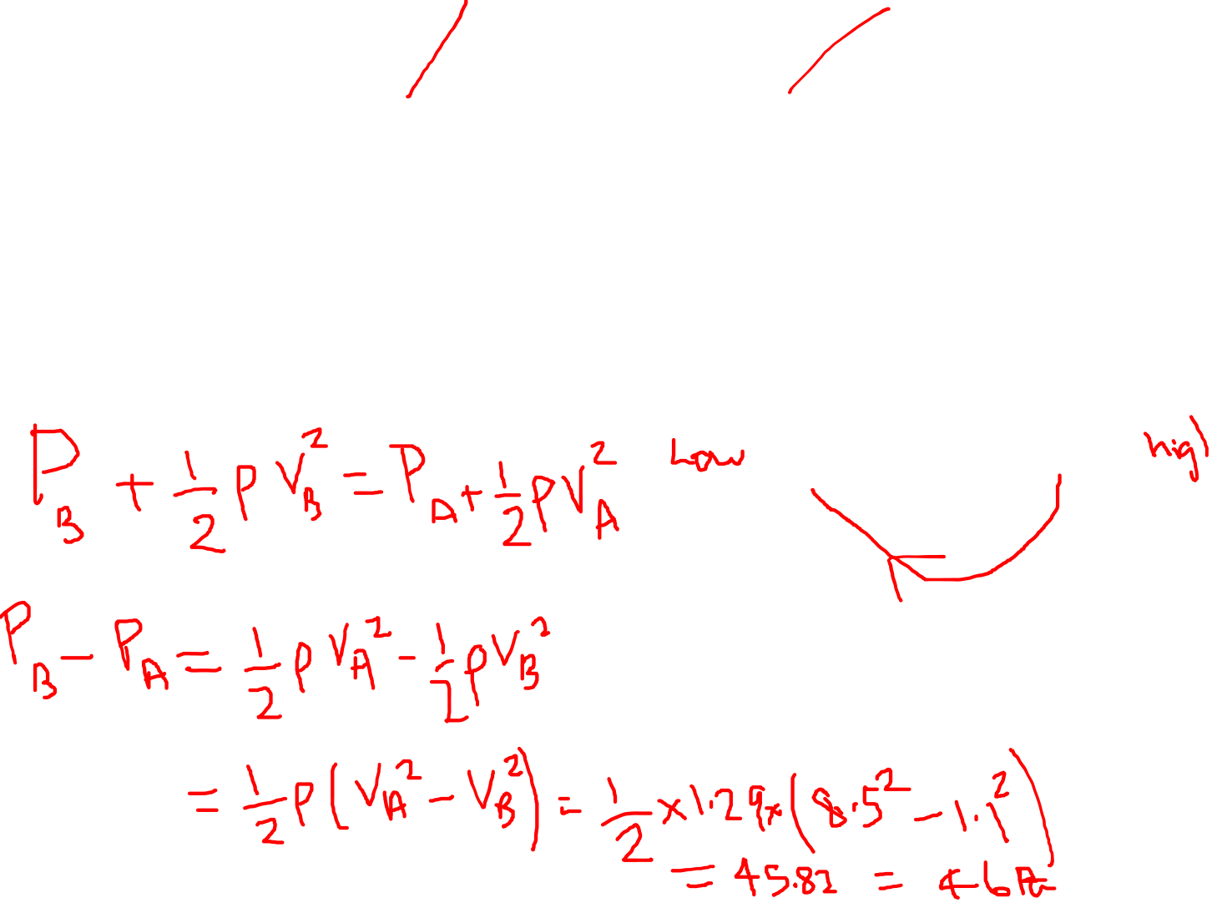
P61 CJ10. Prairie dogs are burrowing rodents. They do not suffocate in their burrows, because the effect of air speed on pressure creates sufficient air circulation. The animals maintain a difference in the shapes of two entrances to the burrow, and because of this difference, the air blows past the openings at different speeds, as the drawing indicates. Assuming that the openings are at the same vertical level, find the difference in air pressure between the openings and indicate which way the air circulates. The density of the air is 1.29 kg/m³.

Slide 3

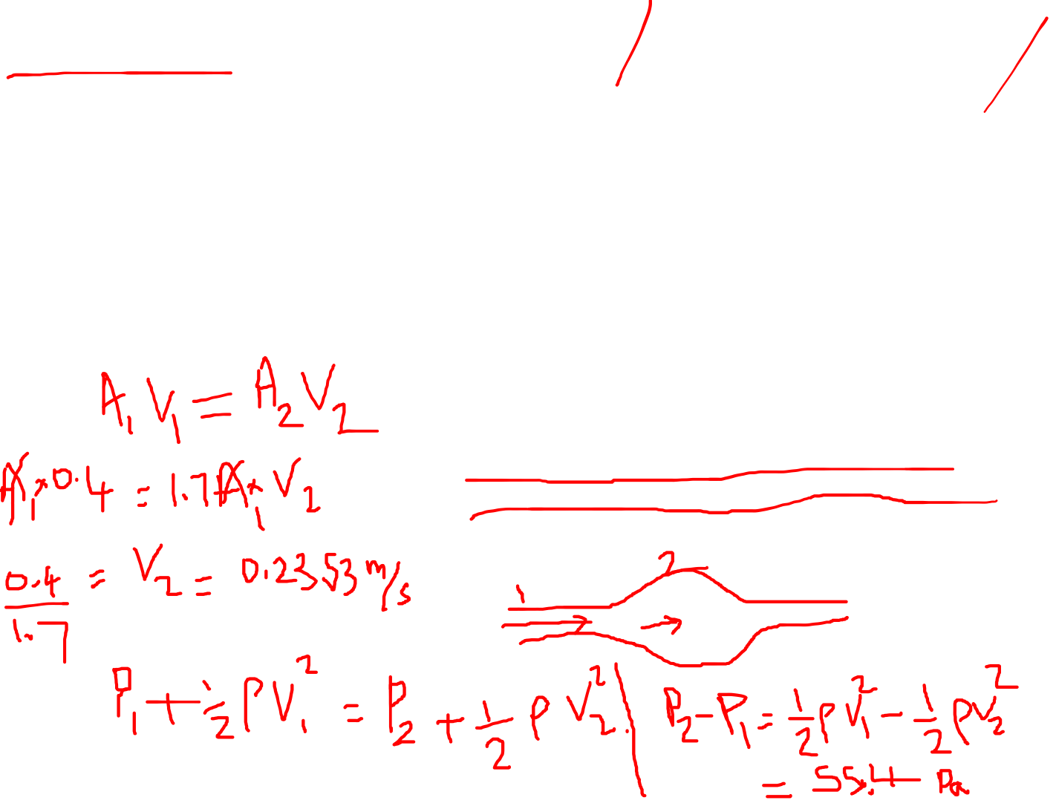
An aneurysm is an abnormal enlargement of a blood vessel such as the aorta. Because of the aneurysm, the normal cross-sectional area A₁ of the aorta increases to a value of A₂ = 1.7 A₁. The speed of the blood through a normal portion of the aorta is v₁ = 0.40 m/s. Assuming that the aorta is horizontal (the person is lying down), determine the amount by which the pressure P₂ in the enlarged region exceeds the pressure P₁ in the normal region. (Density of blood = 1060 kg/m³)

