Slide 1

Ch12: Fluid Dynamics
In Chapter 11 we have seen Fluid Statics, where fluids are at rest.
Fluids also flow.
The physics of fluids in motion—fluid dynamics—allows us to answer questions like the following:
How does a nozzle increase the speed of water emerging from a hose? How does the body regulate blood flow? How airplanes get their lift?

Slide 2
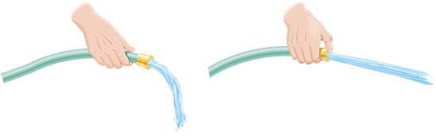
The Equation of Continuity
Q: Have you ever used your thumb to control the water flowing from the end of a hose?
A: When the end of a hose is partially closed off, thus reducing its cross-sectional area, the fluid velocity increases.
This kind of fluid behavior is described by the equation of continuity.

Slide 3
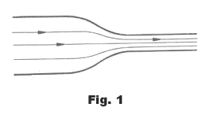
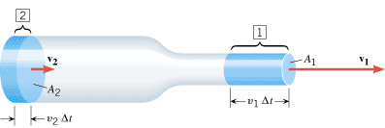


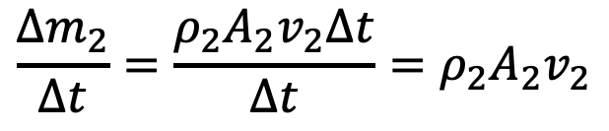

Equation of Continuity
Each line represents a streamline.
Mass flow rate at position 2:
$$\frac{{∆m}_{2}}{∆t}=\frac{ρ_{2}A_{2}v_{2}∆t}{∆t}=ρ_{2}A_{2}v_{2}$$
Mass flow rate at position 1:
$$\frac{{∆m}_{1}}{∆t}=\frac{ρ_{1}A_{1}v_{1}∆t}{∆t}=ρ_{1}A_{1}v_{1}$$
Since the flow rate is the same:
$$ρ_{2}A_{2}v_{2}=ρ_{1}A_{1}v_{1}$$
If the density stays the same,
$$A_{2}v_{2}=A_{1}v_{1}$$

Slide 4

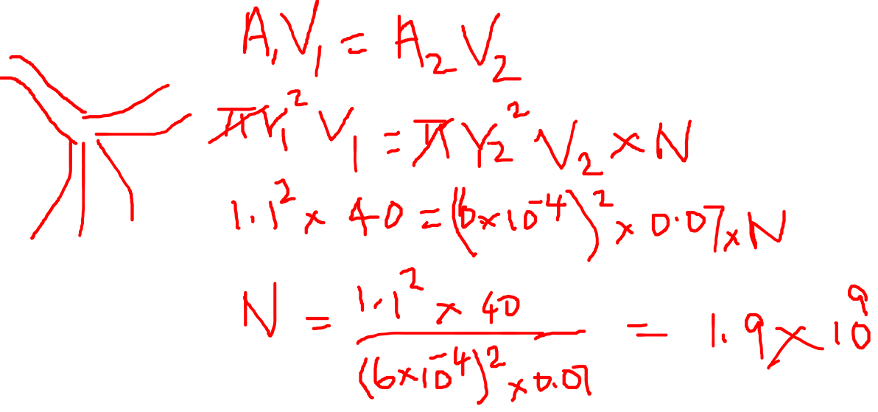
P59 CJ10 The aorta carries blood away from the heart at a speed of about 40 cm/s and has a radius of approximately 1.1 cm. The aorta branches eventually into a large number of tiny capillaries that distribute the blood to the various body organs. In a capillary, the blood speed is approximately 0.07 cm/s, and the radius is about 6 x 10⁻⁴ cm. Treat the blood as an incompressible fluid and use these data to determine the approximate number of capillaries in the human body.

Slide 5
Bernoulli’s Principle
A statement about energy conservation in fluid flow.
Bernoulli's principle states that for a fluid, an increase in the speed of the fluid occurs simultaneously with a decrease in pressure or a decrease in the fluid's potential energy.
This principle is a key concept in fluid dynamics that explains phenomena like how airplane wings generate lift and how ventilation systems work by relating pressure, speed, and height.

Slide 6
Conditions for Bernoulli's equation
The Bernoulli equation applies when the fluid is incompressible, has negligible viscosity (inviscid), and experiences steady flow. Additionally, the flow must be along a single streamline, with no external forces adding or removing energy from the fluid.
Steady flow: The fluid's velocity, density, and pressure at any given point do not change over time.
Incompressible fluid: The density of the fluid remains constant throughout the flow.
Frictionless (inviscid) flow: Viscous forces, which create internal friction and energy loss, are assumed to be negligible.
Flow along a streamline: The equation should be applied to points that lie on the same streamline, representing the path of a fluid particle.
No energy addition or removal: The system has no pumps adding energy or turbines removing energy.

Slide 7
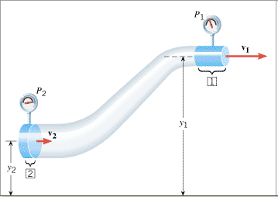
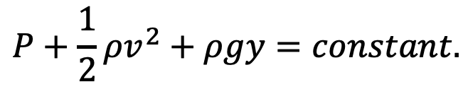
Bernoulli’s Equation
Along a streamline of a fluid flow,
$$P+\frac{1}{2}ρv^{2}+ρgy=constant.$$
In the steady flow of a non-viscous, incompressible fluid of density ρ, the pressure P, the fluid speed v, and the elevation y at any two points (1 and 2) are related by

Slide 8
Bernoulli's principle in action
Shower curtain: When the shower is on, the high-velocity stream of water and air inside the shower creates a region of lower pressure.
The higher pressure outside the shower pushes the curtain inward, causing it to bulge into the stall.

Slide 9
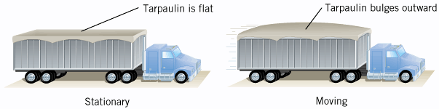
Applications of Bernoulli's Equation
The tarpaulin that covers the cargo is flat when the truck is stationary but bulges outward when the truck is moving.

Slide 10
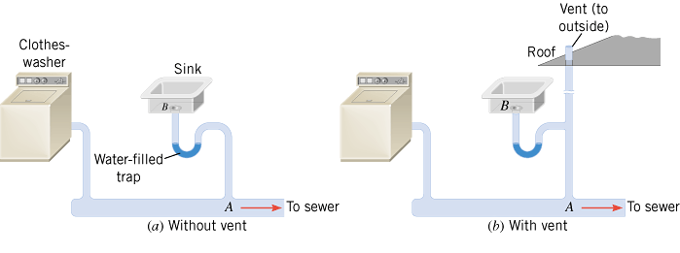
Household Plumbing
In a household plumbing system, a vent is necessary to equalize the pressures at points A and B, thus preventing the trap from being emptied. An empty trap allows sewer gas to enter the house.

Slide 11
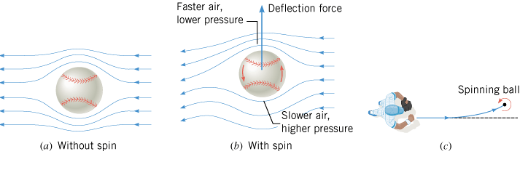
Curveball Pitch

Slide 12
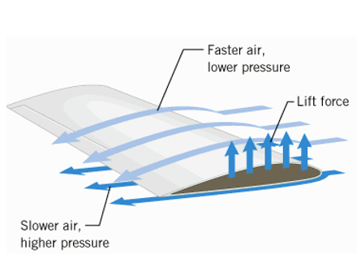
Airplane Wings
The curved top of an airplane wing is longer than the bottom, which forces air to travel faster over the top.
According to Bernoulli's principle, this faster-moving air results in lower pressure on the top of the wing.
The higher pressure on the bottom then creates an upward force called lift.

Slide 13
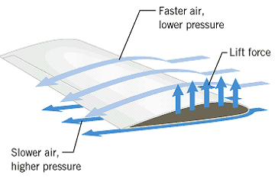
P63 CJ10. An airplane wing is designed so that the speed of the air across the top of the wing is 251 m/s when the speed of the air below the wing is 225 m/s. The density of the air is 1.29 kg/m³. What is the lifting force on a wing of area 24.0 m²?

Slide 14
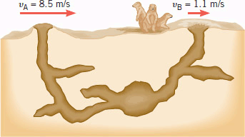
P61 CJ10. Prairie dogs are burrowing rodents. They do not suffocate in their burrows, because the effect of air speed on pressure creates sufficient air circulation. The animals maintain a difference in the shapes of two entrances to the burrow, and because of this difference, the air blows past the openings at different speeds, as the drawing indicates. Assuming that the openings are at the same vertical level, find the difference in air pressure between the openings and indicate which way the air circulates. The density of the air is 1.29 kg/m³.

Slide 15
An aneurysm is an abnormal enlargement of a blood vessel such as the aorta. Because of the aneurysm, the normal cross-sectional area A₁ of the aorta increases to a value of A₂ = 1.7 A₁. The speed of the blood through a normal portion of the aorta is v₁ = 0.40 m/s. Assuming that the aorta is horizontal (the person is lying down), determine the amount by which the pressure P₂ in the enlarged region exceeds the pressure P₁ in the normal region. (Density of blood = 1060 kg/m³)

