Slide 1
C H A P T E R 1 Introduction and The Nature of Physics

Slide 2
Chapter Outline
1.1 Physics: An Introduction Explain the difference between a principle and a law.
Explain the difference between a model and a theory.
1.2 Physical Quantities and Units Perform unit conversions both in the SI and English units.
Explain the most common prefixes in the SI units and be able to write them in scientific notation.
1.3 Accuracy, Precision, and Significant Figures
Determine the appropriate number of significant figures in both addition and subtraction, as well as multiplication and division calculations.
Calculate the percent uncertainty of a measurement.
1.4 Approximation
Make reasonable approximations based on given data.

Slide 3
The Nature of Physics
The word physics comes from Greek, meaning nature. The study of nature came to be called “natural philosophy.”
Physics is the study of the fundamental laws of nature.
Physics deals with the behavior and structure of matter.
Physics is very fundamental and the most basic of the sciences.
Physics can predict how nature will behave in one situation on the basis of experimental data obtained in another situation.

Slide 4
Sub-Fields of Physics
Introductory physics is divided into the following sub-fields:
Mechanics (Chapters 1-12)
Thermal physics (Chapters 13-15)
Wave motion and sound (Chapters 16-17)
Electricity and magnetism (Chapters 18-24)
Light and optics (Chapters 25-27)
Modern physics (Chapters 28-34)

Slide 5
Relativistic Quantum Mechanics
Modern physics: relativity (very fast) and quantum mechanics (very small).
Relativity must be used whenever an object is traveling at greater than about 1% of the speed of light or experiences a strong gravitational field such as that near the Sun.
Quantum mechanics must be used for objects smaller than can be seen with a microscope.
The combination of these two theories is relativistic quantum mechanics, and it describes the behavior of small objects traveling at high speeds or experiencing a strong gravitational field.
Relativistic quantum mechanics is the best universally applicable theory we have.

Slide 6
Historical Development
Models, Theories, and Laws
The Scientific Method
The Evolution of Natural Philosophy into Modern Physics Aristotle (384–322 B.C.)
Galileo Galilei (1564–1642)
Isaac Newton (1642–1727)
Niels Bohr (1885–1962)
Max Planck (1858-1947)
Albert Einstein (1879 – 1955)

Slide 7
Units of Measurement
 | System
 | SI | CGS | BE/USC
Length | meter (m) | centimeter (cm) | foot (ft)
Mass | kilogram (kg) | gram (g) | slug (sl)
Time | second (s) | second (s) | second (s)
SI stands for the French phrase "Le Systeme International d'Unitus."
CGS - centimeter (cm), gram (g), and second.
BE/USC - British Engineering/US Customary.
https://www.nist.gov/si-redefinition

Slide 8
Base Quantities and Units: There are 7 of them
Physical Quantity
Unit
Name
Symbol
Time
second
s
Length
meter
m
Mass
kilogram
kg
Electric current
ampere
A
Temperature
kelvin
K
Amount of substance
mole
mol
Luminous intensity
candela
cd
Units named after people are capitalized.

Slide 9
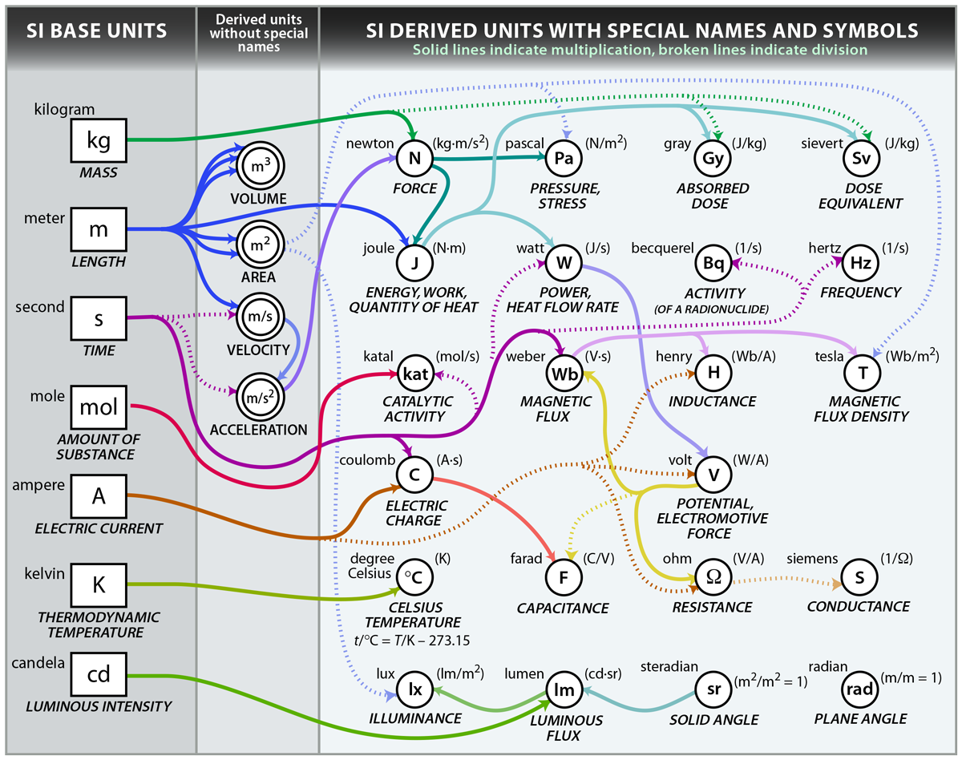
https://www.nist.gov/si-redefinition/kilogram-focus-history

Slide 10
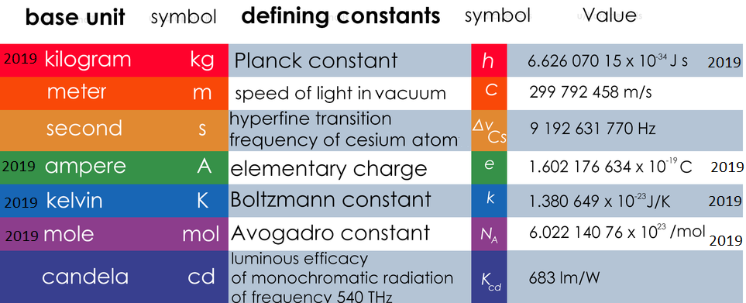
2019 SI Redefinition
https://www.reddit.com/r/coolguides/comments/a83k62/the_international_system_of_units_card/
https://www.nist.gov/si-redefinition/meet-constants

Slide 11
https://www.nist.gov/si-redefinition/meet-constants
The below graphic shows the seven base SI units and the constants used to define them. Click on each of the SI units (outer boxes) to see which constants (inner boxes) define them.

Slide 12
Accuracy and Precision
Accuracy is how close a measurement is to the correct value for that measurement.
The precision of a measurement system is refers to how close the agreement is between repeated measurements.
Low precision and high accuracy
High precision and low accuracy

Slide 13
Uncertainties in Calculations
Adding or Subtraction: add the uncertainties
Multiplication or Division: add the percent uncertainties

Slide 14
Significant Figures
Expressing the significant figures:
In Calculations:
For multiplication and division: The result should have the same number of significant figures as the quantity having the least significant figures entering into the calculation.
For addition and subtraction: The answer can contain no more decimal places than the least precise (decimals) measurement.
In this class you will always express numbers with more than the minimum significant figures, unless asked specifically for a particular problem/question.

Slide 15
Approximation
On many occasions, physicists, other scientists, and engineers need to make approximations or “guesstimates” for a particular quantity.
These approximations allow us to rule out certain scenarios or unrealistic numbers. Approximations also allow us to challenge others and guide us in our approaches to our scientific world.

