Slide 1
Fluid Dynamics
So far we have seen Fluid Statics

Slide 2
The Equation of Continuity
Q: Have you ever used your thumb to control the water flowing from the end of a hose?
A: When the end of a hose is partially closed off, thus reducing its cross-sectional area, the fluid velocity increases.
This kind of fluid behavior is described by the equation of continuity.

Slide 3
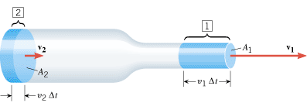
Equation of Continuity
If the density stays the same,

Slide 4
The aorta carries blood away from the heart at a speed of about 40 cm/s and has a radius of approximately 1.1 cm. The aorta branches eventually into a large number of tiny capillaries that distribute the blood to the various body organs. In a capillary, the blood speed is approximately 0.07 cm/s, and the radius is about 6 x 10⁻⁴ cm. Treat the blood as an incompressible fluid, and use these data to determine the approximate number of capillaries in the human body.

Slide 5
Bernoulli’s Equation
In the steady flow of a non-viscous, incompressible fluid of density ρ, the pressure P, the fluid speed v, and the elevation y at any two points (1 and 2) are related by

Slide 6
Applications of Bernoulli's Equation
The tarpaulin that covers the cargo is flat when the truck is stationary but bulges outward when the truck is moving.

Slide 7
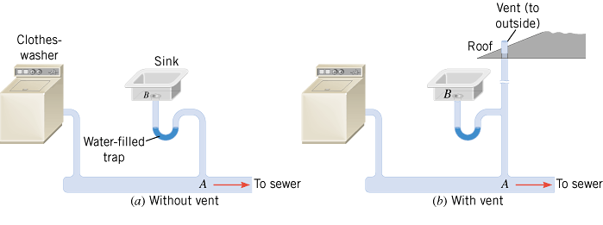
Household Plumbing
In a household plumbing system, a vent is necessary to equalize the pressures at points A and B, thus preventing the trap from being emptied. An empty trap allows sewer gas to enter the house.

Slide 8
Curveball Pitch

Slide 9
Airplane

Slide 10
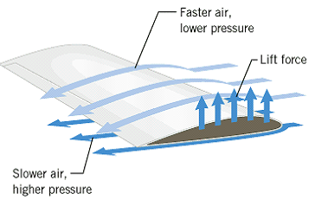
An airplane wing is designed so that the speed of the air across the top of the wing is 251 m/s when the speed of the air below the wing is 225 m/s. The density of the air is 1.29 kg/m³. What is the lifting force on a wing of area 24.0 m²?

Slide 11
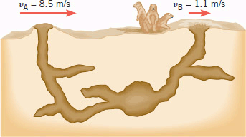
Prairie dogs are burrowing rodents. They do not suffocate in their burrows, because the effect of air speed on pressure creates sufficient air circulation. The animals maintain a difference in the shapes of two entrances to the burrow, and because of this difference, the air blows past the openings at different speeds, as the drawing indicates. Assuming that the openings are at the same vertical level, find the difference in air pressure between the openings and indicate which way the air circulates.

Slide 12
An aneurysm is an abnormal enlargement of a blood vessel such as the aorta. Because of the aneurysm, the normal cross-sectional area A₁ of the aorta increases to a value of A₂ = 1.7 A₁. The speed of the blood through a normal portion of the aorta is v₁ = 0.40 m/s. Assuming that the aorta is horizontal (the person is lying down), determine the amount by which the pressure P₂ in the enlarged region exceeds the pressure P₁ in the normal region. (Density of blood = 1060 kg/m³)

