Slide 1
Mechanics
The study of Physics begins with mechanics.
Mechanics is the branch of physics that focuses on the motion of objects and the forces that cause the motion to change.
There are two parts to mechanics: Kinematics and Dynamics.
Kinematics deals with the concepts that are needed to describe motion, without any reference to forces. Chapter 2: Kinematics in One Dimension Chapter 3: Kinematics in Two Dimensions
Dynamics deals with the effect that forces have on motion. Chapter 4: Forces and Newton’s Laws of Motion Chapter 5: Dynamics of Uniform Circular Motion
Terms in Kinematics: Position, Displacement, Distance, Speed, Velocity, and Acceleration.

Slide 2
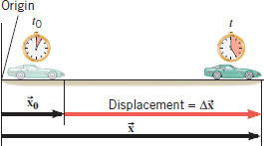
Position and Displacement
Position The position x of a particle on an x axis locates the particle with respect to the origin, of the axis.
The displacement of a particle is the change in its position:
SI Unit of Displacement: meter (m)

Slide 3
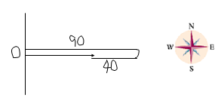
Distance and Displacement
Starting from origin (O), a person walks 90-m east, then turns around and walks 40-m west.
Q: What is the total walked distance?
A: 130-m
Q: What is the displacement?
A: 50-m, due east.
Distance is a scalar. Displacement is a vector.
What does a car odometer measure?

Slide 4
Average Speed
Average speed is the distance per elapsed time.

Slide 5
Average Velocity
Average velocity is the displacement per elapsed time.

Slide 6
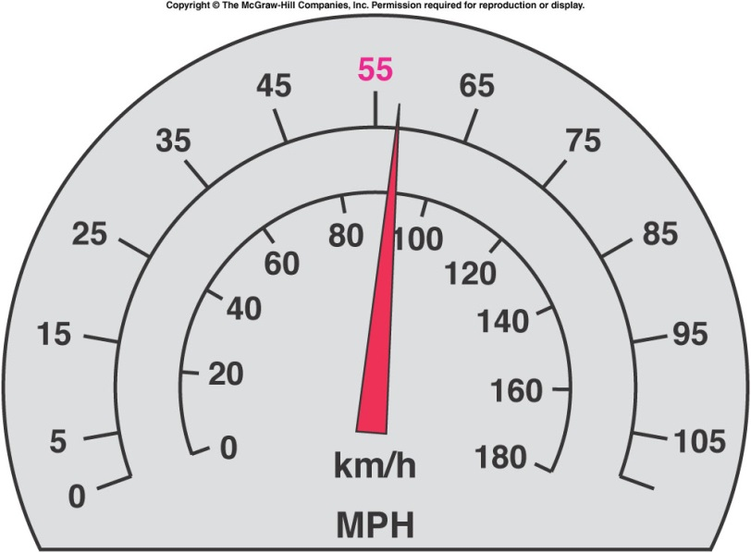
2.5 Instantaneous Velocity and Speed
Instantaneous velocity (or simply velocity) v refers to how fast a particle is moving at a given instant.
The velocity at any instant is obtained from the average velocity by shrinking the time interval, Δt closer and closer to 0. As Δt dwindles, the average velocity approaches a limiting value, which is the velocity at that instant:
Speed is the magnitude of velocity; that is, speed has no direction.
Speed is a scalar.
The speedometer in a car measures speed.
Units for speed & velocity: m/s, M/H, km/H.

Slide 7
Acceleration

