Slide 1
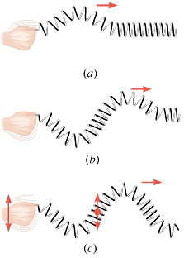
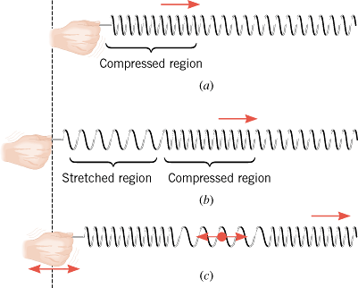
The Nature of Waves
Wave is a traveling disturbance. Wave carries energy from place to place. There are two basic types of waves:
Transverse waves
Longitudinal Waves
The disturbance is perpendicular to the direction of travel of the wave.
Examples: Light wave, waves on a guitar string.
The disturbance is parallel to the direction of travel of the wave.
Example: Sound wave in air.

Slide 2
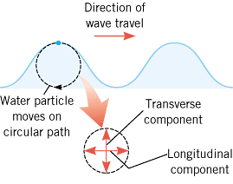
Water Waves
Water waves are partly transverse and longitudinal.
Dominoe Topling:
Human wave at a sport stadium:

Slide 3
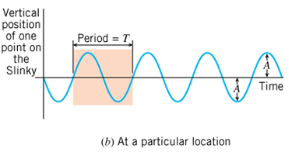
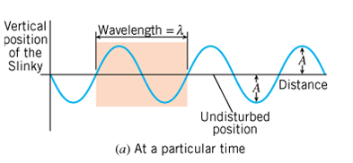
Periodic Waves: waves that repeat
The amplitude, A is the maximum disturbance.
The wavelength, λ is the horizontal length of one cycle of the wave.
The period, T is the time required for one complete up/down cycle of the wave.
The frequency, f is the number of waves per unit time, f=1/T.
Wave Speed =

Slide 4
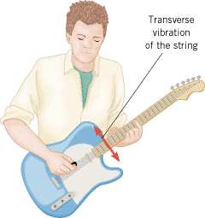
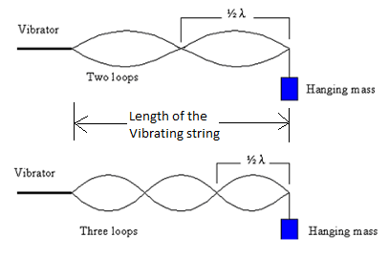
The Speed of a Wave on a String
T = Tension provided by the hanging mass
$μ=\frac{mass}{length}$, of the string.

Slide 5
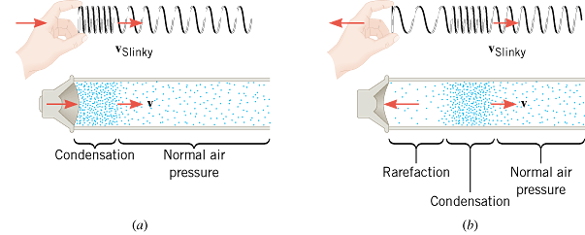
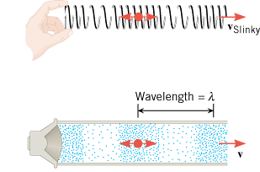
The Nature of Sound
Longitudinal Sound Waves
Sound in air is a longitudinal wave that is created by a vibrating object, such as a guitar string, the human vocal cords, or the diaphragm of a loudspeaker.
Sound cannot propagate in a vacuum. Bell in a vacuum

Slide 6
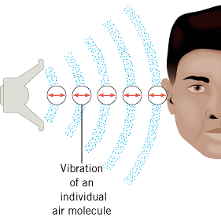
How do we hear?

Slide 7
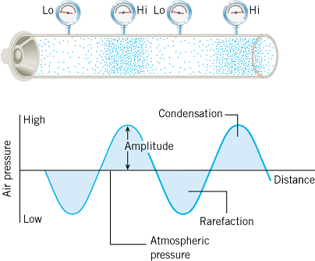
Wave Picture

Slide 8
The Frequency of a Sound Wave
Audible Range: 20 Hz ----- 20,000 Hz.
Infrasonic waves: Sound waves with frequencies < 20 Hz.
Rhinoceroses use infrasonic frequencies as low as 5 Hz to call one another
Ultrasonic waves: Sound waves with frequencies > 20,000 Hz.
Bats use ultrasonic frequencies up to 100 kHz for locating their food sources and navigating.

Slide 9
Objective and Subjective properties of sound
Objective properties can be measured, used in physics.
Subjective properties are subjective to the person, used in music.
Objective property
Subjective quality
Frequency
Pitch
Intensity
Loudness
Waveform
Tymbre or Quality

Slide 10
Speed of Sound in an ideal gas
γ = 1.40 (ratio of specific heats for air) m = 4.8 x 10⁻²⁶ kg (average molecular mass of air) k = 1.38 x 10⁻²³ J/K (Boltzmann constant)
T= temperature in Kelvin
Gases Speed of Sound (m/s)
Air (0 °C) | 331
Air (20 °C) | 343
Carbon dioxide (0 °C) | 259
Oxygen (0 °C) | 316
Helium (0 °C) | 965
Liquids Speed of Sound (m/s)
Chloroform (20 °C) | 1004
Ethyl alcohol (20 °C) | 1162
Mercury (20 °C) | 1450
Fresh water (20 °C) | 1482
Seawater (20 °C) | 1522
Solids Speed of Sound (m/s)
Copper | 5010
Glass (Pyrex) | 5640
Lead | 1960
Steel | 5960
Inhaling Helium and Sulfur Hexafluoride

Slide 11
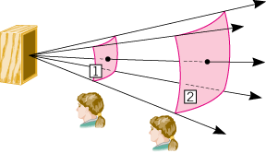
Sound Intensity
The sound intensity I is defined as the sound power P that passes perpendicularly through a surface divided by the area A of that surface:
The unit of sound intensity is power per unit area, or W/m².

Slide 12
Decibels
The decibel (dB) is a measurement unit used when comparing two sound intensities.
The intensity level β (expressed in decibels) relative to the threshold of hearing, I_{o} is defined as follows:

Slide 13
Typical Sound Intensities and Intensity Levels Relative to the Threshold of Hearing
Intensity I (W/m²)
Intensity Level β (dB)
Threshold of hearing
1.0 × 10⁻¹²
0
Rustling leaves
1.0 × 10⁻¹¹
10
Whisper
1.0 × 10⁻¹⁰
20
Normal conversation (1 meter)
3.2 × 10⁻⁶
65
Inside car in city traffic
1.0 × 10⁻⁴
80
Car without muffler
1.0 × 10⁻²
100
Live rock concert
1.0
120
Threshold of pain
10
130

Slide 14
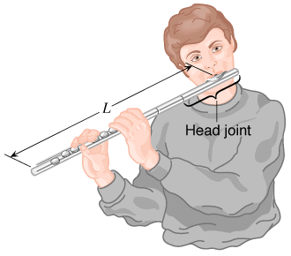
Longitudinal Standing Waves
Musical instruments in the wind family depend on longitudinal standing waves in producing sound.
Since wind instruments (trumpet, flute, clarinet, pipe organ, etc.) are modified tubes or columns of air, it is useful to examine the standing waves that can be set up in such tubes.

Slide 15
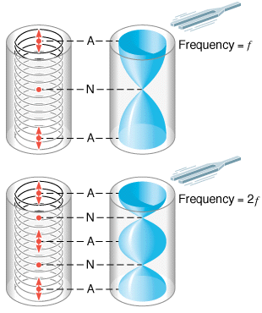
Open tube of air
A pictorial representation of longitudinal standing waves on a Slinky (left side) and in a tube of air (right side) that is open at both ends (A, antinode; N, node).

Slide 16
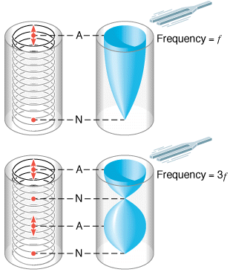
Closed tube of air
A pictorial representation of the longitudinal standing waves on a Slinky (left side) and in a tube of air (right side) that is open only at one end (A, antinode; N, node).

