Slide 1
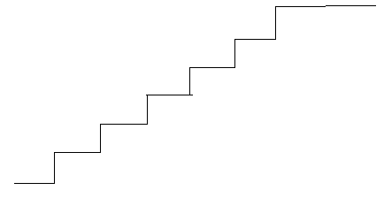
3.5 Addition of Velocities
Relative Velocity
Escalator ride at a mall

Slide 2
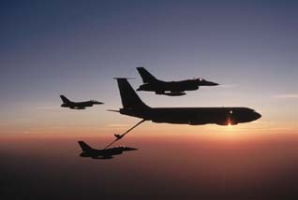
Refueling of Fighter Planes
During midair refueling, the relative velocity of the two planes is zero.

Slide 3
Conceptual Question
CQ 18. A basketball player dribbling down the court usually keeps his eyes fixed on the players around him. He is moving fast. Why doesn’t he need to keep his eyes on the ball?
Since the player is controlling the ball, its relative velocity to his hand is predictable and small.

Slide 4
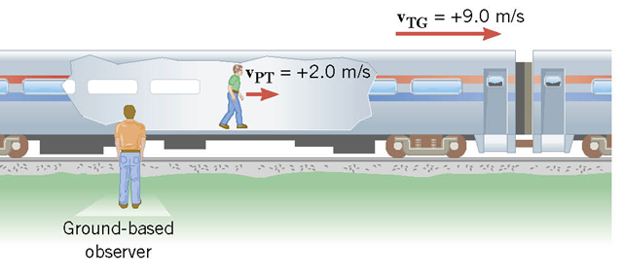

Passenger walking toward the front of a moving train
$$V_{PG}=V_{PT}+V_{TG}$$

Slide 5
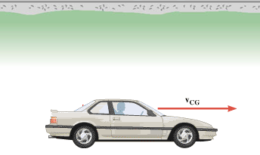

Negative of the velocity
$$−V_{CG}=V_{GC}$$

Slide 6
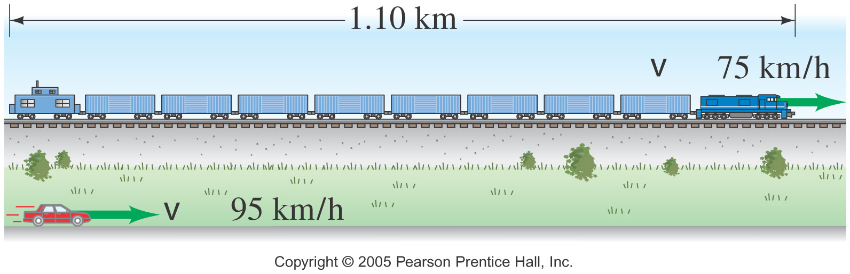
Catching up a passing train
A car traveling 95 km/h overtakes a 1.10 km long train traveling in the same direction on a track parallel to the road. The velocity of the train is 75 km/h, eastward.
What is the velocity of the car relative to the train?
How long does it take the car to pass the train?
What is the velocity of the train relative to the car?

Slide 7
P54. Near the end of a marathon race, the first two runners are separated by a distance of 45.0 m. The front runner has a velocity of 3.50 m/s, and the second a velocity of 4.20 m/s. (a) What is the velocity of the second runner relative to the first? (b) If the front runner is 250 m from the finish line, who will win the race, assuming they run at constant velocity? (c) What distance ahead will the winner be when she crosses the finish line?

Slide 8
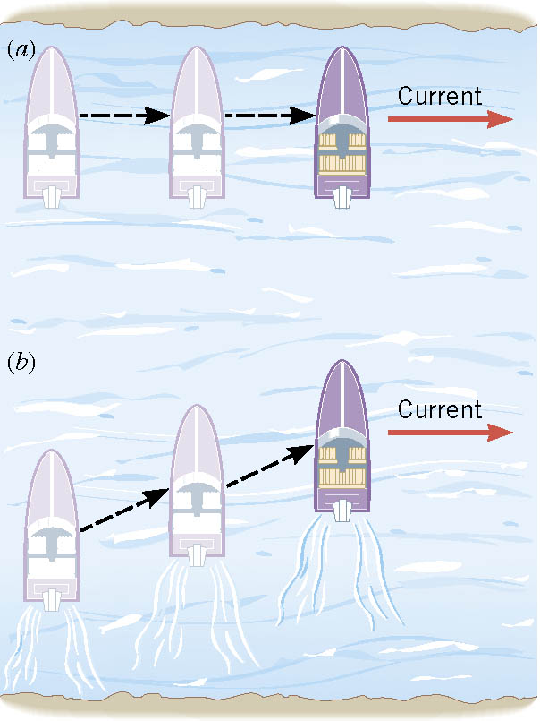
Boat Ride
A boat with its engine turned off is carried along by the current.
With the engine turned on, the boat moves across the river in a diagonal fashion.

Slide 9
Boat Ride Problem
A river is flowing to the east at 2 m/s. A boat is travelling perpendicular to the current at 4 m/s relative to water. What is the velocity of the boat as seen from the shore?

Slide 10
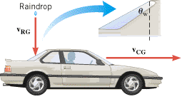
Dry rear window during rain
While driving a car, have you ever noticed that the rear window sometimes remains dry, even though rain is falling?
This phenomenon is a consequence of relative velocity.
A driver determines that he needs a minimum speed of 20 m/s to avoid wetting the rear window. If the rain is falling relative to ground at 10 m/s vertically, calculate the angle of the rear window makes with the vertical, θ_{w}.

