Slide 1
Chapter-3
Kinematics in Two Dimensions
Projectile Motion
Projectile motion is the motion of an object thrown or projected into the air, subject to only the acceleration of gravity.
The object is called a projectile, and its path is called its trajectory.

Slide 2
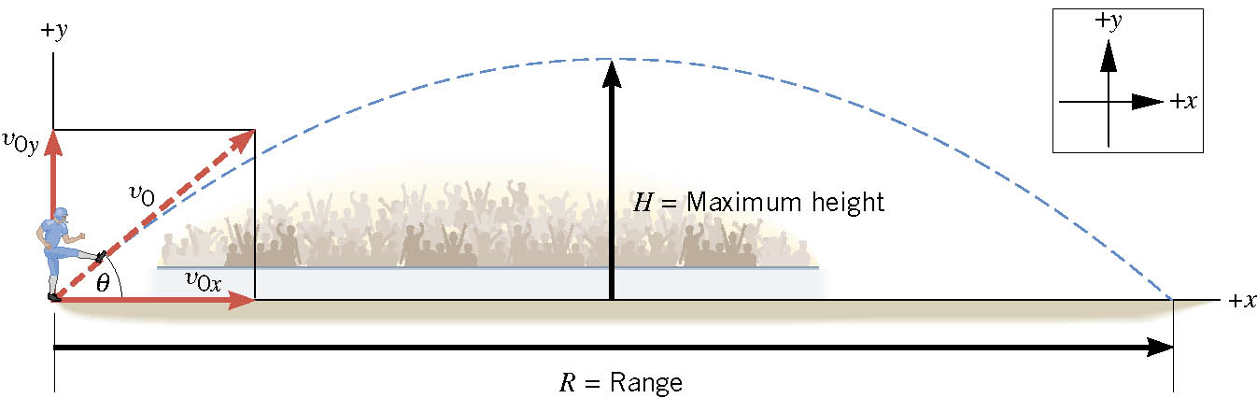
3.4 Projectile Motion
Assumptions:
1. Air resistance is neglected
2. Gravity is constant, 9.8 m/s², down.
What is the launch angle for maximum range?
http://phet.colorado.edu/simulations/sims.php?sim=Projectile_Motion

Slide 3
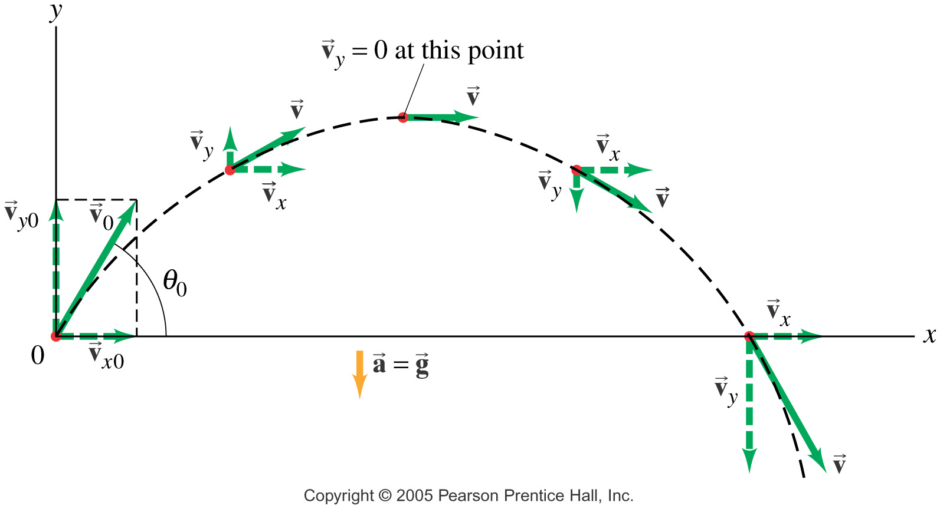
Velocity of a projectile and the shape of its trajectory
Trajectory is an inverted parabola.
14. Answer the following questions for projectile motion on level ground assuming negligible air resistance (the initial angle being neither 0º nor 90º):
Is the acceleration ever zero?
(b) Is the acceleration ever in the same direction as a component of velocity?
(c) Is the acceleration ever opposite in direction to a component of velocity?

Slide 4
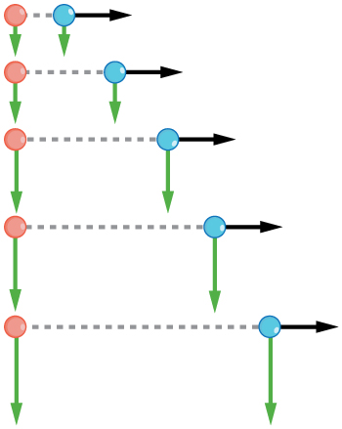
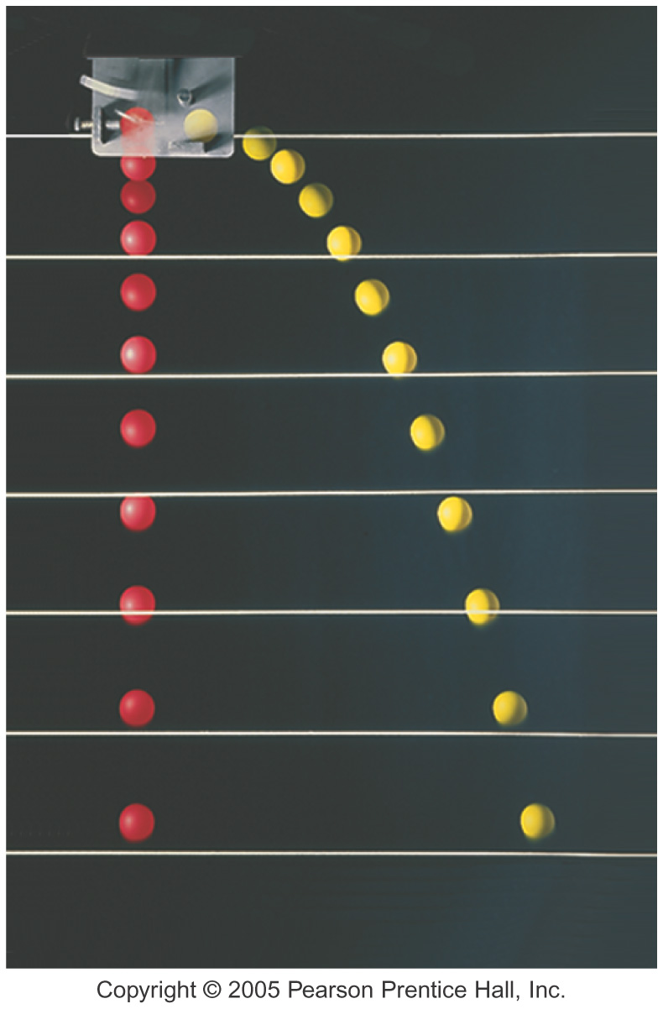
Demonstration
http://www.youtube.com/watch?v=cxvsHNRXLjw

Slide 5
Conceptual Example
Suppose you are walking at constant velocity along a flat walk-way and throw a ball vertically while maintaining the walking velocity. In the absence of the effect of air, where would the ball land—behind you, ahead of you, or in your hands?

Slide 6
Projectile to Satellite
https://www.youtube.com/watch?v=IC1JQu9xGHQ

