Slide 1
Ch3: Projectile Motion Problems
1. | 2. | 3. | 4. | 5.

Slide 2
P26: A ball is kicked with an initial velocity of 16 m/s in the horizontal direction and 12 m/s in the vertical direction. (a) At what speed does the ball hit the ground? (b) For how long does the ball remain in the air? (c)What maximum height is attained by the ball?

Slide 3
A place-kicker kicks a football at an angle of 40⁰ above the horizon with a speed of 22 m/s. Find the hang time, range R, and maximum height H.

Slide 4
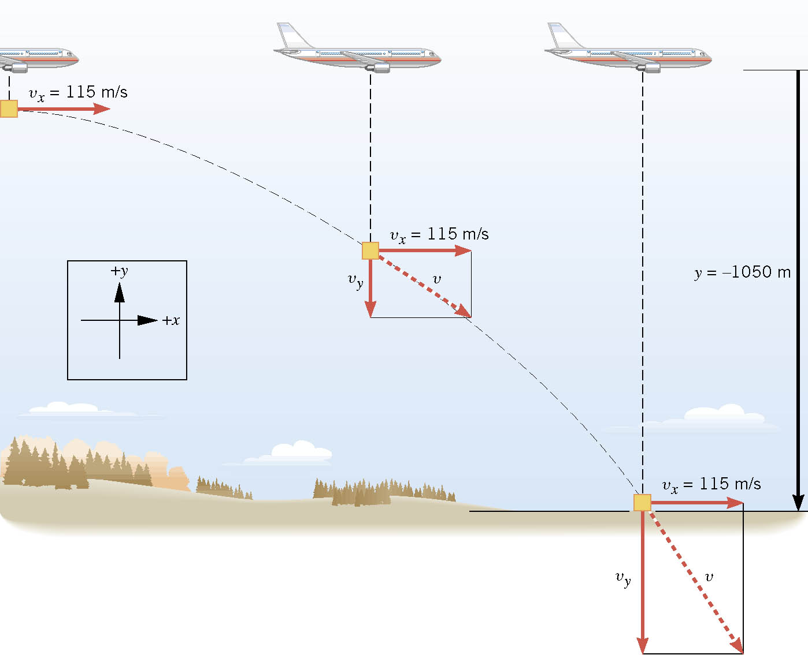
An airplane moving horizontally with a constant velocity of +115 m/s at an altitude of 1050 m. The plane releases a “care package” that falls to the ground along a curved trajectory to reach some stranded hikers. How far horizontally ahead the package should be released?

Slide 5
A player picks up a ground ball and throws it horizontally with a speed of 24 m/s. It is caught after 0.42 s later at point B. a. How far apart are the two players? b. What is the distance of vertical drop, AB?

Slide 6
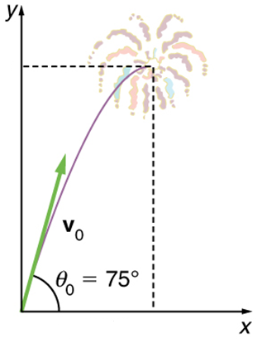
Ex3.4: A Fireworks Projectile Explodes High and Away. During a fireworks display, a shell is shot into the air with an initial speed of 70.0 m/s at an angle of 75.0º above the horizontal, as illustrated in Figure 3.39. The fuse is timed to ignite the shell just as it reaches its highest point above the ground. (a) Calculate the height at which the shell explodes. (b) How much time passed between the launch of the shell and the explosion? (c) What is the horizontal displacement of the shell when it explodes?

