Slide 1
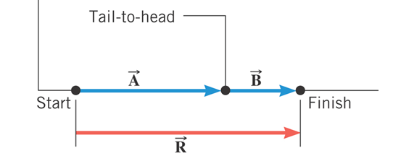

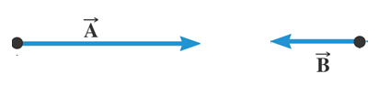
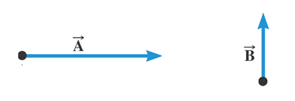
Adding two vectors: A = 110m, B = 50 m

Slide 2
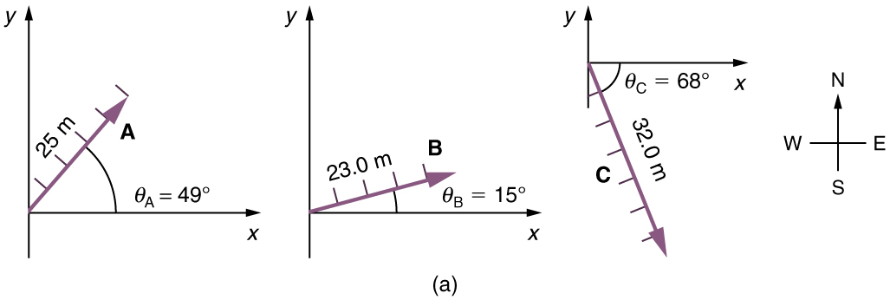
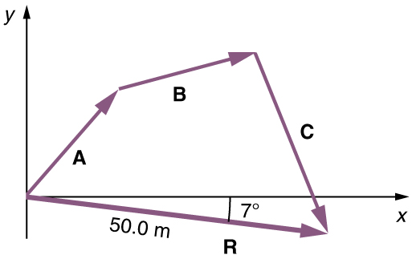
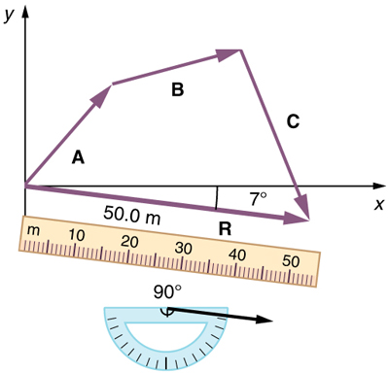
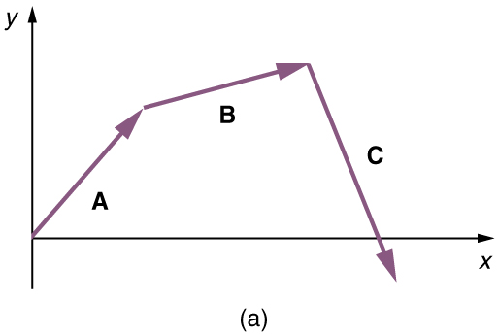
Adding Vectors: Head-to-Tail Method
Example 3.1: A Woman Takes a Walk (Text)
Use the graphical technique for adding vectors to find the total displacement of a person who walks the following three paths (displacements) on a flat field. First, she walks 25.0 m in a direction 49.0º north of east. Then, she walks 23.0 m heading 15.0º north of east. Finally, she turns and walks 32.0 m in a direction 68.0° south of east.

Slide 3
Vector Addition and Subtraction

Slide 4
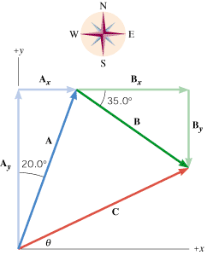
Addition of Vectors using
Vector Components
A jogger runs 145 m in a direction 20.0° east of north (displacement vector A) and then 105 m in a direction 35.0° south of east (displacement vector B).
Using components, determine the magnitude and direction of the resultant vector C.
Vector | X-component | Y-component
A
B
C

Slide 5
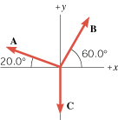
Analytical/Component Method
Find the resultant, R and equilibrant, E of the three vectors in the drawing by means of the component method. The magnitudes of the vectors are
A = 2.50-N, B = 3.00-N, and C = 3.50-N.
Vector | X-component | Y-component
A
B
C
R

