Slide 1
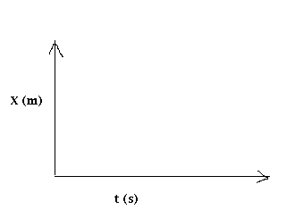
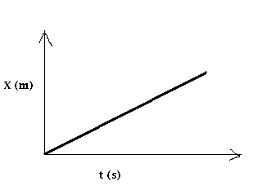
Graphical Analysis of Motion
Graphical analysis is a valuable tool for understanding and visualizing motion.
First, we will graphically look at a motion where a person walks at a constant velocity along a straight-line path.
Can you plot the position, x (m) versus time, t (s) graph?

Slide 2
Position VS. Time graph
What is the slope of the position VS. time graph?

Slide 3
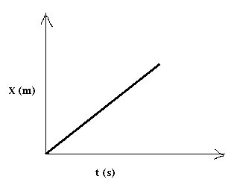
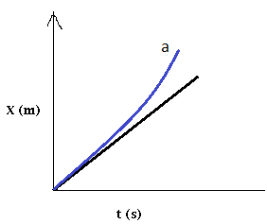
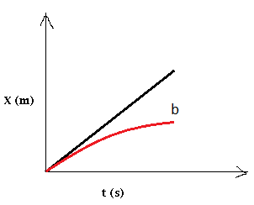
Position VS. Time graph
The position VS. time graph for an object moving with constant velocity is shown below.
How will you modify the graph if the object accelerates.
How will you modify the graph if the object decelerates.

Slide 4
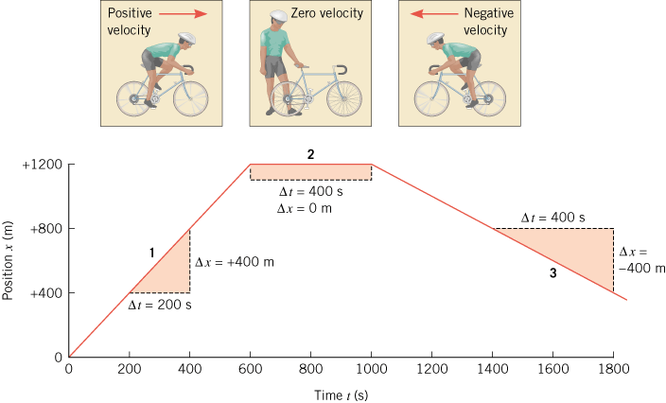
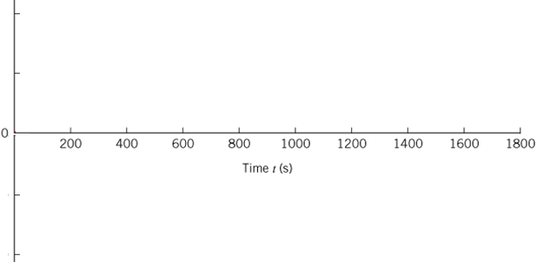
A Bicycle Trip
A bicyclist maintains a constant velocity on the outgoing leg of a journey, zero velocity while stopped for lunch, and another constant velocity on the way back.
Can you plot Velocity VS. Time graph?

Slide 5
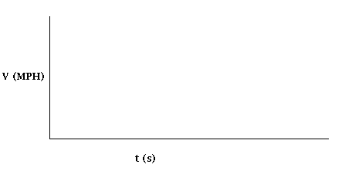
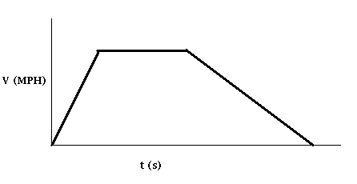
Velocity versus Time graph
A car is moving along a straight-line path starting from rest at a constant acceleration. Once the car reaches a velocity of 45 MPH, that velocity is maintained for a while. Finally, the brakes are applied with a constant deceleration and the car comes to rest.
Can you plot Velocity VS. Time for the car?

Slide 6
Velocity VS. Time
The slope of the velocity versus time graph is the acceleration.
The area under the velocity versus time graph is the displacement.

Slide 7
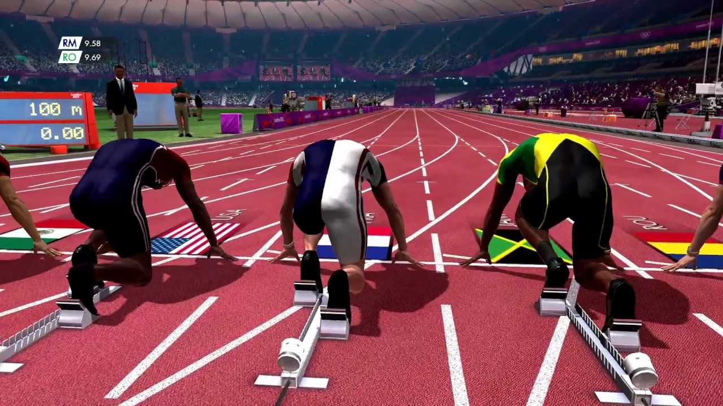
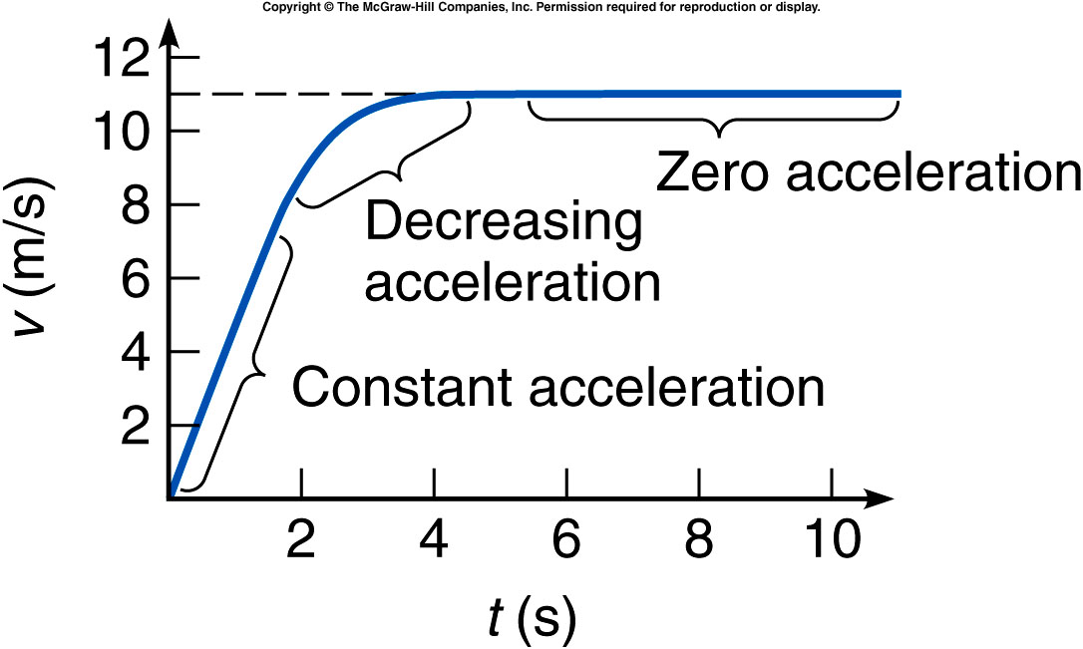
The 100-m Dash
Runners start the race by exerting maximum possible force to gain a maximum initial acceleration.
They maintain this constant acceleration until they reach their highest running velocity, where their acceleration is zero.
They try to maintain this highest velocity until they finish the race.
Can you sketch the Velocity VS Time graph for this motion?

Slide 8
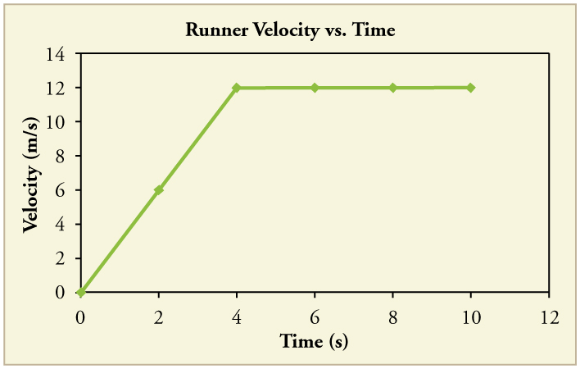
Chapter 2, Problem 65
Openstax-College Phys, 2nd Ed
65. A graph of v(t) is shown for a world-class track sprinter in a 100-m race. (a) What is his average velocity for the first 4 s? (b) What is his instantaneous velocity at t = 5 s ? (c) What is his average acceleration between 0 and 4 s? (d) What is his time for the race?

Slide 9
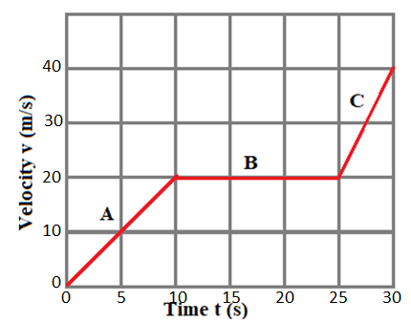
A snowmobile moves according to the
velocity-time graph shown in the drawing.
What is the snowmobile’s average
acceleration during each of the segments
A, B, and C?
How far it travels during each of the
segments A, B, and C?

Slide 10
ex 2.16:
FALLING OBJECT

