Slide 1
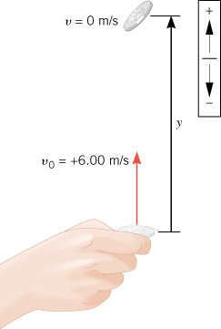
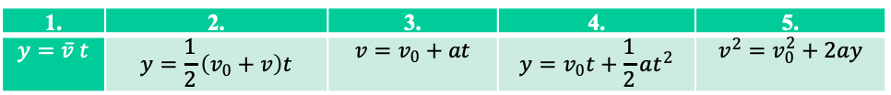
1. | 2. | 3. | 4. | 5.
$$y=\overline{v} t$$ | $$y=\frac{1}{2}\left(v_{0}+v\right)t$$ | $$v=v_{0}+at$$ | $$y=v_{0}t+\frac{1}{2}at^{2}$$ | $$v^{2}=v_{0}^{2}+2ay$$
A football game customarily begins with a coin toss to determine who kicks off. The referee tosses the coin up with an initial speed of 6.00 m/s. In the absence of air resistance, how high does the coin go above its point of release?

Slide 2
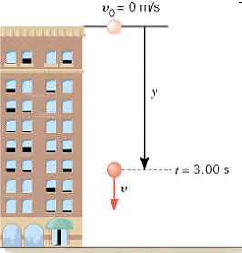
1. | 2. | 3. | 4. | 5.
$$y=\overline{v} t$$ | $$y=\frac{1}{2}\left(v_{0}+v\right)t$$ | $$v=v_{0}+at$$ | $$y=v_{0}t+\frac{1}{2}at^{2}$$ | $$v^{2}=v_{0}^{2}+2ay$$
A stone is dropped from rest from the top of a tall building, as the figure indicates. After 3.00 s of free-fall,
a. what is the velocity v of the stone?
b. what is the displacement y of the stone?

Slide 3
1. | 2. | 3. | 4. | 5.
$$y=\overline{v} t$$ | $$y=\frac{1}{2}\left(v_{0}+v\right)t$$ | $$v=v_{0}+at$$ | $$y=v_{0}t+\frac{1}{2}at^{2}$$ | $$v^{2}=v_{0}^{2}+2ay$$
A stone is dropped from rest from the top of a tall building, as the figure indicates. After 3.00 s of free-fall,
a. what is the velocity v of the stone?
b. what is the displacement y of the stone?

Slide 4
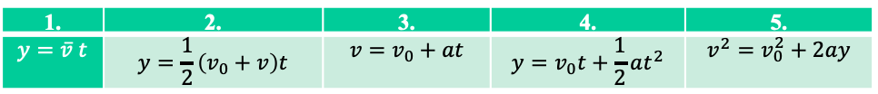
1. | 2. | 3. | 4. | 5.
$$y=\overline{v} t$$ | $$y=\frac{1}{2}\left(v_{0}+v\right)t$$ | $$v=v_{0}+at$$ | $$y=v_{0}t+\frac{1}{2}at^{2}$$ | $$v^{2}=v_{0}^{2}+2ay$$
C2 P57. A coin is dropped from a hot-air balloon that is 300 m above the ground and rising at 10.0 m/s upward. For the coin, find (a) the maximum height reached, (b) its position and velocity 4.00 s after being released, and (c) the time before it hits the ground.

