Slide 1
2.7 Freely Falling Bodies
In the absence of air resistance, all bodies at the same location above the earth fall vertically with the same acceleration, whether they are thrown up or down.
If the distance of the fall is small compared to the radius of the earth (equatorial = 6380 km), the acceleration remains essentially constant throughout the fall.
This idealized motion, in which air resistance is neglected and the acceleration is nearly constant, is known as free-fall. Object can move down or up.
The acceleration of a freely falling body is called the acceleration due to gravity, g.
The acceleration due to gravity is directed downward, toward the center of the earth.
g varies from 9.78 m/s² to 9.83 m/s² , depending on latitude, altitude, underlying geological formations, and local topography.
Near the earth's surface, g = 9.80 m/s², down, is used.
Since the acceleration is constant in free-fall, the equations of kinematics can be used.

Slide 2
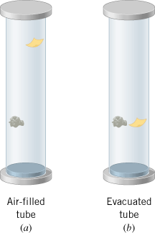
Heavy and light objects fall at the same rate
https://www.youtube.com/watch?v=5C5_dOEyAfk

Slide 3
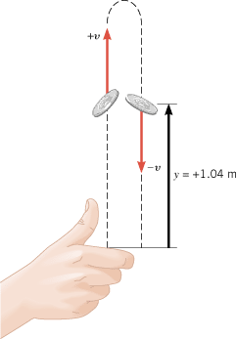
What is the velocity and acceleration at the maximum height?
CQ 20. What is the acceleration of a rock thrown straight upward on the way up? At the top of its flight? On the way down?

