Slide 1
Kinematic Equations
Problem Solving

Slide 2
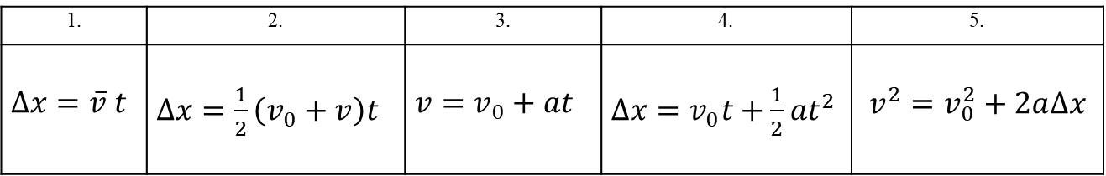
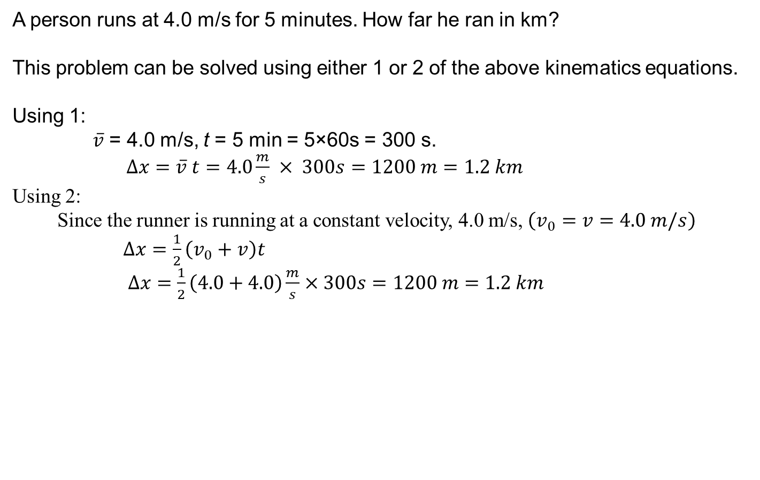
Problem solving using Kinematic Equations
1. | 2. | 3. | 4. | 5.
$∆x=\overline{v} t$ | $∆x=\frac{1}{2}\left(v_{0}+v\right)t$ | $v=v_{0}+at$ | $∆x=v_{0}t+\frac{1}{2}at^{2}$ | $$v^{2}=v_{0}^{2}+2a∆x$$
A person runs at 4.0 m/s for 5 minutes. How far he ran in km?
This problem can be solved using either 1 or 2 of the above kinematics equations.
Using 1:
$\overline{v}$ = 4.0 m/s, t = 5 min = 5×60s = 300 s.
$∆x=\overline{v} t=4.0\frac{m}{s} × 300s=1200 m=1.2 km$
Using 2:
Since the runner is running at a constant velocity, 4.0 m/s, $\left(v_{0}=v=4.0 m/s\right)$
$∆x=\frac{1}{2}\left(v_{0}+v\right)t$
$∆x=\frac{1}{2}\left(4.0+4.0\right)\frac{m}{s}×300s=1200 m=1.2 km$

Slide 3
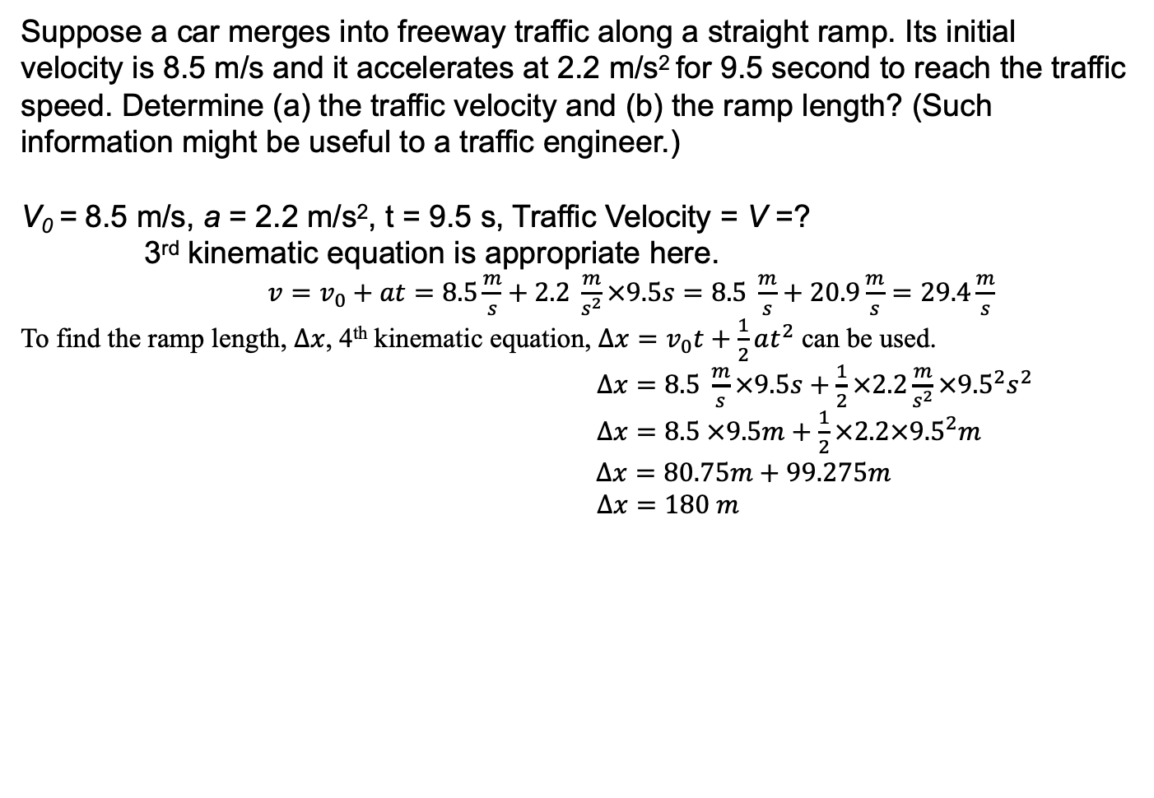
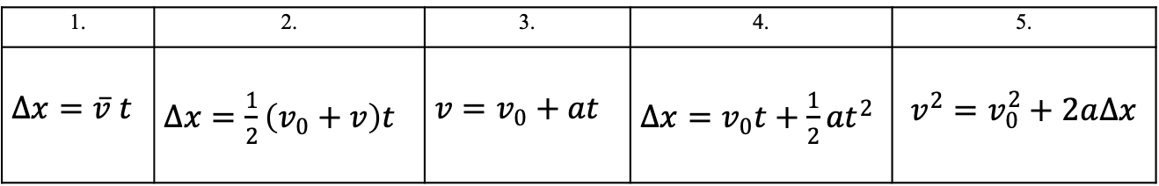
Problem solving using Kinematic Equations
1. | 2. | 3. | 4. | 5.
$∆x=\overline{v} t$ | $∆x=\frac{1}{2}\left(v_{0}+v\right)t$ | $v=v_{0}+at$ | $∆x=v_{0}t+\frac{1}{2}at^{2}$ | $$v^{2}=v_{0}^{2}+2a∆x$$
Suppose a car merges into freeway traffic along a straight ramp. Its initial velocity is 8.5 m/s and it accelerates at 2.2 m/s² for 9.5 second to reach the traffic speed. Determine (a) the traffic velocity and (b) the ramp length? (Such information might be useful to a traffic engineer.)
V₀ = 8.5 m/s, a = 2.2 m/s², t = 9.5 s, Traffic Velocity = V =?
3rd kinematic equation is appropriate here.
$v=v_{0}+at$ $=8.5\frac{m}{s}+2.2 \frac{m}{s^{2}}×9.5s=8.5 \frac{m}{s}+20.9\frac{m}{s}=29.4\frac{m}{s}$
To find the ramp length, $∆x$, 4th kinematic equation, $∆x=v_{0}t+\frac{1}{2}at^{2}$ can be used.
$∆x=8.5 \frac{m}{s}×9.5s+\frac{1}{2}×2.2\frac{m}{s^{2}}×{9.5}^{2}s^{2}$
$∆x=8.5 ×9.5m+\frac{1}{2}×2.2×{9.5}^{2}m$
$∆x=80.75m+99.275m$
$∆x=180 m$

Slide 4
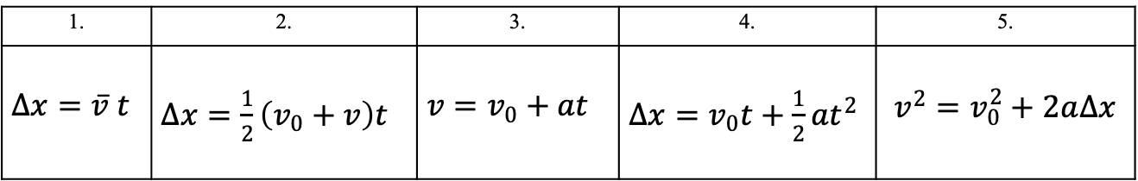
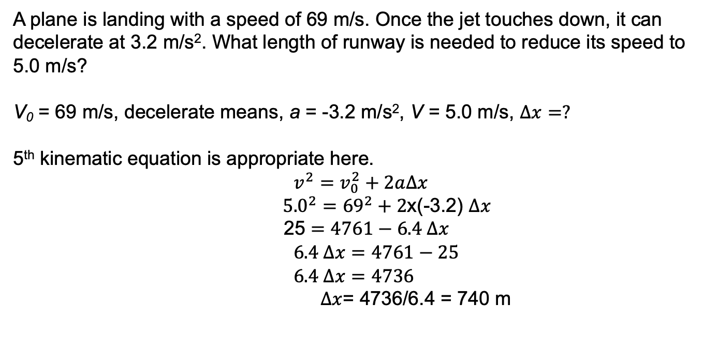
Problem solving using Kinematic Equations
1. | 2. | 3. | 4. | 5.
$∆x=\overline{v} t$ | $∆x=\frac{1}{2}\left(v_{0}+v\right)t$ | $v=v_{0}+at$ | $∆x=v_{0}t+\frac{1}{2}at^{2}$ | $$v^{2}=v_{0}^{2}+2a∆x$$
A plane is landing with a speed of 69 m/s. Once the jet touches down, it can decelerate at 3.2 m/s². What length of runway is needed to reduce its speed to 5.0 m/s?
V₀ = 69 m/s, decelerate means, a = -3.2 m/s², V = 5.0 m/s, $∆x=?$
5th kinematic equation is appropriate here.
$$v^{2}=v_{0}^{2}+2a∆x$$
${5.0}^{2}={69}^{2}+2$x(-3.2) $∆x$
25 $=4761−6.4 ∆x$
$6.4 ∆x=4761−25$
$6.4 ∆x=4736$
$∆x$= 4736/6.4 = 740 m

