Slide 1
Kinematic Equations
Derivation

Slide 2
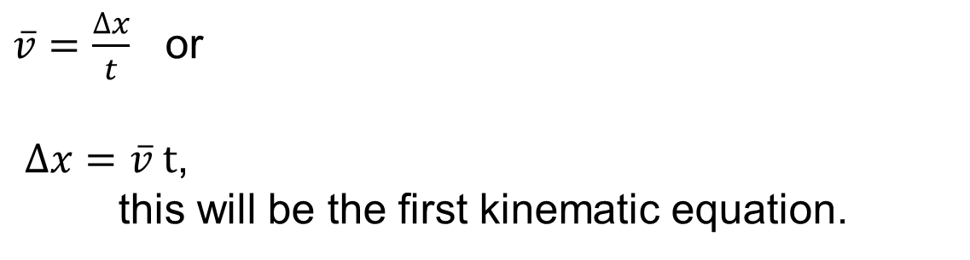
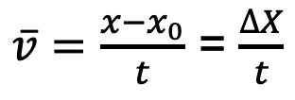
Average Velocity
Average velocity is the displacement per elapsed time.
$\overline{v}=\frac{x−x_{0}}{t}$ = $\frac{∆X}{t}$
$\overline{v}=\frac{∆x}{t}$ or
$∆x=\overline{v} t$,
this will be the first kinematic equation.

Slide 3
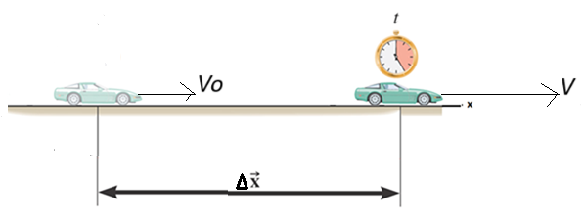

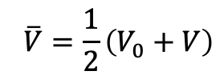


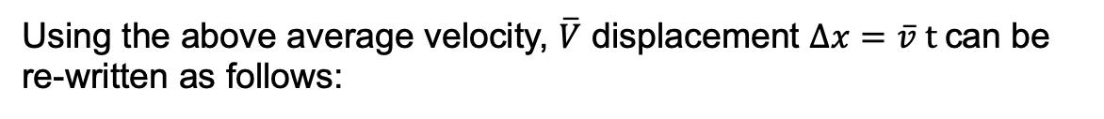

One-Dimensional Motion with constant Acceleration
Consider a car moving with an initial velocity, V₀. It accelerates at a constant rate, a and reaches a final velocity, V along a straight line during a time interval, t. It’s displacement during this time is ∆X.
$$\overline{V}=\frac{1}{2}\left(V_{0}+V\right)$$
Here, average velocity, $\overline{V}$ can be written as follows:
Using the above average velocity, $\overline{V}$ displacement $∆x=\overline{v} t$can be re-written as follows:
$∆X=\frac{1}{2}\left(V_{0}+V\right)t$,
this will be the second kinematic equation.
Acceleration, a is the rate of change in velocity. It can be written as follows:
$$a=\frac{V−V_{0}}{t}$$
OR
$$V−V_{0}=at$$
$$V=V_{0}+at,$$
this will be the third kinematic equation.

Slide 4
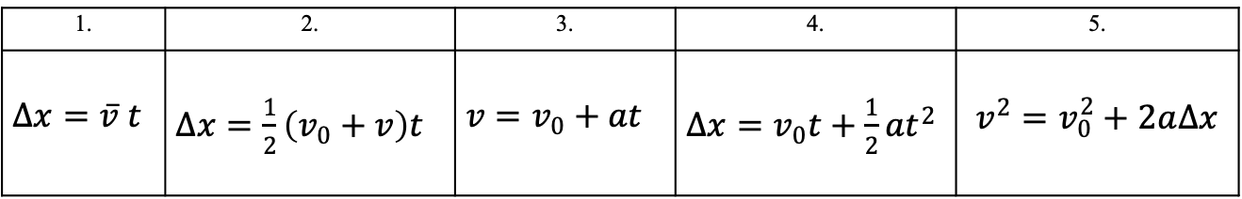
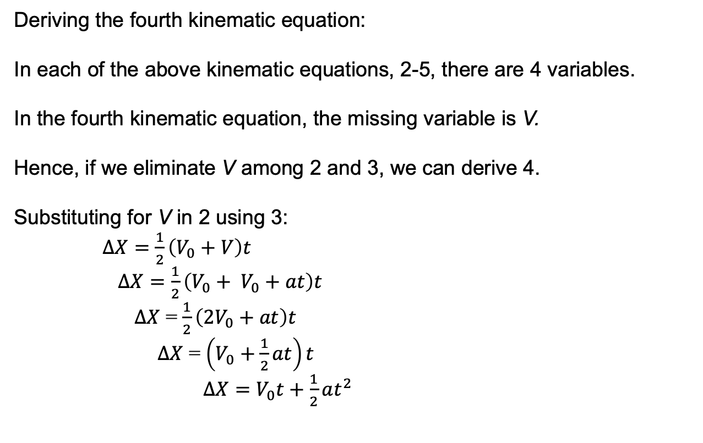
Kinematic Equations
1. | 2. | 3. | 4. | 5.
$∆x=\overline{v} t$ | $∆x=\frac{1}{2}\left(v_{0}+v\right)t$ | $v=v_{0}+at$ | $∆x=v_{0}t+\frac{1}{2}at^{2}$ | $$v^{2}=v_{0}^{2}+2a∆x$$
Deriving the fourth kinematic equation:
In each of the above kinematic equations, 2-5, there are 4 variables.
In the fourth kinematic equation, the missing variable is V.
Hence, if we eliminate V among 2 and 3, we can derive 4.
Substituting for V in 2 using 3:
$∆X=\frac{1}{2}\left(V_{0}+V\right)t$
$∆X=\frac{1}{2}\left(V_{0}+ V_{0}+at\right)t$
$∆X$ = $\frac{1}{2}\left({2V}_{0}+at\right)t$
$∆X$ = $\left(V_{0}+\frac{1}{2}at\right)t$
$∆X=V_{0}t+\frac{1}{2}at^{2}$

Slide 5
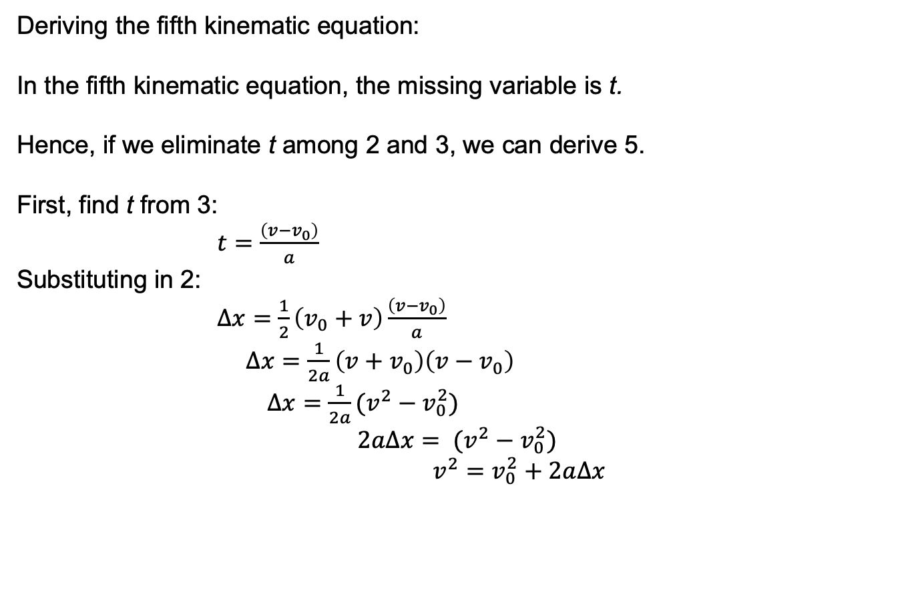
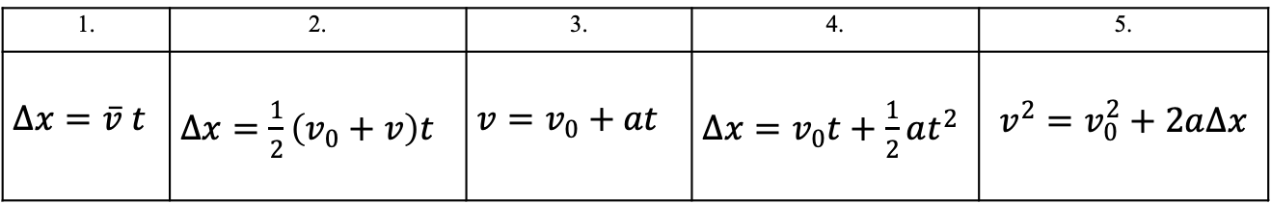
Kinematic Equations
1. | 2. | 3. | 4. | 5.
$∆x=\overline{v} t$ | $∆x=\frac{1}{2}\left(v_{0}+v\right)t$ | $v=v_{0}+at$ | $∆x=v_{0}t+\frac{1}{2}at^{2}$ | $$v^{2}=v_{0}^{2}+2a∆x$$
Deriving the fifth kinematic equation:
In the fifth kinematic equation, the missing variable is t.
Hence, if we eliminate t among 2 and 3, we can derive 5.
First, find t from 3:
$t=\frac{\left(v−v_{0}\right)}{a}$
Substituting in 2:
$∆x=\frac{1}{2}\left(v_{0}+v\right)\frac{\left(v−v_{0}\right)}{a}$
$∆x=\frac{1}{2a}\left(v+v_{0}\right)\left(v−v_{0}\right)$
$∆x=\frac{1}{2a}(v^{2}−v_{0}^{2})$
$$2a∆x= (v^{2}−v_{0}^{2})$$
$v^{2}=v_{0}^{2}+2a∆x$

