Slide 1
Chapter 2: Mechanics
The study of Physics begins with mechanics.
Mechanics is the branch of physics that focuses on the motion of objects and the forces that cause the motion to change.
There are two parts to mechanics: Kinematics and Dynamics.
Kinematics deals with the concepts that are needed to describe motion, without any reference to forces.
Chapter 2: Kinematics in One Dimension
Chapter 3: Kinematics in Two Dimensions
Dynamics deals with the effect that forces have on motion.
Chapter 4 & 5: Forces and Newton’s Laws of Motion
Chapter 6: Dynamics of Uniform Circular Motion
Terms in Kinematics: Position, Displacement, Distance, Speed, Velocity, and Acceleration.

Slide 2
Scalars and Vectors
Physics deals with many physical quantities, which are divided into scalars and vectors.
A scalar quantity is one that can be described by a single number (including any units) giving its size or magnitude. Examples: Time interval, volume, mass, speed, distance, temperature, density, etc.
A quantity that deals with both magnitude and direction is called a vector quantity.
Examples: Force, weight, velocity, displacement, acceleration, momentum, impulse, etc.
We will re-visit vectors again, including in Lab-3.
Vectors are written with bold-face with an arrow on top,

Slide 3
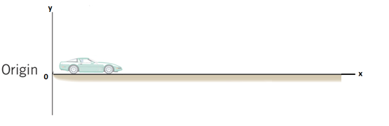
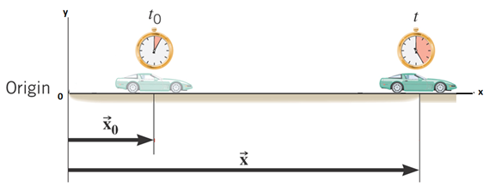
Position

Slide 4
Position and Displacement
Position The position x of a particle on an x axis locates the particle with respect to the origin, of the axis.
The displacement of a particle is the change in its position:
The displacement is a vector that points from the initial position to the final position.
SI Unit of Displacement: meter (m)

Slide 5
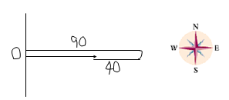
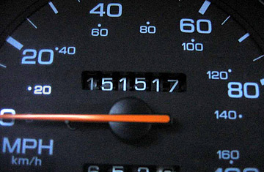
Distance and Displacement
Starting from origin (O), a person walks 90-m east, then turns around and walks 40-m west.
Q: What is the total walked distance?
A: 130-m
Q: What is the displacement?
A: 50-m, due east.
Distance is a scalar. Displacement is a vector.
What does a car odometer measure? Distance
An otherwise prosperous Chrysler decade was tarnished in

Slide 6
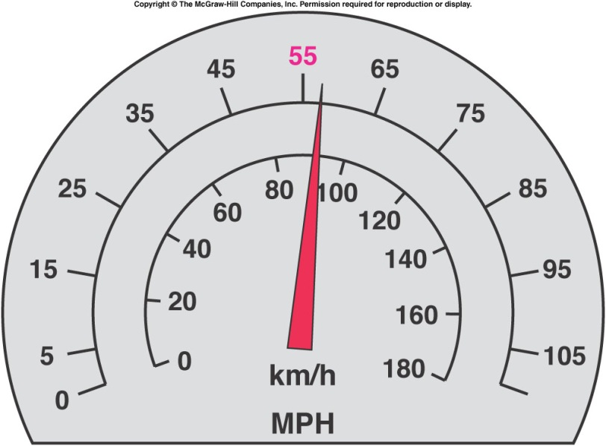
Instantaneous Speed and Velocity
Instantaneous speed refers to how fast something is moving at a given instant.
Speed is a scalar.
The speedometer in a car measures instantaneous speed.
Instantaneous velocity is the instantaneous speed
with the direction specified.
Velocity is a vector.
Units for speed & velocity: m/s, M/H, km/H.

Slide 7
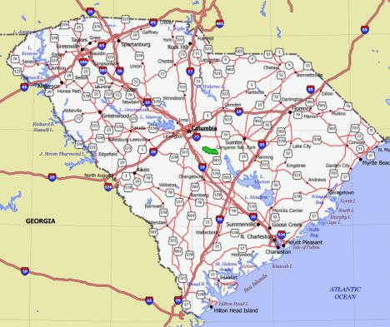
Average Speed
Average speed equals the distance traveled divided by the time of travel.
Unit: MPH, kmPH, m/s
Average Driving Speed:
If you drove 180 miles in 3 hours, your average
Driving speed = 180/3 = 60 MPH.
How long will it take to get to a place that is 480
Miles away?
Time = distance/speed = 480/60 = 8 hours.

