Slide 1
Mechanics
The study of Physics begins with mechanics.
Mechanics is the branch of physics that focuses on the motion of objects and the forces that cause the motion to change.
There are two parts to mechanics: Kinematics and Dynamics.
Kinematics deals with the concepts that are needed to describe motion, without any reference to forces.
Kinematics in One Dimension – Straight line motion.
Kinematics in Two Dimensions – Projectile motion.
Dynamics deals with the effect that forces have on motion.
Forces and Newton’s Laws of Motion
Uniform Circular Motion
Terms in Kinematics: Position, Displacement, Distance, Speed, Velocity, and Acceleration.

Slide 2
Scalars and Vectors
Physics deals with many physical quantities, which are divided into scalars and vectors.
A scalar quantity is one that can be described by a single number (including any units) giving its size or magnitude. Examples: Time interval, volume, mass, speed, distance, temperature, density, etc.
A quantity that deals with both magnitude and direction is called a vector quantity.
Examples: Force, weight, velocity, displacement, acceleration, momentum, impulse, etc.
Vectors are written with bold-face with an arrow on top,

Slide 3
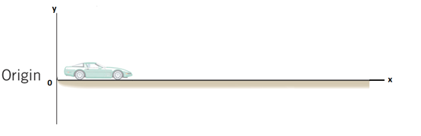
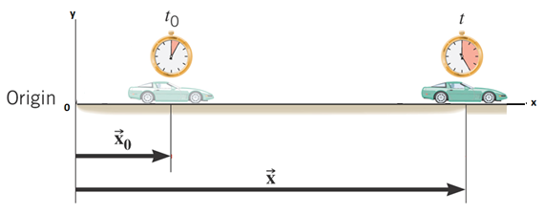
Position
Position The position x of a particle on an x axis locates the particle with respect to the origin, of the axis.
Picture: Fig. 2.1, p26, Physics, Cutnell & Johnston, 10th ed.

Slide 4
Position and Displacement
Position The position x of a particle on an x axis locates the particle with respect to the origin, of the axis.
The displacement of a particle is the change in its position:
The displacement is a vector that points from the initial position to the final position.
SI Unit of Displacement: meter (m)

Slide 5
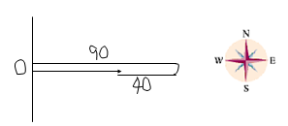
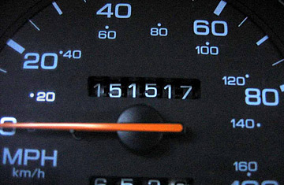
Distance and Displacement
Starting from origin (O), a person walks 90-m east, then turns around and walks 40-m west.
Q: What is the total walked distance?
A: 130-m
Q: What is the displacement?
A: 50-m, due east.
Distance is a scalar. Displacement is a vector.
What does a car odometer measure?
Distance
An otherwise prosperous Chrysler decade was tarnished in

Slide 6
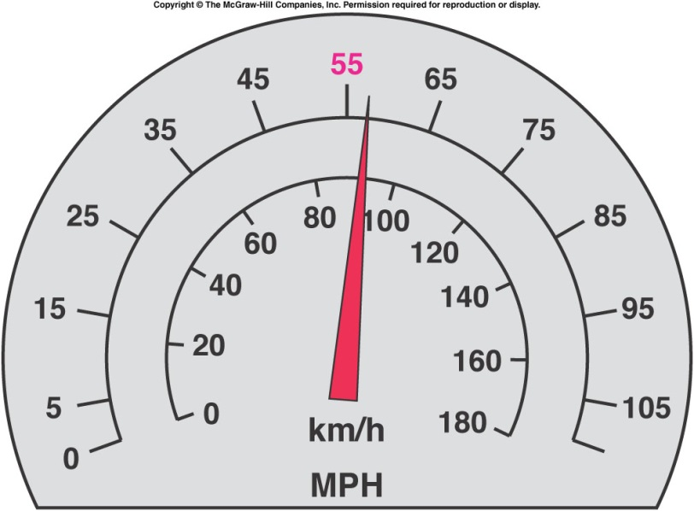
Instantaneous Speed and Velocity
The speedometer in a car measures instantaneous speed.
Instantaneous speed refers to how fast something is moving at a given instant.
Speed is a scalar.
Instantaneous velocity is the instantaneous speed
with the direction specified.
Velocity is a vector.
Units for speed & velocity: m/s, M/H, km/H.

Slide 7
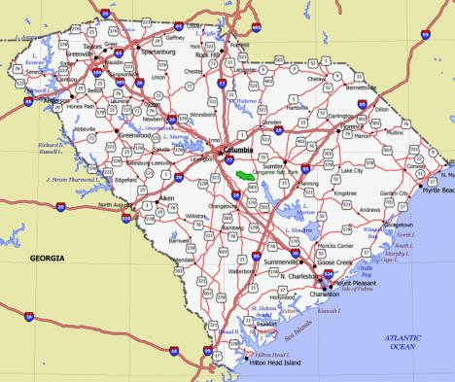
Average Speed
Average speed equals the distance traveled divided by the time of travel.
Unit: MPH, kmPH, m/s
Average Driving Speed:
If you drove 180 miles in 3 hours, your average
Driving speed = 180/3 = 60 MPH.
At this driving speed, How long will it take to get
to a place that is 480 Miles away?
Time = distance/speed = 480/60 = 8 hours.

Slide 8
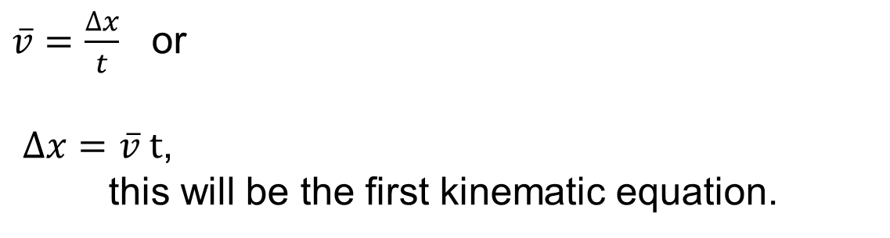
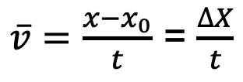
Average Velocity
Average velocity is the displacement per elapsed time.
$\overline{v}=\frac{x−x_{0}}{t}$ = $\frac{∆X}{t}$
$\overline{v}=\frac{∆x}{t}$ or
$∆x=\overline{v} t$,
this will be the first kinematic equation.

Slide 9
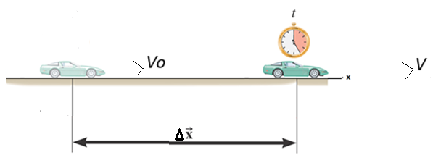

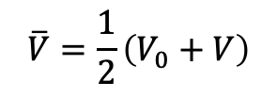


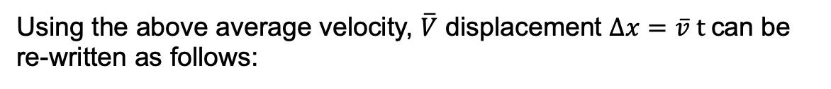

One-Dimensional Motion with constant Acceleration
Consider a car moving with an initial velocity, V₀. It accelerates at a constant rate, a and reaches a final velocity, V along a straight line during a time interval, t. It’s displacement during this time is ∆X.
$$\overline{V}=\frac{1}{2}\left(V_{0}+V\right)$$
Here, average velocity, $\overline{V}$ can be written as follows:
Using the above average velocity, $\overline{V}$ displacement $∆x=\overline{v} t$can be re-written as follows:
$∆X=\frac{1}{2}\left(V_{0}+V\right)t$,
this will be the second kinematic equation.
Acceleration, a is the rate of change in velocity. It can be written as follows:
$$a=\frac{V−V_{0}}{t}$$
OR
$$V−V_{0}=at$$
$$V=V_{0}+at,$$
this will be the third kinematic equation.

Slide 10
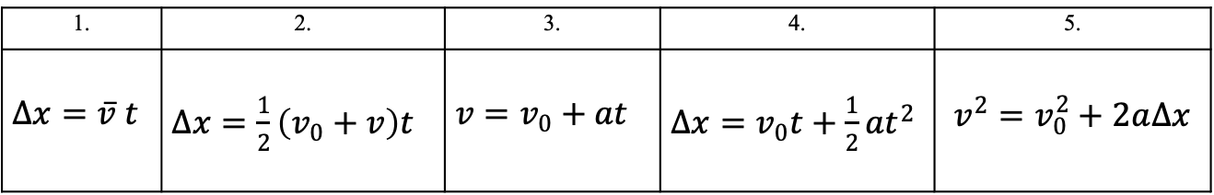
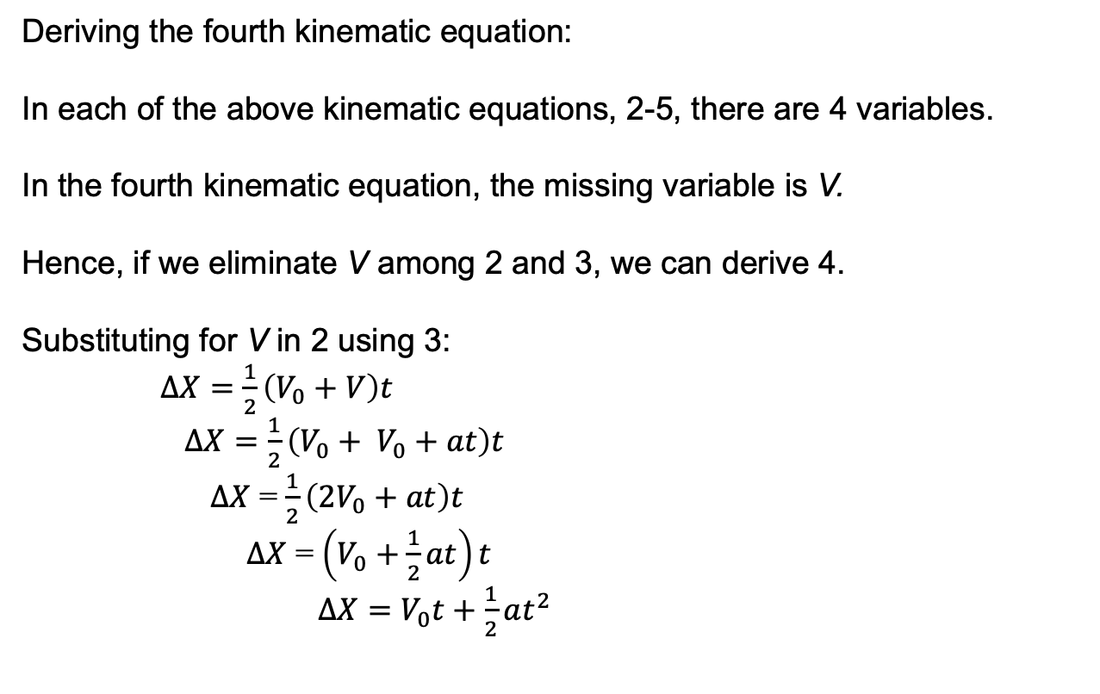
Kinematic Equations
1. | 2. | 3. | 4. | 5.
$∆x=\overline{v} t$ | $∆x=\frac{1}{2}\left(v_{0}+v\right)t$ | $v=v_{0}+at$ | $∆x=v_{0}t+\frac{1}{2}at^{2}$ | $$v^{2}=v_{0}^{2}+2a∆x$$
Deriving the fourth kinematic equation:
In each of the above kinematic equations, 2-5, there are 4 variables.
In the fourth kinematic equation, the missing variable is V.
Hence, if we eliminate V among 2 and 3, we can derive 4.
Substituting for V in 2 using 3:
$∆X=\frac{1}{2}\left(V_{0}+V\right)t$
$∆X=\frac{1}{2}\left(V_{0}+ V_{0}+at\right)t$
$∆X$ = $\frac{1}{2}\left({2V}_{0}+at\right)t$
$∆X$ = $\left(V_{0}+\frac{1}{2}at\right)t$
$∆X=V_{0}t+\frac{1}{2}at^{2}$

Slide 11
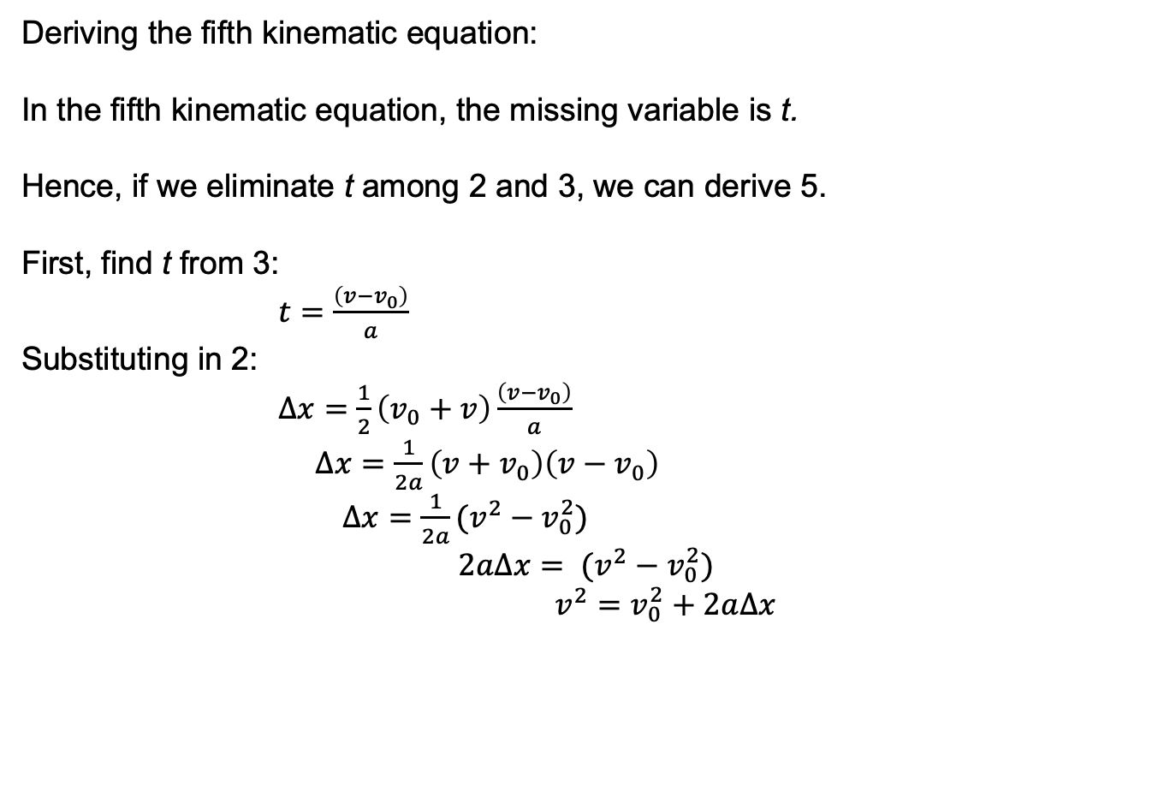
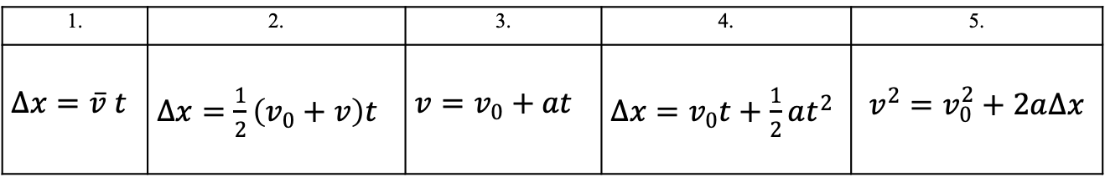
Kinematic Equations
1. | 2. | 3. | 4. | 5.
$∆x=\overline{v} t$ | $∆x=\frac{1}{2}\left(v_{0}+v\right)t$ | $v=v_{0}+at$ | $∆x=v_{0}t+\frac{1}{2}at^{2}$ | $$v^{2}=v_{0}^{2}+2a∆x$$
Deriving the fifth kinematic equation:
In the fifth kinematic equation, the missing variable is t.
Hence, if we eliminate t among 2 and 3, we can derive 5.
First, find t from 3:
$t=\frac{\left(v−v_{0}\right)}{a}$
Substituting in 2:
$∆x=\frac{1}{2}\left(v_{0}+v\right)\frac{\left(v−v_{0}\right)}{a}$
$∆x=\frac{1}{2a}\left(v+v_{0}\right)\left(v−v_{0}\right)$
$∆x=\frac{1}{2a}(v^{2}−v_{0}^{2})$
$$2a∆x= (v^{2}−v_{0}^{2})$$
$v^{2}=v_{0}^{2}+2a∆x$

Slide 12
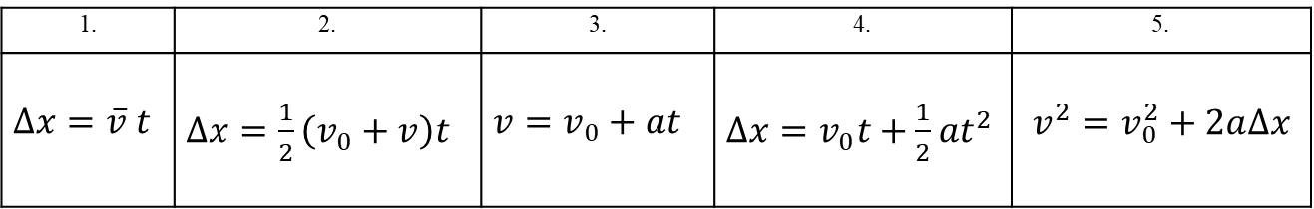
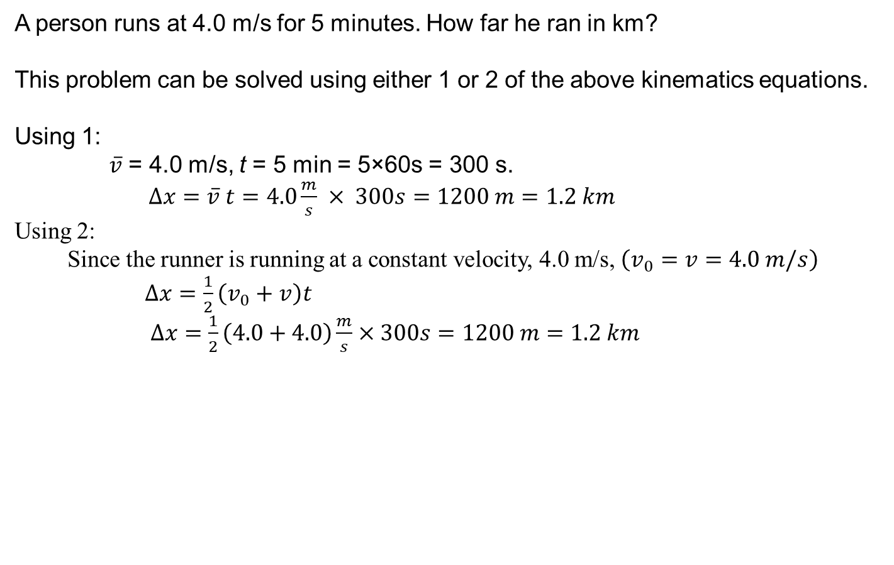
Problem solving using Kinematic Equations
1. | 2. | 3. | 4. | 5.
$∆x=\overline{v} t$ | $∆x=\frac{1}{2}\left(v_{0}+v\right)t$ | $v=v_{0}+at$ | $∆x=v_{0}t+\frac{1}{2}at^{2}$ | $$v^{2}=v_{0}^{2}+2a∆x$$
A person runs at 4.0 m/s for 5 minutes. How far he ran in km?
This problem can be solved using either 1 or 2 of the above kinematics equations.
Using 1:
$\overline{v}$ = 4.0 m/s, t = 5 min = 5×60s = 300 s.
$∆x=\overline{v} t=4.0\frac{m}{s} × 300s=1200 m=1.2 km$
Using 2:
Since the runner is running at a constant velocity, 4.0 m/s, $\left(v_{0}=v=4.0 m/s\right)$
$∆x=\frac{1}{2}\left(v_{0}+v\right)t$
$∆x=\frac{1}{2}\left(4.0+4.0\right)\frac{m}{s}×300s=1200 m=1.2 km$

Slide 13
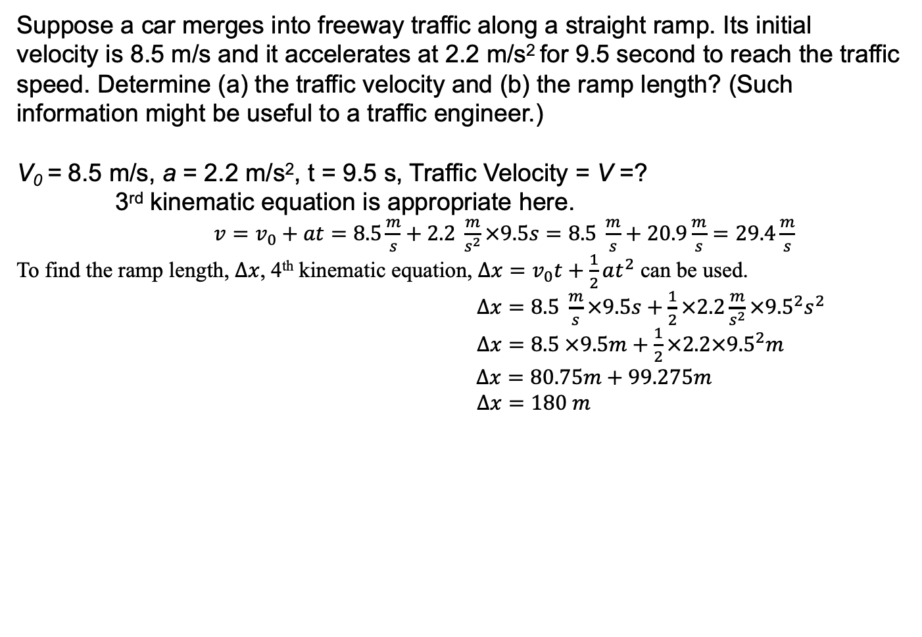
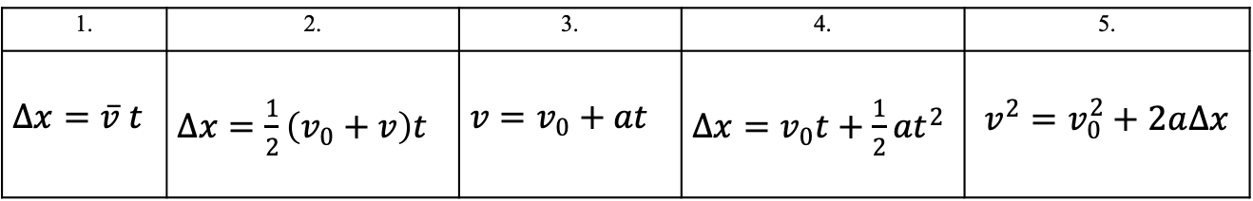
Problem solving using Kinematic Equations
1. | 2. | 3. | 4. | 5.
$∆x=\overline{v} t$ | $∆x=\frac{1}{2}\left(v_{0}+v\right)t$ | $v=v_{0}+at$ | $∆x=v_{0}t+\frac{1}{2}at^{2}$ | $$v^{2}=v_{0}^{2}+2a∆x$$
Suppose a car merges into freeway traffic along a straight ramp. Its initial velocity is 8.5 m/s and it accelerates at 2.2 m/s² for 9.5 second to reach the traffic speed. Determine (a) the traffic velocity and (b) the ramp length? (Such information might be useful to a traffic engineer.)
V₀ = 8.5 m/s, a = 2.2 m/s², t = 9.5 s, Traffic Velocity = V =?
3rd kinematic equation is appropriate here.
$v=v_{0}+at$ $=8.5\frac{m}{s}+2.2 \frac{m}{s^{2}}×9.5s=8.5 \frac{m}{s}+20.9\frac{m}{s}=29.4\frac{m}{s}$
To find the ramp length, $∆x$, 4th kinematic equation, $∆x=v_{0}t+\frac{1}{2}at^{2}$ can be used.
$∆x=8.5 \frac{m}{s}×9.5s+\frac{1}{2}×2.2\frac{m}{s^{2}}×{9.5}^{2}s^{2}$
$∆x=8.5 ×9.5m+\frac{1}{2}×2.2×{9.5}^{2}m$
$∆x=80.75m+99.275m$
$∆x=180 m$

Slide 14
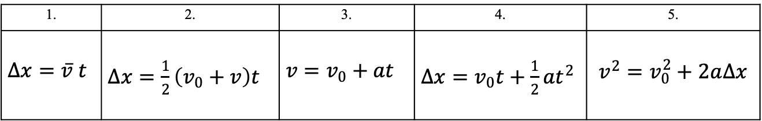
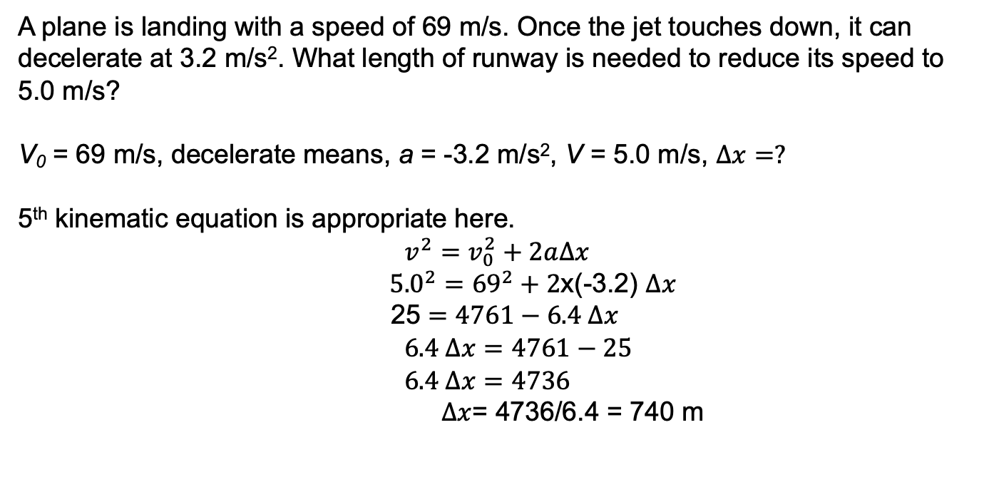
Problem solving using Kinematic Equations
1. | 2. | 3. | 4. | 5.
$∆x=\overline{v} t$ | $∆x=\frac{1}{2}\left(v_{0}+v\right)t$ | $v=v_{0}+at$ | $∆x=v_{0}t+\frac{1}{2}at^{2}$ | $$v^{2}=v_{0}^{2}+2a∆x$$
A plane is landing with a speed of 69 m/s. Once the jet touches down, it can decelerate at 3.2 m/s². What length of runway is needed to reduce its speed to 5.0 m/s?
V₀ = 69 m/s, decelerate means, a = -3.2 m/s², V = 5.0 m/s, $∆x=?$
5th kinematic equation is appropriate here.
$$v^{2}=v_{0}^{2}+2a∆x$$
${5.0}^{2}={69}^{2}+2$x(-3.2) $∆x$
25 $=4761−6.4 ∆x$
$6.4 ∆x=4761−25$
$6.4 ∆x=4736$
$∆x$= 4736/6.4 = 740 m

