Slide 1
Units
Units are necessary during measurement and expressing physical quantities.
Topics:
Systems of units.
SI base units.
Defining Constants for SI units.
Derived units.
Unit conversion

Slide 2
Units of Measurement
There are three systems of units: SI, cgs, and BE/USC.
 | System
Quantity | SI | CGS | BE/USC
Length | meter (m) | centimeter (cm) | foot (ft)
Mass | kilogram (kg) | gram (g) | slug (sl)
Time | second (s) | second (s) | second (s)
SI – International System of Units.
CGS - centimeter (cm), gram (g), and second.
BE/USC - British Engineering/US Customary.

Slide 3
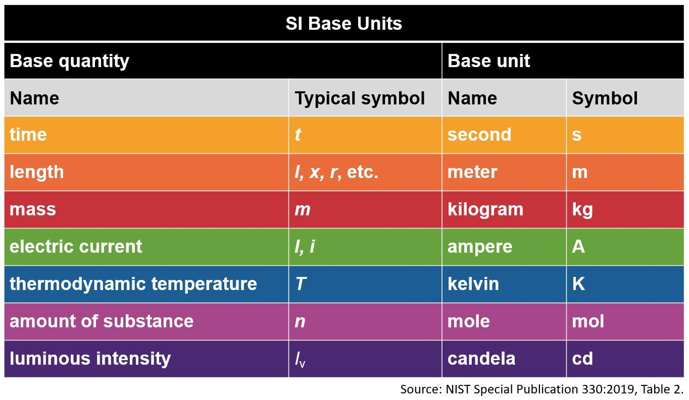
SI Units
https://www.nist.gov/pml/owm/metric-si/si-units
There are seven base units.
Units named after people are capitalized.

Slide 4
Seven Defining Constants of SI
https://www.bipm.org/en/measurement-units/si-defining-constants
the cesium hyperfine frequency, Δν_{Cs} = 9 192 631 770 Hz
the speed of light in vacuum, c = 299 792 458 m/s
the Planck constant, h = 6.626 070 15 x 10^{–34} J.s
the elementary charge, e = 1.602 176 634 x 10^{–19} C
the Boltzmann constant, k = 1.380 649 x 10^{–23} J/K
the Avogadro constant, N_{A} = 6.022 140 76 x 10²³ mol⁻¹
the luminous efficacy of a defined visible radiation, K_{cd} = 683 lm/W

Slide 5
The graphic shows the seven base SI units and the constants used to define them. Go to the website and Click on each of the SI units (outer boxes) to see which constants (inner boxes) define them.
https://www.nist.gov/si-redefinition/meet-constants

Slide 6
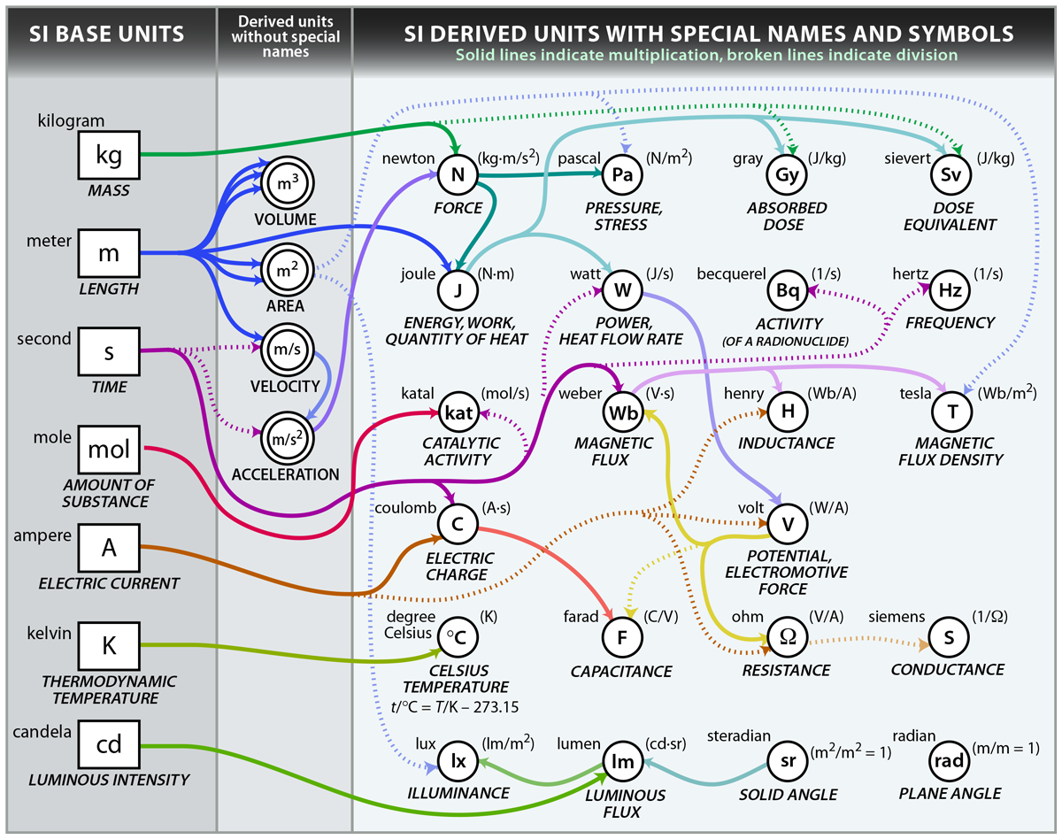
SI Derived Units (There are many of them)
https://www.nist.gov/si-redefinition/kilogram-focus-history

Slide 7
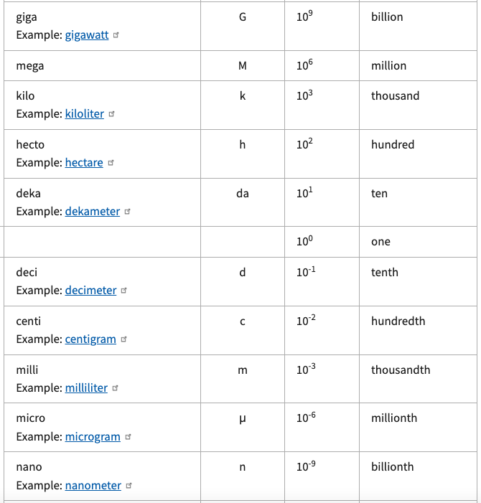
Metric (SI)
Prefixes
Prefixes are used to express very big and very small quantities.
For example, 1000 g = 1 kg.
Go to this website to view all prefixes.

Slide 8
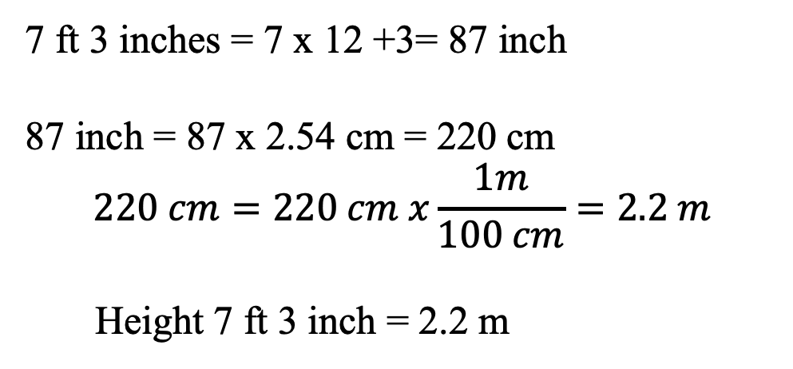
Unit Conversion
A basketball player is 7 ft 3 inches tall. Convert this height to meter, m?
(Use the following conversion factors:
1 ft = 12 inches, 1 inch = 2.54 cm, 1m = 100 cm)
7 ft 3 inches = 7 x 12 +3= 87 inch
87 inch = 87 x 2.54 cm = 220 cm
$$220 cm=220 cm x\frac{1m}{100 cm}=2.2 m$$
Height 7 ft 3 inch = 2.2 m

Slide 9
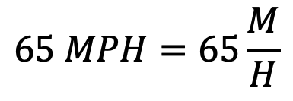
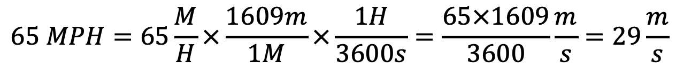
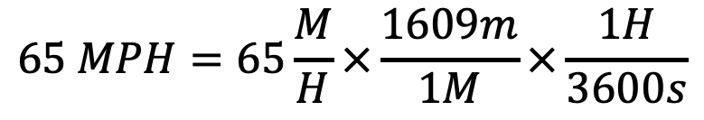
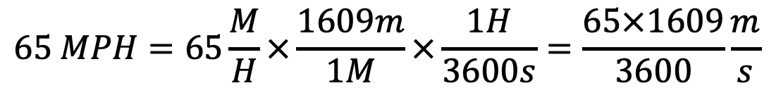
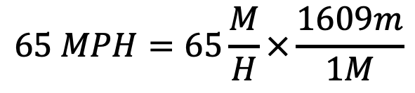
Unit Conversion
Express the speed limit 65 MPH in m/s.
(Useful conversion factors: 1 M = 1609 m, 1 H = 3600 s)
$$65 MPH=65\frac{M}{H}$$
$$65 MPH=65\frac{M}{H}×\frac{1609m}{1M}$$
$$65 MPH=65\frac{M}{H}×\frac{1609m}{1M}×\frac{1H}{3600s}$$
$$65 MPH=65\frac{M}{H}×\frac{1609m}{1M}×\frac{1H}{3600s}=\frac{65×1609}{3600}\frac{m}{s}$$
$$65 MPH=65\frac{M}{H}×\frac{1609m}{1M}×\frac{1H}{3600s}=\frac{65×1609}{3600}\frac{m}{s}=29\frac{m}{s}$$

Slide 10
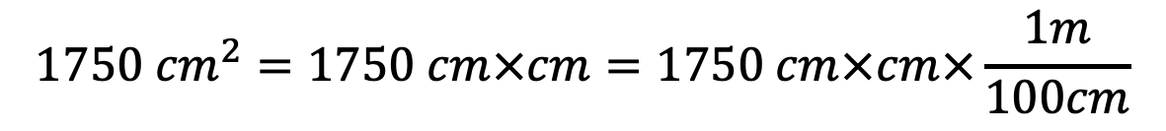

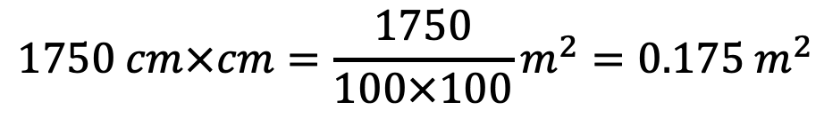

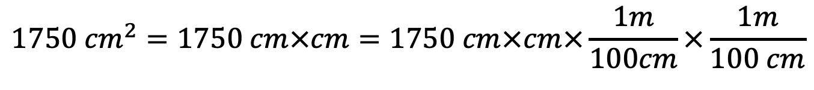
Unit Conversion
Express the area 1750 cm² in m².
(Useful conversion factor: 1 m = 100 cm)
$$1750 {cm}^{2}=1750 cm×cm$$
$$1750 {cm}^{2}=1750 cm×cm=1750 cm×cm×\frac{1m}{100cm}$$
$$1750 {cm}^{2}=1750 cm×cm=1750 cm×cm×\frac{1m}{100cm}×\frac{1m}{100 cm}$$
$$1750 cm×cm=\frac{1750}{100×100}m^{2}=0.175 m^{2}$$
$$1750 {cm}^{2}=0.175 m^{2}$$

Slide 11
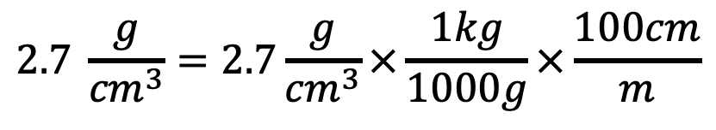
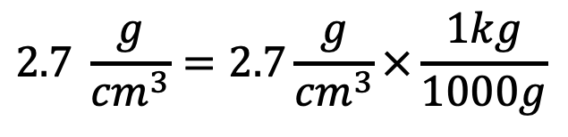
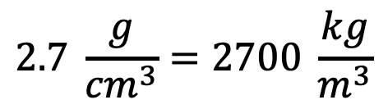
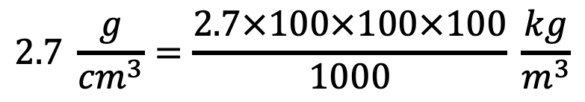
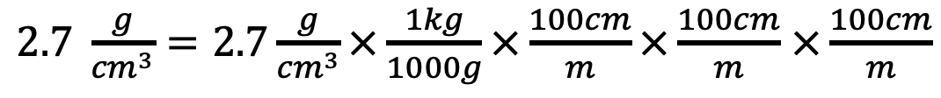
Unit Conversion
Express the density 2.7 g/cm³ in kg/m³.
(Useful conversion factors: 1 kg = 1000 g, 1 m = 100 cm)
$$2.7 \frac{g}{{cm}^{3}}=2.7\frac{g}{{cm}^{3}}×\frac{1kg}{1000g}$$
$$2.7 \frac{g}{{cm}^{3}}=2.7\frac{g}{{cm}^{3}}×\frac{1kg}{1000g}×\frac{100cm}{m}$$
$2.7 \frac{g}{{cm}^{3}}=2.7\frac{g}{{cm}^{3}}×\frac{1kg}{1000g}×\frac{100cm}{m}×\frac{100cm}{m}$ $×\frac{100cm}{m}$
$$2.7 \frac{g}{{cm}^{3}}=\frac{2.7×100×100×100}{1000} \frac{kg}{m^{3}}$$
$$2.7 \frac{g}{{cm}^{3}}=2700 \frac{kg}{m^{3}}$$

