Slide 1
C H A P T E R 1
Introduction and
The Nature of Physics
1.1 Physics: An Introduction
1.2 Physical Quantities and Units
1.3 Accuracy, Precision, and Significant Figures
1.4 Approximation

Slide 2
The Nature of Physics
The word physics comes from Greek, meaning nature. The study of nature came to be called “natural philosophy.”
Physics is the study of the fundamental laws of nature.
Physics deals with the behavior and structure of matter.
Physics is very fundamental and the most basic of the sciences.
Physics can predict how nature will behave in one situation on the basis of experimental data obtained in another similar situation.

Slide 3
Sub-Fields of Physics
Introductory physics is divided into the following sub-fields:
Mechanics (Chapters 1-10)
Fluids (Chapters 11-12)
Thermal physics (Chapters 13-15)
Wave motion and sound (Chapters 16-17)
Electricity and magnetism (Chapters 18-24)
Light and optics (Chapters 25-27)
Modern physics (Chapters 28-34)

Slide 4
Relativistic Quantum Mechanics
Relativistic quantum mechanics is a framework that combines the principles of both special relativity and quantum mechanics.
Modern physics: relativity (very fast) and quantum mechanics (very small).
Relativity must be used whenever an object is traveling at greater than about 1% of the speed of light or experiences a strong gravitational field such as that near the Sun.
Quantum mechanics must be used for objects smaller than can be seen with a microscope, atomic and sub-atomic levels.
The combination of these two theories is relativistic quantum mechanics, and it describes the behavior of small objects traveling at high speeds or experiencing a strong gravitational field.
Relativistic quantum mechanics is the best universally applicable theory we have.

Slide 5
Historical Development
Models, Theories, and Laws
The Scientific Method
The Evolution of Natural Philosophy into Modern Physics
  Aristotle (384-322 B.C)
Galileo Galilei (1564–1642)
Isaac Newton (1642–1727)
Niels Bohr (1885–1962)
Max Planck (1858-1947)
Albert Einstein (1879 – 1955)

Slide 6

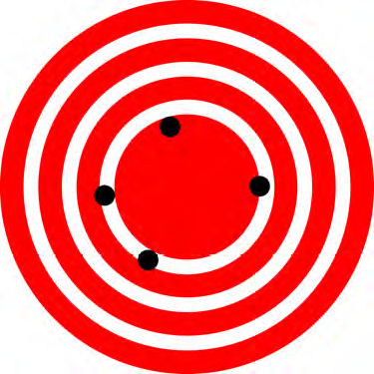
Accuracy and Precision
Accuracy is how close a measurement is to the correct value for that measurement.
The precision of a measurement system is refers to how close the agreement is between repeated measurements.
Low precision and high accuracy
High precision and low accuracy

Slide 7
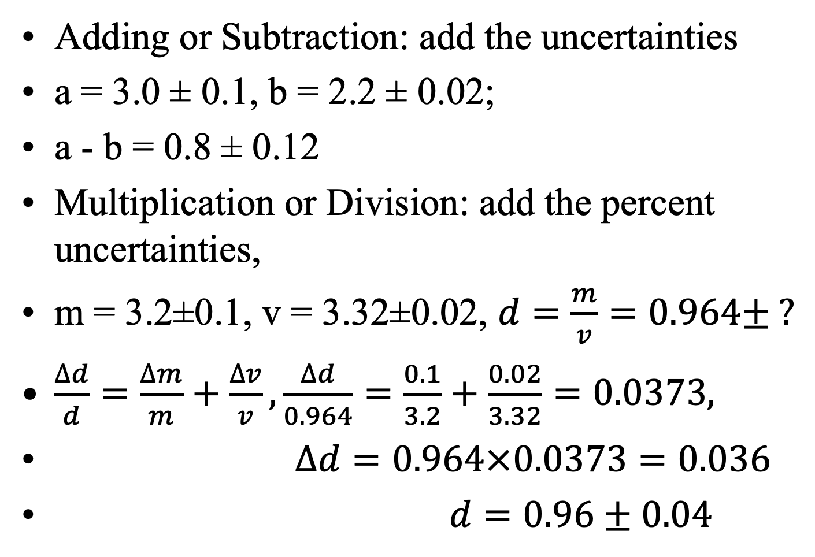
Uncertainties in Calculations
Adding or Subtraction: add the uncertainties
a = 3.0 ± 0.1, b = 2.2 ± 0.02;
a - b = 0.8 ± 0.12
Multiplication or Division: add the percent uncertainties,
m = 3.2±0.1, v = 3.32±0.02, $d=\frac{m}{v}=0.964± ?$
$\frac{∆d}{d}=\frac{∆m}{m}+\frac{∆v}{v}, \frac{∆d}{0.964}=\frac{0.1}{3.2}+\frac{0.02}{3.32}=0.0373,$
$∆d=0.964×0.0373=0.036$
$d=0.96±0.04$

Slide 8
Significant Figures
Expressing the significant figures: 239 (3), 34520 (4), 3.4520E4 (5)
0.07 (1), 7.0E-2 (2), 250 (2), 250. (3)
In Calculations:
For multiplication and division: The result should have the same number of significant figures as the quantity having the least significant figures entering into the calculation.
3.1 x 4.72 = 14.6 = 15
For addition and subtraction: The answer can contain no more decimal places than the least precise measurement.
5.123 + 1.63 = 6.753 = 6.75
In this class you will always express numbers with more than the minimum significant figures, unless asked specifically for a particular problem/question.

Slide 9
Approximation
On many occasions, physicists, other scientists, and engineers need to make approximations or “guesstimates” for a particular quantity.
These approximations allow us to rule out certain scenarios or unrealistic numbers. Approximations also allow us to challenge others and guide us in our approaches to our scientific world.
How long will it take to drive down to a place?
How tall is a 30-story building?

