Slide 1
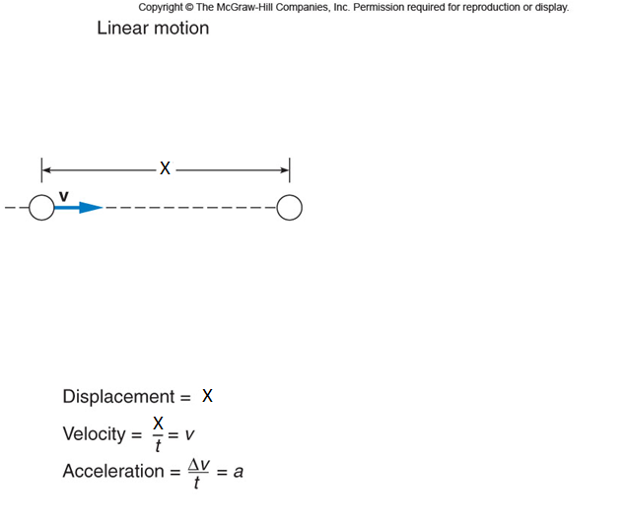
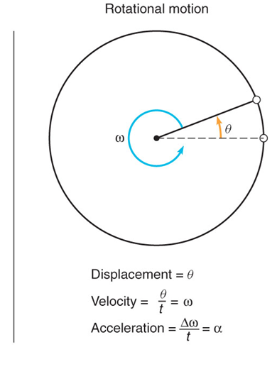
Rotational Motion
$$v=v_{0}+at$$
$$ω=ω_{0}+αt$$

Slide 2
The angle θ
In radian measure, the angle θ is defined to be the arc length s divided by the radius r.

Slide 3
Conversion between degree and radian
π rad = 180⁰

Slide 4
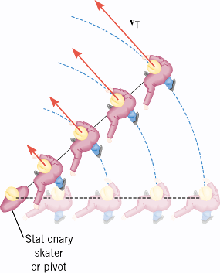
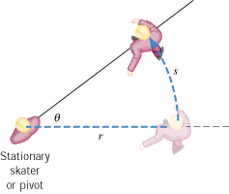
Angular Variables and Tangential/Linear Variables
In the ice-skating stunt known as “crack-the-whip,” a number of skaters attempt to maintain a straight line as they skate around one person (the pivot) who remains in place.
$$θ=\frac{S}{r}$$
$$S=rθ$$
$$\frac{S}{t}=r\frac{θ}{t}$$
$$v=rω$$
$$\frac{v}{t}=r\frac{ω}{t}$$
$$a=rα$$

Slide 5
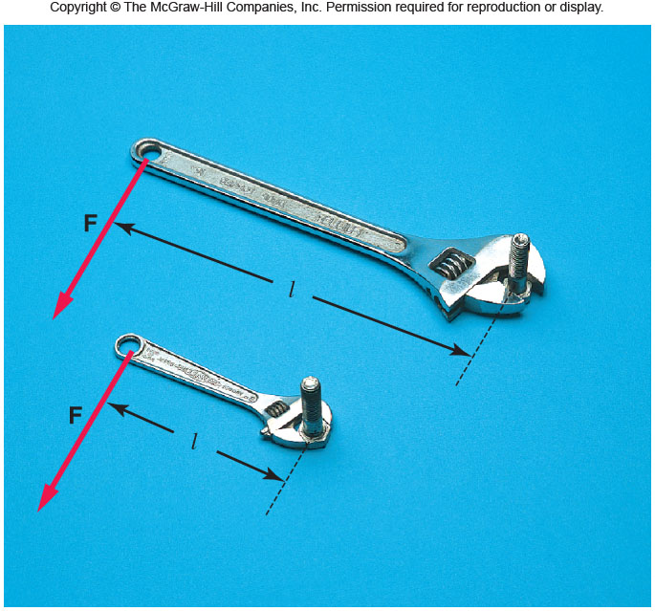
Torque, τ
Torque depends on the applied force and lever-arm.
Torque = Force x lever-arm
Torque is a vector. It comes in clockwise and counter-clock wise directions. Unit of torque = N•m

Slide 6
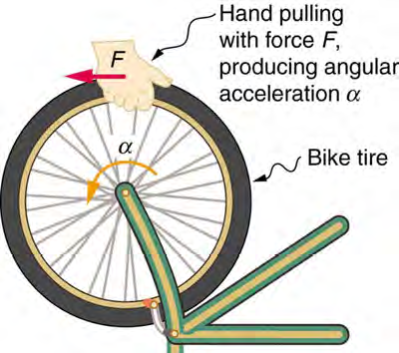
Newton’s 2nd law and Rotational Inertia
$$F=ma$$
$$rF=mra$$
$$rF=mrrα$$
$$rF=mr^{2}α$$
$$τ=Iα$$
$$I=mr^{2}$$
I = Rotational Inertia or Moment of inertia.

Slide 7
NEWTON’S SECOND LAW FOR A RIGID BODY ROTATING ABOUT A FIXED AXIS

Slide 8
Moment of Inertia of point masses
$$I=m_{1}r_{1}^{2}+m_{2}r_{2}^{2}+$$
Moment of inertia (or Rotational inertia) is a scalar.
SI unit for I: kg.m²

Slide 9
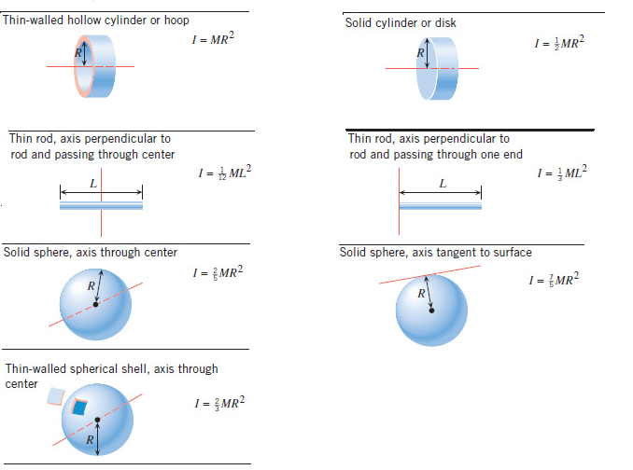
Moment of Inertia, I for Extended regular- shaped objects

Slide 10
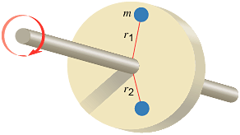
ROTATIONAL KINETIC ENERGY

Slide 11
Demo on Rolling Cylinders

Slide 12
Angular Momentum
The angular momentum L of a body rotating about a fixed axis is the product of the body's moment of inertia I and its angular velocity ω with respect to that axis:
Angular momentum is a vector.
SI Unit of Angular Momentum: kg · m²/s.

Slide 13
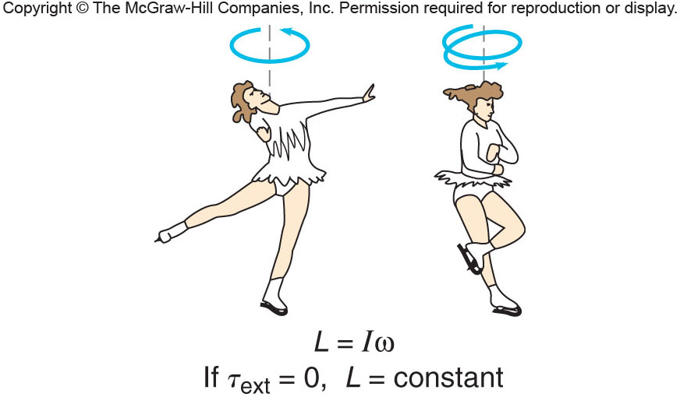
Conservation of Angular Momentum

Slide 14
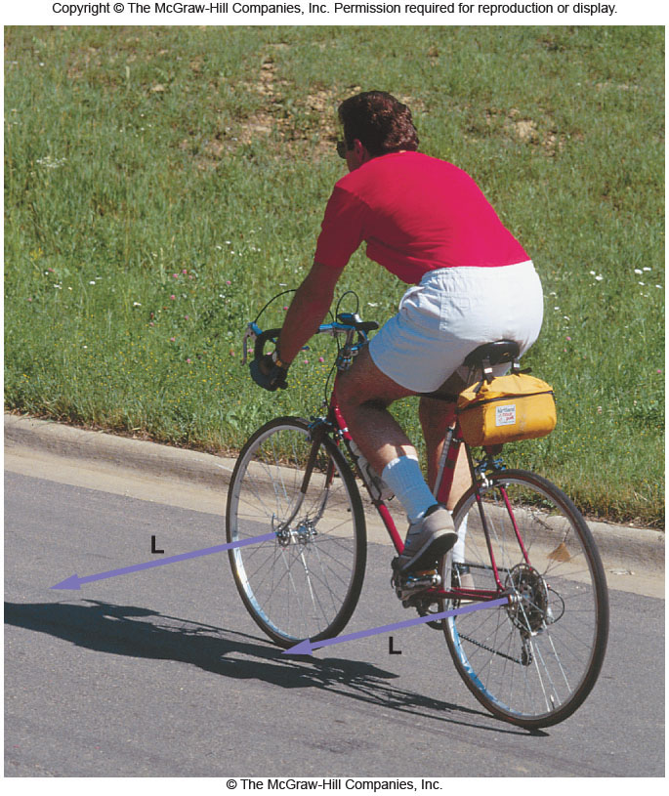
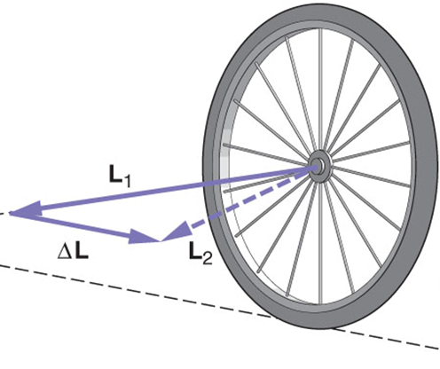
Angular momentum and Bicycles
Explain the role of angular momentum in riding a bicycle?

Slide 15
Equations Sheet
 | MOTION
 | Linear | Rotational
Time interval | t | t
Displacement | d; (d = rθ) | θ
Velocity | v = d/t; (v = rω) | ω = θ/t
Acceleration | a = Δv/t; (a = rα) | α = Δω/t
Kinematic equations | v = v₀ + at | ω = ω₀ + αt
 | v² = v₀² + 2ad | ω² = ω₀² + 2αθ
 | d = v₀t + ½ at² | θ = ω₀t + ½ αt²
 | d = ½(v + v₀)t | θ = ½(ω + ω₀)t
To create | force = F | torque =
Inertia | Mass =m | Rotational inertia = I = Σm_{i}r_{i}²
Newton’s 2nd Law | F_{net} = ma | τ_{net} = Iα
Momentum | p = m·V | L = I·ω
Conservation of momentum | Σm_{i}v_{i} = Σm_{f}v_{f} | ΣI_{i}ω_{i} = ΣI_{f}ω_{f}
Kinetic Energy | Translational Kinetic Energy = TKE = ½ mv² | Rotational Kinetic Energy = RKE = ½ Iω²
Work | W=F·d | W=τ·θ

