Slide 1
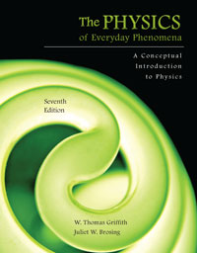
Chapter 17 Light and Image Formation
Lecture PowerPoint
Copyright © The McGraw-Hill Companies, Inc. Permission required for reproduction or display.

Slide 2
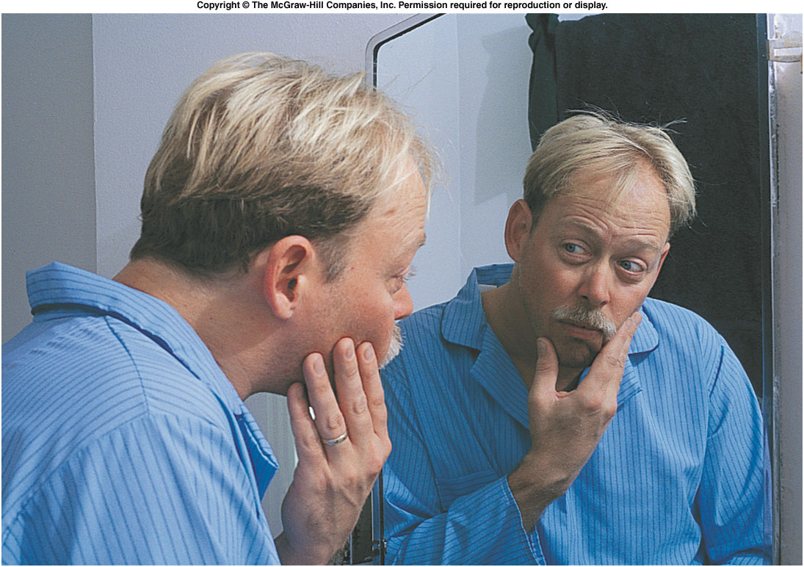
Reflection and Refraction
How is an image in a mirror produced?

Slide 3
Reflection and Image Formation
In chapter 16 we studied physical optics, which involve wave aspects of light such as interference and diffraction.
In this chapter we use geometric optics to describe the behavior of light by using light rays.
A light ray is drawn perpendicular to the wavefronts.
The basic principles are the laws of reflection and refraction.
By drawing light rays, we can predict how and where images will be formed.

Slide 4
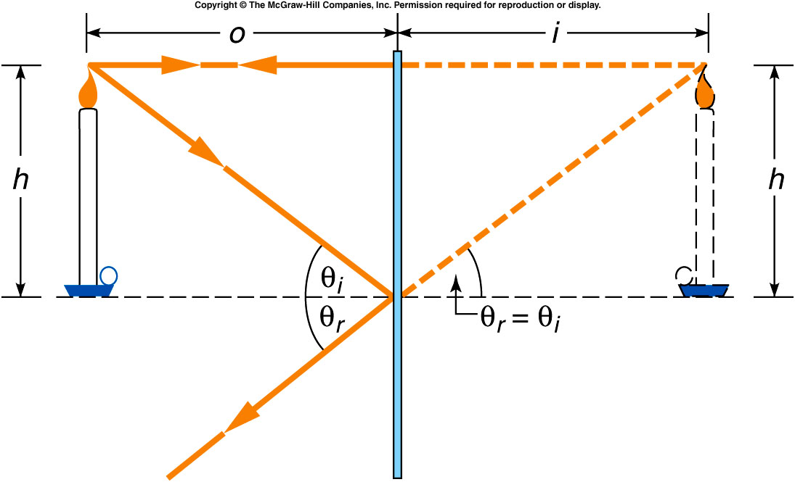
How tall must a plane mirror be in order for you to view your full height reflected in it?
Half your height.
Three-quarters of your height.
A little shorter than your height.
Exactly your height.
A little taller than your height.
Since the light reaching your eyes from your feet would be reflected from a point on the mirror exactly halfway between your feet and your eyes, you would be able to view your feet (and all points between your feet and your eyes) in a mirror that was half as tall as you.

Slide 5
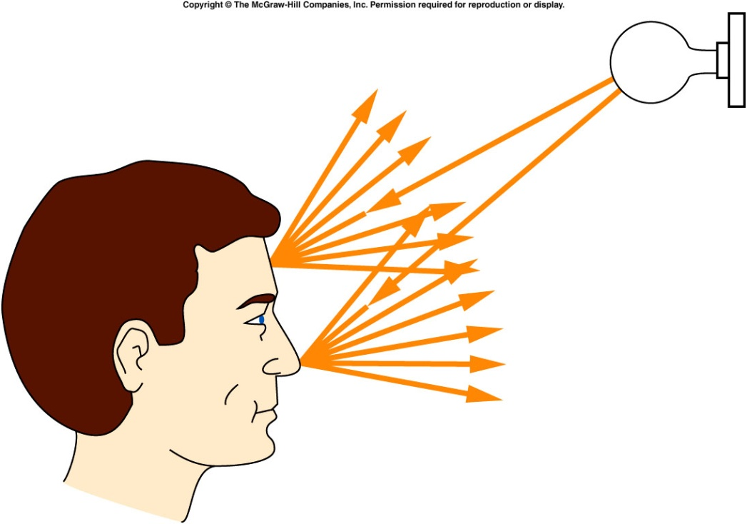
How is your image in a bathroom mirror produced?
Light waves from the bathroom light are scattered off your face in all directions.
Some of that light travels to the mirror.
At the mirror, the light waves are reflected.
You could trace the path of one particular light ray as it strikes one point on your face, travels to the mirror, and is reflected back to your eyes.

Slide 6
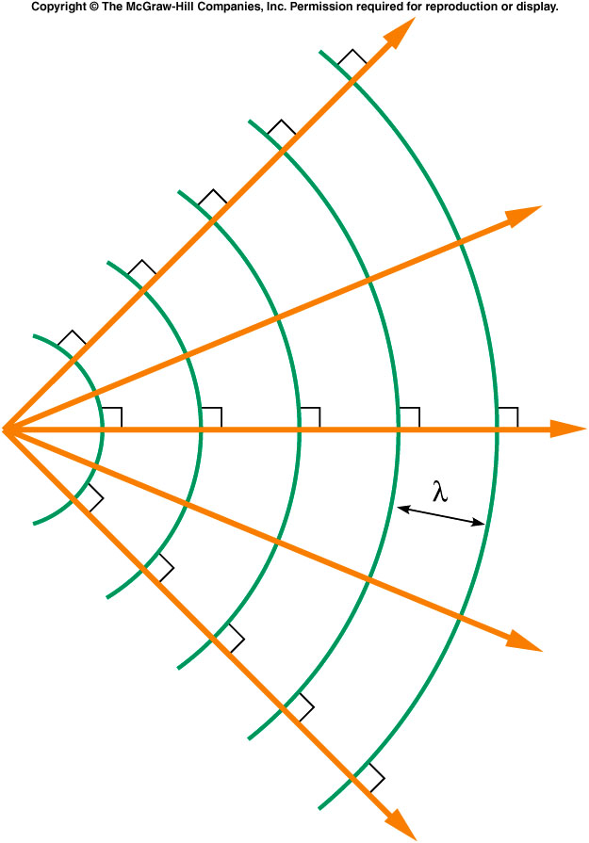
Light rays are drawn so that they are everywhere perpendicular to the wavefronts.
As the scattered waves travel outward in all directions, the light rays would spread out or diverge.
If the waves travel with uniform speed, the rays are straight lines.

Slide 7
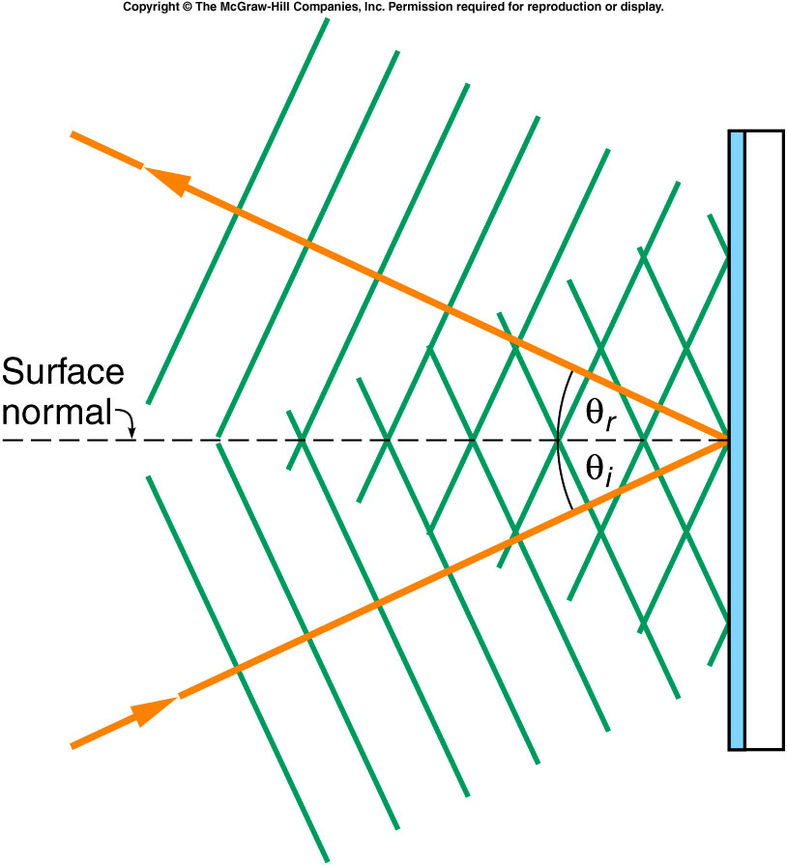
Reflection of light by a flat mirror
Consider plane wavefronts (no curvature) approaching a flat mirror at an angle:
After reflection they travel away from the mirror with the same speed as before reflection.
Some parts of the wavefront are reflected sooner than others.
The reflected wavefronts have the same speed and spacing but a new direction.
The angle between the wavefronts and the mirror is the same for the emerging wave.

Slide 8
Law of Reflection
We usually measure the angles with respect to the surface normal, a line drawn perpendicular to the surface of the mirror.
The angle of incidence is equal to the angle of reflection.

Slide 9
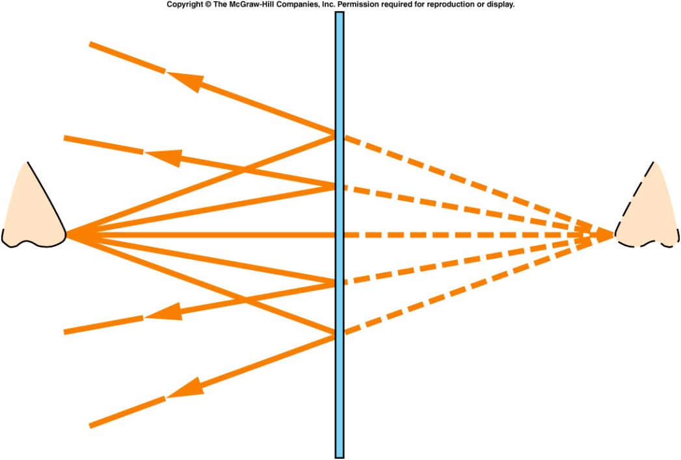
Back to the example of your reflection in the bathroom mirror...
Light rays scattered from your nose are reflected at the mirror according to the law of reflection.
If we extend the reflected rays backward from the mirror, they intersect at a point behind the mirror.
As your eye collects the
reflected rays, it perceives
an image that appears to lie
at this point of intersection.
The distance of the image
behind the mirror is equal to
the distance of the original
object from the front of the
mirror.

Slide 10
For an object standing in front of a plane mirror, we can locate the image by extending two of the rays coming from the top of the object.
The ray that comes into the mirror horizontally and perpendicular to the mirror is reflected back along the same line.
The other ray is reflected at an angle equal to its angle of incidence.
When these two reflected rays are extended back behind the mirror, their intersection locates the top of the image.
Since the bottom of the
image will lie directly
beneath the top of the
image, on the same line or
axis that the object is on,
it is not necessary to draw
rays from the bottom of
the object.

Slide 11
Thus we have found the position of the image, its magnification, and its orientation (whether it is inverted or upright).
The distance of the image from the mirror equals the distance of the object from the mirror: i = o.
The image is the same height as the object, so the magnification = 1.
The image is upright.

Slide 12
How can an image lie behind a mirror hanging on a wall, when no light can reach that point?
Does light actually pass through the position where the image is located?
The light never gets behind the mirror at all, it just appears to come from points behind the mirror as it is reflected.
Since the light never
actually passes
through the point
where the image is
located, the image is
called virtual.

Slide 13
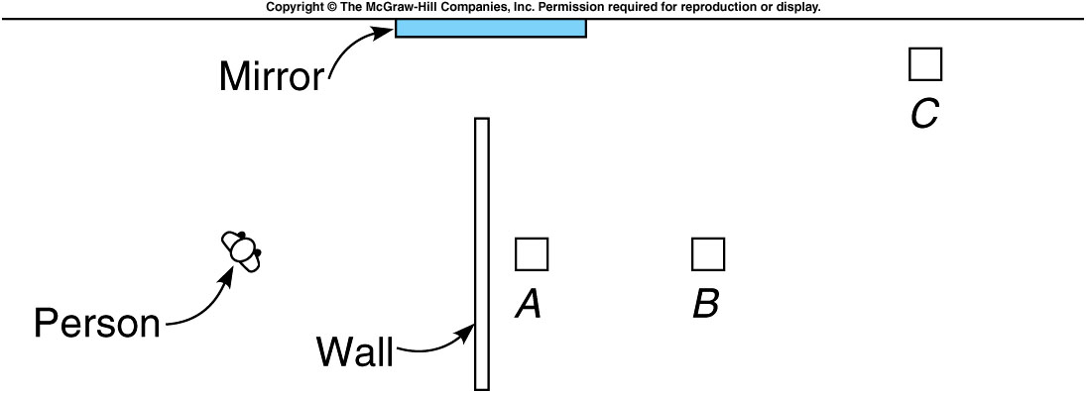
Objects A, B, and C lie in the next room hidden from direct view of the person in the diagram. A plane mirror is placed on the wall of the passageway between the two rooms. Which of the objects will the person be able to see in the mirror?
Object A
Object B
Object C
At the position shown, the person will see a reflected ray only from object B.

Slide 14
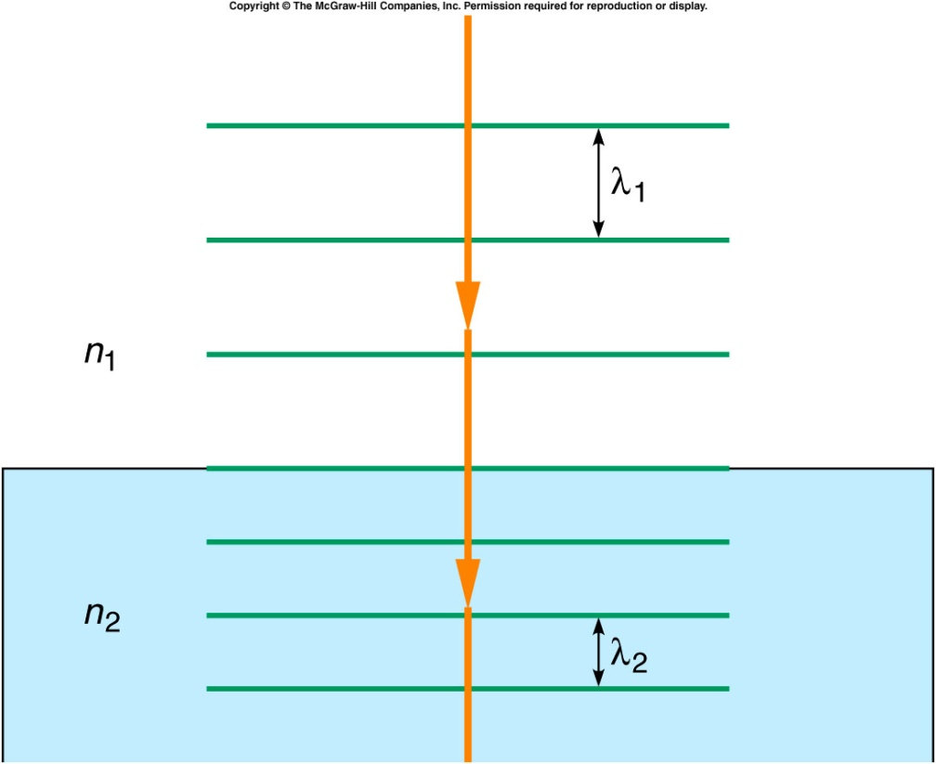
Refraction of Light
What happens to light rays when they encounter a transparent object such as glass or water?
The speed of light in glass or water is less than in air or vacuum.
Thus, the distance between wavefronts (the wavelength) will be shorter.
The index of refraction is the ratio of the speed of light c in a vacuum to the speed of light v in some substance.

Slide 15
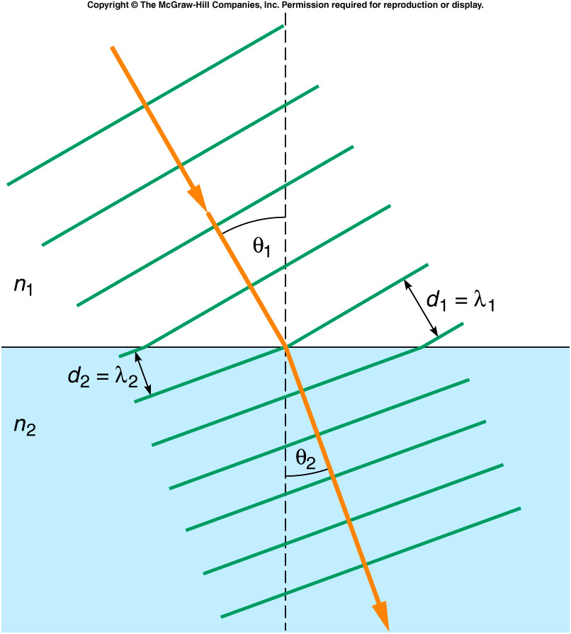
Since the wavefronts do not travel as far in one cycle, the rays bend (much like rows in a marching band bend when one side slows down by taking smaller steps).
The amount of bending
depends on the angle of
incidence.
It also depends on the
indices of refraction of the
materials involved.
A larger difference in
speed will produce a
larger difference in indices
of refraction and a larger
bend in the wavefront and
ray.

Slide 16
Law of Refraction
When light passes from one transparent medium to another, the rays are bent toward the surface normal if the speed of light is smaller in the second medium, and away from the surface normal if the speed of light is greater.
For small angles:

Slide 17
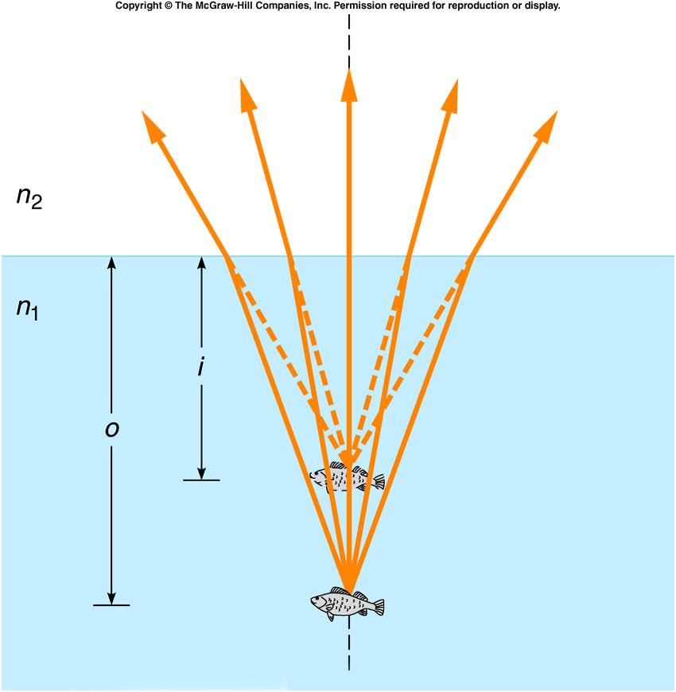
Apparent Depth
The bending of light rays is responsible for some deceptive appearances.
Light traveling up from water into air diverge more strongly in air.
Extending the rays backwards
shows that they appear to
come from a point closer to
the surface of the water than
their actual point of origin.
For example, looking down at
a fish in the water, the fish will
appear closer to the surface
than it actually is:

Slide 18
If you are standing on a bridge over a stream looking down at a fish that is 1 m below the surface, what is the apparent location of the fish? (The index of refraction of air is 1.00 and the index of refraction of water is 1.33.)
1 m below the surface
1.33 m below the surface
0.75 m below the surface
0.5 m below the surface
0.5 m above the surface
.

Slide 19
A girl swimming underwater views a dragonfly hovering over her in the air. The dragonfly appears to be 60 cm above the water surface. What is the actual height of the dragonfly above the water? (The index of refraction of air is 1.00 and the index of refraction of water is 1.33.)
60 cm above the surface
1.33 cm above the surface
45 cm above the surface
79.8 cm above the surface
45 cm below the surface
Since the object (the dragonfly) is in air, the light is initially in air, so n₁=1.
This time we know the image distance and are asked to find the object distance.
The object is actually closer to the water surface than it appears.
.

Slide 20
Total Internal Reflection
Light rays bend away from the axis as they pass into the medium with the lower index of refraction (for example, going from glass or water to air or vacuum).
If the rays are bent so much that the angle of refraction is 90º, the refracted ray would just skim the surface.
The angle of incidence that produces a 90º angle of refraction is called the critical angle θ_{c}.
Rays incident at angles greater than θ_{c} are reflected back inside the glass or water.

Slide 21
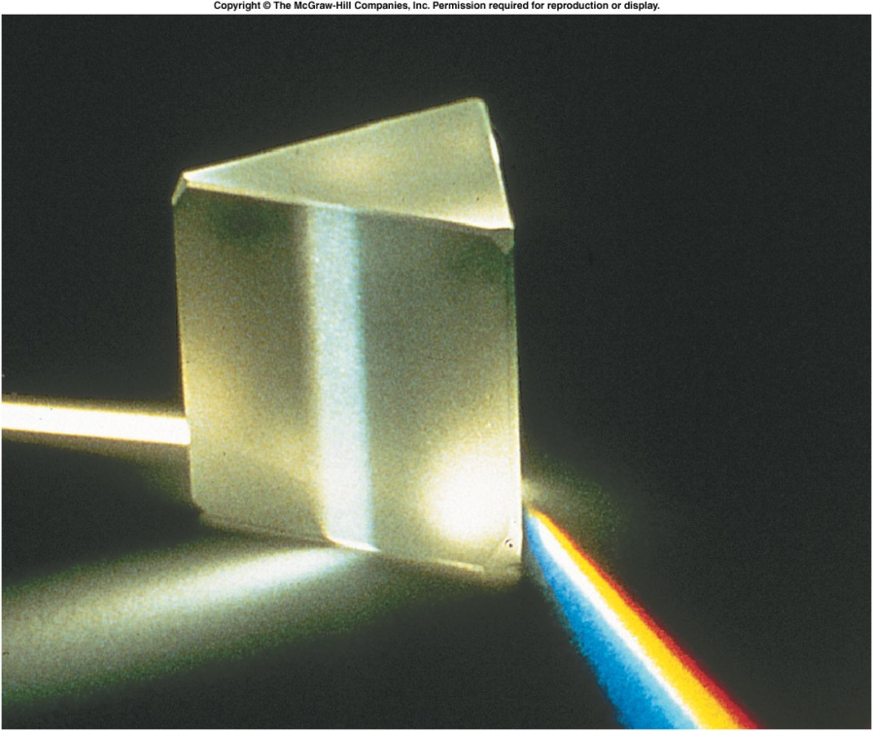
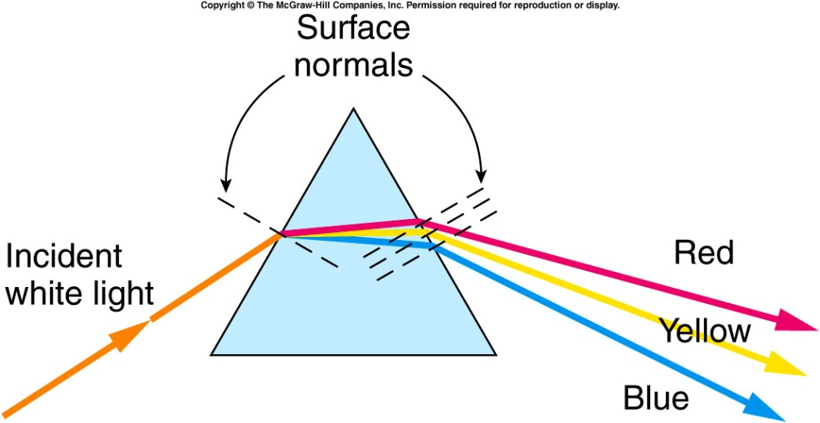
Dispersion
The index of refraction of a material varies with the wavelength of light.
Different wavelengths are bent by different amounts.
The wavelength is associated with the color that we perceive.
Blue light is bent the most, and red light is bent the least.
Light is bent toward the normal as it enters a prism, and away from the normal as it exits the prism.
Blue rays are bent the most.
This is called dispersion.

Slide 22
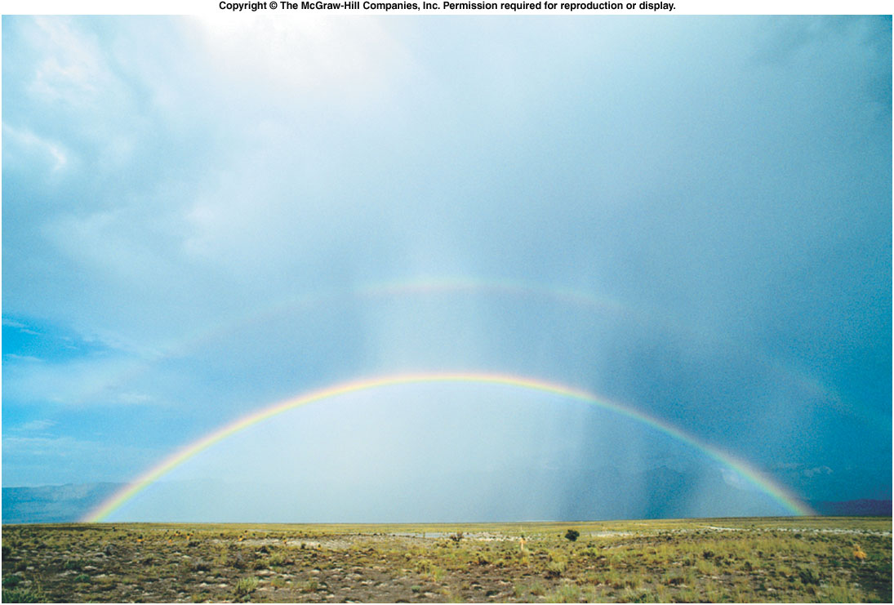
How is a rainbow formed? Where should you look to see a rainbow?

Slide 23
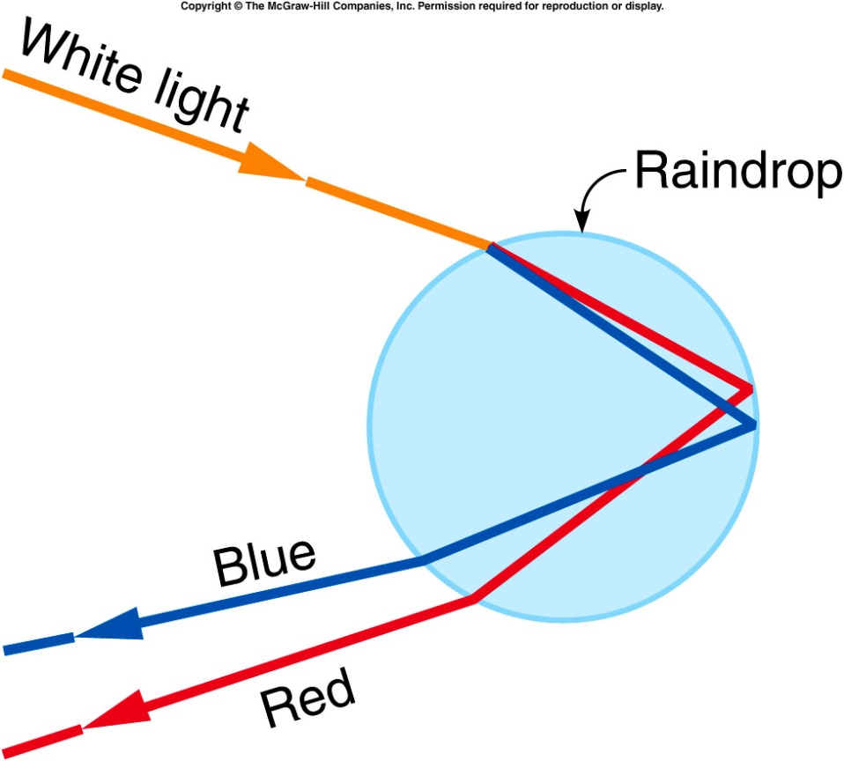
When a light ray strikes the first surface of a raindrop, some of it is refracted into the drop.
Blue light is bent more than red at this surface, producing dispersion.
The light rays then travel through the drop and strike its back surface, where
they are partially reflected.
Some of the light passes
out of the drop, and some
is reflected back toward
the front surface.
At the front surface, the
light rays are refracted
again, with blue light again
being bent the most.

Slide 24
When we view a rainbow, the sun must be behind us and the raindrops in front of us.
Red light is reflected from raindrops at the top of the rainbow or at the greatest angle from the center of the arc.
Blue and violet light is
reflected from raindrops
lying at smaller angles,
or closer to the center of
the arc.

Slide 25
Look carefully at the rainbow again. Can you see a second, fainter rainbow farther from the center of the arc?

Slide 26
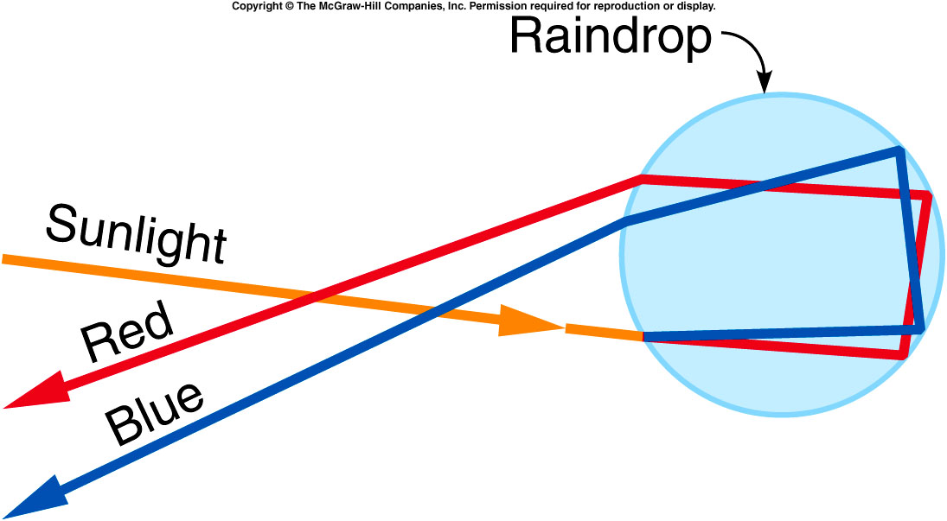
The secondary rainbow is produced by a double reflection inside the raindrops.
Light rays entering near the bottom of the first surface may strike the back surface at a large enough angle of incidence to be reflected twice before getting out of the drop.
In this case the light rays are deviated through a larger angle than the primary rainbow, so the secondary rainbow is
seen outside the arc
of the primary rainbow.
Since the colors are
reversed, the blue light
lies at the top of the
secondary rainbow.

Slide 27
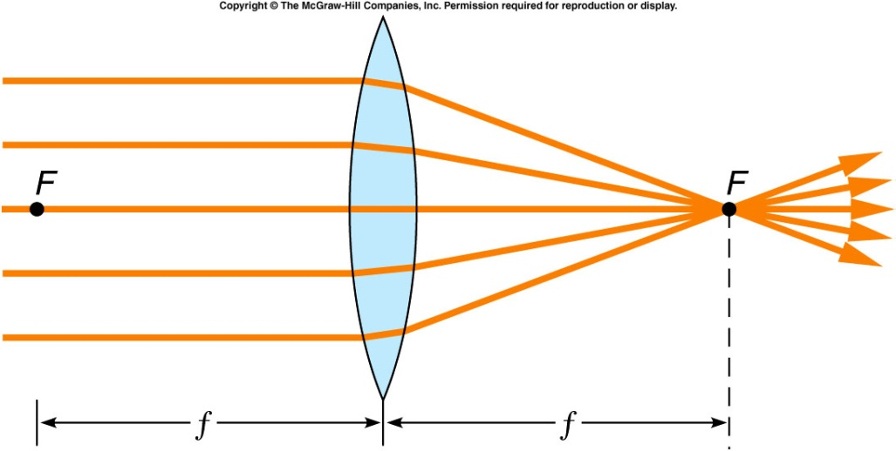
Lenses and Image Formation
The law of refraction also governs the behavior of lenses such as in eyeglasses and contact lenses.
For example, a converging or positive lens:
Light rays are bent toward the surface normal at the first surface and away from the surface normal at the second surface, resulting in the ray bending toward the axis.
Incident parallel rays all pass through the focal point F.
The distance from the center of the lens to the focal point is the focal length f.

Slide 28
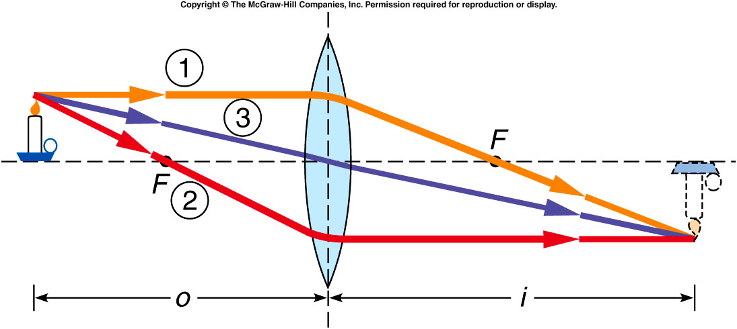
For an object lying beyond the focal point of a positive lens, we can locate the image by tracing three rays coming from the top of the object.
A ray that comes into the lens horizontally and parallel to the axis is bent so that it passes through the focal point on the far side of the lens.
A ray coming through the focal point on the near side emerges parallel to the axis.
A ray coming in through the center of the lens passes through the lens without being bent.
The image lies on the opposite side of the lens from the object.
It is a real image since the light rays pass through the actual image point.
The image is upside-down or inverted.
The magnification is the ratio of the image height to the object height.
A negative magnification
represents an inverted image
and a positive magnification
represents an upright image.

Slide 29
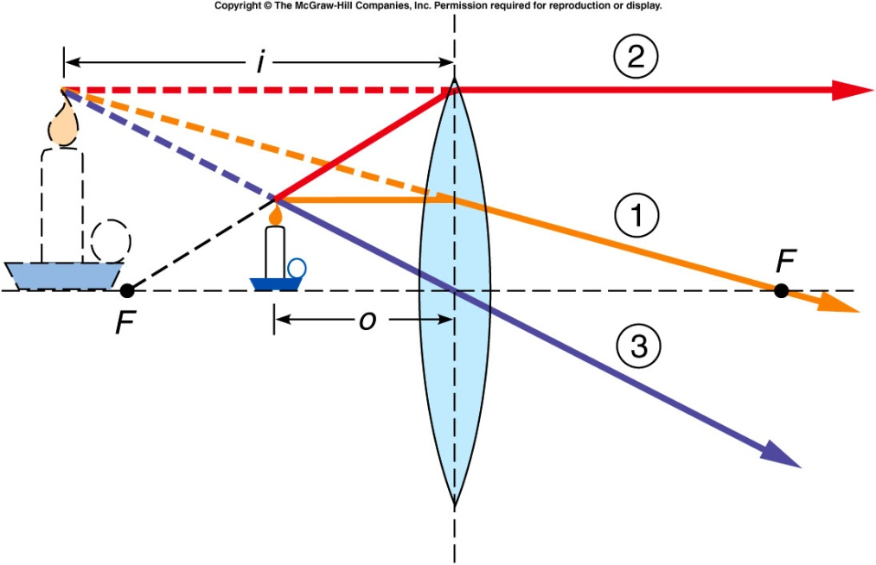
For an object lying “inside” the focal point of a positive lens, we can get a virtual image with a positive magnification.
Here, the image distance is negative since the image is virtual and lies on the side of the lens from which the light is coming.
The emerging light rays appear to diverge from a point behind the object.
The image is upright.

Slide 30
An object 2 cm in height lies 10 cm to the left of a positive lens with a focal length of 20 cm. Where is the image located?

Slide 31
An object 2 cm in height lies 10 cm to the left of a positive lens with a focal length of 20 cm. What is its magnification?

Slide 32
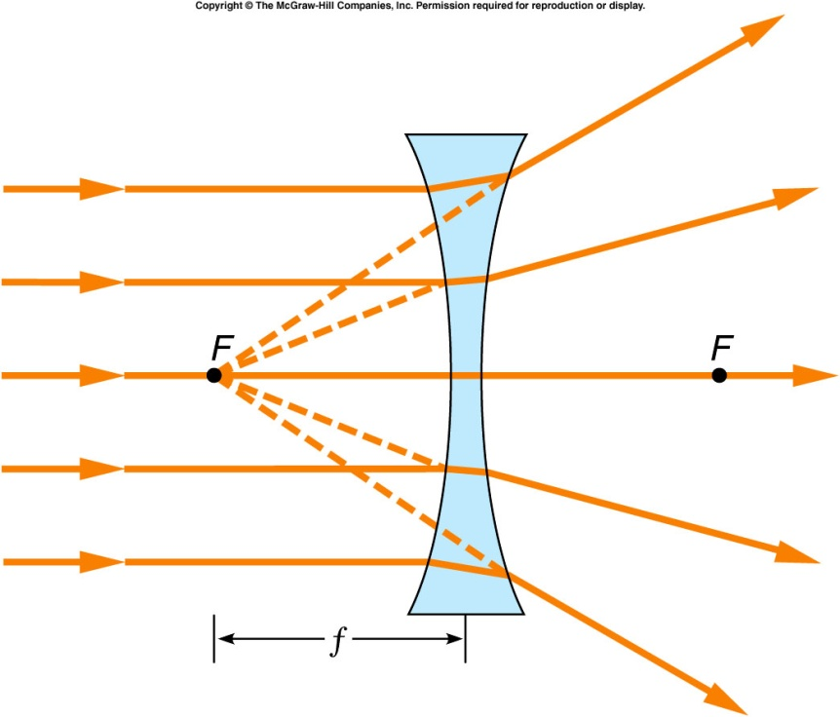
Now consider a diverging or negative lens:
Light rays are bent toward the surface normal at the first surface and away from the surface normal at the second surface, resulting in the ray bending away from the axis.
Incident parallel rays all appear to be coming from the focal point F.
The distance from the center of the lens to the focal point is the focal length f.

Slide 33
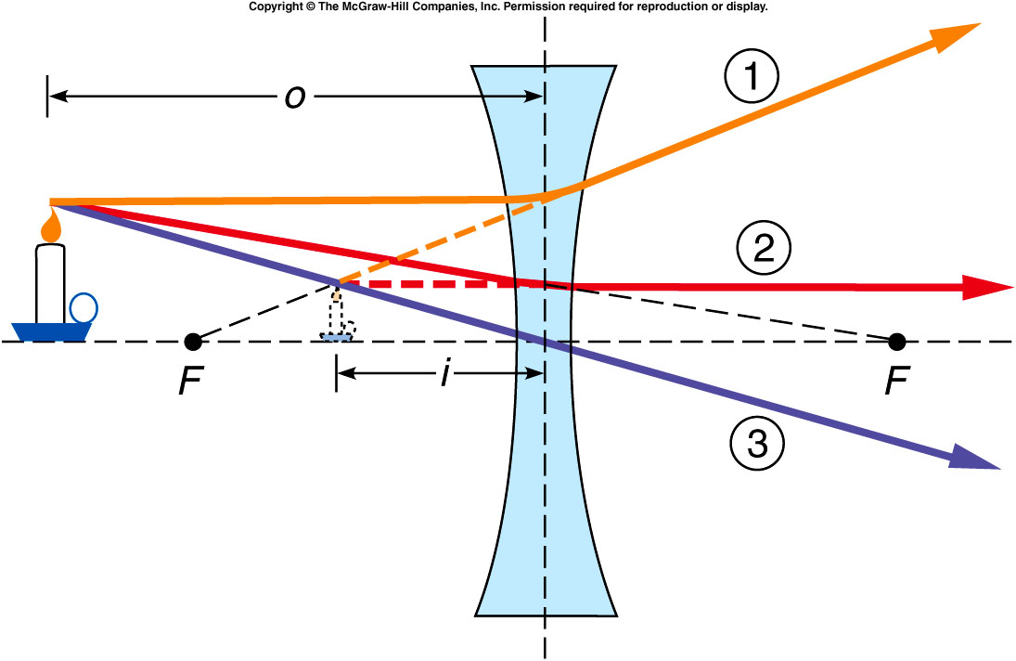
For an object lying beyond the focal point of a positive lens, we can locate the image by tracing three rays coming from the top of the object.
A ray that comes into the lens horizontally and parallel to the axis is bent away from the axis so that it appears to come from the focal point on the near side of the lens.
A ray coming in toward the focal point on the far side emerges parallel to the axis.
A ray coming in through the center of the lens passes through the lens without being bent.
The image lies on the same side of the lens from the object.
It is a virtual image since the
light rays do not pass through
the actual image point.
The image is upright and
reduced in size.

Slide 34
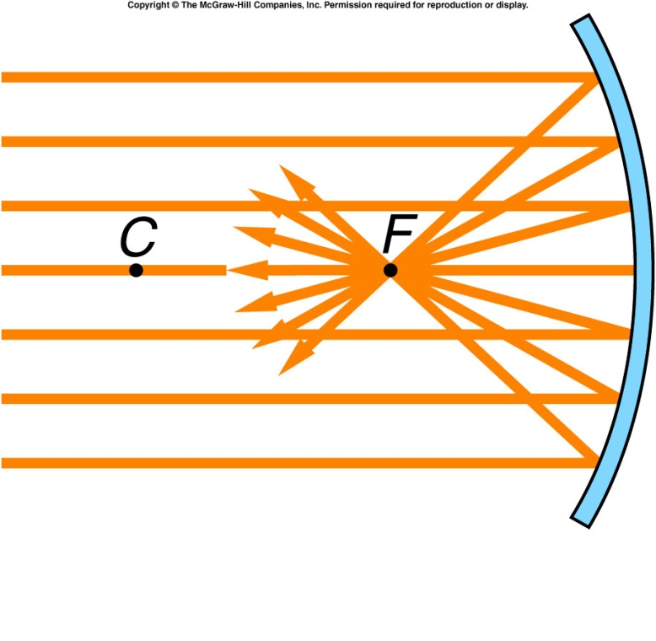
Focusing Light with Curved Mirrors
A spherical reflecting surface can focus light rays in a manner similar to a lens.
For example, concave mirrors:
The center of curvature lies on the axis.
The law of reflection dictates where each ray will go.
The surface normal for each ray is found by drawing a line from the center of curvature to the surface.

Slide 35
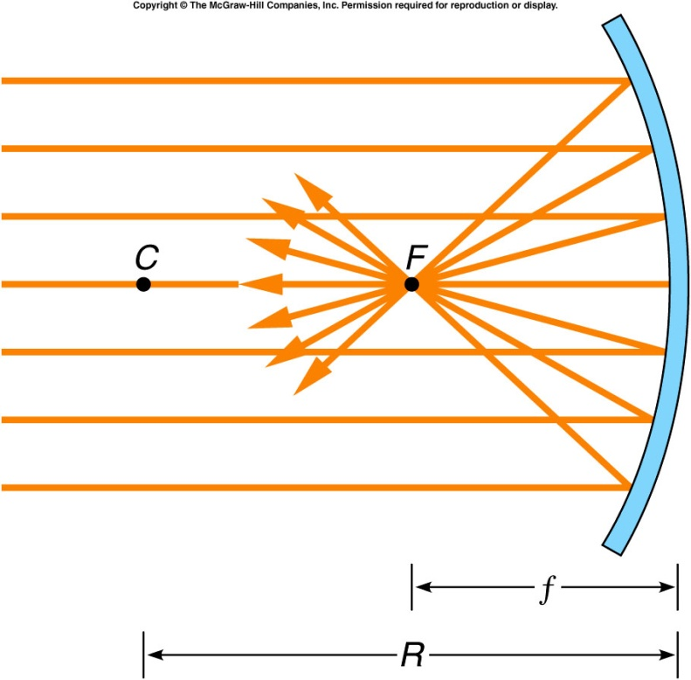
Focusing Light with Curved Mirrors
A spherical reflecting surface can focus light rays in a manner similar to a lens.
For example, concave mirrors:
Incident parallel rays are reflected back through a common focal point F.
The focal length f is half the radius of curvature R.

Slide 36
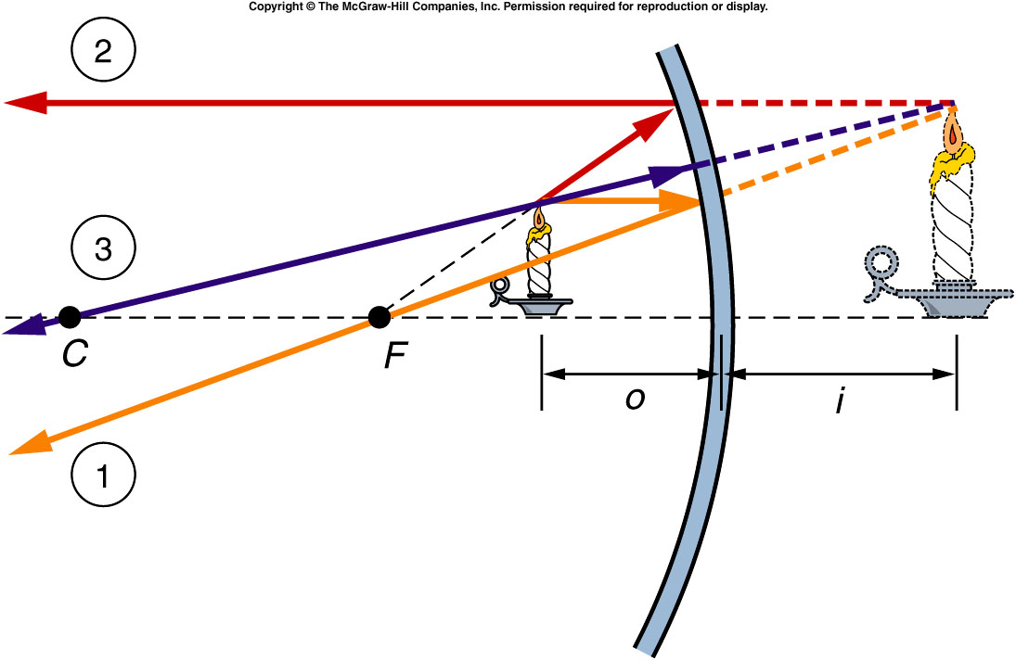
For an object lying inside the focal point of a concave mirror, we can locate the image by tracing three rays coming from the top of the object.
A ray that comes into the mirror horizontally and parallel to the axis is reflected through the focal point.
A ray coming in through the focal point is reflected parallel to the axis.
A ray coming in along a line passing through the center of curvature is reflected back along itself.
Extend these three rays backward to find the point where they intersect behind the mirror.
This is where they all appear to originate, so this is the top of the image.
The image is virtual since the
light rays do not pass through
the actual image point.
The image is upright and
magnified.

Slide 37
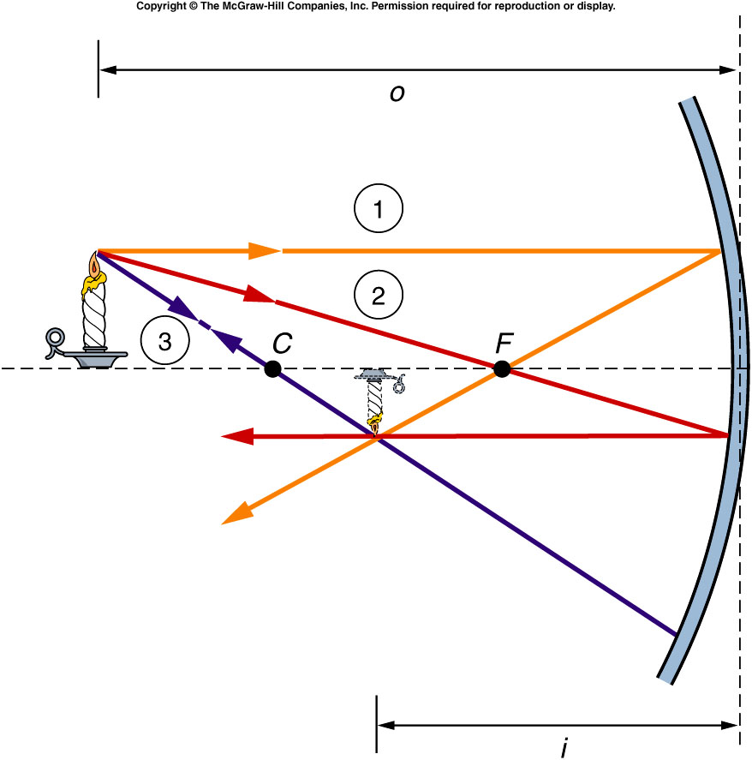
For an object lying beyond the focal point of a concave mirror, a real image is formed.
The rays intersect at a point on the same side of the mirror as the object and then diverge again from this point.
We see an image that lies in
front of the mirror.
The image is real since the
light rays do pass through
the actual image point.
The image is inverted.

Slide 38
An object lies 5 cm to the left of a concave mirror with a focal length of +10 cm. Where is the image located? Is it real or virtual?

Slide 39
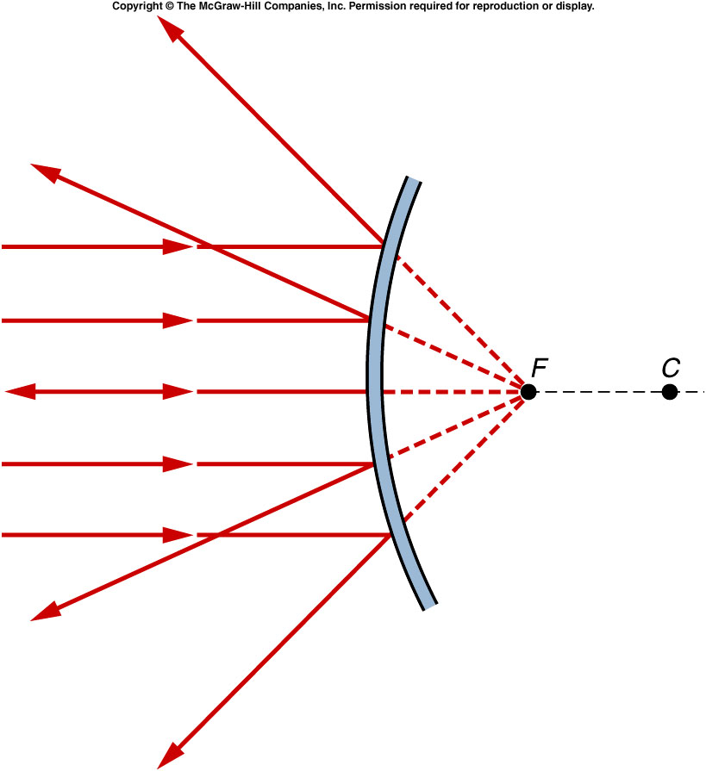
Now consider a diverging or convex mirror:
Incident parallel rays all appear to be coming from the focal point F, behind the mirror.
Parallel light rays diverge as they leave the mirror rather than converging as they do with a concave mirror.
The distance from the center of the lens to the focal point is the focal length f.

Slide 40
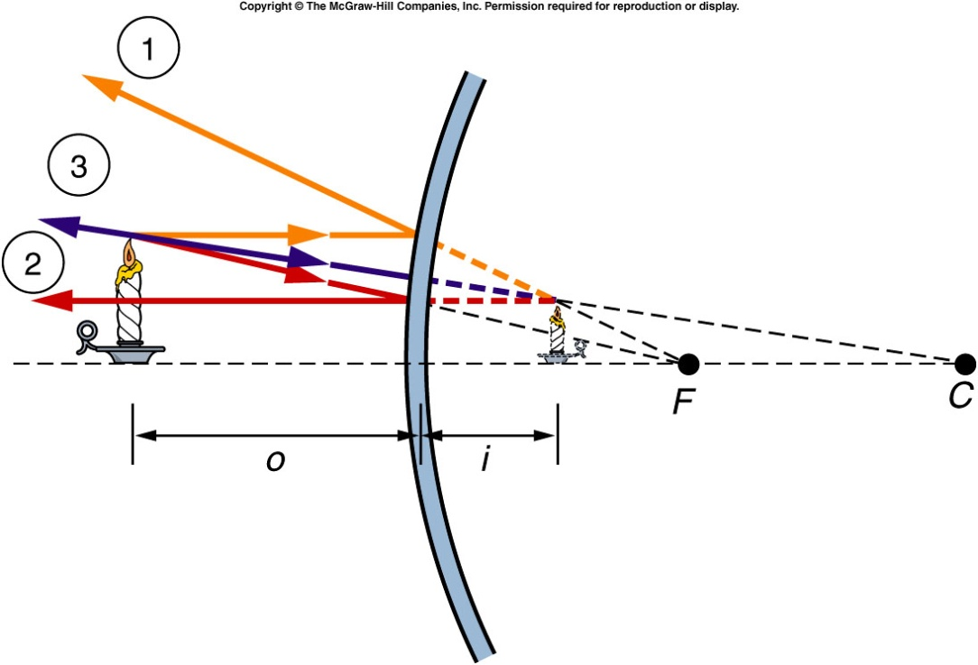
For an object lying in front of a convex mirror, we can locate the image by tracing three rays coming from the top of the object.
A ray that comes into the lens horizontally and parallel to the axis is reflected as though it came from the focal point.
A ray coming in toward the focal point is reflected parallel to the axis.
A ray coming in toward the center of curvature is reflected back along itself.
When extended backward, these three rays all appear to come from a point behind the mirror.
The image is virtual since
it lies behind the mirror and
light rays do not pass through
the actual image point.
The image distance will always
be negative (behind the mirror).
The image is upright and
reduced in size.

Slide 41
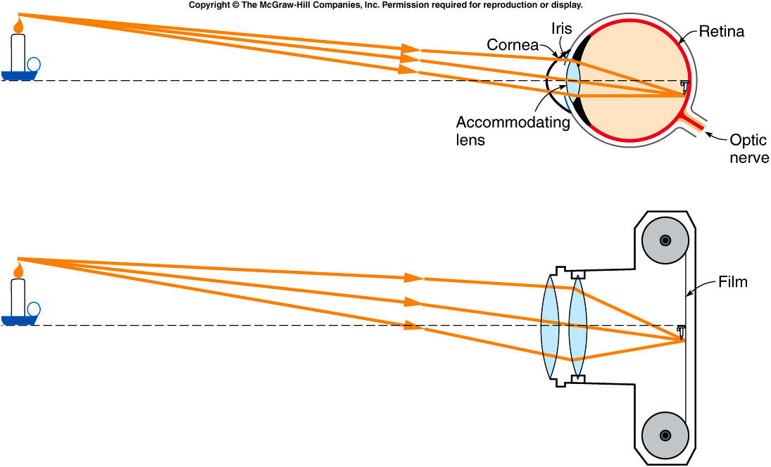
Eyeglasses, Microscopes, and Telescopes
Our eyes contain two positive lenses that focus light rays on the back surface or retina of the eyeball:
The curved membrane forming the front surface of the eye called the cornea does most of the focusing.
The accommodating lens attached to muscles inside the eye is for fine-tuning.
This is similar to how a camera uses a compound positive lens system to focus light rays onto film at the back of the camera.

Slide 42
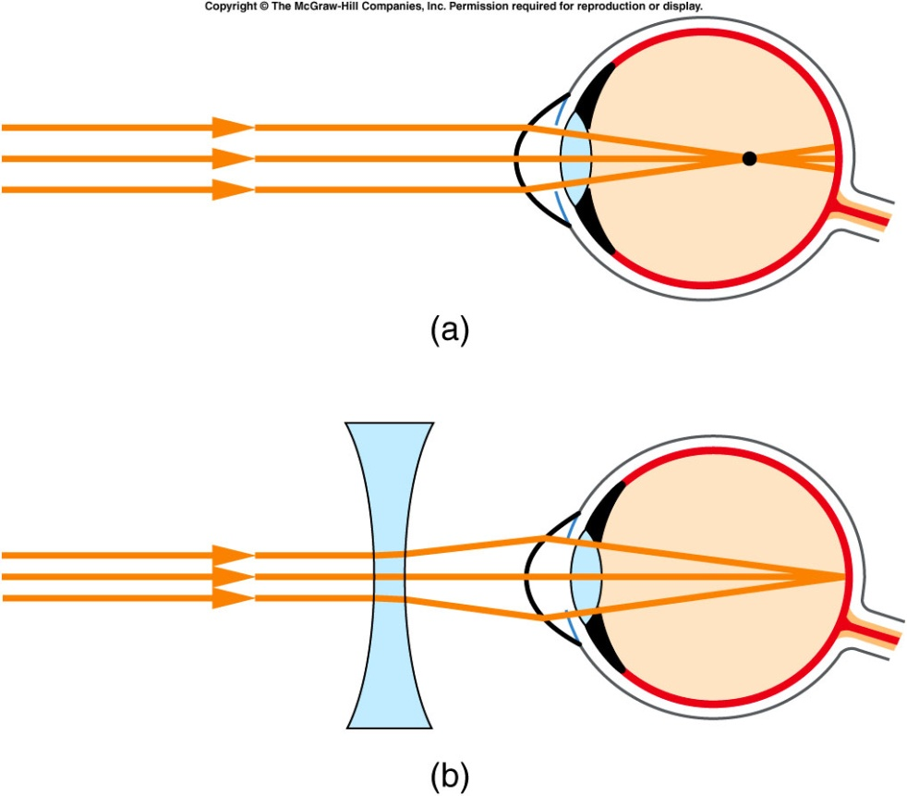
The most common visual problem of people who do a lot of reading is nearsightedness or myopia.
The eyes bend the parallel light rays from a distant object too strongly, so that they focus in front of the retina.
By the time the rays reach the retina, they are diverging again and no longer form a sharp focus.
Negative eyeglass lenses correct the problem by diverging the incident light rays.
A myopic person can see
near objects distinctly,
because the incident light
rays are already diverging
instead of coming in parallel.

Slide 43
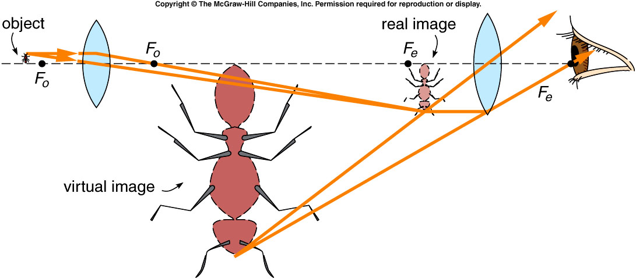
A microscope consists of two positive lenses held together by a connecting tube (not shown).
The object being viewed is placed near the first lens or objective lens.
The objective lens forms a real, inverted image.
This real image becomes the object for the second lens, the eyepiece or ocular lens.
The magnification of each lens is multiplied to give the overall magnification of the microscope.
The microscope is a striking example of how developments in one area of science have a dramatic impact on other areas such as medicine and biology.

Slide 44
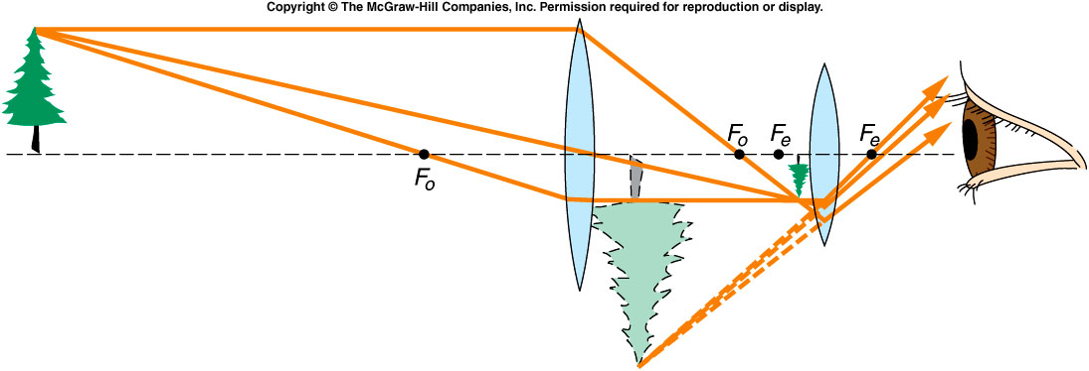
The invention of the telescope had an equally dramatic impact on areas such as astronomy.
Large objects appear tiny when they are very far away.
The objective lens of a telescope forms a real image which is reduced in size rather than magnified.
This image is smaller than the actual object, but since it is much closer to the eye, it forms a larger image on the retina when viewed through the eyepiece.

Slide 45
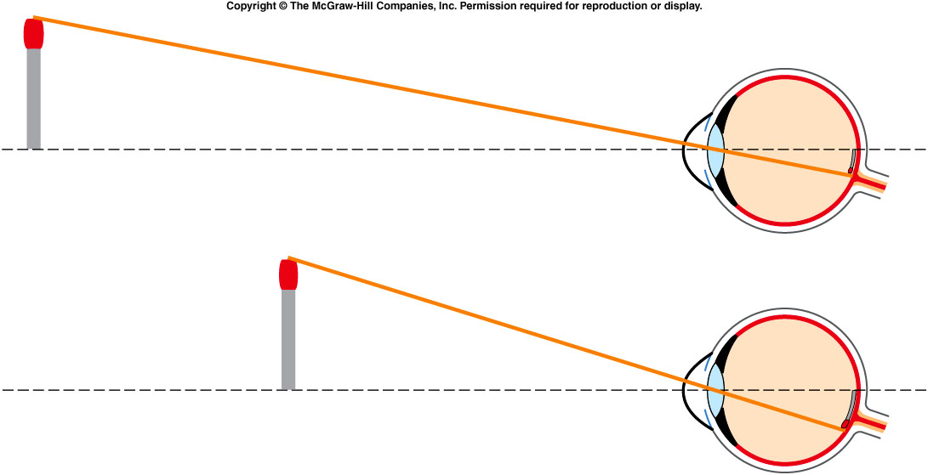
Two objects of the same size but at different distances from the eye form different-sized images on the retina.
We can see more detail on the nearer object.
We have achieved an angular magnification.
The overall angular magnification produced by a telescope is equal to the ratio of the focal length of the objective lens to the focal length of the eyepiece lens.

Slide 46
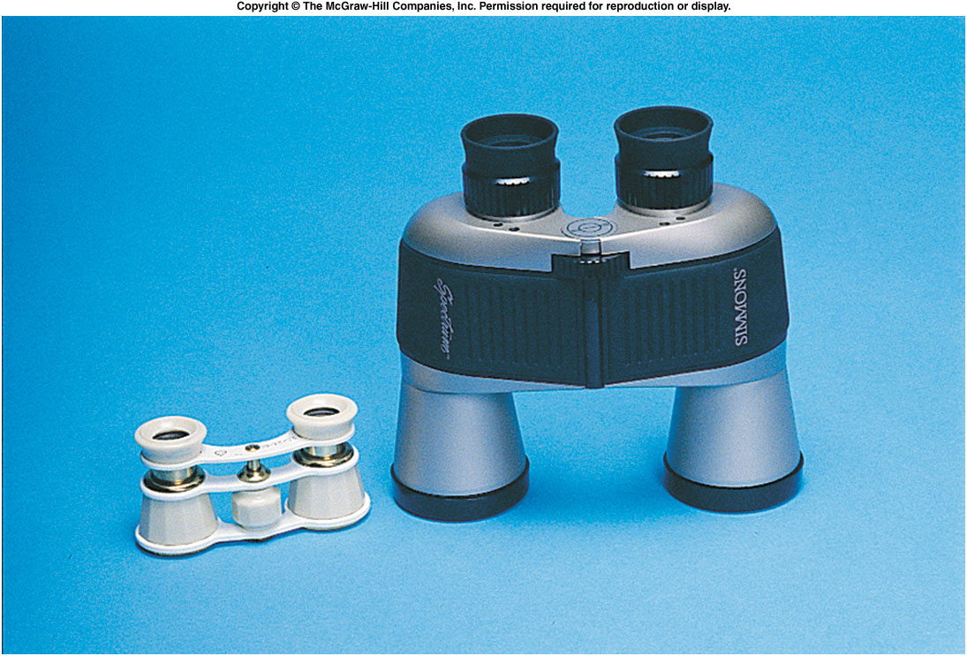
The image formed by most astronomical telescopes is inverted, which is not desirable for viewing objects on earth.
The most familiar form of terrestrial telescope is a pair of prism binoculars, which use multiple reflections in prisms to reinvert the image.
Opera glasses are a simpler form of terrestrial telescope, which uses negative lenses for the eyepieces in order to reinvert the image.
This also makes the tubes shorter so the opera glasses are smaller and easier to carry, but has the disadvantage of a narrow field of view and weak magnification.

