Slide 1
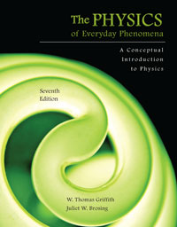
Chapter 10 Temperature and Heat
Lecture PowerPoint
Copyright © The McGraw-Hill Companies, Inc. Permission required for reproduction or display.

Slide 2
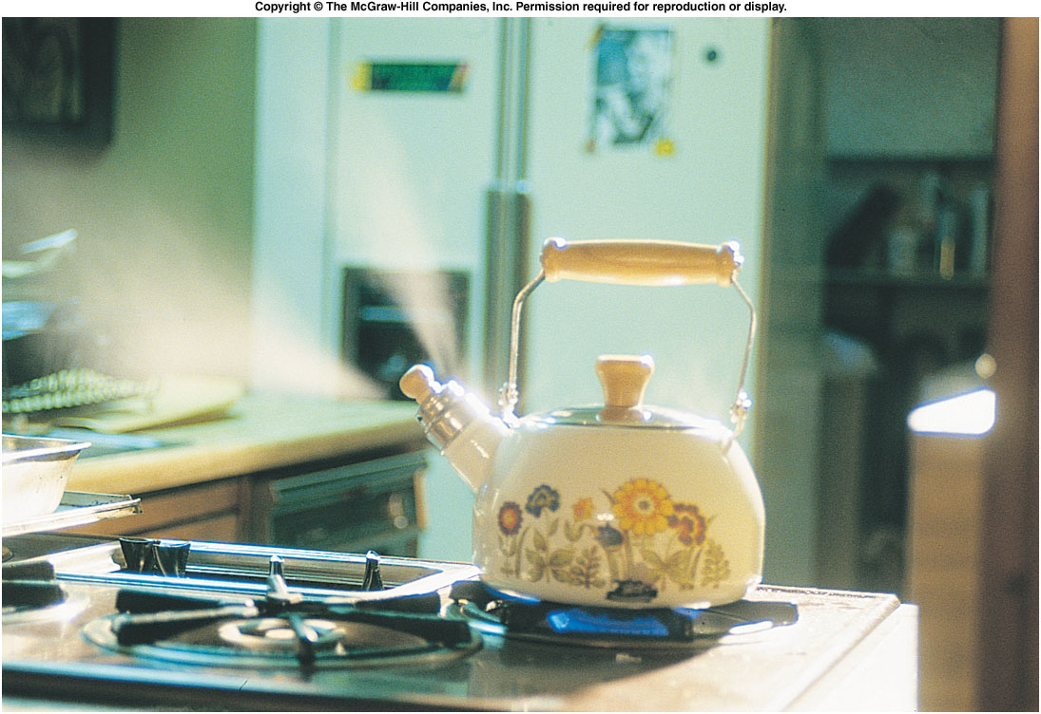
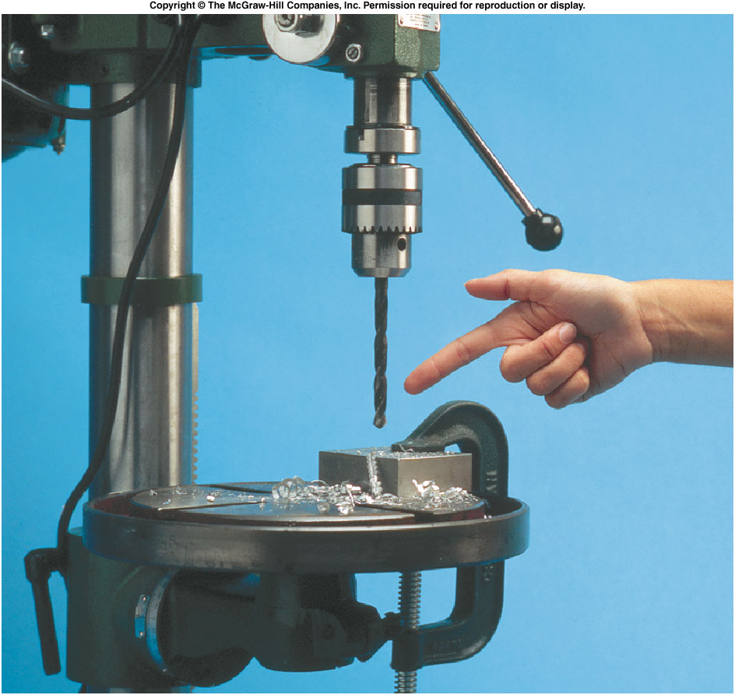
What are temperature and heat?
Are they the same? What causes heat?

Slide 3
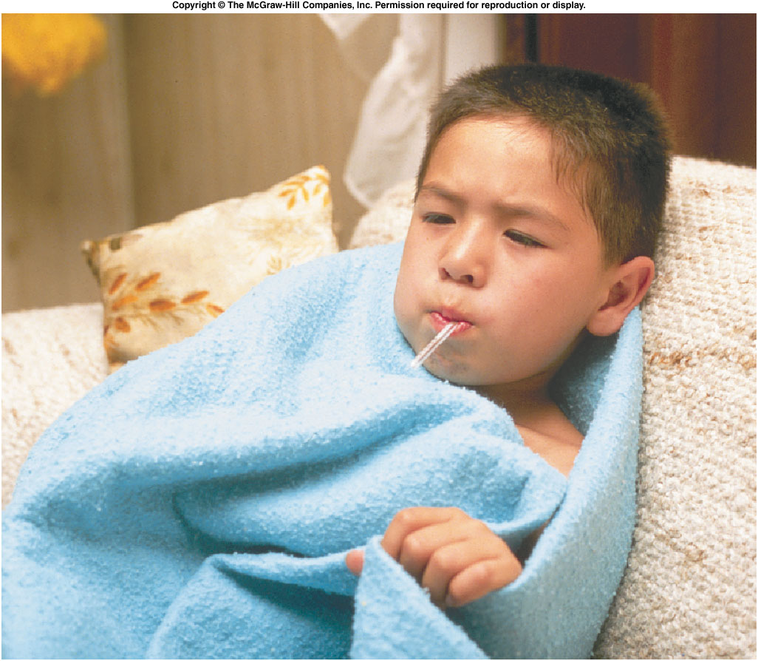
What Is Temperature?
How do we measure temperature?
What are we actually measuring?

Slide 4
Temperature and Its Measurement
If two objects are in contact with one another long enough, the two objects have the same temperature.
This begins to define temperature, by defining when two objects have the same temperature.
When the physical properties are no longer changing, the objects are said to be in thermal equilibrium.
Two or more objects in thermal equilibrium have the same temperature.
This is the zeroth law of thermodynamics.

Slide 5
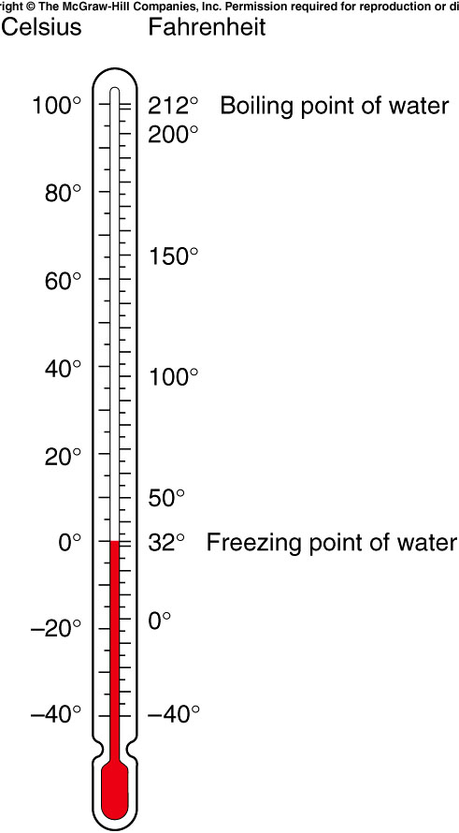
The first widely used temperature scale was devised by Gabriel Fahrenheit.
Another widely used scale was devised by Anders Celsius.
The Celsius degree is larger than the Fahrenheit degree: the ratio of Fahrenheit degrees to Celsius degrees is 180/100, or 9/5.
They are both equal at -40°.

Slide 6
The zero point on the Fahrenheit scale was based on the temperature of a mixture of salt and ice in a saturated salt solution.
The zero point on the Celsius scale is the freezing point of water.
Both scales go below zero.
Is there such a thing as absolute zero?

Slide 7
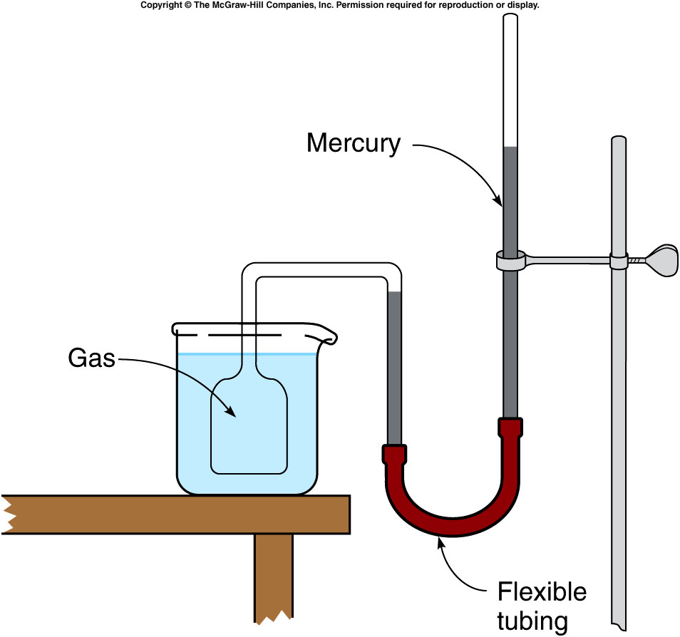
What is absolute zero?
If the volume of a gas is kept constant while the temperature is increased, the pressure will increase.
This can be used as a means of measuring temperature.
A constant-volume gas thermometer allows the pressure to change with temperature while the volume is held constant.
The difference in height of the two mercury columns is proportional to the pressure.

Slide 8
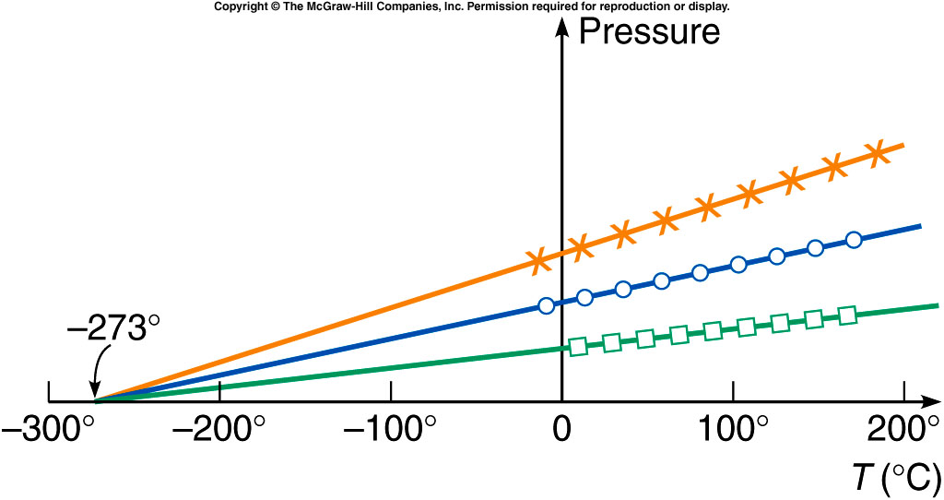
We can then plot the pressure of a gas as a function of the temperature.
The curves for different gases or amounts are all straight lines.
When these lines are extended backward to zero pressure, they all intersect at the same temperature, -273.2°C.
Since negative pressure has no meaning, this suggests that the temperature can never get lower than -273.2°C, or 0 K (kelvin).

Slide 9
Can anything ever get colder than 0 K?
No.
Can absolute zero ever be reached?
No.

Slide 10
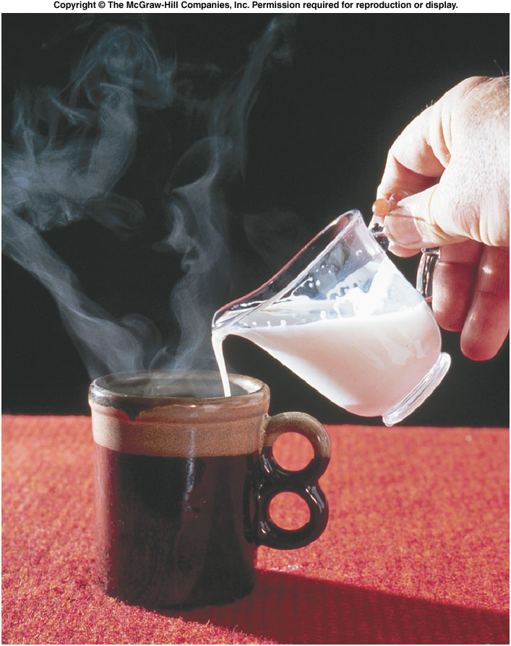
Heat and Specific Heat Capacity
What happens when objects or fluids at different temperatures come in contact with one another?
The colder object gets hotter, and the hotter object gets colder, until they both reach the same temperature.
What is it that flows between the objects to account for this?
We use the term heat for this quantity.

Slide 11
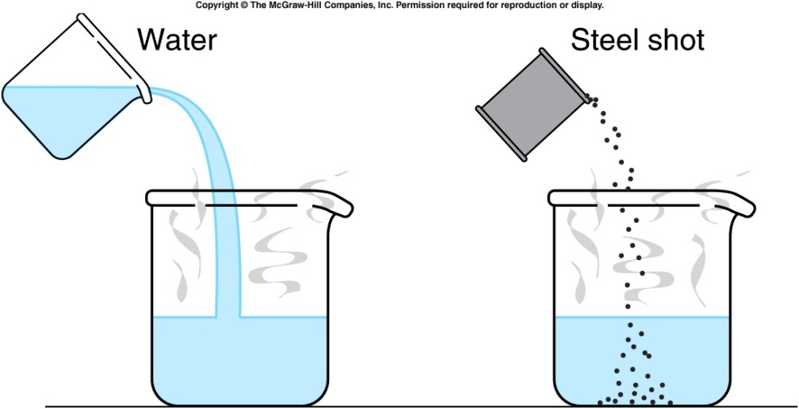
Heat and Specific Heat Capacity
Heat flow is a form of energy transfer between objects.
One-hundred grams of room-temperature water is more effective than 100 grams of room-temperature steel shot in cooling a hot cup of water.
Steel has a lower specific heat capacity than water.
The specific heat capacity of a material is the relative amount of heat needed to raise its temperature.

Slide 12
The specific heat capacity of a material is the quantity of heat needed to change a unit mass of the material by a unit amount in temperature.
For example, to change 1 gram by 1 Celsius degree.
It is a property of the material, determined by experiment.
The specific heat capacity of water is 1 cal/g⋅C°: it takes 1 calorie of heat to raise the temperature of 1 gram of water by 1°C.
We can then calculate how much heat must be absorbed by a material to change its temperature by a given amount:
Q = mcΔT where Q = quantity of heat
m = mass
c = specific heat capacity
ΔT = change in temperature

Slide 13
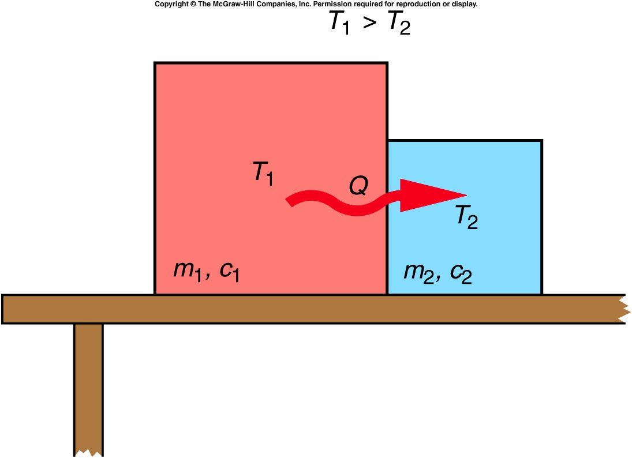
When two objects at different temperatures are placed in contact, heat will flow from the object with the higher temperature to the object with the lower temperature.
Heat added increases temperature, and heat removed decreases temperature.
Heat and temperature
are not the same.
Temperature is a
quantity that tells us
which direction the
heat will flow.

Slide 14
Phase Changes and Latent Heat
When an object goes through a change of phase or state, heat is added or removed without changing the temperature. Instead, the state of matter changes: solid to liquid, for example.
The amount of heat needed per unit mass to produce a phase change is called the latent heat.
The latent heat of fusion of water corresponds to the amount of heat needed to melt one gram of ice.
The latent heat of vaporization of water corresponds to the amount of heat needed to turn one gram of water into steam.

Slide 15
If the specific heat capacity of ice is 0.5 cal/g⋅ °C, how much heat would have to be added to 200 g of ice, initially at a temperature of -10°C, to raise the ice to the melting point?
m = 200 g
c = 0.5 cal/g⋅ °C
T = -10°C
Q = mcΔT
= (200 g)(0.5 cal/g⋅ °C)(10°C) = 1,000 cal
(heat required to raise the temperature)
1,000 cal
2,000 cal
4,000 cal
0 cal

Slide 16
If the specific heat capacity of ice is 0.5 cal/g⋅ °C, how much heat would have to be added to 200 g of ice, initially at a temperature of -10°C, to completely melt the ice?
L_{f} = 80 cal/g Q = mL_{f}
= (200 g)(80 cal/g) = 16,000 cal
(heat required to melt the ice)
Total heat required to raise the ice to 0°C and then to melt the ice is:
1,000 cal + 16,000 cal = 17,000 cal = 17 kcal
1,000 cal
14,000 cal
16,000 cal
17,000 cal

Slide 17
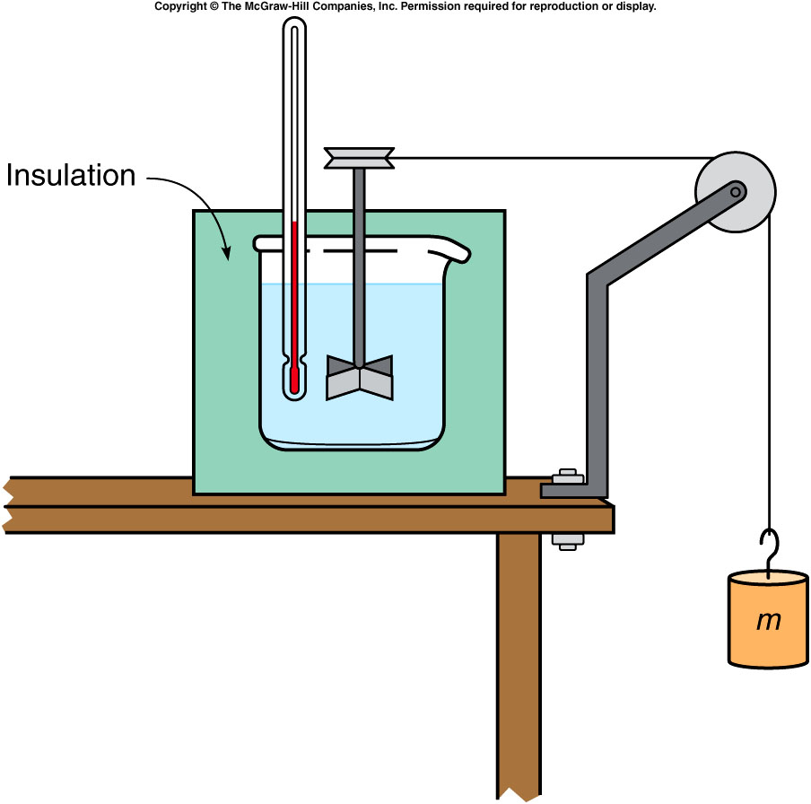
Joule’s Experiment and the First Law of Thermodynamics
Rumford noticed that cannon barrels became hot during drilling.
Joule performed a series of experiments showing that mechanical work could raise the temperature of a system.
In one such experiment, a falling mass turns a paddle in an insulated beaker of water, producing an increase in temperature.

Slide 18
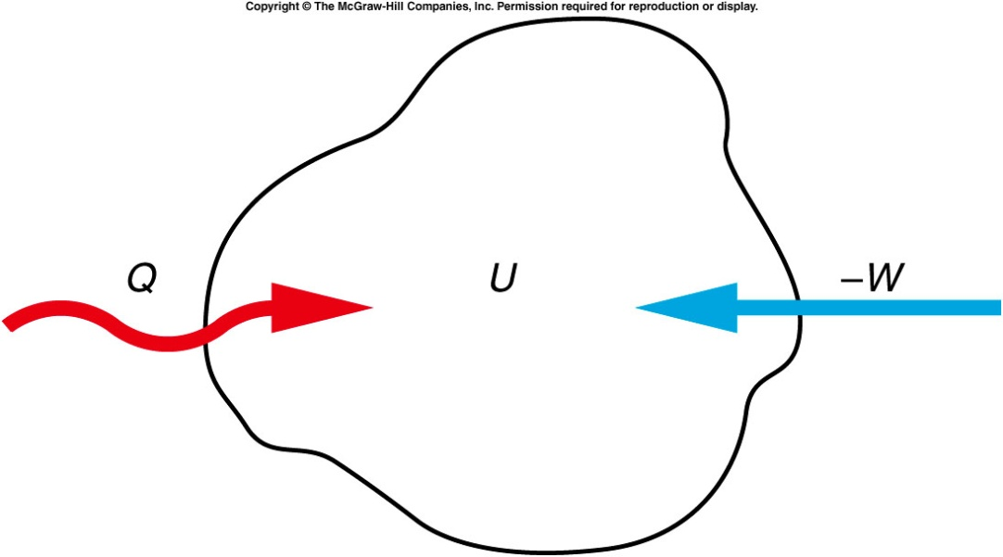
Joule’s Experiment and the First Law of Thermodynamics
Joule’s experiments led to Kelvin’s statement of the first law of thermodynamics.
Both work and heat represent transfers of energy into or out of a system.
If energy is added to a system either as work or heat, the internal energy of the system increases accordingly.
The increase in the internal
energy of a system is equal
to the amount of heat added
to a system minus the
amount of work done by the
system. ΔU = Q - W

Slide 19
Joule’s Experiment and the First Law of Thermodynamics
This introduced the concept of the internal energy of a system.
An increase in internal energy may show up as an increase in temperature, or as a change in phase, or any other increase in the kinetic and/or potential energy of the atoms or molecules making up the system.
Internal energy is a property of the system uniquely determined by the state of the system.
The internal energy of the system is the sum of the kinetic and potential energies of the atoms and molecules making up the system.

Slide 20
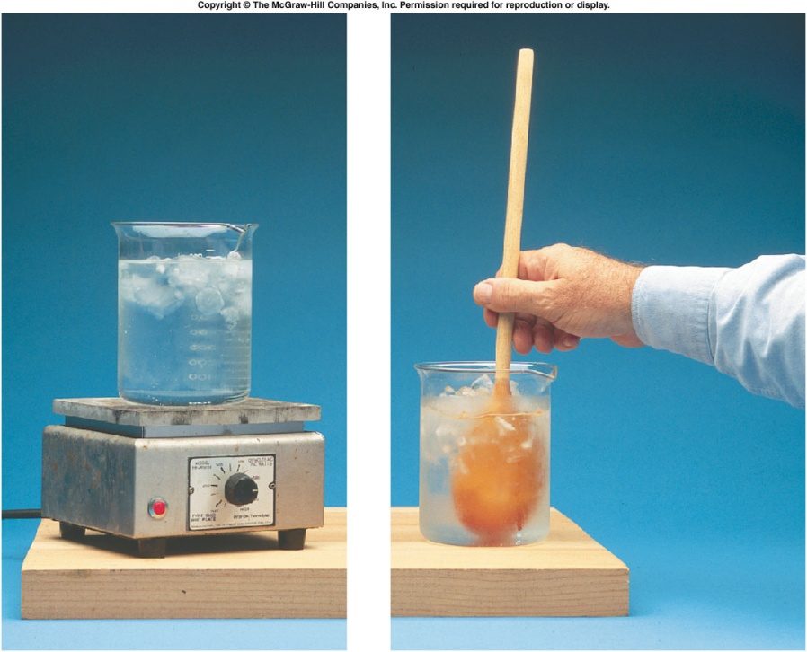
A hot plate is used to transfer 400 cal of heat to a beaker containing ice and water; 500 J of work are also done on the contents of the beaker by stirring. What is the increase in internal energy of the ice-water mixture?
900 J
1180 J
1680 J
2180 J
W = -500 J
Q = 400 cal
= (400 cal)(4.19 J/cal)
= 1680 J
ΔU = Q - W
= 1680 J - (-500 J)
= 2180 J

Slide 21
A hot plate is used to transfer 400 cal of heat to a beaker containing ice and water; 500 J of work are also done on the contents of the beaker by stirring. How much ice melts in this process?
0.037 g
0.154 g
6.5 g
27.25 g
L_{f} = 80 cal/g
= (80 cal/g)(4.19 J/cal)
= 335 J/g
ΔU = mL_{f}
m = ΔU / L_{f}
= (2180 J) / (335 J/g)
= 6.5 g

Slide 22
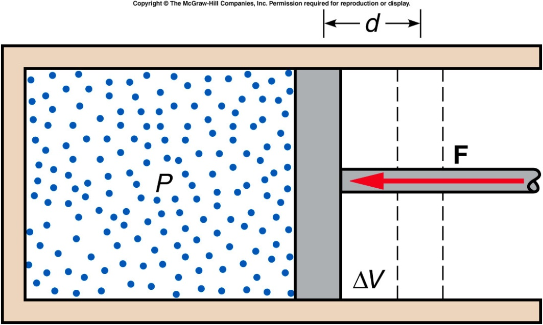
Gas Behavior and The First Law
Consider a gas in a cylinder with a movable piston.
If the piston is pushed inward by an external force, work is done on the gas, adding energy to the system.
The force exerted on the piston by the gas equals the pressure of the gas times the area of the piston: F = PA
The work done equals the force exerted by the piston times the distance the piston moves:
W = Fd = (PA)d = PΔV

Slide 23
If the gas is being compressed, the change in volume is negative, and the work done is negative.
Work done on the system is negative.
Negative work increases the energy of the system.
If the gas is expanding, positive work is done by the gas on its surroundings, and the internal energy of the gas decreases.

Slide 24
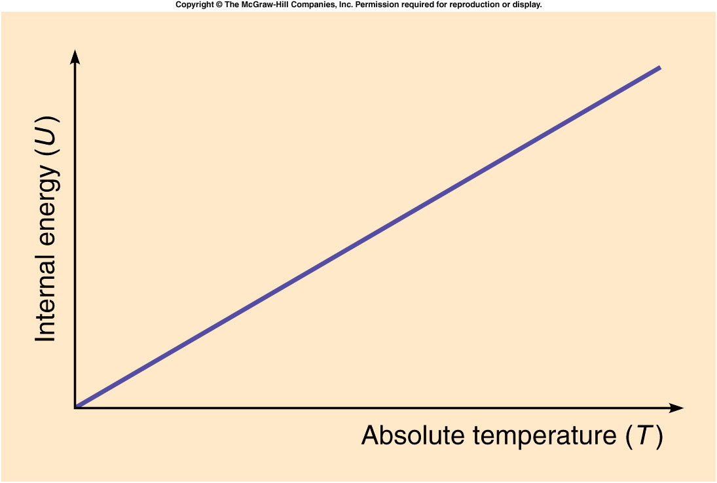
An ideal gas is a gas for which the forces between atoms are small enough to be ignored.
For an ideal gas, absolute
temperature is directly
related to the average
kinetic energy of the
molecules of the system.
Most gases behave
approximately as
ideal gases.
If the process is adiabatic, no heat flows into or out of the gas.
Even though no heat is added, the temperature of a gas will increase in an adiabatic compression, since the internal energy increases.

Slide 25
In an isothermal process, the temperature does not change.
The internal energy must be constant.
The change in internal energy, ΔU, is zero.
If an amount of heat Q is added to the gas, an equal amount of work W will be done by the gas on its surroundings, from ΔU = Q - W.
In an isobaric process, the pressure of the gas remains constant.
The internal energy increases as the gas is heated, and so does the temperature.
The gas also expands, removing some of the internal energy.
Experiments determined that the pressure, volume, and absolute temperature of an ideal gas are related by the equation of state:
PV = NkT where N is the number of molecules
and k is Boltzmann’s constant.

Slide 26
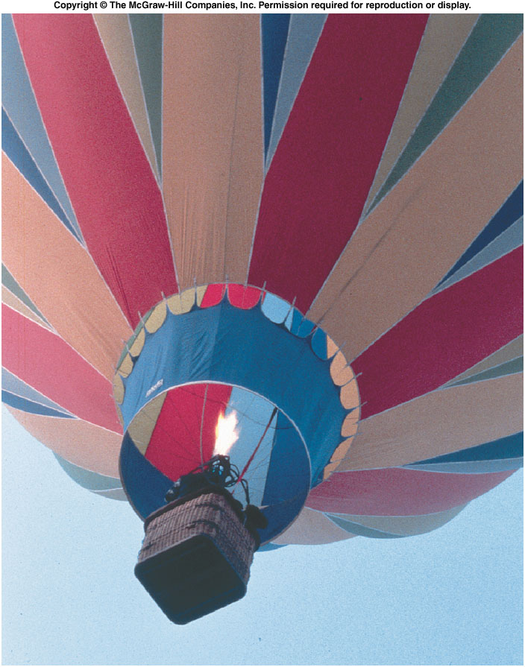
What process makes a hot-air balloon rise?
When gas is heated in a hot-air balloon, the pressure, not the temperature, remains constant.
The gas undergoes an isobaric expansion.
Since the gas has expanded, the density has decreased.
The balloon experiences a buoyant force because the gas inside the balloon is less dense than the surrounding atmosphere.

Slide 27
The Flow of Heat
There are three basic processes for heat flow:
Conduction
Convection
Radiation

Slide 28
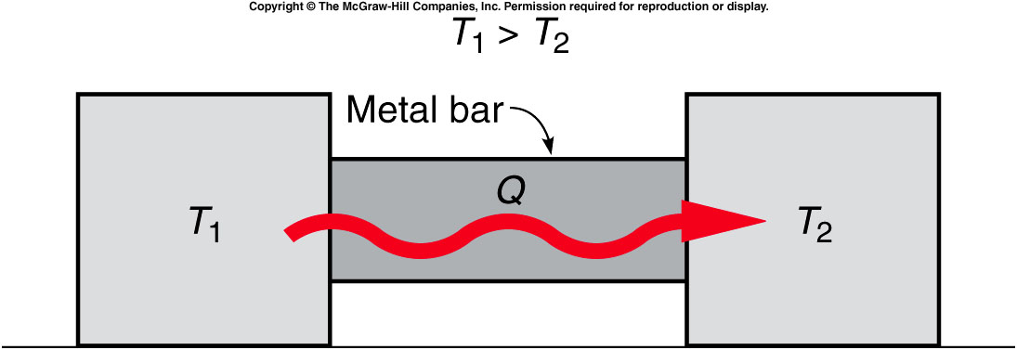
In conduction, heat flows through a material when objects at different temperatures are placed in contact with one another.

Slide 29
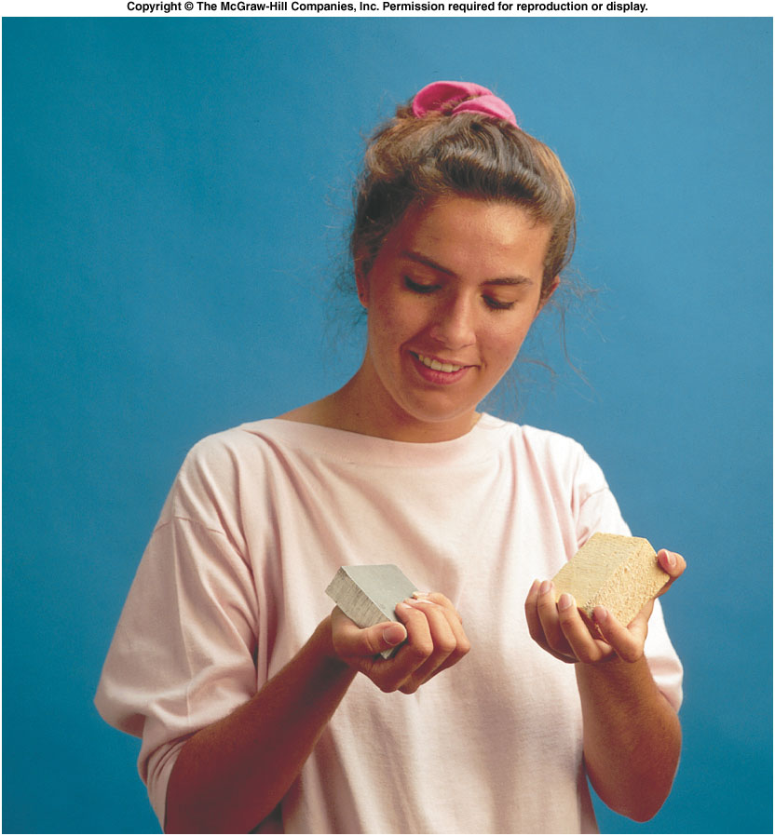
Conduction
The rate of heat flow depends on the temperature difference between the objects.
It also depends on the thermal conductivity of the materials, a measure of how well the materials conduct heat.
For example, a metal block at room temperature will feel colder than a wood block of the exact same temperature.
The metal block is a better thermal conductor, so heat flows more readily from your hand into the metal.
Since contact with the metal cools your hand more rapidly, the metal feels colder.

Slide 30
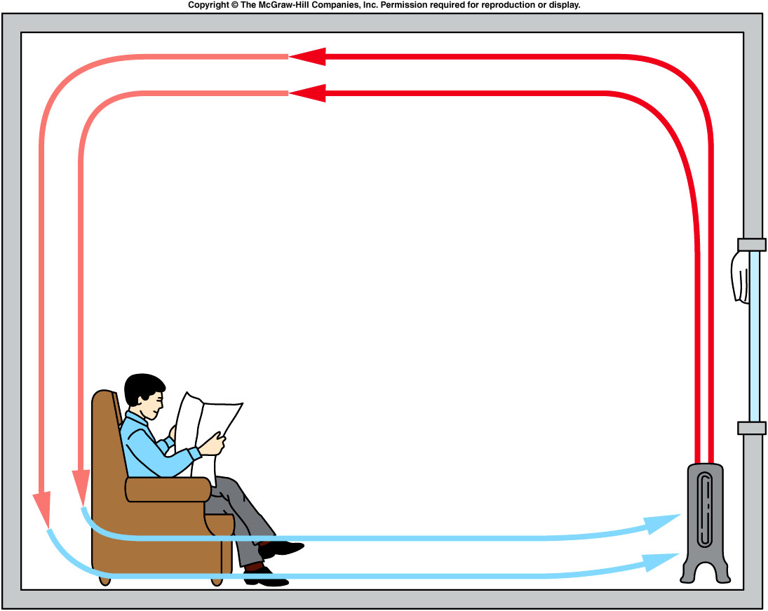
In convection, heat is transferred by the motion of a fluid containing thermal energy.
Convection is the main method of heating a house.
It is also the main method heat is lost from buildings.

Slide 31
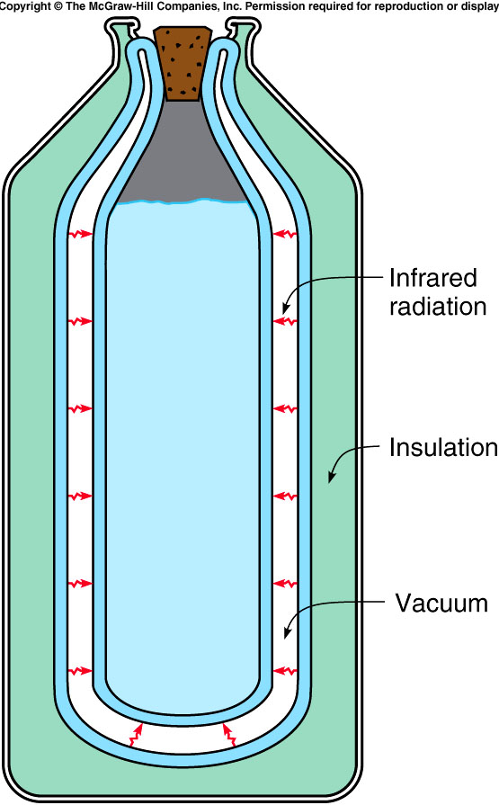
In radiation, heat energy is transferred by electromagnetic waves.
The electromagnetic waves involved in the transfer of heat lie primarily in the infrared portion of the spectrum.
Unlike conduction and convection, which both require a medium to travel through, radiation can take place across a vacuum.
For example, the evacuated space in a thermos bottle.
The radiation is reduced to a minimum by silvering the facing walls of the evacuated space.

Slide 32
What process makes a car’s interior heat up when parked in the sun?
radiation
Why are houses insulated with material in the walls instead of just empty space?
To reduce convection and conduction
Why is this insulated material often foil-backed?
To limit radiation
Is a light-colored roof or a dark-colored roof more energy efficient?
Light colored roofs keep a house cooler reducing cooling costs.

Slide 33
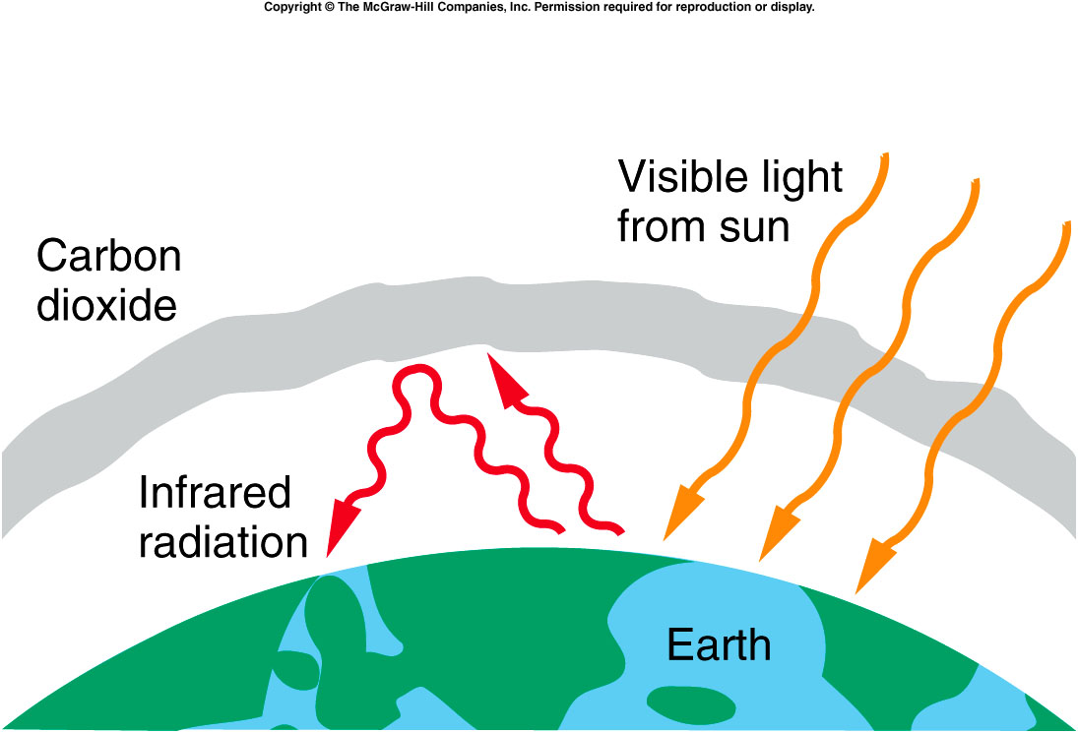
What heat-flow processes are involved in the greenhouse effect?

Slide 34
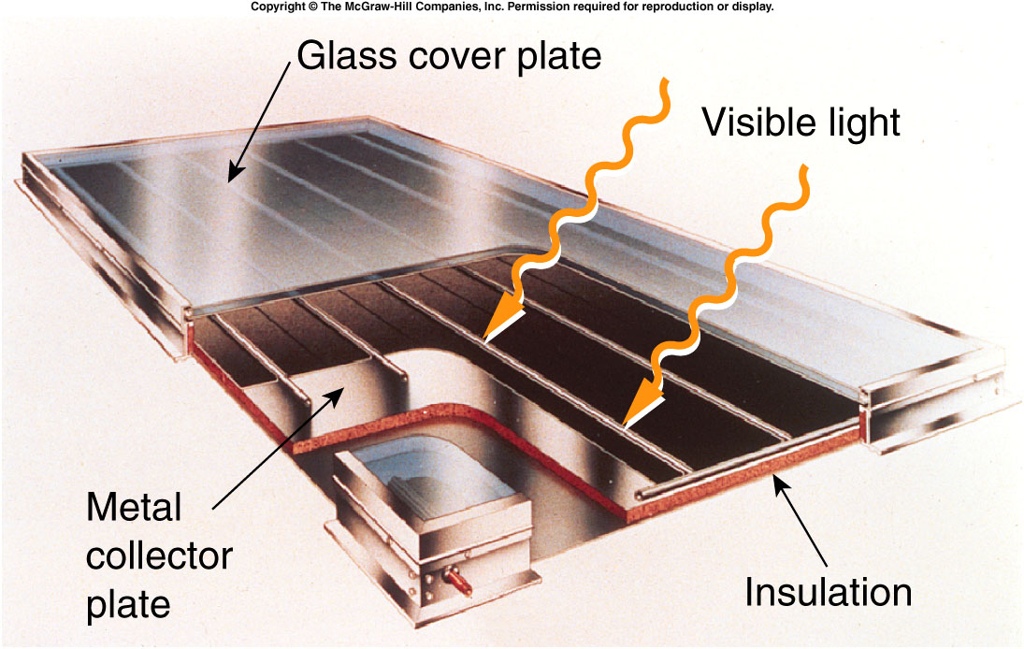
What heat-flow processes are involved in solar collectors?

