Slide 1
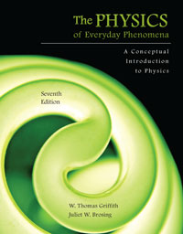
Chapter 3 Falling Objects and Projectile Motion
Lecture PowerPoint
Copyright © The McGraw-Hill Companies, Inc. Permission required for reproduction or display.

Slide 2
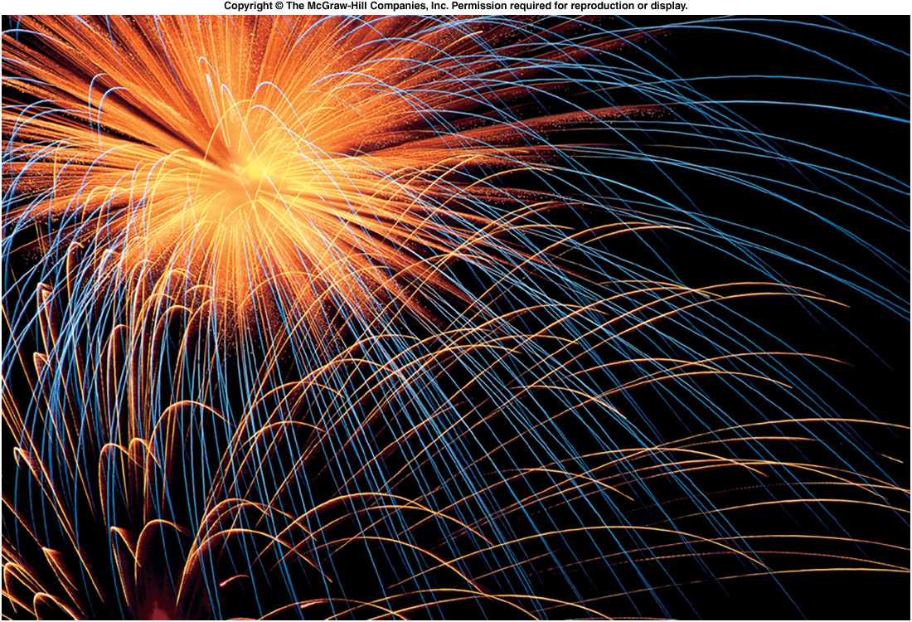
Gravity influences motion in a particular way.

Slide 3
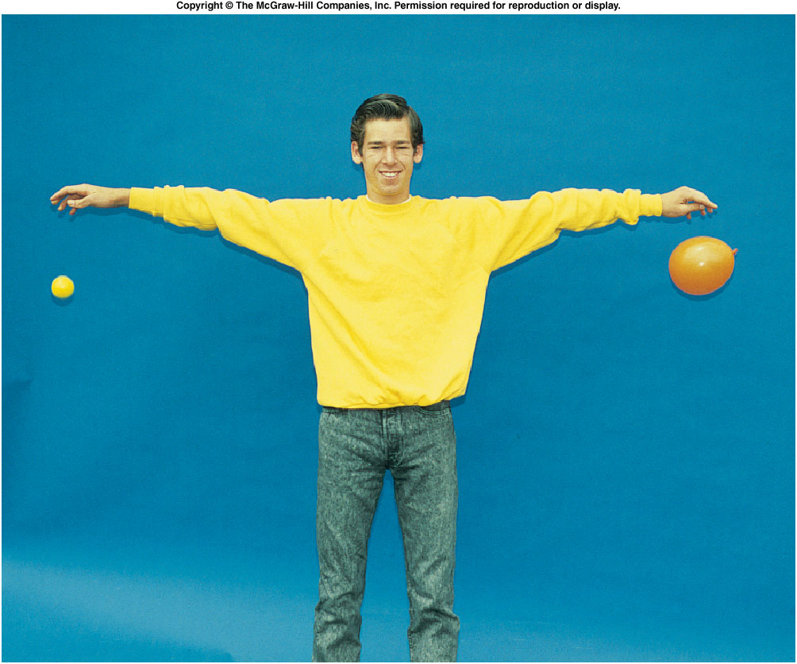
How does a dropped object behave?
Does the object accelerate, or is the speed constant?
Do two objects behave differently if they have:
different masses?
different shapes?

Slide 4
Acceleration Due to Gravity
Earth exerts a gravitational force on objects that is attractive (towards Earth’s surface).
Near Earth’s surface, this force produces a constant acceleration downward.
To measure this acceleration, we need to slow down the action.
Galileo was the first to accurately measure this acceleration due to gravity.
By rolling objects down an inclined plane, he slowed the motion enough to establish that the gravitational acceleration is uniform, or constant with time.

Slide 5
Inclined Plane Experiment
Does the marble pick up speed as it rolls?
Is it moving faster at the bottom of the incline than it was halfway down?

Slide 6
Flashes of a stroboscope illuminate a falling ball at equal time intervals.
Distance covered in successive time intervals increases regularly.
Since distance covered in equal time intervals is increasing, the velocity must be increasing.

Slide 7
Average velocity for a time interval is given by dividing the distance traveled in that time interval by the time of the interval.
For example, between the 2nd and 3rd flashes, the ball travels a distance of
4.8 cm - 1.2 cm = 3.6 cm
in a time of 0.05 s:

Slide 8
The velocity values steadily increase.
Time | Position | Average velocity
0 s | 0 cm
0.05 s | 1.2 cm | 24 cm/s
0.10 s | 4.8 cm | 72 cm/s
0.15 s | 11.0 cm | 124 cm/s
0.20 s | 19.7 cm | 174 cm/s
0.25 s | 30.6 cm | 218 cm/s
0.30 s | 44.0 cm | 268 cm/s
0.35 s | 60.0 cm | 320 cm/s

Slide 9
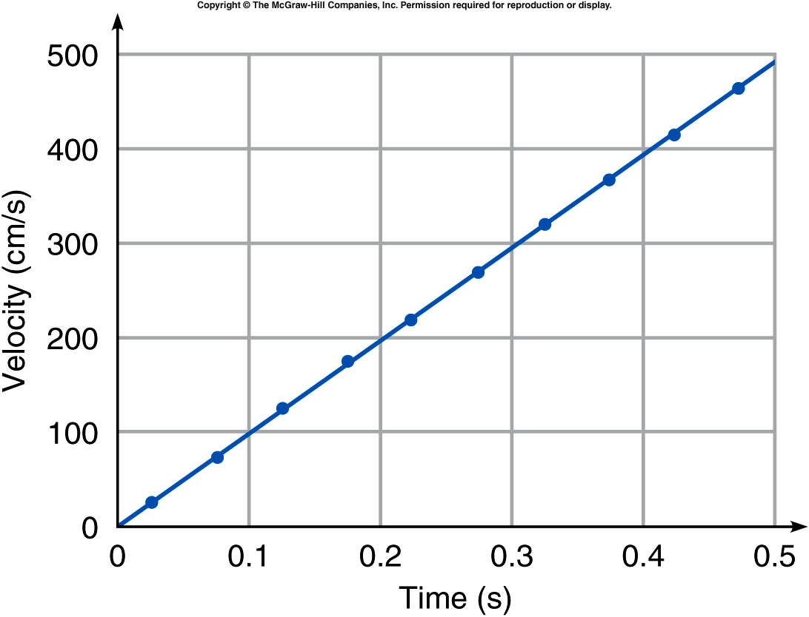
The velocity values steadily increase.
Each point is plotted at the midpoint between the two times.

Slide 10
The slope of the line is constant.
Thus, the acceleration is constant.

Slide 12
The diagram shows the positions at 0.10-sec intervals of a ball moving left to right. Is the ball accelerated?
Yes.
No.
Unable to determine.
The ball moves an equal distance during each 0.10-sec interval, so the speed does not change. Since the ball moves in a straight line at a constant speed, it is not accelerated.

Slide 13
The diagram shows the positions at 0.05-sec intervals of two balls moving left to right. Are either or both of these balls accelerated?
Both balls are accelerated. Ball A covers an increasing distance in each 0.05-sec interval, so it is speeding up. Ball B is covering less and less distance with each interval, so it is slowing down. Both are accelerations.
Ball A is accelerated.
Ball B is accelerated.
Both balls are accelerated.
Neither ball is accelerated.

Slide 14
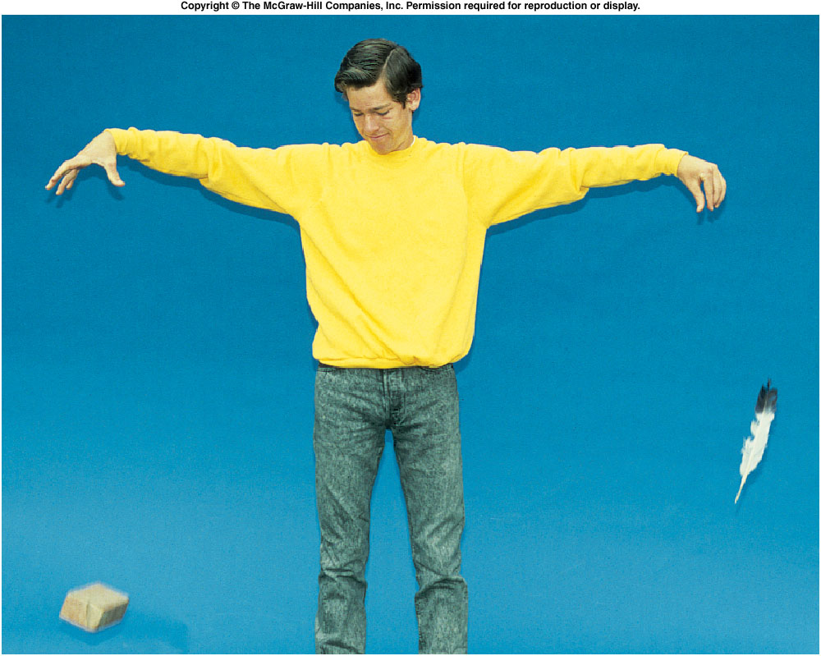
How does a dropped object behave?
Do two objects behave differently if they have:
different masses?
different shapes?
The feather falls more slowly than the brick.
But what is the REAL reason?
Air resistance!

Slide 15
How does a dropped object behave?
http://www.youtube.com/watch?v=PE81zGhnb0w
Dave Scott on the Moon, dropping feather and hammer.
If we drop a feather and a brick in a vacuum, they reach the ground at the same time.
Gravitational acceleration does NOT depend on the weight of the object.
Notes:
Fig. 2.co
Guidelines Regarding the Use or Reproduction of NASA Material Obtained From a JSC Web Pages
NASA generally has no objection to the reproduction and use of NASA material (e.g., audio transmissions and recordings; video transmission or recordings; still or motion picture photography; or World Wide Web pages), subject to the following conditions: 1. You may use NASA imagery, video and audio material if it is for educational or informational purposes, including photo collections, textbooks, public exhibits and Internet Web pages. 2. This general permission does not include the NASA insignia logo (the blue "meatball" insignia), the NASA logotype (the red "worm" logo), and the NASA seal. These images may not be used by persons who are not NASA employees or on products (including web pages) that are not NASA sponsored. 3. NASA material may not be used to state or imply the endorsement by NASA or by any NASA employee of a commercial product, service, or activity, or used in any manner that might mislead. If the NASA material is to be used for commercial purposes, especially including advertisements, it must not explicitly or implicitly convey NASA's endorsement of commercial goods or services. If a NASA image includes an identifiable person, using the image for commercial purposes may infringe that person's right of privacy or publicity, and permission should be obtained from the person. 4. NASA should be acknowledged as the source of the material. 5. It is unlawful to falsely claim copyright or other rights in NASA material. 6. NASA shall in no way be liable for any costs, expenses, claims, or demands arising out of the use of NASA material by a recipient or a recipient's distributees. 7. NASA does not indemnify nor hold harmless users of NASA material, nor release such users from copyright infringement, nor grant exclusive use rights with respect to NASA material. 8. NASA material is not protected by copyright unless noted. If copyrighted, permission should be obtained from the copyright owner prior to use. If not copyrighted, NASA material may be reproduced and distributed without further permission from NASA. 9. Some NASA material may incorporate music or footage that is copyrighted and licensed for the particular NASA work. Any editing or otherwise altering of the work may not be covered under the original license, and therefore would require permission of the copyright owner. 10. NASA does not endorse or sponsor any commercial product, service, or activity. 11. Use of the NASA name or initials as an identifying symbol by organizations other than NASA (such as on foods, packaging, containers, signs, or any promotional material) is prohibited. The only exceptions are noted immediately below.-- NASA does permit the use of the NASA Logo and Insignia on novelty and souvenir-type items.However, such items may be sold and manufactured only after a proposal has been submitted to and approved by a representative from the Public Services Division (202/358-1750) in accordance with 14 CFR (Code of Federal Regulations) Part 1221. NASA does not grant anyone exclusive rights to use any of the Agency identities. 12. NASA emblems should be reproduced only from original reproduction proofs, transparencies, or computer files available from NASA Headquarters. Please be advised that approval must be granted by the Public Services Division (see above) before any reproduction materials can be obtained. 13. NASA personnel are not authorized to sign indemnity or hold harmless statements, releases from copyright infringement, or documents granting exclusive use rights. 14. Photographs are not protected by copyright unless noted. If copyrighted, permission should be obtained from the copyright owner prior to use. If not copyrighted, photographs may be reproduced and distributed without further permission from NASA. If a recognizable person appears in the photograph, use for commercial purposes may infringe a right of privacy or publicity and permission should be obtained from the recognizable person. 15. Audio recordings are not protected by copyright unless noted. A cassette may be excerpted or reproduced and distributed, without further permission from NASA. However, use of a portion or segment of an audiotape, such as talent, narration or music, may infringe a right of publicity or copyright and permission should be obtained from the source.16. Videotape and Motion Picture recordings are not protected by copyright unless noted. A recording may be reproduced and distributed, without further permission from NASA. Copyrighted music or footage, which is incorporated in a production, may not be used unless permission is obtained from the copyright owner. While in most instances using non-copyrighted segments is permitted, use for a commercial purpose of a portion or segment containing talent or a recognizable person may infringe a right of publicity and permission should be obtained from the talent or recognizable person. These guidelines also apply to NASA's "live television" satellite broadcasts.For answers to additional questions, contact:Bert Ulrich NASA Headquarters Public Services Division (POS) 300 E St. SW Washington, DC 20546 Internet: bert.ulrich@hq.nasa.govBack to TopNASA�s Use of Third Party MediaNASA makes every attempt to use media on our web pages (e.g., graphics, artwork, sounds), provided by other parties, that is free for use or in the public domain. If you notice copyright violations on a NASA JSC web page, please contact the Web Curator. Of course, it is not our intention to use material illegally. Many items are collected from the Internet, where copyright information is often not available.References･Freedom of Information Act (5 USC 552, 14 CFR 1206, 1213)･Privacy Act of 1974 (5 USC 552a, 14 CFR 1212)･Government Wide Employee Ethics Regulations (5 CFR 2635)･Use of NASA Seal and Other Devices (14 CFR 1221)･NASA CIO memo, "Guidance on Implementation of NASA Website Privacy Statement" dated June 1, 1998･"Policy on Placement of Information on Unprotected Computer Systems" in JPD 2800.4,･"JSC Internal Web Page Policies" in JPD 2800.4,･"Policies Regarding External Links on JSC Web Pages" in JPD 2800.4,･International Traffic in Arms Regulations (22 CFR 120)･Department of Commerce Export Administration Regulations with Commerce Control List (15 CFR 730-74)･OMB Memo M-99-18, �Privacy Policies on Federal Web Sites� dated June 22, 1999･OMB Memo M-00-13, �Privacy Policies and Data Collection on Federal Web Sites�･NASA CIO Memo, �NASA Web Site Privacy Policy� dated May 22, 2003Back to Topﾊﾊ Curator: Herbert Babineaux(herbert.j.babineaux@nasa.gov) Responsible NASA Official: Jean E. Carter (jsc.cio@jsc.nasa.gov) Page Updated: 04 October 2004

Slide 16
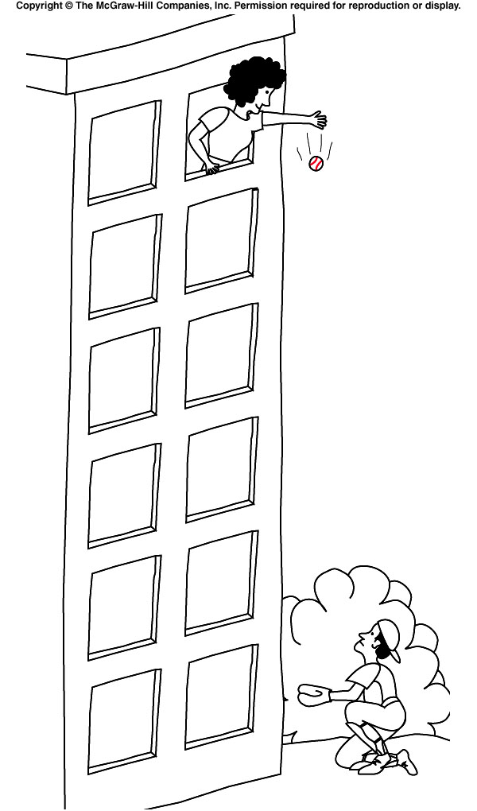
Tracking a Falling Object
How long does it take for the ball to reach the ground?
How fast is it traveling when it gets there?
Assuming air resistance effects are small, the ball accelerates at 9.8 m/s² ≈ 10 m/s².
Each second, its velocity increases by 10 m/s.

Slide 17
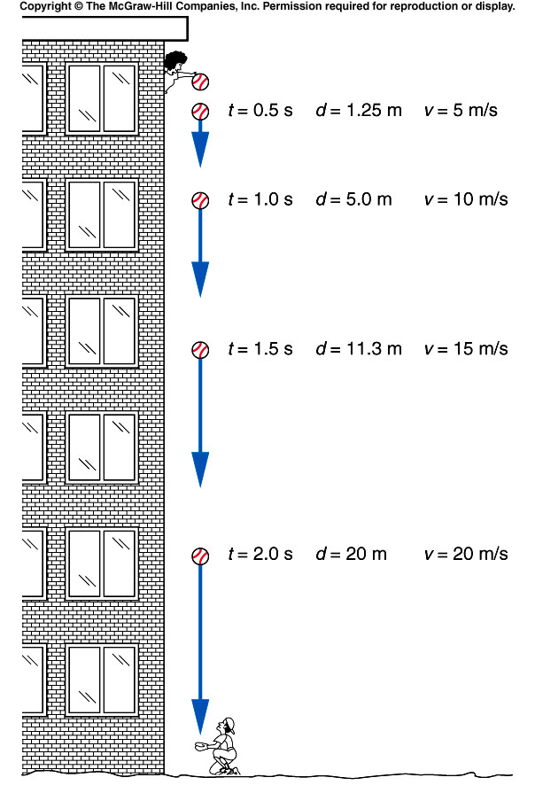
Tracking a Falling Object
Starting from rest, its velocity has increased to 10 m/s after the first second; to 20 m/s after 2 s; to 30 m/s after 3 s; etc.
10 m/s ≈ 22 MPH
30 m/s ≈ 70 MPH!
During the first second, its average velocity is 10 m/s ÷ 2 = 5 m/s, during which time it travels 5 m. In the first half second, it travels 1.25 m.

Slide 18
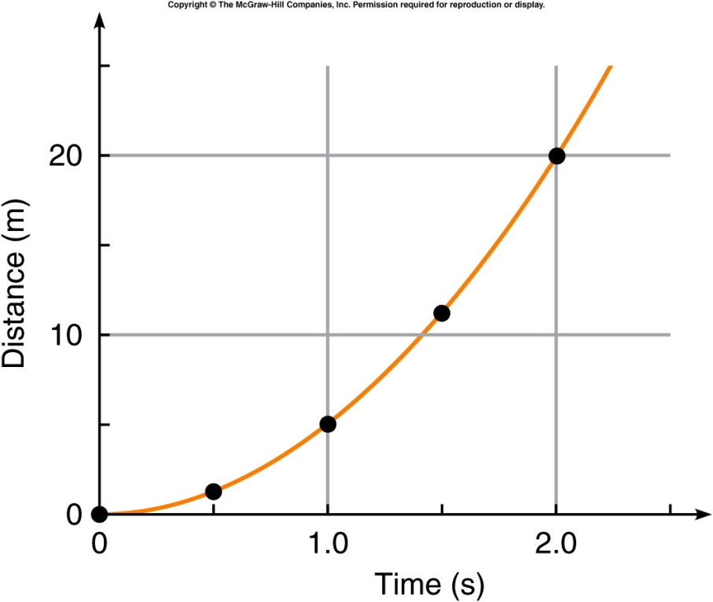
Tracking a Falling Object
The distance increases in proportion to the square of the time:

Slide 19
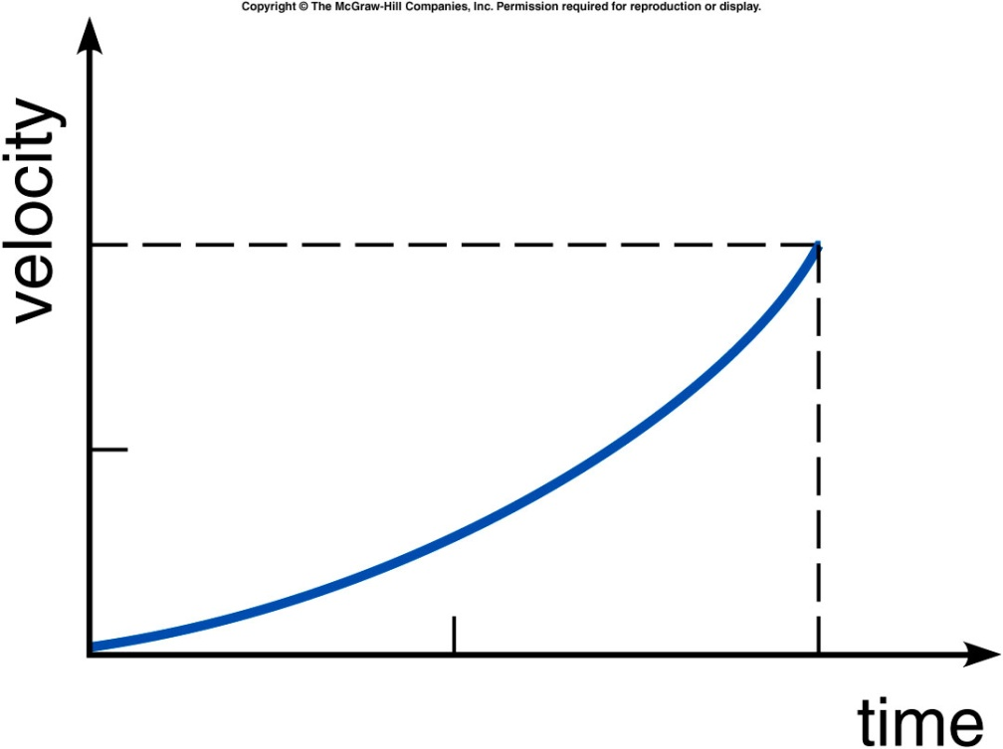
The velocity-versus-time graph for a certain falling object is shown. Is the acceleration of this object constant?
Yes.
No.
Impossible to tell
from this graph.
Constant acceleration would require the v vs. t curve to be a straight line. This graph is curving upward, so the slope (and the acceleration) is increasing.

Slide 20
Throwing a ball downward
Let the ball be thrown downward instead of being dropped.
It will have a starting velocity different from zero.
It will reach the ground more rapidly.
It will have a larger velocity when it reaches the ground.

Slide 21
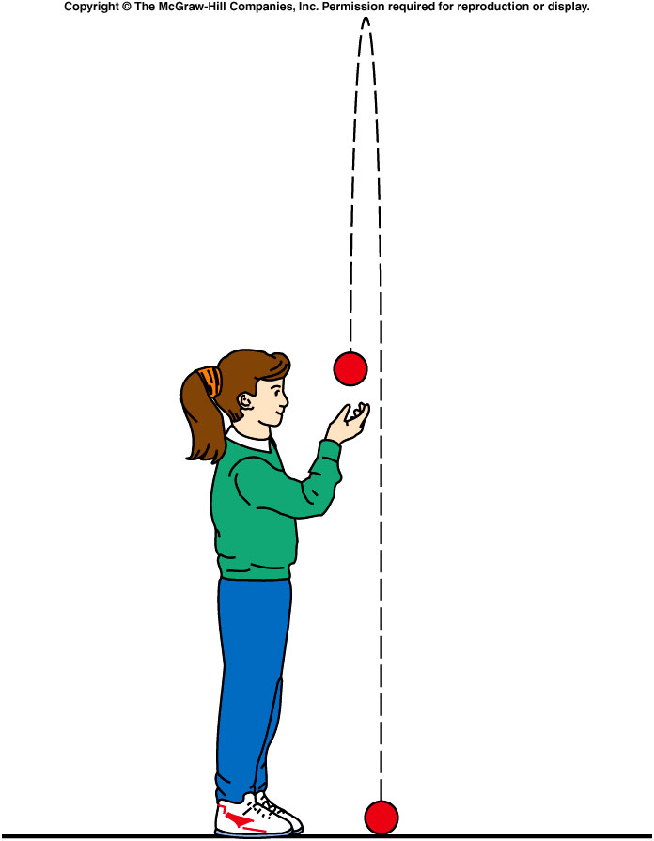
Beyond Free Fall: Throwing a Ball Upward
What if the ball is thrown upward?
Gravitational acceleration is always directed downward, toward the center of the Earth.
Here, the acceleration is in the opposite direction to the original upward velocity.

Slide 22
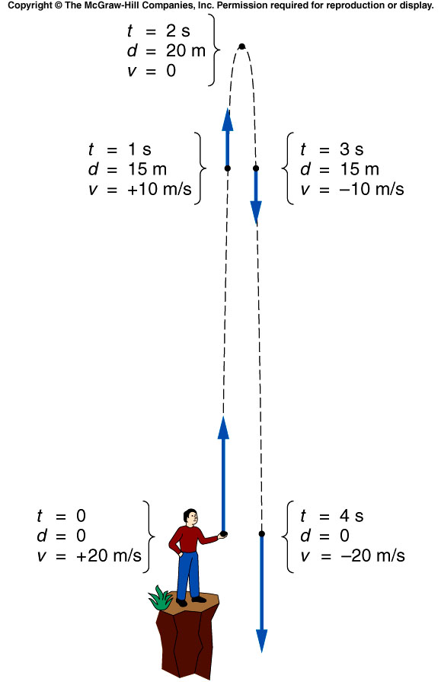
Let the initial velocity be 20 m/s upward.
It immediately starts experiencing a downward acceleration due to gravity, of approximately 10 m/s.
Every second, the velocity decreases by 10 m/s.
After 2 s, the ball has reached its highest point.
Its velocity changes direction, from upward to downward, passing through a value of 0 m/s.
Now, the downward acceleration increases the downward velocity.

Slide 23
What is the ball’s acceleration at the top of its path (at t=2 s)?
zero.
+10 m/s
-10 m/s
+10 m/s²
-10 m/s²
Gravity does not “turn off” at the top! The ball’s velocity is still changing, as it changes from going up to going down. For a moment the velocity is zero, but the gravitational acceleration is a constant throughout the path.

Slide 24
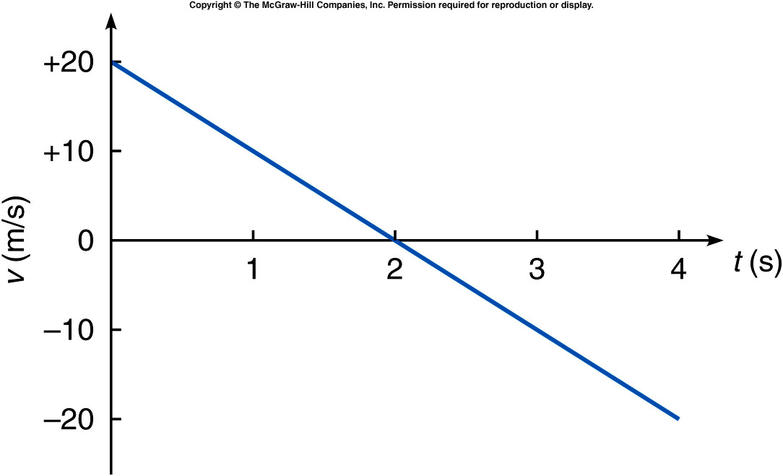
The velocity-vs-time plot starts with +20 m/s (upward) at time t=0 and changes at a steady rate of -10 m/s² (decreasing 10 m/s each second).
Positive velocities correspond to upward motion; negative velocities correspond to downward motion.
The slope is constant and negative (for constant downward acceleration).

Slide 25
Projectile Motion
The path that a moving object follows is called its trajectory.
An object thrown horizontally is accelerated downward under the influence of gravity.
Gravitational acceleration is only vertical, not horizontal.
The object’s horizontal velocity is unchanged, if we can neglect air resistance.
Projectile motion involves the trajectories and velocities of objects that have been launched, shot, or thrown.

Slide 26
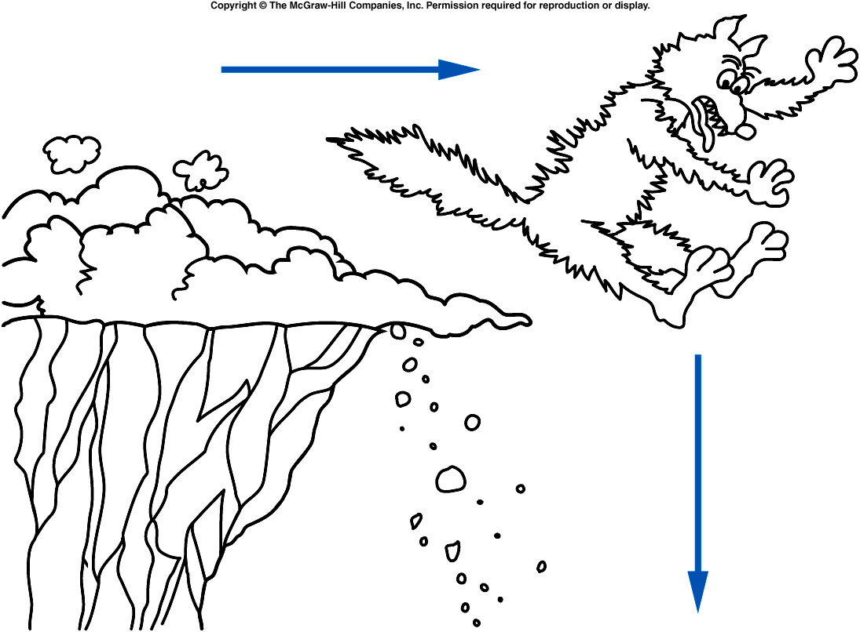
Does this represent a realistic trajectory?
Yes.
No.
Maybe.
The coyote would not go straight horizontally, pause, and then fall straight down. There are many examples in movies and on television of unrealistic trajectories. Can you think of any others?
Notes:
(Speed: when the bus “jumps”;
Spider-man 2: when he suddenly loses
his web power.)

Slide 27
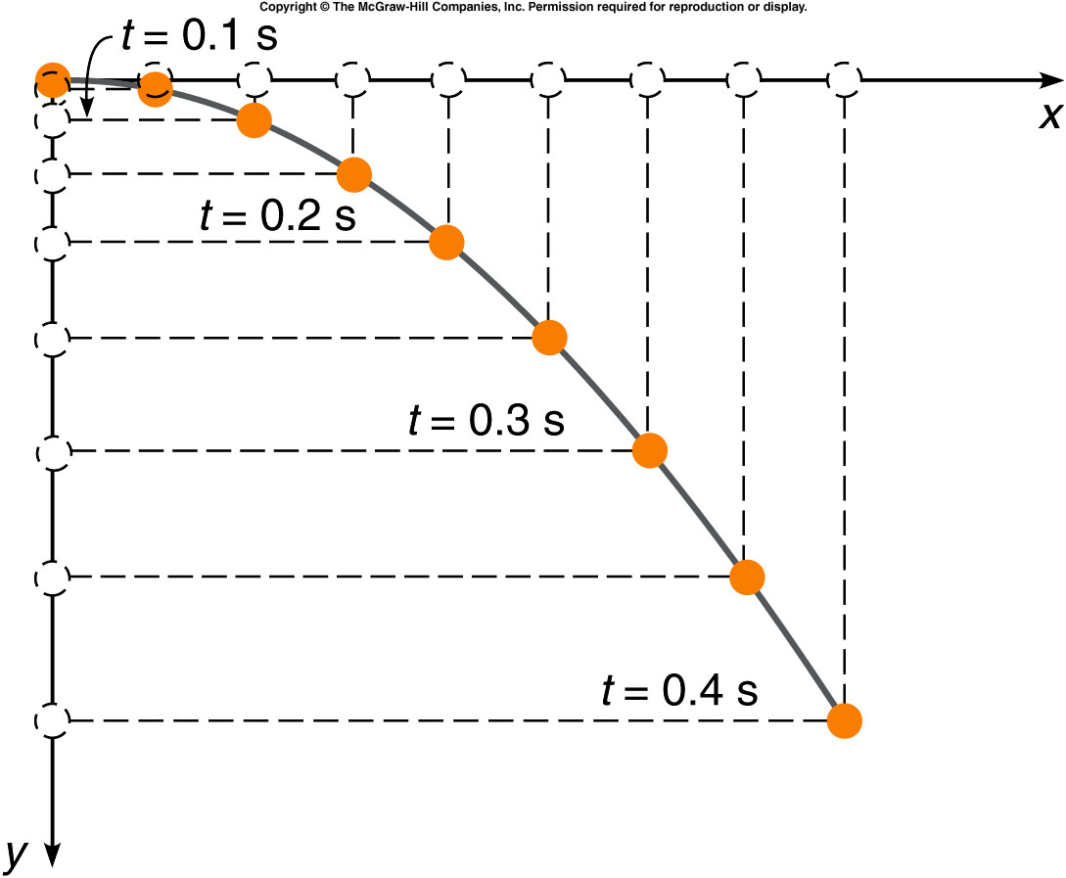
What does the trajectory look like?
The acceleration of the horizontal motion is zero (in the absence of air resistance).
The object moves with
constant horizontal velocity.
It travels equal horizontal
distances in equal time
intervals.
The acceleration in the
vertical direction is constant.
Its vertical velocity increases
downward just like the falling
ball.
In each successive time
interval, it falls a greater
distance than in the previous
time interval.

Slide 28
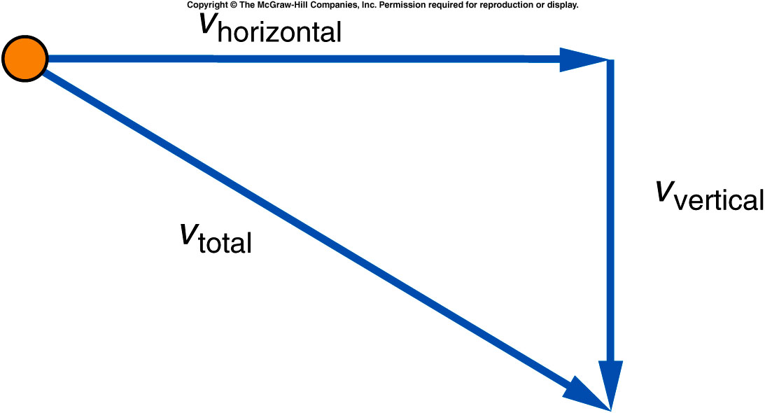
What does the trajectory look like?
The total velocity at any point is found by adding the vertical component of the velocity, at that point, to the horizontal component of the velocity at that point.
The horizontal velocity
remains constant, because
there is no acceleration in
that direction.
The length of the horizontal
velocity vector doesn’t
change.
The downward (vertical) velocity gets larger and larger, due to
the acceleration due to gravity.

Slide 29
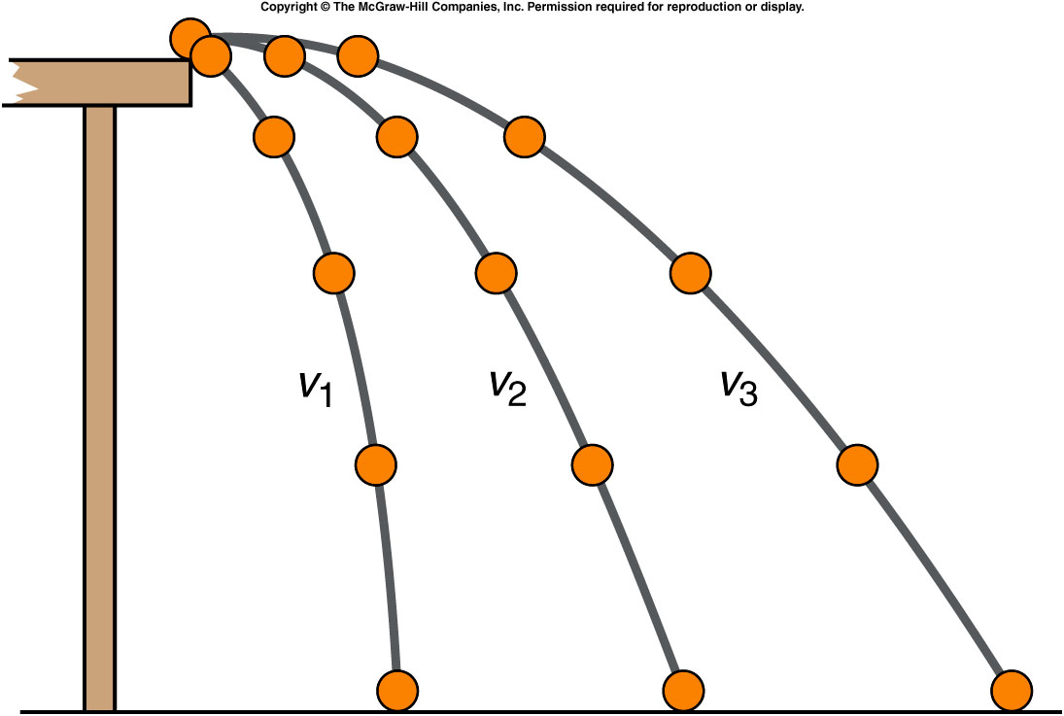
What does the trajectory look like?
Trajectories for different initial velocities of a ball rolling off a table:
The largest initial velocity is v₃.
The smallest initial velocity is v₁.
The ball travels
greater horizontal
distances when
projected with a
larger initial
horizontal velocity.

Slide 30
Which of these three balls would hit the floor first if all three left the tabletop at the same time?
The ball with initial velocity v₁.
The ball with initial velocity v₂.
The ball with initial velocity v₃.
They would all hit at the same time.
Since all three balls undergo the same downward acceleration, and they all start with a vertical velocity of zero, they would all fall the same distance in the same time!

Slide 31
Projectile Motion
Treating the vertical motion independently of the horizontal motion, and then combining them to find the trajectory, is the secret.
A horizontal glide combines with a vertical plunge to produce a graceful curve.
The downward gravitational acceleration behaves the same as for any falling object.
There is no acceleration in the horizontal direction if air resistance can be ignored.
The projectile moves with constant horizontal velocity while it is accelerating downward.

Slide 32
Hitting a Target
If the rifle is fired directly at the target in a horizontal direction, will the bullet hit the center of the target?
Does the bullet fall during its flight?

Slide 33
Hitting a Target
The trajectory depends on the initial velocity.
The trajectory depends on the launch angle.

Slide 34
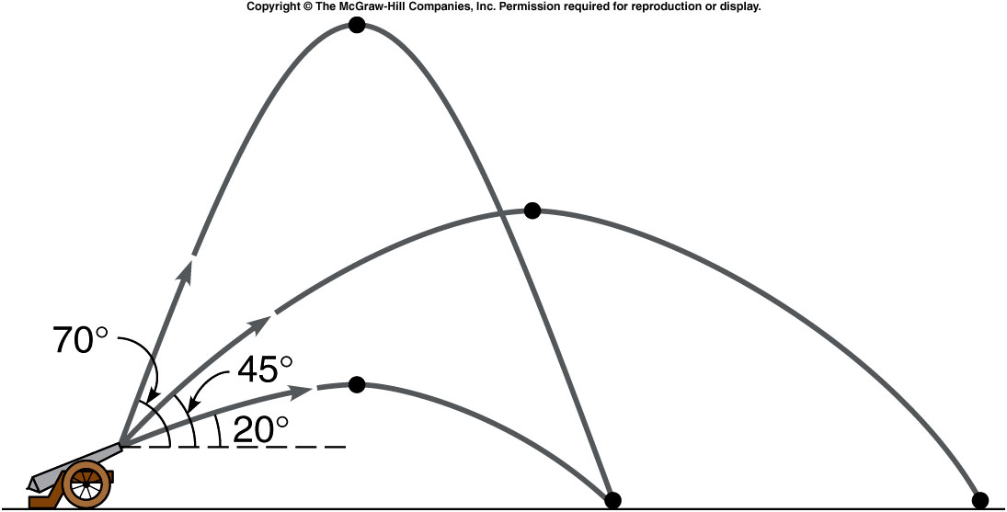
Hitting a Target
The greatest distance is achieved using an angle close to 45° if the effects of air resistance are negligible.

Slide 35
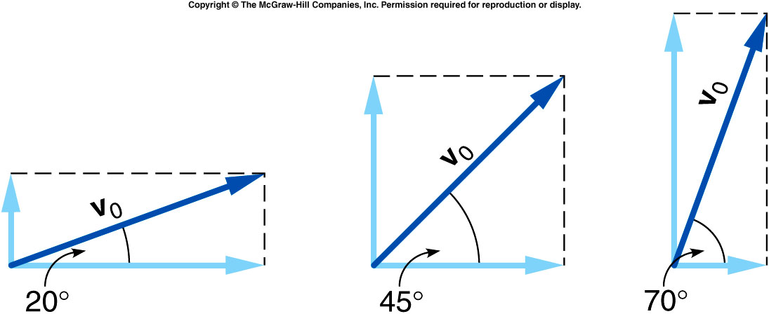
Hitting a Target
For the lowest angle, the horizontal velocity is much greater than the initial vertical velocity.
The ball does not go very high, so its time of flight is short.

Slide 36
Hitting a Target
For the highest angle, the initial vertical velocity is much greater than the horizontal velocity.
The ball goes higher, so its time of flight is longer, but it does not travel very far horizontally.

Slide 37
Hitting a Target
The intermediate angle of 45° divides the initial velocity equally between the vertical and the horizontal.
The ball stays in the air longer than at low angles, but also travels with a greater horizontal velocity than at high angles.

Slide 38
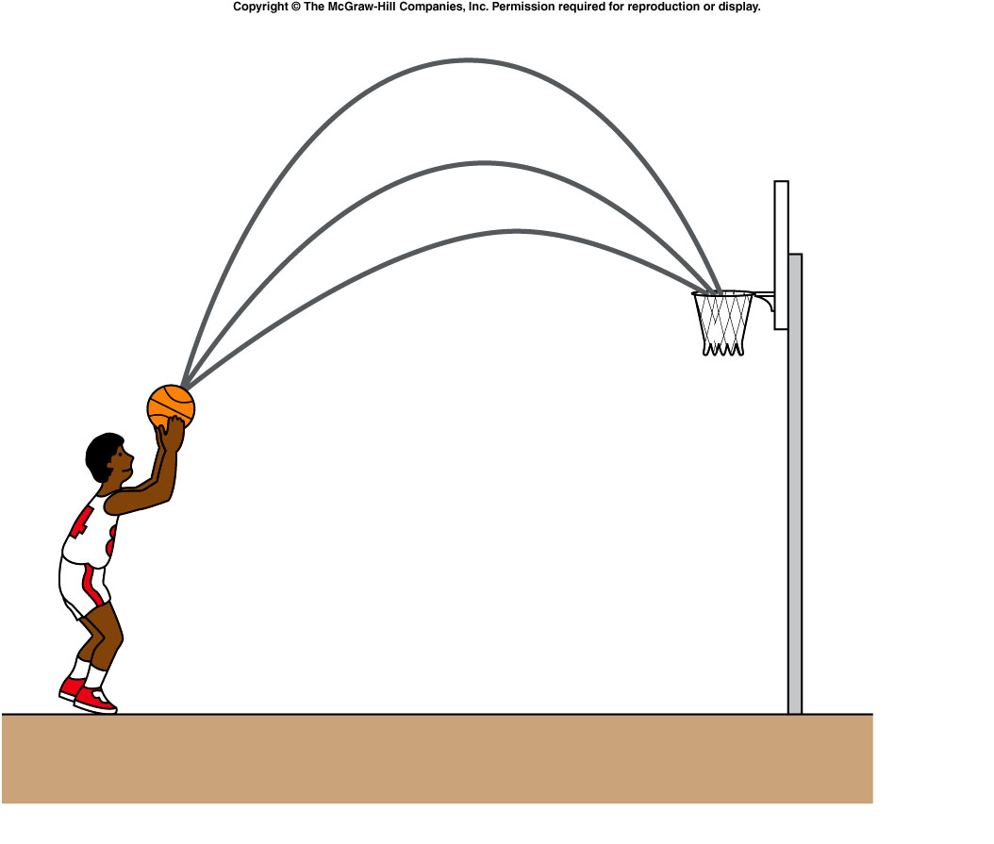
Which free-throw trajectory has the greatest chance of success?
upper.
middle.
lower.
The upper path is more likely to go thru if the ball player has the same control for either path.
What factors determine the best trajectory?
Are these factors different for different situations?

Slide 39
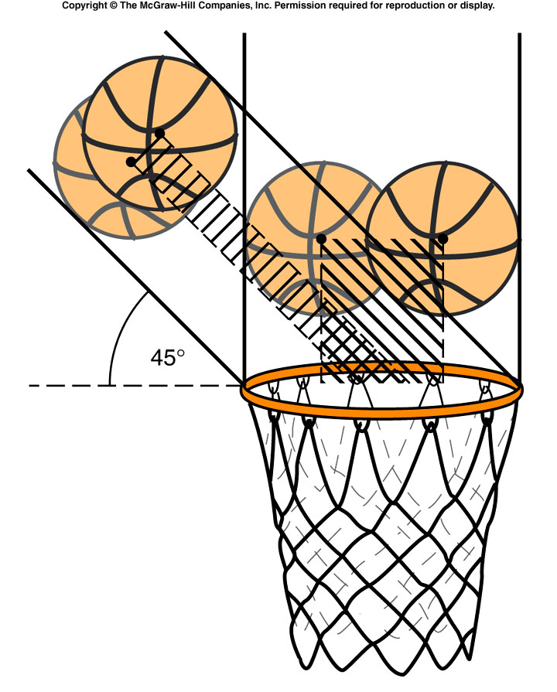
The ball coming straight down has a wider range of possible paths.

Slide 40
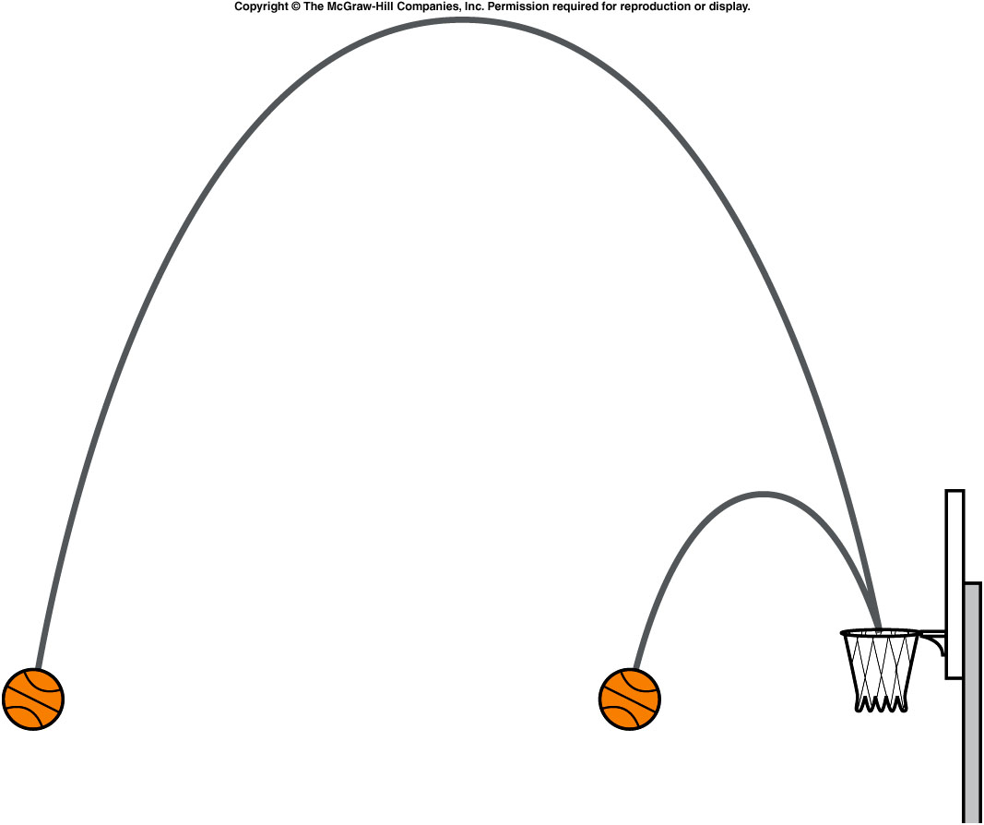
An arched shot from farther away stays in the air longer than an arched shot from closer to the basket.
Away from the basket, flatter trajectories allow more accurate control.
Spin of the basketball, height of release, and other factors also play a role.

Slide 41
Which of the two trajectories shown will result in a longer time for the ball to reach home plate?
The higher trajectory takes longer. The time of flight is determined by the initial vertical velocity component which also determines the maximum height reached.
The higher trajectory.
The lower trajectory.
They will take the same time.

