Slide 1
Chapter-6 Work, Power, Energy
Work and Power
Kinetic Energy
Potential Energy: Gravitational & Elastic
Conservation of Energy
Energy Transformations
Energy and the Pole Vault

Slide 2
Work
Work done in moving an object by a force is defined as follows:
Work = Force × Distance. W = F × d.
Here the force acts along the distance.
Work is a scalar. The SI unit for work is, N.m = joule = J
Q: Ramps enable loading easy. Explain why?
(SP6, Hwk)

Slide 3
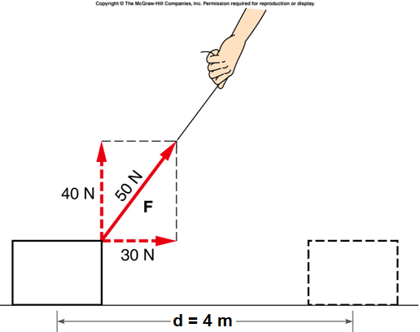
Does any force do work?
W = F × d
E5: a. Work done by the 30 N force?
b. Work done by the 40 N force?
c. Work done by the 50 N force?
Q: Work done in pushing an immobile wall?

Slide 4
Power
The rate at which work is done is called the power.
Power is a scalar quantity. The SI unit for power is Watt, W.
1 W = 1 J/s.
Before the arrival of machines horses were used to do work. With this originated the unit horsepower, hp.
1 hp = 746 W = 550 ft•lb/s.
Why mountain roads are made round and round not straight up?

Slide 5
Kinetic Energy
Kinetic energy is the energy of motion. The word “kinetic” originated from the Greek word kinetikos, meaning “motion”.
If an object of mass, m moves with a velocity v, then the kinetic energy, KE is given by the following equation,
Kinetic energy is a scalar quantity. It also has the same unit as work, joule (J).
1 J = 1 kg.m²/s².
Do problem E7 (Hwk).

Slide 6
W = F × d = KE_{f} − KE_{i}.
Positive work
Negative work

Slide 7
Gravitational Potential Energy
Gravitational potential energy, GPE is the energy stored in an object as a result of its height. It can be calculated using weight, which is mass times gravity, and height. It is given by the following equation,
Gravitational potential energy is a scalar quantity.
The SI unit for it is also joule, J.

Slide 8
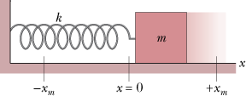
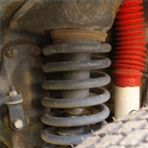
Elastic Potential energy
Elastic potential energy is the energy stored in elastic materials as the result of their stretching or compressing.
How shock absorbers work?

Slide 9
Conservation of Energy
The swing of the pendulum demonstrates the principle of conservation of energy.
Mechanical energy = KE + PE
In the absence of friction and air drag, the total mechanical energy of a system remains a constant.
http://www.youtube.com/watch?v=BVxEEn3w688

Slide 10
How is energy analysis like accounting?
Try SP5, Hwk.

Slide 11
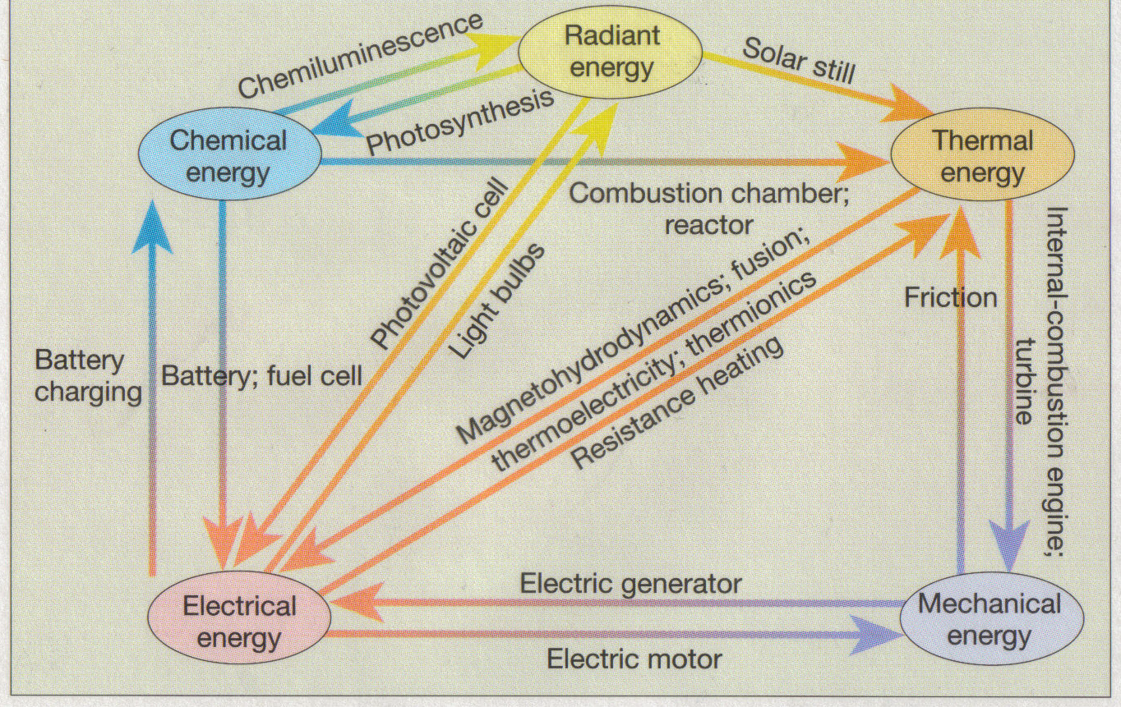
Energy: Forms and Transformations

Slide 12
Energy Transformations in Pole Vault (p114, textbook)
Forms of Energy:
Energy Transformations:

