Slide 1
Equations of Kinematics in One Dimension
Kinematic equations for a one dimensional motion with constant acceleration are,
v = v₀ + at
x = ½(v₀ + v)t
x = v₀ t + ½at²
v² = v₀² + 2ax ;
x = distance, a = acceleration, v = final velocity, v₀ = initial velocity, t = travel time.

Slide 2
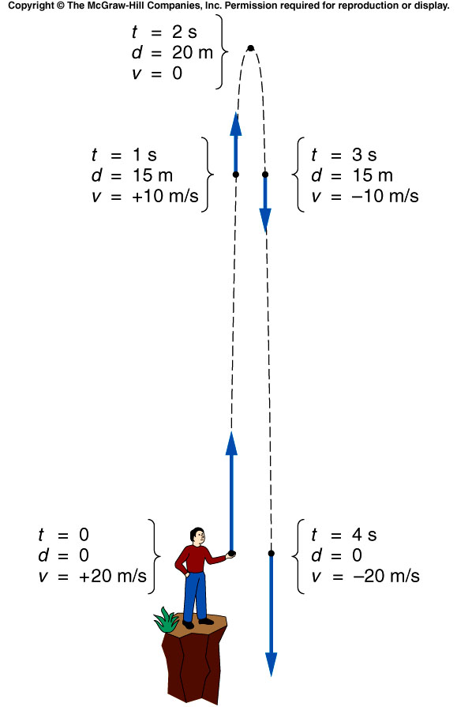
Vertical Projectile Motion, (g = -10 m/s^2)
Try E7, E8, E9; Ch3 POEP

Slide 3
Kinematics Equations in 2 Dimensions

Slide 4
Projectile Motion
Assumptions:
1. Air resistance is neglected
2. Gravity is constant, 9.8 m/s², down.
What is the launch angle for maximum range?
http://phet.colorado.edu/simulations/sims.php?sim=Projectile_Motion

Slide 5
Velocity of the football

Slide 6
Playing Shortstop
A player picks up a ground ball and throws it horizontally with a speed of 24 m/s. It is caught after 0.42 s later at point B.
a. How far apart are the two players?
b. What is the distance of vertical drop, AB?
Try SP5, POEP.

Slide 7
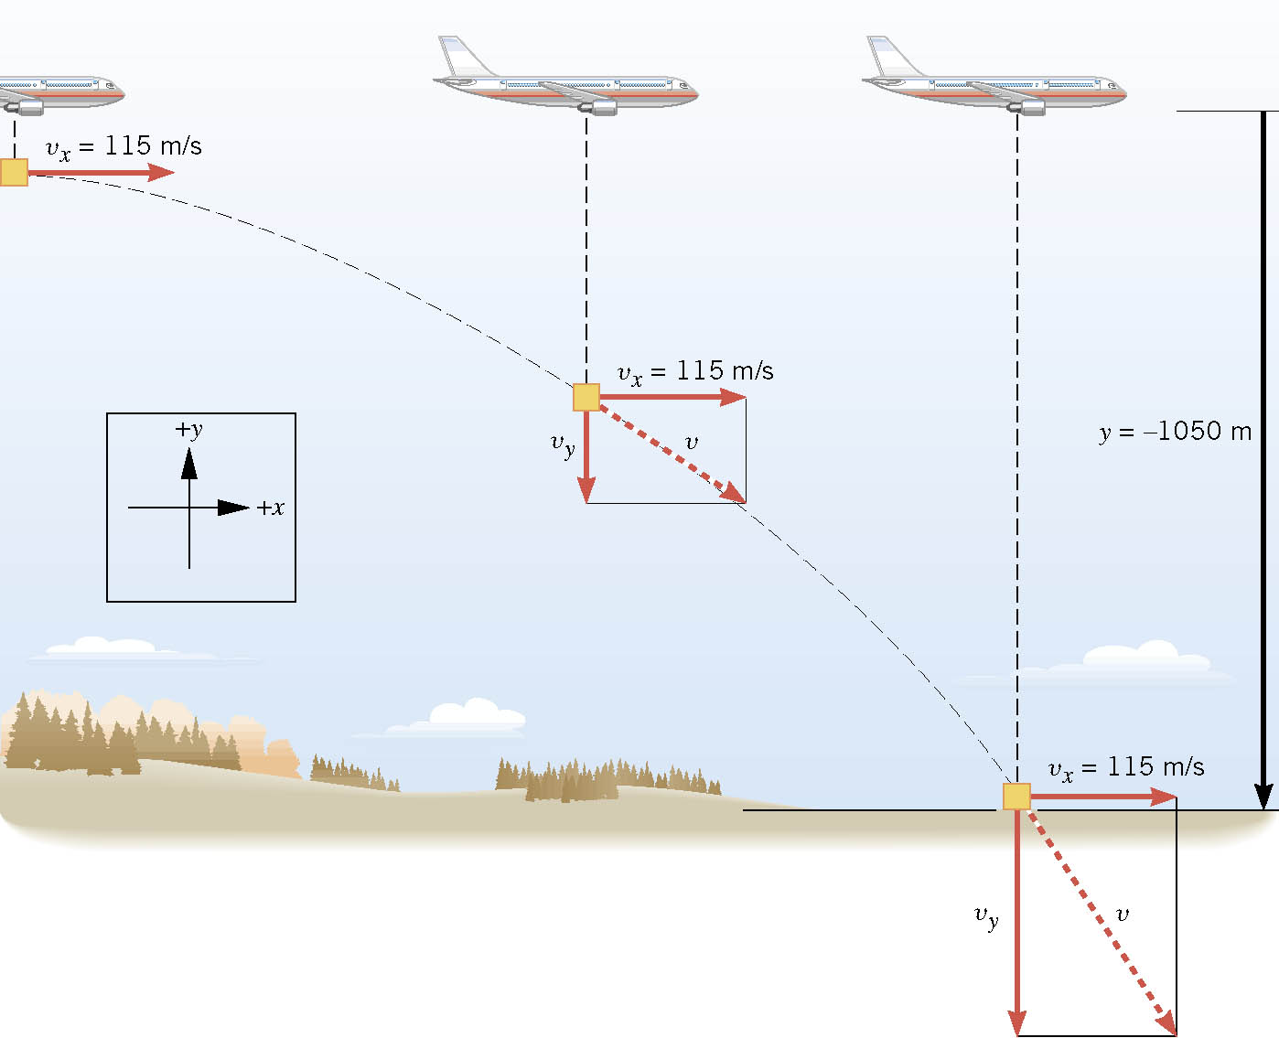
A Falling Care Package
An airplane moving horizontally with a constant velocity of +115 m/s at an altitude of 1050 m. The plane releases a “care package” that falls to the ground along a curved trajectory to reach some stranded hikers. How far horizontally ahead the package should be released?

Slide 8
Football Kickoff
A place-kicker kicks a football at an angle of 40⁰ above the horizon with a speed of 22 m/s. Find the maximum height H, range R, and the hang time.

Slide 9
Demonstration
http://www.youtube.com/watch?v=cxvsHNRXLjw

Slide 10
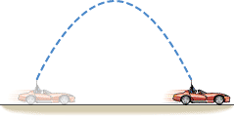
Conceptual Example
Suppose you are a passenger in a convertible with the top down. The car is moving to the right at a constant velocity. Assume that you throw a ball straight upward. In the absence of air resistance, where would the ball land—behind you, ahead of you, or in your lap?

