Slide 1
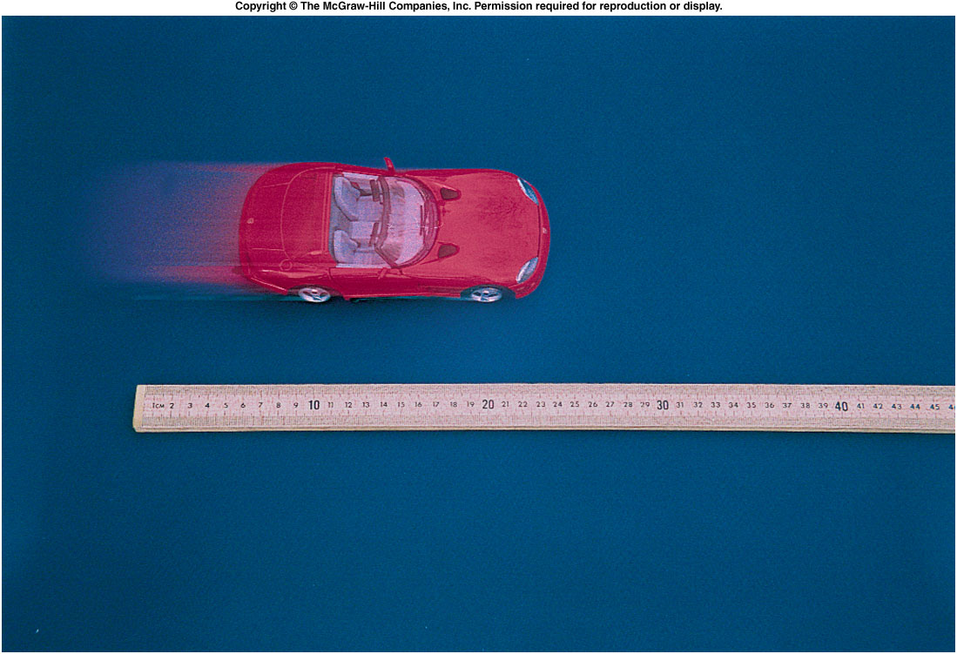
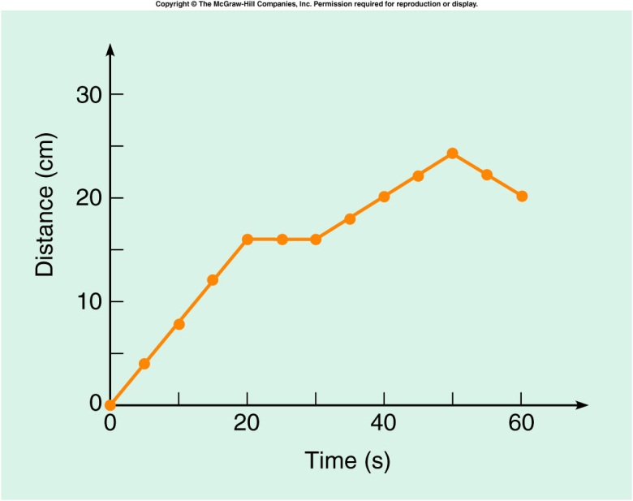
Graphing Motion
Time (s) | Distance (cm)
0 | 0
5 | 4.1
10 | 7.9
15 | 12.1
20 | 16.0
25 | 16.0
30 | 16.0
35 | 18.0
40 | 20.1
45 | 21.9
50 | 24.0
55 | 22.1
60 | 20.0

Slide 2
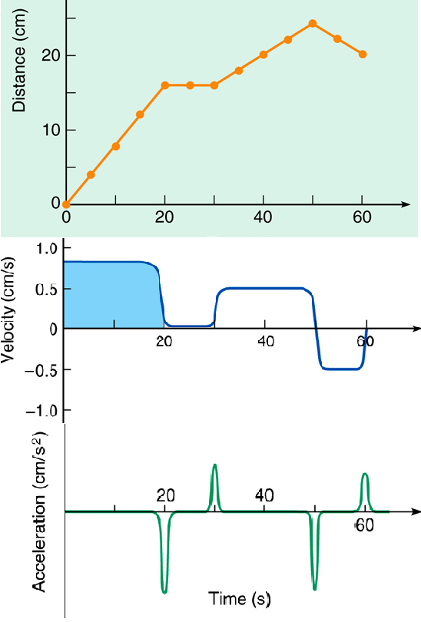
Speed, Velocity, Acceleration, and Displacement for a moving Toy Car
Instantaneous Speed = Slope of the Distance VS. Time graph.
Instantaneous Velocity = Slope of the Displacement VS. Time graph.
Displacement is obtained from the area under the Velocity VERSUS time graph.
Instantaneous acceleration = Slope of the Velocity VS. Time graph.

Slide 3
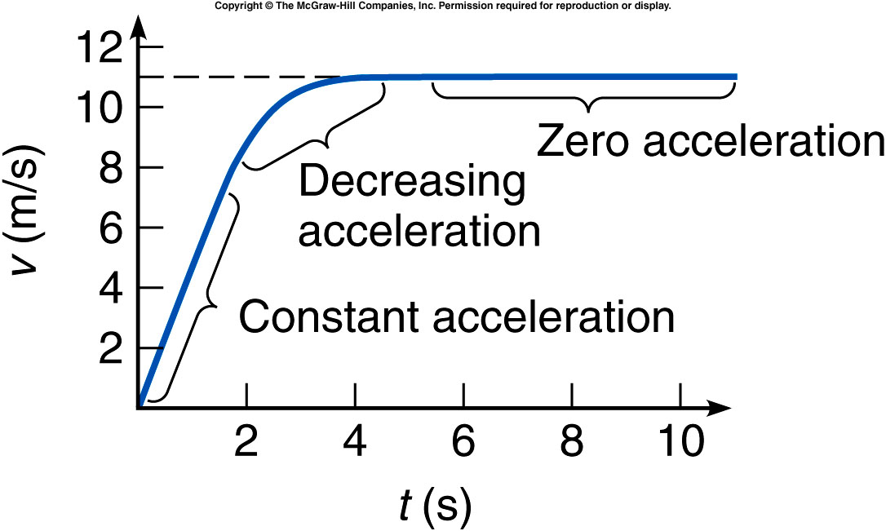
The 100-m Dash
http://en.wikipedia.org/wiki/Men's_100_metres_world_record_progression
http://ezinearticles.com/?Sprinting-100m---Improve-Sprinting-Times-For-100m-Dash-With-These-Tips&id=4479853

Slide 4
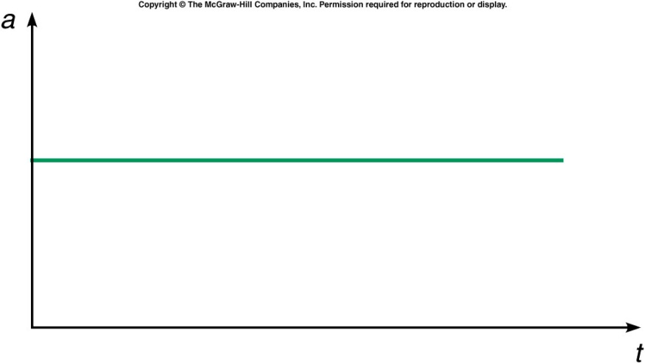
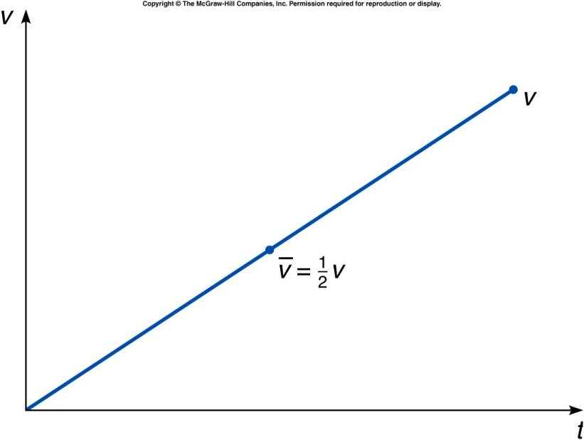
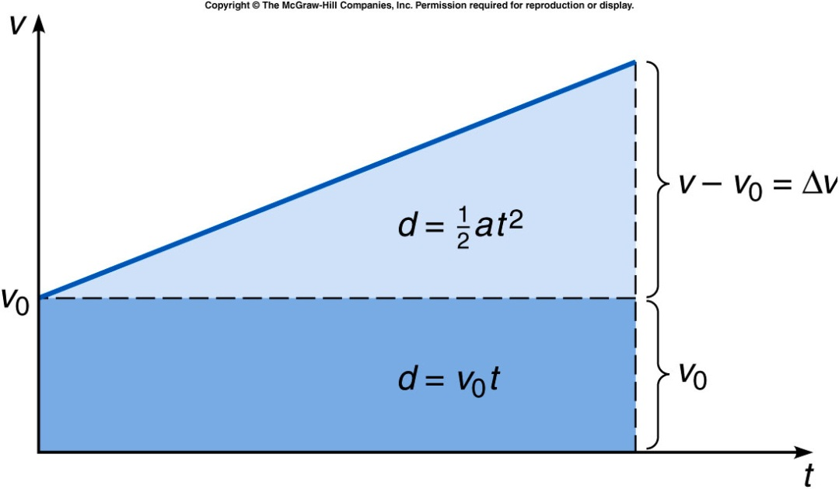
Uniform Acceleration

