Slide 1
CHAPTERS-16&17 Light, Color, and Image Formation
Electromagnetic wave
Light and Color
Reflection and Image Formation
Refraction of Light and Rainbow
Lenses and Image Formation
Eyeglasses, Microscopes, and Telescopes

Slide 2
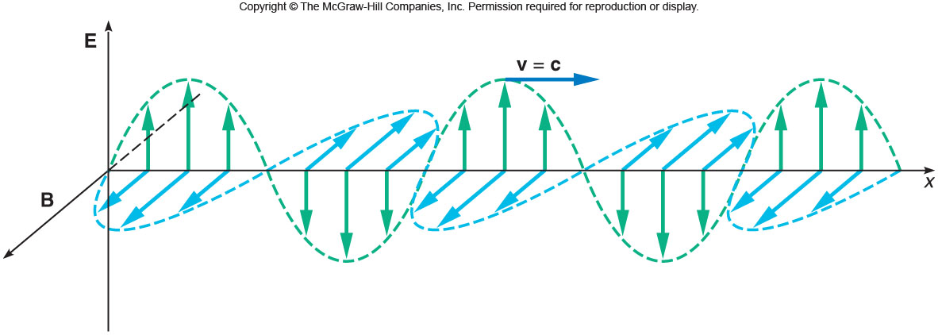
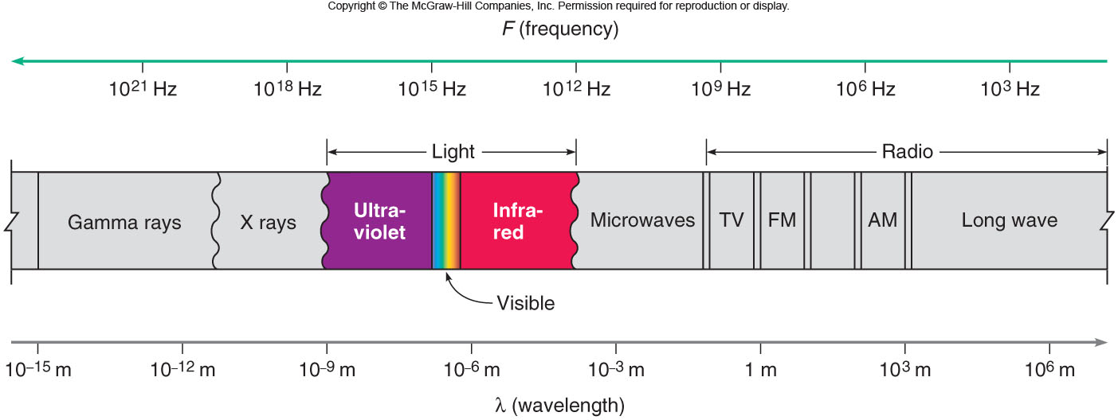
Light is an Electromagnetic wave
The changing magnetic field (B) creates an electric field (E) that fluctuates in time. It propagates at the speed, c = 3 x 10⁸ m/s.
$$v=λf$$
Ch16: E2

Slide 3
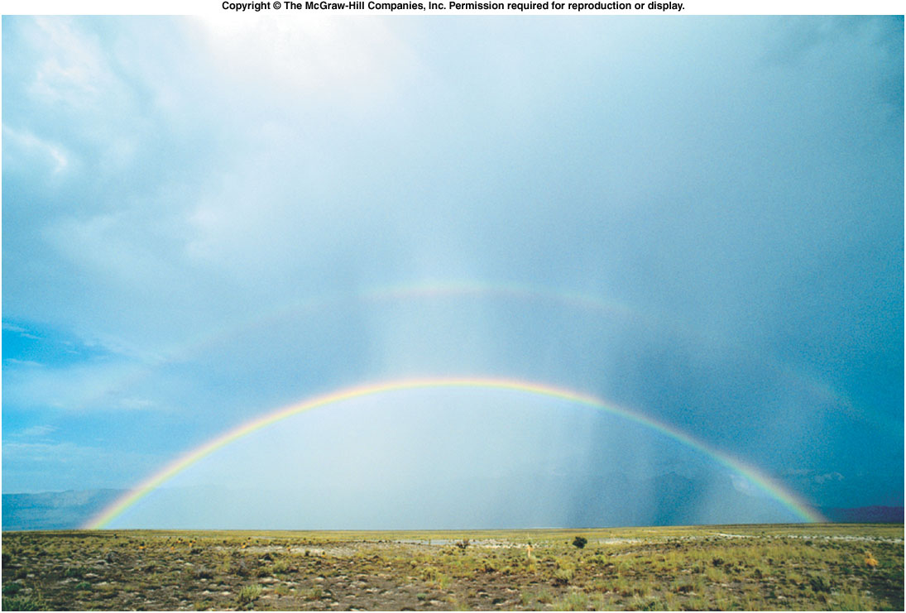
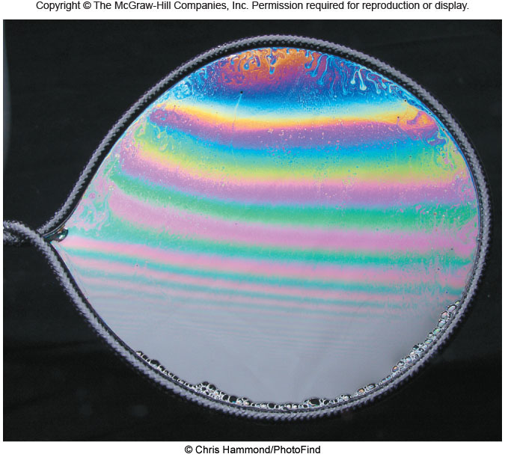
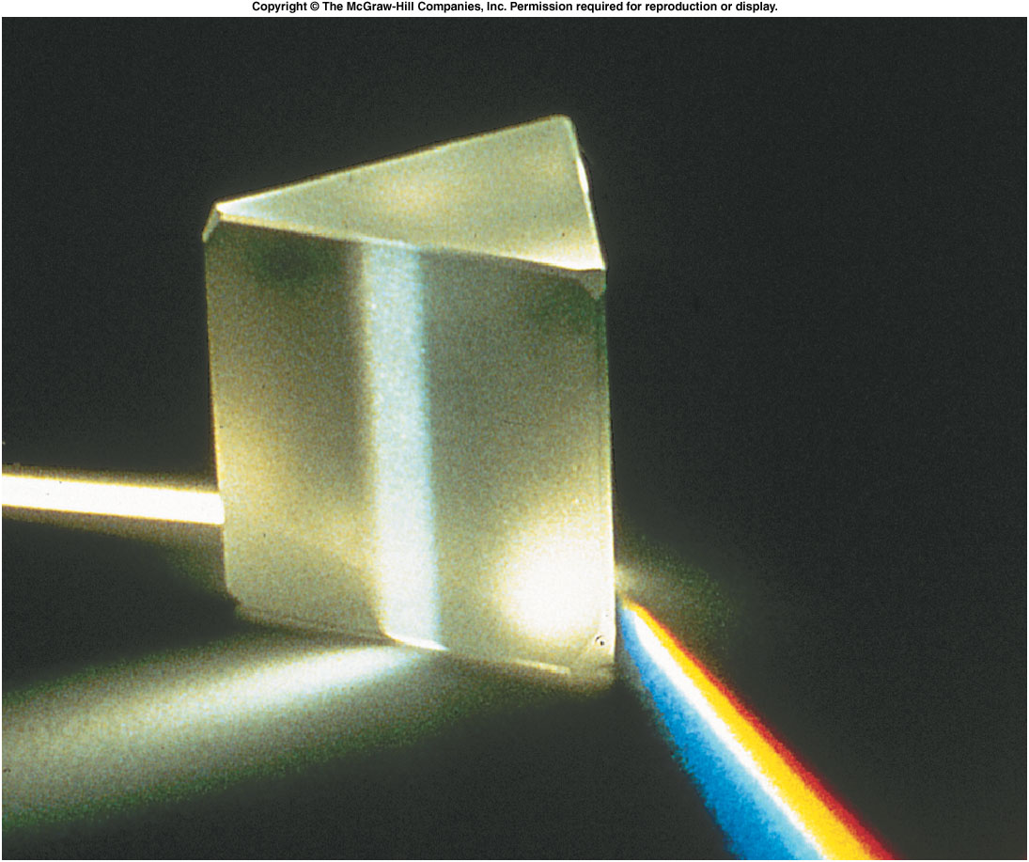
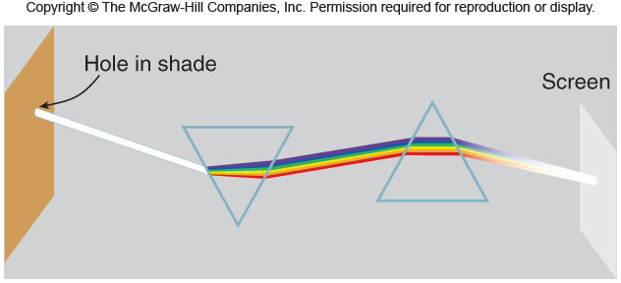
Light and Color

Slide 4
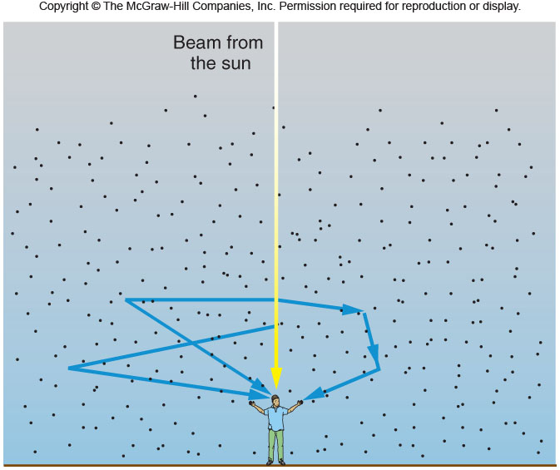
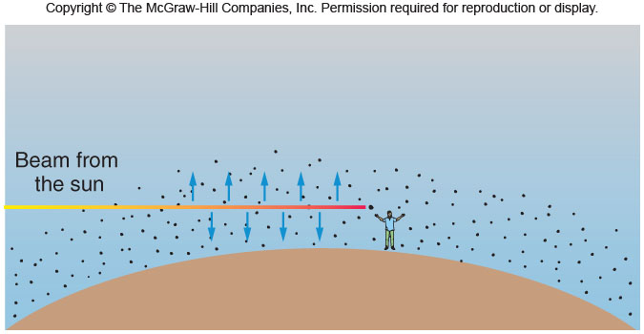
Blue Skies and Red Sunsets

Slide 5
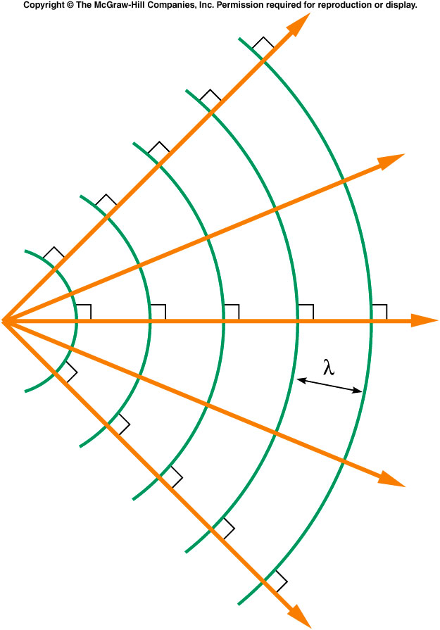
How Are Light Rays Related to wavefronts?
Wavefronts are perpendicular to the rays.

Slide 6
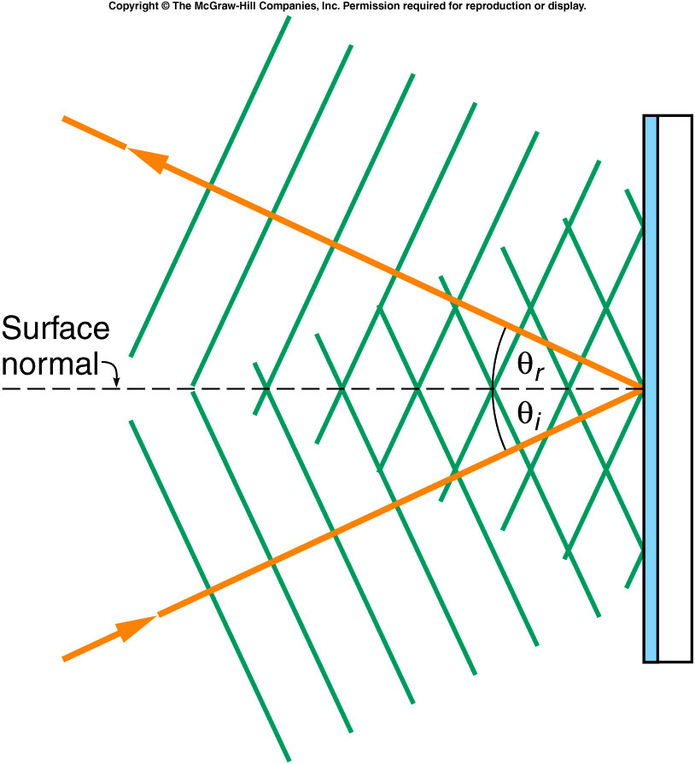
The Law of Reflection
The angle of incidence = The angle of reflection.

Slide 7
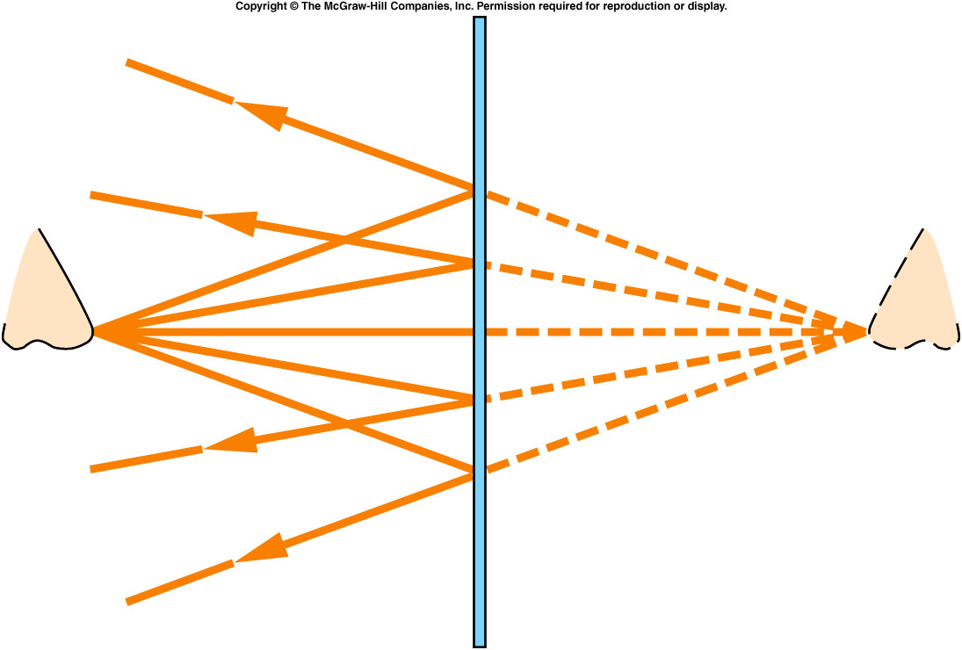
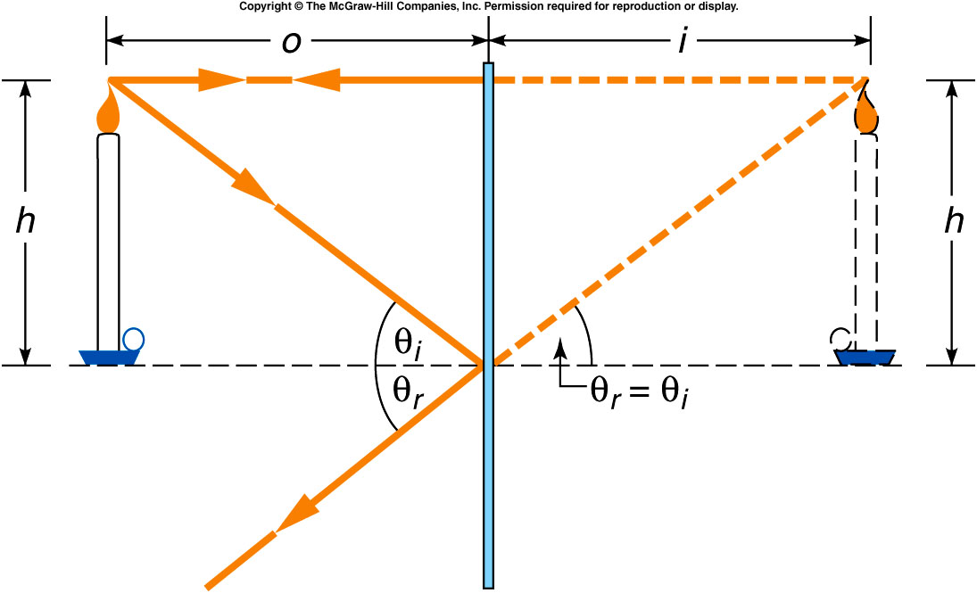
How Are Images Formed by a Plane Mirror?

Slide 8
The Index of Refraction
Substance | Index of Refraction, n (at λ = 589 nm )
Solids at 20 °C
Diamond | 2.419
Glass, crown | 1.523
Ice ( ) | 1.309
Sodium chloride | 1.544
Quartz
Crystalline | 1.544
Fused | 1.458
Liquids at 20 °C
Benzene | 1.501
Carbon disulfide | 1.632
Carbon tetrachloride | 1.461
Ethyl alcohol | 1.362
Water | 1.333
Gases at 0 °C, 1 atm
Air | 1.000 293
Carbon dioxide | 1.000 45
Oxygen, | 1.000 271
Hydrogen, | 1.000 139
The index of refraction n of a material is the ratio of the speed c of light in a vacuum to the speed v of light in the material:
Q: What is the speed of light in water?

Slide 9
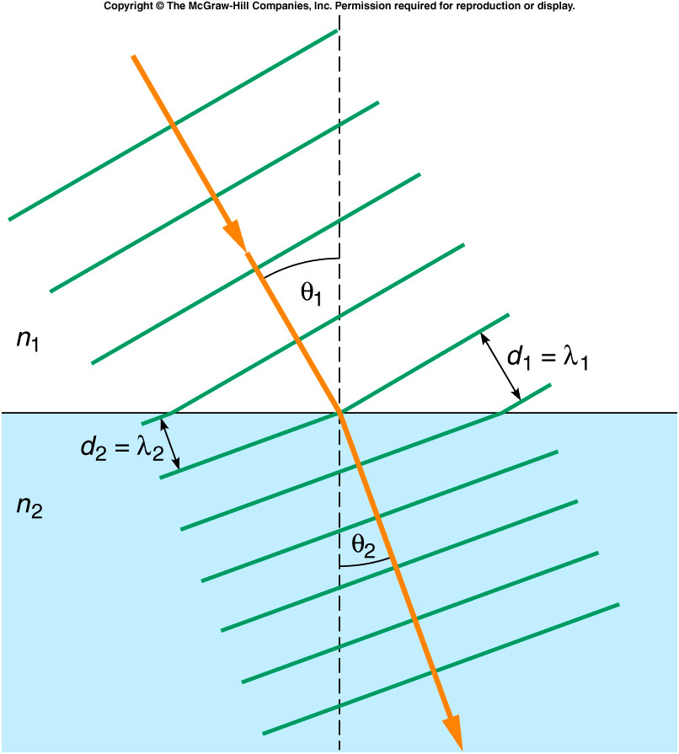
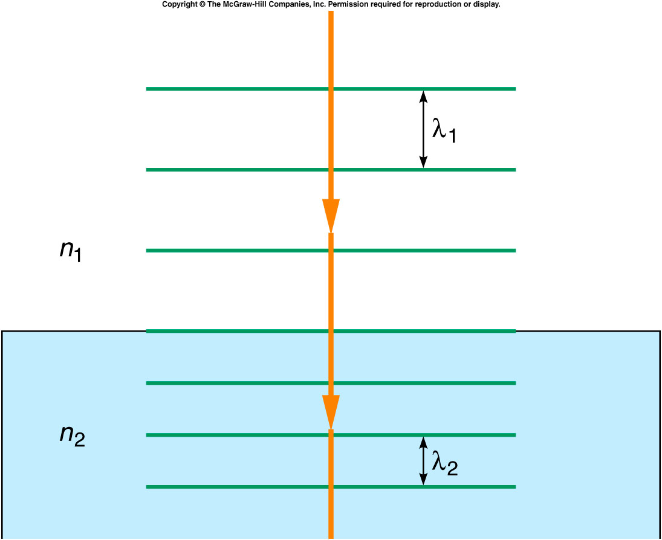
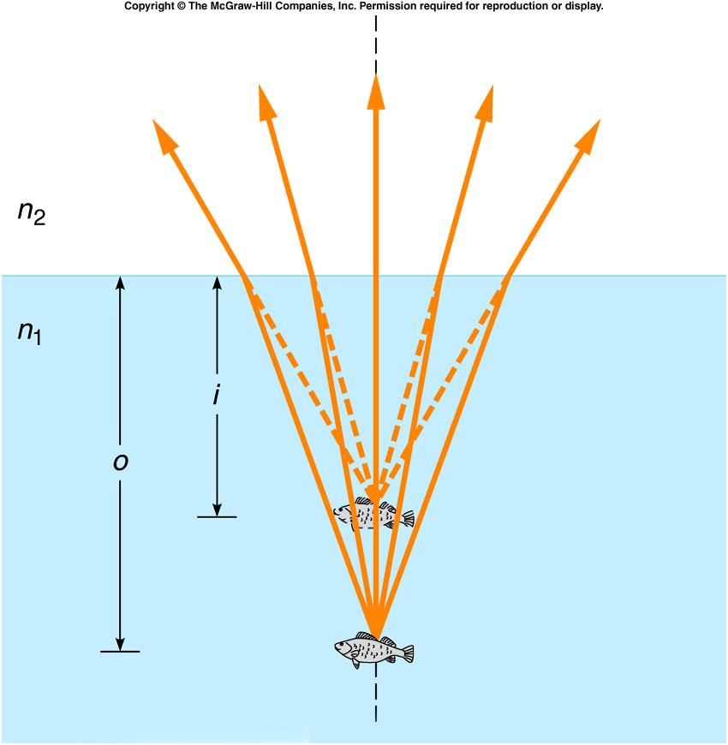
Refraction of Light
Apparent Depth of Fish Is Smaller Than Actual Depth Due to Refraction.

Slide 10
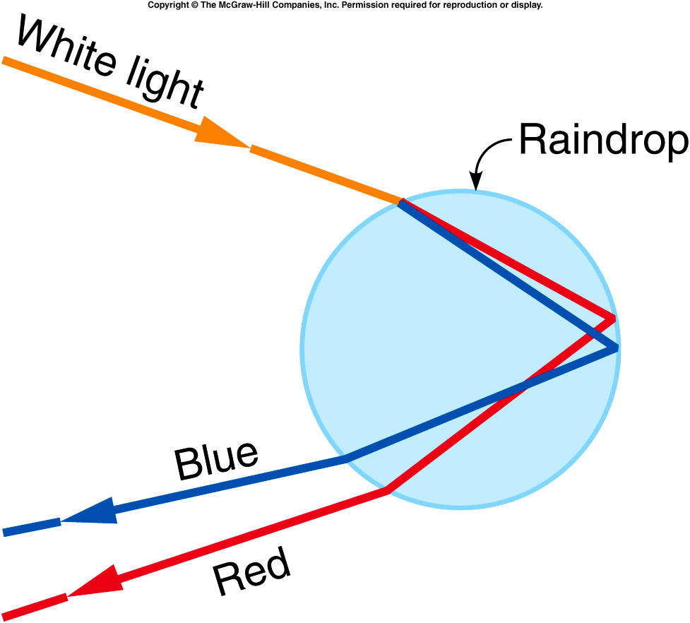
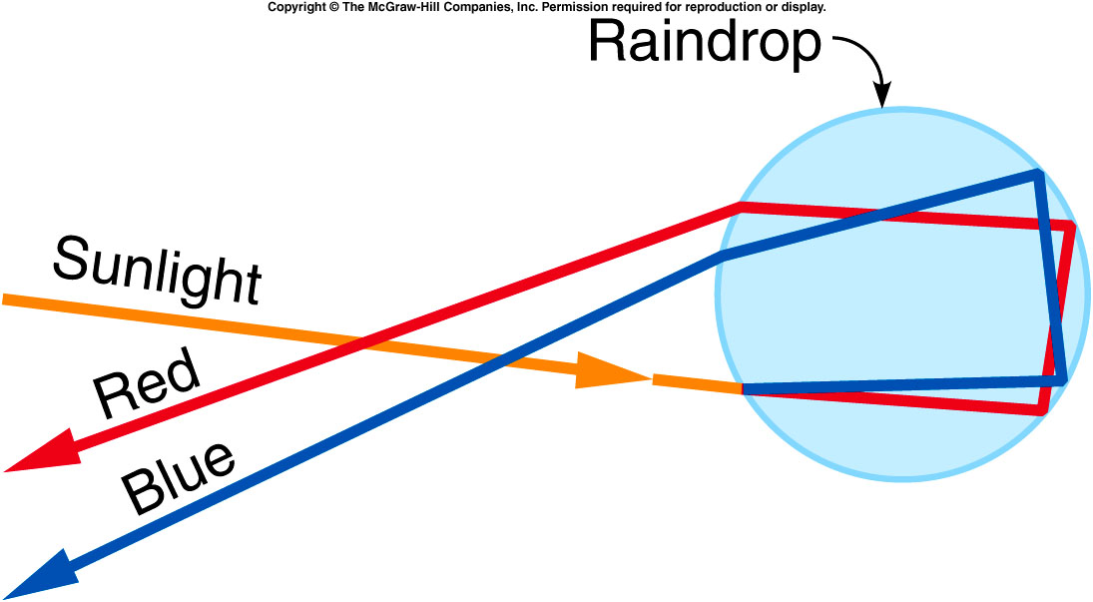
Rainbow
Water droplet disperses the light into colors.
Primary Rainbow
Colors are reversed and less intense.

Slide 11
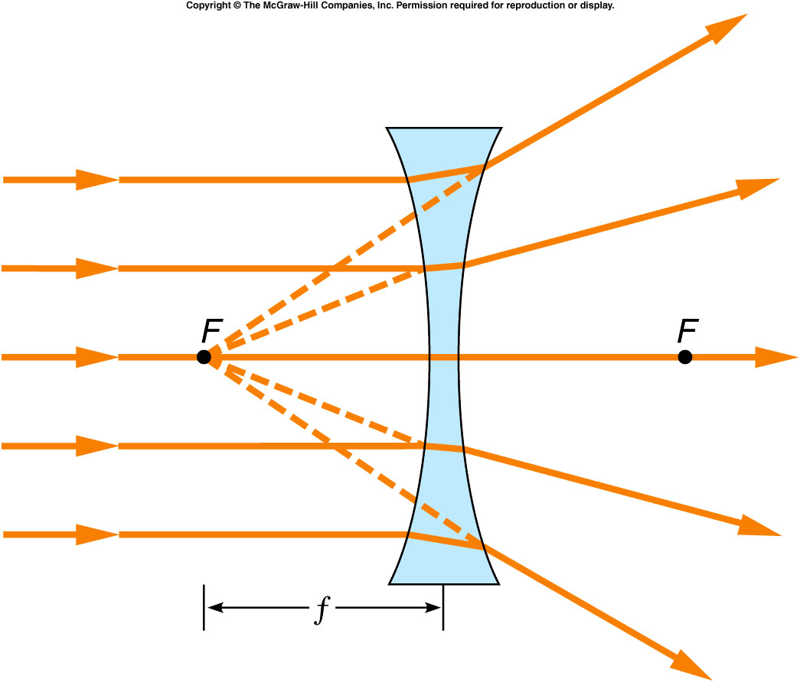
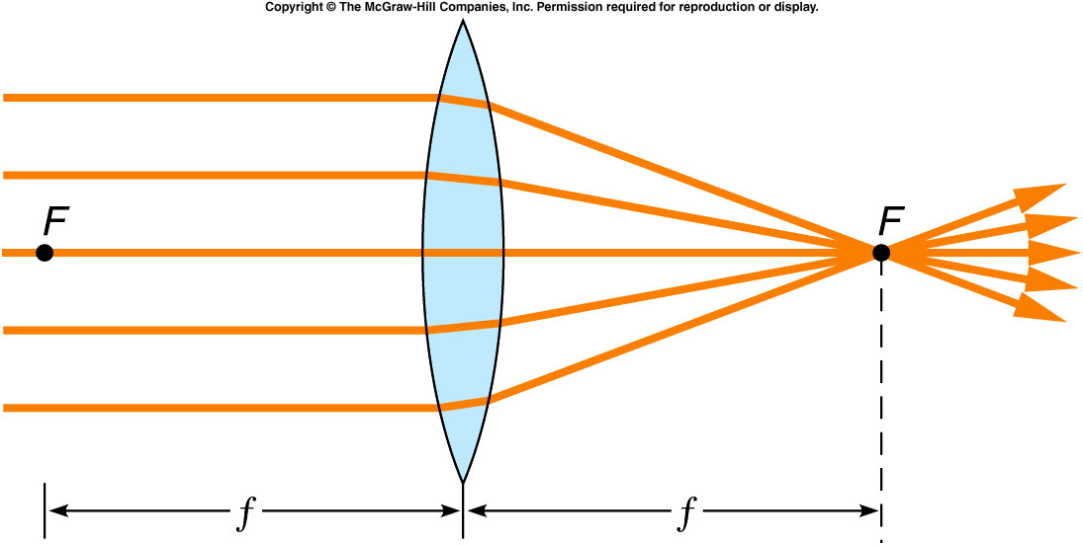
Focal Point (F) and Focal Length (f) of lenses
Converging or Positive lens
Diverging or Negative lens
Power of a lens =1/f

Slide 12
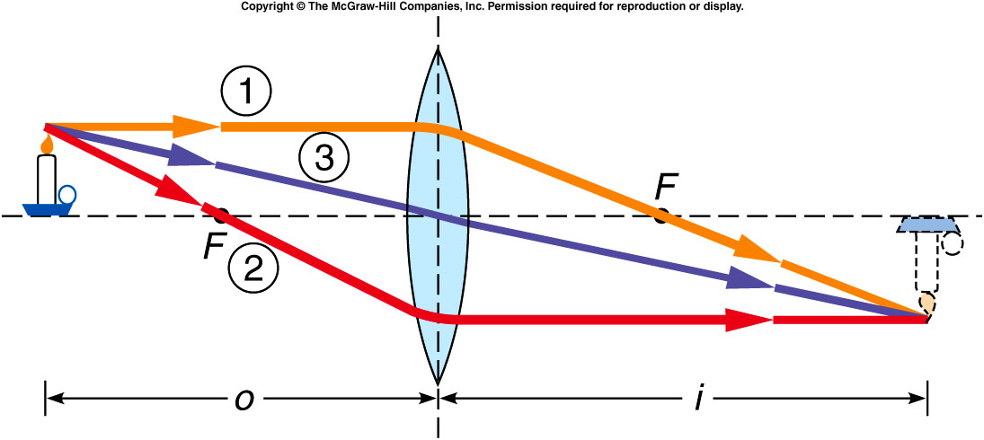
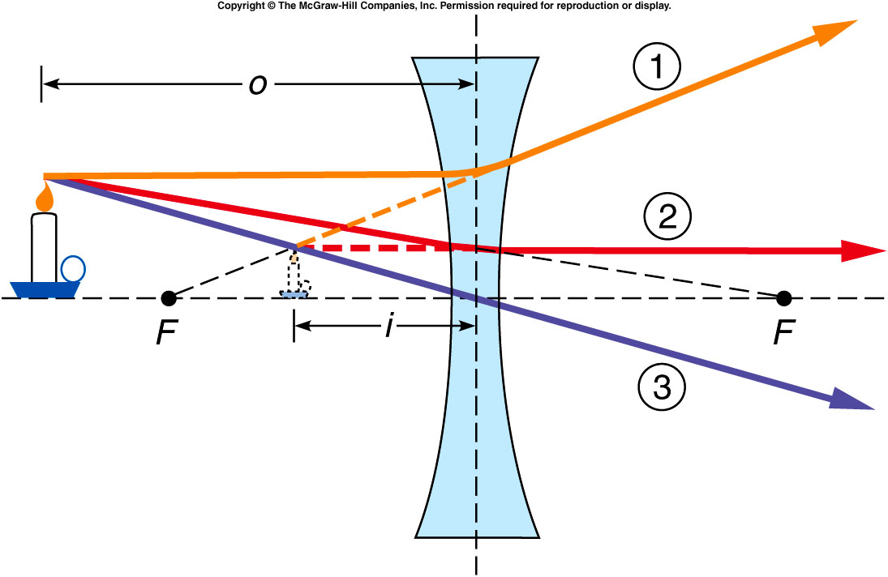
Ray Diagram

Slide 13
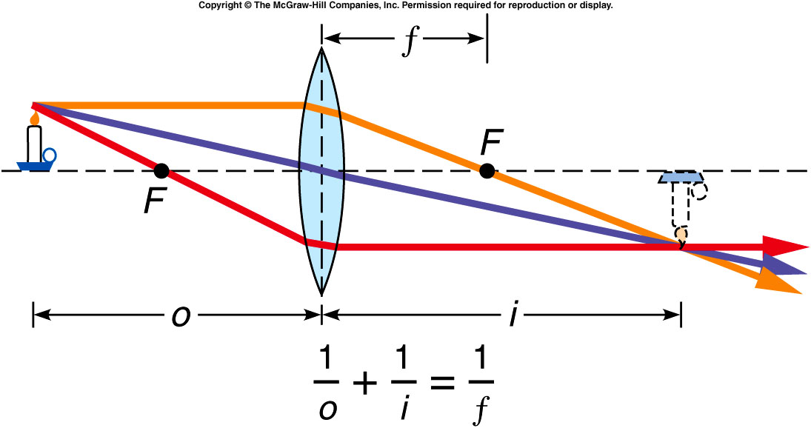
Lens Equation and Magnification, m
E6: A positive lens has a focal length of 12 cm. An object is located at a distance of 3 cm from the lens.
How far from the lens is the image?
State three properties of the image? (real/virtual, erect/inverted, magnified/reduced)
Draw a ray diagram and show the image formation.

Slide 14
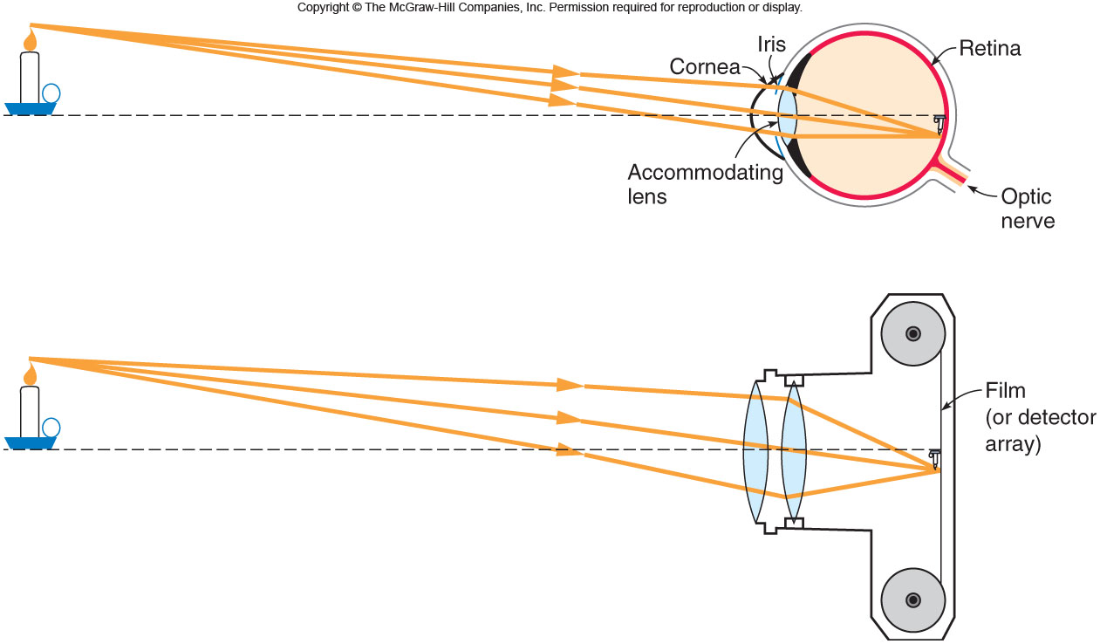
Optical Instruments
Human eye
Camera
Eyeglasses
Microscope
Telescope

Slide 15
Human Eye: Vision Defects
Nearsightedness (Myopia): can see only nearby objects clearly. Correction is made with a Diverging lens or negative lens.

Slide 16
Human Eye: Vision Defects
Farsightedness (Hyperobia): can see only far objects clearly. Correction is made with a converging lens or positive lens.

Slide 17
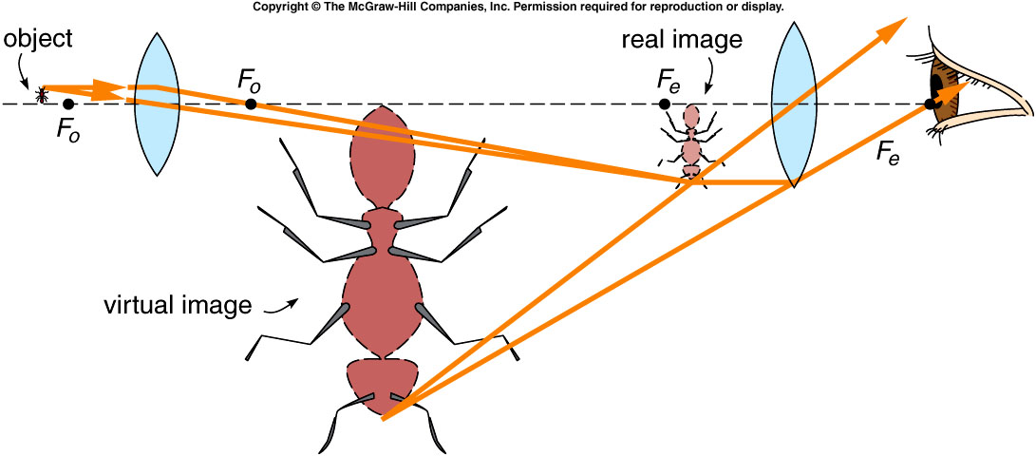
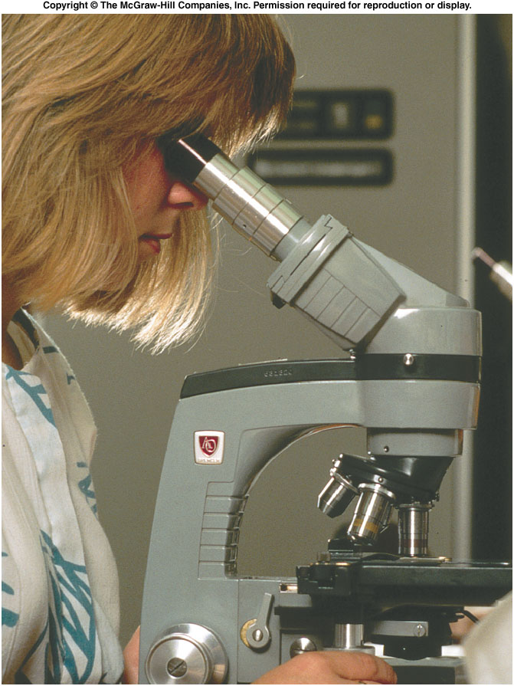
Microscope
Used to view small things nearby.
Consists of two positive lenses, objective and eyepiece.
Final image is magnified and inverted.
A laboratory microscope has 3 or 4 objective lenses.

Slide 18
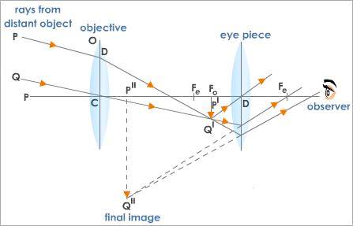
Astronomical Telescope
Used to view things far away.
Consists of two positive lenses, objective and eyepiece.
Final image is magnified and inverted.

