Slide 1
CH-4: Newton’s Laws: Explaining Motion
Brief History
Aristotle (384-322 B.C)
Galileo Galilei (1564-1642)
Isaac Newton (1642-1727)
Albert Einstein (1879–1955)
Newton’s laws of motion: 1st law, 2nd law, 3rd law
Applications of Newton’s laws
CH-5: Centripetal Force Newton’s Law of gravitation

Slide 2
Aristotle (384-322 B.C)
Believed that a force had to act for an object to move.
Did not distinguish acceleration from velocity.
Believed that a heavy object would fall more quickly than a lighter object.
Earth-centered model of the solar system.

Slide 3
Galileo Galilei (1564-1642)
Advocated Copernicus’s Sun-centered model of the solar system.
Showed that heavy and light objects fell at the same rate.
Argued that no force is required to maintain motion.
Developed mathematical description of motion.

Slide 4
Isaac Newton (1642-1727)
Laws of motion, can be used to analyze motion of ordinary objects.
Not valid for speeds close to the speed of light. Need to use the theory of relativity.
Not valid for atomic sized particles. Need to use quantum mechanics.

Slide 5
Albert Einstein (1879–1955)
At the beginning of the 20th century, Albert Einstein (1879–1955) developed the theory of relativity and, along with many other scientists, developed quantum theory. This theory does not have the constraints present in classical physics.

Slide 6
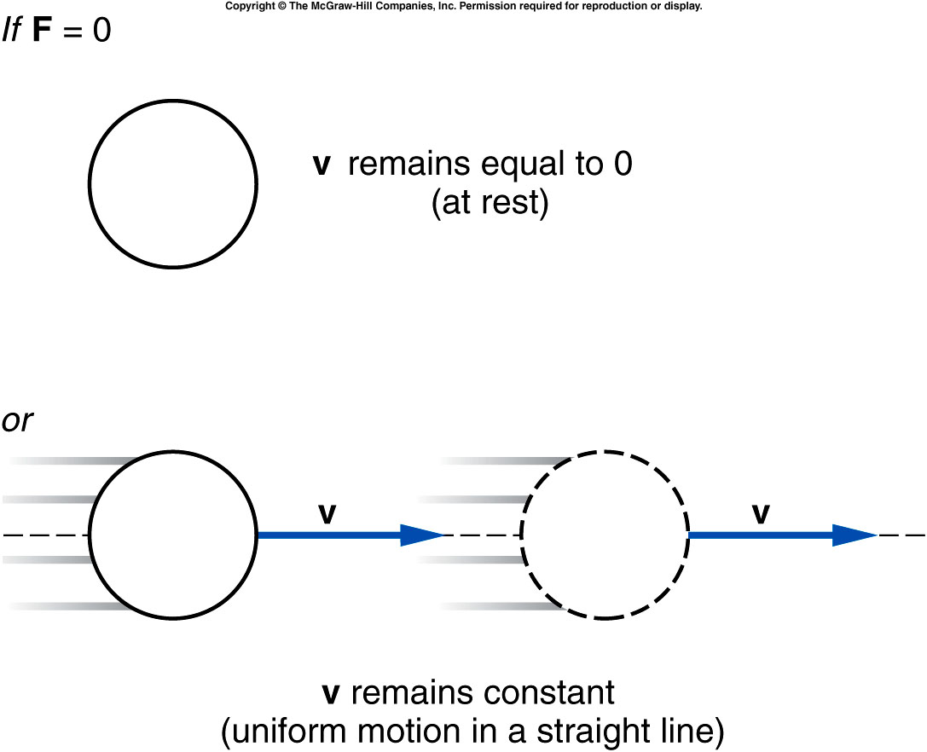
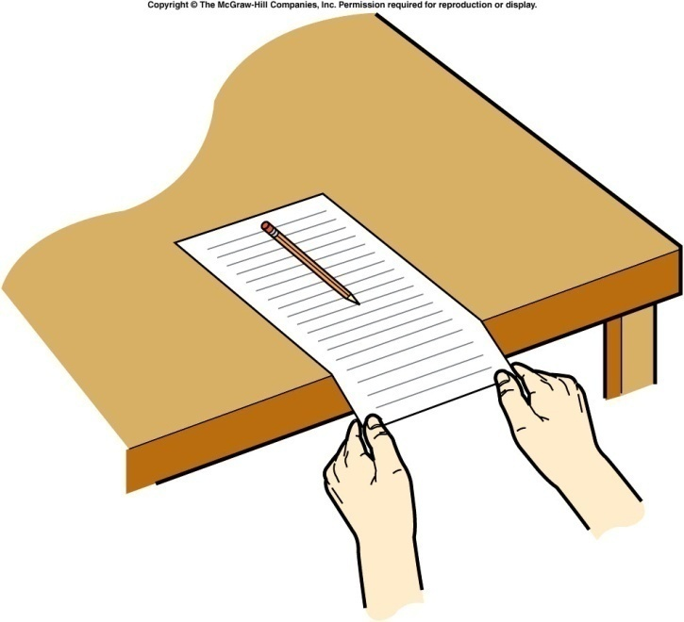
Newton’s First Law of Motion
http://www.ispot.tv/ad/7V7z/celebrex-body-in-motion
An object remains in a state of rest or in a state of motion at a constant speed along a straight line, unless it is compelled to change that state by a net force.

Slide 7
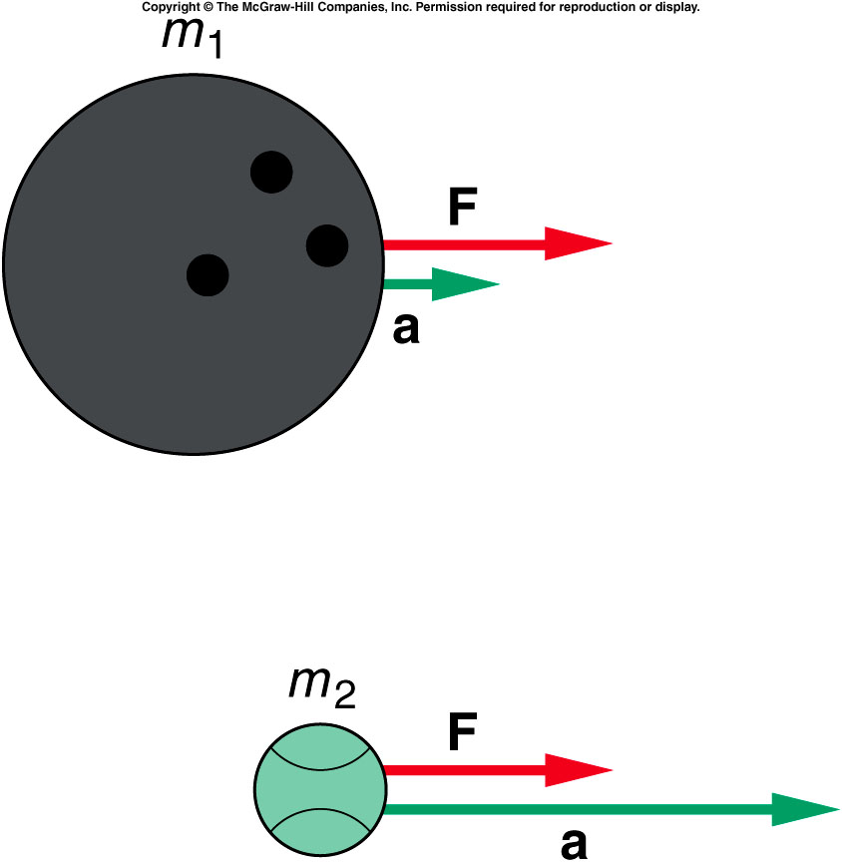
Newton's Second Law of Motion
When a net external force F acts on an object of mass m, the acceleration a that results is directly proportional to the net force and has a magnitude that is inversely proportional to the mass. The direction of the acceleration is the same as the direction of the net force.
SI Unit of Force: kg · m/s² = newton (N)

Slide 8
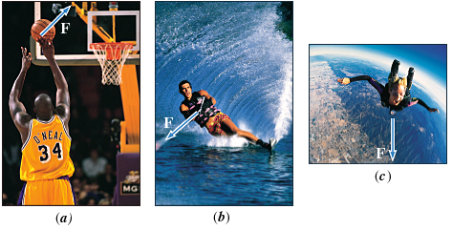
The Concept of Force
In common usage, a force is a push or a pull.
Forces can be categorized as,
Contact forces and Non-Contact forces.

Slide 9
How do forces add?

Slide 10
Mass and Weight
The weight of an object on the earth is the gravitational force that the earth exerts on the object. The weight always acts downward, toward the center of the earth. On another astronomical body, the weight is the gravitational force exerted on the object by that body.
Weight = Mass x Gravity
SI Unit of Weight: : newton (N)
Ex: How much one may weigh in moon?

Slide 11
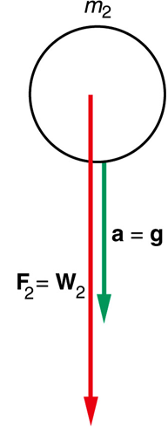
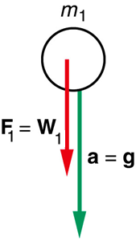
Why is the gravitational acceleration is independent of mass?

Slide 12
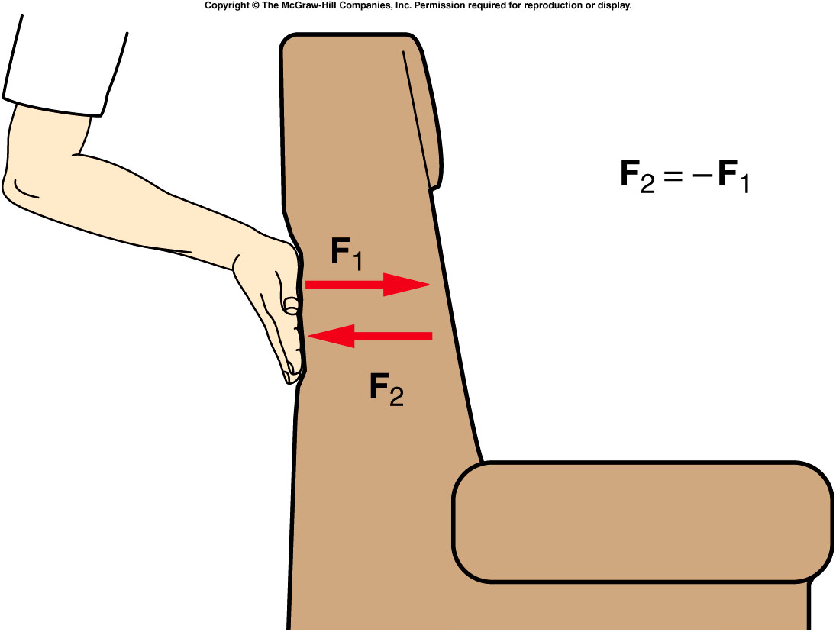
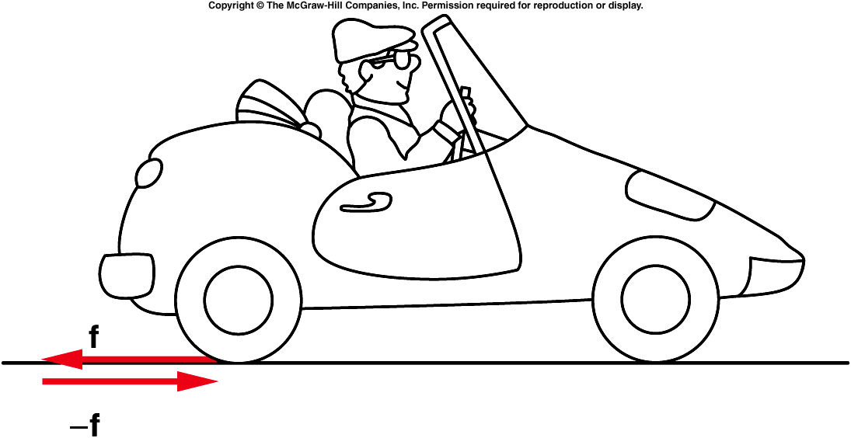
Newton’s Third Law
If object A exerts a force on object B, object B exerts a force on object A that is equal in magnitude but opposite in direction to the force exerted on B.

Slide 13
Examples of Newton's 3rd Law

Slide 14
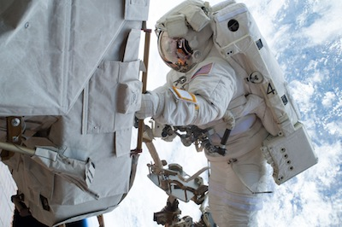
Example
Suppose that the mass of the spacecraft in is mS = 11 000 kg and that the mass of the astronaut is mA = 92 kg. In addition, assume that the astronaut exerts a force of P = +36 N on the spacecraft. Find the accelerations of the spacecraft and the astronaut.
Astronauts use a tether to stay connected to the space capsule.

Slide 15
Identifying Forces
Textbook resting on a table
Object resting on an inclined plane
Mass hanging on a string
Ladder on a wall

Slide 16
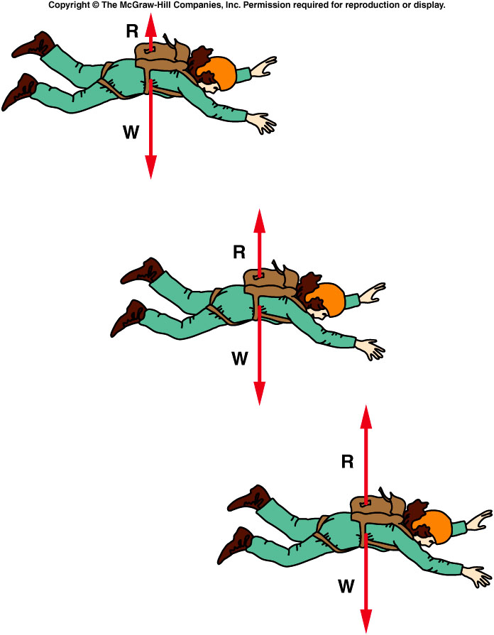
Does a sky diver continue to accelerate?

Slide 17
Motion of Connected Objects
m₁= 10 kg
m₂= 8 kg
What is the acceleration of the two carts?
What is the net force acting on each cart?
Atwood’s Machine: Q32, Ch-4

Slide 18
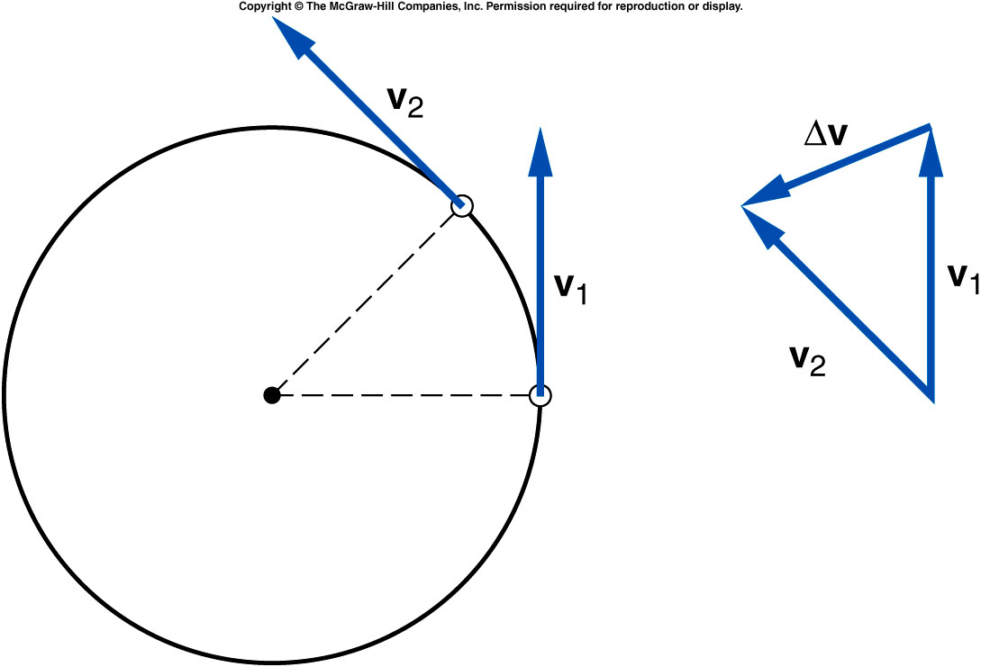
CH-5: Centripetal Acceleration (a_{c}) and Force (F_{c})
Q: Consider a ball of mass, m twirled in a horizontal circle at constant speed, v. Is there any acceleration?
A: Yes. Centripetal Acceleration
Centripetal acceleration is the rate of change in velocity of an object that is associated with the change in direction of the velocity.
It is always perpendicular to the velocity vector and points toward the center of the curve.

Slide 19
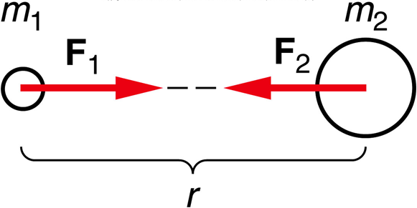
CH-5: Newton’s Law of Universal Gravitation
Every body in the universe attracts every other body with a force that is directly proportional to the product of the masses of the bodies and inversely proportional to the square of the distance between the bodies.
The law of gravitation is universal and very fundamental. It can be used to understand the motions of planets and moons, determine the surface gravity of planets, and the orbital motion of artificial satellites around the Earth.

Slide 20
Gravity and Satellite
Calculating the Earth’s acceleration due to gravity.
Calculating the speed of orbiting International Space Station.

