Slide 1
CHAPTERS-16&17 Light, Color, and Image Formation
Electromagnetic wave
Light and Color
Reflection and Image Formation
Refraction of Light and Rainbow
Lenses and Image Formation
Eyeglasses, Microscopes, and Telescopes
Laser Refractive Surgery

Slide 2
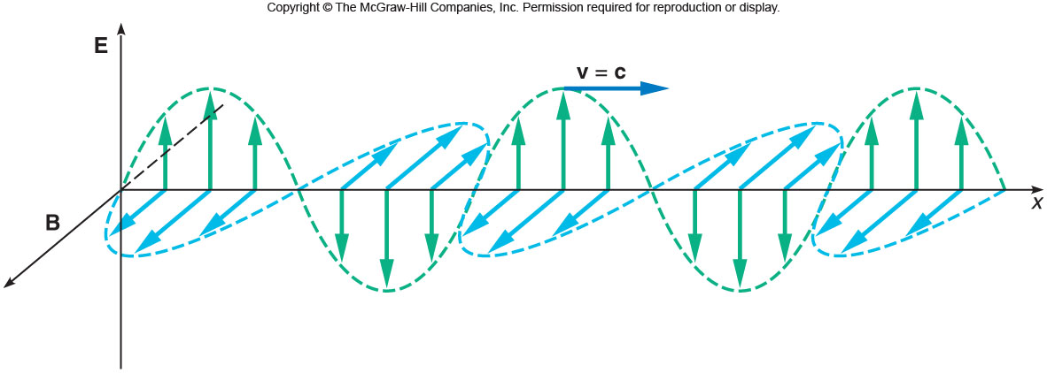
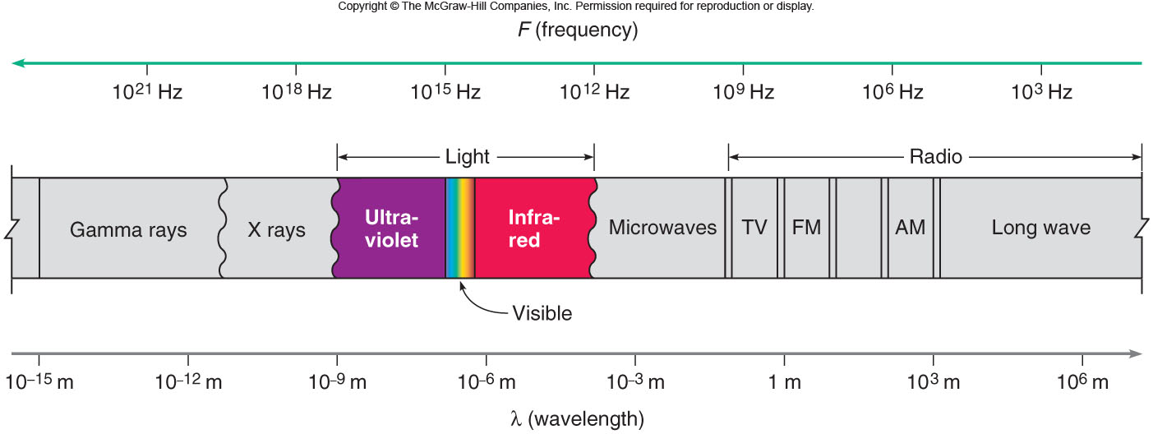
Light is an Electromagnetic wave
The changing magnetic field (B) creates an electric field (E) that fluctuates in time. It propagates at the speed, c = 3 x 10⁸ m/s.

Slide 3
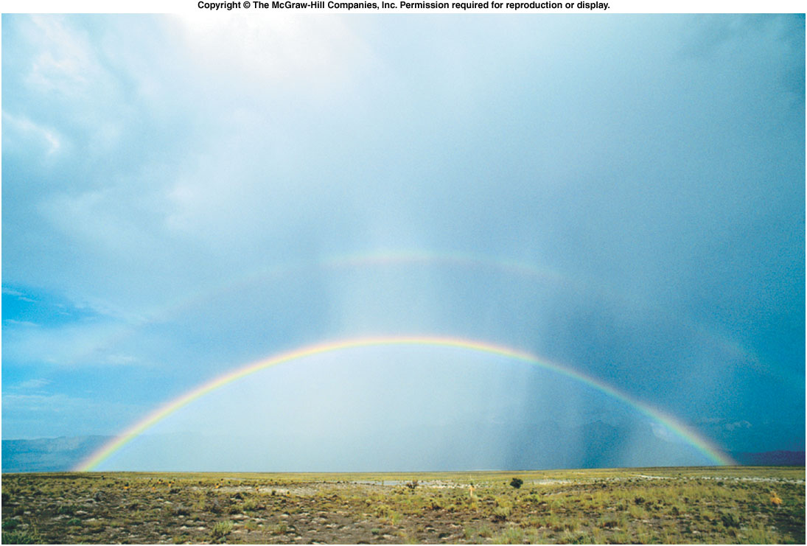
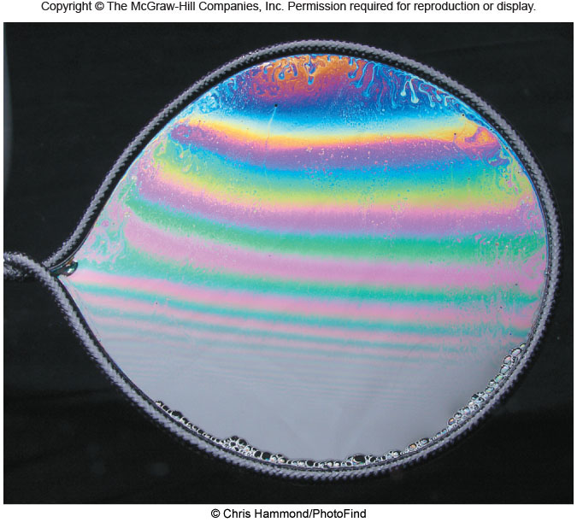
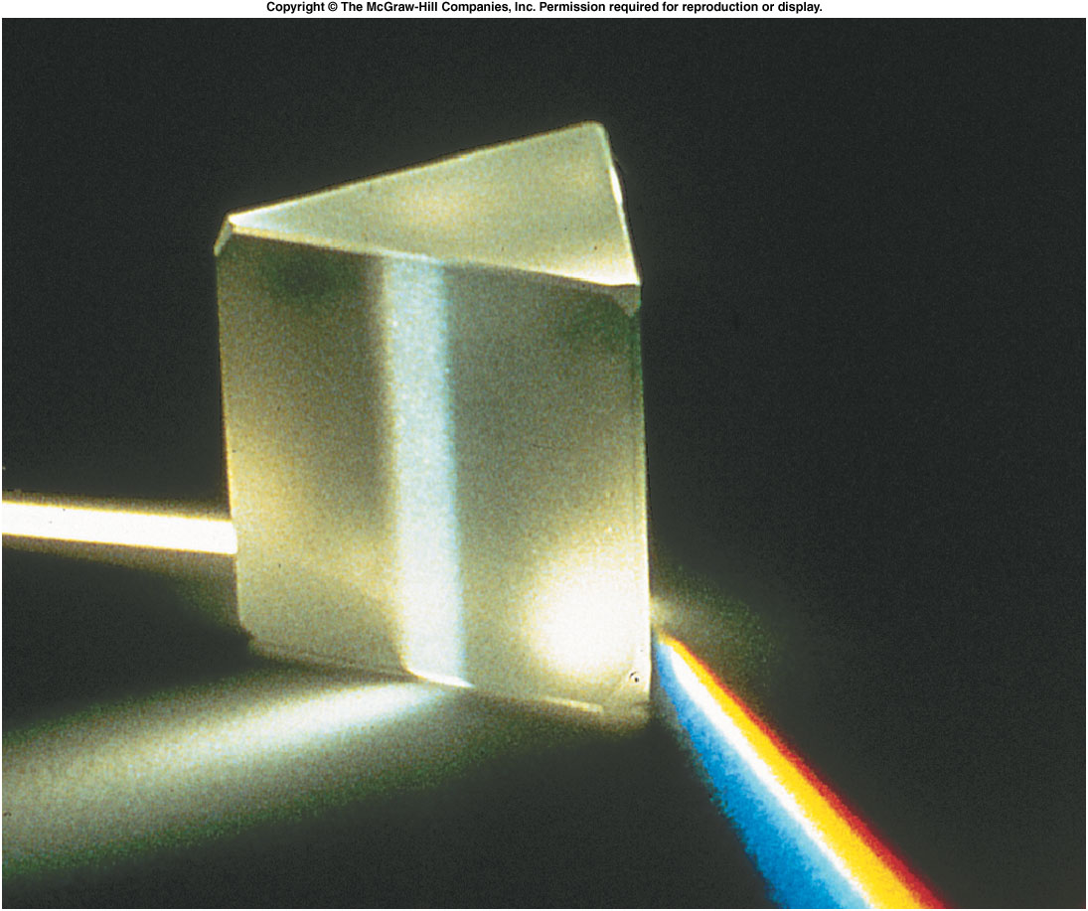
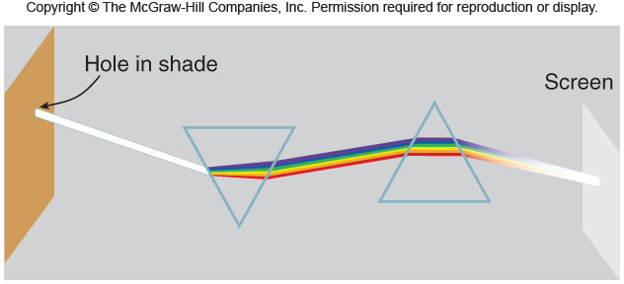
Light and Color

Slide 4
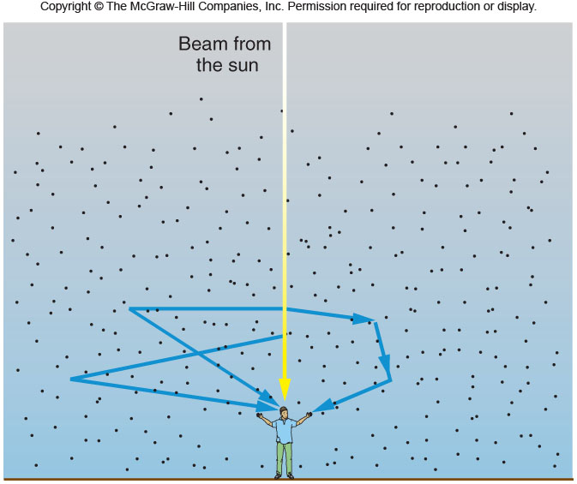
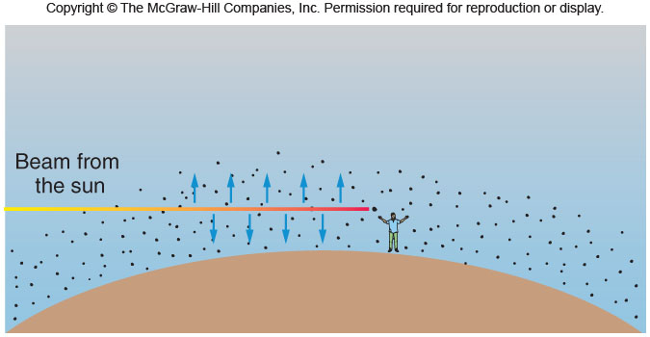
Blue Skies and Red Sunsets

Slide 5
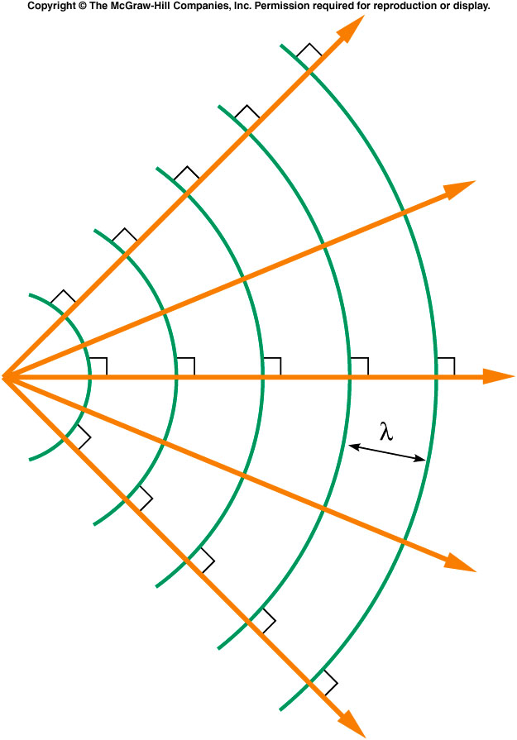
How Are Light Rays Related to wavefronts?
Wavefronts are perpendicular to the rays.

Slide 6
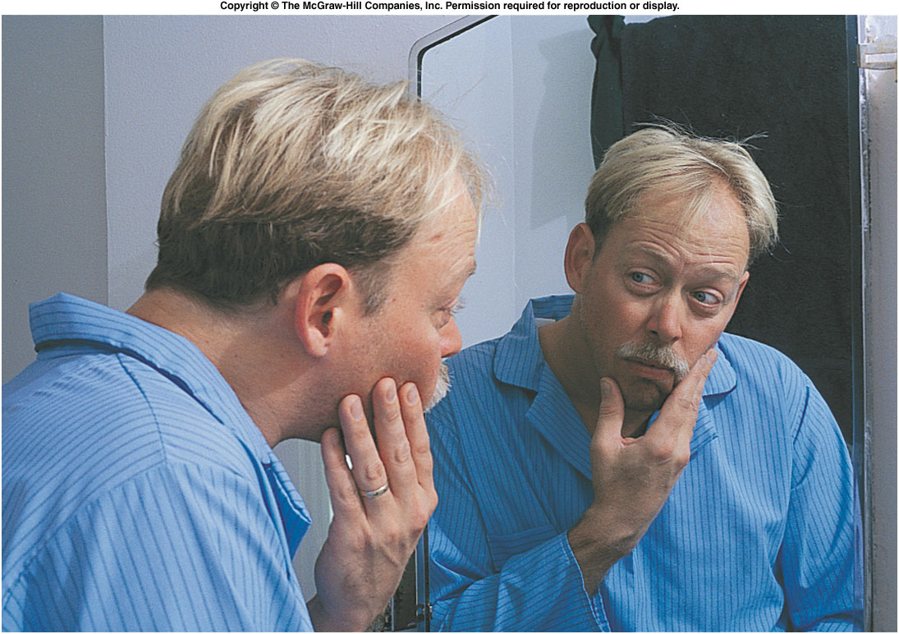
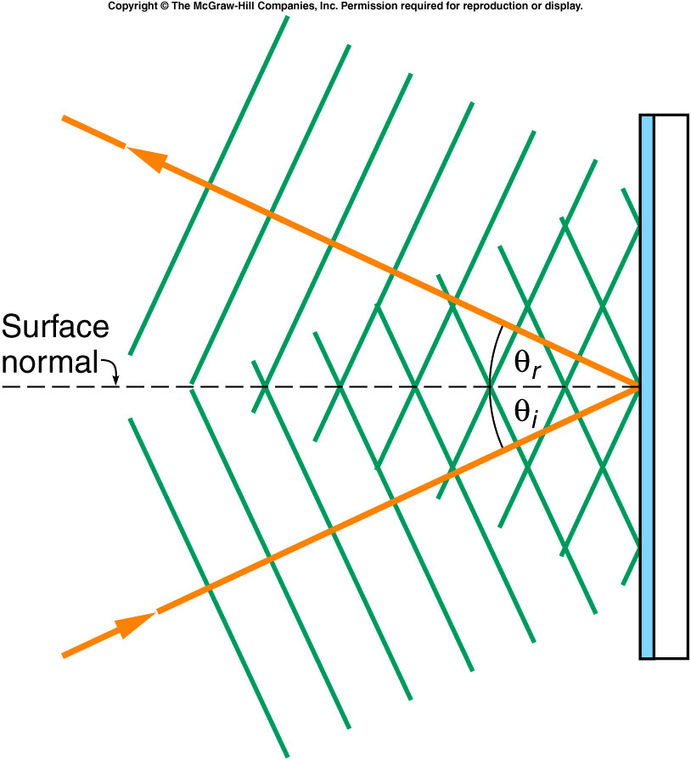
How Does an Image Formed in a Plane Mirror?
Reflection
The Law of Reflection:
The angle of incidence = The angle of reflection.

Slide 7
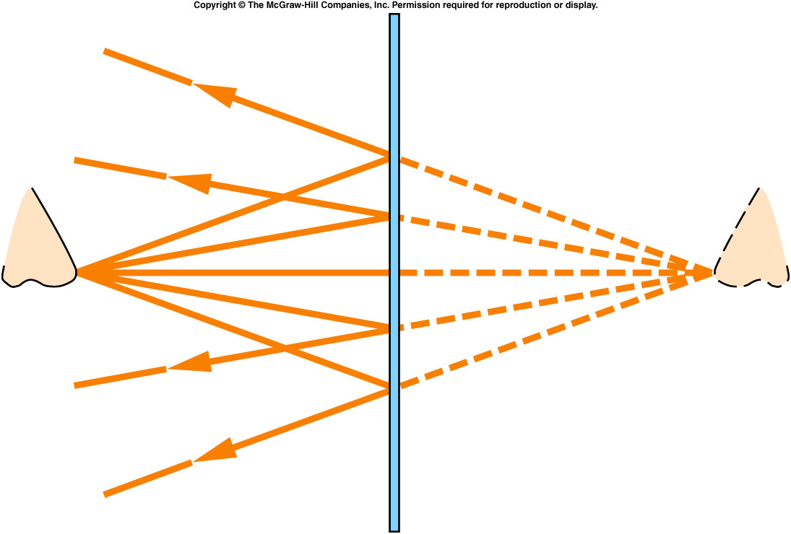
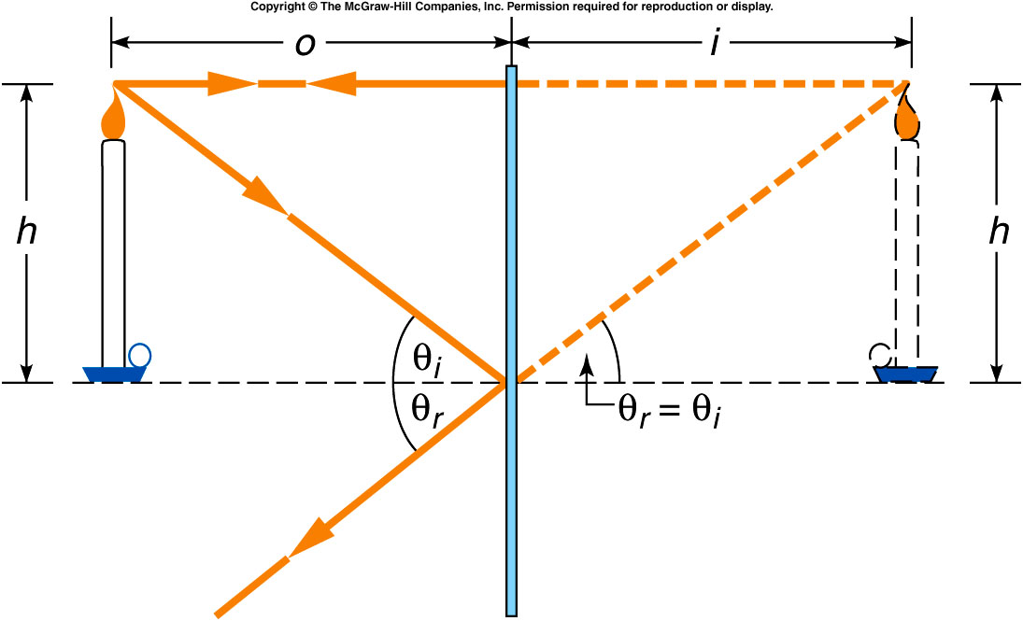
How Are Images Formed by a Plane Mirror?

Slide 8
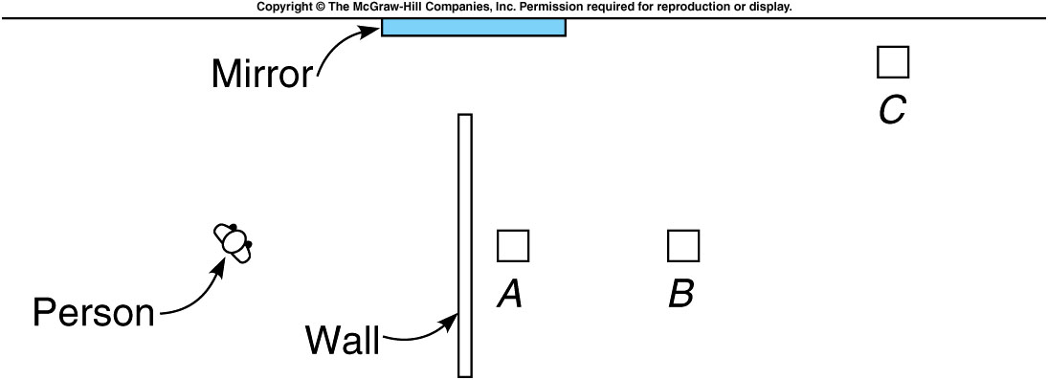
Q7

Slide 9
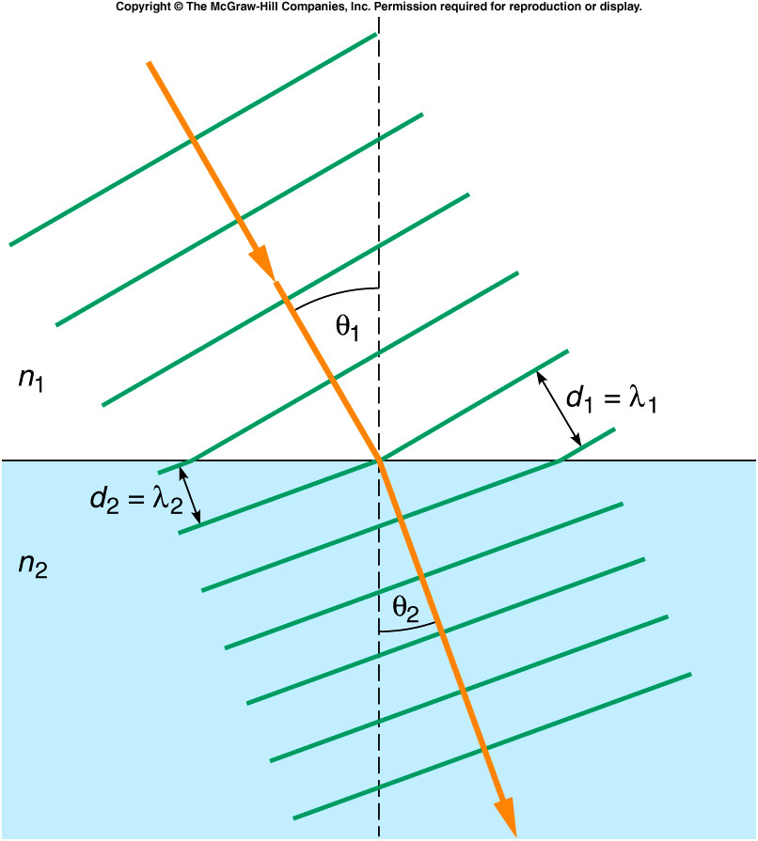
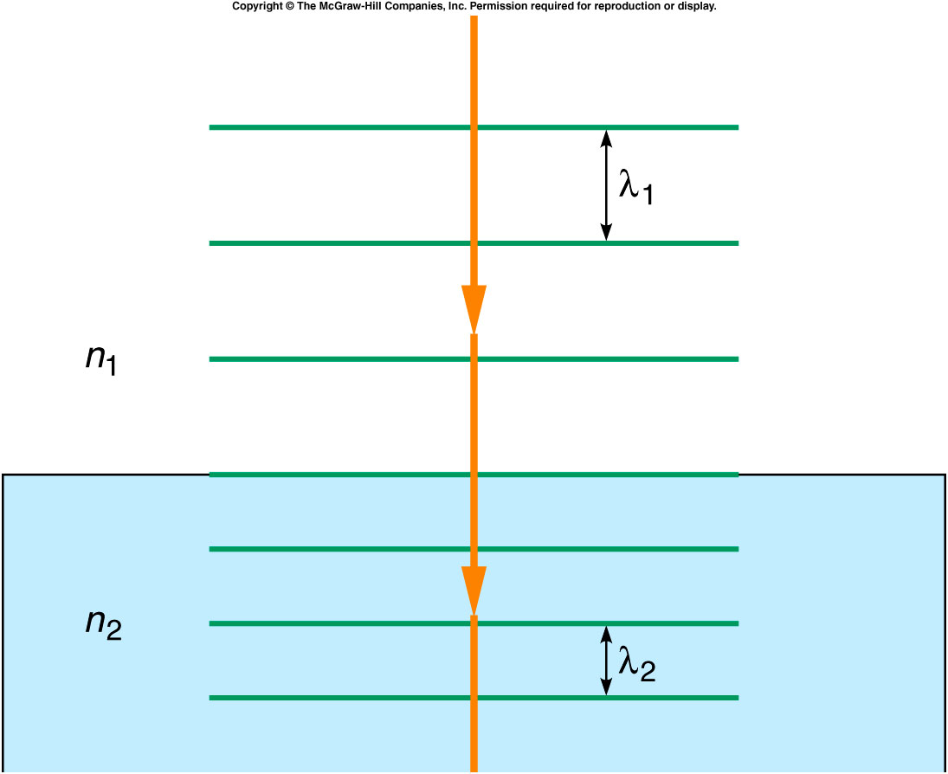
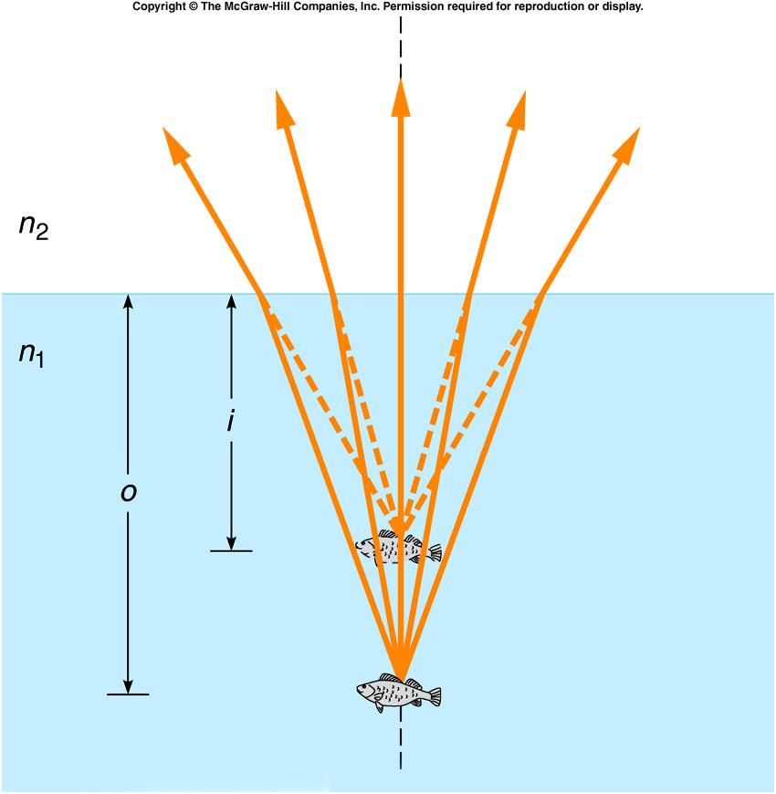
Refraction of Light
Apparent Depth of Fish Is Smaller Than Actual Depth Due to Refraction

Slide 10
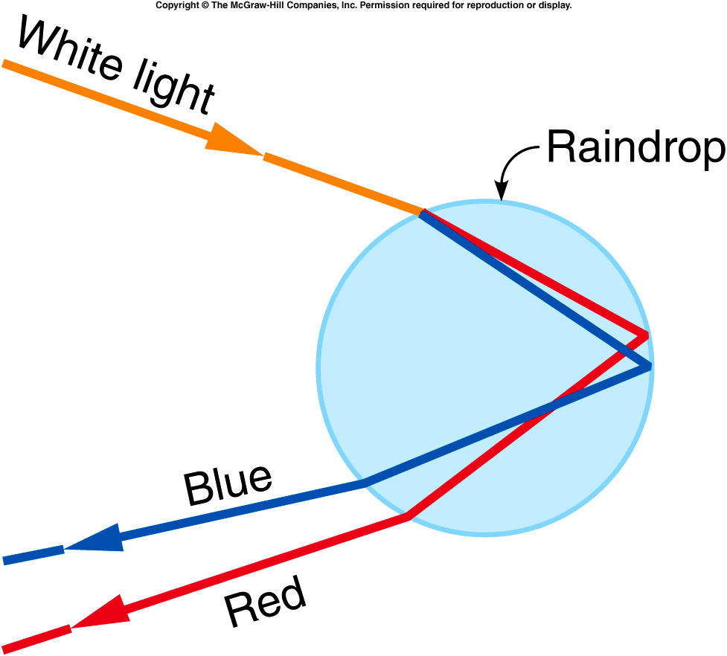
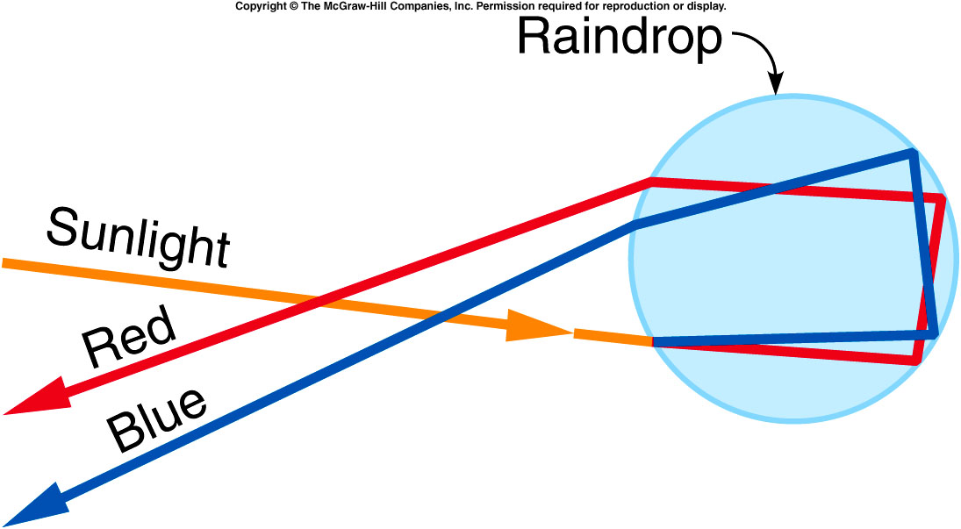
Rainbow
Water droplet disperses the light into colors.
Primary Rainbow
Colors are reversed and less intense.

Slide 11
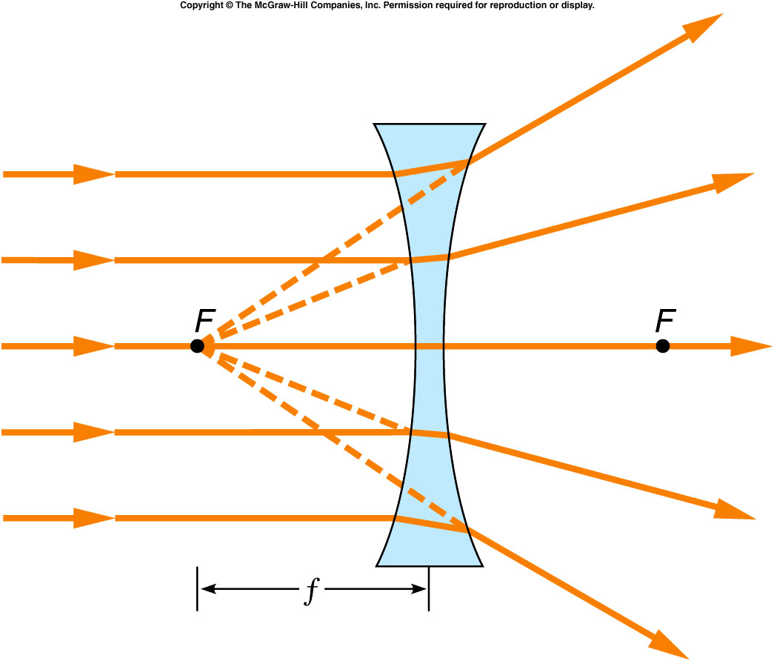
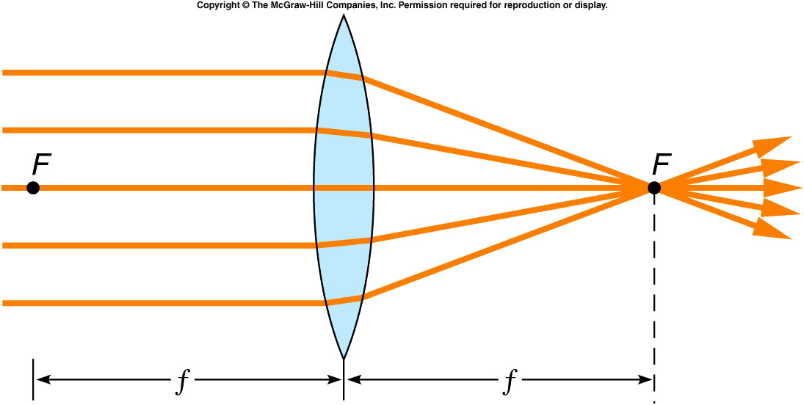
Focal Point (F) and Focal Length (f) of lenses
Converging or Positive lens
Diverging or Negative lens
Power of a lens =1/f

Slide 12
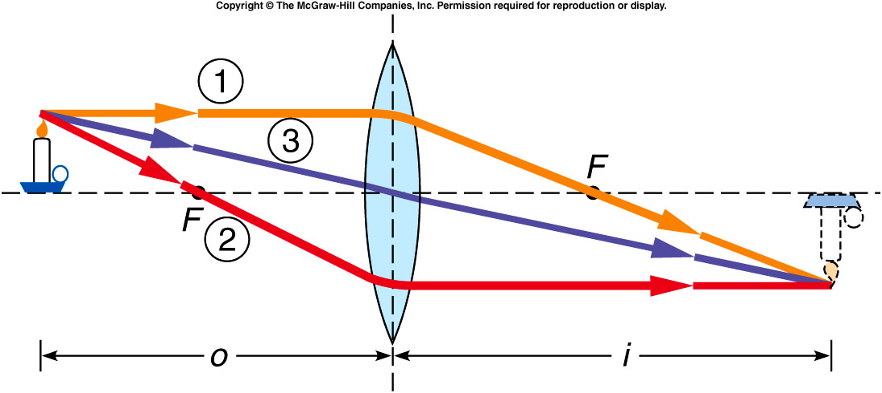
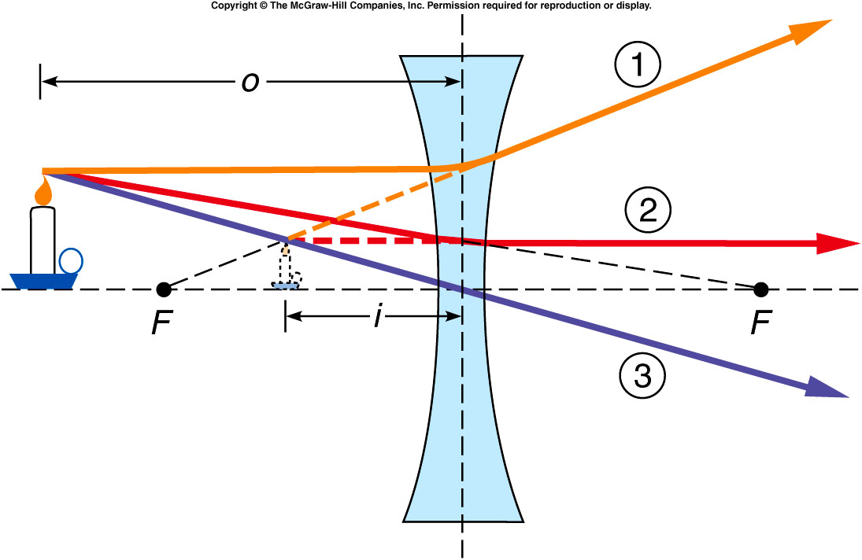
Ray Diagram

Slide 13
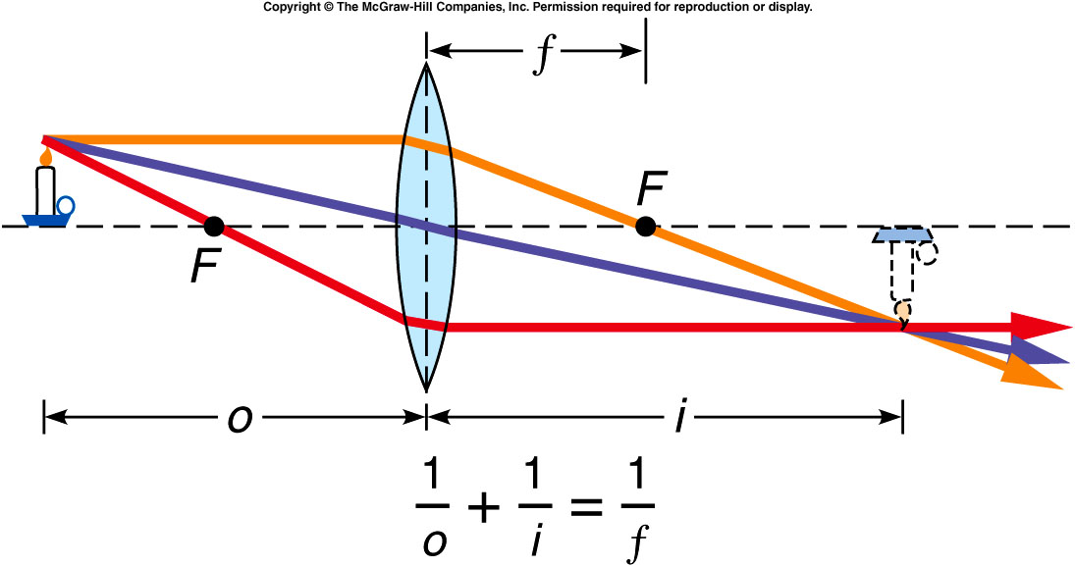
Lens Equation and Magnification, m
E6: A positive lens has a focal length of 12 cm. An object is located at a distance of 3 cm from the lens.
How far from the lens is the image?
State three properties of the image? (real/virtual, erect/inverted, magnified/reduced)
Draw a ray diagram and show the image formation.

Slide 14
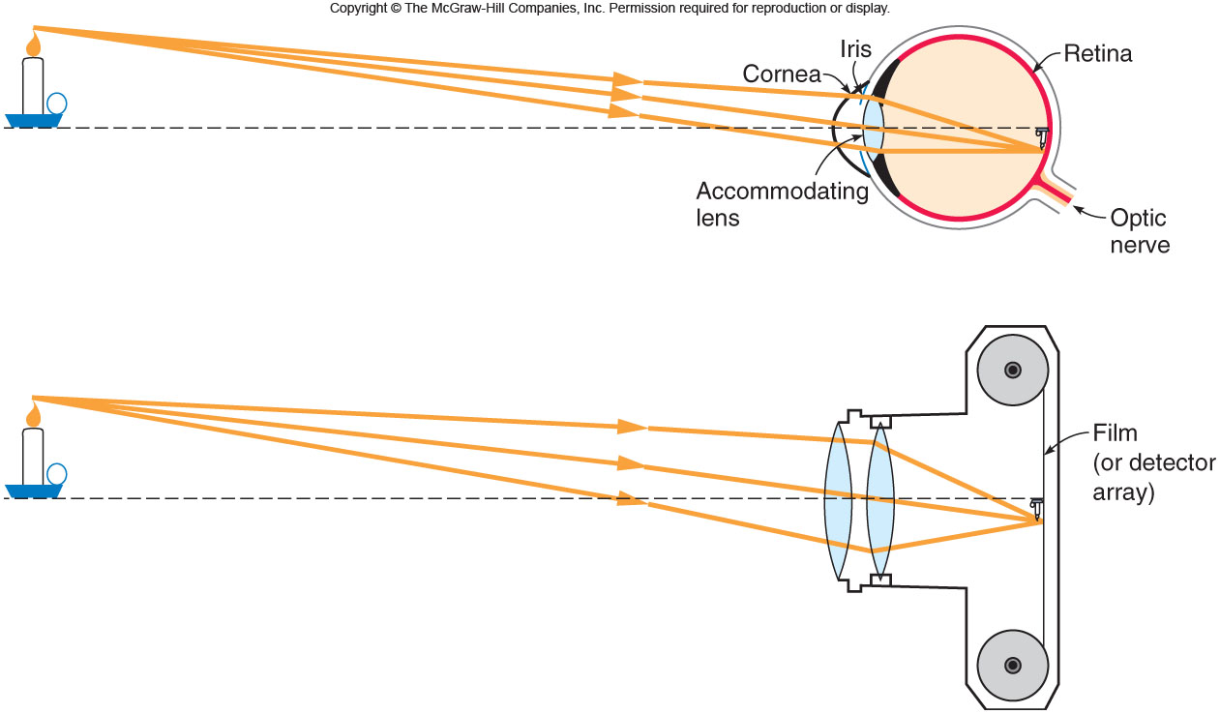
Optical Instruments
Human eye
Camera
Eyeglasses
Microscope
Telescope

Slide 15
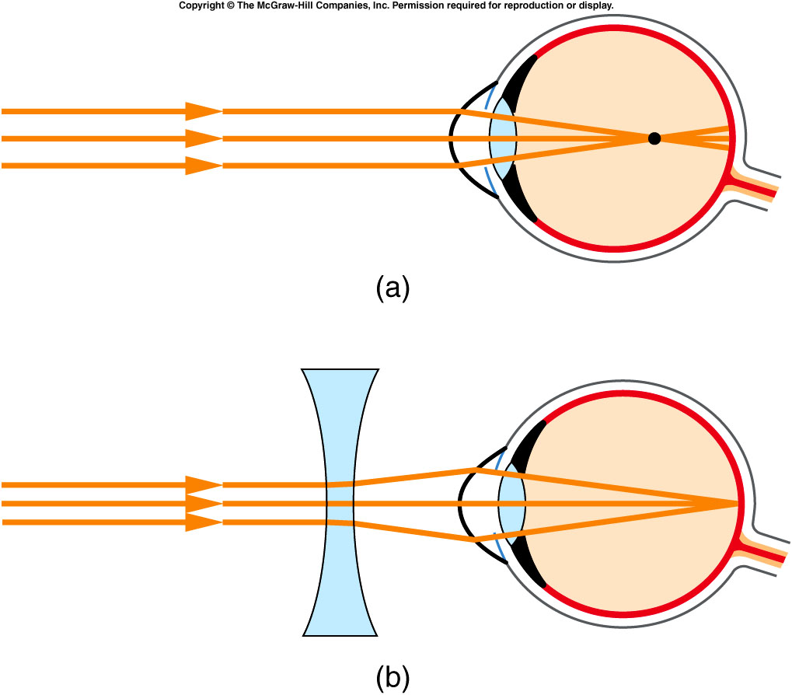
Human Eye: Vision Defects
Nearsightedness: can see only nearby objects clearly. Correction is made with a Diverging lens or negative lens.
Farsightedness: can see only far objects clearly. Correction is made with a converging lens or positive lens.
Nearsighted Eye, Myopia
Farsighted Eye,Hyperobia

Slide 16
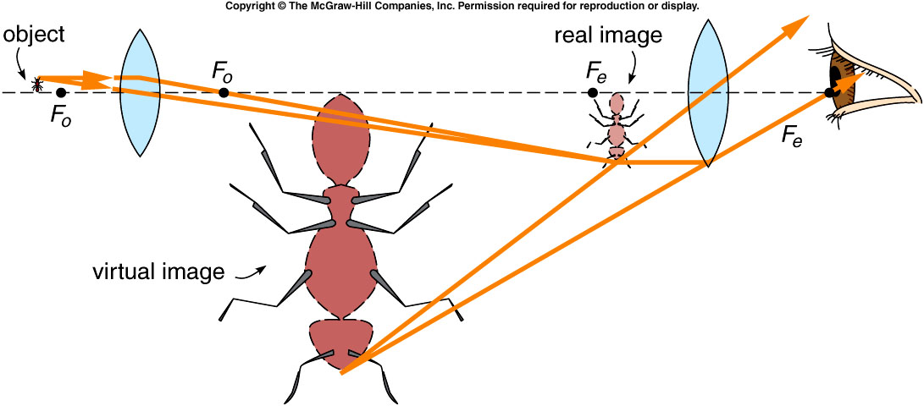
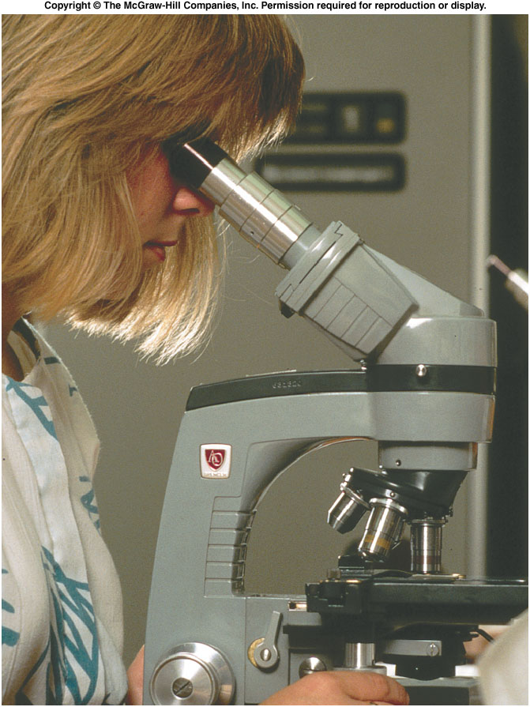
Microscope
Used to view small things nearby.
Consists of two positive lenses, objective and eyepiece.
Final image is magnified and inverted.
A laboratory microscope has 3 or 4 objective lenses.

Slide 17
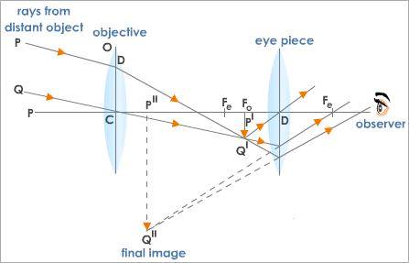
Astronomical Telescope
Used to view things far away.
Consists of two positive lenses, objective and eyepiece.
Final image is magnified and inverted.

Slide 18
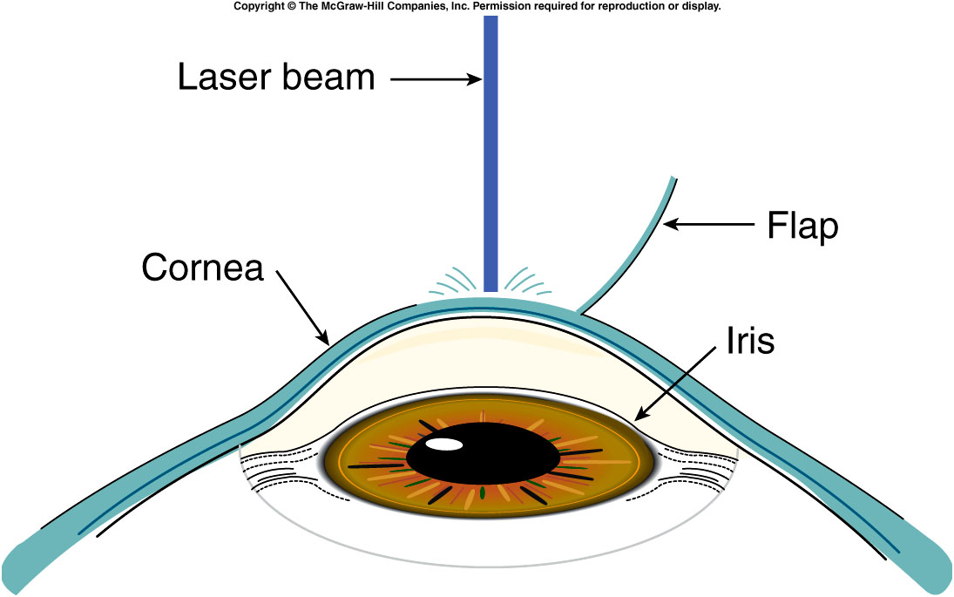
LASIK: Reading assignment

