Slide 1
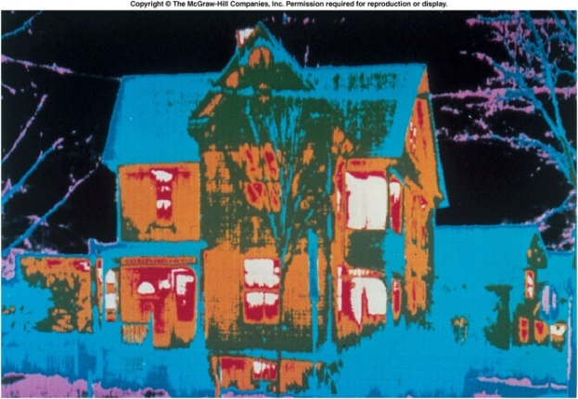
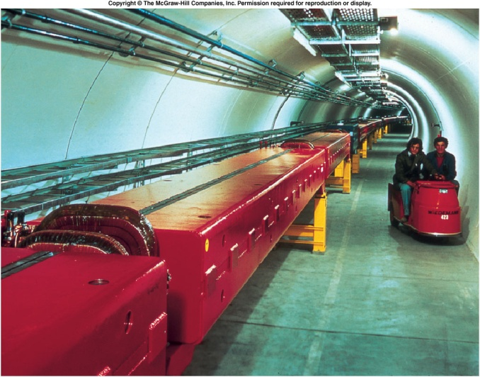
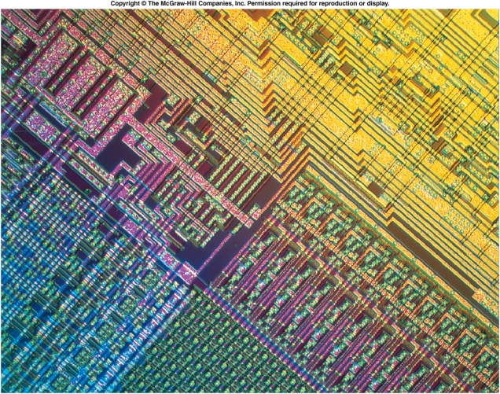
Physics
Physics is the study of the laws of nature that govern the behaviour of the universe, from the very smallest scales of sub-atomic particles to the very largest in cosmology. It applies these laws to the solution of practical problems and to the development of new technologies.
Physics can be divided into classical physics and modern physics.
Classical Physics: Mechanics, Thermodynamics, Electricity and Magnetism, and Optics.
Modern Physics: Atomic physics, Nuclear Physics, Particle physics, and Condensed-Matter physics.
http://davidbrin.wordpress.com/2011/01/04/which-science-is-the-most-fundamental/

Slide 2
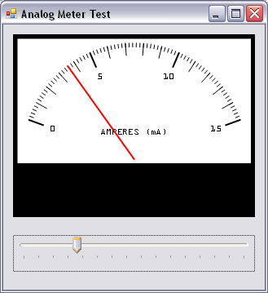
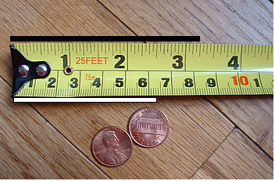
Measurements
How many centimeters are there in a foot? (1 inch = 2.54 cm)
Measure the length and width of a table and calculate its surface area.

Slide 3
Units
A physical quantity is a quantity that can be used in the mathematical equations of science and technology.
A unit is a particular physical quantity, defined and adopted by convention, with which other particular quantities of the same kind are compared to express their value.
SI base units:
SI derived units:
SI prefixes:
Fundamental physical constants:
http://physics.nist.gov/cuu/Units/index.html

Slide 4
Significant Figures, Scientific Notation, and Metric Prefixes
Light and Sound: Discussion
What is the speed of sound and light?
Speed of sound in air (at 20⁰C) = 343 m/s or 767 MPH
Speed of light = 299792458 m/s
Mean Earth-Sun Distance = 149600000000 m.
How much time it take for the sunlight to reach earth?
Why study everyday phenomena?

Slide 5
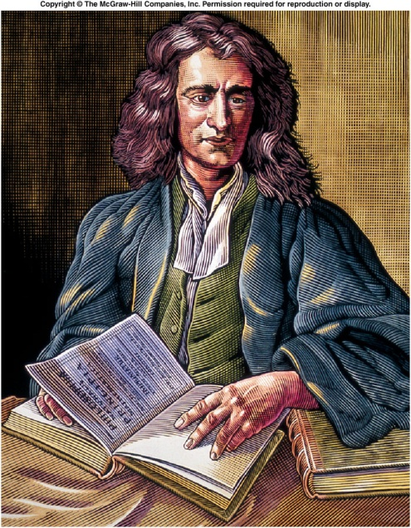
Newtonian Revolution
The study of Physics begins with Newtonian mechanics.
Mechanics is the branch of physics that focuses on the motion of objects and the forces that cause the motion to change.
There are two parts to mechanics: Kinematics and Dynamics.
Kinematics deals with the concepts that are needed to describe motion, without any reference to forces. Chapter 2: Describing Motion
Chapter 3: Falling Objects and Projectile Motion
Dynamics deals with the effect that forces have on motion Chapter 4: Newton’s Laws-Explaining motion

Slide 6
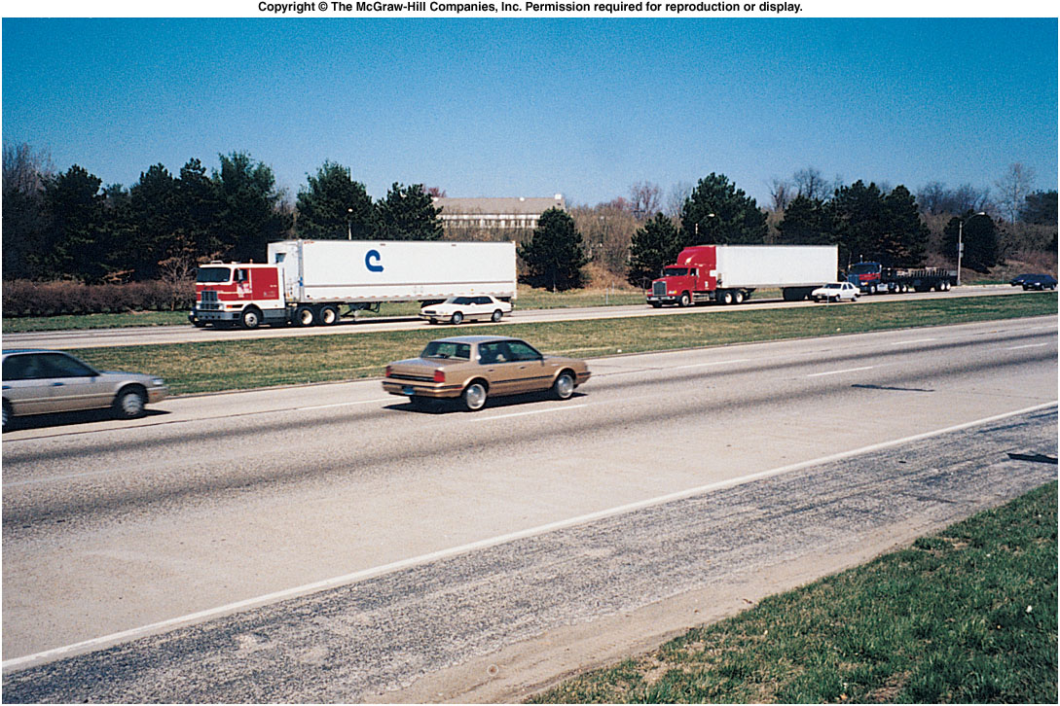
Chapter 2 Describing Motion
Speed: Average and Instantaneous
Velocity
Acceleration
Graphing motion

Slide 7
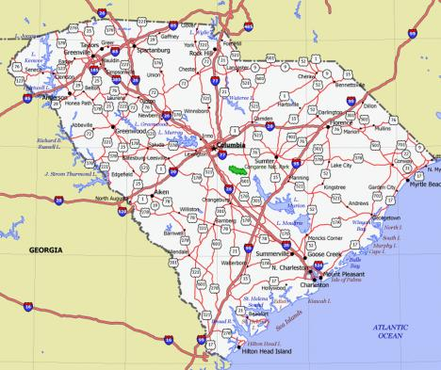
Average Speed
Average speed equals the distance traveled divided by the time of travel.
Unit: MPH, kmPH, m/s
Speed calculation:

Slide 8
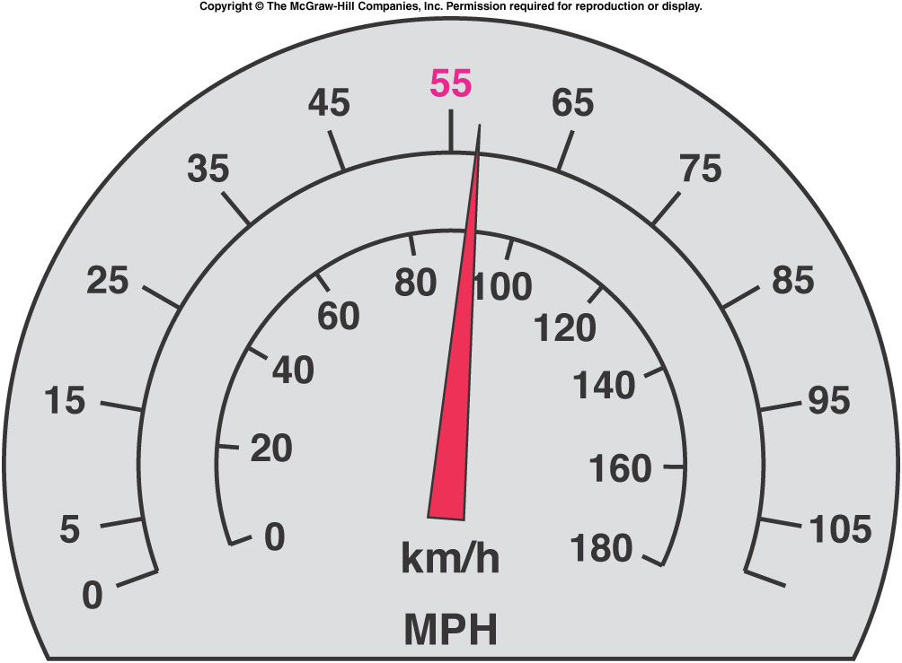
Instantaneous Speed
http://www.physicsclassroom.com/mmedia/kinema/trip.cfm
Unit Conversion:

Slide 9
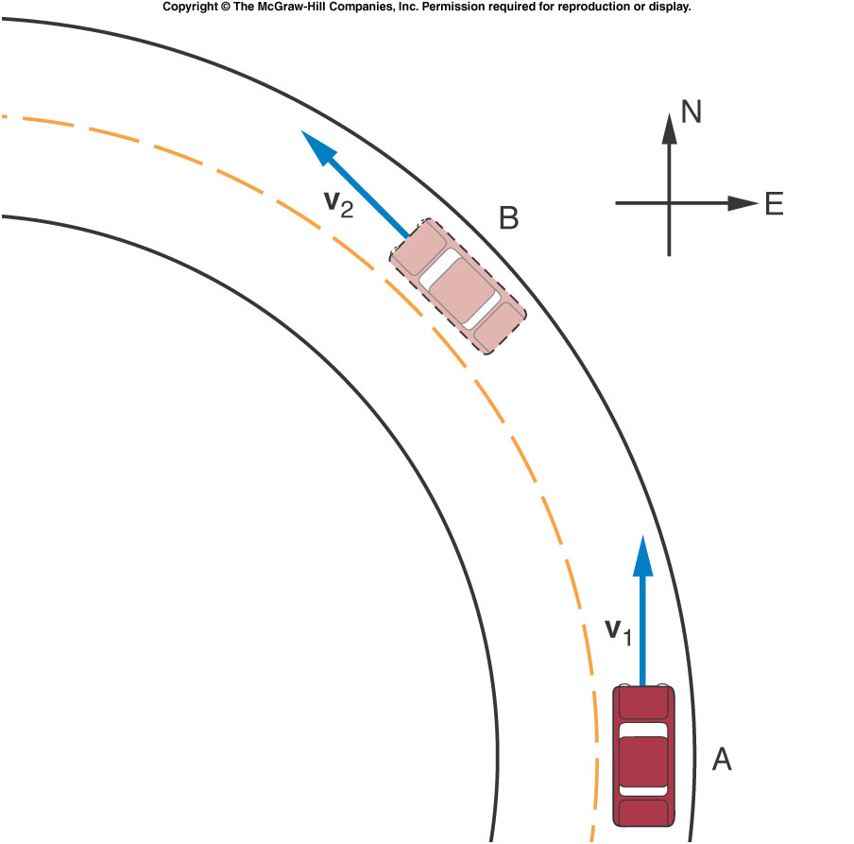
Velocity = Speed with Direction
Velocity can be changed by changing speed or direction or both.

Slide 10
Vectors and Scalars
Physics deals with many physical quantities, which are divided into scalars and vectors.
A scalar quantity is one that can be described by a single number (including any units) giving its size or magnitude.
Examples: Distance, Time, volume, mass, temperature, and density.
A quantity that deals with both magnitude and direction is called a vector quantity.
Examples: Displacement, Force, weight, and velocity.

Slide 11
Distance and Displacement
Starting from origin, O a person walks 90-m east, then turns around and walks 40-m west.
Q: What is the total walked distance? A: 130-m
Q: What is the displacement? A: 50-m, due east.

Slide 12
Scalars and Vectors
Scalar | Vector
Distance (m) | Displacement (m)
Speed (m/s) | Velocity (m/s)
Mass (kg) | Weight (N)

Slide 13
Acceleration
Acceleration is the rate at which velocity changes.
Acceleration is a vector quantity.
Unit of acceleration: m/s²
Acceleration of a sports car:

Slide 14
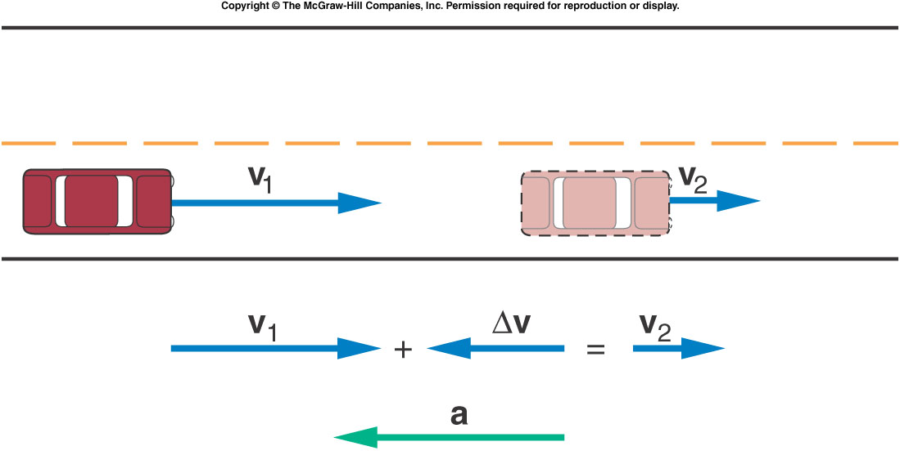
Deceleration or Negative Acceleration
An object speeds up when the acceleration and velocity vectors point in the same direction.
Whenever the acceleration and velocity vectors have opposite directions, the object slows down and is said to be “decelerating.”
V₁ = 20 m/s due east
V₂ = 10 m/s due east
t = 2.0 s a = ?

Slide 15
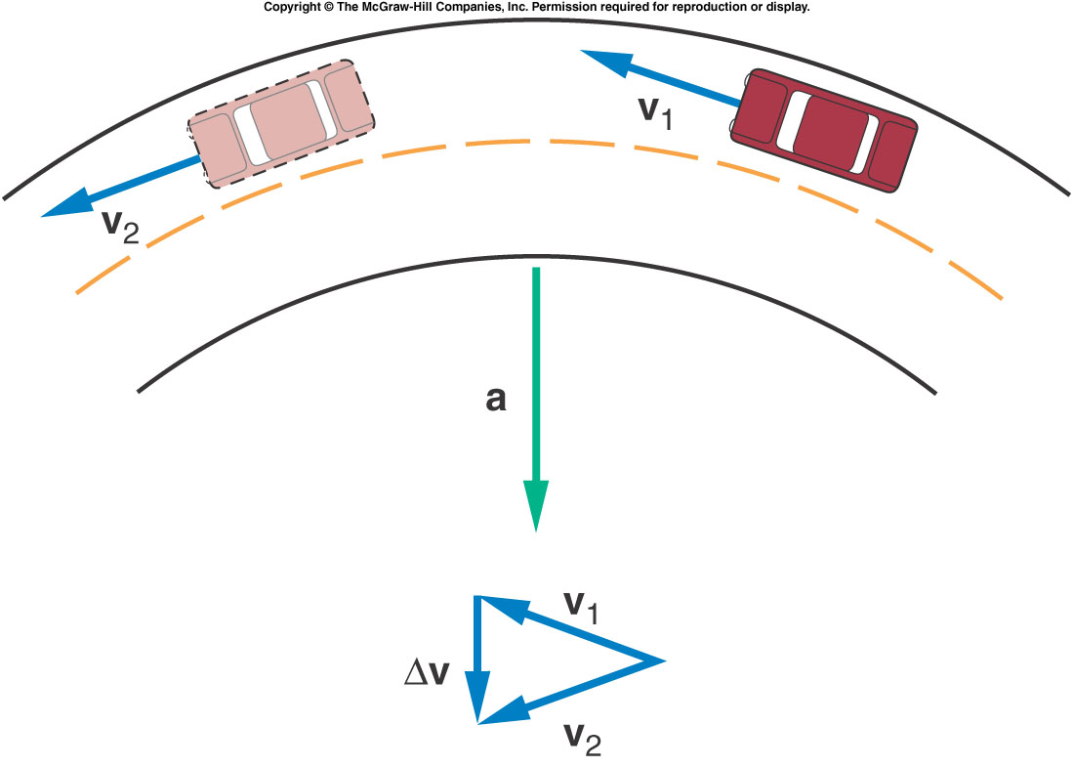
Can a Car Be Accelerating When Its Speed Is Constant?

Slide 16
Exercises and Problems
A person covers a distance of 320 miles in a travel time of 8 hours. What is the average speed for this trip?
A car travels with an average speed of 55 miles/hr. What is this speed in m/s?
The velocity of a car moving in a straight line increases from 8 m/s to 22 m/s in 7 seconds. What is the average acceleration of the car during this period?

