Slide 1
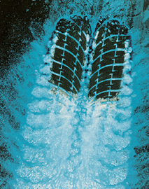
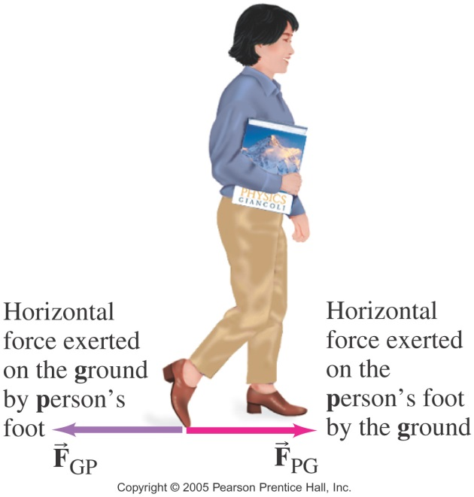
Static and Kinetic Frictional Forces Read 5.1 OpenStax
There are situations where friction helps us and at other times it is a hindrance.
Advantages of friction:
Disadvantages of friction: wear and tear & energy loss.

Slide 2
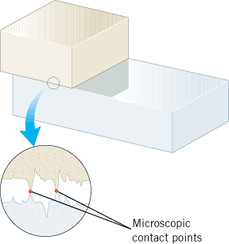
Microscopic view of Frictional Forces

Slide 3
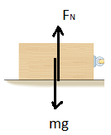
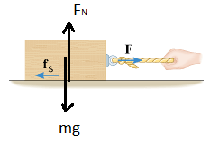
Frictional force VERSUS Applied force

Slide 4
Frictional force VERSUS Applied force

Slide 5
Static Frictional Force
The magnitude f_{s} of the static frictional force can have any value from zero up to a maximum value of f_{s}^{MAX}, depending on the applied force.
f_{s} ≤ f_{s}^{MAX}
f_{s}^{MAX} = μ _{s}F_{N}

Slide 6
Kinetic Frictional Force
The magnitude f_{k} of the kinetic frictional force is given by,

Slide 7
Coefficients of Friction

Slide 8
P4, Chap 5, OpenStax
4. Suppose you have a 120-kg wooden crate resting on a wood floor. (a) What maximum force can you exert horizontally on the crate without moving it? (b) If you continue to exert this force once the crate starts to slip, what will its acceleration then be?

Slide 9
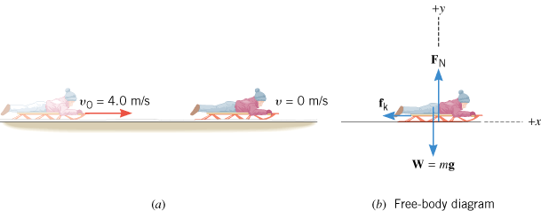
EXAMPLE on Sled Riding
A sled is traveling at 4.00 m/s along a horizontal stretch of snow, as Figure 4.23a illustrates. The coefficient of kinetic friction is μ_{k} = 0.0500. How far does the sled go before stopping?

Slide 10
Friction and FBD
A child on a sled (total mass = 35.0-kg) is pushed by another child along a horizontal surface at a constant velocity. The pushing force has a magnitude 45.0-N, which is applied at, θ = 26.0⁰ angle as shown below. Frictional force is also present.
a. Draw a free-body diagram for the child-sled system.
b. Determine the coefficient of kinetic friction between the sled and ground.

