Slide 1
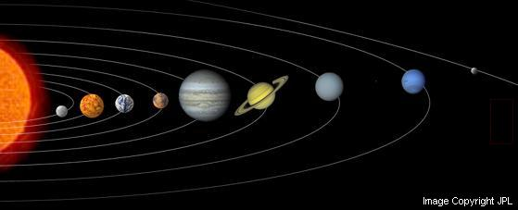
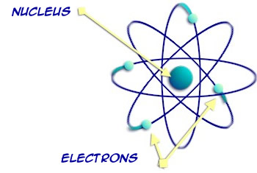
Gravitational Force & Electrostatic Force

Slide 2
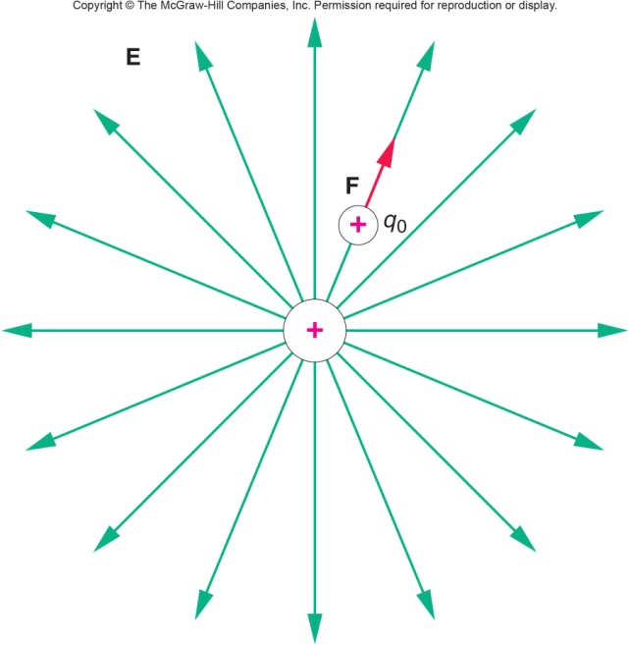
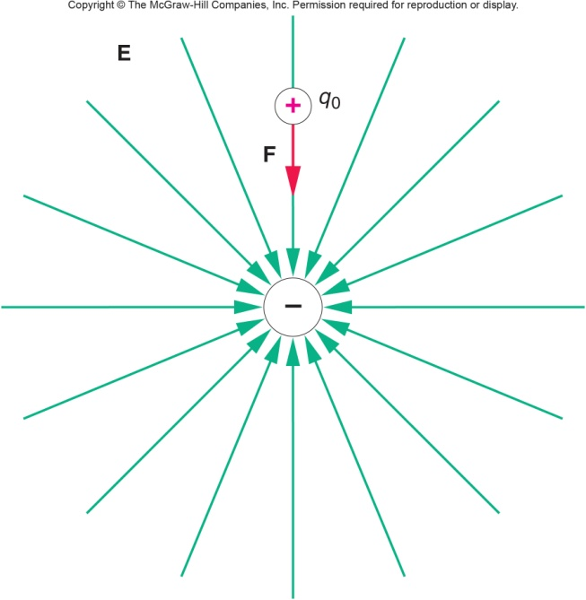
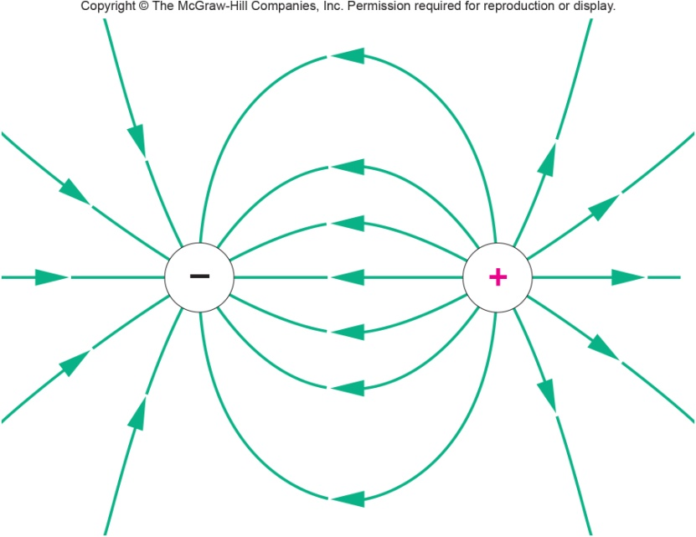
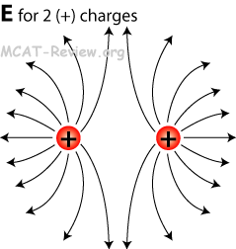
Electric Field Lines

Slide 3
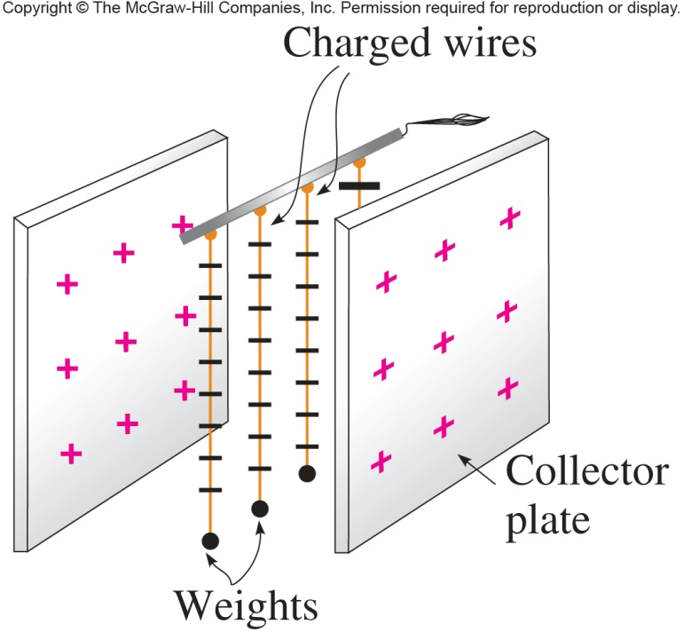
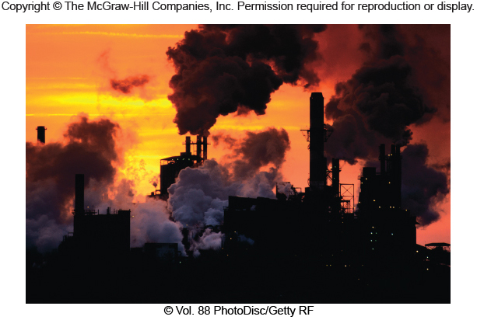
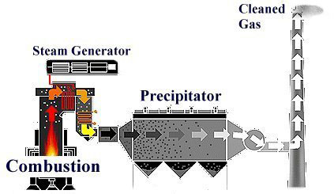
Applications of electrostatics
a. Electrostatic Precipitator (p243, Text)
b. Photocopying Machine
http://www.youtube.com/watch?v=HFxo4j1EWsA&list=PL77E87113C3F4C5B7
http://indianapublicmedia.org/amomentofscience/photocopying-machines-work/
http://www.neundorfer.com/knowledge_base/electrostatic_precipitators.aspx

Slide 4
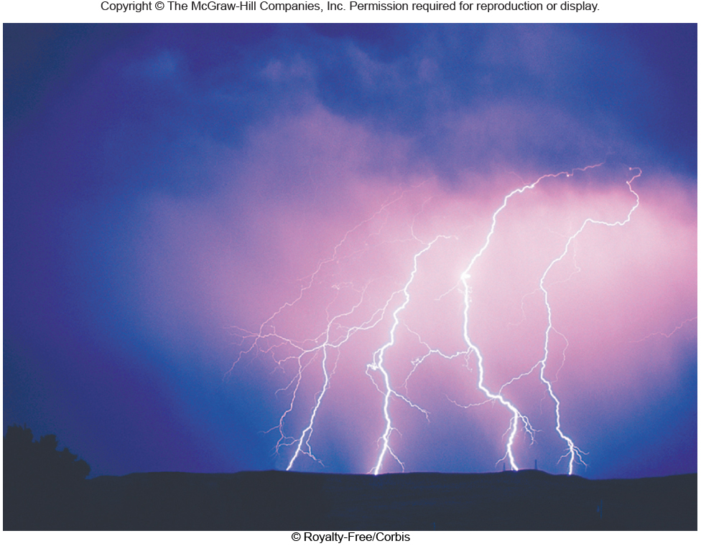
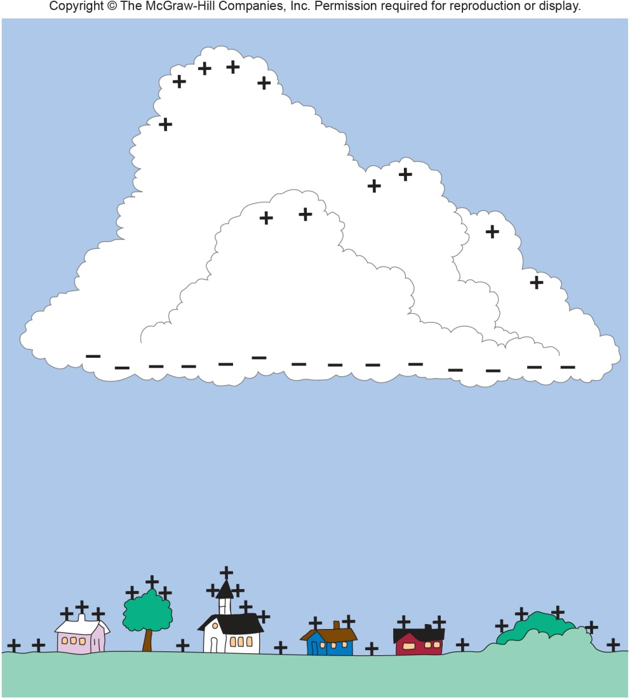
Applications of electrostatics Lightning (p252, Text)

