Slide 1
CH-4: Newton’s Laws: Explaining Motion
1.Brief History
Aristotle (384-322 B.C)
Galileo Galilei (1564-1642)
Isaac Newton (1642-1727)
2.Newton’s laws of motion: 1st law, 2nd law, 3rd law
3.Applications of Newton’s laws

Slide 2
Aristotle (384-322 B.C)
Believed that a force had to act for an object to move.
Did not distinguish acceleration from velocity.
Believed that a heavy object would fall more quickly than a lighter object.
Earth-centered model of the solar system.

Slide 3
Galileo Galilei (1564-1642)
Advocated Copernicus’s Sun-centered model of the solar system.
Showed that heavy and light objects fell at the same rate.
Argued that no force is required to maintain motion.
Developed mathematical description of motion.

Slide 4
Isaac Newton (1642-1727)
Laws of motion, can be used to analyze motion of ordinary objects.
Not valid for speeds close to the speed of light. Need to use the theory of relativity.
Not valid for atomic sized particles. Need to use quantum mechanics.

Slide 5
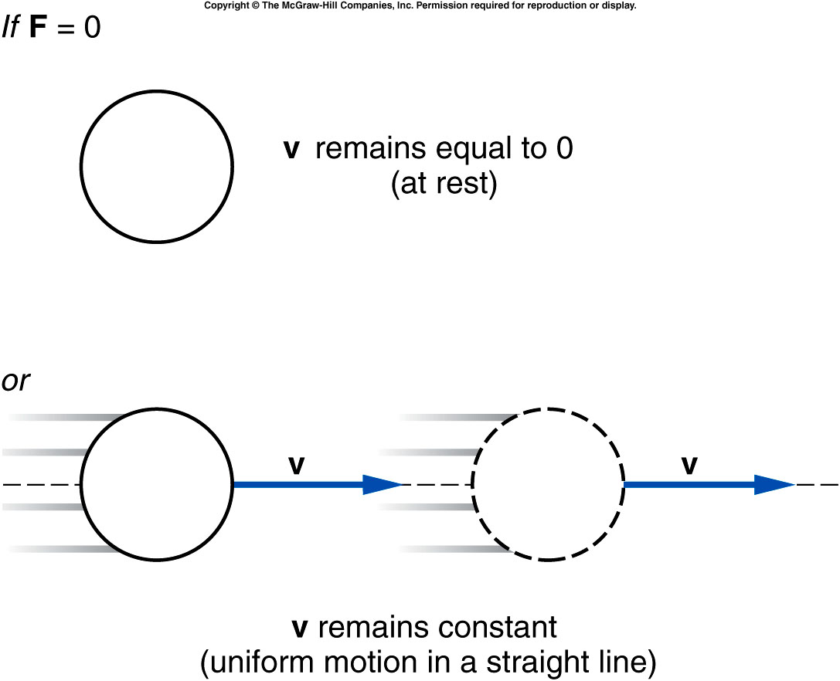
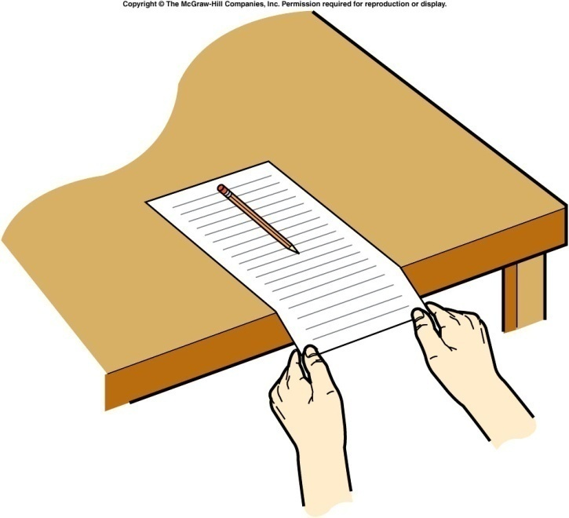
Newton’s First Law of Motion
An object remains in a state of rest or in a state of motion at a constant speed along a straight line, unless it is compelled to change that state by a net force.

Slide 6
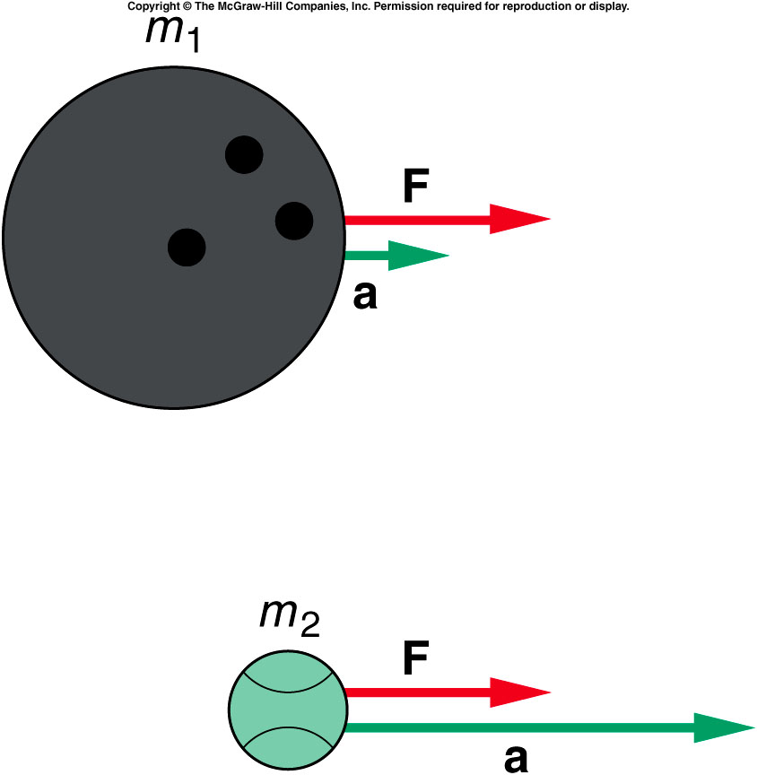
Newton's Second Law of Motion
When a net external force F acts on an object of mass m, the acceleration a that results is directly proportional to the net force and has a magnitude that is inversely proportional to the mass. The direction of the acceleration is the same as the direction of the net force.
SI Unit of Force: kg · m/s² = newton (N)

Slide 7
How do forces add?

Slide 8
Mass and Weight
The weight of an object on the earth is the gravitational force that the earth exerts on the object. The weight always acts downward, toward the center of the earth. On another astronomical body, the weight is the gravitational force exerted on the object by that body.
Weight = Mass x Gravity
SI Unit of Weight: : newton (N)
Ex: How much one may weigh in moon?

Slide 9
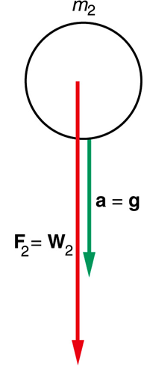
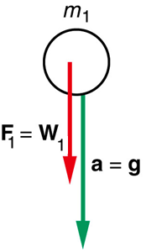
Why is the gravitational acceleration is independent of mass?

Slide 10
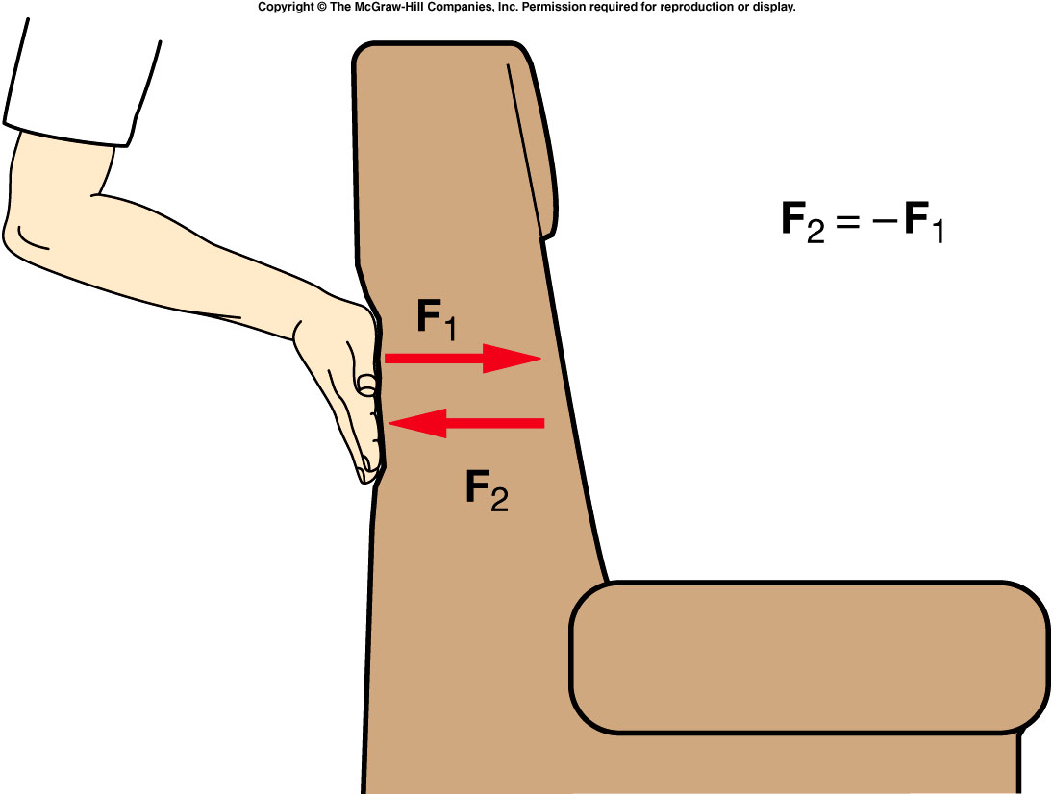
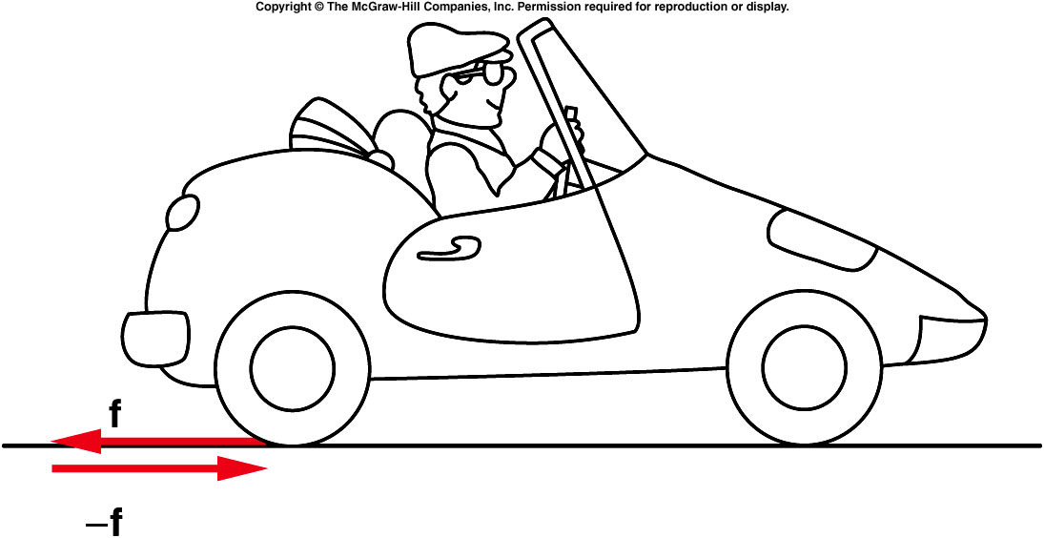
Newton’s Third Law
If object A exerts a force on object B, object B exerts a force on object A that is equal in magnitude but opposite in direction to the force exerted on B.

Slide 11
Examples of Newton's 3rd Law

Slide 12
Identifying Forces
Textbook resting on a table
Object resting on an inclined plane
Mass hanging on a string
Ladder on a wall

Slide 13
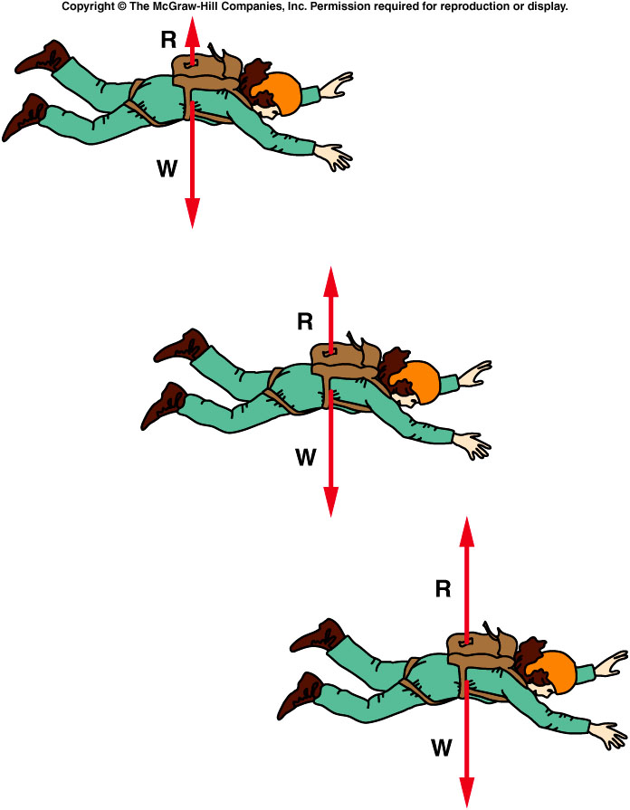
Does a sky diver continue to accelerate?
Q: Just before opening her parachute a skydiver of mass 50 kg reaches terminal velocity. Calculate the force of air resistance.

Slide 14
Motion of Connected Objects
m₁= 10 kg
m₂= 8 kg
What is the acceleration of the two carts?
What is the net force acting on each cart?

