Slide 1
Chapter-3 Falling Objects and Projectile Motion
Overview:
Explore how objects move under the influence of gravity close to the surface of the earth.
Outline:
Acceleration due to gravity
Falling object
Projectile motion

Slide 2
Falling Objects
Why objects fall to the ground when released?
When you drop objects of different sizes and weights, do they reach the ground at the same time? (Click the link below)
http://www.teachersdomain.org/resource/phy03.sci.phys.mfw.galmoon/
Measuring the acceleration due to gravity for Earth: 9.8 m/s²

Slide 3
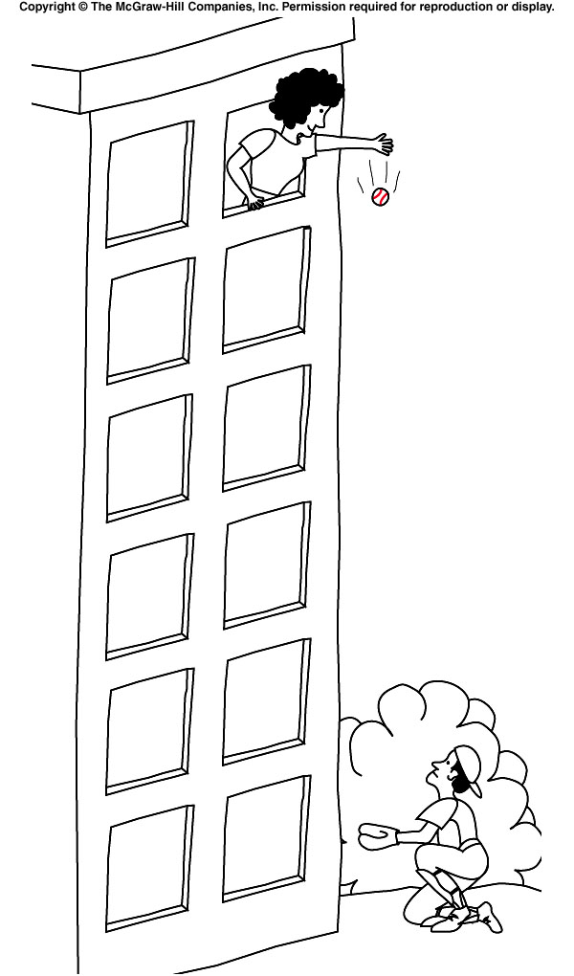
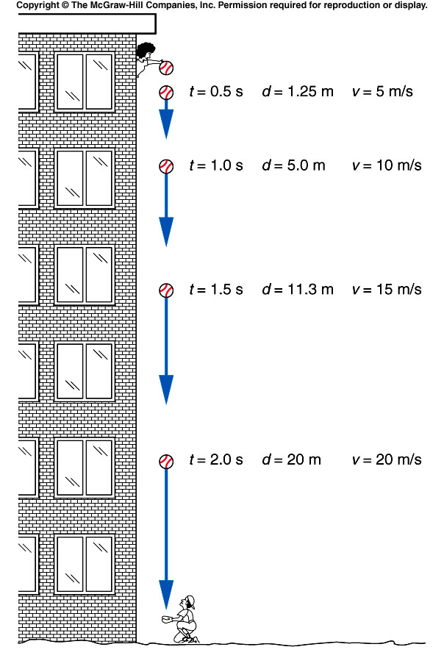
Falling Object: Velocity and Distance

Slide 4
Spread Sheet (Excel) Calculations v=v₀ + at d=v₀t+1/2 at²
Reaction Time Experiment

Slide 5
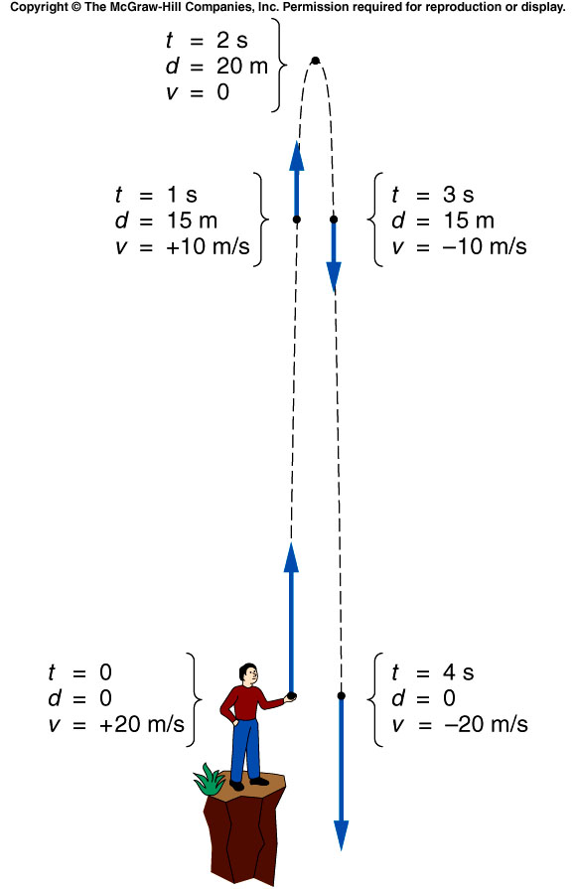
Throwing up a ball: Velocity and Distance
Q: A ball is thrown straight upward and then returns to the Earth. Does the acceleration change during this motion?

Slide 6
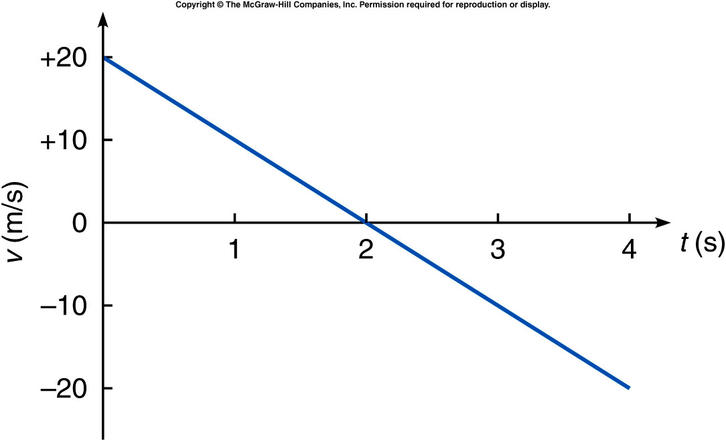
Throwing up a ball: Velocity VS. Time graph

Slide 7
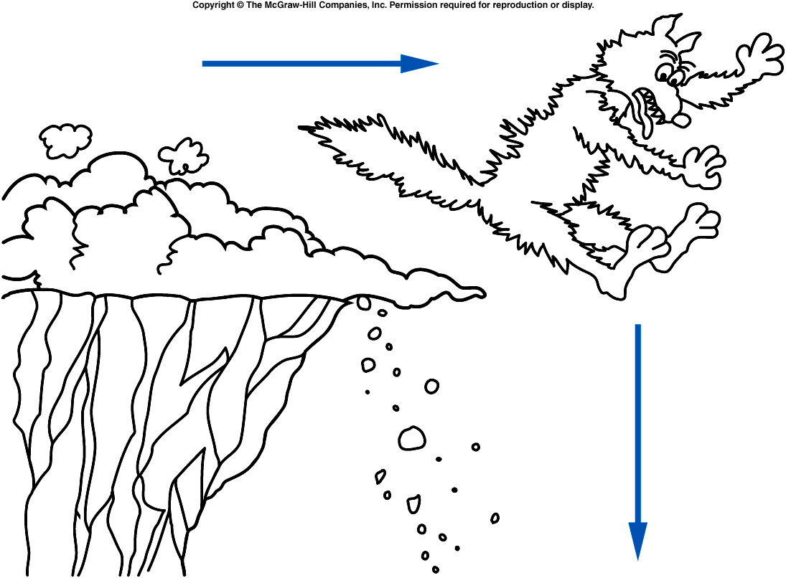
Projectile Motion: A Cartoon Coyote Falling off a Cliff
We need to consider the horizontal and vertical motions separately in projectile motions. Time is the same for both motions.

Slide 8
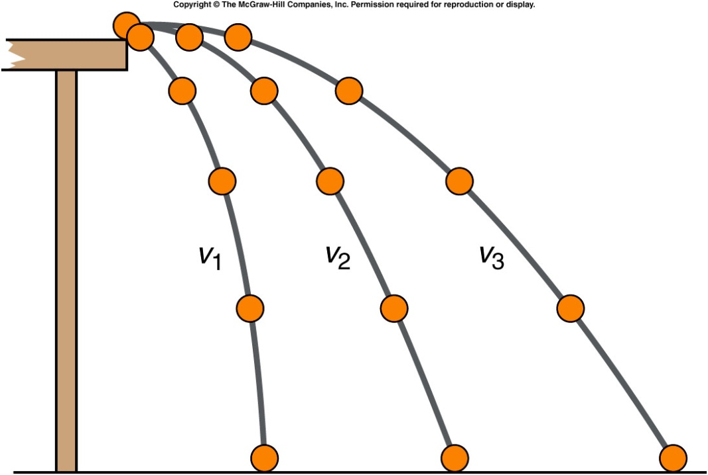
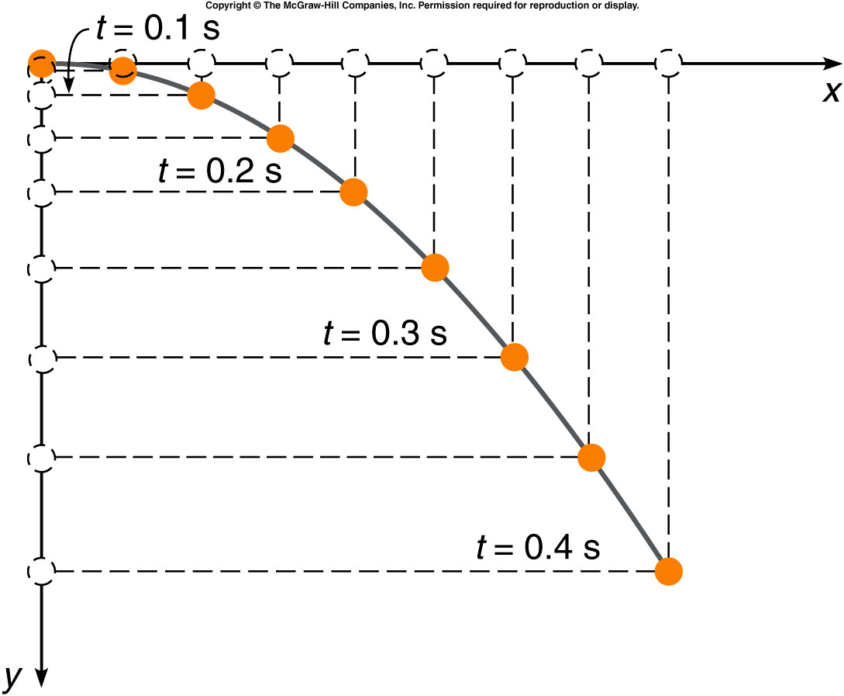
Horizontal and Vertical motions
Q: What determines the time of flight? A: Vertical motion
Practice Sample Exercise in example box 3.4

Slide 9
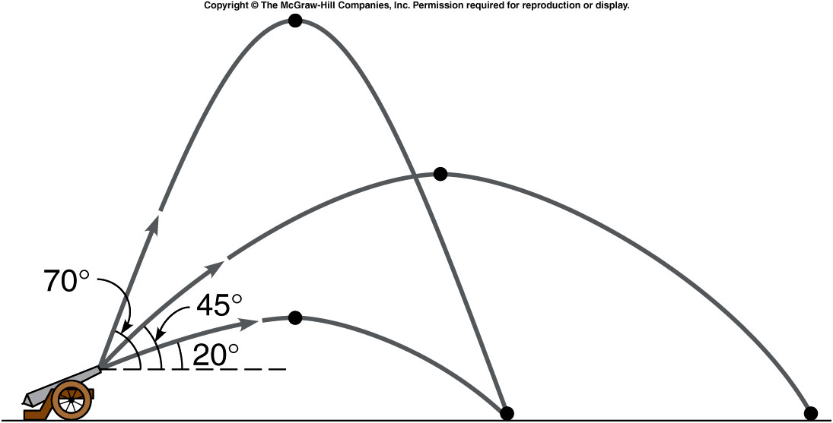
Angle for maximum Range
http://phet.colorado.edu/simulations/sims.php?sim=Projectile_Motion
Go to the above website and determine the angle for maximum range by firing at different angles. ______________

