Slide 1
Magnets and Electromagnetism
Chapter Outline
Magnets, magnetic poles, and magnetic force.
Magnetic effects of electric current.
Magnetic effects of current loops.
Faraday’s law of electromagnetic induction.
Lenz’s law.
Generators.
Transformers.

Slide 2
A collection of magnets

Slide 3
Magnetic Poles
Unlike poles attract each other and Like poles repel each other.

Slide 4
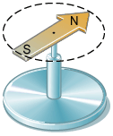
Magnetic Compass
The needle of a compass is a permanent magnet that has a north magnetic pole (N) at one end and a south magnetic pole (S) at the other.

Slide 5
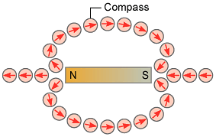
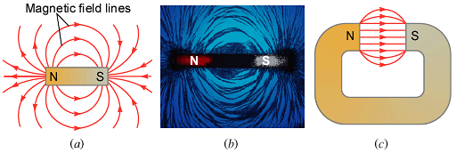
Magnetic Field of Magnets

Slide 6
Magnetic fields and Electric Fields

Slide 7
Magnetic Field of the Earth

Slide 8
Magnetic field by Electric Current
Electric current can produce a magnetic fields.

Slide 9
Magnetic field due to a long straight current

Slide 10
Current loop and Bar magnet
The magnetic fields are similar for a current loop and a bar magnet.

Slide 11
Torque on a current loop

Slide 12
DC Motor

Slide 13
Analog Ammeter

Slide 14
Electromagnet

Slide 15
Faraday’s Law

Slide 16
Induced Emf and Induced Current
(a) When there is no relative motion between the coil of wire and the bar magnet, there is no current in the coil. (b) A current is created in the coil when the magnet moves toward the coil. (c) A current also exists when the magnet moves away from the coil, but the direction of the current is opposite to that in ( b).

Slide 17
Faraday’s law

Slide 18
Faraday's Law of Electromagnetic Induction
Michael Faraday found experimentally that the magnitude of the induced emf is proportional to the rate at which the magnetic flux changed. Faraday’s law can be written as,
where N is the number of turns in the loops, A is the area of one loop, ξ is the induced emf, and B┴ is the perpendicular component of the magnetic field.

Slide 19
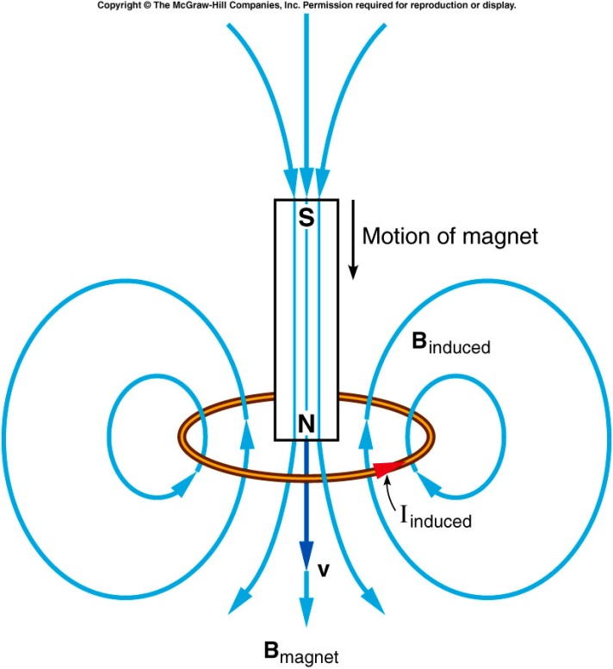
Lenz’s Law
The SI unit for the induced emf is the volt, V. The minus sign in the above Faraday’s law of induction is due to the fact that the induced emf will always oppose the change. It is also known as the Lenz’s law and it is stated as follows,
The current from the induced emf will produce a magnetic field, which will always oppose the original change in the magnetic flux.

Slide 20
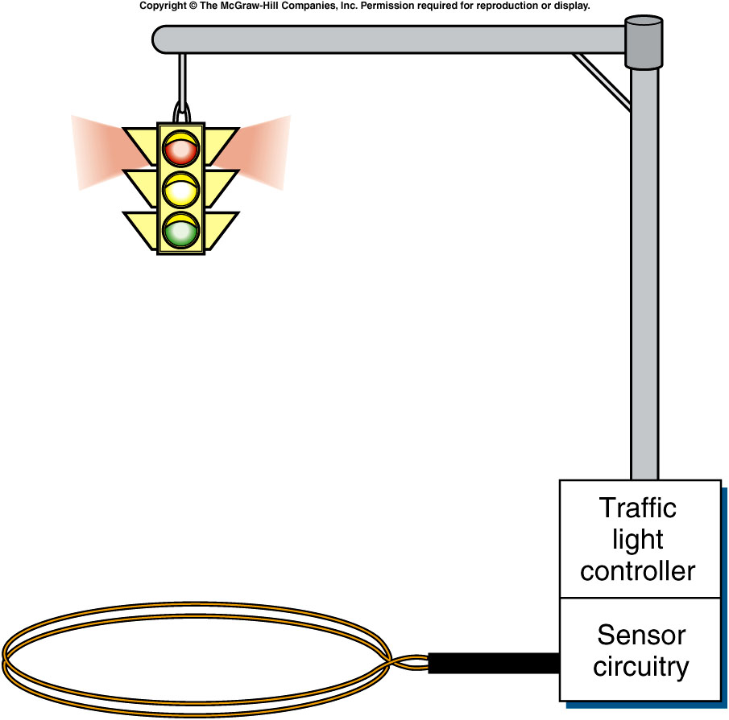
Vehicle Sensors at Traffic Lights

Slide 21
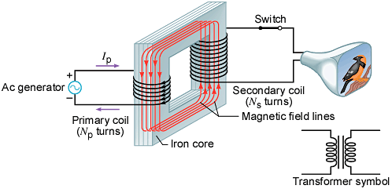
Transformers
A transformer is a device for increasing or decreasing an ac voltage.
A transformer consists of a primary coil and a secondary coil, both wound on an iron core. The changing magnetic flux produced by the current in the primary coil induces an emf in the secondary coil. At the far right is the symbol for a transformer.

Slide 22
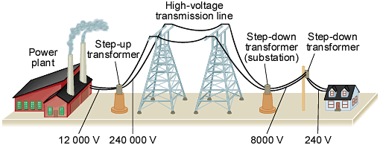
Power Transmission
Transformers play a key role in the transmission of electric power.

Slide 23
Transformer
A transformer consists of two coils, a primary and a secondary, wound around a soft iron core
The two coils are linked by the magnetic field.
The soft iron core will provide a medium by which the magnetic flux from the primary coil is transferred to the secondary coil.
Transformers are designed so that nearly all the magnetic flux from the primary coil is transferred to the secondary coil.

Slide 24
Step-Down Transformer
SP4

