Slide 1
Chapter-11 Heat Engines and the Laws of Thermodynamics
1 Heat Engines and First law of thermodynamics
2 Second Law of Thermodynamics
3 Refrigerators and Heat pumps
4 Thermal Power Plants and Energy Resources
Everyday Phenomenon: Hybrid Vehicles

Slide 2
Auto Fuel

Slide 3
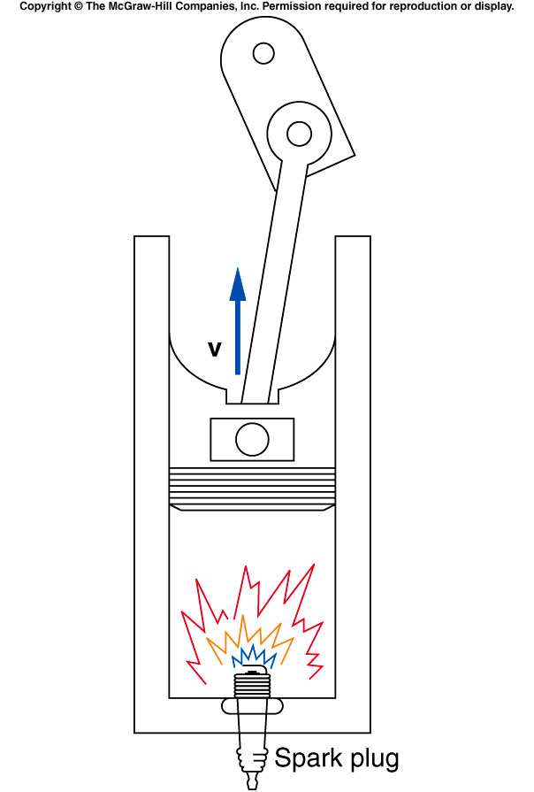
Gasoline Engine
Four Strokes of a gasoline engine:
Intake
Compression
Ignition and power
Exhaust
http://www.youtube.com/watch?v=_QXH5MaoKEE

Slide 4
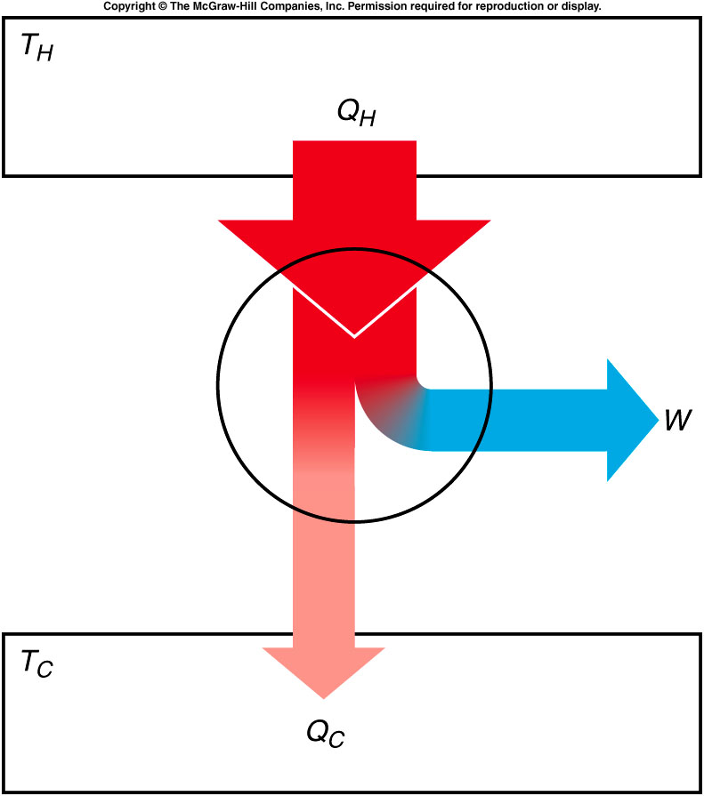
Heat Engines

Slide 5
Heat Engines
A heat engine is any device that uses heat to perform work. It has three essential features:
1. Heat is supplied to the engine at a relatively high temperature, hot reservoir.
2. Part of the input heat is used to perform work by the working substance of the engine, which is the material within the engine that actually does the work
3. The remainder of the input heat is rejected at a temperature lower than the input temperature to a place called the cold reservoir.
Q_{H} = Q_{C} + W

Slide 6
The First Law of Thermodynamics
The internal energy of a system changes from an initial value U_{i} to a final value of U_{f} due to heat Q and work W:

Slide 7
Efficiency,e of a Heat Engine
Q_{H} = Q_{C} + W

Slide 8
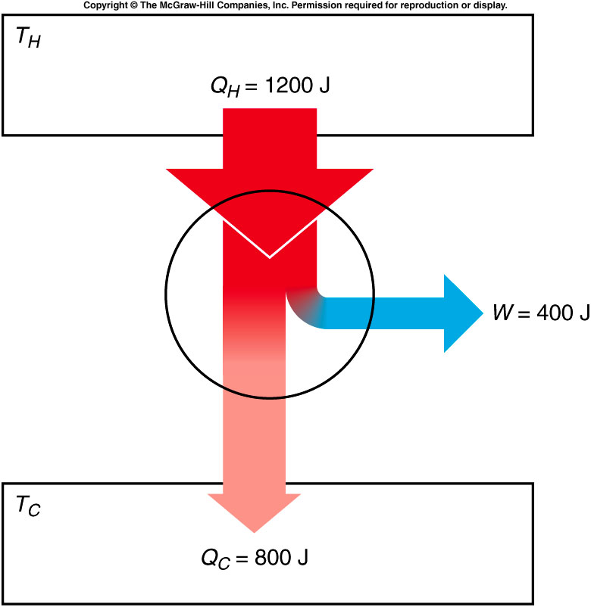
Try This Box 11.1

Slide 9
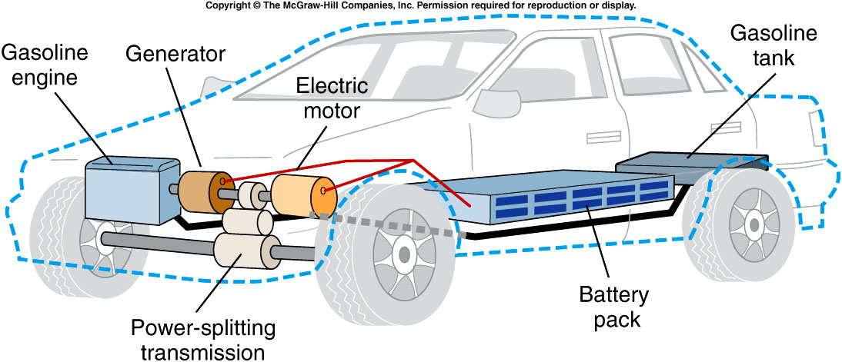
Hybrid Automobile Engines

Slide 10
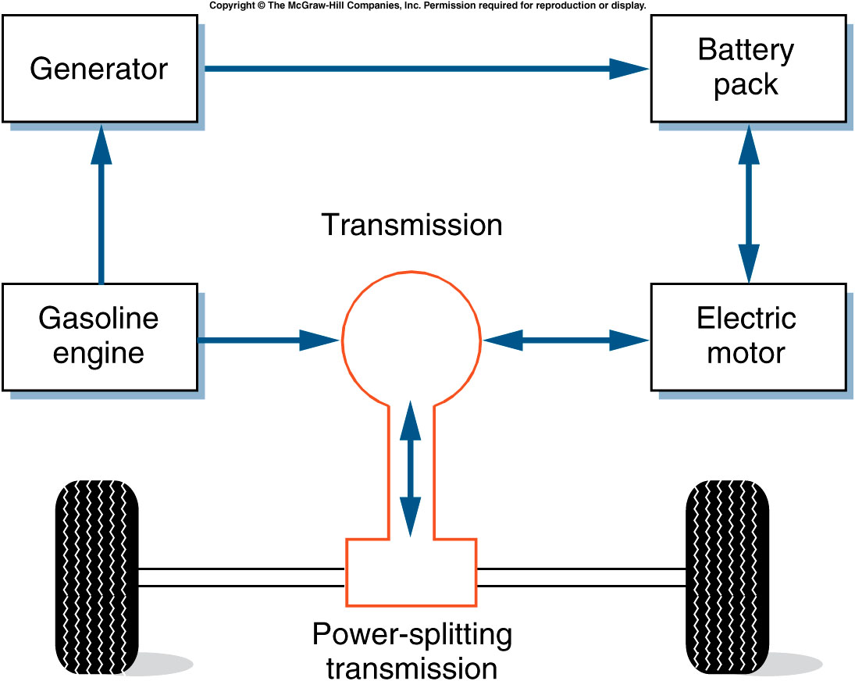
Hybrid Automobile Engines

Slide 11
Second Law of Thermodynamics
Kelvin’s statement:
No engine, working in a continuous cycle, can take heat from a reservoir at a single temperature and convert that heat completely to work.
Clausius’s Statement:
Heat will never flow from a colder body to a hotter body unless some other process is also involved.

Slide 12
Entropy and the Second Law
Entropy:
Entropy is a measure of the disorder of a system.
Second law: The entropy of the universe or of an isolated system can only increase or remain constant. It will never decrease.

Slide 13
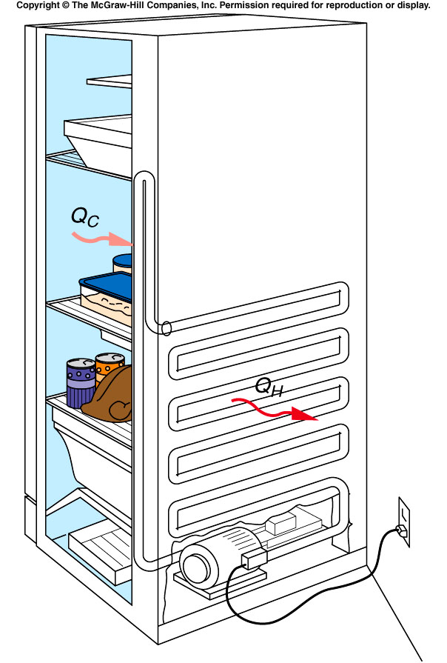
Refrigerator
A refrigerator pumps heat from the cooler interior to the warmer room.

Slide 14
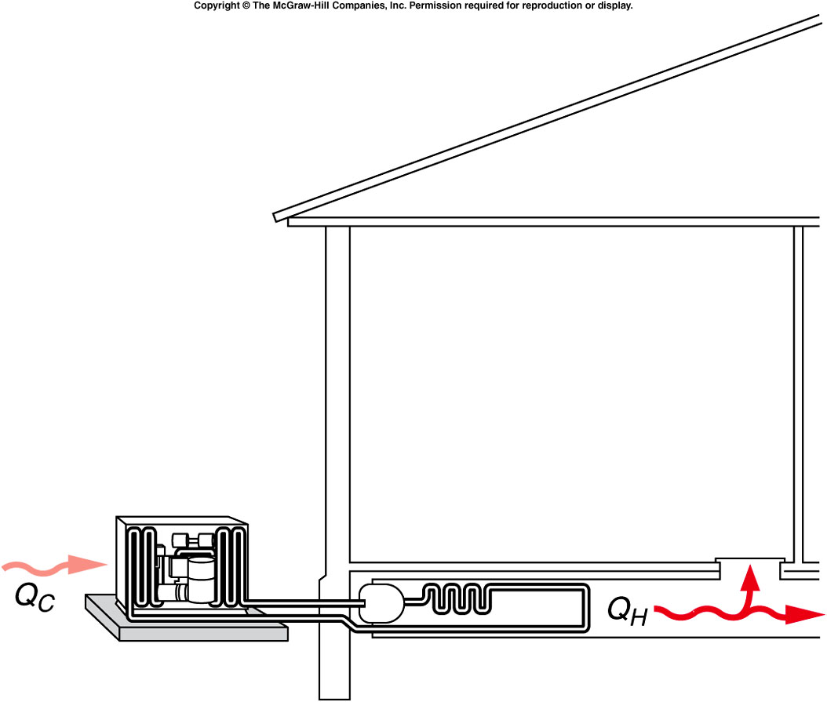
Heat Pump
A heat pump removes heat from the outside air and pumps it into the warmer house.

Slide 15
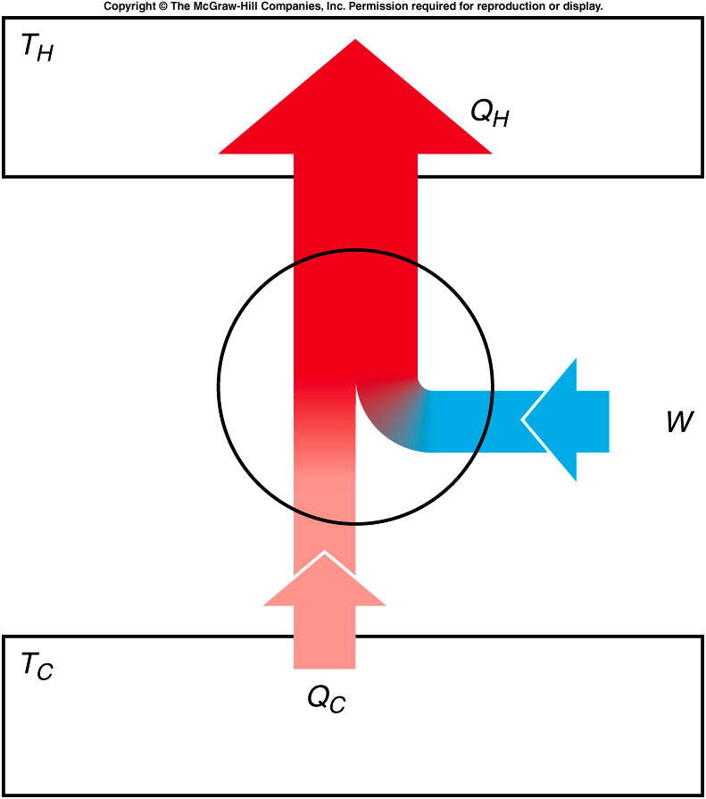
Schematic Representation of a Heat Pump or Refrigerator

Slide 16
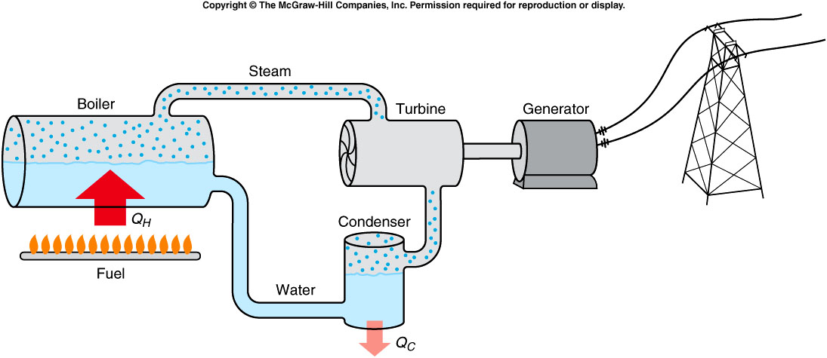
Thermal Power Plant
http://www.duke-energy.com/about-energy/generating_electricity.asp

Slide 17
Nuclear Power Plant

Slide 18
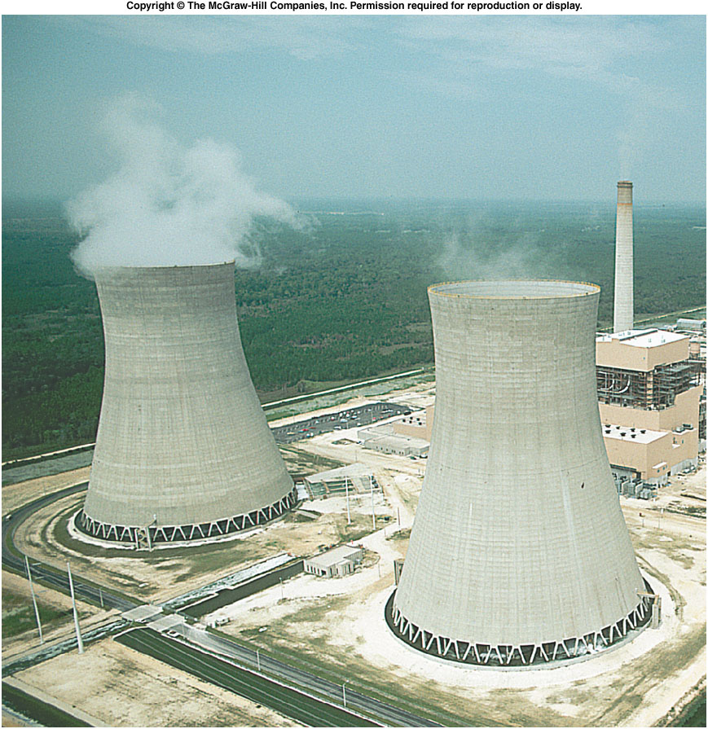
Cooling Towers of Power Plants

Slide 19
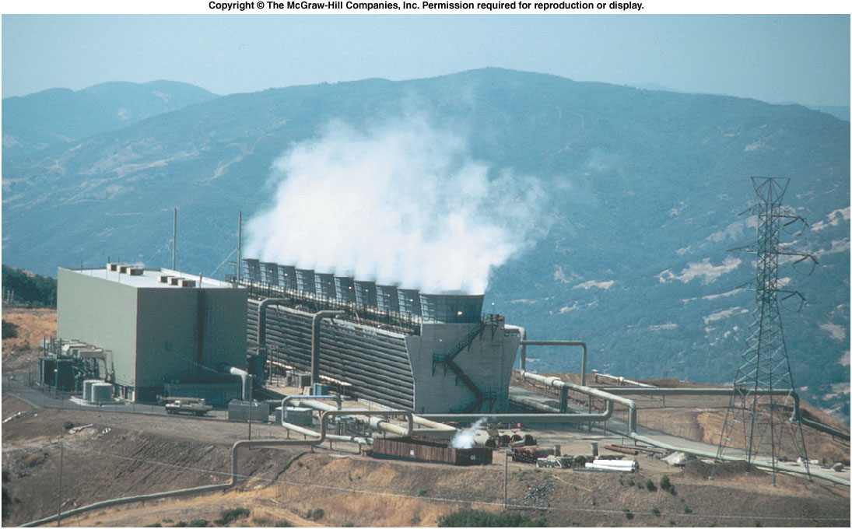
The Geysers (geothermal) Power Plant
http://www.youtube.com/watch?v=sEdWXbn35kQ
http://www.youtube.com/watch?v=G2KACcNyJ5g

Slide 20
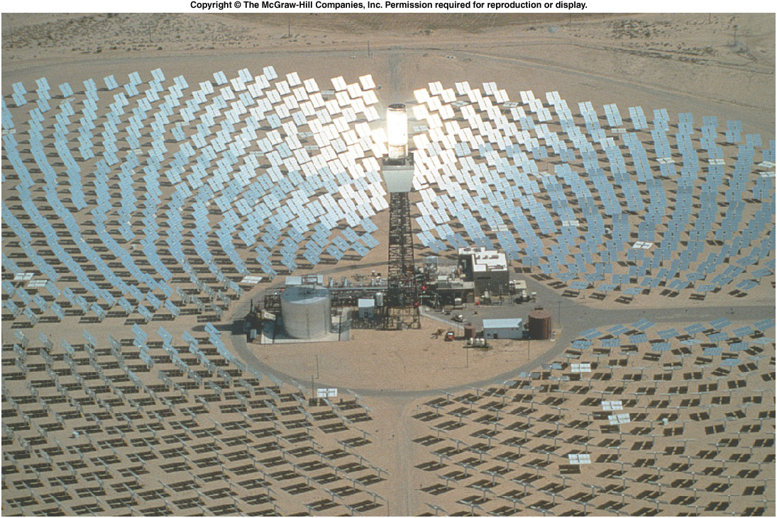
Solar-thermal Power Plant
http://www.youtube.com/watch?v=ewjxBonbjXU

