Slide 1
Final Presentation
Hypothetical Protein YckF Bacillus subtilis Nitrogenase Iron Protein Azotobacter vinelandii Diaminopimelate dicarboxylase Mycobacterium tuberculosis
Glutamyl t-RNA Synthetase Thermus thermophilus
Presented by Zachary A. Curry
CHEM 525—Biochemistry II

Slide 2
Where are we going?
Bacterial Proteins!
Hypothetical Protein YckF
Nitrogenase Iron Protein
Diaminopimelate dicarboxylase
Glutamyl t-RNA Synthetase
Biology, structure, and function of each
Notes:
All are bacterial proteins

Slide 3
Hypothetical Protein YckF
Bacillus subtilis
PDB: 1M3S
Sanishvili R, Wu R, Kim DE, Watson JD, Collart F, and Joachimiak A (2004)
Structural Biology Center and Midwest Center for Structural Genomics Argonne National Laboratory, Argonne, IL
Funded by the Protein Structure Initiative
Solve structures of family members → correct structure prediction

Slide 4
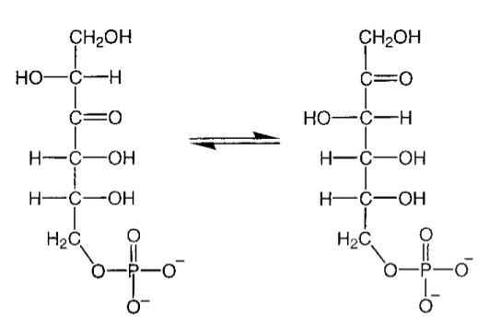
What does YckF do?
Isomerase
6-phospho-3-hexuloisomerase
Catalyzes the isomerization of D-arabino-3-hexulose-6-phosphate to D-fructose-6-phosphate
Forms a strong tetramer
(79.6 kDa) in solution
Possible coopertivity
Taylor EJ, Charnock SJ, et. al. Acta Crystallographica Sec D 57, 1138-40, 2001

Slide 5
The Bigger Picture
Part of the Ribulose Monophosphate pathway
Typically used by methylotrophs for growth on single-carbon substrates, using RMP as a carbon-acceptor
Bacillus subtilis is not a methylotroph!
Speculated for detoxification of formaldehyde

Slide 6
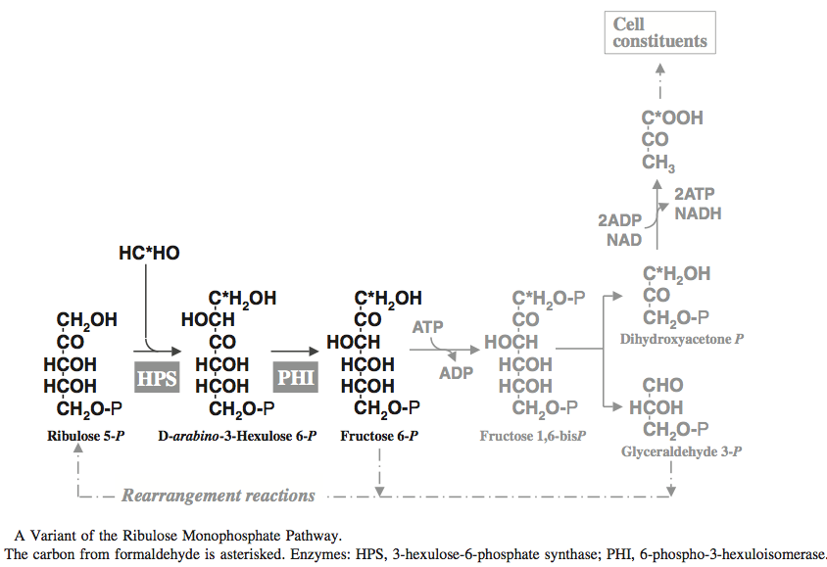
The Bigger Picture
The Ribulose Monophosphate Pathway
Assimilation & detoxification of formaldehyde
Kato, Yurimoto, et al. Biosci. Biotechnol. Biochem. 70 (1) 10-21, 2006
Notes:
Produces pyruvate -> Fatty Acids, Sugars, etc.

Slide 7
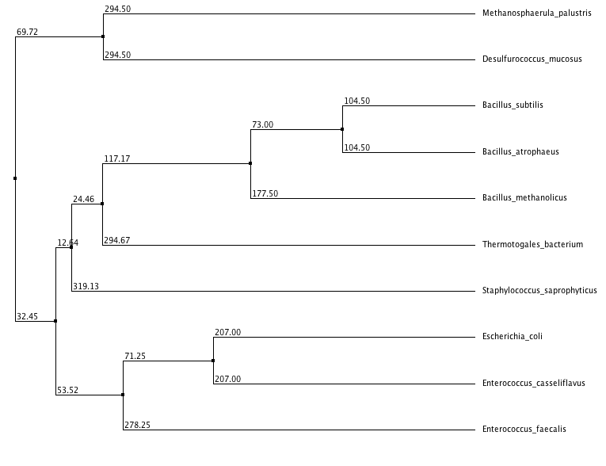
Methanotrophs(Methylotrophs)
Bacillus
Enterobacteria
Notes:
Bacillus oxidizes methanol (not a mthanotroph)
Entner–Doudoroff pathway (yields less ATP than normal glycolysis)

Slide 8
From Sequence to Structure
Isomerization reaction catalyzed by Nucleophilic Glu152
Structural rigidity positioning Glu152
Conserved structural residues
α-helix
Positioned by Arg-46
Active site surrounded by sugar-phosphate binding loops
Functional promiscuity
Bind a variety of sugar-phosphates
Highly conserved in sugar isomerases

Slide 9
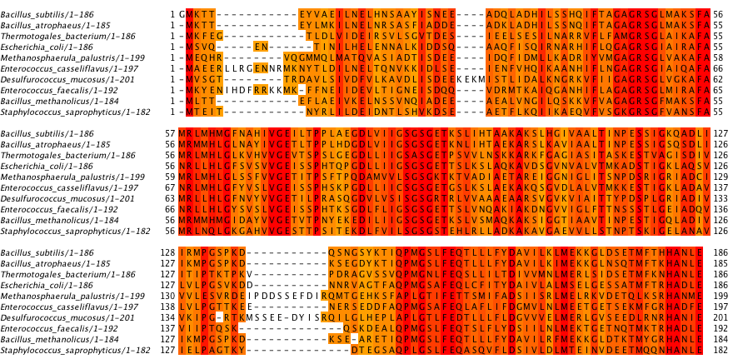
CLUSTALW Multiple Sequence Allignment
Notes:
ASP (D) coordinates ARG (R) to properly position Glutamic Acid (E)

Slide 10
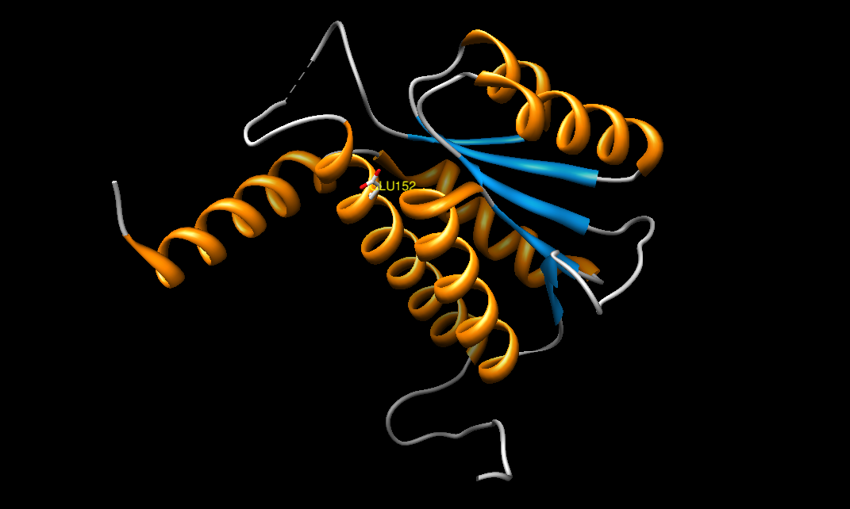

Slide 11
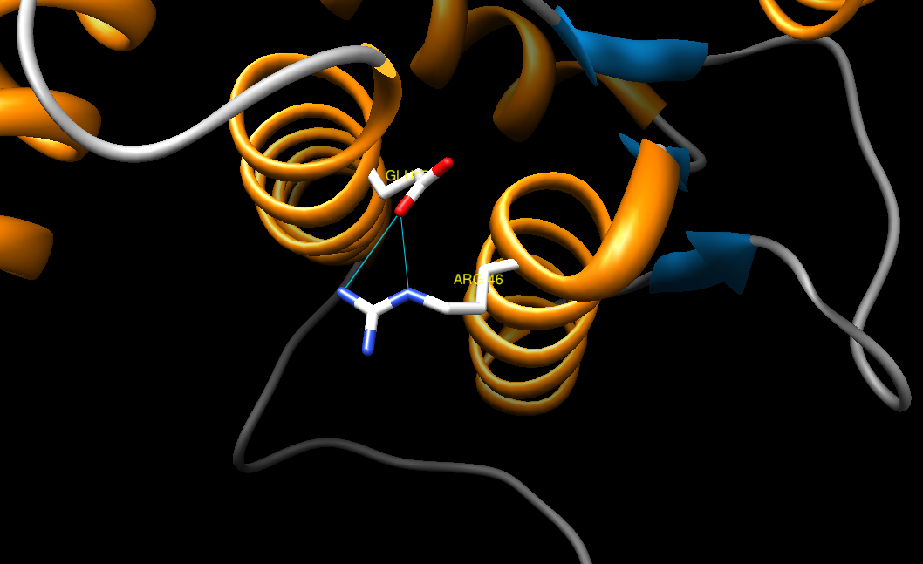
Notes:
GLU is coordinated via alpha helix and, most importantly, ARG

Slide 12
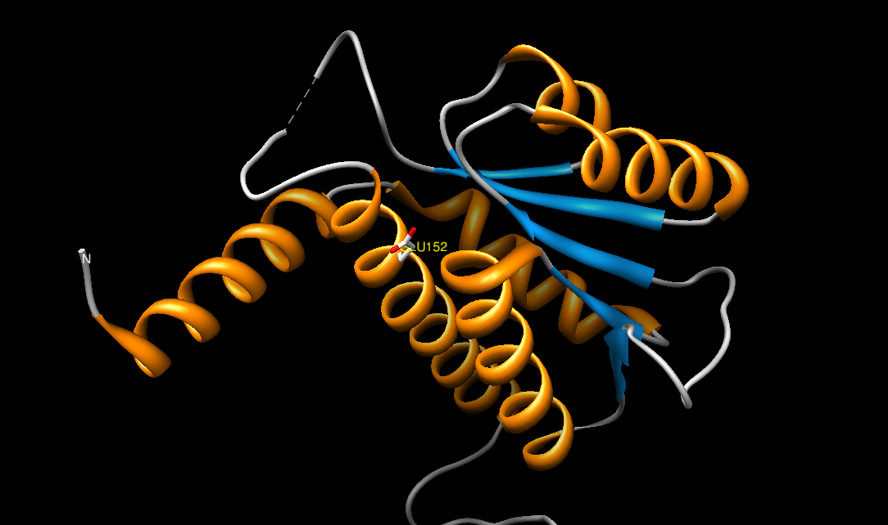
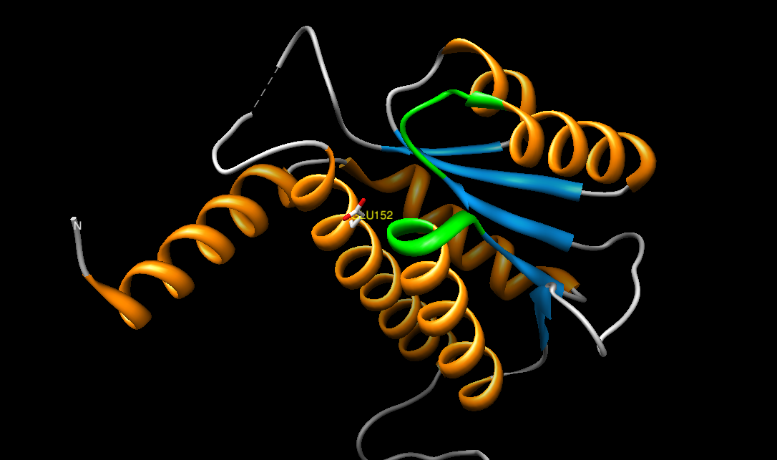

Slide 13
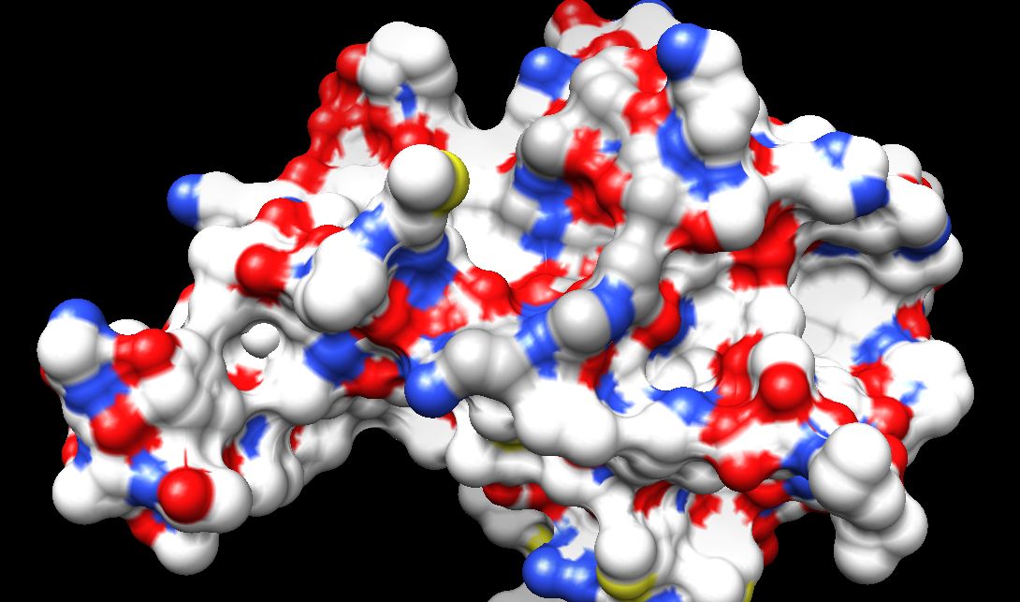
Loops
Glu 152

Slide 15
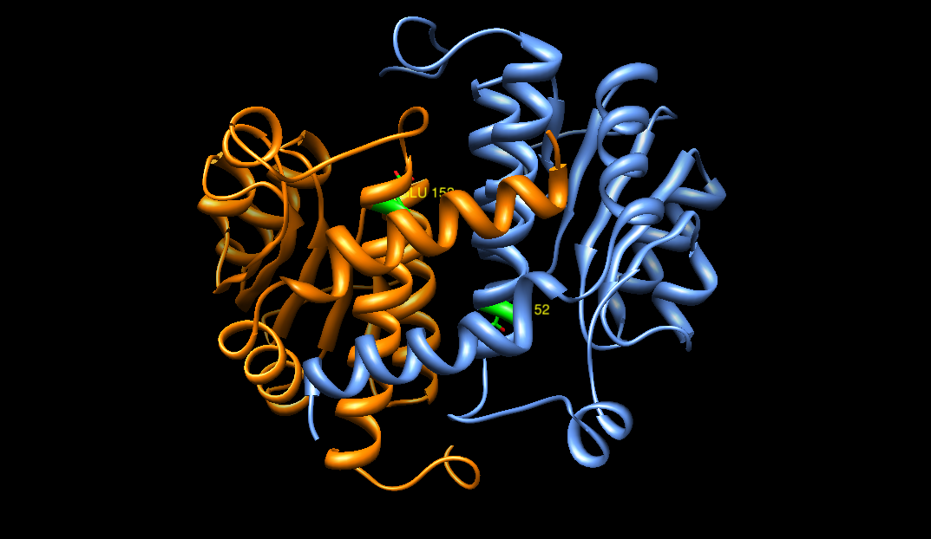

Slide 16
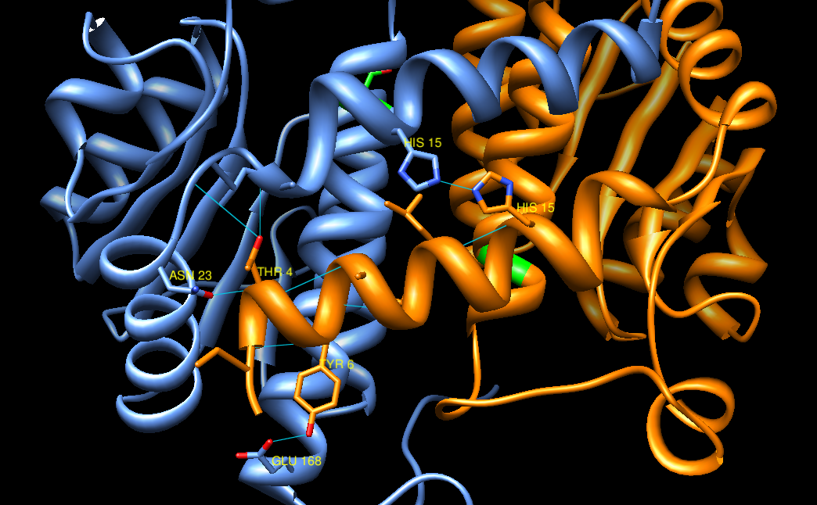

Slide 17
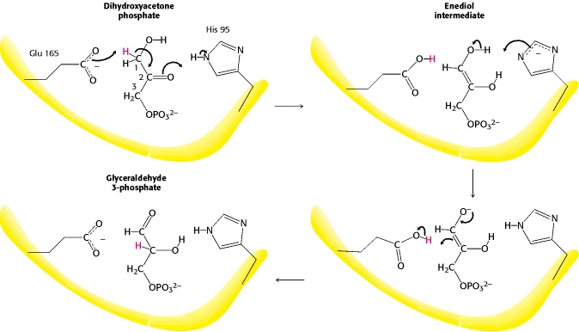
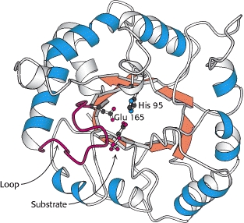
Mechanism (proposed)
Nucleophilic Glu attack, H⁺ removal → Tautamerization
Facilitated by H₂O
Active site it open, many waters present in crystal
Mechanism similar to other isomerases (?)
Triose Phosphate Isomerase
http://www.ncbi.nlm.nih.gov/books/NBK22593/

Slide 18
YckF and GlmS
YckF is structurally similar to glucosamine 6-phosphate synthase (GlmS)
Share phosphate-binding loops
Sequentially different
GlmS converts fructose-6P into glucose-6P
Teplyakov A et. al. Protein Science (1999), 8:596–602

Slide 20
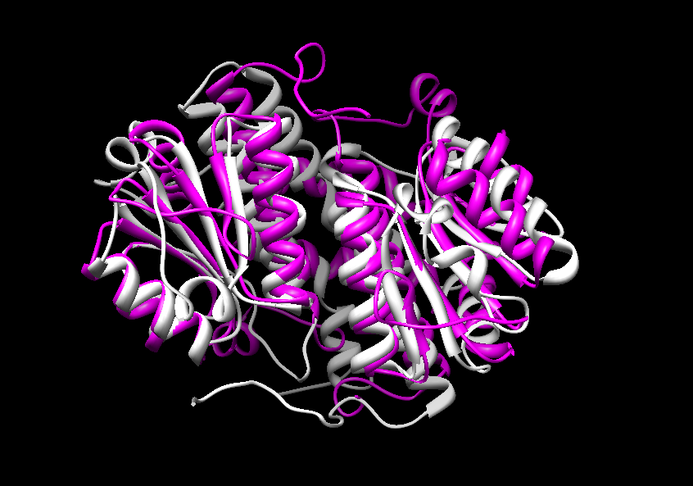
YckF and GlmS

Slide 21
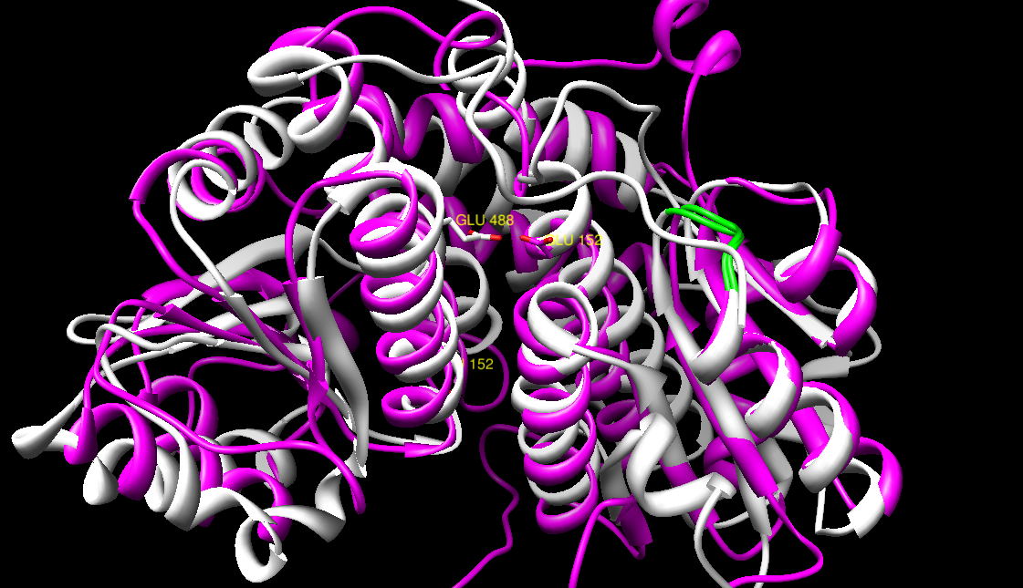
YckF and GlmS

Slide 22
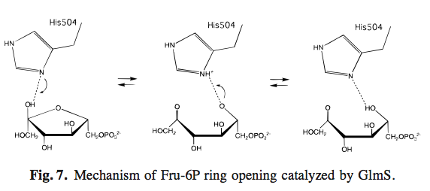
Cyclic or Linear?
GlmS “linearizes” sugar prior to catalysis
This could either be spontanteous or base-catalyzed
Spontaneous: Fru-6P is about 20 s⁻¹
Base-catalyzed, not in proximity to active site
Teplyakov A et. al. Protein Science (1999), 8:596–602

Slide 23
Returning to YckF
Linear arabinose
Substrate Docking with Vina
Arabinose-6-Phosphate analogue
Binding affinity = -3.7 kcal/mol
Coordinated by loops!
Trott O, Olson AJ. J. Computational Chemistry 31(2), 455-61, 2010

Slide 24
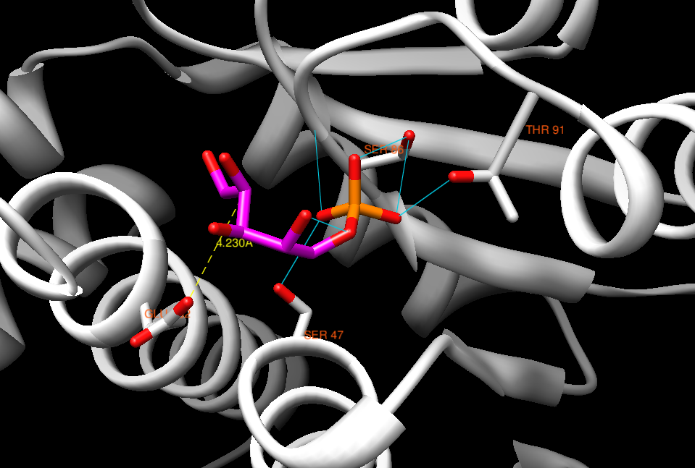
ARB
Notes:
Hydrogen not shown
No hydrogen bonding -> a variety of conformers could lead to rxn
Perfect? No… but needs

Slide 25
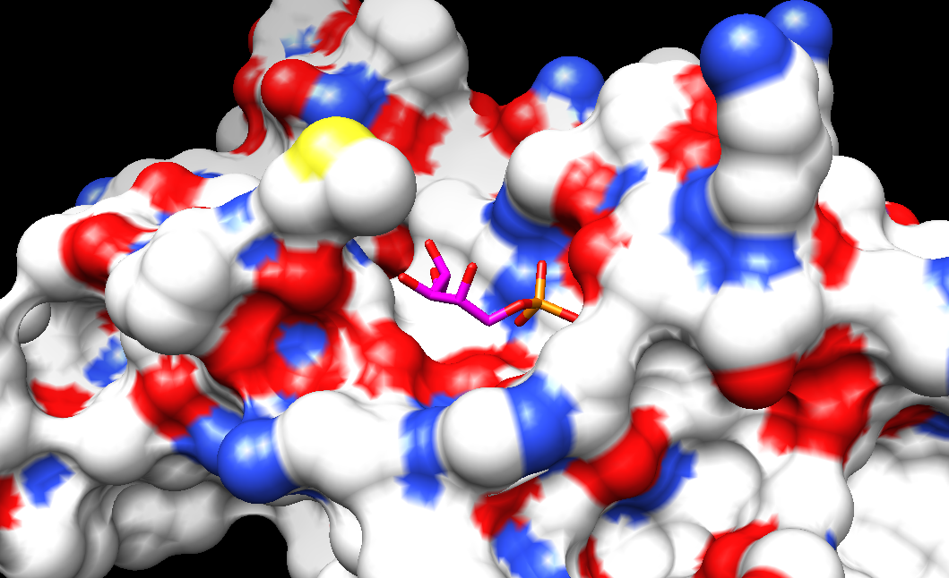
Loops
Glu 152
ARB
ARB

Slide 26
Where are we going?
Hypothetical Protein YckF
Nitrogenase Iron Protein
Diaminopimelate dicarboxylase
Glutamyl t-RNA Synthetase
Notes:
All are bacterial proteins

Slide 27
Nitrogenase Iron (Fe) Protein
Azotobacter vinelandii
PDB: 2AFH, 2AFI, 2AFK
Tezcan FA, Kaiser JT, Mustafi D, Walton MY, Howard JB, Rees DC (2004)
Division of Chemistry and Chemical Engineering
California Institute of Technology, Pasadena, CA
Department of Biochemistry
University of Minnesota, Minneapolis, MN

Slide 28
What does Nitrogenase Fe (Av2) do?
Part of Nitrogen Fixation in Azotobacter vinelandii
Aerobic, easily culturable
Hallmark of many diazotrophic bacteria
What is Nitrogen-Fixation?
N₂ (g) → NH₃ (aq)
Building block of amino acids, nucleic acids, etc.
Part of global nitrogen cycle
Important for plant nutrition
What bacteria do this?

Slide 29
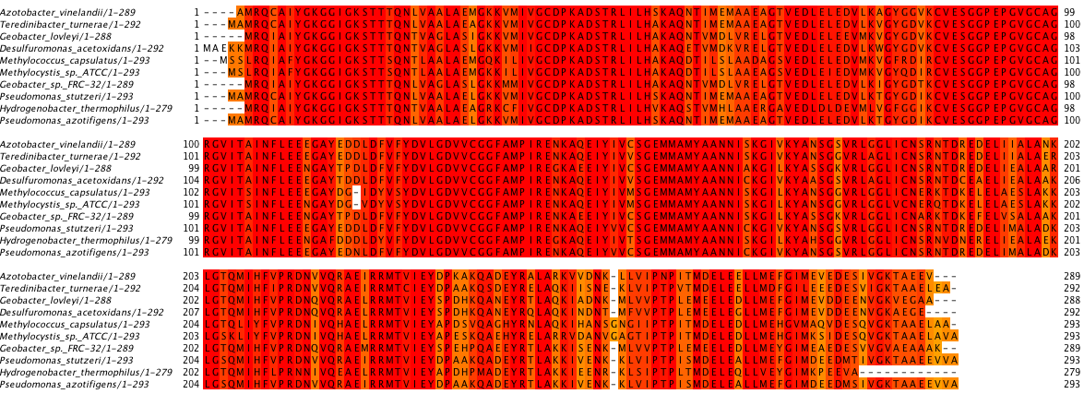

Slide 30
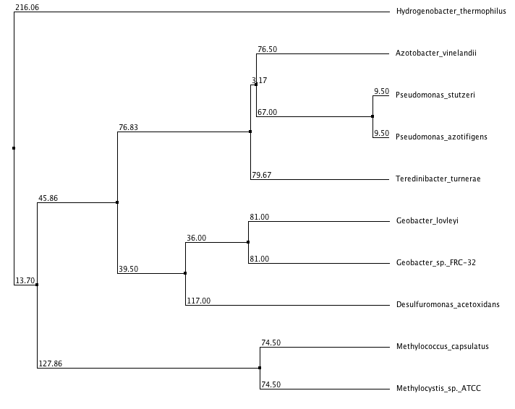
Hydrogen-oxidizing Thermophile
Diazotrophs
(N₂-fixing)
Denitrifying (!)
Metal and Radionuclide Reducing
Sulfur Reducing
Methylotrophs
Notes:
All are nitrogen fixers, few are solely known for it
Denitrifying – produce N2. Why might they have this enzyme? ON/OFF GENE REGULATION

Slide 31
How does Nitrogenase Fe Work?
It provides the electrons to reduce N₂ with its partner:
MoFe nitrogenase
Dynamic complex
Proposed “Mechanism”:
Substrate (N₂) bound to MoFe
Fe protein reduced by electron carriers
Ferridoxin or flavodoxin
Fe protein has [4Fe-4S] metal cluster
Fe transfers electrons to MoFe with MgATP hydrolysis
1 or 2 e⁻ per ATP hydrolyzed
Repeat until substrate is fully reduced

Slide 32
Redox Cycles (Oh my!)
Fe Nitrogenase [4Fe-4S] crystals, oxidized and reduced
Proposed:
Original oxidation state dictates number of electrons transferred per ATP
Difficult to study
[4Fe-4S]^{3+/2+}
[4Fe-4S]^{2+/+}
[4Fe-4S]^{0/2+}
Reaction is thermodynamically favorable without ATP
Why is it there? Allostery and Kinetics
1 e⁻/cycle
2 e⁻/cycle
Notes:
Protein switch & prevents back reaction

Slide 33
JUST GET TO THE STUCTURE ALREADY!
Homodimer with metallocluster at interface
[4Fe-4S]
Anionic, cubane structure
Coordinated by cysteine ligands
Also coordinated by polar α-helix
Backbone NH…S Hydrogen Bonding
2 ATP Binding Sites
Conformational shift → FeMo Protein Binding

Slide 34
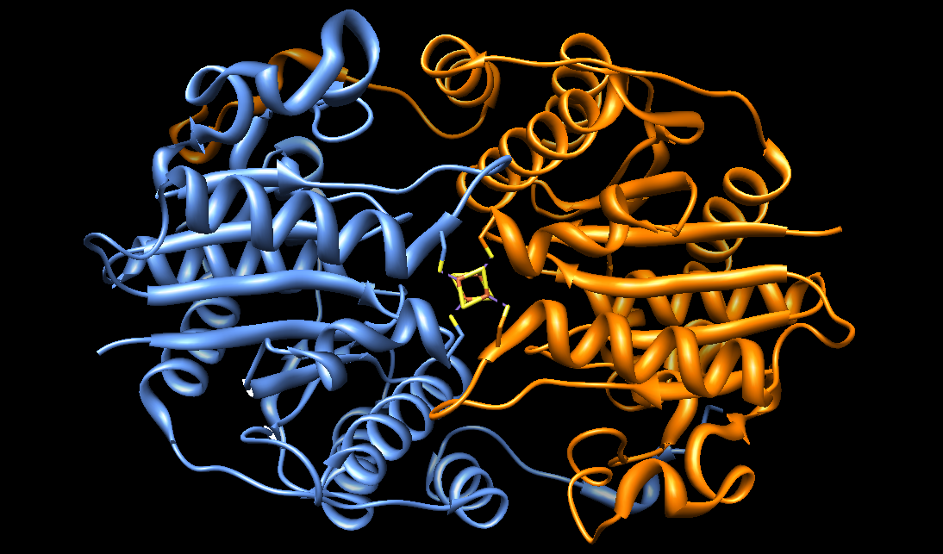
ATP-Binding

Slide 35
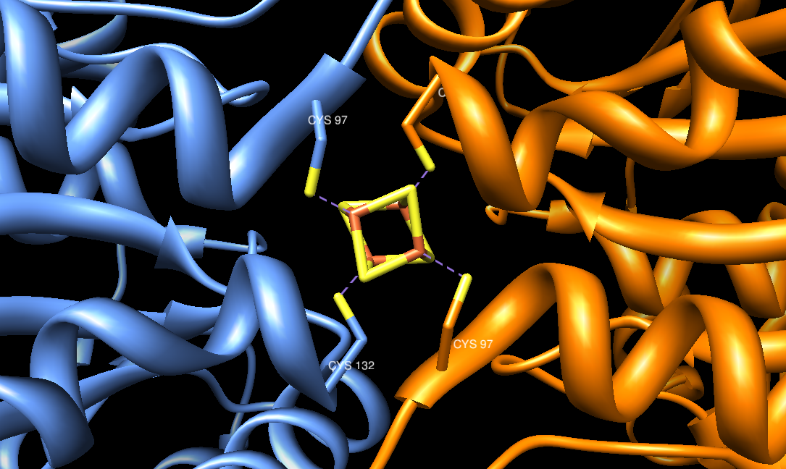

Slide 36
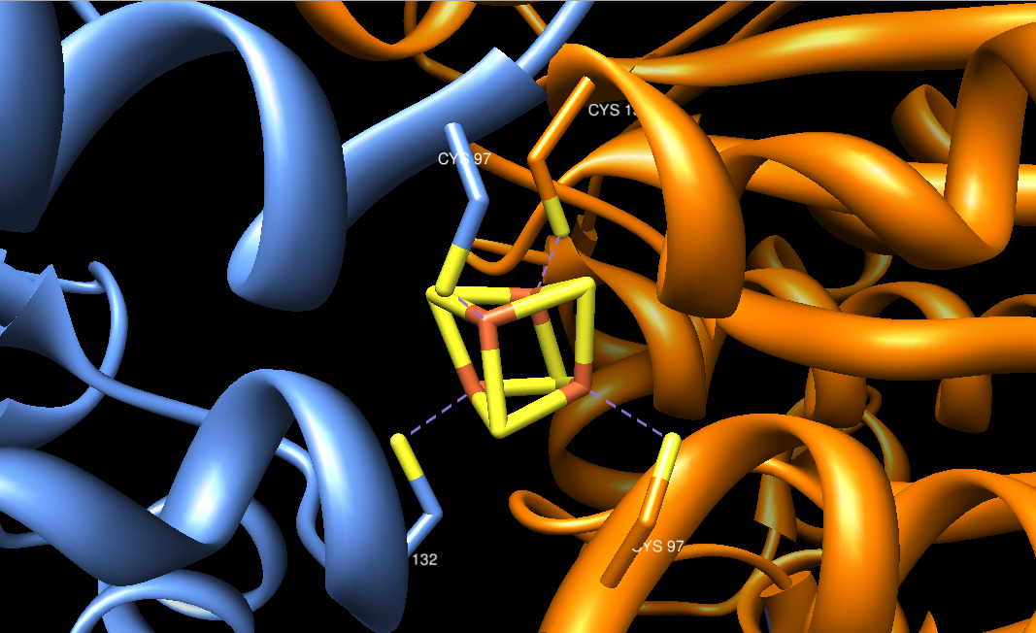

Slide 37
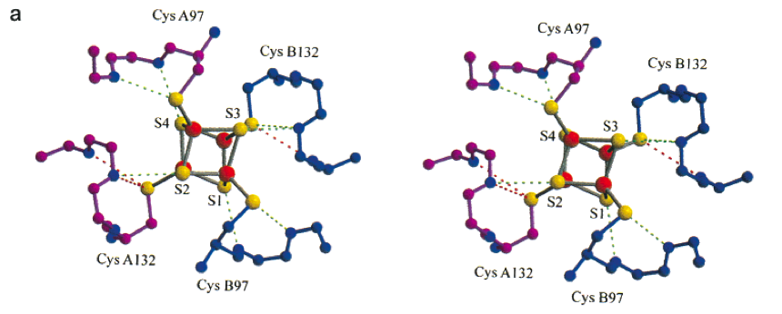
NH…S Hydrogen Boding
Strop et. al. Biochemistry 40(3), 651-656 ,2001

Slide 38
The Metal Complex!
The [4Fe-4S] cluster has greatest solvent-accessibility
Solvent exposure facilitates reduction in similar proteins
Facilitates 3 different oxidation states
NH…S increase stability of cluster when in reduced form
More H-bonds with cluster then in similar proteins
Limiting reactivity until protein complexes with MoFe?
Cluster can exist in slightly varying forms
Different oxidation states can change cluster volume
Based on model compounds of known oxidation states

Slide 39
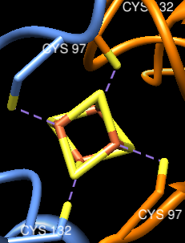
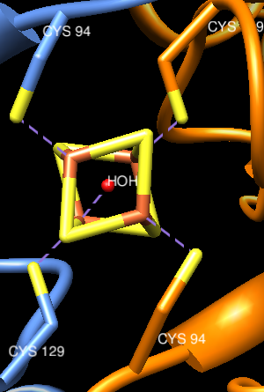
Qualitative Comparison
PDB: 1G1M 1G5P 1CP2
Notes:
Different tetrahedron volumes, bond angels

Slide 40
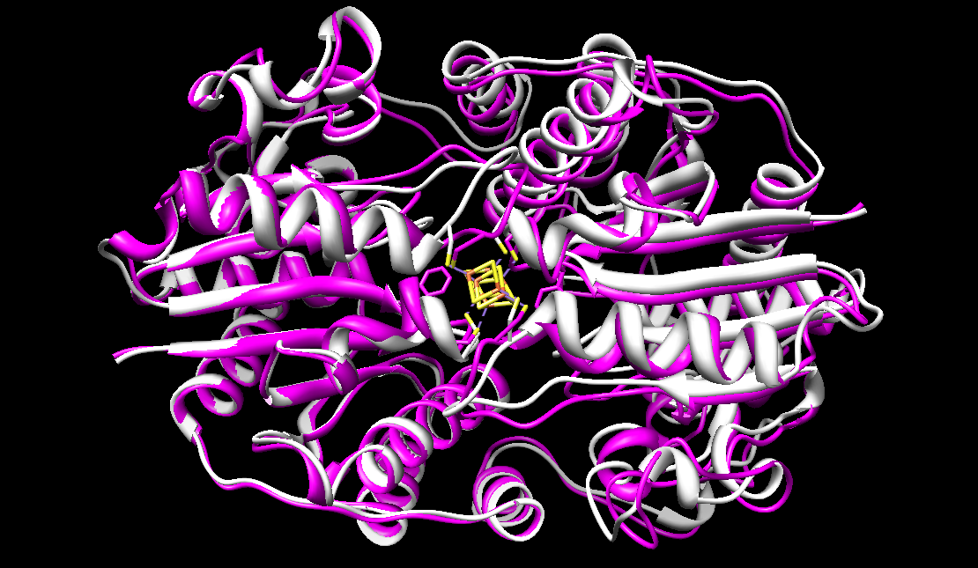
1G1M (white) & 1G5P (purple)

Slide 41
ATP-Binding
Walker A Motif
GXX-XXGKS/T
Ability for Fe Protein to bind to MoFe protein determined by nucleotide binding:
ADP and Nucleotide-free forms of protein are “off”
Slower reaction rate
ATP-bound state is “on”
Competitive inhibition by ADP
ATP hydrolysis controls Fe:MoFe disassoiation/assocation
Let’s look an an ADP-bound form…

Slide 42
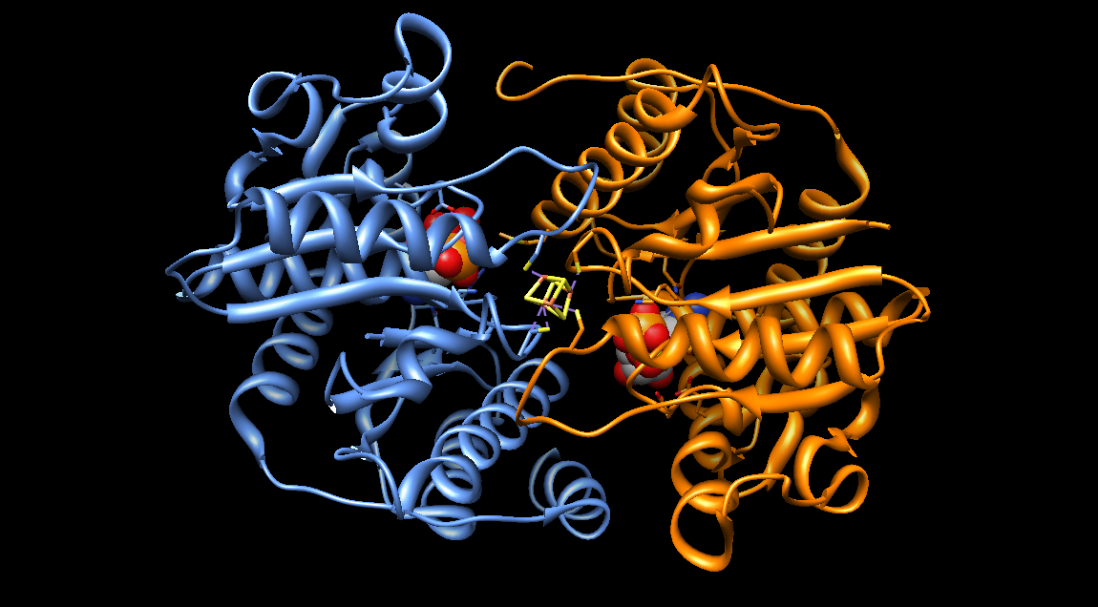

Slide 43
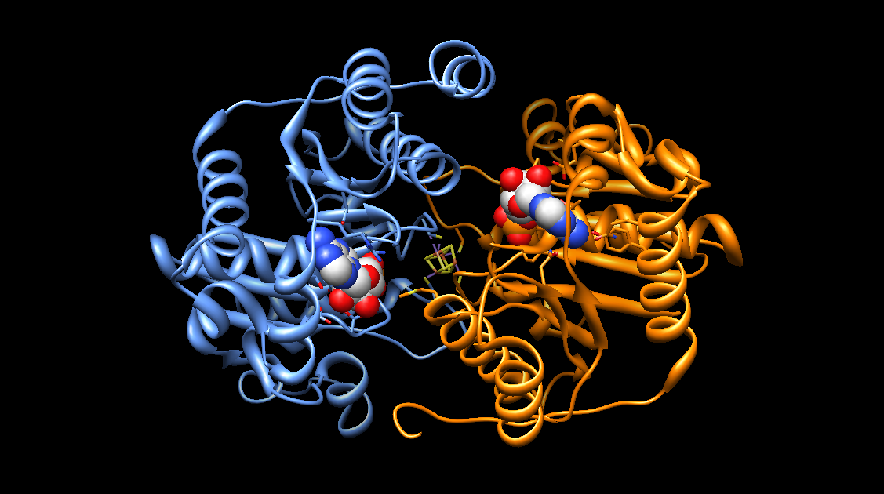

Slide 44
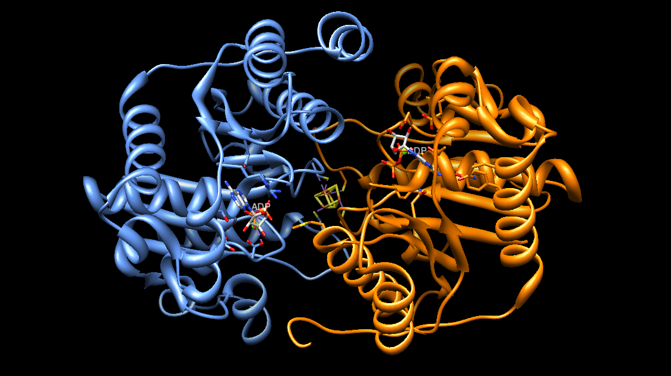

Slide 45
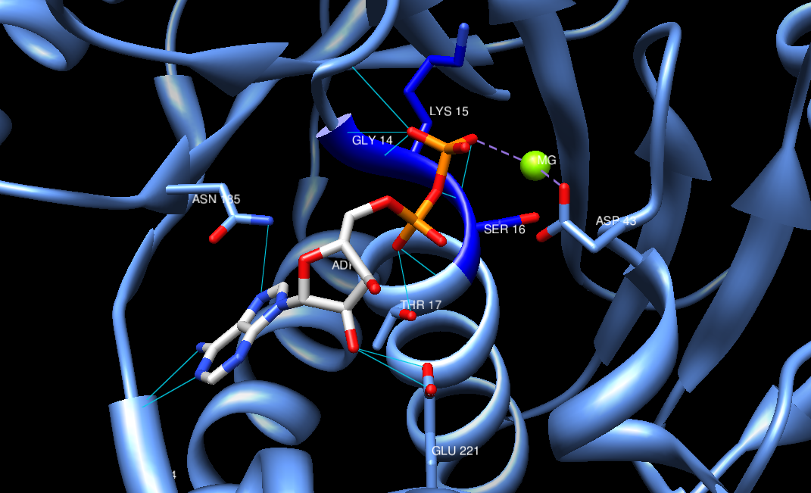
ADP-Bound
Tezcan et. al. Science 309, 1377-80, 2005

Slide 46
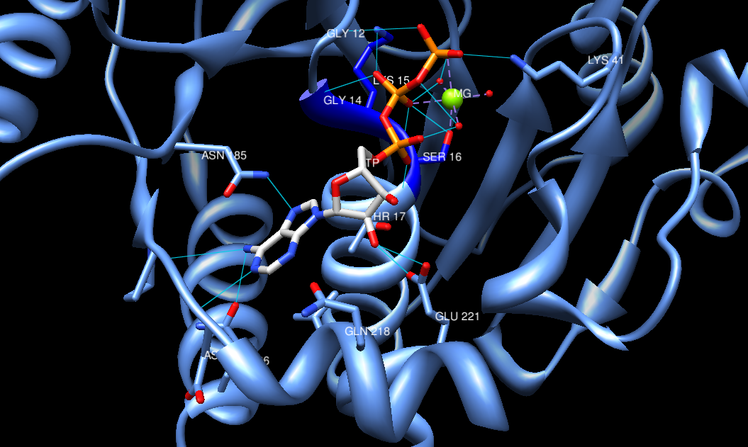
ATP-Bound

Slide 47
ADP vs. ATP
Dynamic Competition:
ATP & ADP compete for binding sites on Nitrogenase Fe
Bound Nitrogenase Fe protein competes for MoFe Binding
Not to mention the reaction & product release…
Net Result:
Association & Dissociation until N₂ is full reduced
Would GTP also work?
Vina

Slide 48
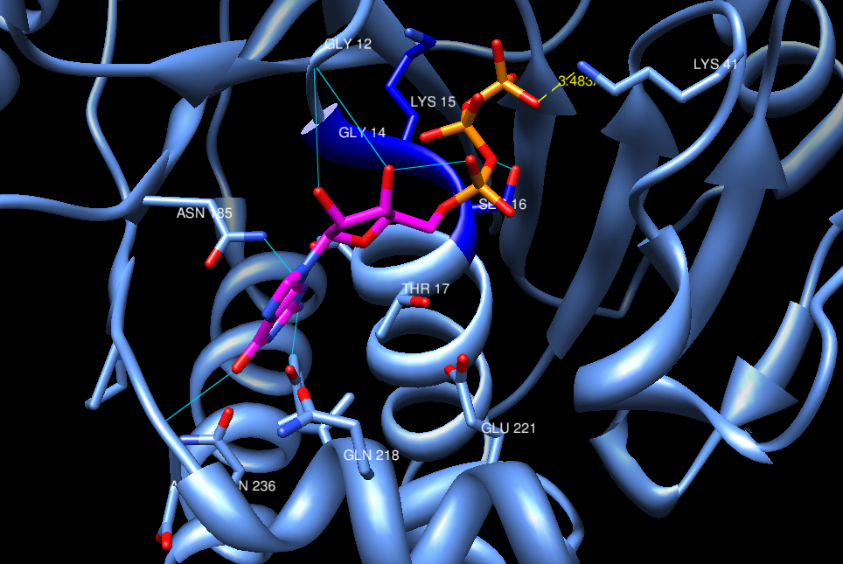
GTP-Bound

Slide 49
Protein-Protein Interactions
Number of Hydrogen Bonds and Salt Bridges numerous
Number of IMF is linked to stronger protein-protein interactions
Facilitates nitrogen fixation
Bonding is linked to ATP/ADP binding

Slide 50
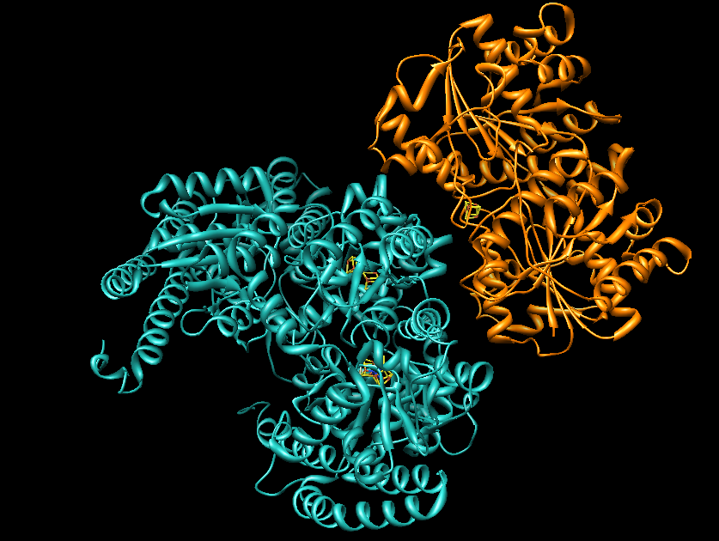
Nitrogenase Fe (ADP) w/ MoFe Protein
MoFe
Nitrogenase Fe

Slide 51
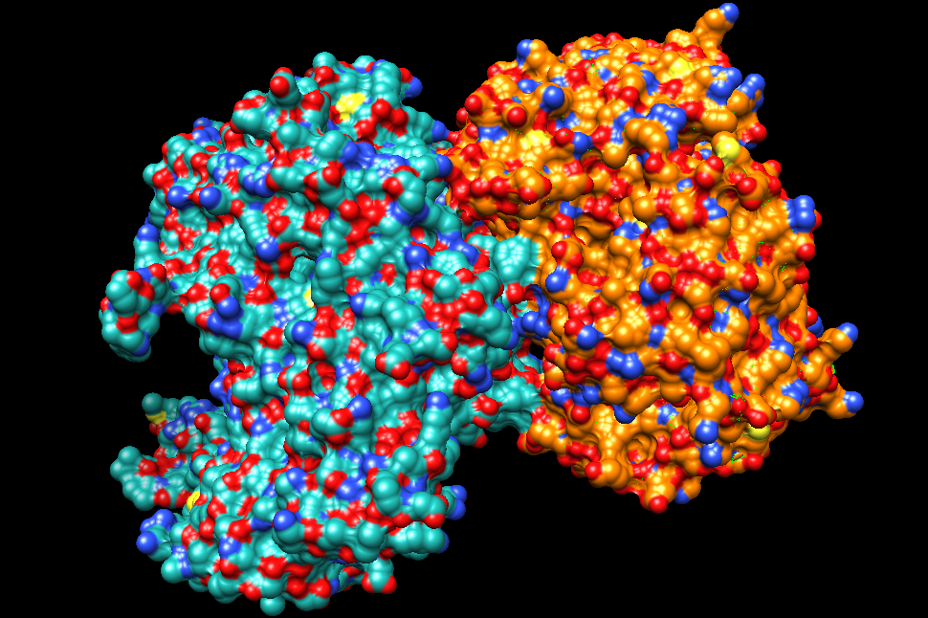

Slide 52
Where are we going?
Hypothetical Protein YckF
Nitrogenase Iron Protein
Diaminopimelate dicarboxylase
Glutamyl t-RNA Synthetase
Notes:
All are bacterial proteins

Slide 53
Diaminopimelate Decarboxylase
Mycobacterium tuberculosis
PDB: 1HKV, 1HKW
Gokulan K, Rupp B, Pavelka MS, Jacobs WR, Sacchettini JC (2003)
Department of Biophysics and Biochemistry
Texas A&M University, College Station Texas
Lawrence Livermore National Laboratory
Livermore, CA
HHMI, Albert Einstein College of Medicine
The Bronx, New York

Slide 54
What does DAPDC it do?
Lysine biosynthesis!
Extremely important for proper cellular expression, protein folding, etc.
Catalyzes the formation of Lysine from
meso-diaminiopimelate
Component of bacterial cell walls
Crosslinks peptidoglycan in Gram neg. and pos. bacteria

Slide 55
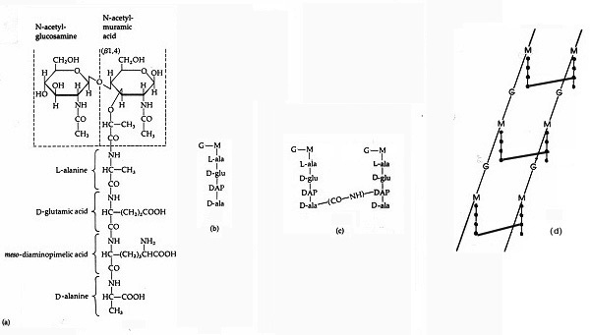
Figure 16. The structure of the muramic acid subunit of the peptidoglycan of Escherichia coli. This is the type of murein found in most Gram-negative bacteria. The glycan backbone is a repeat polymer of two amino sugars, N-acetylglucosamine (G) and N-acetylmuramic acid (M). Attached to the N-acetylmuramic acid is a tetrapeptide consisting of L-ala-D-glu-DAP-D-ala. b. Abbreviated structure of the muramic acid subunit. c. Nearby tetrapeptide side chains may be linked to one another by an interpeptide bond between DAP on one chain and D-ala on the other. d. The polymeric form of the molecule.
http://www.textbookofbacteriology.net/structure_5.html

Slide 56
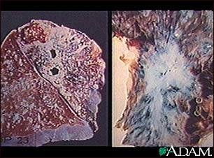
One last note…
Why study this enzyme?
Does Mycobacterium tuberculosis sound familiar?
Substrate and reaction are not found in mammals
Great target for antibiotics
http://medicalimages.allrefer.com/large/tuberculosis-in-the-lung.jpg

Slide 57
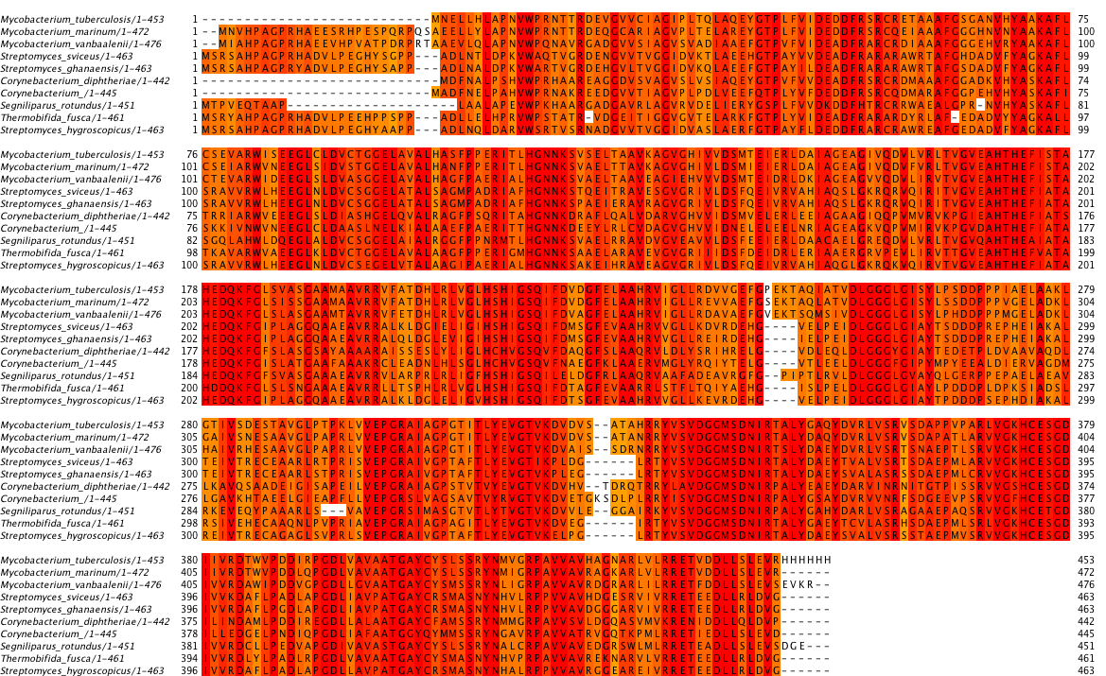

Slide 58
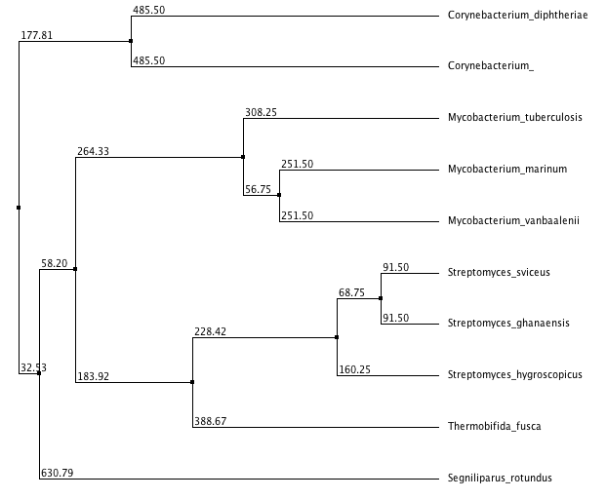
Gram (+)
Part of normal Human Flora
tuberculostearicum
Human Pathogens
Able to grow on polycyclic aromatic hydrocarbons
Well studied antibiotic producers
Break down plant cell walls
Gram (-) Opportunistic Pathogen
Notes:
All are nitrogen fixers, few are solely known for it
Denitrifying – produce N2. Why might they have this enzyme? ON/OFF GENE REGULATION

Slide 59
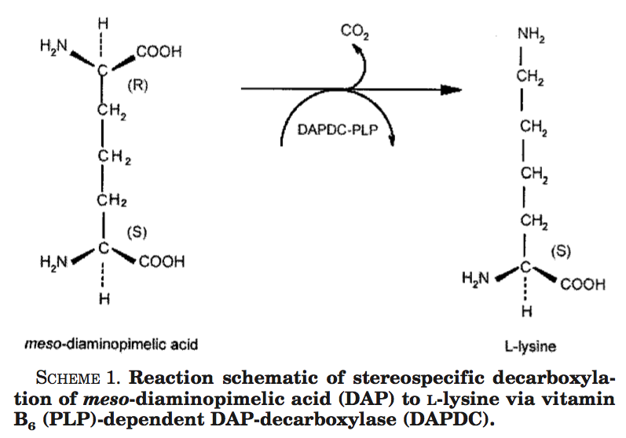
What is the Reaction?
meso-Diaminopimelate → Lysine
Stereospecific & irreversible
Uses a Vitamin B₆ cofactor
Covalently linked to the protein
Gokulan et. al. Journal of Biological Chemistry 278(20) 18588-96 (2003)

Slide 60
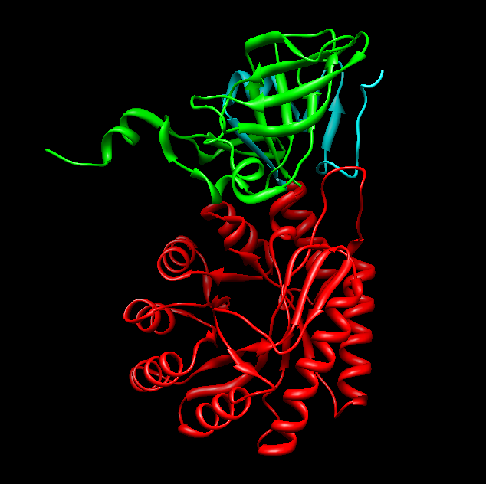
Let’s talk about the structure…
Homotetramer in solution
Genetic studies suggest constitutive expression
3 Domains:
TIM barrel
alpha/beta domain
C-term. domain
Active Site

Slide 61
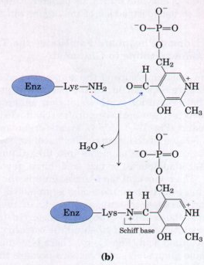
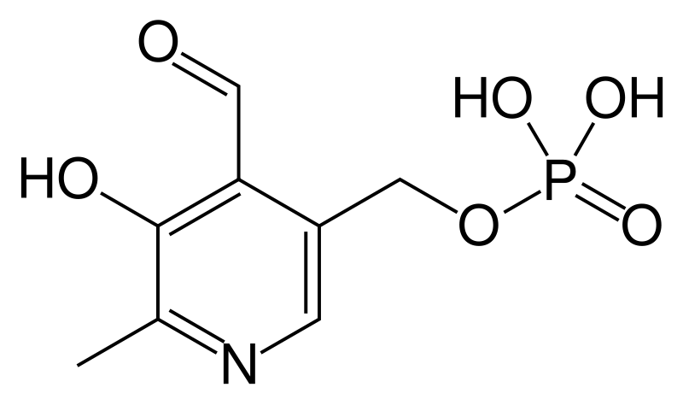
Vitamin B₆
Pyridoxal-5-phosphate
Covalently linked to Lys 72 via Schiff Base mechanism
http://en.wikipedia.org/wiki/File:Pyridoxal-phosphate.svg, http://www.bioinfo.org.cn/book/biochemistry/chapt17/512.jpg

Slide 62
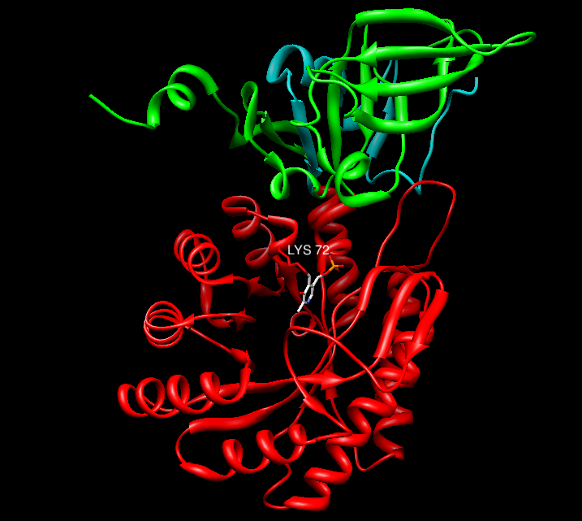
Where is this in DAPDC?

Slide 63
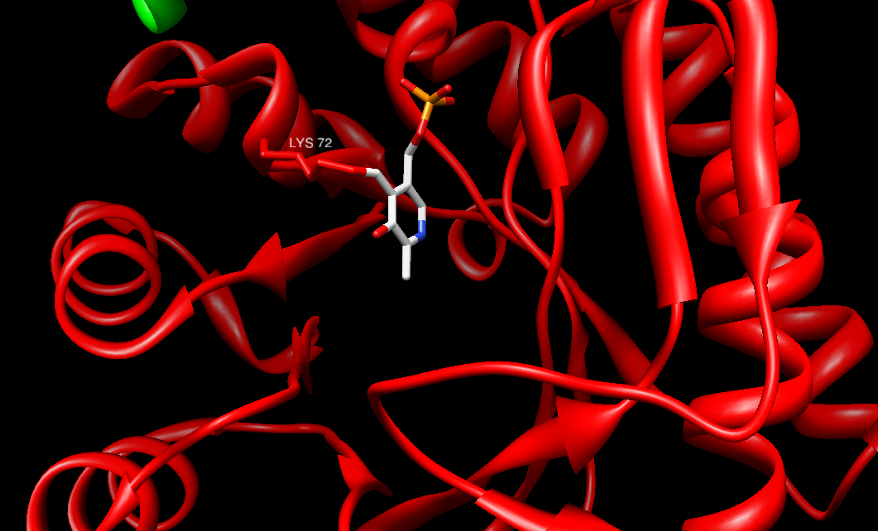

Slide 64
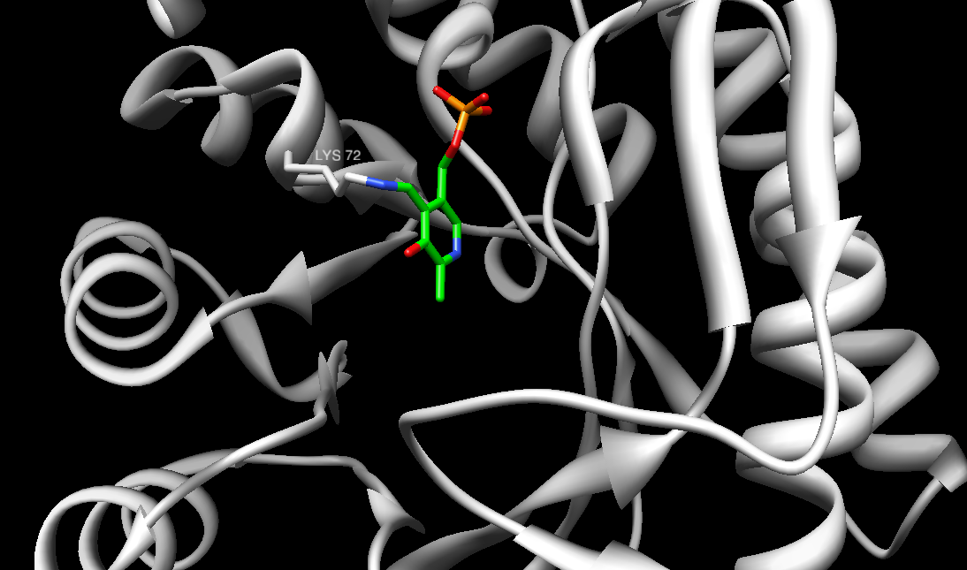
B6

Slide 65
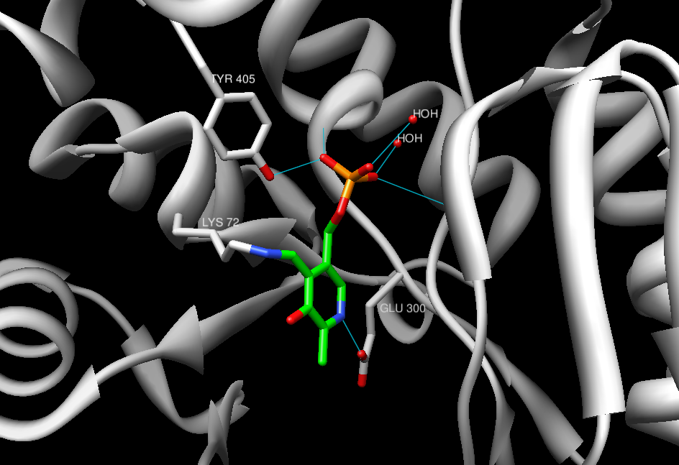

Slide 66
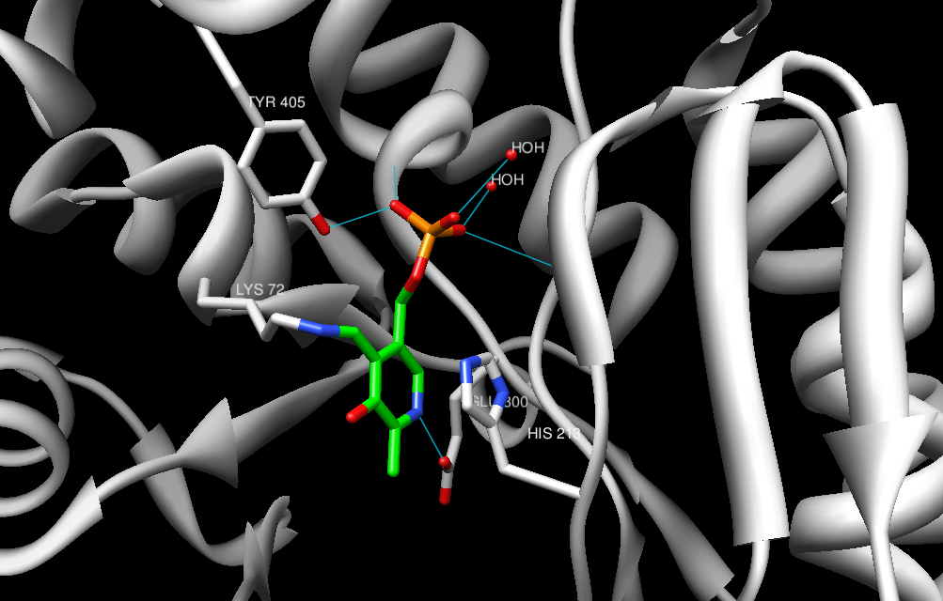
π-π interaction

Slide 67
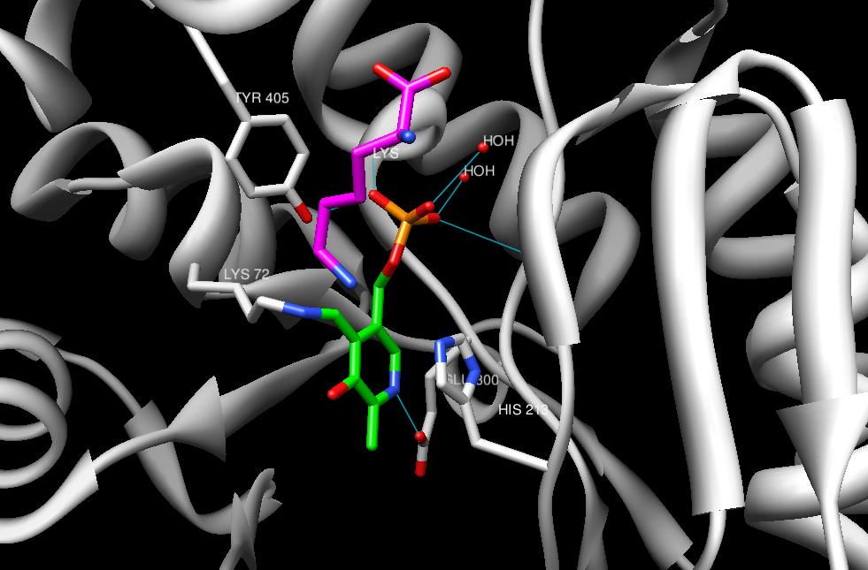

Slide 68
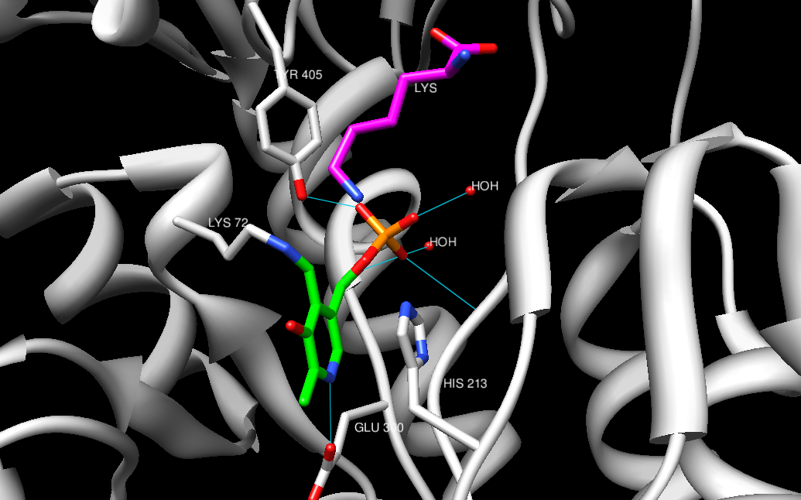

Slide 69
Great! Now, how does this happen?
Akhtar M Biochemistry 29:7648-60 (1990)

Slide 71
Inhibition
Antitubercular/anti-mycobacterial agent development
α-difluoromethylornithine (DFMO/Eflornithine)
Suicide inhibitor
Targets T. brucei ornithine decarboxylase
Links Pyridoxal-5-phosphate w/ Cysteine
Does it affect DAPDC?
VINA!
http://www.lookchem.com/300w%5C2010-8%5C0af42779-57bb-445f-9dae-f06983d113d7.png

Slide 72
DFMO

Slide 73
That might not work…
I designed my own:
Difluoromethyllysine (DFML)
Already exists… (otherwise I would have patented it)
“Zach AttackTM”
http://enzyme-information.info/Mol/Mol.image.php4?ID=20914

Slide 75
Where are we going?
Hypothetical Protein YckF
Nitrogenase Iron Protein
Diaminopimelate dicarboxylase
Glutamyl t-RNA Synthetase
Notes:
All are bacterial proteins

Slide 76
Glutamyl-tRNA Synthetase
Thermus thermophilus
PDB: 1J09, 1N75, 1N77, 1N78
Sekine S-I, Nureki O, Dubois DY, Bernier S, et. al. (2003)
Cellular Signaling Laboratory and Structurome Group
RIKEN Harima Institute at Hyogo, Japan
Department of Biophysics and Biochemistry
University of Tokyo, Japan

Slide 77
What does Glutamyl-tRNA synthetase do?
Catalyzes the aminoacylation of tRNA^{Glu}
Ligates the correct tRNA molecule with the correct amino acid
Specific for tRNA with YUC (Glutamate) anticodons
Y = pyrimidines (C or T)
Remember:
tRNA has anticodon
mRNA has codon
Why is this enzyme important?
Proper expression of the genetic code!
http://www.wiley.com/college/boyer/0470003790/structure/tRNA/trna_diagram.gif

Slide 78
http://kvhs.nbed.nb.ca/gallant/biology/translation_elongation.jpg

Slide 80
Proteobateria
Oxidize organic compounds
Thermophiles
(optimal growth at 65-70°C)
Highly resistant to toxins, UV and
γ-radiation
Filamentous Human Pathogens
(gastroinestinal
& oral)
Thermophile
(≥65°C)
Notes:
All are nitrogen fixers, few are solely known for it
Denitrifying – produce N2. Why might they have this enzyme? ON/OFF GENE REGULATION

Slide 81
Mechanistically Speaking…
Glutamyl-tRNA synthetase:
Positions backbone carboxylate carbon of free Glutamate to attack ATP-α phosphorous
Diphosphate leaving group
Formation of Glu-AMP intermediate
Nucleophilic attack by tRNA base 3’-OH
Formation of tRNA-amino acid ester
Proximity and Coaxial orientation

Slide 82
http://web.virginia.edu/Heidi/chapter32/Images/8883n32_05.jpg
Notes:
http://web.virginia.edu/Heidi/chapter32/Images/8883n32_05.jpg

Slide 83
Stuctures!
Glutamyl-tRNA synthetase (GluRS)
CP domain
Rossman-fold domain
Active site
SC-fold domain
2x Anticodon-binding domains
Unique configuration complementary
to tRNA bidning

Slide 84
Bridging Structure and Fucntion
tRNA synthetase is activated by tRNA binding
Requires correct tRNA anticodon
CUC in these models
Places ATP in correct orientation
Active-site rearrangement
ATP can have both a “productive” and “nonproductive” orientation within the active site
KISKR motif
HVGT motif
Distance

Slide 85
Active Site(s)
Anticodon Recognition
GluRS
GluRS-tRNA^{Glu} boud

Slide 86
Trp 209
Glu 208
ATP
KISKR motif
HVGT motif

Slide 89
Active Site Specificity
Notice Arg5
Idea: Arg5 is essential to substrate binding
To test: In silico mutagenesis & binding studies with Vina
Used the inactive form of tRNA synthetase
Crystal structure with Glu bound
Removed ATP
Arg5→Asp, binding with arginine
Arg5→Trp, binding with phenylalanine

Slide 90
Arg5→Asp, binding with arginine
Arg

Slide 91
Arg5→Trp, binding with phenylalanine
Phe

Slide 92
t-RNA binding: Changes in Active Site
That was in the inactive form
What about t-RNA binding?
ATP “inactive” → “active” substites
No KISKR or HVGT motif HB
t-RNA, ATP GluRS
tRNA, glutamol-AMP GluRS
Aminoacyl-adenylate analog
C=O → CH₂

Slide 93
A
HOH
ATP
KISKR motif
HVGT motif

Slide 94
ATP shift, not Glu
Notes:
Many of the same residues coordinating Glu are still there. ATP is differentially bound!

Slide 95
A
A
C
AMP-Glu Analog

Slide 96
A
AMP-Glu Analog

Slide 97
Whew!
So, we’ve established how the active site works…
But, how does tRNA^{Glu} correctly pair the Glutamate with the cognate tRNA molecule?
tRNA anticodon recognition site
CUC
http://www.wiley.com/college/boyer/0470003790/structure/tRNA/trna_diagram.gif

Slide 102
(A)

Slide 104
This Mutation?
Arg358Gln mutation
Non-disciminating synthetase
Allowed for aminoacylation (Glu) of both Glu and Gln tRNAs.
Glu anticodon: YUC
Gln anticodon: YUG
Sekine S-I et. al. Nature Structural Biology 8(3), 203-6 ,2001

Slide 105
Thank you!!!
Questions?

