Slide 1
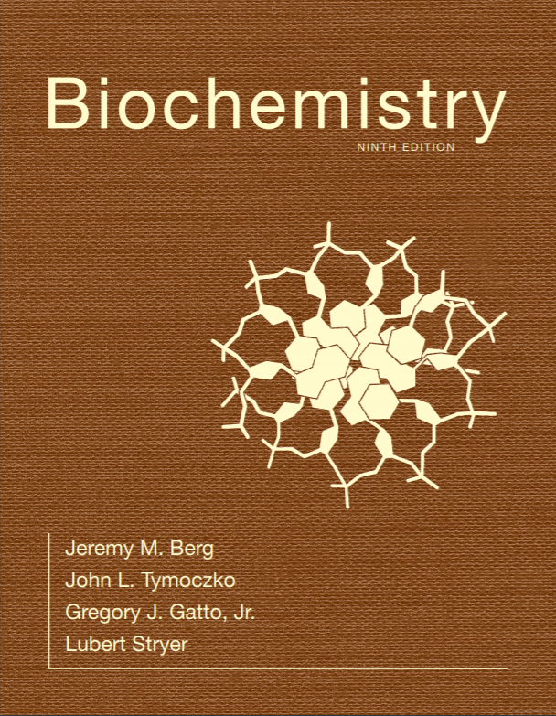
Chapter 8
Enzymes: Basic Concepts and Kinetics
© 2019 W. H. Freeman and Company
Notes:
Corresponding Chapters: 1, 2, 8, 9, 10

Slide 2
Ch.8 Learning Objectives
By the end of this chapter, you should be able to:
Describe the relations between the enzyme catalysis of a reaction, the thermodynamics of the reaction, and the formation of the transition state.
Explain the relation between the transition state and the active site of an enzyme, and list the characteristics of active sites.
Explain what reaction velocity is.
Explain how reaction velocity is determined and how reaction velocities are used to characterize enzyme activity.
Explain how different types of reversible inhibitors can be identified.

Slide 3
Ch.8 Outline
8.1 Enzymes Are Powerful and Highly Specific Catalysts
8.2 Gibbs Free Energy Is a Useful Thermodynamic Function for Understanding Enzymes
8.3 Enzymes Accelerate Reactions by Facilitating the Formation of the Transition State
8.4 The Michaelis–Menten Model Accounts for the Kinetic Properties of Many Enzymes
8.5 Enzymes Can Be Inhibited by Specific Molecules

Slide 4
Enzymes are Remarkable Catalysts
They are crucial in speeding up important chemical reactions and are also the target of many drugs.
Example: omeprazole is used to inhibit the K+/H+ ATPase, the enzyme that acidifies the stomach.
When this enzyme is too active, painful heartburn results and can increase risk for stomach cancer; so omeprazole is an important inhibitor.
Most biological catalysts are proteins, although some are RNA.
Enzymes function by stabilizing the transition state, the highest-energy species in the reaction pathway.

Slide 5
Section 8.1 Enzymes Are Powerful and Highly Specific Catalysts
Enzymes are protein catalysts that can accelerate the rate of a reaction many million-fold.
Even a reaction as simple as the addition of a molecule of water to carbon dioxide in red blood cells requires an enzyme, carbonic anhydrase, to proceed at a reasonable rate.

Slide 6
Rate Enhancement by Selected Enzymes

Slide 7
Enzymes Catalyze Highly Specific Reactions
Reactants in enzyme-catalyzed reactions are called substrates.
Enzymes tend to be highly specific. Example: proteolytic enzymes catalyze the hydrolysis of peptide bonds.
However, most proteolytic enzymes also catalyze the hydrolysis of an ester bond, and these reactions can often be easily monitored in lab investigations.

Slide 8
Proteases Readily Break Peptide Bonds, but can Also Break Ester Bonds

Slide 9
Enzyme Specificity (1/2)
Enzymes can display a high degree of specificity, due to the precise interaction of the enzyme and the substrate.
The proteolytic enzymes trypsin and papain have different degrees of specificity.

Slide 10
Enzyme Specificity (2/2)
Notes:
FIGURE 8.1 Enzyme specificity. (A) Trypsin cleaves on the carboxyl side of arginine and lysine residues, whereas (B) thrombin cleaves Arg–Gly bonds in particular sequences only.

Slide 11
Section 8.2 Gibbs Free Energy Is a Useful Thermodynamic Function for Understanding Enzymes
The free-energy change provides information about the spontaneity but not the rate of a reaction.
A reaction will occur without the input of energy, or spontaneously, only if ΔG is negative. Such reactions are called exergonic reactions.
If a reaction is at equilibrium, there is no net change in the amount of reactant or product. At equilibrium, ΔG =0.
A reaction will not occur spontaneously if the ΔG is positive. These reactions are called endergonic reactions.
The ΔG of a reaction depends only on the free energy difference between reactants and products and is independent of how the reaction occurs.
The ΔG of a reaction provides no information about the rate of the reaction.

Slide 12
The Standard Free-energy Change of a Reaction is Related to the Equilibrium Constant (1/4)
For the reaction
the free energy change is given by
At any conditon
where ΔGº is the standard free-energy change, R is the gas constant, T is 298 kelvins, and the square brackets denote concentration in moles.

Slide 13
Units of Energy
A kilojoule (kJ) is equal to 1000 J.
A joule (J) is the amount of energy needed to apply a 1-newton force over a distance of 1 meter.
A kilocalorie (kcal) is equal to 1000 cal.
A calorie (cal) is equivalent to the amount of heat required to raise the temperature of 1 gram of water from 14.5°C to 15.5°C. 1 kJ = 0.239 kcal.

Slide 14
The Standard Free-energy Change of a Reaction is Related to the Equilibrium Constant (2/4)
ΔGº′ symbolizes the standard free energy change at pH 7.
At equilibrium, ΔG =0; so for the reaction in question
or

Slide 15
The Standard Free-energy Change of a Reaction is Related to the Equilibrium Constant (3/4)
The equilibrium constant for the reaction under standard conditions is
[Products]
or
[Reactants]
Thus,
which can be arranged to give
or

Slide 16
The Standard Free-energy Change of a Reaction is Related to the Equilibrium Constant (4/4)
Why is this true?
Highly exergonic reactions have large K′_{eq} values, and highly endergonic values have small K′_{eq} values.
The actual ΔG of a reaction can differ from its ΔGº′, depending on the concentrations of the reactants and products.
Example: under standard conditions, the isomerization of DHAP to GAP is endergonic, but in glycolysis in the cell, the formation of GAP can be exergonic when DHAP concentrations are high.

Slide 17
Enzymes Alter Only the Reaction Rate and Not the Reaction Equilibrium
The reaction equilibrium is determined only by the free-energy difference between the products and reactants. Enzymes cannot alter this difference.
The uncatalyzed reaction gets there, eventually
Notes:
FIGURE 8.2 Enzymes accelerate the reaction rate. The same equilibrium point is reached but much more quickly in the presence of an enzyme.

Slide 18
Section 8.3 Enzymes Accelerate Reactions by Facilitating the Formation of the Transition State
A chemical reaction proceeds through a transition state, a molecular form that is no longer substrate but not yet product.
The transition state is designated by the double dagger.
The energy required to form the transition state from the substrate is called the activation energy, symbolized by ΔG‡.
Enzymes facilitate the formation of the transition state.

Slide 19
The Transition State
To understand the rate increase achieved by enzymes, assume that the transition state is in equilibrium with the substrate.
K⏇
The rate of reaction is proportional to the concentration of X‡
V α [X‡]
because only X‡ can be converted into product.
The concentration of X‡ depends on the energy difference between X‡ and S, the activation energy.

Slide 20
Enzymes Decrease the Activation Energy
Notes:
FIGURE 8.3 Enzymes decrease the activation energy. Enzymes accelerate reactions by decreasing ΔG‡, the free energy of activation.

Slide 21
Reaction Velocity Versus Substrate Concentration in an Enzyme-catalyzed Reaction
Notes:
FIGURE 8.4 Reaction velocity versus substrate concentration in an enzyme-catalyzed reaction. An enzyme-catalyzed reaction approaches a maximal velocity.

Slide 22
The Active Sites of Enzymes have Some Common Features
The active site is a three-dimensional cleft or crevice created by amino acids from different parts of the primary structure.
The active site constitutes a small portion of the enzyme volume.
Active sites create unique microenvironments.
The interaction of the enzyme and substrate at the active site involves multiple weak interactions.
Enzyme specificity depends on the molecular architecture at the active site.

Slide 23
Active Sites May Include Distant Residues
Notes:
FIGURE 8.6 Active sites may include distant residues. (A) Ribbon diagram of the enzyme lysozyme with several components of the active site shown in color. (B) A schematic representation of the primary structure of lysozyme shows that the active site is composed of residues that come from different parts of the polypeptide chain. [Drawn from 6LYZ.pdb.]

Slide 24
Enzymes Do Not Interact with Their Substrates Like a Lock and Key
Notes:
FIGURE 8.8 Lock-and-key model of enzyme–substrate binding. In this model, the active site of the unbound enzyme is complementary in shape to the substrate.

Slide 25
The Enzyme Changes Shape Upon Substrate Binding, a Phenomenon Called Induced Fit
Notes:
FIGURE 8.9 Induced-fit model of enzyme–substrate binding. In this model, the enzyme changes shape on substrate binding. The active site forms a shape complementary to the substrate only after the substrate has been bound.

Slide 26
Recognition (Binding)
All protein molecules function via binding other molecules
May be other macromolecules or ligands
Binding involves the noncovalent interaction of the protein and the target
VDW interactions: Hydrophobic and London Forces (<- Interactions that occur at limit of the Van der Waals radius only)
Specificity of Binding relies upon the complementarity of shape and character of the protein/ligand complex

Slide 27
Microenvironments
A binding site must provide complementarity for a ligand
An active site must contain catalytically important chemical groups in a specific state AS WELL AS a binding site that can accommodate the transition state
The microenvironment of each ensures ligand complementarity or chemical readiness

Slide 28
Microenvironments: Binding Sites
The binding site may be a cleft or groove on the surface of the protein
Formed as a result of the overall fold
These sites may have an environment that is very different from the solvent
Lipid binding
Charge patches

Slide 29
Microenvironments: Active Sites
Most enzymes use general acid/base catalysis
Protons are donated or accepted b/w catalytically important side chains and/or water molecules
Example: Asp and Lys in an active site
Charge state of each at physiological pH?
What should form/happen between them?
2. It doesn’t, why?
Microenvironment!
Surrounding residues H-bond or use VDW to pull Lys just far enough away
3. When substrate/cofactors bind, active site geometry rearranges to place groups in position

Slide 30
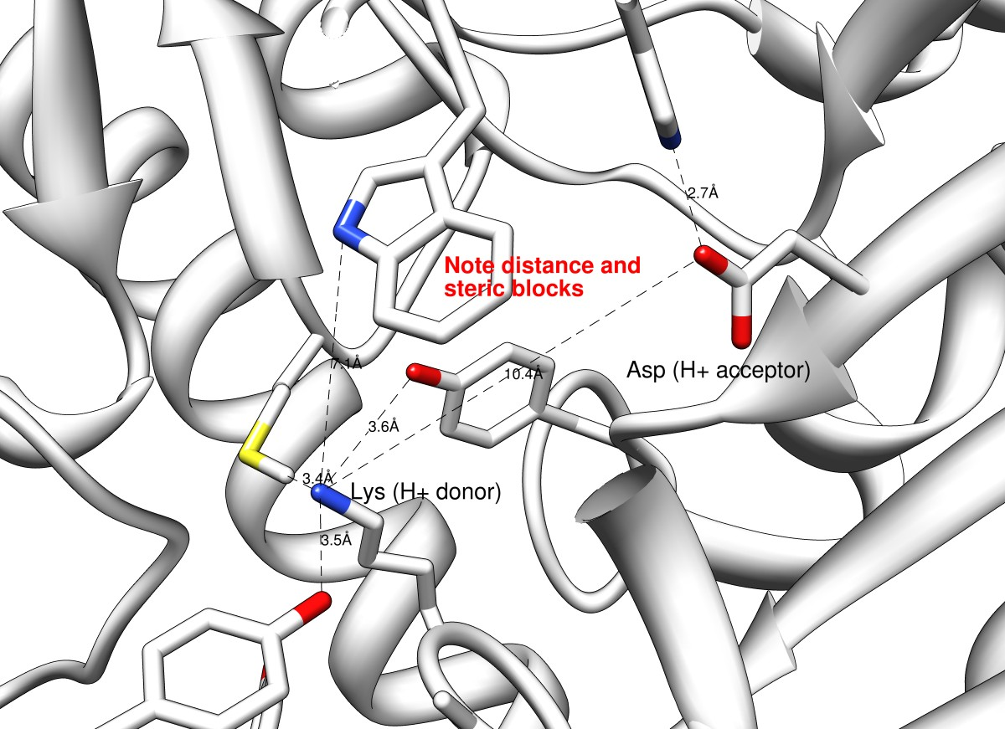
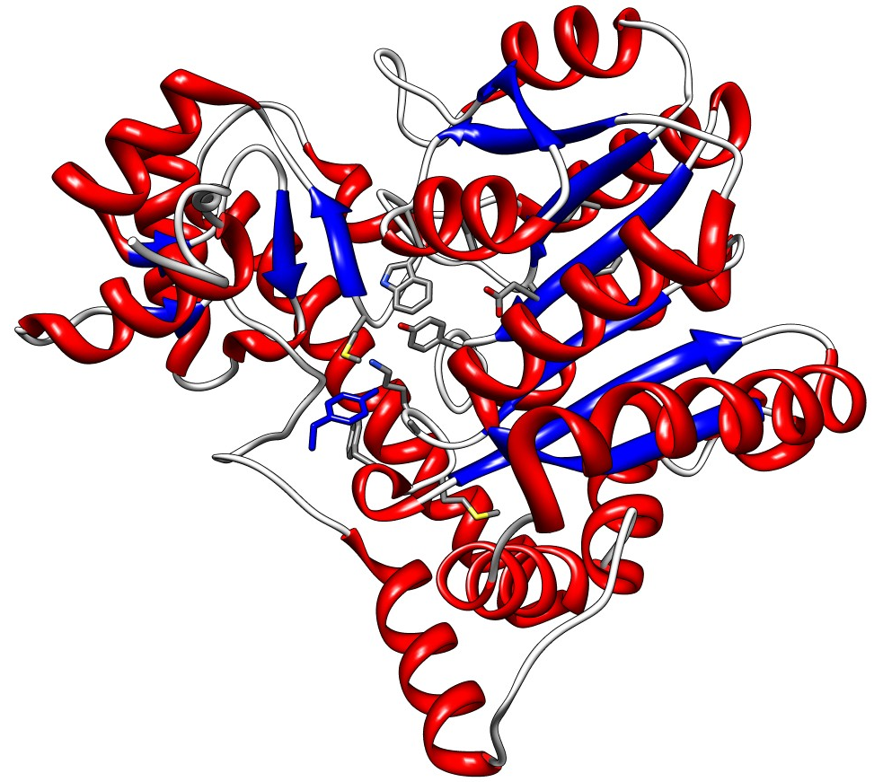
Aspartate aminotransferase

Slide 31
Microenvironments and Thermodynamics
Binding sites must have shape complementarity and have a microenvironment that is substantially different from solvent
Active sites must manipulate the microenvironment surrounding the chemically relevant moieties
Prevent acid/base interactions and salt bridge formation
Alter proton affinities
Stabilize products / destabilize substrates

Slide 32
Microenvironments and Thermodynamics
Two things to consider:
The bunching/crowding of similarly charged residues is a repulsive force and is energetically unfavorable
Providing an environment that prevents acid/base interactions (pre-binding) or electrostatic interactions introduces strain and is energetically unfavorable

Slide 33
Difference b/w Binding Affinity and Specificity
Binding affinity is a measure of the strength of binding
Depends on VDW interactions
Holds ligand for reaction
Binding specificity refers to the potential to bind a ligand at all
Depends on anisotropic forces (Differ in strength depending on direction you measure them)
Hydrogen bonding
Serves to guide ligand in binding site with appropriate orientation

Slide 34
Active Site Geometry
We can break the active site down into two subsites:
Specificity or Binding subsite: VDW and Polar interactions hold the substrate
Reaction subsite: Chemistry is carried out
Protein engineering relies upon this splitting of duties
The specificity can be changed without changing the chemistry

Slide 35
Qualitatively speaking, How?
Enzymes speed up reactions through various means
Optimal ligand orientation w.r.t. catalytic residues
Chemical properties of amino acids
Destabilize substrate
Stabilize transition state or product
Polarize binds
Form covalent intermediates
Provide a solvent-shielded scaffold/workbench

Slide 36
Qualitatively speaking, How?
Enzymes speed up reactions through various means
Optimal ligand orientation w.r.t. catalytic residues
Chemical properties of amino acids
Destabilize substrate
Stabilize transition state or product
Polarize binds
Form covalent intermediates
Provide a solvent-shielded scaffold/workbench

Slide 37
Qualitatively speaking, How?
The rearrangement of covalent bonds in the substrate may result from the formation of transient bonds b/w the enzyme and the substrate
The ES complex has a binding energy associated with it. This binding energy is a major source of the free energy needed to lower the activation energy
The ΔG released by forming several weak binds between the enzyme and substrate drives catalysis
The binding energy contributes to the mandatory specificity as well
Weak interactions are optimized in the transition state
The active site of many enzymes is complementary to the transition state
This pulls the substrate along the reaction coordinate

Slide 38
Section 8.4 The Michaelis–Menten Model Accounts for the Kinetic Properties of Many Enzymes
Consider a simple reaction:
The velocity or rate of the reaction is determined by measuring how much A disappears as a function of time or how much P appears as a function of time.
Suppose that we can readily measure the disappearance of A. The velocity of the reaction is given by the formula below, where k is a proportionality constant.
When the velocity of a reaction is directly proportional to reactant concentration, the reaction is called a first-order reaction and the proportionality constant has the units s⁻¹.

Slide 39
Kinetics is the Study of Reaction Rates
Many important biochemical reactions are bimolecular or second-order reactions:
or
The rate equations for these reactions are
and
The proportionality constant for second-order reactions has the units M⁻¹s⁻¹.

Slide 40
The Steady-state Assumption Facilitates a Description of Enzyme Kinetics (1/7)
A common means of investigating enzyme kinetics is measuring velocity as a function of substrate concentration with a fixed amount of enzyme.
Consider a simple reaction in which the enzyme E catalyzes the conversion of S→P:
with k₁, k₂, k₋₁, and k₋₂ being the rate constants for the indicated reaction steps. So as to ignore the reverse reaction of P→S, we measure activity when [P] ≈ 0.
Under these conditions, the velocity is called the initial velocity, or V_{o}.

Slide 41
Determining the Relation Between Initial Velocity and Substrate Concentration
Notes:
FIGURE 8.10 Determining the relation between initial velocity and substrate concentration. (A) The amount of product formed at different substrate concentrations is plotted as a function of time. The initial velocity (V₀) for each substrate concentration is determined from the slope of the curve at the beginning of a reaction, when the reverse reaction is insignificant. (B) The values for initial velocity determined in part A are then plotted, with error bars, against substrate concentration. (C) The data points are connected to clearly reveal the relationship of initial velocity to substrate concentration.

Slide 42
Michaelis–Menten Kinetics
Notes:
FIGURE 8.11 Michaelis–Menten kinetics. A plot of the reaction velocity (V₀) as a function of the substrate concentration [S] for an enzyme that obeys Michaelis–Menten kinetics shows that the maximal velocity (V_{max}) is approached asymptotically. The Michaelis constant (K_{M}) is the substrate concentration yielding a velocity of V_{max}/2.

Slide 43
The Steady-state Assumption Facilitates a Description of Enzyme Kinetics (2/7)
To quantitatively understand enzymes kinetics, we need an equation that relates rate of catalysis to substrate concentration, enzyme concentration, and the rates of the individual steps.
We start by recognizing that
We will use the steady-state assumption that the rate of formation of ES is equal to the rate of breakdown of ES. Thus,
This equation can be rearranged to

Slide 44
The Steady-state Assumption Facilitates a Description of Enzyme Kinetics (3/7)
We can define a new constant, K_{M}, called the Michaelis constant
K_{M} has the units of concentration and is independent of enzyme or substrate concentration. Thus,
becomes

Slide 45
The Steady-state Assumption Facilitates a Description of Enzyme Kinetics (4/7)
The amount of free enzyme is equal to the total amount of enzyme present minus any enzyme bound to substrate.
Substituting this equation for [E] in
yields

Slide 46
The Steady-state Assumption Facilitates a Description of Enzyme Kinetics (5/7)
This equation can be rearranged to yield
Recall that
Thus,

Slide 47
The Steady-state Assumption Facilitates a Description of Enzyme Kinetics (6/7)
The maximal rate of catalysis, V_{max}, occurs when all of the enzyme is bound to substrate.
[ES] = [E]_{T}
Substituting the equation for V_{max} into
yields the Michaelis-Menten equation

Slide 48
The Steady-state Assumption Facilitates a Description of Enzyme Kinetics (7/7)
The Michaelis-Menten equation describes the initial reaction velocity as a function of substrate concentration.
When V_{o} = ½V_{max}, K_{M} =[S]. Thus, K_{M} is the substrate concentration that yields ½V_{max}.

Slide 49
K_{M} and V_{max} Values can be Determined by Several Means
The Michaelis-Menten equation can be manipulated into one that yields a straight line plot.
This double-reciprocal equation is also called the Lineweaver-Burk equation.

Slide 50
A Double-reciprocal or Lineweaver–Burk Plot
Notes:
FIGURE 8.12 A double-reciprocal or Lineweaver–Burk plot. A double reciprocal plot of enzyme kinetics is generated by plotting 1/V₀ as a function of 1/[S]. The slope is K_{M}/V_{max}, the intercept on the vertical axis is 1/V_{max}, and the intercept on the horizontal axis is -1/K_{M}.

Slide 51
K_{M} and V_{max} Values are Important Enzyme Characteristics (1/2)
K_{M} values for enzymes vary widely, and evidence suggests that the K_{M} value is approximately the substrate concentration of the enzyme in vivo.
K_{M} approximates the dissociation constant of the ES complex only if k₋₁>k₂.

Slide 52
K_{M} Values of Some Enzymes

Slide 53
K_{M} and V_{max} Values are Important Enzyme Characteristics (2/2)
If the enzyme concentration, [E]_{T}, is known, then
and
k₂, also called k_{cat}, is the turnover number of the enzyme, which is the number of substrate molecules converted into product per second.
K_{M} and V_{max} also allow the determination of ƒ_{ES}, the fraction of enzymes bound to substrate.

Slide 54
Turnover Numbers of Some Enzymes

Slide 55
k_{cat}/K_{M} is a Measure of Catalytic Efficiency (1/2)
If the concentration of S is much smaller than K_{M}, the Michaelis-Menten equation becomes
Under the same conditions, [E] ≈ [E]_{T}; thus

Slide 56
k_{cat}/K_{M} is a Measure of Catalytic Efficiency (2/2)
The reaction rate is directly proportional to k_{cat}/K_{M}.
Expanding this term yields
Reaction rate is limited by k₁. This rate cannot be faster than the diffusion-limited interaction of E and S.
Some enzymes have k_{cat}/K_{M} values approaching the rate of diffusion. Such enzymes are catalytically perfect.
Those that use electrostatic interactions to entice the substrate into the active site are sometimes referred to as using the Circe effect.

Slide 57
Substrate Preferences of Chymotrypsin

Slide 58
Enzymes for which k_{cat}/K_{M} is Close to the Diffusion-controlled Rate of Encounter

Slide 59
Most Biochemical Reactions Include Multiple Substrates
There are two classes of multiple substrate reactions: sequential and double-displacement reactions.
Sequential reactions, which may be random or ordered, are characterized by the formation of a ternary complex consisting of the enzyme and both substrates.
Double-displacement reactions are characterized by the formation of a substituted enzyme intermediate.

Slide 60
An Ordered Sequential Reaction

Slide 61
A Random Sequential Reaction

Slide 62
Double-displacement (Ping-pong) Reaction

Slide 63
Allosteric Enzymes Do Not Obey Michaelis–Menten Kinetics
Not all enzymes display Michaelis-Menten kinetics.
An important group of enzymes are allosteric enzymes, which display cooperative substrate binding. Their kinetics can often be observed as a sigmoidal reaction velocity curve.
Notes:
FIGURE 8.13 Kinetics for an allosteric enzyme. Allosteric enzymes display a sigmoidal dependence of reaction velocity on substrate concentration.

Slide 64
Section 8.5 Enzymes Can Be Inhibited by Specific Molecules
Irreversible enzyme inhibitors bind covalently or noncovalently to the enzyme, but with a negligible dissociation constant.
Reversible inhibition is characterized by a rapid dissociation of the enzyme-inhibitor complex.
There are three common types of reversible inhibition:
Competitive inhibition: The inhibitor is structurally similar to the substrate and can bind to the active site, preventing the actual substrate from binding.
Uncompetitive inhibition: The inhibitor binds only to the enzyme-substrate complex in what is essentially substrate-dependent inhibition.
Noncompetitive inhibition: The inhibitor binds either the enzyme or enzyme-substrate complex.

Slide 65
Distinction Between Reversible Inhibitors
Inhibitor interferes with binding of substrate (Km changes)
Inhibitor interferes with release of product (Km and Vm change by same amount)
Inhibitor interferes with conversion of substrate to product (Vm changes)
Notes:
FIGURE 8.14 Distinction between reversible inhibitors. (A) Enzyme–substrate complex; (B) a competitive inhibitor binds at the active site and thus prevents the substrate from binding; (C) an uncompetitive inhibitor binds only to the enzyme–substrate complex; (D) a noncompetitive inhibitor does not prevent the substrate from binding.

Slide 66
Some Competitive Inhibitors are Useful Drugs
An early example is the antibiotic sulfanilamide.
Sulfanilamide mimics p-aminobenzoic acid (PABA), a metabolite needed by bacteria for synthesis of the coenzyme folic acid. Sulfanilamide binds to the enzyme that normally metabolizes PABA and competitively inhibits it, preventing folic acid synthesis.
Because humans get folic acid from their diet, they are not affected by this drug.

Slide 67
The Different Types of Reversible Inhibitors are Kinetically Distinguishable (1/4)
In competitive inhibition, the inhibitor competes with the substrate for the active site. The dissociation constant of the inhibitor is given by
In competitive inhibition, V_{max} of the enzyme is unchanged because the inhibition can be overcome by a sufficiently high concentration of substrate.
However, K_{M} in the presence of inhibitor, called K_{M}^{app}, is increased.

Slide 68
Kinetics of a Competitive Inhibitor
Notes:
FIGURE 8.15 Kinetics of a competitive inhibitor. As the concentration of a competitive inhibitor increases, higher concentrations of substrate are required to attain a particular reaction velocity. The reaction pathway suggests how sufficiently high concentrations of substrate can completely relieve competitive inhibition.

Slide 69
The Different Types of Reversible Inhibitors are Kinetically Distinguishable (2/4)
In uncompetitive inhibition, the enzyme-inhibitor-substrate complex does not form product. The apparent V_{max,} called V_{max}^{app} , is lower in the presence of inhibitor.
The K_{M} is also lower.
Uncompetitive inhibition cannot be overcome by the addition of excess substrate.

Slide 70
Kinetics of an Uncompetitive Inhibitor
Notes:
FIGURE 8.16 Kinetics of an uncompetitive inhibitor. The reaction pathway shows that the inhibitor binds only to the enzyme–substrate complex. Consequently, V_{max} cannot be attained, even at high substrate concentrations. The apparent value for K_{M} is lowered, becoming smaller as more inhibitor is added.

Slide 71
The Different Types of Reversible Inhibitors are Kinetically Distinguishable (3/4)
In noncompetitive inhibition, the inhibitor can bind to free enzyme or to the enzyme-substrate complex. In either case, the binding of inhibitor prevents the formation of product.
V_{max} in the presence of a noncompetitive inhibitor is lower.
K_{M} is not changed by the presence of a noncompetitive inhibitor.
Noncompetitive inhibition cannot be overcome by increasing substrate concentration.

Slide 72
Kinetics of a Noncompetitive Inhibitor
Notes:
FIGURE 8.17 Kinetics of a noncompetitive inhibitor. The reaction pathway shows that the inhibitor binds both to free enzyme and to an enzyme–substrate complex. Consequently, as with uncompetitive inhibition, V_{max} cannot be attained. In pure noncompetitive inhibition, K_{M} remains unchanged, and so the reaction rate increases more slowly at low substrate concentrations than is the case for uncompetitive competition.

Slide 73
The Different Types of Reversible Inhibitors are Kinetically Distinguishable (4/4)
Double-reciprocal plots highlight the differences in the types of reversible inhibition. The equation for a double-reciprocal plot in the presence of a competitive inhibitor is
The equation in the presence of an uncompetitive inhibitor is

Slide 74
Competitive Inhibition Illustrated on a Double-reciprocal Plot
Notes:
FIGURE 8.18 Competitive inhibition illustrated on a double-reciprocal plot. A double-reciprocal plot of enzyme kinetics in the presence and absence of a competitive inhibitor illustrates that the inhibitor has no effect on V_{max} but increases K_{M}.

Slide 75
Uncompetitive Inhibition Illustrated by a Double-reciprocal Plot
Notes:
FIGURE 8.19 Uncompetitive inhibition illustrated by a double-reciprocal plot. An uncompetitive inhibitor does not affect the slope of the double-reciprocal plot. V_{max} and K_{M} are reduced by equivalent amounts.

Slide 76
Noncompetitive Inhibition Illustrated on a Double-reciprocal Plot
Notes:
FIGURE 8.20 Noncompetitive inhibition illustrated on a double-reciprocal plot. A double-reciprocal plot of enzyme kinetics in the presence and absence of a pure noncompetitive inhibitor shows that K_{M} is unaltered and V_{max} is decreased.

