Slide 1
Welcome to CHEM523
Please go the the course website on the chem.Winthrop.edu server:
http://chem.winthrop.edu/faculty/hurlbert/link_to_webpages/courses/chem523/chem523home.html
Familiarize yourself with the course format and what is expected of you.
READ THE SYLLABUS

Slide 2
Welcome to CHEM523
Should you have any questions, email me and I will post the question (anonymously) and my answer on the “Discussion Board” webpage on the chem.Winthrop.edu server.
No, I don’t use Blackboard.
  Just this morning, it stopped working and you deserve the best, all of the time.
  I also don’t use what I can’t control

Slide 3
What is Biochemistry?

Slide 4
Ch.1 Learning Objectives
By the end of this chapter, you should be able to:
Compare and contrast the unity of biology at the organismal and the biochemical levels.
Discuss important interactions between atoms including covalent bonds, ionic interactions, hydrogen bonds, and van der Waals interactions.
Describe the structure of water and its contribution to interactions between molecules through the hydrophobic effect.
Discuss the conservation of energy and the first law of thermodynamics.
Discuss the concepts of entropy and enthalpy and the second law of thermodynamics.
Discuss acid-base reactions and perform calculations using the definitions of pH and pKa as well as the Henderson–Hasselbalch equation.
Explain the roles of buffers in stabilizing the pH of solutions.

Slide 5
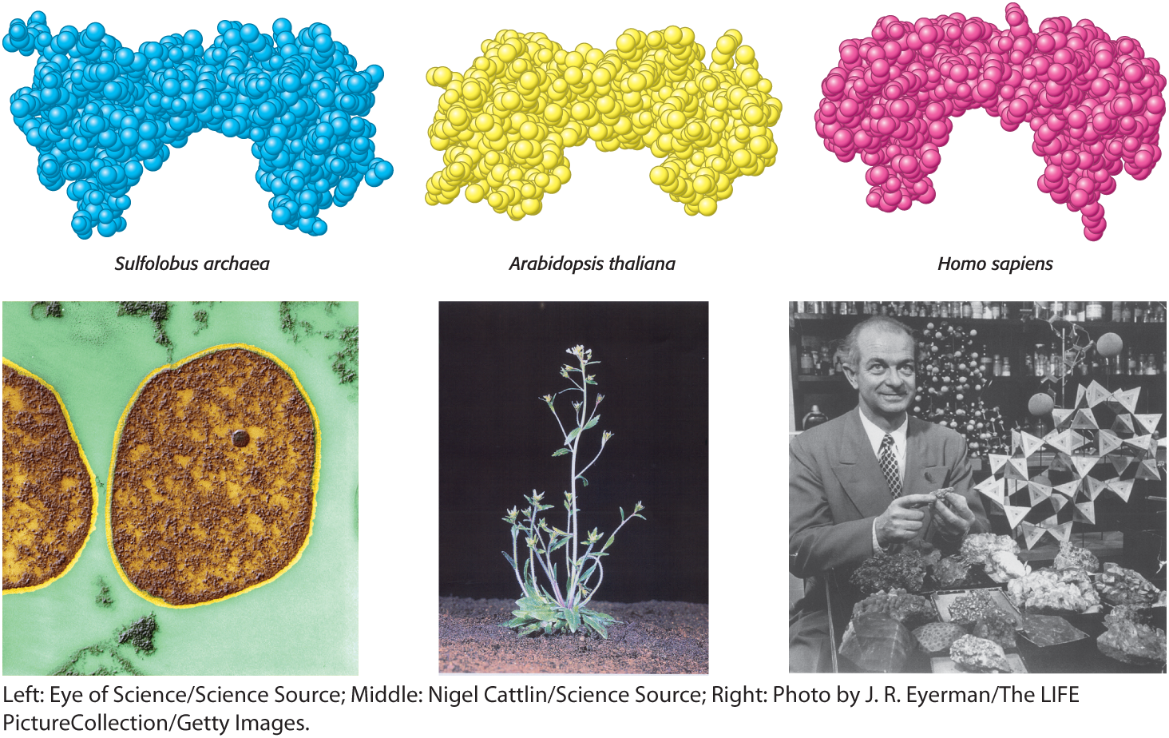

Slide 6
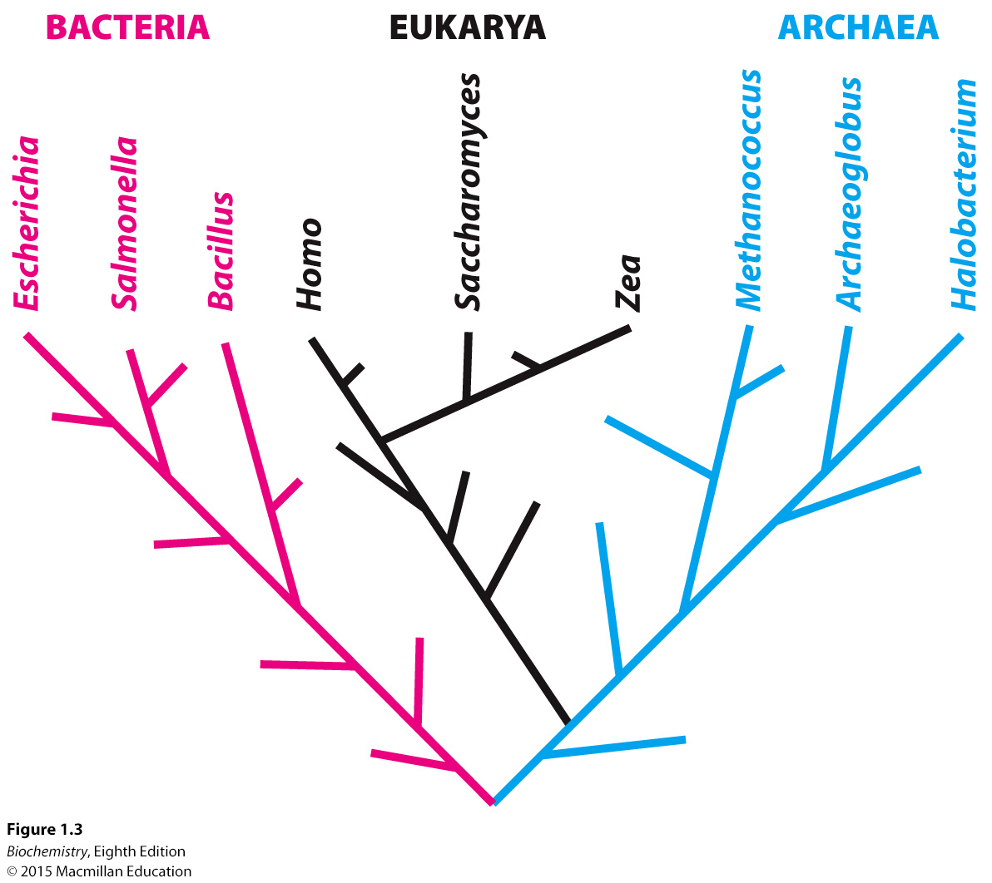
On the basis of biochemical characteristics, all organisms can be placed in one of three domains.
We could use any number of parameters to construct the tree: metabolic capabilities, 16S rRNA sequence, lipid composition, etc

Slide 7
Covalent Bonds
Covalent bonds, formed by electron sharing between two adjacent atoms, are the strongest bonds.
  A typical C–C covalent bond has a distance of 1.54 Å and a bond energy of 355 kJ mol⁻¹ (85 kcal mol⁻¹).
  1 Å (Angstrom) is 0.1 nm, or 10⁻¹⁰ m.

Slide 8
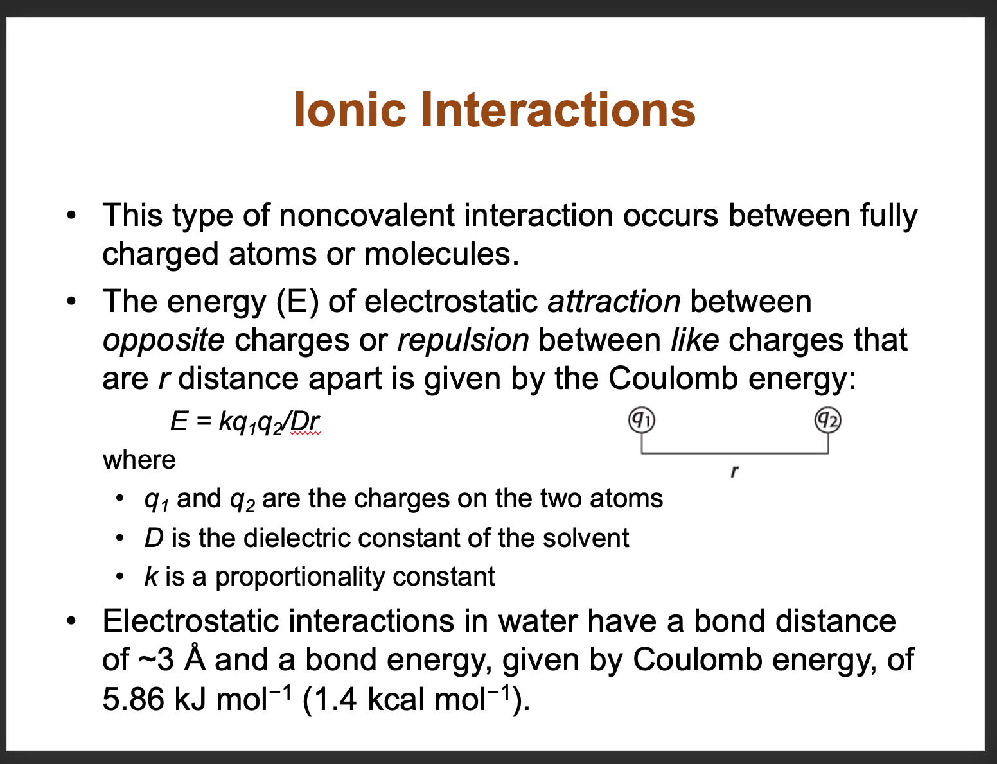
22

Slide 9
Intermolecular Forces
Covalent bonds and Ion-Ion interactions are important when making molecules. But intermolecular interactions are guided by Four Basic Types of Non Covalent Interactions or Intermolecular Forces
Ion-Dipole
Dipole-Dipole
Dipole-Induced dipole
London Forces
The strength of the interactions in each force is inversely proportional to the distance between the interacting species

Slide 10
Coulomb’s Law and Interacting Species
The force between two interacting ions is equal to the magnitude of the charges divided by the square of the distance between them.
k = proportionality constant = 8.99x10⁹ JmC⁻²
D is the dielectric constant
The dielectric constant is a measure of the ability of the solvent or medium containing the charges to keep them apart (D for a vacuum is 1, D for a brick wall is ∞)

Slide 11
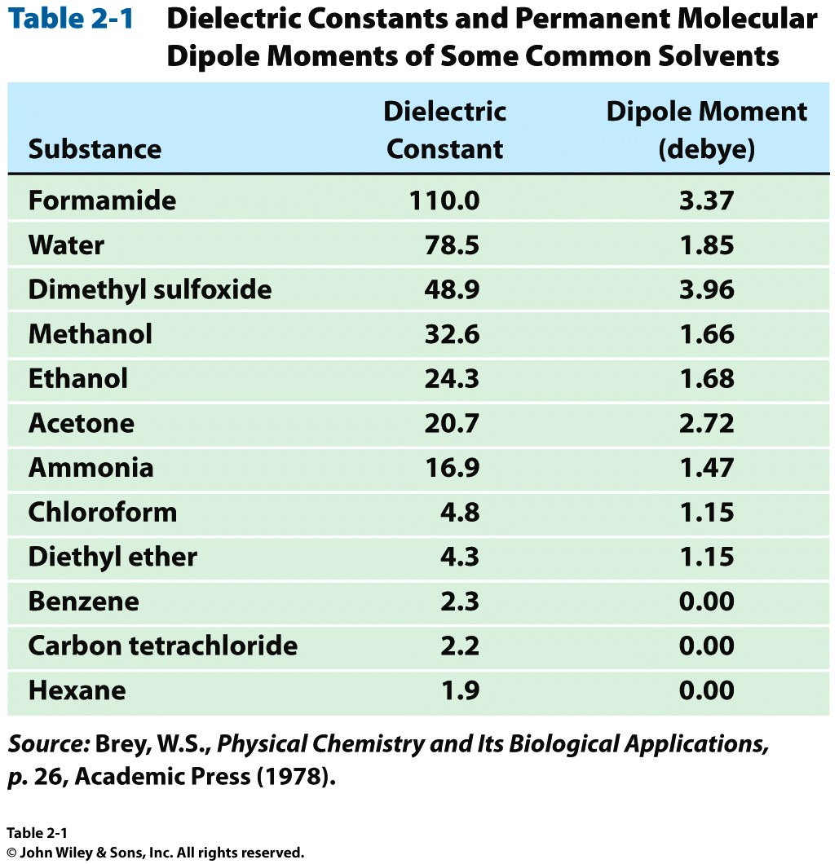
Dielectric Constants
Note: As the polarity of the solvent decreases, what happens to the dielectric constant?
What does this mean for physical phenomena?
Do salts dissolve in fats or water?

Slide 12
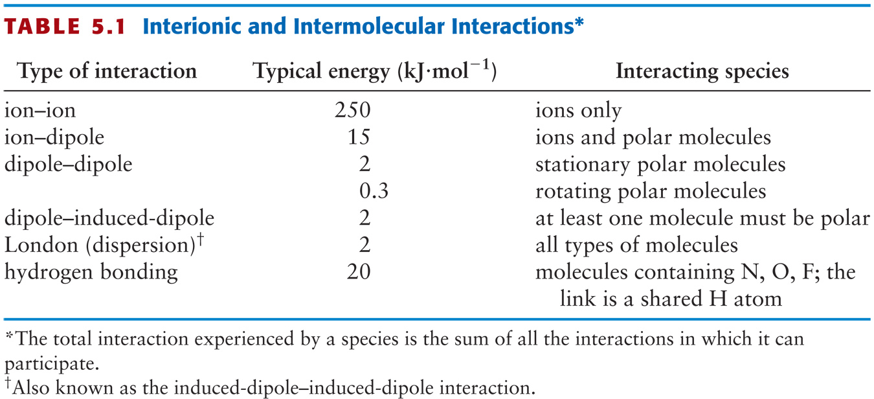
Interion and Intermolecular Forces
Ion-Ion interactions are the strongest interactions and hydrogen bonds are a special case of dipole-dipole interactions
  Example of an ion-ion interaction?
Let’s look at the various interactions given in the table

Slide 13
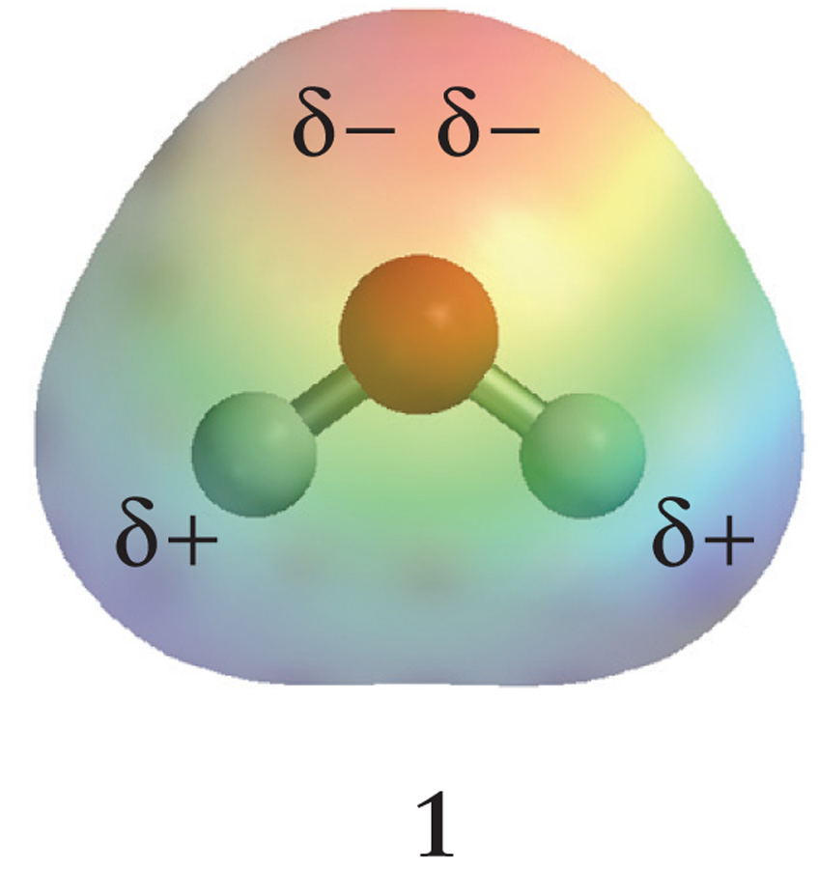
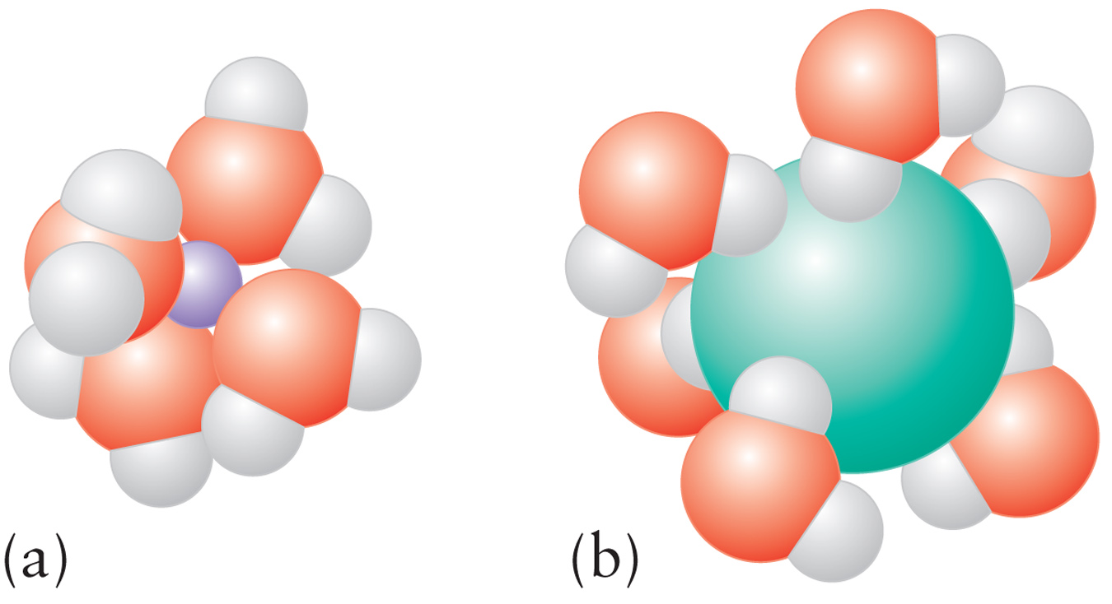
Ion-Dipole Interactions
Best example: Hydrated Ions
The polar character of the water molecule allows it to interact with cations or anions
We can describe the interaction energy:
z = ion charge
µ = Electric dipole moment
r = distance

Slide 14
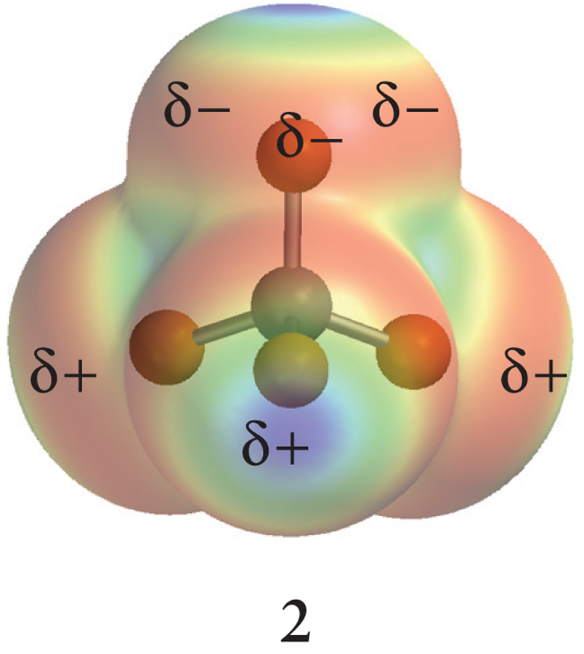
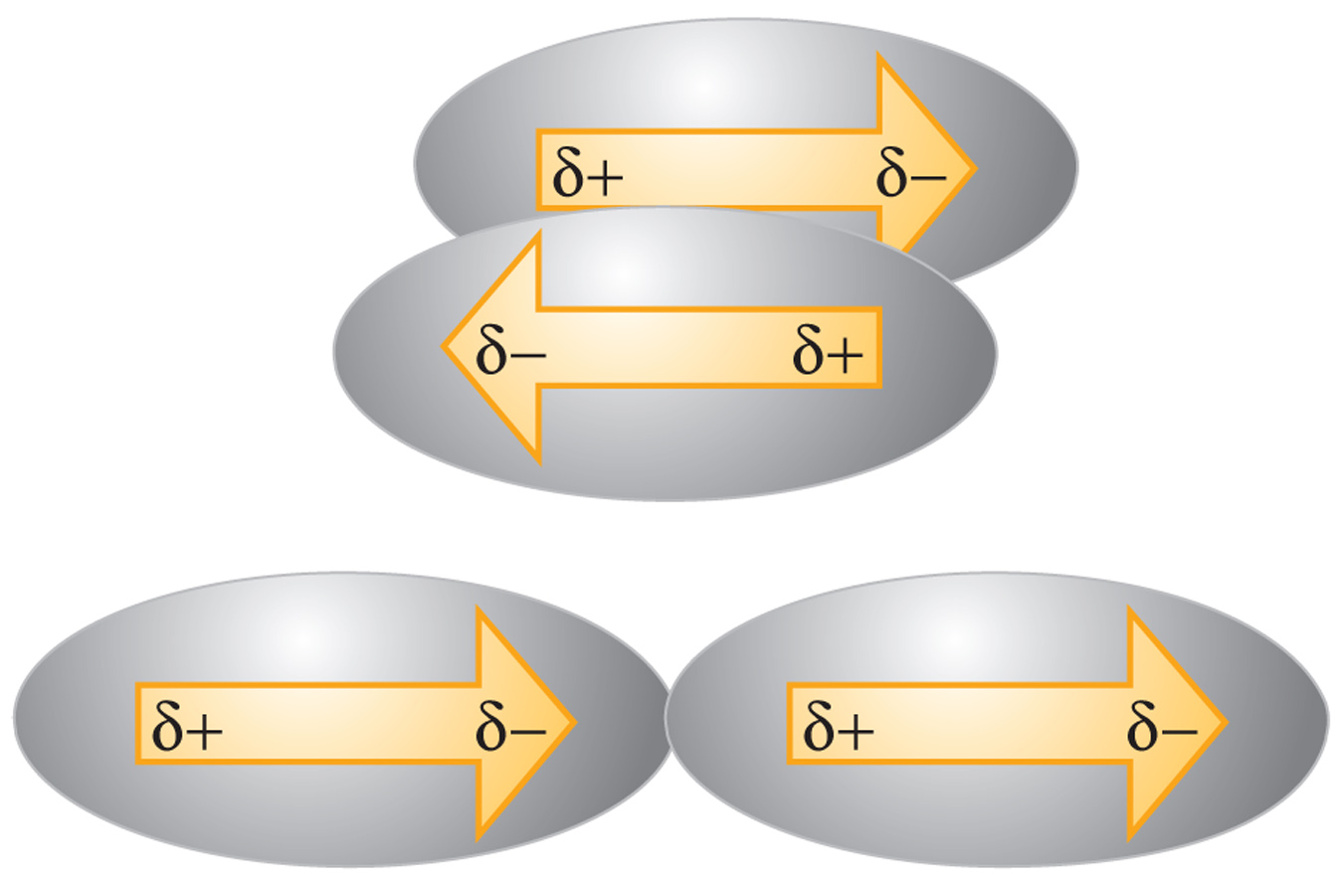
Dipole-Dipole interactions
Let’s look at the interactions between polar molecules
The Dipole-Dipole interactions force some order in the solution

Slide 15
Dipole-Dipole interactions
Dipole-Dipole interaction energy:
µ₁: Dipole moment of molecule 1
µ₂: Dipole moment of Molecule 2
The fact that the distance is cubed means that the energy falls of much more rapidly than ion-ion interactions as the interacting species are separated

Slide 16
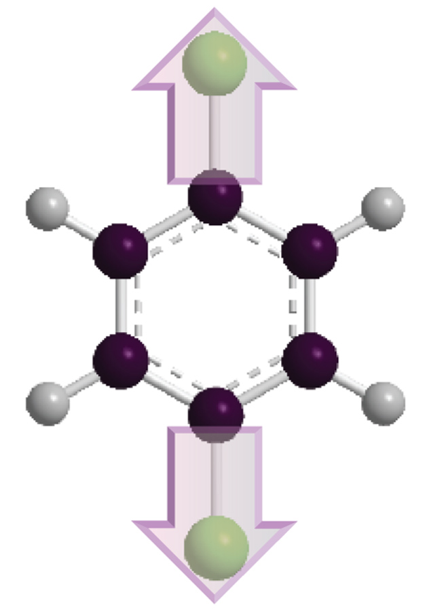
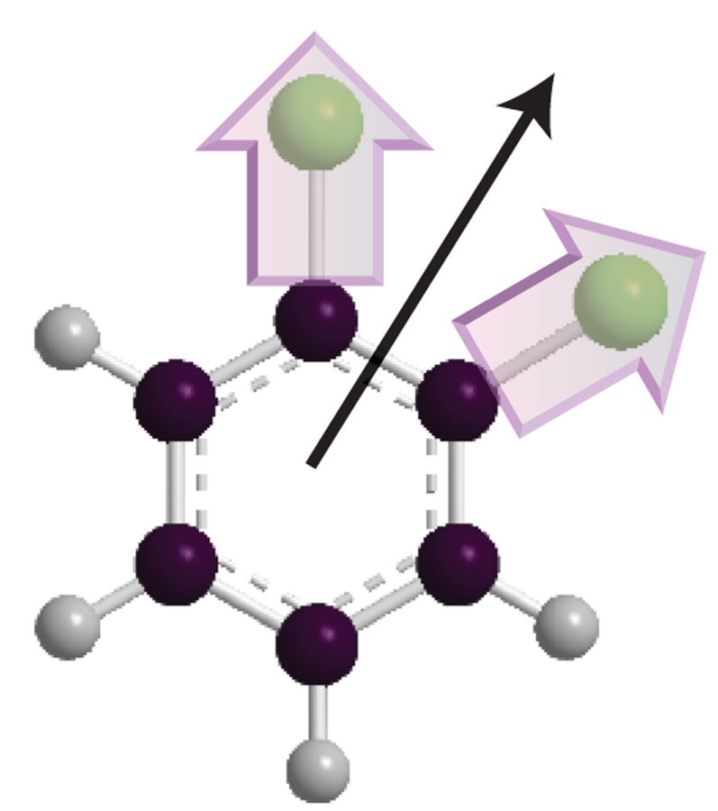
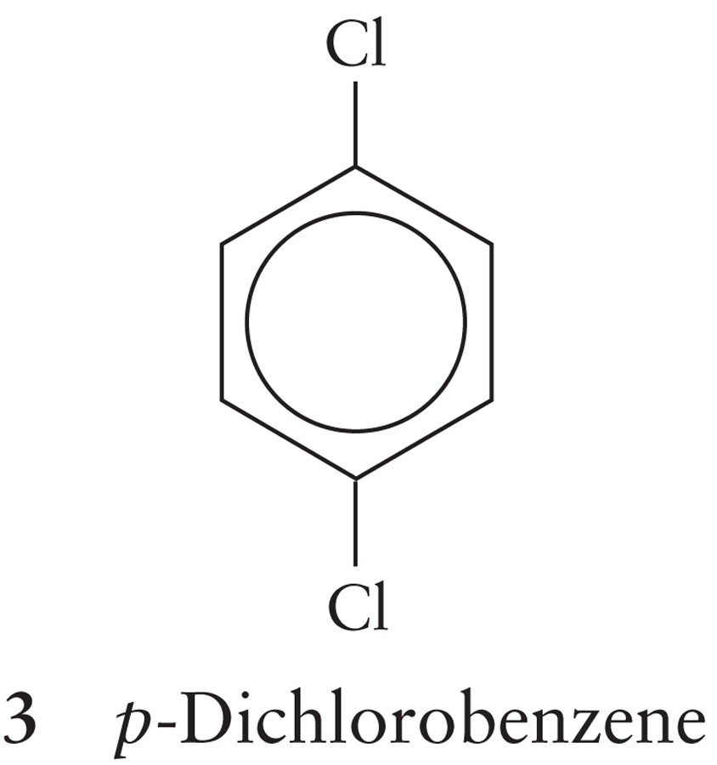
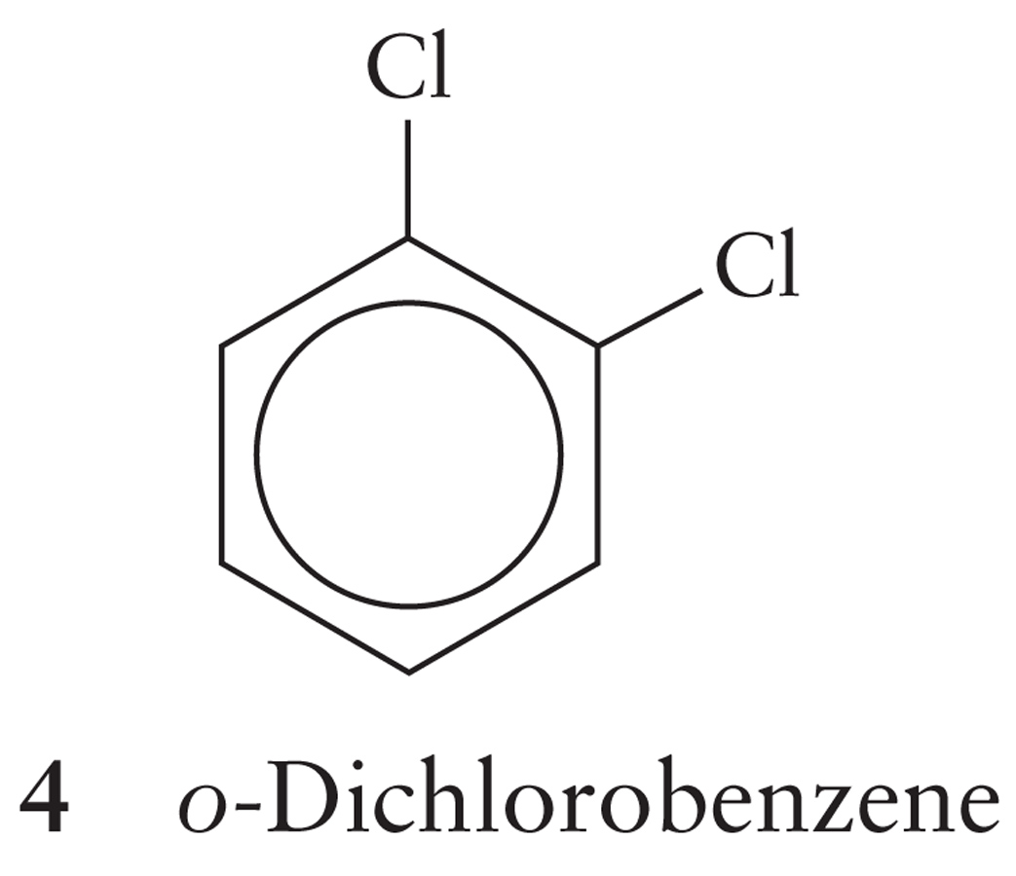
Which molecule has the higher boiling point:
p-dichlorobenzene and o-dichlorobenzene
Dipole moment for the molecules?

Slide 17
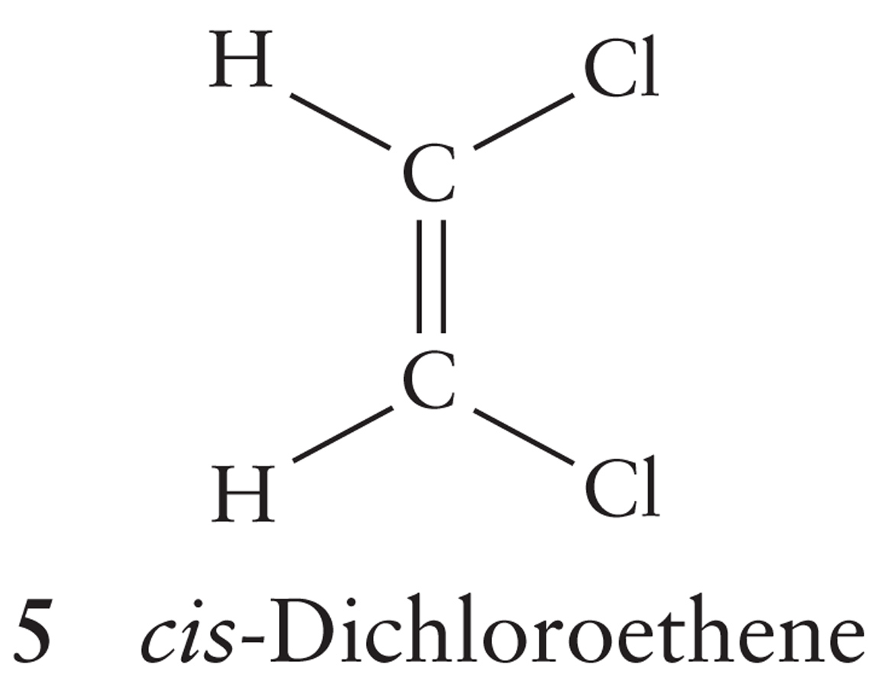
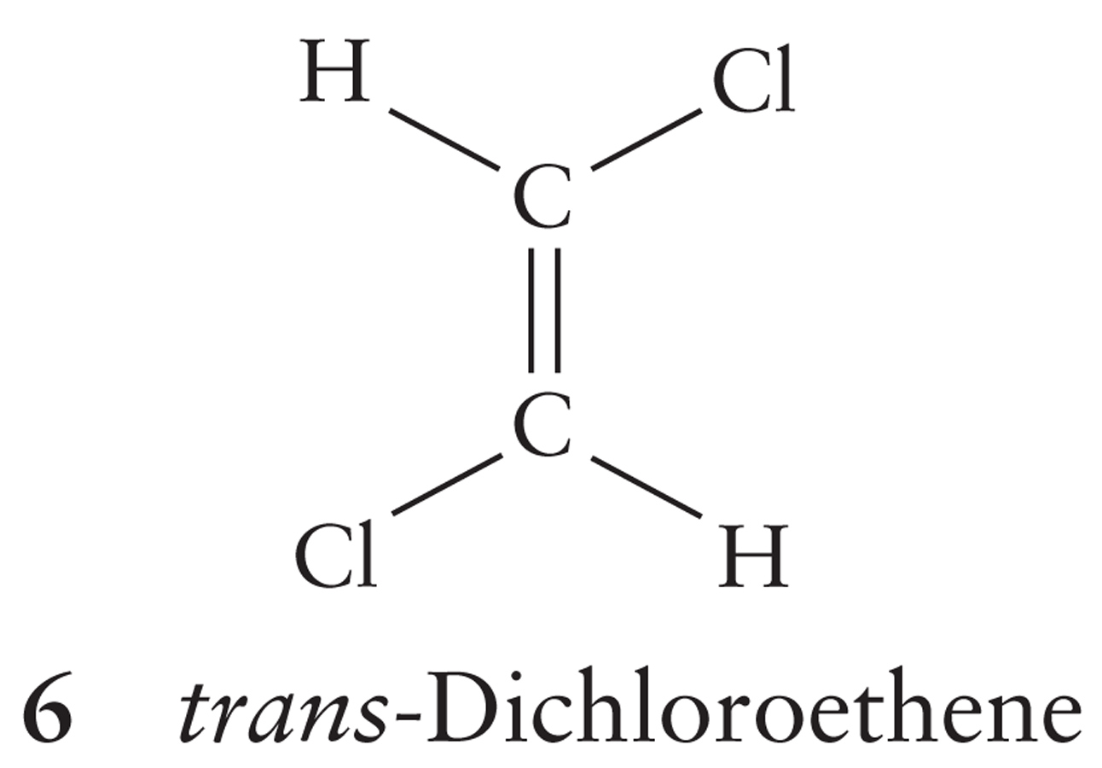
Which molecule has the higher boiling point:
cis-dichloroethene or trans-dichloroethene?

Slide 18
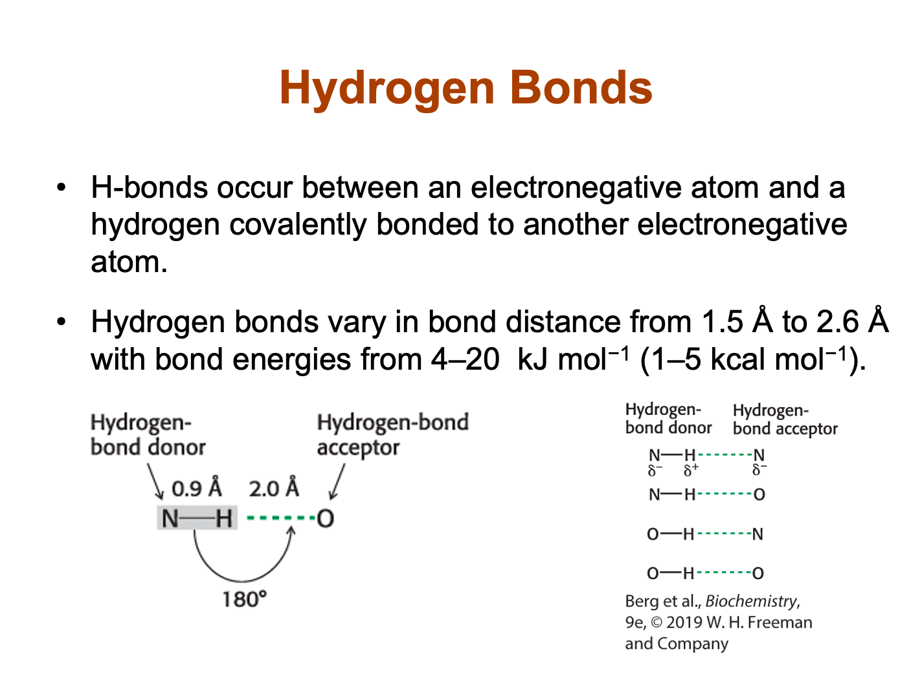
A special case of dipole-dipole interactions

Slide 19
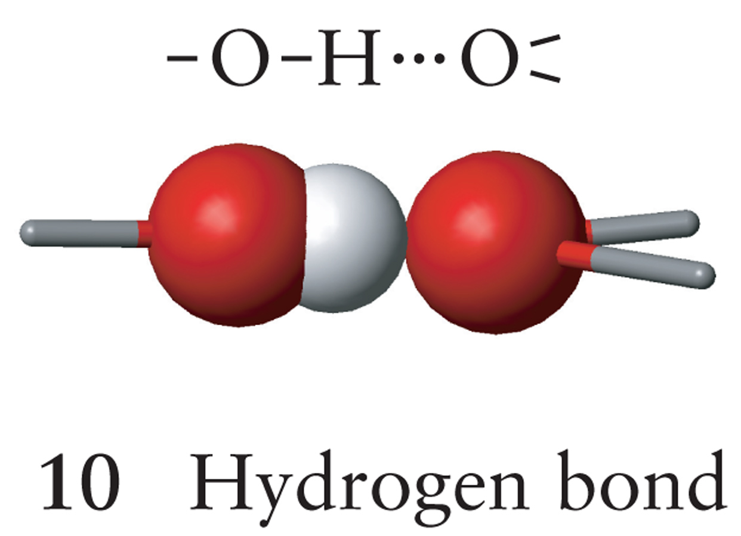
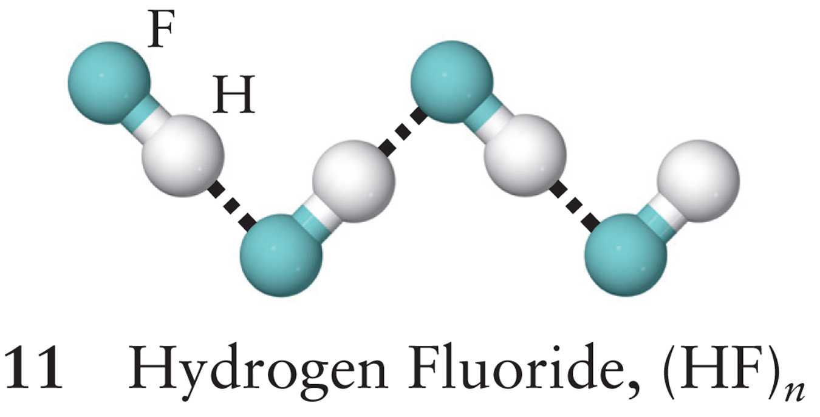
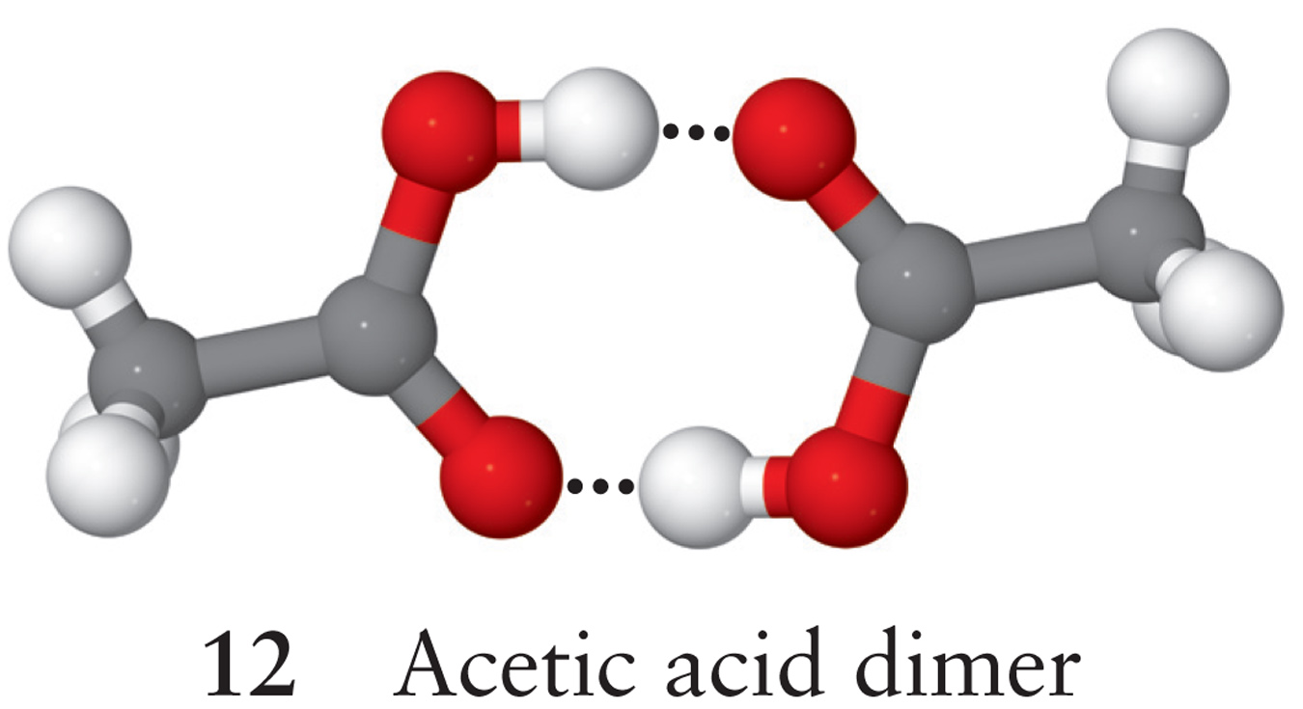
Hydrogen Bonding
Hydrogen bonds are one of the most important interactions in biological systems
Hydrogen Bonds:
Hold proteins together
Allow DNA base pairs to match up
Allow structural polymers to interact
Hydrogen bonds are the strongest type of non-ionic intermolecular force

Slide 20
Dipole - Induced Dipole
The presence of a molecule with a strong dipole moment can induce or create a dipole in a non-polar molecule
  This depends on the strength of the dipole and the polarizability of the nonpolar molecule
μ₁: Dipole moment of molecule 1
α₂: Polarizability of molecule 2

Slide 21
London Forces
London Forces are attractive forces between non-polar molecules
(all molecules have them, but they are much weaker than other types)
How do these interactions arise?

Slide 22
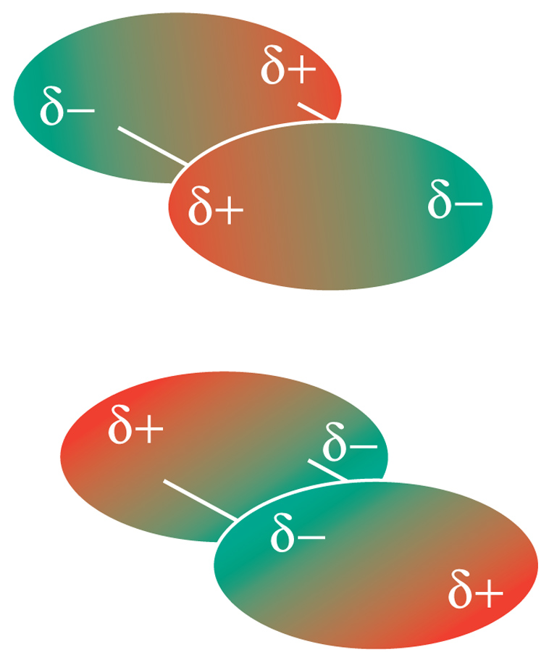
London Forces
The electron clouds are constantly shifting and sometimes the molecule gets a small dipole moment
  Neighboring nonpolar molecules will have their electron clouds distorted and will form a dipole of opposite orientation
Then the process starts over (Dipole disappears and reforms) (1x10⁻¹⁶ sec to form and disappear)

Slide 23
London Forces
α₁: Polarizability of molecule 1
α₂: Polarizability of molecule 2
r⁶ !!!!
Very short range effects!!
What determines Polarizability?
  Large atomic radii
  Low Zeff
High Polarizability = Large London Interactions

Slide 24
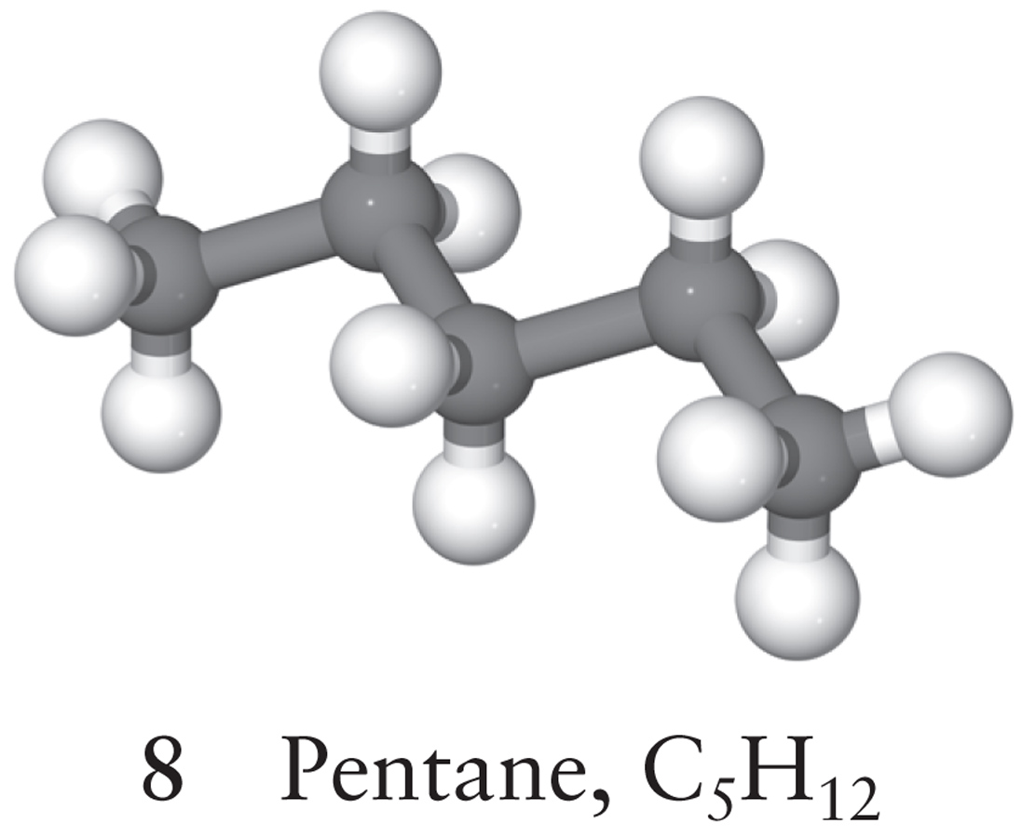
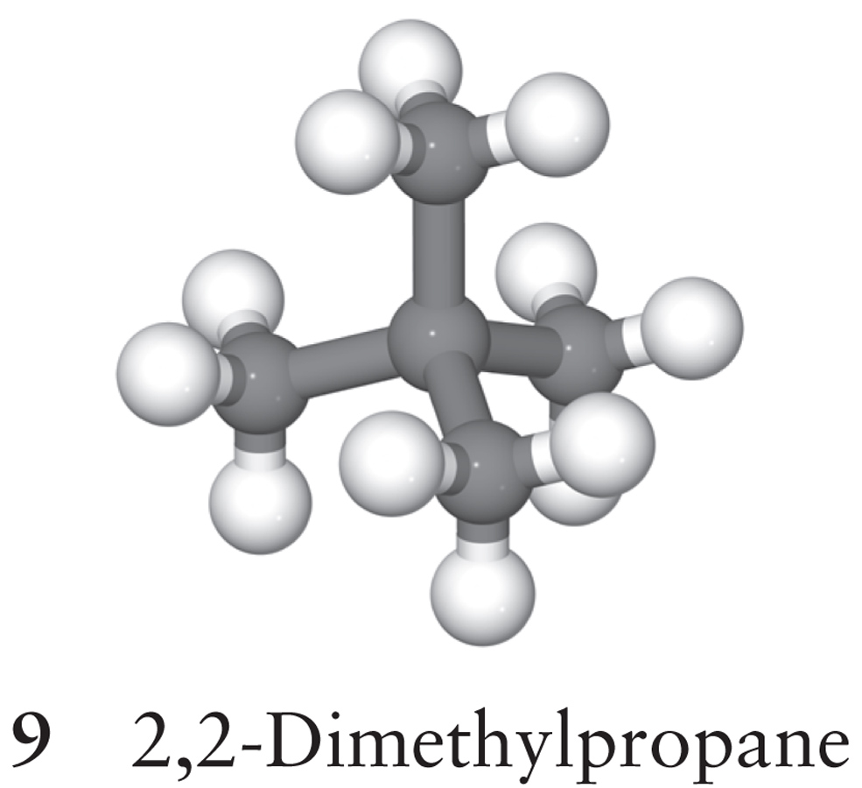
London Forces and Molecular Shape
Because the London Force energy drops off VERY sharply as a function of distance, molecular shape is a major contributor to London Force energy
Which has the higher boiling point?

Slide 25
Implications of Intermolecular Forces
Species form greater interactions if their shape is complementary and if they are attracted to their partner. (What is true at the atomic scale is true on the macroscopic scale!)
This effects:
Ice formation
Salt dissolution
Boiling points
Protein Folding / Unfolding (←Soon precious, soon!)
Much, much more!

Slide 26
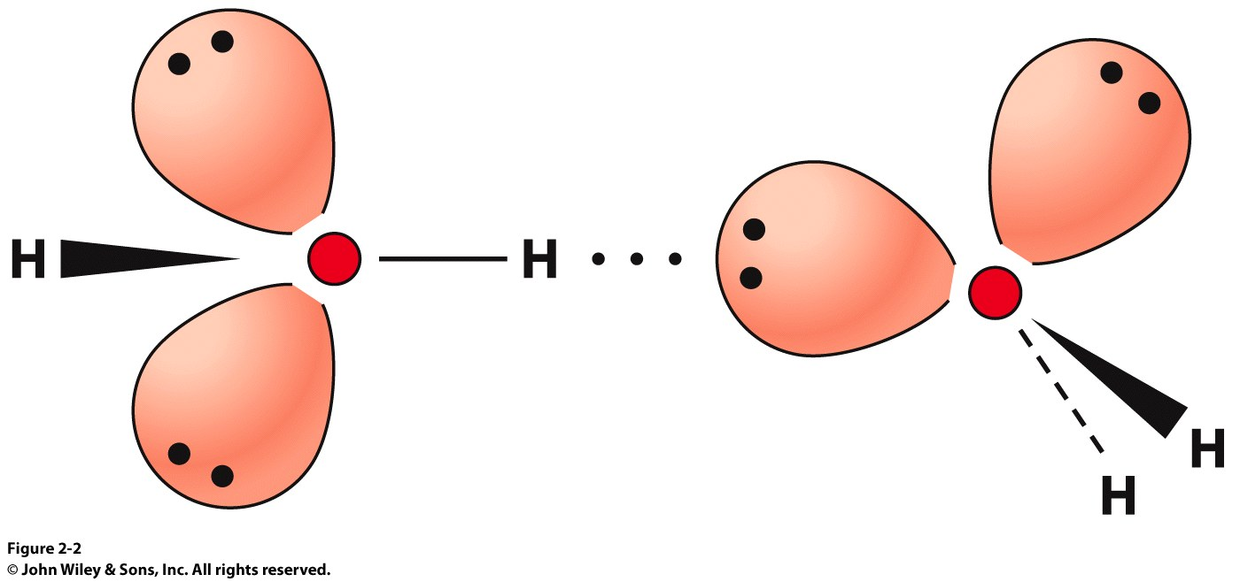

Back to water…
Water forms a special type of Dipole/Dipole interaction: Hydrogen Bonding
Bond Length:
Avg H-bond length: 1.8 Å
Avg O-H bond length: 2.6 Å
Bond Energies:
Avg. H-bond energy: 20 kJ/mole
Avg. O-H bond energy: 460 kJ/mole

Slide 27
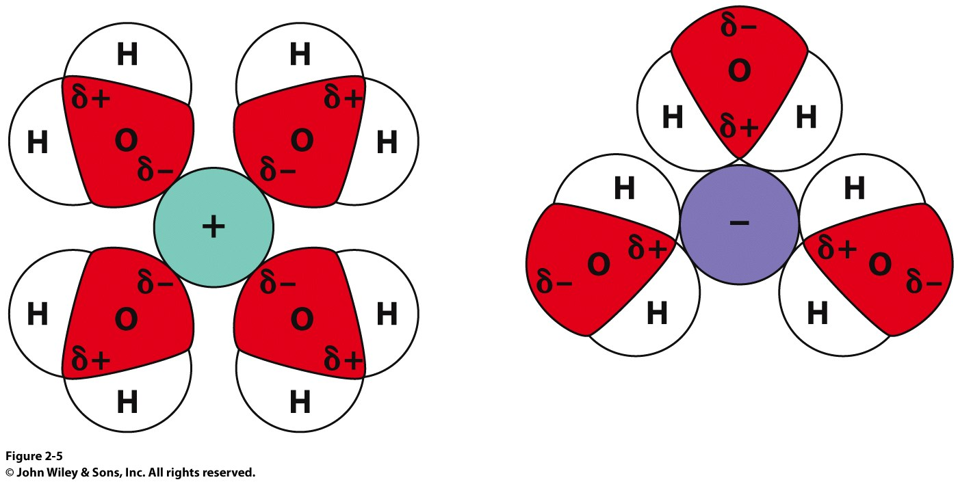
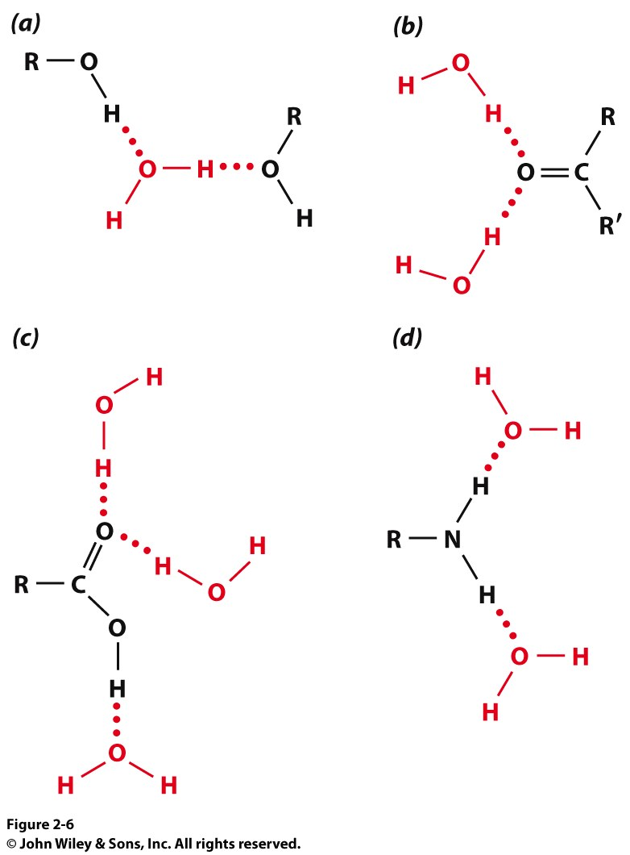
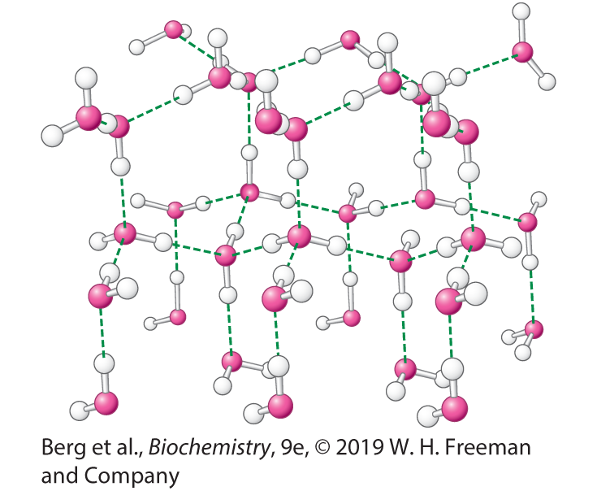
Solvation of ions by water
Ion-Dipole Interaction
Hydrogen Bonding
Dipole-Dipole Interaction

Slide 28

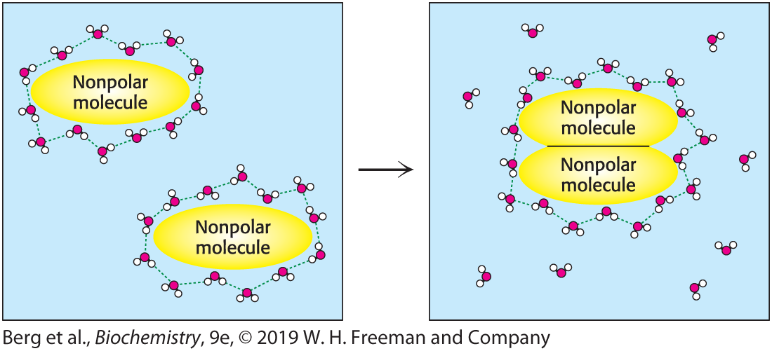
The hydrophobic effect.
Nonpolar molecules in water can be driven together by the hydrophobic effect which is powered by the increase in entropy of water. The associated interactions are called hydrophobic interaction.
Clathrate Cages = Ordered Water = Decreased ΔS = Not favorable

Slide 34
Acids/Bases, Titrations and Buffers
This is the third class you have had dealing with acids and bases, for chemistry majors, it is the fourth.
You MUST know this backwards and forwards
Strong Acid / Strong Base Titration:
HA + B- → A- + HB
Acid Base Conj Base Conj Acid
Bronsted/Lowry definition of and acid and a base:
Acids donate protons and bases accept them
This definition works for biochemistry

Slide 35
Weak Acids / Bases
HA + H₂O ⬄H₃O+ + A⁻
NH₃ + H₂O ⬄ NH4+ + OH-
CH₃COOH + H₂O ⬄ CH₃COO⁻ + H₃O⁺
Only a fraction of the weak acid or base ionizes with water.
The acid or base is in equilibrium with its conjugate acid or conjugate base

Slide 36
Equilibrium Constants
Equilibrium constants, K, are ALWAYS product concentrations divided by reactant concentrations. ALWAYS.
K_{eq} = Equilibrium constant of a reaction
K_{sp} = Solubility product for a salt
K_{a} = Acid dissociation constant for a weak acid
K_{b} = Base dissociation constant for a weak base
Take acetic acid for example:
CH₃COOH + H₂O ⬄ CH₃COO⁻ + H₃O⁺

Slide 37
Henderson-Hasselbach Equation
To determine the concentrations of the species in a solution of a weak acid or base, we need to use the definition of K_{a} and pH
HA + H₂O ⬄H₃O+ + A⁻
K_{a} = [H₃O⁺][A⁻]/[HA]
[H₃O⁺] = K_{a}([HA]/[A⁻]) and pH = -log[H₃O⁺]
pH = log K_{a} + log([A⁻]/[HA]) but pK_{a} = -log K_{a} so,
pH = pK_{a} + log([A⁻]/[HA])

Slide 38
Henderson-Hasselbach Equation
pH = pK_{a} + log([A⁻]/[HA])
The pK_{a} of an acid is equal to the pH of the solution when the molar concentrations of the acid and its conjugate base are equal.
COMMIT THIS TO MEMORY!

Slide 39
The pK_{a}
When we are titrating a weak acid/base there is a special point in the titration where we have reacted off exactly half of the starting number of moles of acid (we’ll stay with acids for this example, but it is true for bases as well)
At this point, we have forced half of our weak acid molecules to become conjugate base molecules, so [HA]=[A⁻]
If we look at the Henderson-Hasselbach equations
pH = pK_{a} + log([A⁻]/[HA])
But when [HA]=[A⁻],
pH = pK_{a} + log (1) => pH = pK_{a}

Slide 40
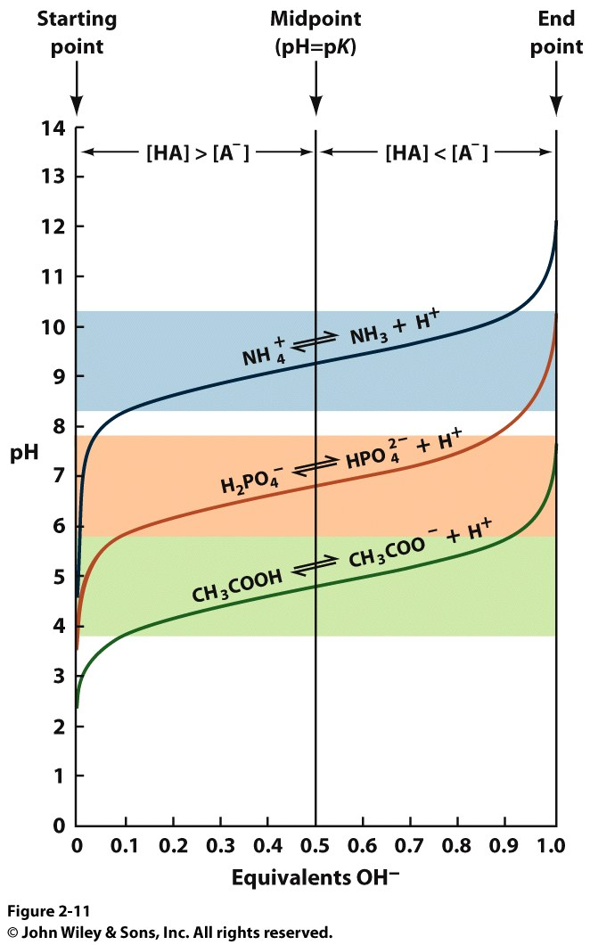
The pK_{a}
Don’t forget:
At the pK_{a}, exactly one half of our starting acid molecules have been converted to conjugate base molecules
At pH < pK_{a}, [HA] > [A-]
At pH > pK_{a}, [A-] > [HA]

Slide 41
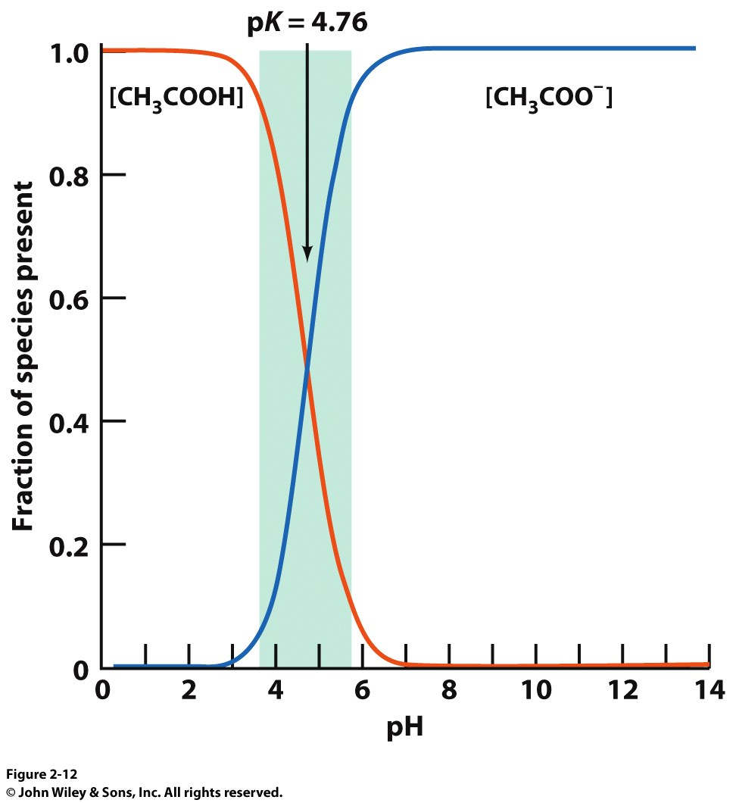
We can look at titrations another way
As we “eat” up or react off CH₃COOH, we start making making CH₃COO⁻

Slide 42
Buffers
Near the pK_{a} of a weak acid, the slope of the titration curve is very low.
Why?
The presence of nearly equal quantities of the weak acid and its conjugate base.
What does this mean?
If we add some OH⁻, what will happen?
If we add some H⁺, what will happen?
The solution is BUFFERED against pH changes near the pK_{a} of the weak acid

Slide 43
For next class
Download and install the Rocketbook app on your smartphone or tablet
Send me a test scan BEFORE the end of the day tomorrow (Wednesday, 25 August) and you’ll get 2.5 extra credit points
  Seem too small for you to bother? 2.5 points is one quarter of a letter grade on a test.
Check the Course Schedule page and see if something is due BEFORE the start of class on Thursday
  Spoiler Alert: SOMETHING IS!

