Slide 1
The Central Dogma
The flow of genetic information is generally from DNA to RNA to proteins, a scheme called the central dogma.

Slide 2
Section 4.1 A Nucleic Acid Consists of Four Kinds of Bases Linked to a Sugar­­–Phosphate Backbone
Nucleic acids are long, linear polymers constructed from four types of monomers.
Each monomer consists of a sugar, a phosphate, and a nitrogenous base.
The sequence of the bases is the information content of the nucleic acid.

Slide 3
Polymeric Structure of Nucleic Acids
Notes:
FIGURE 4.1 Polymeric structure of nucleic acids.

Slide 4
DNA and RNA Differ in the Sugar Component and One of the Bases
The sugar component of deoxyribonucleic acid (DNA) is deoxyribose, a ribose in which the 2’-hydroxyl is replaced with a hydrogen.
Ribonucleic acid (RNA) contains the sugar ribose.
The backbones of DNA and RNA consist of sugars linked by phosphodiester bridges between the 3’-hydroxyl of one sugar and the 5’-hydroxyl of an adjacent sugar.
Bases are attached to carbon atom 1’ in the sugar.
Two of the bases are purines (adenine and guanine), and two are pyrimidines [cytosine and thymine (DNA) or uracil (RNA)].

Slide 5
Ribose and Deoxyribose
Notes:
FIGURE 4.2 Ribose and deoxyribose. Atoms in sugar units are numbered with primes to distinguish them from atoms in bases (see Figure 4.4).

Slide 6
Backbones of DNA and RNA
Notes:
FIGURE 4.3 Backbones of DNA and RNA. The backbones of these nucleic acids are formed by 3′-to-5′ phosphodiester linkages. A sugar unit is highlighted in red and a phosphate group in blue.

Slide 7
Purines and Pyrimidines
Notes:
FIGURE 4.4 Purines and pyrimidines. Atoms within bases are numbered without primes. Uracil instead of thymine is present in RNA.

Slide 8
Nucleotides are the Monomeric Units of Nucleic Acids
A nitrogenous base bound to a sugar is called a nucleoside. The nucleosides of DNA are deoxyadenosine, deoxyguanosine, deoxycytidine, and deoxythymidine. By convention, deoxythymidine, which rarely occurs in RNA, is simply called thymidine.
The nucleosides of RNA are adenosine, guanosine, cytidine, and uridine.
The C-1’ of the sugar is attached to the N-9 of the purine or the N-1 of the pyrimidine by a β-glycosidic bond.
A nucleotide is a nucleoside with one or more phosphoryl groups.
Nucleoside triphosphates are the building blocks of DNA and RNA.

Slide 9
β-Glycosidic Linkage in a Nucleoside
Notes:
FIGURE 4.5 β-Glycosidic linkage in a nucleoside.

Slide 10
Examples of Nucleotides
Notes:
FIGURE 4.6 Nucleotides adenosine 5′-triphosphate (5′-ATP) and deoxyguanosine 3′-monophosphate (3′-dGMP).

Slide 11
Nucleic Acid Conventions
Nucleic acid chains are represented by abbreviations such as pApGpCpT, pAGCT, or more simply AGCT.
Nucleic acid chains have directionality since the two ends are different. One end has a phosphoryl group attached to the 5’ carbon atom of the sugar, and one end has a free hydroxyl attached to the 3’ carbon of the sugar.
By convention, nucleic acid sequences are typically written from left to right in the 5’-to-3’ direction.

Slide 12
A Stylized Structure of a DNA Chain
Notes:
FIGURE 4.7 Structure of a DNA chain. The chain has a 5′ end, which is usually attached to a phosphoryl group, and a 3′ end, which is usually a free hydroxyl group.

Slide 13
Section 4.2 A Pair of Nucleic Acid Strands with Complementary Sequences Can Form a Double-Helical Structure
The double helix is stabilized by hydrogen bonds and van der Waals interactions.
Because of the base pairing rules (A-T and G-C), the sequence of one strand determines the sequence of the partner strand.
The two strands can be separated and complementary sequences synthesized to generate two identical daughter strands.

Slide 14
X-ray Diffraction Photograph of a Hydrated DNA fiber
Notes:
FIGURE 4.10 X-ray diffraction photograph of a hydrated DNA fiber. When crystals of a biomolecule are irradiated with x-rays, the x-rays are diffracted and these diffracted x-rays are seen as a series of spots, called reflections, on a screen behind the crystal. The structure of the molecule can be determined by the pattern of the reflections (Section 3.5). In regard to DNA crystals, the central cross is diagnostic of a helical structure. The strong arcs on the meridian arise from the stack of nucleotide bases, which are 3.4 Å apart. [Science Photo Library.]

Slide 15
X-Ray Diffraction Image of B-form DNA
The X-pattern in the middle shows that the molecule is helical
The regularity of the spot spacings shows that the structure is regular and repeating
The spacing between the bars is indicative of the helical turn distance (34 Å is the height of one turn)

Slide 16
X-Ray Diffraction Image of B-form DNA
The distance from the middle to the top or bottom bar is the distance b/w the base pair stacks (3.4 Å)
The height of each turn (34Å) and the distance between the stacked base pairs (3.4Å) told Watson and Crick that there were 10 base pairs per turn!

Slide 17
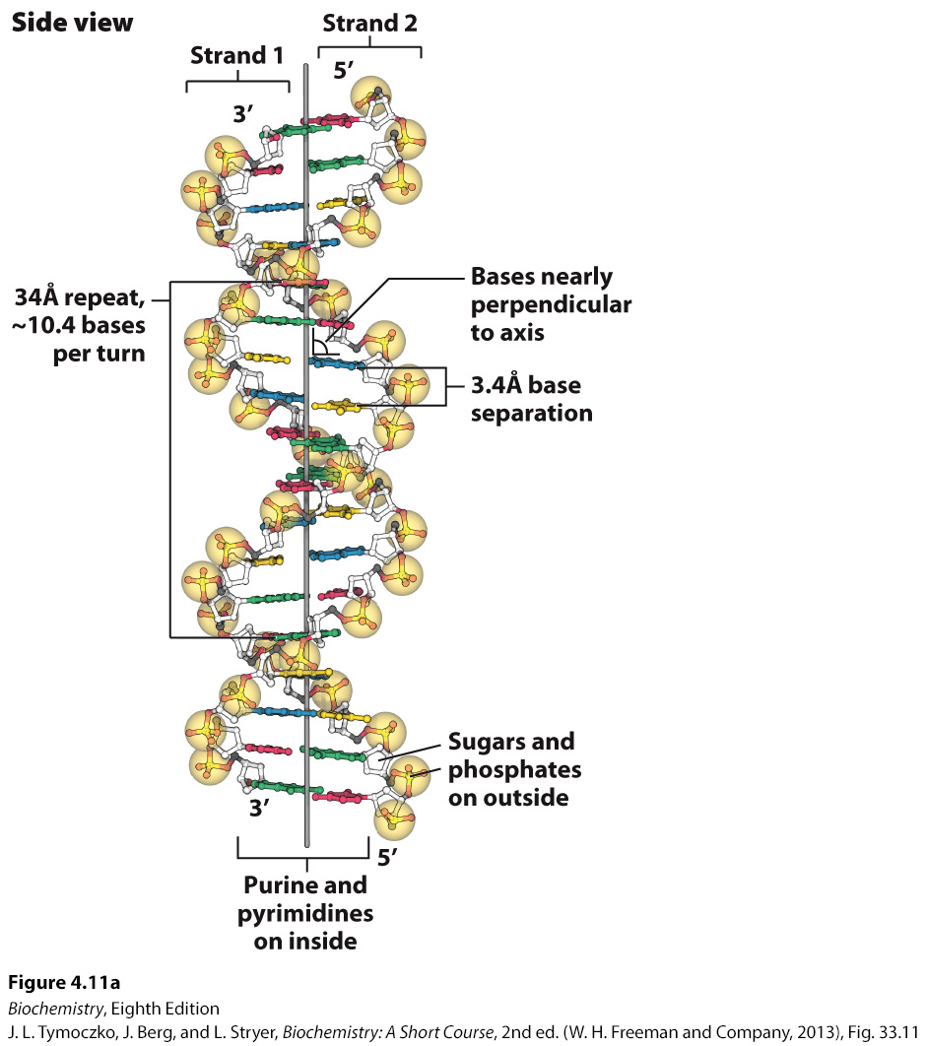
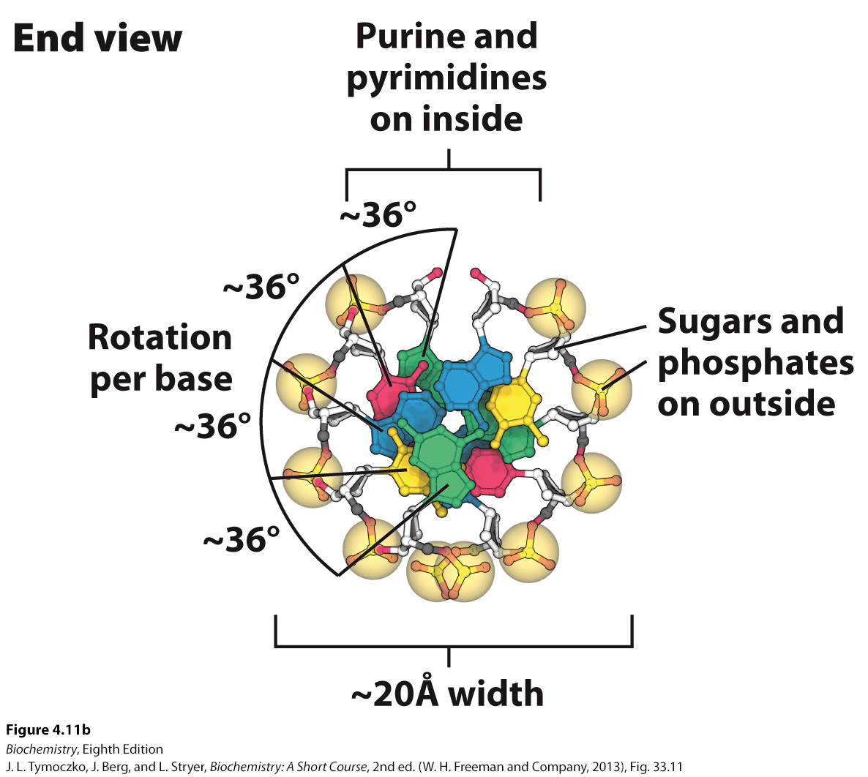
Watson–Crick Model of Double-helical DNA
Notes:
FIGURE 4.11 Watson–Crick model of double-helical DNA. (A) Side view. Adjacent bases are separated by 3.4 Å. The structure repeats along the helical axis (vertical) at intervals of 34 Å, which corresponds to approximately 10 nucleotides on each chain. (B) Axial view, looking down the helix axis, reveals a rotation of 36° per base and shows that the bases are stacked on top of one another [Source: J. L. Tymoczko, J. Berg, and L. Stryer, Biochemistry: A Short Course, 2nd ed. (W. H. Freeman and Company, 2013), Fig. 33.11.]

Slide 18
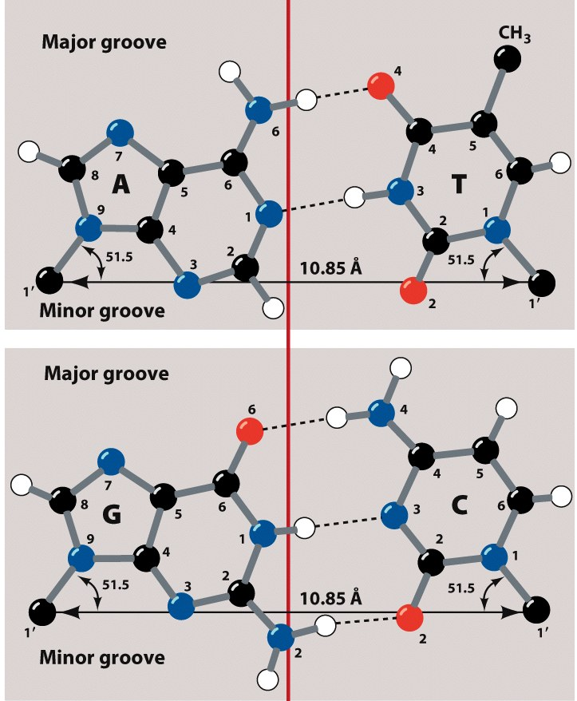
Structures of the Base Pairs Proposed by Watson and Crick
The Watson-Crick base pairing keep the helix from distorting
Perfect example of form and function
Notes:
FIGURE 4.12 Structures of the base pairs proposed by Watson and Crick.

Slide 19
Implications on DNA – Protein Interactions
On the major and minor grooves of DNA, chemical moieties on the nitrogenous bases are available to interact with amino acid side chains of proteins
Most frequent amino acid side chains found to interact with DNA are:
Asn, Gln, Glu, Lys and Arg
There is much greater variation in the Major groove (one more position), so proteins have more chances at selectivity

Slide 20
Features of the Watson–Crick Model of DNA Deduced from the Diffraction Patterns
Two helical, antiparallel polynucleotide strands are coiled around a common axis in a right-handed helix.
The sugar–phosphate backbones are on the outside and the purine and pyrimidine bases lie on the inside of the helix.
The bases are nearly perpendicular to the helix axis.
The various measurements in Angstroms of the helix could be determined.

Slide 21
Base Compositions Experimentally Determined for a Variety of Organisms
In 1950–before the three-dimensional structure of DNA was established–Erwin Chargaff observed that the adenine:thymine and guanine:cytosine ratios were each nearly 1:1 in a variety of organisms while the adenine:guanine ratio varied

Slide 22
A Side View of DNA
The van der Waals interactions that help to stabilize DNA are sometimes referred to as “base stacking” interactions.
Notes:
FIGURE 4.13 A side view of DNA. Base pairs are stacked nearly one on top of another in the double helix. The stacked bases interact with van der Waals forces. Such stacking forces help stabilize the double helix. [Source: J. L. Tymoczko, J. Berg, and L. Stryer, Biochemistry: A Short Course, 2nd ed. (W. H. Freeman and Company, 2013), Fig. 33.13.]

Slide 23
DNA can Assume a Variety of Structural Forms
In the cell, the most commonly seen form of the DNA double helix is called the B form or the Watson–Crick helix.
The double helix can also exist in an A form, which is shorter and wider than the B form with the bases at an angle rather than perpendicular to the helix axis. In the A forms, the sugar is in the C-3’-endo conformation, while the sugar is in C-2’-endo configuration in the B form.
The A form is seen in RNA double helices and in RNA–DNA hybrid helices, structures observed in transcription and RNA processing.

Slide 24
B-form and A-form DNA
Notes:
FIGURE 4.14 B-form and A-form DNA. Space-filling models of 10 base pairs of B-form and A-form DNA depict their right-handed helical structures. Notice that the B-form helix is longer and narrower than the A-form helix. The carbon atoms of the backbone are shown in white. [Drawn from 1BNA.pdb and 1DNZ.pdb.]

Slide 25
Some DNA Molecules are Circular and Supercoiled
To fit inside a cell, the DNA molecule must be compacted. In E. coli, the DNA double helix is a circular molecule that is twisted into a superhelix by the process of supercoiling.
The relaxed circular DNA and the superhelix form are topological isomers of each other.
Notes:
FIGURE 4.17 Electron micrographs of circular DNA from mitochondria. (A) Relaxed form. (B) Supercoiled form. [Courtesy of Dr. David Clayton.]

Slide 26
Single-stranded Nucleic Acids can Adopt Elaborate Structures
A common structural motif seen in nucleic acids, most notably RNA, is the stem-loop, which occurs when complementary sequences in the same strand form a double helix.
Non-Watson-Crick base pairs occur frequently in RNA.
More elaborate structures may form, often stabilized by Mg²⁺ ions.

Slide 27
Stem-loop Structures
Notes:
FIGURE 4.18 Stem-loop structures. Stem-loop structures can be formed from single-stranded DNA and RNA molecules.

Slide 28
Complex Structure of an RNA Molecule
Notes:
FIGURE 4.19 Complex structure of an RNA molecule. A single-stranded RNA molecule can fold back on itself to form a complex structure. (A) The nucleotide sequence showing Watson–Crick base pairs and other nonstandard base pairings in stem-loop structures. (B) The three-dimensional structure and one important long-range interaction between three bases. In the three-dimensional structure at the left, cytidine nucleotides are shown in blue, adenosine in red, guanosine in black, and uridine in green. In the detailed projection, hydrogen bonds within the Watson–Crick base pair are shown as dashed black lines; additional hydrogen bonds are shown as dashed green lines.

Slide 29
Section 4.3 The Double Helix Facilitates the Accurate Transmission of Hereditary Information
Because of the base-pairing rules, the sequence of one strand determines the sequence of the partner strand.
The two strands can be separated and complementary sequences synthesized to generate two identical daughter strands.
Because the two daughter helices have one parent strand and one newly synthesized strand, the replication process is called semiconservative replication.

Slide 30
Differences in DNA Density Established the Validity of the Semiconservative Replication Hypothesis
Meselson and Stahl elegantly demonstrated that replication is semiconservative by growing bacteria in growth media supplemented with ¹⁵N.
The bacteria were then shifted to growth media with ¹⁴N as the nitrogen source.
Density gradient centrifugation established that upon the shift to ¹⁴N medium, newly synthesized DNA consisted of DNA with equal parts ¹⁵N-DNA and ¹⁴N-DNA, a result consistent with semiconservative replication.

Slide 31
Resolution of ¹⁴N DNA and ¹⁵N DNA by Density-gradient Centrifugation
The ¹⁵N isotope is heavier than the ¹⁴N isotope.
Density-gradient centrifugation can be used to distinguish between DNA that contains ¹⁵N and DNA that contains ¹⁴N.
Notes:
FIGURE 4.20 Resolution of ¹⁴N DNA and ¹⁵N DNA by density-gradient centrifugation. (A) Ultraviolet-absorption photograph of a centrifuged cell showing the two distinct bands of DNA. (B) Densitometric tracing of the absorption photograph. [Data from M. Meselson and F. W. Stahl. Proc. Natl. Acad. Sci. U.S.A. 44:671–682, 1958.]

Slide 32
Detection of Semiconservative Replication of E. coli DNA by Density-gradient Centrifugation
Notes:
FIGURE 4.21 Detection of semiconservative replication of E. coli DNA by density-gradient centrifugation. The position of a band of DNA depends on its content of ¹⁴N and ¹⁵N. After 1.0 generation, all of the DNA molecules were hybrids containing equal amounts of ¹⁴N and ¹⁵N. [Data from M. Meselson and F. W. Stahl. Proc. Natl. Acad. Sci. U.S.A. 44:671–682, 1958.]

Slide 33
Semiconservative Replication
Notes:
FIGURE 4.22 Diagram of semiconservative replication. Parental DNA is shown in blue and newly synthesized DNA in red. [Information from M. Meselson and F. W. Stahl. Proc. Natl. Acad. Sci. U.S.A. 44:671–682, 1958.]

Slide 34
The Double Helix can be Reversibly Melted
During replication or transcription, the two strands of the DNA double helix must be separated.
In the laboratory, DNA strands can be separated by heating a solution of DNA, a process called denaturation or melting. The temperature at which half of the DNA molecules are denatured is called the melting temperature (T_{m}).
Melting can be observed because bases stacked in a double helix absorb less ultraviolet light than bases in a single-stranded molecule, a phenomenon called hypochromism.
Upon cooling, the two strands can bind to each other to reform the double helix, a process called reannealing.

Slide 35
Hypochromism
The absorbance of a solution of DNA in the UV range increases by ~40% when it denatures.
Why might this be?
Notes:
FIGURE 4.23 Hypochromism. (A) Single-stranded DNA absorbs light more effectively than does double-helical DNA. (B) The absorbance of a DNA solution at a wavelength of 260 nm increases when the double helix is melted into single strands.

