Slide 1
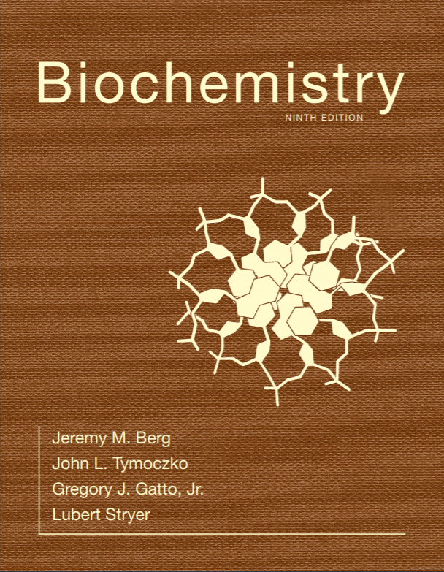
Chapter 31
Protein Synthesis
© 2019 W. H. Freeman and Company
Notes:
Corresponding Chapters: 1, 2, 8, 9, 10

Slide 2
Ch.31 Learning Objectives
By the end of this chapter, you should be able to:
Explain how nucleic acid information is translated into amino acid sequence and define the role of aminoacyl tRNA synthetases in this process.
Define the role of ribosomes in protein synthesis.

Slide 3
Ch.31 Outline
31.1 Protein Synthesis Requires the Translation of Nucleotide Sequences into Amino Acid Sequences
31.2 Aminoacyl Transfer RNA Synthetases Read the Genetic Code
31.3 The Ribosome Is the Site of Protein Synthesis
31.5 A Variety of Antibiotics and Toxins Can Inhibit Protein Synthesis

Slide 4
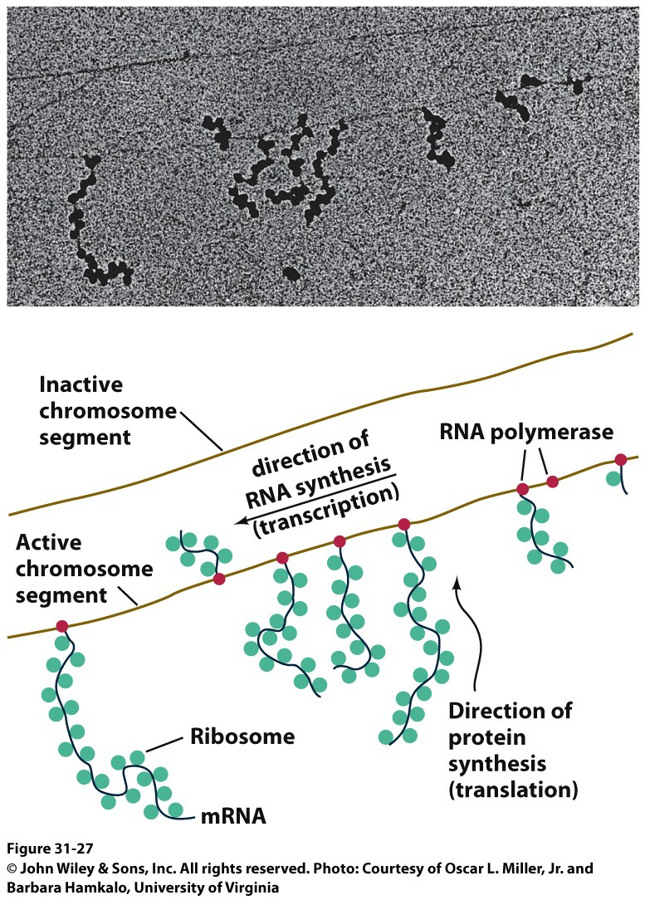
The Third Pillar of the Central Dogma
Translation / Protein Synthesis
We’ve replicated our DNA, transcribed a gene (or an operon) and now we have to make protein
In 1961 Francis Crick and Sydney ,Brenner devised the Adaptor Hypothesis

Slide 5
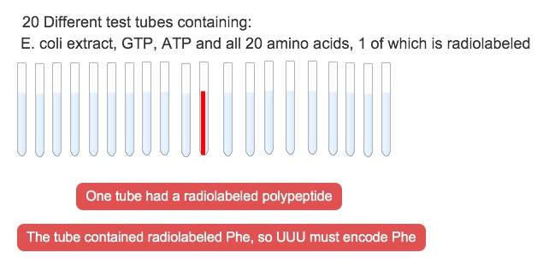
We need to review the message and Codons
5’-(UUU)_{X}-3’
mRNA is read in the 5’ → 3’ direction
The code was “cracked” by many scientists using synthetic mRNAs of a single repeating base
Nuremberg and Matthaei had the seminal experiment

Slide 6
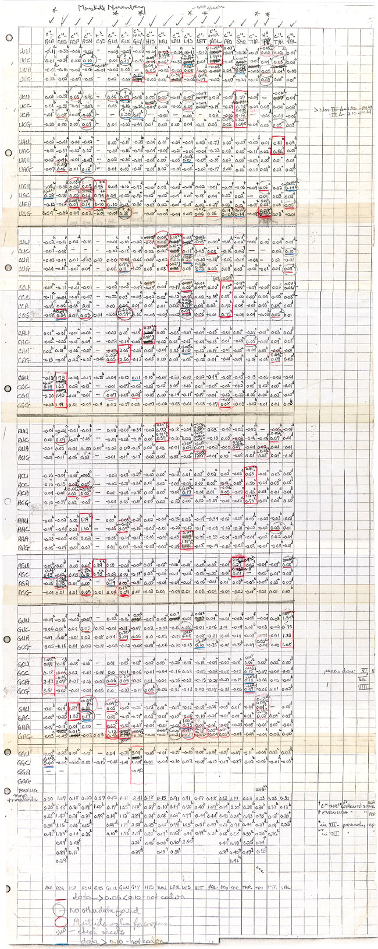
We need to review the message and Codons
They did the same thing for Poly CCC, Poly AAA and Poly GGG
They found radiolabeled polyPro, polyLys and polyGly, respectively
They also found that UAG, UAA and UGA are stop codons
They also found that AUG is the start codon (initiation codon)
This was pure luck
The ribosome will indiscriminately start translation at the high Mg²⁺ levels used in their experiment

Slide 7
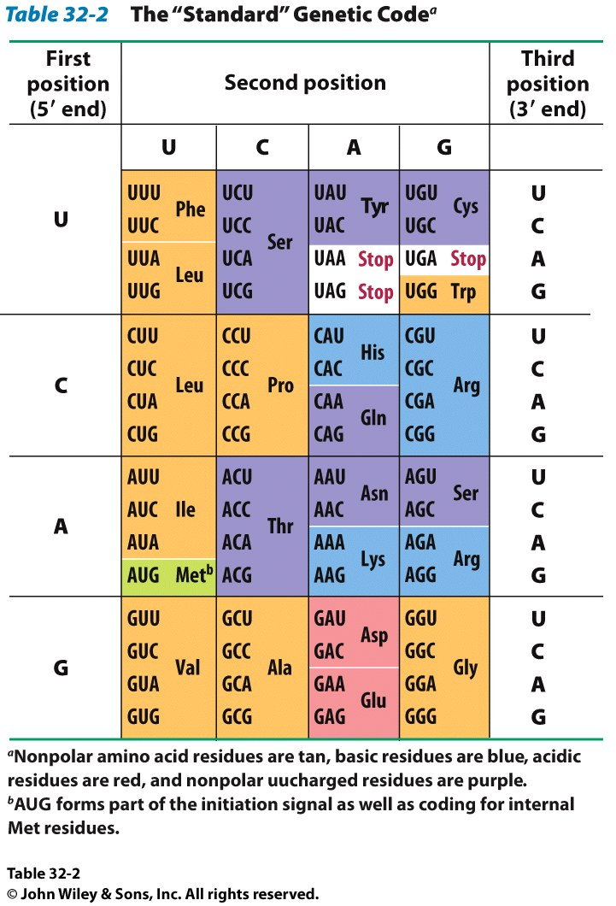
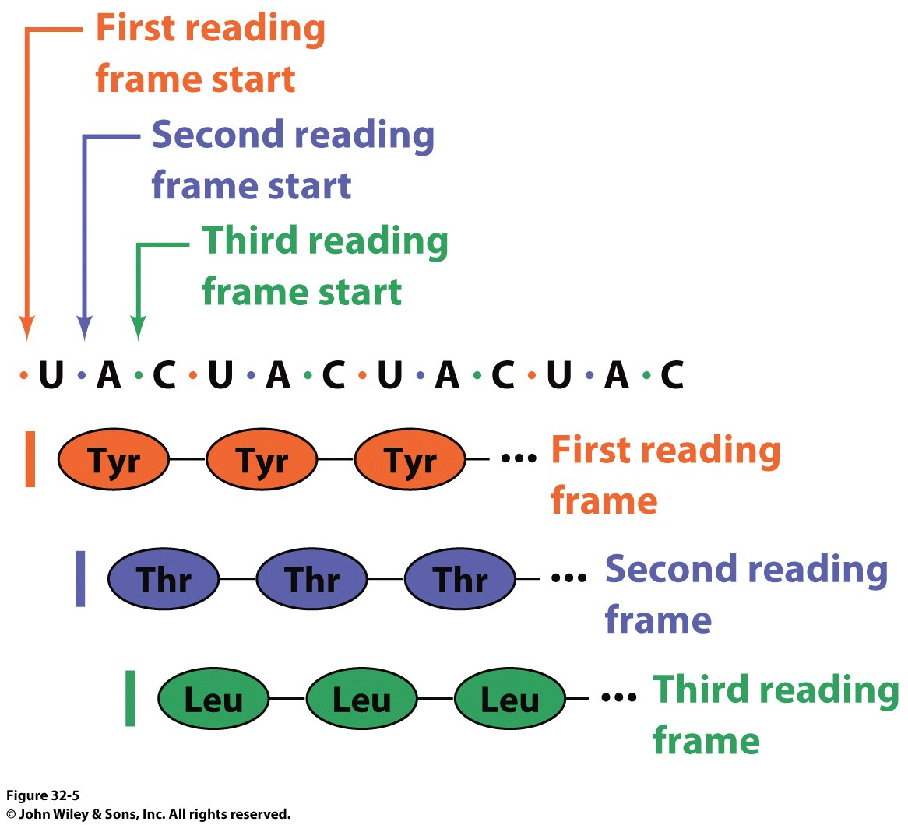
The result of many different experiments was…
The genetic code is written in 3 base codons
The genetic code is highly degenerate
Three amino acids are encoded by six codons each (R, L and S)
Codons specifying the same amino acid are called Synonyms

Slide 8
The result of many different experiments was…
The arrangement of the codon table is non-random
Most synonyms occupy the same box
The third position doesn’t seem to matter as much (“wobble”)
The degeneracy gives an organism the potential to accept point mutations without a phenotypic change

Slide 9
The result of many different experiments was…
The “wobble” actually refers to the wobbling of the anticodon loop of tRNA when pairing with mRNA
The 1st two bases of the codon form tight H-bond interactions with the second two bases of the anticodon loop

Slide 10
Characteristics of the Genetic Code
Three nucleotides, called a codon, encode an amino acid.
The code is nonoverlapping.
The code has no punctuation.
The code has directionality. It is read from the 5′ end of the mRNA to the 3′ end.
The code is degenerate in that some amino acids are encoded by more than one codon; this minimizes the deleterious effects of mutations.

Slide 11
Transfer RNAs are the Adaptor Molecules in Protein Synthesis
Transfer RNA molecules react with specific amino acids in a reaction catalyzed by aminoacyl-tRNA synthetases.
Transfer RNA molecules also contain a template recognition site, called the anticodon. The anticodon, which consists of three bases, recognizes a complementary 3-base sequence in the mRNA called the codon.

Slide 12
tRNA and aminoacyl tRNA formation
All tRNAs share the following:
5’ phosphate group
7 bp stem that includes the 5’ phosphate group. This is called the Acceptor Stem on the Amino Acid Arm
The D Arm which contains dihydrouridine
5 bp stem that contains the anticodon loop called the Anticodon Arm
5 bp stem containing the sequence TΨC where Ψ is pseudouridine

Slide 13
Attachment of an Amino Acid to a tRNA Molecule
Notes:
FIGURE 4.33 Attachment of an amino acid to a tRNA molecule. The amino acid (shown in blue) is esterified to the 3′-hydroxyl group of the terminal adenylate of tRNA. [Source: J. L. Tymoczko, J. Berg, and L. Stryer, Biochemistry: A Short Course, 2nd ed. (W. H. Freeman and Company, 2013), Fig. 39.3.]

Slide 14
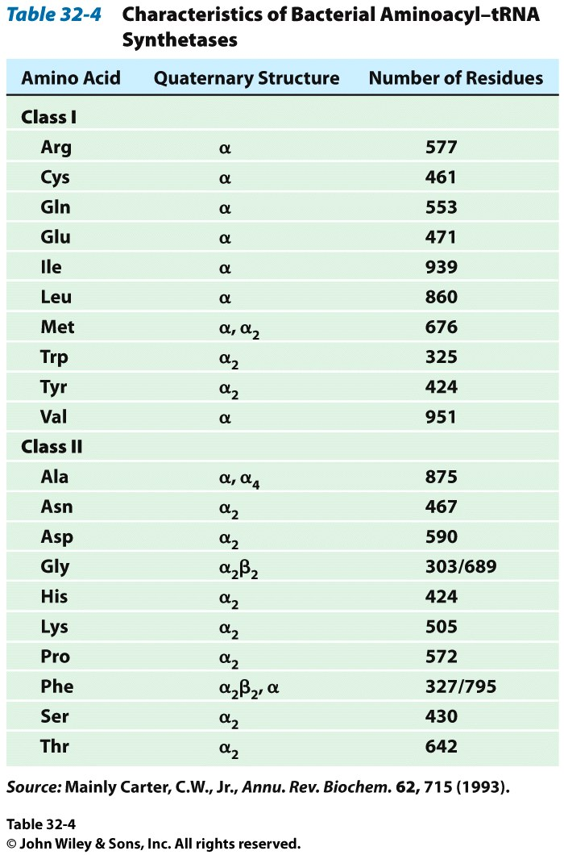
How do tRNAs get loaded?
All cells have one aminoacyl tRNA synthetase for each amino acid
They all catalyze the same base reaction, but are divided into 2 classes based upon primary and tertiary structure
There is no evidence that the classes share a common ancestor through evolution
Amino acid + tRNA + ATP → aminoacyltRNA + AMP + PPi

Slide 15
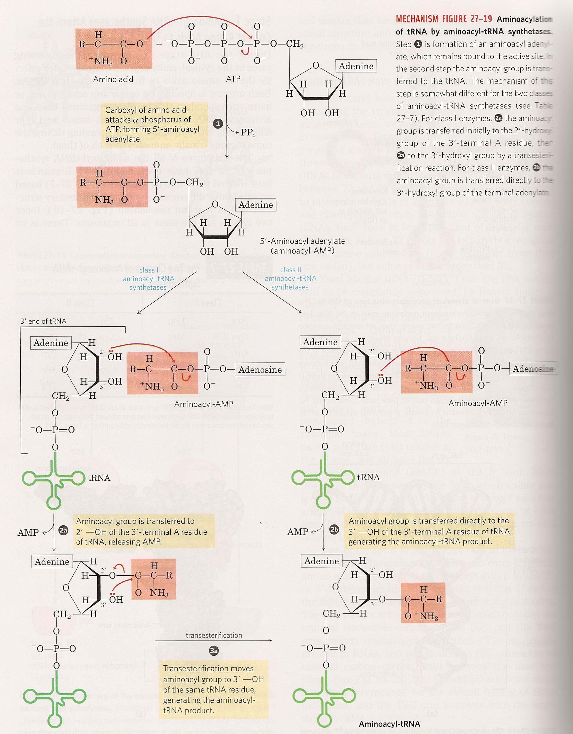
How do tRNAs get loaded?
Class II synthetases have the 3’ hydroxyl attack the amino acid carbonyl carbon directly
Class I synthetases have the 2’ hydroxyl attack the carbonyl and then transfer the amino acid to the 3’ hydroxyl

Slide 16
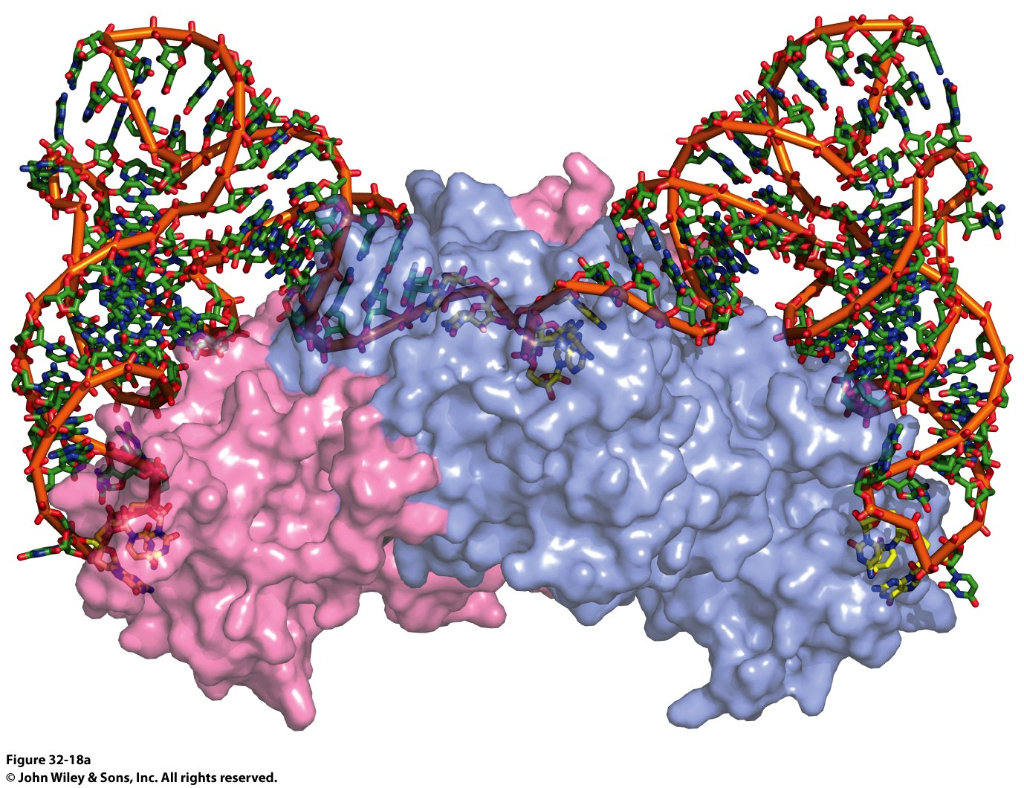
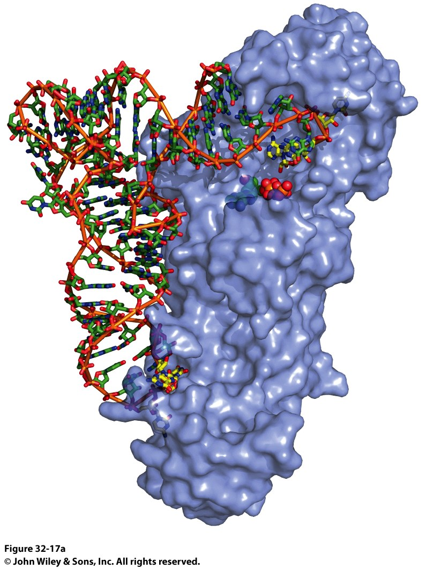
Why the Difference? Mysteries…
Class I Synthetase
Class II Synthetase

Slide 17
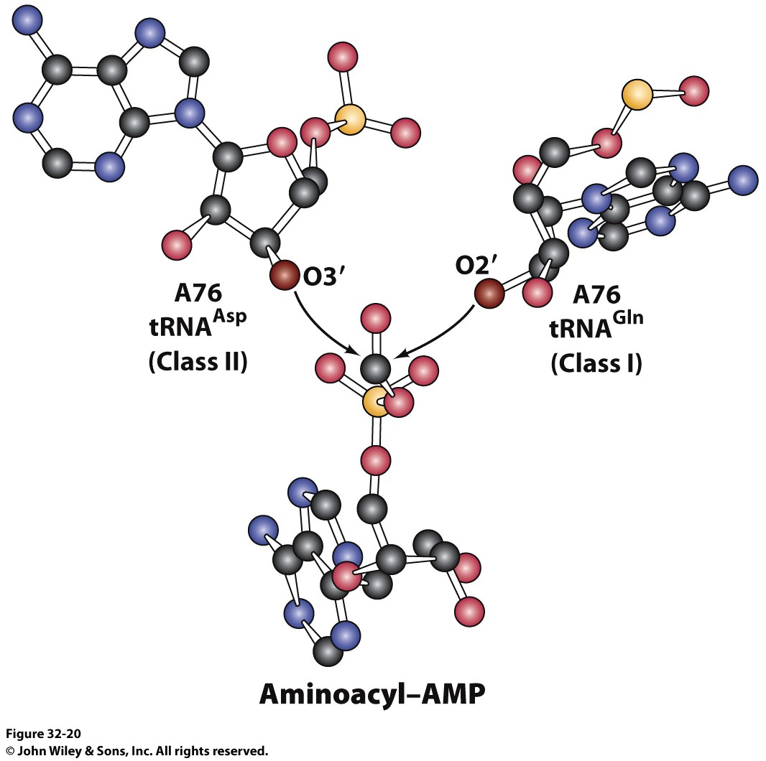
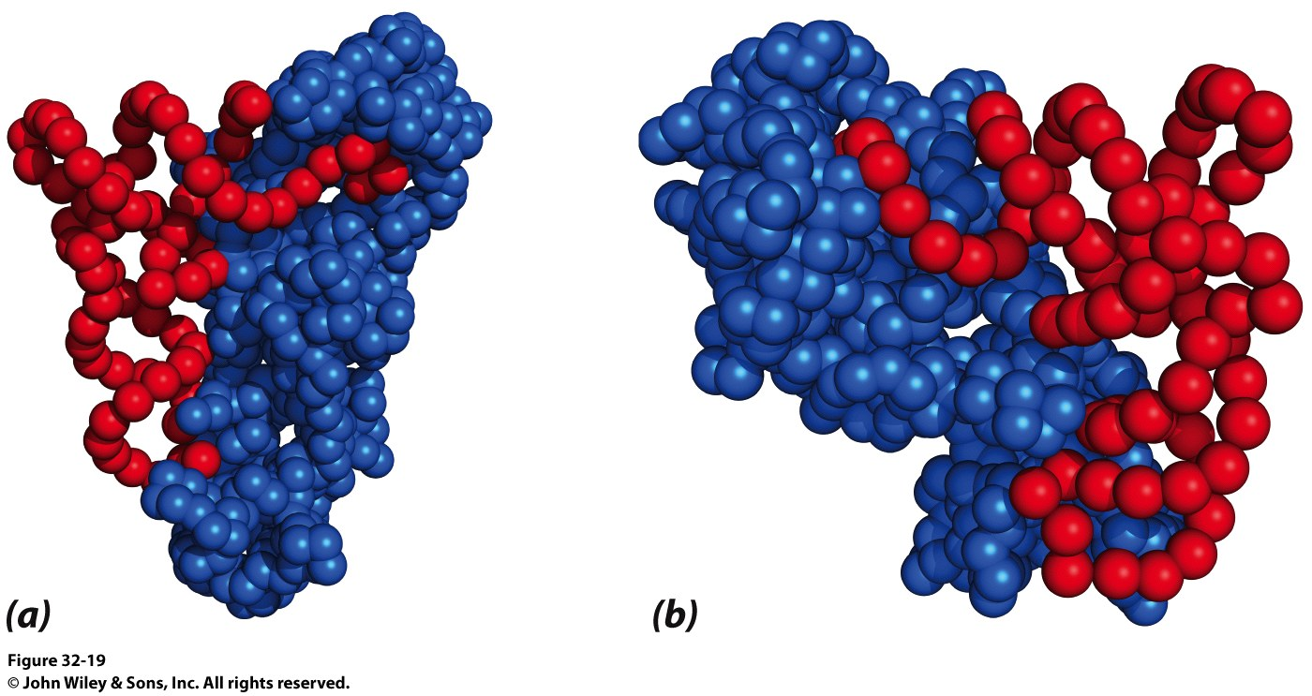
Why the Difference?

Slide 18
General Structure of an Aminoacyl-tRNA
Notes:
FIGURE 4.34 General structure of an aminoacyl-tRNA. The amino acid is attached at the 3′ end of the RNA. The anticodon is the template-recognition site. Notice that the tRNA has a cloverleaf structure with many hydrogen bonds (green dots) between bases.

Slide 19
Where are we and Where have we been?
Nucleotide structure
Chargaff’s rules for hydrogen bonding between nitrogenous bases
Role hydrogen bond acceptors, donors and methyl groups play on specificity of protein/DNA interactions
Structure of the phosphodiester backbone of DNA
Physical dimensions of B-DNA (we ignored A-form and Z-form DNA)
DNA is supercoiled in the cell (by topoisomerase)
DNA and RNA can form stem-loop structures
Messelson/Stahl experiment proved DNA replication is semiconservative
DNA can be “melted” and every sequence of DNA has a specific Tm determined by its sequence. Why?
Hypochromism. What is is and why?
DNA synthesis
Reaction mechanism for DNA PolI and DNA PolIII both require what?
What is pyrophosphate hydriolysis and why does it matter?
Formation of the replication fork requires what proteins? What does each do?

Slide 20
Where are we and Where have we been?
DNA synthesis cont’d
What proteins are in the replisome?
What do we need in a polymerase?
Requirements of DNA polymerases that RNA polymerases don’t have. Why?
Speed vs. Fidelity (relative to organisms)
How do DNA polymerases maintain fidelity?
If a mistake is made, how is it corrected?
3’->5’ exonuclease activity vs. 5’ -> 3’ exonuclease activity
Why E. coli DNA polymerases have which activity?
Why?
Mechanism of each exonuclease activity (one requires Mg2+ ions, one requires Zn2+ and a Tyr)
Slide 66. Period. Done. Know what each protein does and the role each plays in DNA replication. Know those and any specific mechanisms for selected proteins and you’re golden.

Slide 21
Where are we and Where have we been?
Mechanism of DNA Ligase (ATP vs NAD+ for eukaryotes and prokaryotes)
How does DNA replication stop?
RNA polymerase holoenzyme is different from the core enzyme?
What does that sigma subunit do? Why is it important?
Structure of a promoter.
Sequences that matter and why
Structure of the active RNAP complex with DNA
Adapter hypothesis and how it was proven by Francis Crick and Sydney Brenner
Codon table and wobble
Characteristics of genetic code

Slide 22
Polypeptide-chain Growth
Notes:
FIGURE 31.1 Polypeptide-chain growth. Proteins are synthesized by the successive addition of amino acids to the carboxyl terminus.

Slide 23
Section 31.3 The Ribosome Is the Site of Protein Synthesis
The ribosome is the site of protein synthesis. The E. coli ribosome sediments under centrifugation at 70S and is composed of two subunits, a large 50S subunit and a smaller 30S subunit.
The 50S subunit is composed of 34 proteins and a 23S rRNA as well as a 5S rRNA.
The 30S subunit contains 21 proteins and a molecule of 16S rRNA.

Slide 24
Overview of the 5 Stages of Protein Synthesis
Stage 1: Activation of amino acids (Formation of aminoacyl tRNA)
Costs ATP for every single amino acid conjugated to tRNA
Catalyzed by tRNA synthetases
See last lecture for details about tRNA and aminoacyl tRNA synthetases

Slide 25
Overview of the 5 Stages of Protein Synthesis
Stage 2: Initiation
mRNA to be translated binds to the small subunit of the ribosome
The large subunit, initiating aminoacyl tRNA, GTP and initiation factors bind and the process start

Slide 26
Overview of the 5 Stages of Protein Synthesis
Stage 3: Elongation
Amino acids are added to the nascent polypeptide
The ribosome moves along the mRNA (or is it the other way around?) via GTP hydrolysis

Slide 27
Overview of the 5 Stages of Protein Synthesis
Stage 4: Termination
When the stop codon is reached, the ribosome releases the polypeptide and dissociates

Slide 28
Overview of the 5 Stages of Protein Synthesis
Stage 5: Protein Folding and Posttranslational Modifications
We’ve already covered this!

Slide 29
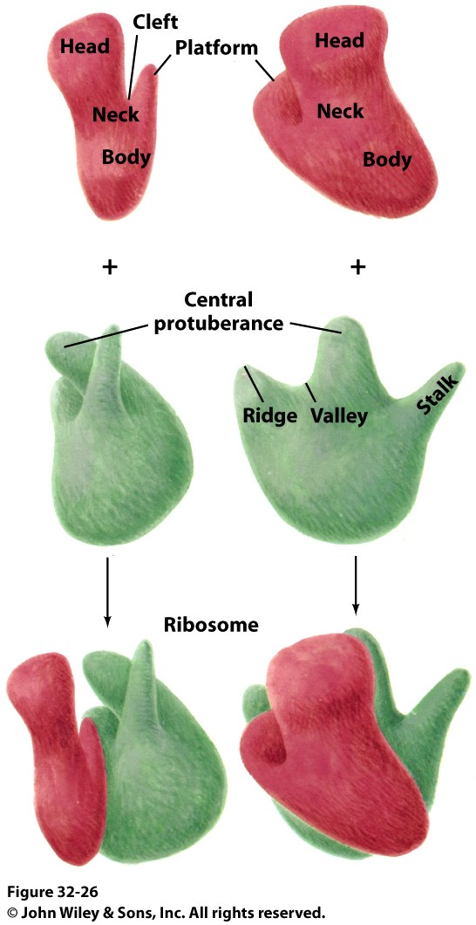
Stage 2: Initiation of Protein Synthesis
Bacterial Ribosome
Yeast Ribosome
Enter the Ribosome: The largest protein/nucleic acid complex known
Essentially a ribozyme (2/3 RNA and 1/3 Protein)
The most important macromolecule in the cell

Slide 30
Ribosomal RNAs (5S, 16S, and 23S rRNA) Play a Central Role in Protein Synthesis
Two-thirds of the mass of ribosomes is RNA, which is critical for the structure and function of the ribosome.
The ribosomal RNAs fold into complex structures with many short duplex regions.
Ribosomal RNA is the actual catalyst for protein synthesis, with the ribosomal proteins making only a minor contribution.

Slide 31
Ribosomal RNA Folding Pattern
Notes:
FIGURE 31.15 Ribosomal RNA folding pattern. (A) The secondary structure of 16S ribosomal RNA deduced from sequence comparison and the results of chemical studies. (B) The tertiary structure of 16S RNA determined by x-ray crystallography. [(A) Courtesy of Dr. Bryn Weiser and Dr. Harry Noller; (B) drawn from 1FJG.pdb.]

Slide 32
The Ribosome at High Resolution
Notes:
FIGURE 31.14 The ribosome at high resolution. Detailed models of the ribosome based on the results of x-ray crystallographic studies of the 70S ribosome and the 30S and 50S subunits: (left) view of the part of the 50S subunit that interacts with the 30S subunit; (center) side view of the 70S ribosome; (right) view of the part of the 30S subunit that interacts with the 50S subunit. 23S RNA is shown in yellow, 5S RNA in orange, 16S RNA in green, proteins of the 50S subunit in red, and proteins of the 30S subunit in blue. Notice that the interface between the 50S and the 30S subunits consists entirely of RNA. [Drawn from 1GIX.pdb and 1GIY.pdb.]

Slide 33
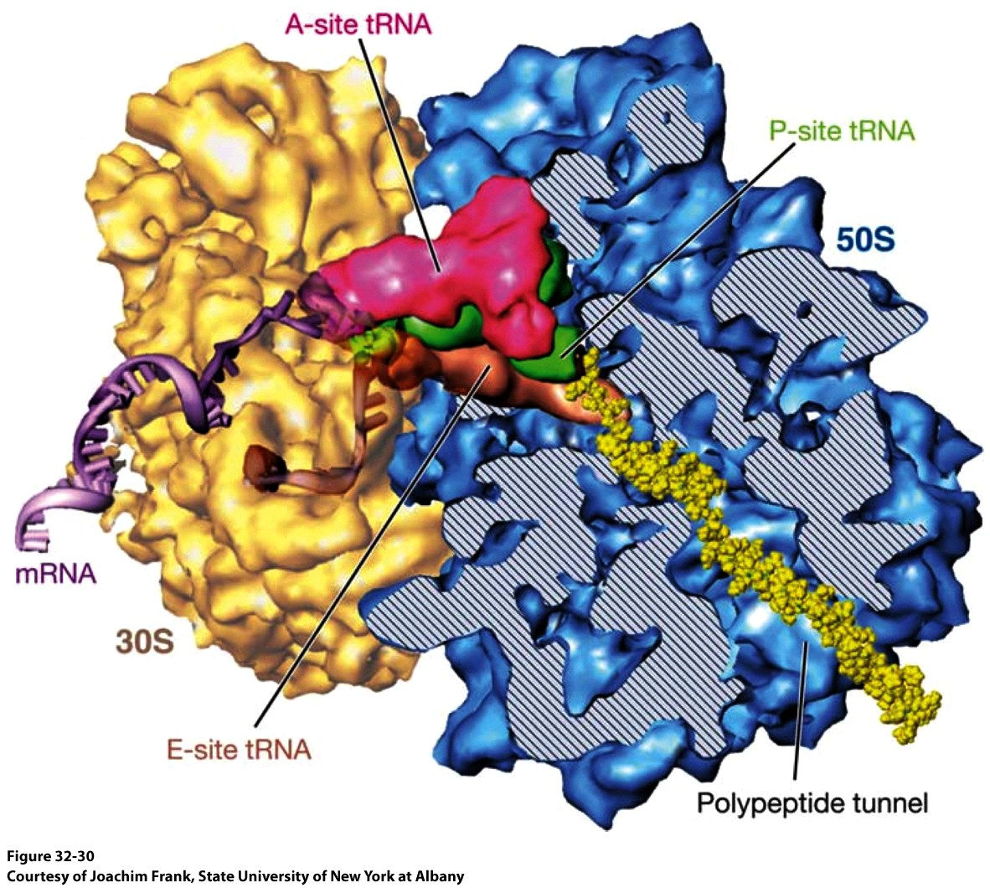
Stage 2: Initiation of Protein Synthesis

Slide 34
Ribosomes Have Three tRNA-binding Sites that Bridge the 30S and 50S Subunits
There are three tRNA binding sites on the ribosome. At each site, the tRNA is in contact with both the 30S subunit, which holds the mRNA template, and the 50S subunit.
The A (aminoacyl) site binds the incoming tRNA.
The P (peptidyl) site binds the tRNA with the growing peptide chain.
The E (exit) site binds the uncharged tRNA that will soon leave.
The acceptor ends of the tRNAs in the A site and P site are near one another at a site on the 50S subunit where the peptide bond is formed. A tunnel connects this site to the back of the ribosome through which the polypeptide chain exits the ribosome during synthesis.

Slide 35
Transfer RNA-binding Sites
Notes:
FIGURE 31.16 Transfer RNA-binding sites. (A) Three tRNA-binding sites are present on the 70S ribosome. They are called the A (for aminoacyl), P (for peptidyl), and E (for exit) sites. Each tRNA molecule contacts both the 30S and the 50S subunit. (B) The tRNA molecules in sites A and P are base-paired with mRNA. [(B) Drawn from 1JGP. pdb.]

Slide 36
An Active Ribosome
Notes:
FIGURE 31.17 An active ribosome. This schematic representation shows the relations among the key components of the translation machinery.

Slide 37
The Start Signal is Usually AUG Preceded by Several Bases that Pair with 16S rRNA (1/2)
Many mRNAs in bacteria are polycistronic, meaning that a single mRNA encodes for multiple proteins. Each of the coding regions has its own initiation site.
The first codon to be translated is usually AUG, which codes for methionine.
Sequences in the mRNA denote where initiation occurs and where translation stops.

Slide 38
The Start Signal is Usually AUG Preceded by Several Bases that Pair with 16S rRNA (2/2)
Initiation in bacteria begins at least 25 nucleotides downstream (i.e., 3′ ) of the 5′ end of the mRNA. The nucleotides between the 5′ end and the first codon translated are the 5′ untranslated region (5′ UTR).
The 5′ UTR contains information called the Shine–Dalgarno sequence, which directs the protein synthesis machinery to the start site.
The Shine–Dalgarno sequence is a purine-rich sequence approximately 10 base pairs upstream of the start site that interacts with the 16S rRNA to correctly position the AUG codon in the A site.

Slide 39
Initiation Sites
Notes:
FIGURE 31.18 Initiation sites. Sequences of mRNA initiation sites for protein synthesis in some bacterial and viral mRNA molecules. Comparison of these sequences reveals some recurring features.

Slide 40
Bacterial Protein Synthesis is Initiated by Formylmethionyl Transfer RNA
A modified form of methionine, N-formylmethionine (fMet), is the initiator amino acid in most proteins in bacteria.
It is activated by attachment to the initiator tRNA called tRNA_{f}. fMet-tRNA_{f} binds only to the initiation codon (AUG) and not to AUG codons elsewhere in the mRNA.
Another tRNA (tRNA_{m}) recognizes internal codons for methionine.
The same synthetase activates both tRNA_{m} and tRNA_{f}, and a specific transformylase modifies the methionine attached to tRNA_{f}.

Slide 41
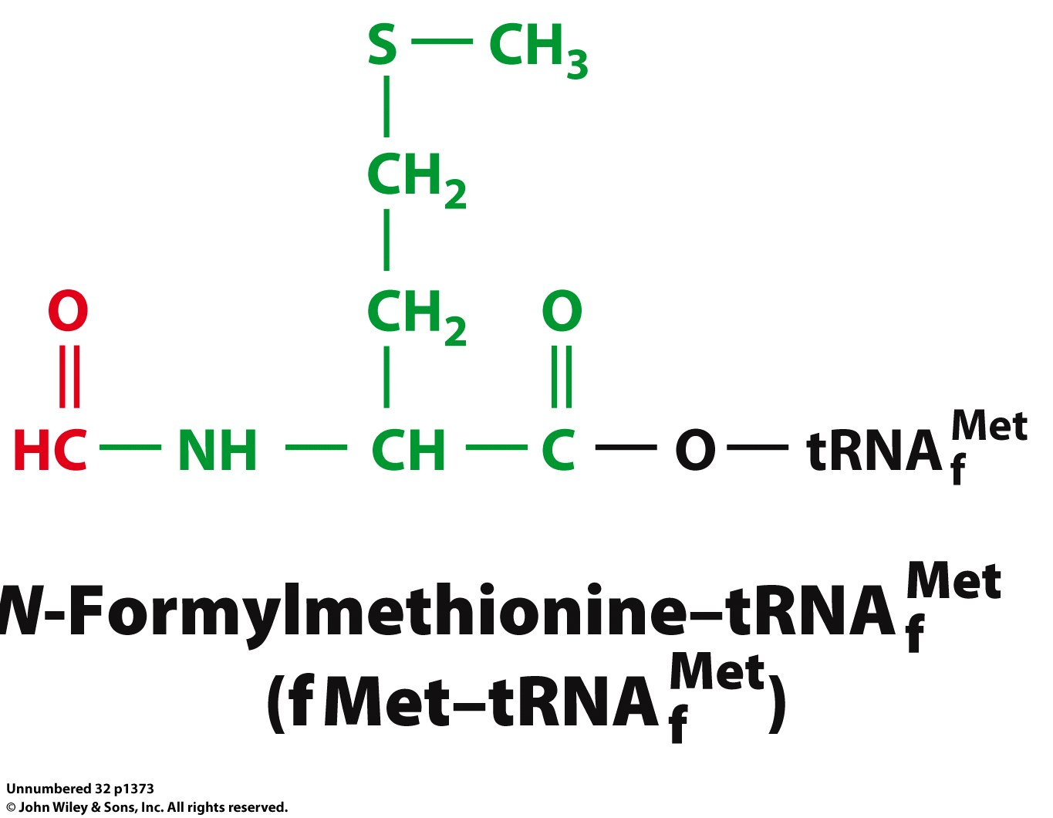
Chain Initiation
Half of mature E. coli proteins begin with methionine.
This codon is otherwise very rare
N-formyl-methionine is the very first amino acid added to every protein made in prokaryotes and eukaryotes
It is often cleaved off later
Why is N-formyl-methionine the first amino acid?
Dr. H drew Met, N-Foryml-Met and a dipeptide on the board.
It worked and I learned something. Yay learning! I feel so alive and powerful with KNOWLEDGE!!!! I might go read my textbook later. Hahahahahahahahahahahahaha! Yeah, right.

Slide 42
Formylmethionyl-tRNA_{f} is Placed in the P site of the Ribosome in the Formation of the 70S Initiation Complex
Initiation factors (IF) assist in the assembly of the protein-synthesizing machinery.
IF1 and IF3 bind the 30S subunit to prevent premature binding to the 50S subunit.
IF2, in cooperation with GTP, delivers fMet-tRNA_{f} to the mRNA, which is already correctly positioned on the 30S subunit by the Shine–Dalgarno sequence, to form the 30S initiation complex.
The 50S subunit binds, leading to the hydrolysis of GTP by IF2 and departure of the initiation factors, forming the 70S initiation complex. The fMet-tRNA_{f} occupies the P site bound to AUG, thereby establishing the reading frame.

Slide 43
16S rRNA Monitors Base-pairing Between the Codon and the Anticodon
Notes:
FIGURE 31.7 16S rRNA monitors base-pairing between the codon and the anticodon. Adenine 1493, one of three universally conserved bases in 16S rRNA, forms hydrogen bonds with the bases in both the codon and the anticodon only if the codon and anticodon are correctly paired. [Information from J. M. Ogle and V. Ramakrishnan, Annu. Rev. Biochem. 74:129–177, 2005, Fig. 2a.]

Slide 44
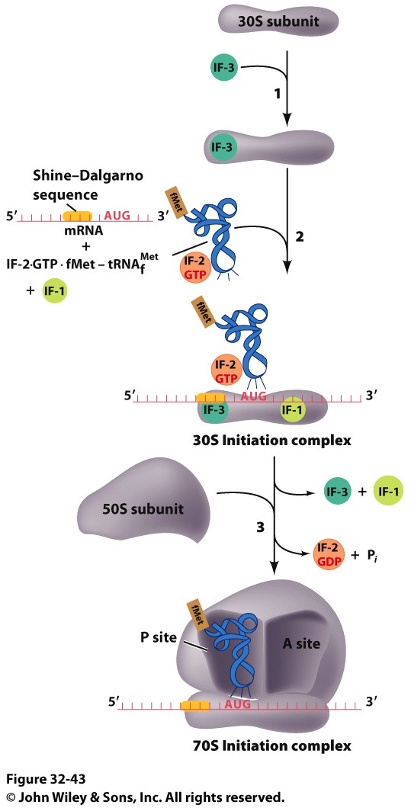
Stage 2: The Initiation Complex
IF3 Binds to the 30S subunit
Prevents the large subunit from binding
mRNA, fMet-tRNA/IF2/GTP and IF1 bind
mRNA Shine-Delgarno sequence binds to complementary sequence on 16S rRNA
IF1 binds to the A-site
The fMet-tRNA/IF2/GTP ternary complex binds to the initiation codon in the P-site
The 50S subunit associates with the 30S subunit and IF2 hydrolyzes its bound GTP
This causes a conformational shift in the 30S subunit and all 3 initiation factors dissociate as does GDP and PPi

Slide 45
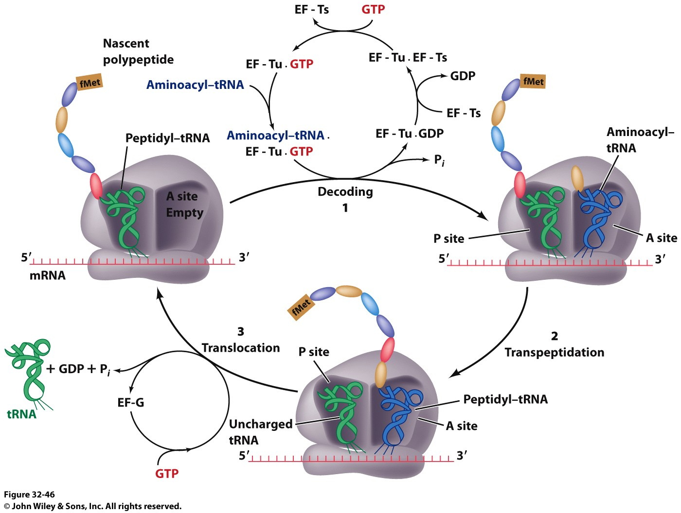
Stage 3: Elongation
3 Step Reaction Cycle
Decoding: Binding of aminoacyl-tRNA complementary to mRNA codon
Transpeptidation: Peptidyl group in P-site is transferred to the A-site
Translocation: A-site and P-site contents are transferred to the P-site and E-site, respectively
mRNA is translocated through the ribosome

Slide 46
Stage 3, Step 1: Decoding
EF-Tu/GTp complex binds to aminoacyl-tRNA
Ternary complex binds to the A-site of ribosome
GTP is hydrolyzed and the aminoacyl-tRNA complexes with codon via anticodon
EF-Tu is the most abundant protein in E. coli (~100,000 copies/cell)
Without EF-Tu, the rate of aminoacyl-tRNA binding to the A-site is too low to support cell growth

Slide 47
Stage 3, Step 1: Decoding
EF-Ts displaces the GDP from EF-Tu
When EF-Tu binds another aminoacyl-tRNA, it dissociates from EF-Ts and also binds GTP
It is then ready to load that aminoacyl-tRNA into the A-site if it pairs with the codon

Slide 48
Stage 3, Step 2: Transpeptidation
The ribosome enhances the rate of peptide bond formation by properly positioning and orienting the substrates and/or excluding water from the active site rather than by chemical catalysis
The ribosome is a workbench
Net effect: An amino acid is added to the polypeptide chain and the chain is transferred to the aminoacyl-tRNA in the A-site from the aminoacyl-tRNA in the P-site

Slide 49
Stage 3, Step 2: Transpeptidation
Note the conformational change of the tRNA in P-site
After peptide transfer, part of the molecule has moved over to the E-site

Slide 50
Peptidyl Transferase Catalyzes Peptide-bond Synthesis
The ribosome is now primed to catalyze peptide bond formation.
The exergonic process of peptide bond formation is catalyzed within the large subunit by region within the 23S RNA called the peptidyl transferase center.
The amino group of the aminoacyl-tRNA attacks the carbonyl group of the ester linkage of the peptidyl-tRNA, forming an eight-membered transition state.
The transition state collapses to form the peptide bond and a deacylated tRNA.
Some of the catalytic power is due to catalysis by proximity and orientation.

Slide 51
Peptide-bond Formation
Notes:
FIGURE 31.23 Peptide-bond formation. (A) The amino group of the aminoacyl-tRNA attacks the carbonyl group of the ester linkage of the peptidyl-tRNA. (B) An eight-membered transition state is formed. Note: Not all atoms are shown and some bond lengths are exaggerated for clarity. (C) This transition state collapses to form the peptide bond and release the deacylated tRNA.

Slide 52
Stage 3, Step 3: Translocation
EF-G/GTP binds to A-site tRNA
As it does, it hydrolyzes GTP which causes a conformational change in the ribosome
The mRNA slides over one codon; The peptidyl-tRNA in the A-site moves to the P-site and the tRNA in the P-site moves to the E-site
Notice how structurally similar EF-Tu and EF-G are

Slide 53
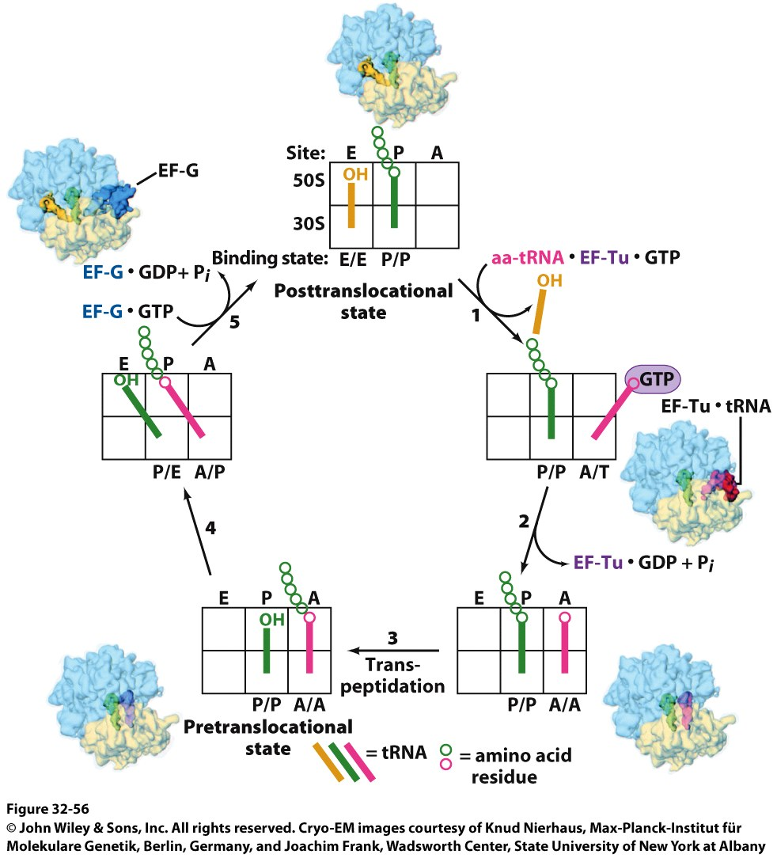
Stage 3, Step 3: Translocation
Note the sliding of moieties!

Slide 54
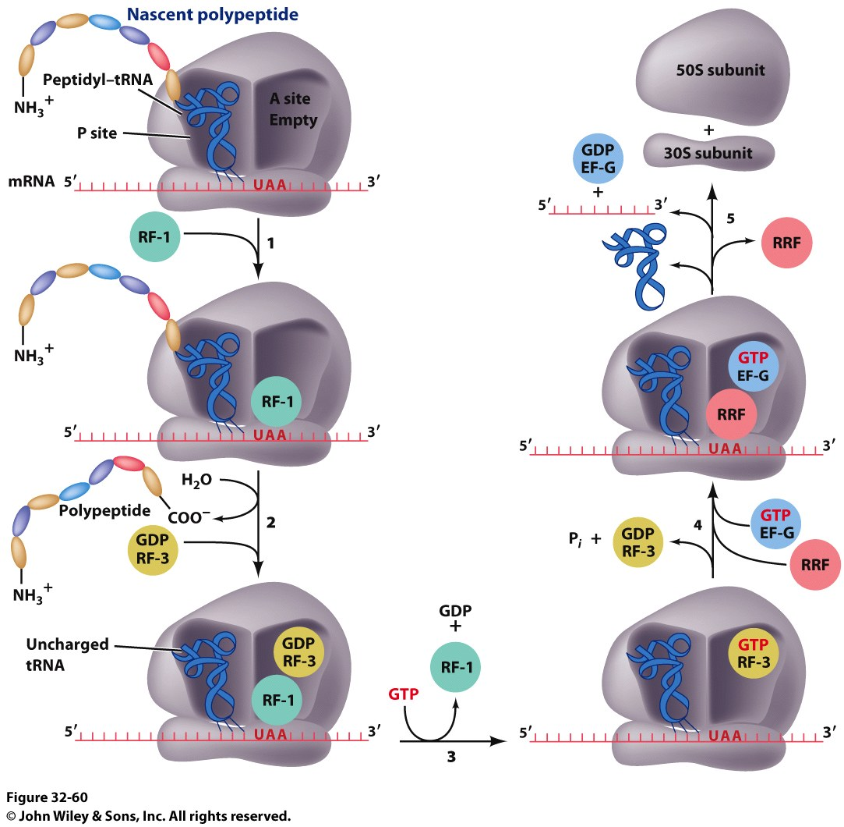
Stage 4: Termination
RF-1 (UAA or UAG) or RF-2 (UAA or UGA) bind to the A-site
Binding of RF-1 or RF-2 to the A-site causes hydrolysis of polypeptide from the tRNA in the P-site
RF-3 binds to RF-Tu/EF-G site, binds GTP and hydrolyzes it
The hydrolysis of GTP by RF-3 causes a conformational change in the ribosome that allows EF-G/GTP and Ribosome Recycling Factor (RRF) to bind

Slide 55
Stage 4: Termination
EF-G hydrolyzes GTP which translocates RRF to the P-site
The ribosome dissociates and all other molecules dissociate from the subunits as well

Slide 56
PLACEHOLDER AFTER JCH CREATED SLIDES

Slide 57
The Formation of a Peptide Bond is Followed by the GTP-driven Translocation of tRNAs and mRNA
Upon peptide bond formation, the growing chain is in the P site of the 50S subunit while attached to the tRNA whose anticodon is in the A site on the 30S subunit. The tRNA in the P site of the 30S subunit is uncharged.
Elongation factor G, also called the translocase, uses the energy of GTP hydrolysis to translocate the mRNA by one codon.
Upon translocation, the peptidyl-tRNA is fully in the P site, the A site is vacant, and uncharged tRNA is in the E site, disengaged from the mRNA.
The polypeptide chain grows from the amino terminal to the carboxyl terminal end.

Slide 58
Mechanism of Protein Synthesis
Notes:
FIGURE 31.24 Mechanism of protein synthesis. The cycle begins with peptidyl-tRNA in the P site. (1) An aminoacyl-tRNA binds in the A site. (2) With both sites occupied, a new peptide bond is formed. (3) The tRNAs and the mRNA are translocated through the action of elongation factor G, which moves the deacylated tRNA to the E site. (4) Once there, the tRNA is free to dissociate to complete the cycle.

Slide 59
Translocation Mechanism
Notes:
FIGURE 31.25 Translocation mechanism. In the GTP form, EF-G binds to the A site on the 50S subunit. This binding stimulates GTP hydrolysis, inducing a conformational change in EF-G that forces the tRNAs and mRNA to move through the ribosome by a distance corresponding to one codon.

Slide 60
Polysomes
Transcription of a segment of DNA from E. coli generates mRNA molecules that are immediately translated by multiple ribosomes.
Notes:
FIGURE 31.26 Polysomes. Transcription of a segment of DNA from E. coli generates mRNA molecules that are immediately translated by multiple ribosomes. [From O. L. Miller, Jr., B. A. Hamkalo, and C. A. Thomas, Jr. Science 169(1970):392. Reprinted with permission from AAAS.]

Slide 61
Protein Synthesis is Terminated by Release Factors that Read Stop Codons
Elongation continues with the growing chain exiting the ribosome through the channel in the 50S subunit until a stop codon (UAA, UGA, or UAG) appears in the A site.
Stop codons are recognized by proteins called release factors (RFs).
RFs facilitate the attack of a water molecule on the ester linkage between the polypeptide chain and tRNA in the P site, releasing the complete protein.
EF-G and ribosome release factor (RRF) catalyze the dissociation for the ribosome, mRNA, and attached tRNA in a reaction facilitated by GTP hydrolysis.

Slide 62
Termination of Protein Synthesis
Notes:
FIGURE 31.27 Termination of protein synthesis. A release factor recognizes a stop codon in the A site and stimulates the release of the completed protein from the tRNA in the P site.

