Slide 1
DNA is a linear polymer composed of monomers consisting of deoxyribose sugar, a phosphate and one of four bases.

Slide 2
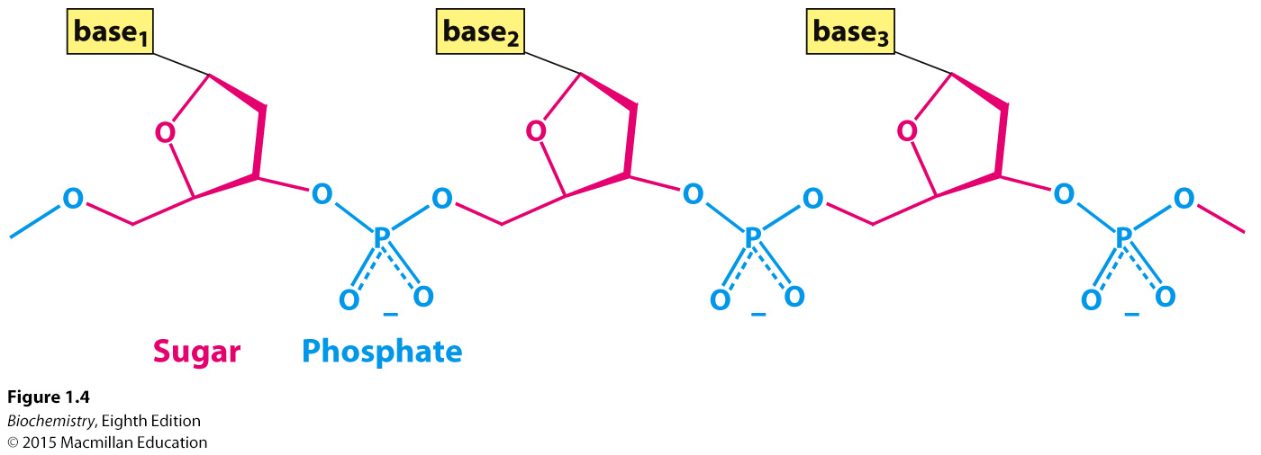
The linked sugar and phosphate compose the backbone of the DNA.
Notes:
FIGURE 1.4 Covalent structure of DNA. Each unit of the polymeric structure is composed of a sugar (deoxyribose), a phosphate, and a variable base that protrudes from the sugar–phosphate backbone.

Slide 3
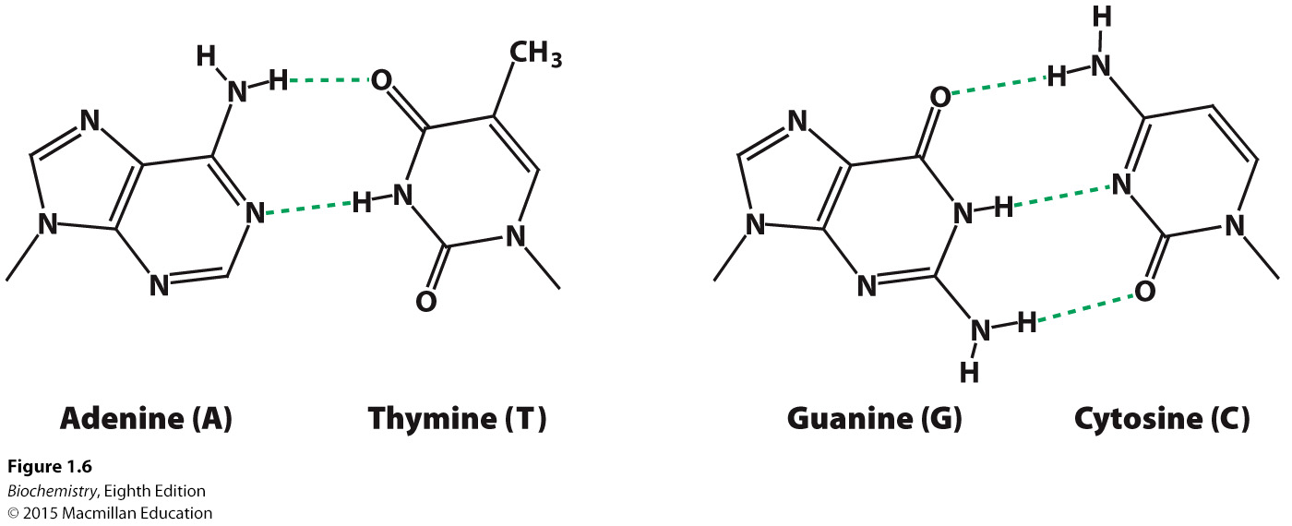
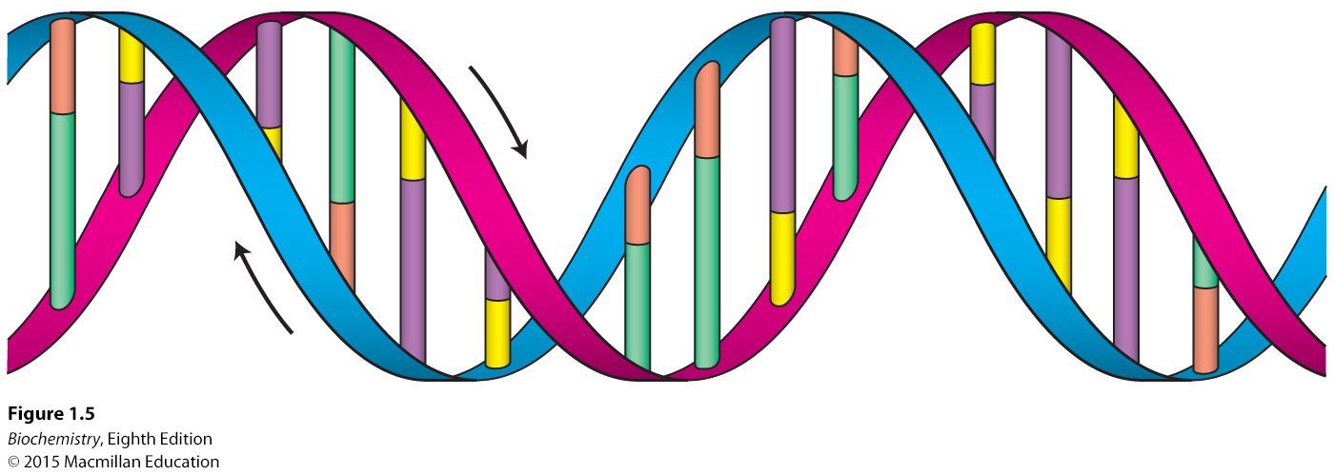
The two strands of a DNA double helix are formed by hydrogen bonds between specific base pairs in the different strands:
A binds to T
G binds to C

Slide 4
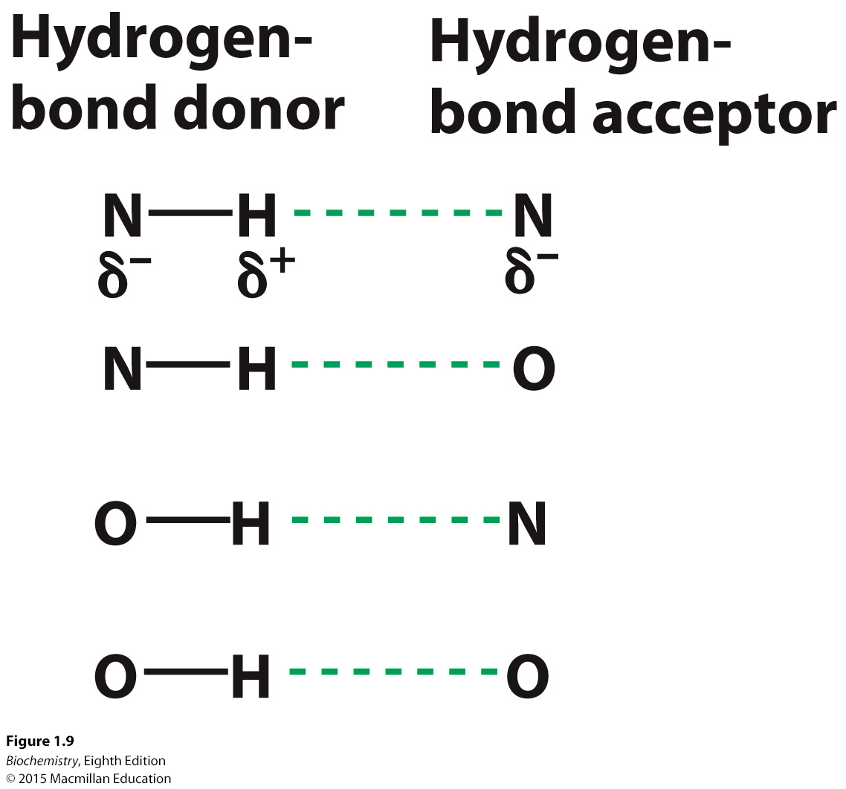
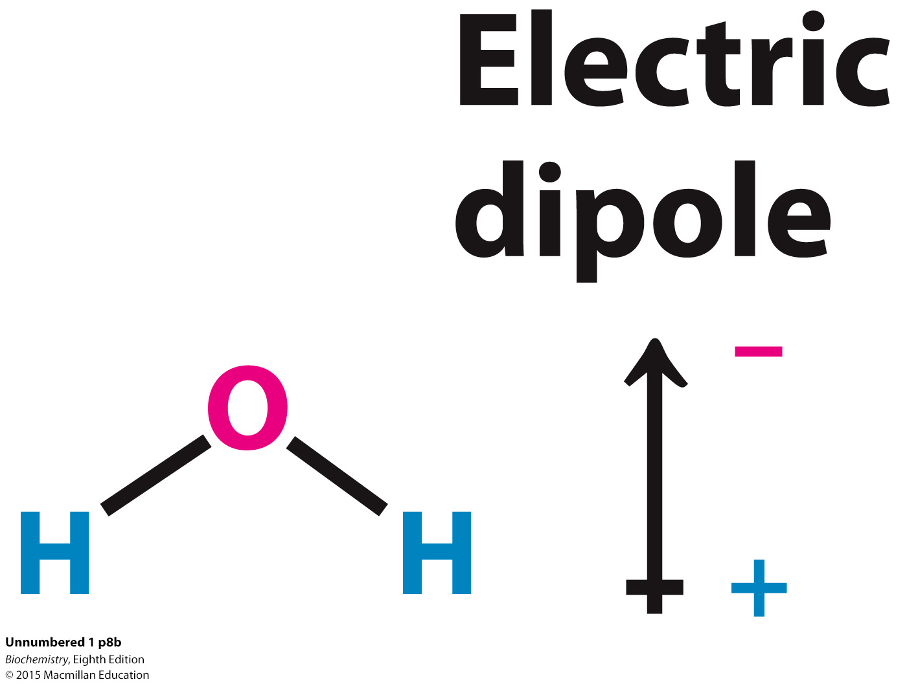
Properties of water.
Water is a polar molecule. The charges on the molecule are not evenly distributed.

Slide 5
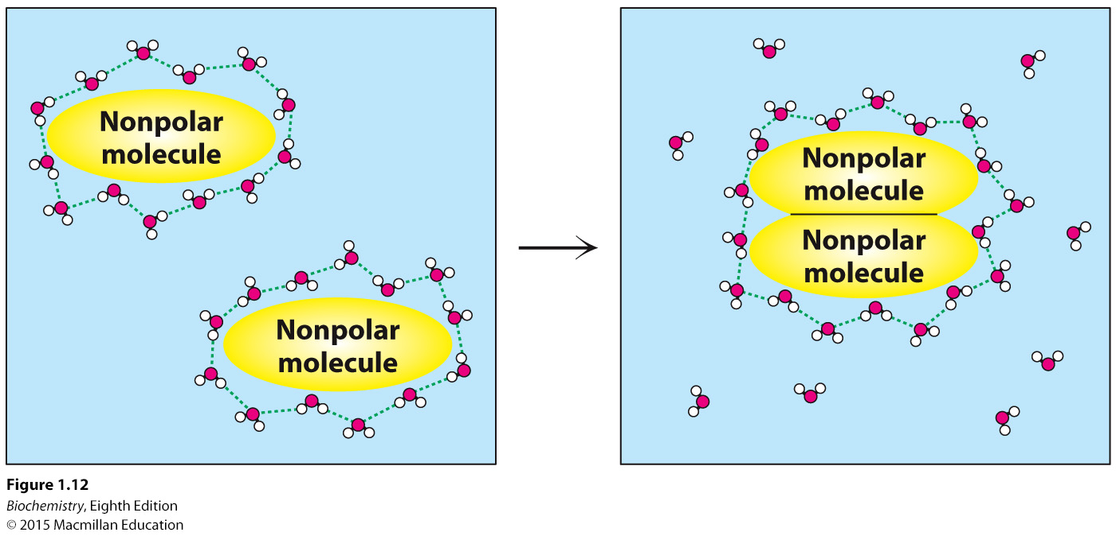
The hydrophobic effect.
Nonpolar molecules in water can be driven together by the hydrophobic effect which is powered by the increase in entropy of water. The associated interactions are called hydrophobic interaction.
Notes:
FIGURE 1.12 The hydrophobic effect. The aggregation of nonpolar groups in water leads to the release of water molecules, initially interacting with the nonpolar surface, into bulk water. The release of water molecules into solution makes the aggregation of nonpolar groups favorable.

Slide 6
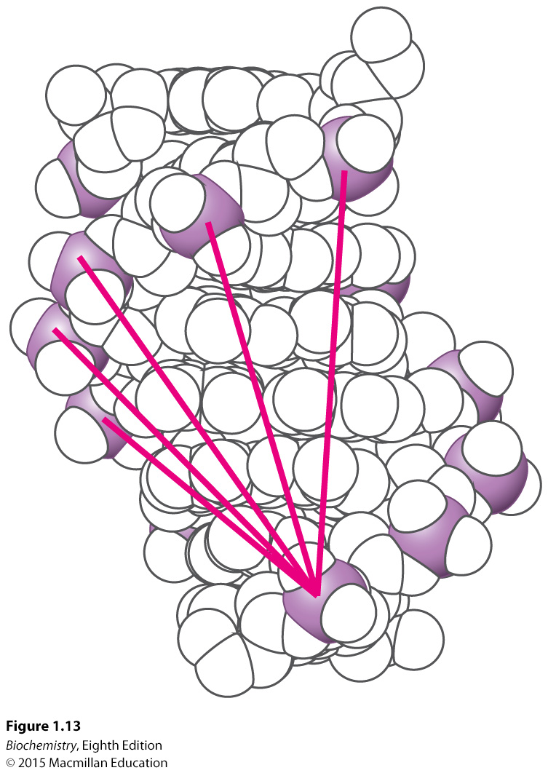
Notes:
FIGURE 1.13 Electrostatic interactions in DNA. Each unit within the double helix includes a phosphate group (the phosphorus atom being shown in purple) that bears a negative charge. The unfavorable interactions of one phosphate with several others are shown by red lines. These repulsive interactions oppose the formation of a double helix.

Slide 7
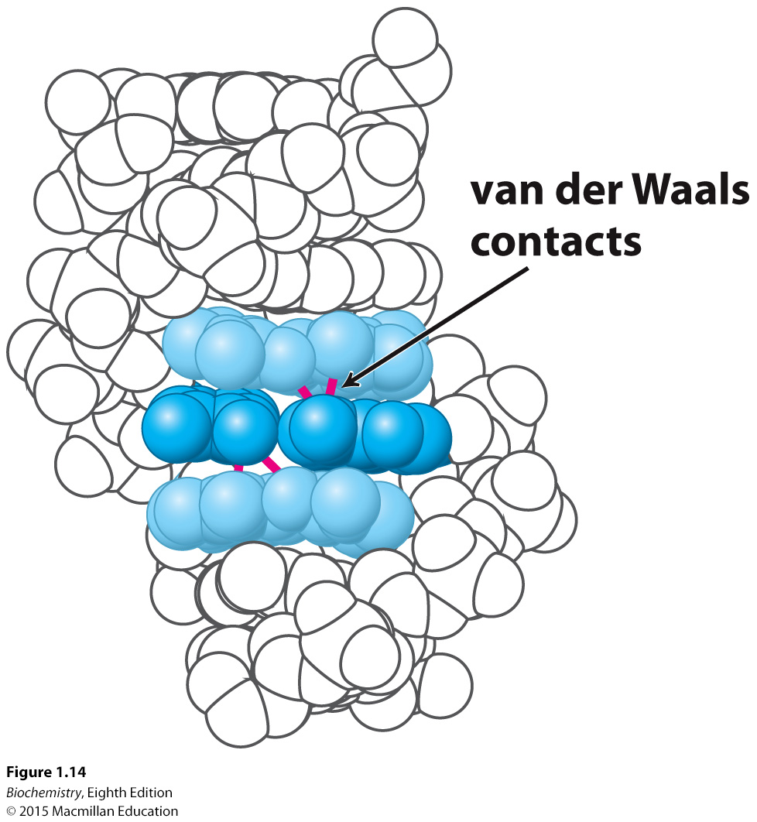
In the interior of the helix, bases are stacked and interact with one another through van der Waals interactions.
Notes:
FIGURE 1.14 Base stacking. In the DNA double helix, adjacent base pairs are stacked nearly on top of one another, and so many atoms in each base pair are separated by their van der Waals contact distance. The central base pair is shown in dark blue and the two adjacent base pairs in light blue. Several van der Waals contacts are shown in red.

Slide 8
Acid-base reactions involve the addition or removal of a H⁺ ion.
Such reactions are important in biochemistry.
pH is a measure of the H⁺ concentration and is defined by
H⁺ and OH⁻ ions are formed upon the dissociation of H₂O.

Slide 9
The equilibrium constant K_{eq} for the dissociation of water is given by
K_{w}, the ion constant of water is given by
This can be simplified to

Slide 10
From this, we can calculate
At pH 7, [H⁺] = [OH⁻] = 10⁻⁷

Slide 11
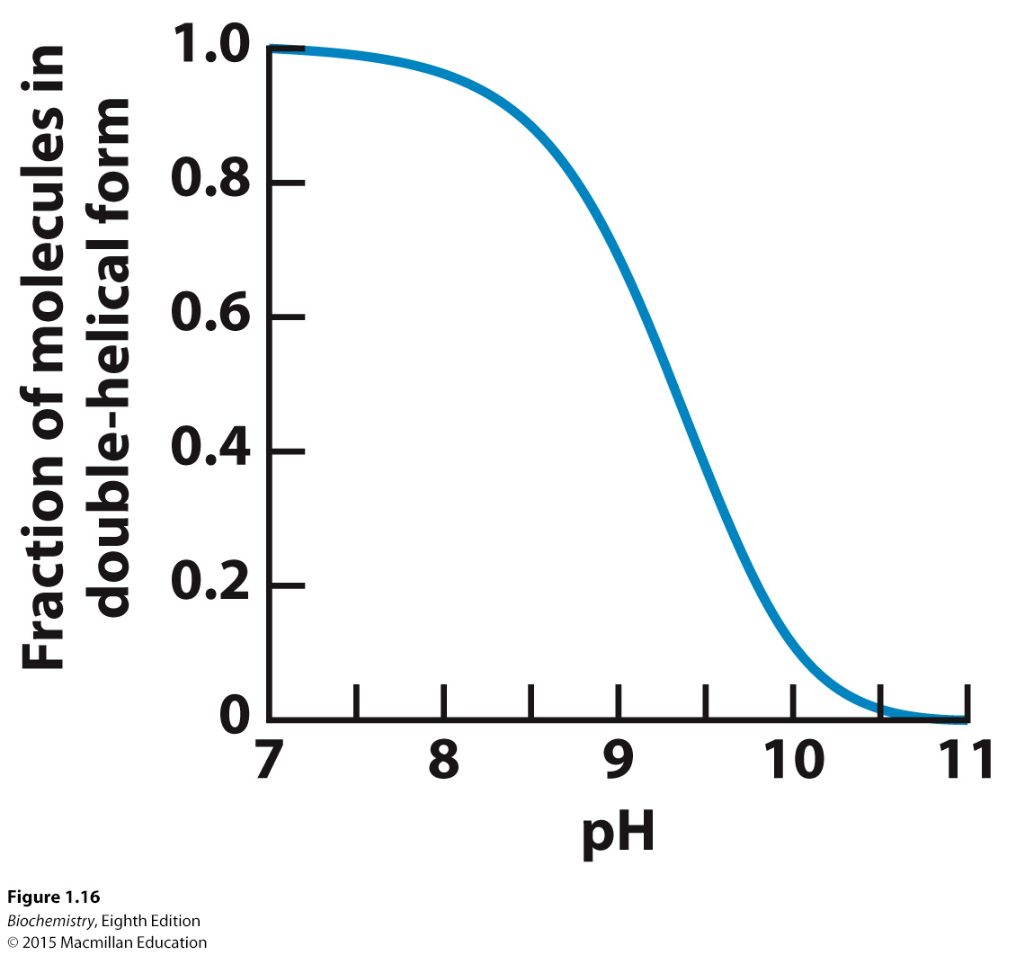
As base is added to a solution of double helical DNA, the helix is disrupted or denatured.
Notes:
FIGURE 1.16 DNA denaturation by the addition of a base. The addition of a base to a solution of double-helical DNA initially at pH 7 causes the double helix to separate into single strands. The process is half complete at slightly above pH 9.

Slide 12
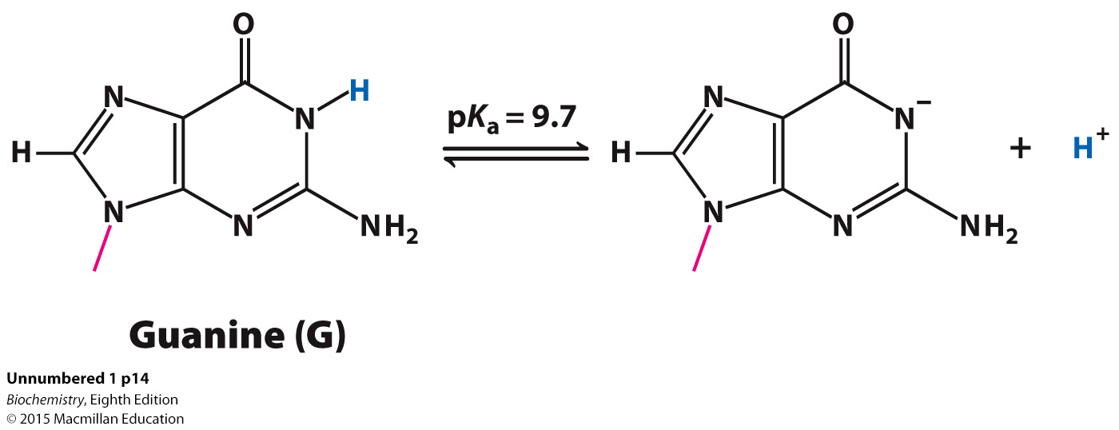
The chemical basis of the denaturation is the disruption of base-pairing. For example, the loss of a proton by the base guanine prevents base pairing with cytosine.

Slide 13
More generally, proton removal from any molecule HA is described by
The pK_{a} value indicates the susceptibility of proton removal.
When pH = pK_{a}
and

Slide 14
Dividing by H⁺ yields
or
Thus, when the pH is equal to the pK_{a}, the concentration of the protonated form of HA (the acid) is equal to the deprotonated form A⁻ (the base).
The N-1 proton of guanine has a pK_{a} of 9.7. When the pH is near or exceeds this value, the proton is lost, base pairing is disrupted and the helix is denatured.

Slide 15
An acid-base conjugate pair resists changes in the pH of a solution.
In other words, it acts as a buffer. A buffer is most effective at a pH near its pK_{a}.

Slide 16
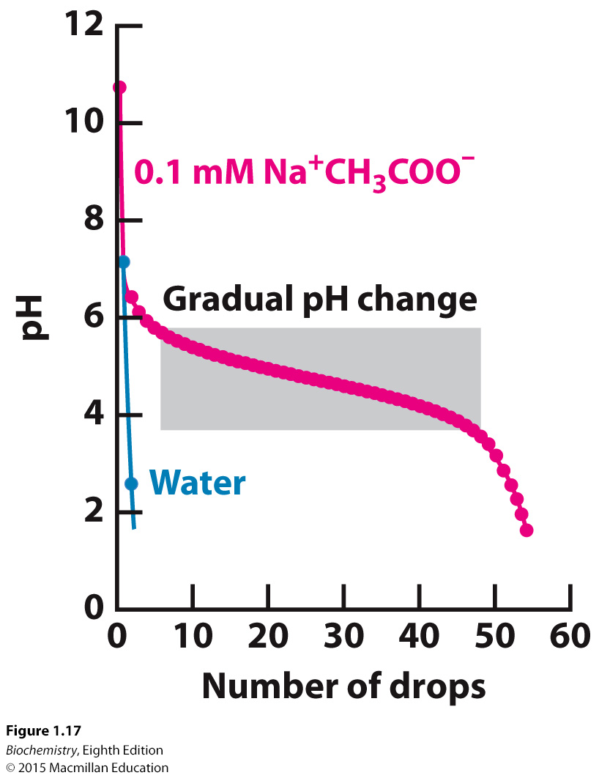
Notes:
FIGURE 1.17 Buffer action. The addition of a strong acid, 1 M HCl, to pure water results in an immediate drop in pH to near 2. In contrast, the addition of the acid to a 0.1 M sodium acetate (Na⁺ CH₃COO⁻) solution results in a much more gradual change in pH until the pH drops below 3.5.

Slide 17
We can understand the effects of a buffer in quantitative terms.
The ionization reaction of a weak acid is given by
The equilibrium constant for this reaction is
Taking the logarithms of both sides yields

Slide 18
Substituting pK_{a} and pH and rearranging yield the Henderson-Hasselbalch equation
Consideration of this equation reveals that weak acids are most effective as buffers at pH near their pK_{a}.

Slide 19
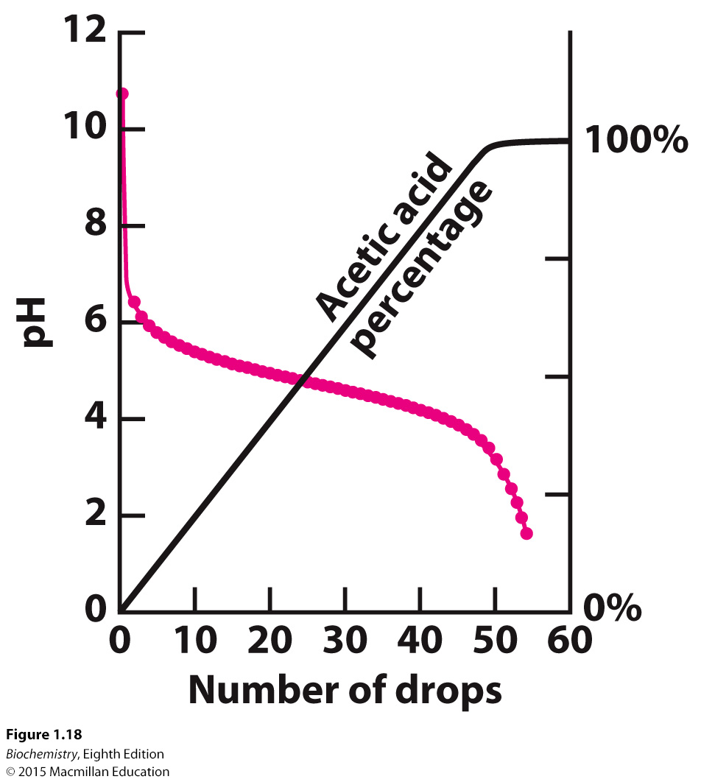
Notes:
FIGURE 1.18 Buffer protonation. When acid is added to sodium acetate, the added hydrogen ions are used to convert acetate ion into acetic acid. Because the proton concentration does not increase significantly, the pH remains relatively constant until all of the acetate has been converted into acetic acid.

Slide 20
Physiological pH is typically 7.4. Phosphoric acid is an important buffer in biological systems.

