Slide 1
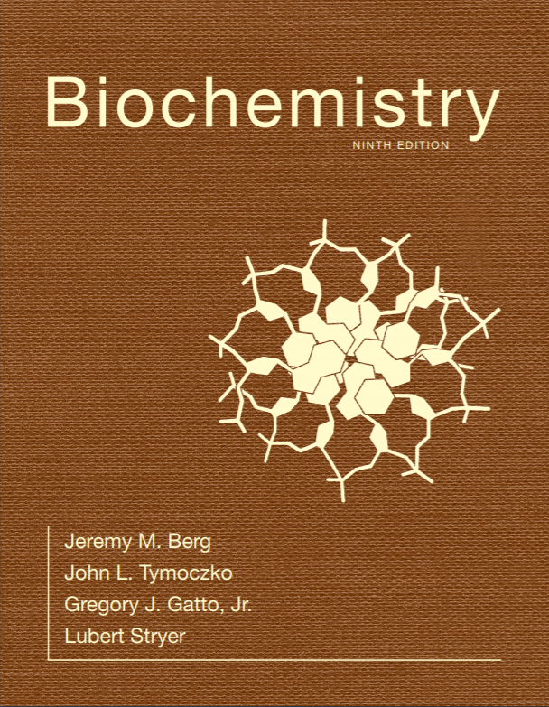
Chapter 9
Catalytic Strategies
© 2019 W. H. Freeman and Company
Notes:
Corresponding Chapters: 1, 2, 8, 9, 10

Slide 2
Ch.9 Learning Objectives
By the end of this chapter, you should be able to:
Discuss four general strategies used by enzymes to accelerate particular reactions.
Give examples of specific chemical features of enzyme active sites that facilitate increasing the rates of specific reactions.
Give an example of when high absolute rate acceleration is physiologically important and how an enzyme achieves this acceleration.
Understand when high specificity is important for an enzyme and how this specificity is achieved.
Discuss some of the experimental approaches that are used to elucidate enzymatic mechanisms.

Slide 3
Ch.9 Outline
9.1 Proteases Facilitate a Fundamentally Difficult Reaction
9.2 Carbonic Anhydrases Make a Fast Reaction Faster

Slide 4
A Few Basic Catalytic Principles are Used by Many Enzymes
Common catalytic strategies include the following:
Covalent catalysis: The active site contains a nucleophile that is briefly covalently modified.
General acid-base catalysis: A molecule other than water donates or accepts a proton.
Catalysis by approximation: The enzyme brings two substrates together in an orientation that facilitates catalysis.
Metal ion catalysis: Metal ions function in a number of ways, including serving as an electrophilic catalyst.

Slide 5
Section 9.1 Proteases Facilitate a Fundamentally Difficult Reaction
Proteases cleave proteins by hydrolysis. Protein hydrolysis is exergonic but kinetically very slow.
The resonance stabilization of the peptide bond accounts for its resistance to hydrolysis.

Slide 6
Chymotrypsin Possesses a Highly Reactive Serine Residue
Chymotrypsin is a proteolytic enzyme secreted by the pancreas that hydrolyzes peptide bonds selectively on the carboxyl side of large hydrophobic residues.
In the process of catalysis, serine 195 becomes a strong nucleophile that attacks the carbonyl group of the peptide bond in the substrate.
Evidence for this came from studies showing that the group-specific reagent diisopropylphosphofluoridate (DIPF) modifies only serine 195, one of 28 serine residues in chymotrypsin; this is sufficient to inhibit the enzyme.

Slide 7
Specificity of Chymotrypsin
Very low k_{cat}/K_{m} so I don’t consider it a significant substrate
Notes:
FIGURE 9.1 Specificity of chymotrypsin. Chymotrypsin cleaves proteins on the carboxyl side of aromatic or large hydrophobic amino acids (shaded orange). The likely bonds cleaved by chymotrypsin are indicated in red.

Slide 8
An Unusually Reactive Serine Residue in Chymotrypsin
Notes:
FIGURE 9.2 An unusually reactive serine residue in chymotrypsin. Chymotrypsin is inactivated by treatment with diisopropylphosphofluoridate (DIPF), which reacts only with serine 195 among 28 possible serine residues.

Slide 9
Chymotrypsin Action Proceeds in Two Steps Linked by a Covalently Bound Intermediate
Chromogenic substrates generate colored products, facilitating enzymatic studies.
N-Acetyl-L-phenylalanine-p-nitrophenyl ester is a chromogenic substrate for chymotrypsin.
Studies with the chromogenic substrate revealed that catalysis by chymotrypsin occurs in two stages: a rapid step (pre-steady state) and a slower step (steady state).
The steps in catalysis are explained by the rapid formation of an acyl-enzyme intermediate and a slower release of the acyl component to regenerate the free enzyme.

Slide 10
Chromogenic Substrate
Notes:
FIGURE 9.3 Chromogenic substrate. N-Acetyl-l-phenylalanine p-nitrophenyl ester yields a yellow product, p-nitrophenolate, on cleavage by chymotrypsin. p-Nitrophenolate forms by deprotonation of p-nitrophenol at pH 7.

Slide 11
Kinetics of Chymotrypsin Catalysis
Notes:
FIGURE 9.4 Kinetics of chymotrypsin catalysis. Two phases are evident in the cleaving of N-acetyl-l-phenylalanine p-nitrophenyl ester by chymotrypsin: a rapid burst phase (pre-steady-state) and a steady-state phase.

Slide 12
Covalent Catalysis
Notes:
FIGURE 9.5 Covalent catalysis. Hydrolysis by chymotrypsin takes place in two phases: (A) acylation to form the acyl-enzyme intermediate followed by (B) deacylation to regenerate the free enzyme.

Slide 13
Serine is Part of a Catalytic Triad that also Includes Histidine and Aspartate
Histidine acts as a base catalyst, removing a proton from serine 195 and generating a highly reactive alkoxide ion.
The alkoxide ion attacks the peptide bond of the substrate.
Aspartate orients the histidine and renders it a better proton acceptor.

Slide 14
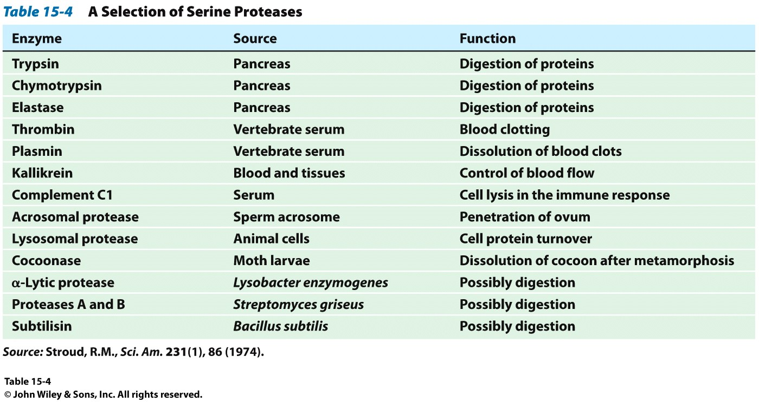
Example Mechanism: Serine Proteases
These are amazing proteins that are vital to biological processes in all living cells: Metabolism, immune response, blood clotting and more

Slide 15
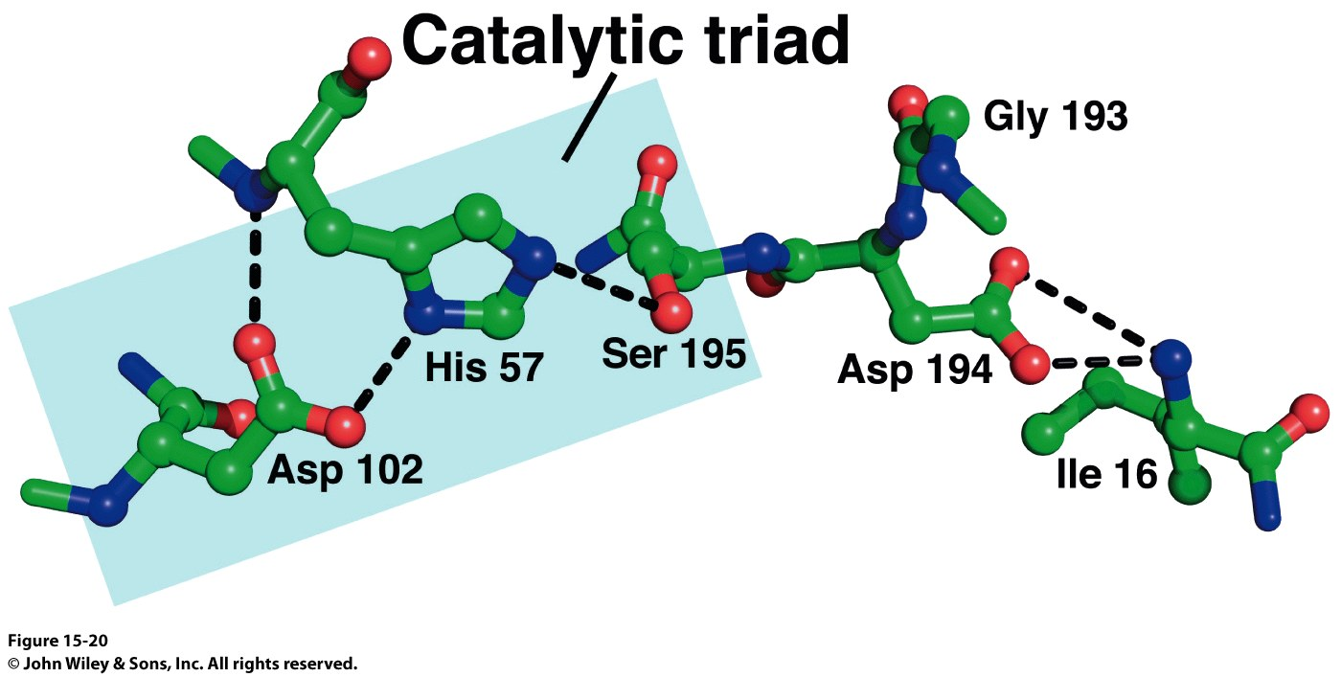
Example Mechanism: Serine Proteases
Chymotrypsin, trypsin and elastase are among the most well characterized proteins in the family
All rely upon a single structural motif: The Catalytic Triad
Asp-His-Ser
Trypsin Active Site

Slide 16
Location of the Active Site in Chymotrypsin
Notes:
FIGURE 9.6 Location of the active site in chymotrypsin. Chymotrypsin consists of three chains, shown in ribbon form in orange, blue, and green. The side chains of the catalytic triad residues are shown as ball-and-stick representations. Notice these side chains, including serine 195, lining the active site in the upper half of the structure. Also notice two intrastrand and two interstrand disulfide bonds in various locations throughout the molecule. [Drawn from 1GCT.pdb.]

Slide 17
The Catalytic Triad
Notes:
FIGURE 9.7 The catalytic triad. The catalytic triad, shown on the left, converts serine 195 into a potent nucleophile, as illustrated on the right.

Slide 18
Peptide Hydrolysis by Chymotrypsin
Notes:
FIGURE 9.8 Peptide hydrolysis by chymotrypsin. The mechanism of peptide hydrolysis illustrates the principles of covalent and acid–base catalysis. The reaction proceeds in eight steps: (1) substrate binding, (2) nucleophilic attack of serine on the peptide carbonyl group, (3) collapse of the tetrahedral intermediate, (4) release of the amine component, (5) water binding, (6) nucleophilic attack of water on the acyl-enzyme intermediate, (7) collapse of the tetrahedral intermediate, and (8) release of the carboxylic acid component. The dashed green lines represent hydrogen bonds.

Slide 19
Stabilization of the Transition State
The oxyanion hole, a region of the active site, stabilizes the tetrahedral reaction intermediate.
Why does this matter? Remember that enzymes stabilize transition states, making them more likely to happen.
Notes:
FIGURE 9.9 The oxyanion hole. The structure stabilizes the tetrahedral intermediate of the chymotrypsin reaction. Notice that hydrogen bonds (shown in green) link peptide NH groups and the negatively charged oxygen atom of the intermediate.

Slide 20
The Specificity Pocket
The specificity of chymotrypsin is accounted for by the S₁ pocket, a hydrophobic pocket that binds a hydrophobic residue on the substrate and positions the adjacent peptide bond for cleavage.
Some proteases have more complex specificity patterns. Residues on the amino-terminal side of the bond to be cleaved are labeled P₁, P₂, P₃, and so forth, while those on the carboxyl side are labeled P₁′, P₂′, and so forth.
The corresponding sites on the enzyme are referred to as S₁, S₂ or S₁′, S₂′ and so forth.

Slide 21
Specificity Pocket of Chymotrypsin
Notes:
FIGURE 9.10 Specificity pocket of chymotrypsin. Notice that this pocket is lined with hydrophobic residues and is deep, favoring the binding of residues with long hydrophobic side chains such as phenylalanine (shown in green). The active site serine residue (serine 195) is positioned to cleave the peptide backbone between the residue bound in the pocket and the next residue in the sequence. The key amino acids that constitute the binding site are identified.

Slide 22
Specificity Nomenclature for Protease–substrate Interactions
Specificity Determinant
In carboxy-side cleaving proteases
Scissile Bond
Notes:
FIGURE 9.11 Specificity nomenclature for protease–substrate interactions. The potential sites of interaction of the substrate with the enzyme are designated P (shown in red), and corresponding binding sites on the enzyme are designated S. The scissile bond (also shown in red) is the reference point.

Slide 23
Catalytic Triads are Found in Other Hydrolytic Enzymes
Many other proteases have been identified that are homologs of chymotrypsin and use the same catalytic triad strategy.
Structural differences in the S₁ pockets account for the different specificities.
Other proteases are not homologs of chymotrypsin, but still use the catalytic triad strategy.
Evidence suggests that the catalytic triad has independently evolved at least three times.

Slide 24
Structural Similarity of Trypsin and Chymotrypsin
Example of Divergent evolution within a species.
A single ancestral gene multiplies and changes substrate specificity, giving the host cell a wider range of materials to use
Notes:
FIGURE 9.12 Structural similarity of trypsin and chymotrypsin. An overlay of the structure of chymotrypsin (red) on that of trypsin (blue) is shown. Notice the high degree of similarity. Only α-carbon-atom positions are shown. The mean deviation in position between corresponding α-carbon atoms is quite small, only 1.7 Å. [Drawn from 5PTP.pdb and 1GCT.pdb.]

Slide 25
The S₁ Pockets of Chymotrypsin, Trypsin, and Elastase (Divergent Evolution within a species)
Notes:
FIGURE 9.13 The S1 pockets of chymotrypsin, trypsin, and elastase. Certain residues play key roles in determining the specificity of these enzymes. The side chains of these residues, as well as those of the active-site serine residues, are shown in color.

Slide 26
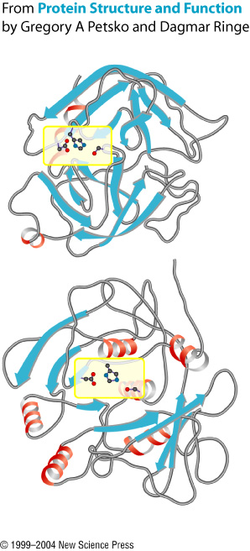
Serine Proteases and Evolution
Chymotrypsin
Several superfamilies of serine proteases exist
No obvious sequence or structural relationships b/w members of different families
The catalytic residues are in the same structural location in every superfamily
Only commonality b/w them
Active site similarity is the result of convergent evolution
Divergent evolution has created enzymes with differing substrate specificities within each superfamily
Remember: What determines substrate specificity in serine proteases?
Subtilisin

Slide 27
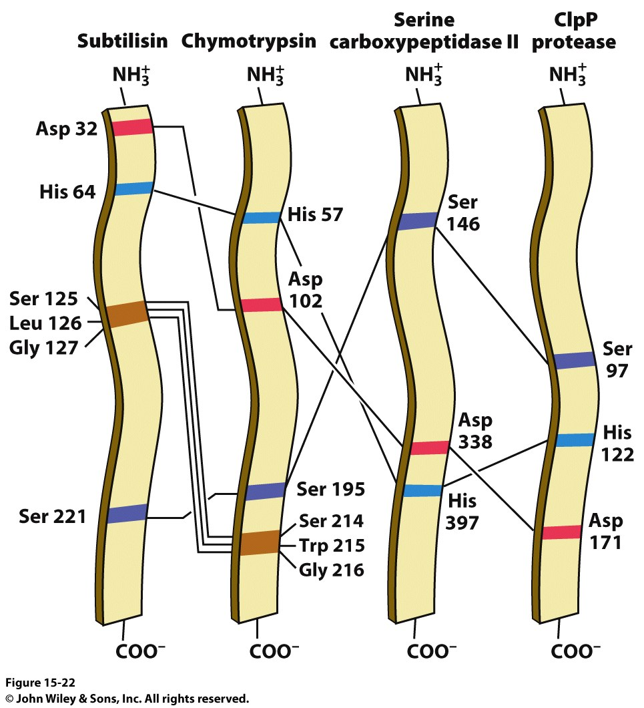
Serine Proteases and Evolution
Several superfamilies of serine proteases exist
No obvious sequence or structural relationships b/w members of different families
The catalytic residues are in the same structural location in every superfamily
Only commonality b/w them
Active site similarity is the result of Convergent Evolution
Divergent Evolution has created enzymes with differing substrate specificities within each superfamily
Remember: What determines substrate specificity in serine proteases?

Slide 28
The Catalytic Triad and Oxyanion Hole of Subtilisin
Notes:
FIGURE 9.14 The catalytic triad and oxyanion hole of subtilisin. Notice the two enzyme NH groups (both in the backbone and in the side chain of Asn 155) located in the oxyanion hole. The NH groups will stabilize a negative charge that develops on the peptide bond attacked by nucleophilic serine 221 of the catalytic triad.

Slide 29
The Catalytic Triad has been Dissected by Site-directed Mutagenesis
Site-directed mutagenesis was used to explore the catalytic triad of the protease subtilisin.
Each member of the catalytic triad was mutated to alanine with dramatic loss of activity, with little impact on K_{M}.
Activity in each of the catalytic triad mutants was still much higher than in the absence of enzyme, suggesting that transition state stabilization was still an important contribution in these mutants.

Slide 30
Site-directed Mutagenesis of Subtilisin
Notes:
FIGURE 9.15 Site-directed mutagenesis of subtilisin. Residues of the catalytic triad were mutated to alanine, and the activity of the mutated enzyme was measured. Mutations in any component of the catalytic triad cause a dramatic loss of enzyme activity. Note that the activity is displayed on a logarithmic scale. The mutations are identified as follows: the first letter is the one-letter abbreviation for the amino acid being altered; the number identifies the position of the residue in the primary structure; and the second letter is the one-letter abbreviation for the amino acid replacing the original one. Uncat. refers to the estimated rate for the uncatalyzed reaction.

Slide 31
Cysteine, Aspartyl, and Metalloproteases are Other Major Classes of Peptide-cleaving Enzymes
Not all proteases rely on an activated serine at the active site.
Cysteine, aspartate, and metals can be used to generate a nucleophile that attacks the carbonyl group of the peptide bond.

Slide 32
Three Classes of Proteases and Their Active Sites
Mutate the Ser to a Cys and you get…
Get 2 Asp together (HIV protease dimer I showed you)
One is acid, one is base and a water in the middle
You’ll see carbonic anhydrase’s Zn²⁺ do something to water in a bit. Same thing here.
Notes:
FIGURE 9.16 Three classes of proteases and their active sites. These examples of a cysteine protease, an aspartyl protease, and a metalloprotease use a histidine-activated cysteine residue, an aspartate-activated water molecule, and a metal-activated water molecule, respectively, as the nucleophile. The two halves of renin are in blue and red to highlight the approximate twofold symmetry of aspartyl proteases. Notice how different these active sites are despite the similarity in the reactions they catalyze. [Drawn from 1PPN.pdb.; 1HRN. pdb; 1LND.pdb.]

Slide 33
The Activation Strategies for Three Classes of Proteases
Notes:
FIGURE 9.17 The activation strategies for three classes of proteases. The peptide carbonyl group is attacked by (A) a histidine-activated cysteine in the cysteine proteases, (B) an aspartate-activated water molecule in the aspartyl proteases, and (C) a metal-activated water molecule in the metalloproteases. For the metalloproteases, the letter B represents a base (often glutamate) that helps deprotonate the metal-bound water.

Slide 34
Protease Inhibitors are Important Drugs
Indinavir, an inhibitor of the HIV aspartyl protease, is an important drug used in the treatment of AIDS.
Indinavir is a substrate analog of the HIV protease.

Slide 35
HIV Protease, a Dimeric Aspartyl Protease
Notes:
FIGURE 9.18 HIV protease, a dimeric aspartyl protease. The protease is a dimer of identical subunits, shown in blue and yellow, consisting of 99 amino acids each. Notice the placement of active-site aspartic acid residues, one from each chain, which are shown as ball-and-stick structures. The flaps will close down on the binding pocket after substrate has been bound. [Drawn from 3PHV.pdb.]

Slide 36
Indinavir, an HIV Protease Inhibitor
Notes:
FIGURE 9.19 Indinavir, an HIV protease inhibitor. The structure of indinavir (Crixivan) is shown in comparison with that of a peptide substrate of HIV protease. The scissile bond in the substrate is highlighted in red.

Slide 37
HIV Protease–indinavir Complex
Notes:
FIGURE 9.20 HIV protease–indinavir complex. (Left) The HIV protease is shown with the inhibitor indinavir bound at the active site. Notice the twofold symmetry of the enzyme structure. (Right) The drug has been rotated to reveal its approximately twofold symmetric conformation. [Drawn from 1HSH.pdb.]

Slide 38
Section 9.2 Carbonic Anhydrases Make a Fast Reaction Faster
Carbon dioxide is an end product of aerobic metabolism. It is converted into bicarbonate ion and a proton by the enzyme carbonic anhydrase. In the lungs, the bicarbonate is converted to CO₂ and exhaled.
Carbonic anhydrases play roles in the generation of the aqueous humor of the eye, and a lack of carbonic anhydrase activity has been associated with osteopetrosis (excessive formation of dense bones) and intellectual disability.

Slide 39
Carbonic Anhydrase Contains a Bound Zinc Ion Essential for Catalytic Activity
The human genome contains at least seven genes encoding carbonic anhydrase, and they are all homologs.
It was the first known zinc-containing enzyme; now hundreds of enzymes are known to bind zinc.
The Zn²⁺ is bound to four ligands: three coordination sites are bound to histidine residues, and one is bound to either a water molecule or a hydroxide ion (depending on pH).

Slide 40
The Structure of Human Carbonic Anhydrase II and its Zinc Site
Notes:
FIGURE 9.21 The structure of human carbonic anhydrase II and its zinc site. (Left) Notice that the zinc ion is bound to the imidazole rings of three histidine residues as well as to a water molecule. (Right) Notice the location of the zinc site in a cleft near the center of the enzyme. [Drawn from 1CA2.pdb.]

Slide 41
Catalysis Entails Zinc Activation of a Water Molecule (1/2)
The maximal rate of carbon dioxide hydration is attained at pH 8. Activity falls with a drop in pH, and the titration curve suggests that an active site component with a pK_{a} of 7 is required.
Zn²⁺ lowers the pK_{a} of water to 7, generating the potent nucleophile OH⁻.
Adjacent to Zn²⁺ is a carbon dioxide binding site.
The OH⁻ attacks the CO₂, converting it to bicarbonate.
Studies with synthetic analog systems confirm the important role of Zn²⁺.

Slide 42
Effect of pH on Carbonic Anhydrase Activity
Notes:
FIGURE 9.22 Effect of pH on carbonic anhydrase activity. Changes in pH alter the rate of carbon dioxide hydration catalyzed by carbonic anhydrase II. The enzyme is maximally active at high pH.

Slide 43
The pK_{a} of Zinc-bound Water
Ordinary water at 25C:
H₂O <-> H⁺ + OH⁻
Keq = Ka = [H⁺][OH⁻]=[1x10⁻⁷][1x10⁻⁷]
Ka=1x10⁻¹⁴
pKa=14, which makes sense, because water isn’t very acidic. Which is good.
Notes:
FIGURE 9.23 The pK_{a} of zinc-bound water. Binding to zinc lowers the pK_{a} of water from 15.7 to 7.

Slide 44
Carbon Dioxide Binding Site
Notes:
FIGURE 9.24 Carbon dioxide binding site. Crystals of carbonic anhydrase were exposed to carbon dioxide gas at high pressure and low temperature, and x-ray diffraction data were collected. The electron density for carbon dioxide, clearly visible adjacent to the zinc and its bound water, reveals the carbon dioxide binding site. Hydrophobic amino acids are shaded green, and the magenta ones are hydrophilic. [Information from J. F. Domsic et al., J. Biol. Chem. 283:30766–30771, 2008.]

Slide 45
Catalysis Entails Zinc Activation of a Water Molecule (2/2)
A proposed mechanism for the hydration of carbon dioxide:
Zn²⁺ generates OH⁻ by facilitating the release of a H⁺ from water.
CO₂ binds to the active site and is positioned to react with OH⁻.
The OH⁻ attacks the CO₂, generating HCO₃⁻.
The active site is regenerated with the release of HCO₃⁻ and binding of H₂O.
Studies with a synthetic analog system provide support for the proposed mechanism.

Slide 46
Mechanism of Carbonic Anhydrase
Notes:
FIGURE 9.25 Mechanism of carbonic anhydrase. The zinc-bound hydroxide mechanism for the hydration of carbon dioxide reveals one aspect of metal ion catalysis. The reaction proceeds in four steps: (1) water deprotonation, (2) carbon dioxide binding, (3) nucleophilic attack by hydroxide on carbon dioxide, and (4) displacement of bicarbonate ion by water.

Slide 47
A Proton Shuttle Facilitates Rapid Regeneration of the Active Form of the Enzyme
The zinc-bound water molecule must lose a proton to begin the hydration reaction.
The backward reaction, the reprotonation of the OH⁻, is prevented by the binding of the released proton by a molecule of buffer.
A histidine residue at the active site serves as a proton shuttle, transferring the proton from water to the buffer.

Slide 48
Kinetics of Water Deprotonation
The back reaction (k₋₁) happens very readily
Notes:
FIGURE 9.27 Kinetics of water deprotonation. The kinetics of deprotonation and protonation of the zinc-bound water molecule in carbonic anhydrase.

Slide 49
The Effect of Buffer on Deprotonation
The back reaction (k₋₁) is prevented by the buffer molecule accepting the proton
Notes:
FIGURE 9.28 The effect of buffer on deprotonation. The deprotonation of the zinc-bound water molecule in carbonic anhydrase is aided by buffer component B.

Slide 50
Histidine Proton Shuttle
Notes:
FIGURE 9.30 Histidine proton shuttle. (1) Histidine 64 abstracts a proton from the zinc-bound water molecule, generating a nucleophilic hydroxide ion and a protonated histidine. (2) The buffer (B) removes a proton from the histidine, regenerating the unprotonated form.

