Slide 1
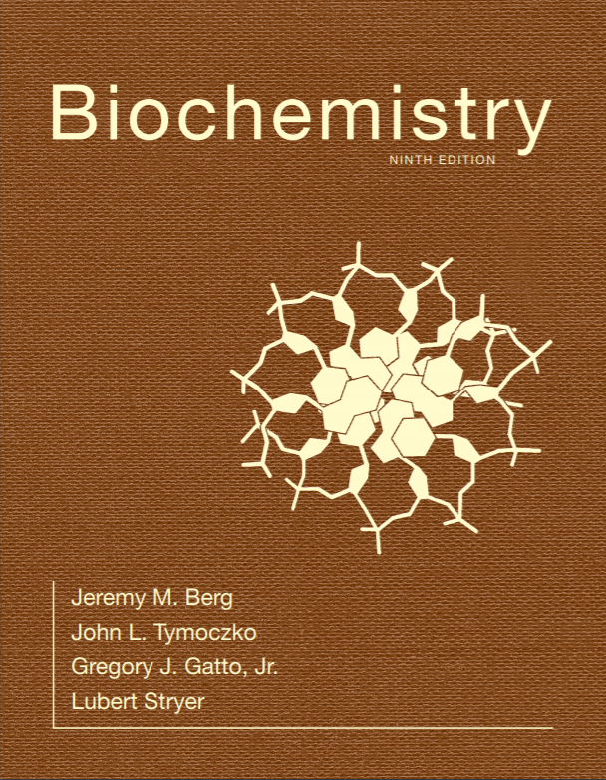
Chapter 3
Exploring Proteins and Proteomes
© 2019 W. H. Freeman and Company
Notes:
Corresponding Chapters: 1, 2, 8, 9, 10

Slide 2
Ch.3 Learning Objectives
By the end of this chapter, you should be able to:
Explain the importance of protein purification and how it can be quantified.
Describe the different types of chromatography used to purify proteins.
Describe the different methods available for determining the mass of a protein.
Explain how antibodies can be used as tools for protein identification, purification, and quantitation.
Describe how proteins are sequenced, and explain why sequence determination is important.

Slide 3
The Proteome is the Functional Representation of the Genome
The proteome is the entire set of proteins expressed and modified by a cell under a particular set of biochemical conditions.
Unlike the genome, the proteome is not an unvarying characteristic of the cell.
Different cell/tissue types in the same organism have the same genome, but different proteomes

Slide 4
Section 3.1 The Purification of Proteins Is an Essential First Step in Understanding Their Function
Proteins can be purified on the basis of differences in their chemical properties.
Protein purification requires a test, or assay, that determines whether the protein of interest is present.
Example: an assay for the enzyme lactate dehydrogenase is based on the fact that a product of the reaction, NADH, can be detected spectrophotometrically.
Remember Beer’s Law?

Slide 5
Proteins Must be Released from the Cell to be Purified
Intact cells are disrupted to form a homogenate, which is a mixture of all of the components of the cell.
The homogenate is then centrifuged at low speed to yield a pellet consisting of nuclei and a supernatant.
This supernatant is then centrifuged at a higher centrifugal force to yield another pellet and supernatant.
This process, called differential centrifugation, is repeated several more times to yield a series of pellets enriched in various cellular materials and a final supernatant, the soluble portion of the cytoplasm.

Slide 6
Differential Centrifugation
Supernatant = Liquid present after centrifugation
Supernatant contains all of the solusble enzymes from the cytoplasm
Notes:
FIGURE 3.1 Differential centrifugation. Cells are disrupted in a homogenizer, and the resulting mixture, called the homogenate, is centrifuged in a step-by-step fashion of increasing centrifugal force. The denser material will form a pellet at lower centrifugal force than will the less dense material. The isolated fractions can be used for further purification. [Photographs courtesy of Dr. S. Fleischer and Dr. B. Fleischer.]

Slide 7
Salting Out and Dialysis
Salting out
Salting out takes advantage of the fact that the solubility of proteins varies with the salt concentration.
Most proteins require some salt to dissolve in water, a process called salting in. As the salt concentration is increased, different proteins will precipitate at different characteristic salt concentrations, a process called salting out.
Dialysis
The salt can be removed from a protein solution by dialysis.
The protein solution is placed in a cellophane bag with pores too small to allow the protein to diffuse but big enough to allow the salt to equilibrate with the solution surround the dialysis bag.
This can also work for other small soluble contaminants.

Slide 8
Dialysis
A variety of pore sizes of dialysis tubing is available, each with a different Molecular Weight Cut Off (MWCO)
The larger the MWCO, the larger the solute that can leave the interior of the bag and into the buffer
Why? Speed. If your protein is 50 KDa and you use a 3KDa MWCO tubing, it will take longer to reach equilibrium.
Notes:
FIGURE 3.2 Dialysis. Protein molecules (red) are retained within the dialysis bag, whereas small molecules (blue) diffuse down their concentration gradient into the surrounding medium.

Slide 9
Column Chromatographic Methods
Inert beads made of cellulose or acrylamide can have activated chemical groups placed on them
These chemical groups can impart specific properties such as: charge, binding of metal ions, covalent attachment of chemical compounds.
All chromatographic methods have the same basic steps, with the distinction between them primarily consisting of how the target protein is eluted from the column

Slide 10
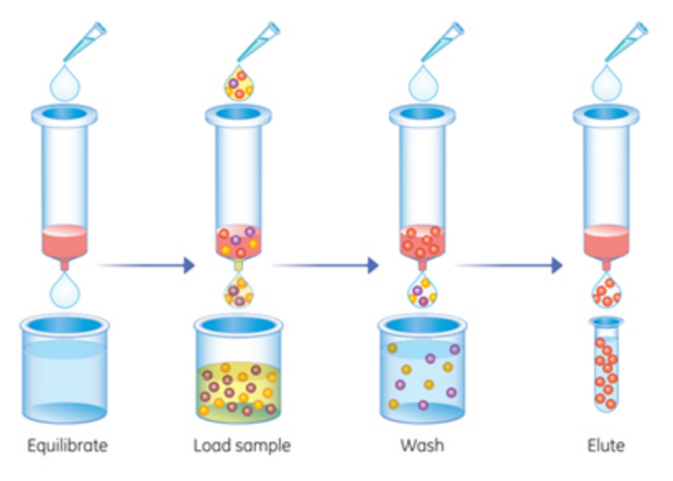
Column Chromatographic Methods
How we elute the protein in each method is the primary source of difference between the various chromatographic methods
https://www.sigmaaldrich.com/technical-documents/protocols/biology/affinity-chromatography-tagged-proteins/manual-purification-using-his-gravitrap-talon.html

Slide 11
Ion-exchange Chromatography (1/2)
Ion exchange chromatography allows separation of proteins on the basis of charge. The beads in the column are made so as to have a charge.
Every protein has a certain pH where the sum of all the pKa values of the ionizable amino acids is zero. It is called the “Isoelectric Point” and can be viewed as the “pKa of the protein”
When a mixture of proteins is passed through the column, proteins with the same charge as that on the column will exit the column quickly.
Proteins with the opposite charge will bind to the beads and are subsequently released by increasing the salt concentration or adjusting the pH of the buffer that is passed through the column.

Slide 12
Ion-exchange Chromatography (2/2)
In cation exchange chromatography (pictured at left), the beads have negative charge
In anion exchange chromatography, the beads have positive charge
Example of CIEX
Notes:
FIGURE 3.4 Ion-exchange chromatography. This technique separates proteins mainly according to their net charge.

Slide 13
Affinity Chromatography (1/2)
Affinity chromatography takes advantage of the fact that some proteins have a high affinity for specific chemicals or chemical groups.
Beads are made with the specific chemical attached. A protein mixture is passed through the column, and only proteins with affinity for the attached group will be retained.
The bound protein is then released by passing a solution enriched in the chemical to which the protein is bound through the column.

Slide 14
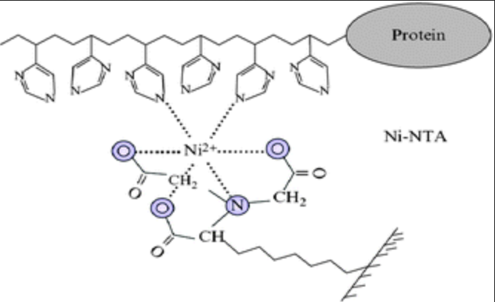
Affinity Chromatography (2/2)
Glucose binding Affinity Chromatography (GBP)
Nickel ion Metal Chelating Affinity Chromatography (Ni2⁺-MCAC)
Protein binds resin imidazole groups of hexahistidine-tagged protein
Elute with the addition of free imidazole
https://pubs.rsc.org/services/images/RSCpubs.ePlatform.Service.FreeContent.ImageService.svc/ImageService/Articleimage/2013/NJ/c2nj40558j/c2nj40558j-f6.gif
Notes:
FIGURE 3.5 Affinity chromatography. Affinity chromatography of concanavalin A (shown in yellow) on a solid support containing covalently attached glucose residues (G).

Slide 15
Gel-filtration Chromatography (1/2)
Gel filtration chromatography, also known as molecular exclusion chromatography, allows the separation of proteins on the basis of size.
A glass column is filled with porous beads. When a protein solution is passed over the beads, large proteins cannot enter the beads and exit the column first.
Small proteins can enter the beads and thus have a longer path and exit the column last.
Gel filtration chromatography IS USUALLY THE LAST STEP OF A PURIFICATION SCHEME
Why? How many protein molecules and types are in a cell lysate? Too many to resolve via GF chromatography

Slide 16
Gel-filtration Chromatography (2/2)
Notes:
FIGURE 3.3 Gel-filtration chromatography. A mixture of proteins in a small volume is applied to a column filled with porous beads. Because large proteins cannot enter the internal volume of the beads, they emerge sooner than do small ones.

Slide 17
Gel Electrophoresis (1/2)
Proteins will migrate in an electrical field with a velocity (v) directly proportional to electric field strength (E), the charge on the protein (z), and inversely proportional to the frictional coefficient ( f ).
v = Ez/f
The frictional coefficient is a function of the protein mass, shape, and radius (r) and the density of the medium ( η ).
f = 6pηr
When the migration occurs in a gel, it is called gel electrophoresis.

Slide 18
Gel Electrophoresis (2/2)
Sodium dodecyl sulfate-polyacrylamide gel electrophoresis (SDS-PAGE) allows accurate determination of mass.
SDS denatures proteins, and for most proteins, 1 molecule of SDS binds for every two amino acids.
Thus, proteins have the same charge-to-mass ratio and migrate in the gel on the basis of mass only.

Slide 19
Polyacrylamide Gel Electrophoresis
Notes:
FIGURE 3.7 Polyacrylamide gel electrophoresis. (A) Gel electrophoresis apparatus. Typically, several samples undergo electrophoresis on one flat polyacrylamide gel. A microliter pipette is used to place solutions of proteins in the wells of the slab. A cover is then placed over the gel chamber and voltage is applied. The negatively charged SDS (sodium dodecyl sulfate)–protein complexes migrate in the direction of the anode, at the bottom of the gel. (B) The sieving action of a porous polyacrylamide gel separates proteins according to size, with the smallest moving most rapidly.

Slide 20
Staining of Proteins After Electrophoresis
Proteins separated by SDS-PAGE are visualized by staining the gel with dyes such as Coomassie blue.
Notes:
FIGURE 3.9 Staining of proteins after electrophoresis. Mixtures of proteins from cellular extracts subjected to electrophoresis on an SDS–polyacrylamide gel can be visualized by staining with Coomassie blue. The first lane contains a mixture of proteins of known molecular weights, which can be used to estimate the sizes of the bands in the samples. [© Dr. Robert Farrell.]

Slide 21
Isoelectric Focusing (1/2)
Isoelectric focusing allows separation of proteins in a gel on the basis of their relative amounts of acidic (lower-pKa) and basic (higher-pKa) amino acids.
Asp and Glu, which have carboxyl groups, are uncharged when they are protonated.
Lys, Arg, and His, which have various types of N-containing groups, are uncharged when deprotonated.
If a mixture of proteins is placed in a gel with a pH gradient and an electrical field is applied, each protein will migrate to its isoelectric point (pI), the pH at which it has no net charge.
When they are uncharged, molecules always stop migrating during electrophoresis.

Slide 22
Isoelectric Focusing (2/2)
Notes:
FIGURE 3.11 The principle of isoelectric focusing. A pH gradient is established in a gel before loading the sample. (A) Each protein, represented by the different colored circles, will possess a net positive charge in the regions of the gel where the pH is lower than its respective pI value and a net negative charge where the pH is greater than its pI. When voltage is applied to the gel, each protein will migrate to its pI, the location at which it has no net charge. (B) The proteins form bands that can be excised and used for further experimentation.

Slide 23
Two-dimensional Electrophoresis (1/2)
In two-dimensional gel electrophoresis, proteins are separated in one direction by isoelectric focusing.
This gel is then attached to an SDS-PAGE gel, and electrophoresis is performed at a 90º angle to the direction of the isoelectric focusing separation.

Slide 24
Two-dimensional Electrophoresis (2/2)
First Dimension: IEF (Charge separation)
Second Dimension: SDS-PAGE (Mass separation)
You have to perform the IEF first, then place the IEF gel on top of a SDS-PAGE gel and then run the second dimension
Notes:
FIGURE 3.12 Two-dimensional gel electrophoresis. (A) A protein sample is initially fractionated in one dimension by isoelectric focusing as described in Figure 3.11. The isoelectric focusing gel is then attached to an SDS–polyacrylamide gel, and electrophoresis is performed in the second dimension, perpendicular to the original separation. Proteins with the same pI are now separated on the basis of mass. (B) Proteins from E. coli were separated by two-dimensional gel electrophoresis, resolving more than a thousand different proteins. The proteins were first separated according to their isoelectric pH in the horizontal direction and then by their apparent mass in the vertical direction. [(B) Courtesy of Dr. Patrick H. O’Farrell.]

Slide 25
Alterations in Protein Levels Detected by Two-dimensional Gel Electrophoresis
Two-dimensional electrophoresis can be used to detect differences in protein expression under different physiological circumstances.
Notes:
FIGURE 3.13 Alterations in protein levels detected by two-dimensional gel electrophoresis. Samples of normal colon mucosa and colorectal tumor tissue from the same person were analyzed by two-dimensional gel electrophoresis. In the gel section shown, changes in the intensity of several spots are evident, including a dramatic increase in levels of the protein indicated by the arrow, corresponding to the enzyme glyceraldehyde-3-phosphate dehydrogenase. [Courtesy of Lin Quinsong © 2010, The American Society for Biochemistry and Molecular Biology.]

Slide 26
A Protein Purification Scheme can be Quantitatively Evaluated
The effectiveness of a purification scheme is measured by calculating the specific activity after each separation technique.
Specific activity is the ratio of enzyme activity to total protein concentration. Specific activity should increase with each step of the purification procedure since total protein is being removed while desired enzyme is being retained.
SDS-PAGE allows a visual evaluation of the purification scheme.

Slide 27
Quantification of a Purification Protocol for a Fictitious Enzyme
Affinity
Gel filtration
Current Sp. Act./Initial Sp. Act.

Slide 28
Electrophoretic Analysis of a Protein Purification
Affinity
Gel Filtration
MW (kDa)
6
100
75
65
50
37
25
15
Notes:
FIGURE 3.14 Electrophoretic analysis of a protein purification. The purification scheme in Table 3.1 was analyzed by SDS-PAGE. Each lane contained 50 μg of sample. The effectiveness of the purification can be seen as the band for the protein of interest becomes more prominent relative to other bands.

Slide 29
Protein Purification can be Made Easier with the Use of Recombinant DNA Technology
Large quantities of proteins can be obtained.
Proteins can be modified with affinity tags that allow purification of the protein or visualization of the protein in the cell.
Proteins with modified primary structure can be generated.

Slide 30
Section 3.2 Immunology Provides Important Techniques with Which to Investigate Proteins
Antibodies to specific proteins can be generated.
An antibody is a protein synthesized in response to the presence of a foreign substance called an antigen.
The antibody recognizes a particular structural feature on the antigen called the antigenic determinant or epitope.

Slide 31
Antibody Structure
Fab Domain = Fragment Antigen Binding Domain
This domain binds a specific epitope of an antigen
Each Immunoglobulin has 2 of these domains
Each different clone of a plasma cell produces a different Fab for the same antigen
Fc Domain = Fragment Constant Domain
Species Specific for all antibodies produced by the organism
Mouse Fc domains are different from Human Fc domains in both 1◦ and 3◦ structure
This is critical for all immunological based assays!
Notes:
FIGURE 3.17 Antibody structure. (A) Immunoglobulin G (IgG) consists of four chains, two heavy chains (blue) and two light chains (red), linked by disulfide bonds. The heavy and light chains come together to form F_{ab} domains, which have the antigen-binding sites at the ends. The two heavy chains form the F_{c} domain. Notice that the F_{ab} domains are linked to the F_{c} domain by flexible linkers. (B) A more schematic representation of an IgG molecule. [Drawn from 1IGT.pdb.]

Slide 32
Antigen–antibody Interactions
Same color scheme as previous slide
Among the most specific interactions in the biological world
Average K_{D}=1x10⁻¹¹
Notes:
FIGURE 3.18 Antigen–antibody interactions. A protein antigen (in this case, lysozyme) binds to the end of an F_{ab} domain of an antibody. Notice that the end of the antibody and the antigen have complementary shapes, allowing a large amount of surface to be buried on binding. [Drawn from 1YQV.pdb.]

Slide 33
Antibodies to Specific Proteins can be Generated
Any antibody-producing cell synthesizes antibodies that recognize only one epitope. Each antibody-producing cell thus synthesizes a monoclonal antibody.
Any antigen may have multiple epitopes. The antibodies produced to the antigen by different cells are said to be polyclonal.

Slide 34
Polyclonal and Monoclonal Antibodies
Antibody pool produced by several different activated B-cell clones (plasma cells) One antibody is blue, one is red.
Note how one antibody binds one epitope (grey blob) and the second antibody binds a different epitope (red triangle)
Antibody pool produced by one activated B-cell clone (plasma cells)
Note how one antibody binds only one of the 3 possible epitopes (blue square)
Notes:
FIGURE 3.19 Polyclonal and monoclonal antibodies. Most antigens have several epitopes. Polyclonal antibodies are heterogeneous mixtures of antibodies, each specific for one of the various epitopes on an antigen. Monoclonal antibodies are all identical, produced by clones of a single antibody-producing cell. They recognize one specific epitope. [Information from R. A. Goldsby, T. J. Kindt, and B. A. Osborne, Kuby Immunology, 4th ed. (W. H. Freeman and Company, 2000), p. 154.]

Slide 35
Preparation of Monoclonal Antibodies
Inject mouse with antigen and harvest B-cells cells from spleen
Immortal myeloma cells from culture
Antibody producing B-cells (short lived)
B-cell / Myeloma hybrid cells that are immortal can be selected for a single clone producing antibodies against one epitope of the antigen
Monoclonal antibody production phase
You can then grow the clones in culture or in a mouse, either way, you get a single antibody type that binds a single epitope of an antigen
Notes:
FIGURE 3.20 Preparation of monoclonal antibodies. Hybridoma cells are formed by the fusion of antibody-producing cells and myeloma cells. The hybrid cells are allowed to proliferate by growing them in selective medium. They are then screened to determine which ones produce antibody of the desired specificity. [Information from C. Milstein. Monoclonal antibodies. Copyright © 1980 by Scientific American, Inc. All rights reserved.]

Slide 36
Proteins can be Detected and Quantified by Using an Enzyme-linked Immunosorbent Assay
Antibodies can be used as a reagent to quantify the amount of a protein or other antigen.
Enzyme-linked immunosorbent assay (ELISA) quantifies the amount of protein present because the antibody is linked to an enzyme that produces a readily identified colored product.
Reporter Enzymes Typically Used:
Alkaline phosphatase (Visible product)
Horseradish peroxidase (Fluorescent product)

Slide 37
Indirect ELISA and Sandwich ELISA
Tests for presence of antibodies in patient sample (eg: HIV or COVID-19)
Tests for presence of specific antigen in patient sample
Notes:
FIGURE 3.22 Indirect ELISA and sandwich ELISA. (A) In indirect ELISA, the production of color indicates the amount of an antibody to a specific antigen. (B) In sandwich ELISA, the production of color indicates the quantity of antigen. [Information from R. A. Goldsby, T. J. Kindt, and B. A. Osborne, Kuby Immunology, 4th ed. (W. H. Freeman and Company, 2000), p. 162.]

Slide 38
Western Blotting Permits the Detection of Proteins Separated by Gel Electrophoresis
In western blotting, or immunoblotting, proteins are separated in an SDS-PAGE gel, transferred to a polymer, and then stained with an antibody specific for the protein, called the primary antibody. At this stage, the protein is still not readily detectable.
A second antibody, the secondary antibody, specific for the first antibody is then added.
The secondary antibody is attached to an enzyme that generates a chemiluminescent product or contains a fluorescently labeled tag, thereby allowing the detection of the primary antibody and revealing the location of the protein of interest.

Slide 39
Western Blotting
Notes:
FIGURE 3.23 Western blotting. Proteins on an SDS–polyacrylamide gel are transferred to a polymer sheet. The sheet is first treated with a primary antibody, which is specific for the protein of interest, and then washed to remove unbound antibody. Next, the sheet is treated with a secondary antibody, which recognizes the primary antibody, and washed again. Since the secondary antibody is labeled (here, with a fluorescent tag indicated by the yellow circle), the band containing the protein of interest can be identified.

Slide 40
Section 3.3 Mass Spectrometry Is a Powerful Technique for the Identification of Peptides and Proteins
Mass spectrometry allows the highly accurate and sensitive detection of the mass of the molecule of interest, or analyte.
Mass spectrometers convert the analyte into gas-phase ions. The mass-to-charge ratio (m/z) can be determined.
Mass spectrometers consist of three components: an ion source, a mass analyzer, and a detector.
Matrix-assisted laser desorption/ionization (MALDI) is often combined with a time-of-flight (TOF) detector.

Slide 41
MALDI-TOF Mass Spectrometry
All mass spec systems have the same block diagram: Sample chamber -> Mass analyzer -> Detector
Notes:
Figure 3.28 MALDI-TOF mass spectrometry. (1) The protein sample, embedded in an appropriate matrix, is ionized by the application of a laser beam. (2) An electric field accelerates the ions through the flight tube toward the detector. (3) The lightest ions arrive first. (4) The ionizing laser pulse also triggers a clock that measures the time of flight (TOF) for the ions. [Information from J. T. Watson, Introduction to Mass Spectrometry, 3rd ed. (Lippincott-Raven, 1997), p. 279.]

Slide 42
MALDI-TOF Mass Spectrum of Insulin and β-lactoglobulin
Notes:
FIGURE 3.29 MALDI-TOF mass spectrum of insulin and β-lactoglobulin. A mixture of 5 pmol each of insulin (I) and β-lactoglobulin (L) was ionized by MALDI, which produces predominantly singly charged molecular ions from peptides and proteins—the insulin ion (I+H)⁺ and the lactoglobulin ion (L+H)⁺. Molecules with multiple charges, such as those for β-lactoglobulin indicated by the blue arrows, as well as small quantities of a singly charged dimer of insulin (2 I+H)⁺ also are produced. [Data from J. T. Watson, Introduction to Mass Spectrometry, 3rd ed. (Lippincott-Raven, 1997), p. 282.]

Slide 43
Peptides can be Sequenced by Edman Degradation
Although mass spectrometry has replaced most chemical methods for determining amino acid sequence, it is illustrative to examine a once popular chemical method, the Edman degradation (only useful for peptides, have to break proteins down into peptides first).
The amino acid sequence of a protein can be determined by Edman degradation. The protein is exposed to phenyl isothiocyanate (PTH), which reacts with the N-terminal amino acid to form a PTH derivative. The PTH–amino acid can be released without cleaving the remainder of the protein, and the degradation is subsequently repeated.
High-performance liquid chromatography is used to identify the amino acids.

Slide 44
The Edman Degradation
Notes:
FIGURE 3.30 The Edman degradation. The labeled amino-terminal residue (PTH–alanine in the first round) can be released without hydrolyzing the rest of the peptide. Hence, the amino-terminal residue of the shortened peptide (Gly-Asp-Phe-Arg-Gly) can be determined in the second round. Three more rounds of the Edman degradation reveal the complete sequence of the original peptide.

Slide 45
Specific Cleavage of Polypeptides
Yes, remember!
No, don’t remember!
(V8 Protease)
Only in specifically modified types of chymotrypsin!

Slide 46
Overlap Peptides
Total amino acid analysis (not the order, just the composition)
These have been sequenced after cleavage by each enzyme
Put the leftovers in place once you’ve got the big overlap pieces set
Notes:
FIGURE 3.32 Overlap peptides. The peptide obtained by chymotryptic digestion overlaps two tryptic peptides, establishing their order.

Slide 47
Example Sequencing Problem
A hexapeptide was isolated from a small glowing frog by the water treatment plant on Cherry Road. Total acid hydrolysis revealed the following amino acids in the peptide: C, H, I, K, L, R.
Edman degradation of the intact peptide yielded an R
Trypsin degradation of the peptide yielded an R, a dipeptide and a tripeptide.
Edman degradation of the dipeptide yielded a C, and Edman degradation of the tripeptide yielded an H
Carboxypeptidase treatment of the tripeptide yielded an L
Carboyxpeptidase treatment of the hexapeptide yielded an L
What is the amino acid sequence of the peptide?
Notes:
FIGURE 3.32 Overlap peptides. The peptide obtained by chymotryptic digestion overlaps two tryptic peptides, establishing their order.

Slide 48
Example Sequencing Problem 2
A heptapeptide from a patient living on a small island is being evaluated for its role in extending the life, agility and general awesomeness.
Total acid hydrolysis of the heptapeptide yielded a: D, M, 2 N, R, 2 W
Carboxypeptidase treatment of the heptapeptide yielded an N
Typsin treatment of the heptapeptide yielded a tetrapeptide and a tripeptide
Chymotrypsin treatment of the heptapeptide yielded a W, a tetrapeptide and a dipeptide.
Staph V8 protease (cleaves after Asp or Glu) yielded a tripeptide and a tetrapeptide
Cyanogen bromide treatment yielded a hexapeptide and an N
What is the amino acid sequence of the peptide?
Notes:
FIGURE 3.32 Overlap peptides. The peptide obtained by chymotryptic digestion overlaps two tryptic peptides, establishing their order.

Slide 49
The Amino Acid Sequence can Provide a Wealth of Information as to the Protein’s Structure, Function, and History
Amino acid sequences of proteins can be compared to identify similarities.
Comparison of the sequence of the same protein from different species yields evolutionary information.
Amino acid sequence searches can reveal the presence of internal repeats.
Sequencing information can identify signals that determine the location of the protein or processing signals.
Sequence information can be used to generate antibodies for the protein.
Amino acid sequence can be used to generate DNA probes specific for the gene encoding the protein.

