Slide 1
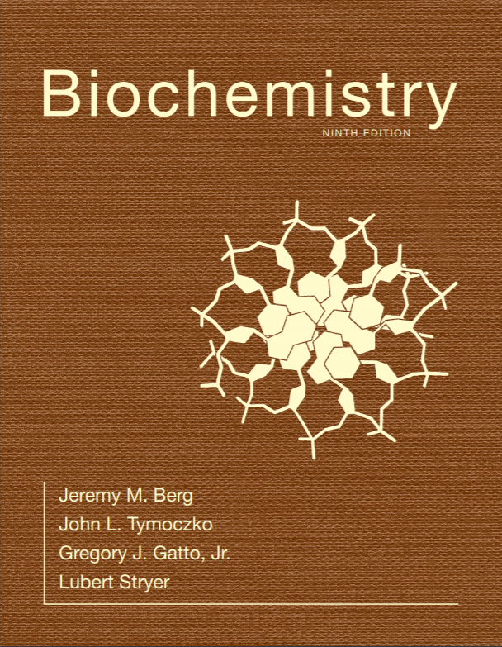
Chapter 15
Metabolism: Basic Concepts and Design
© 2019 W. H. Freeman and Company
Notes:
Corresponding Chapters: 1, 2, 8, 9, 10

Slide 2
Ch.15 Outline
15.1 Metabolism Is Composed of Many Coupled, Interconnecting Reactions
15.2 ATP Is the Universal Currency of Free Energy in Biological Systems
15.3 The Oxidation of Carbon Fuels Is an Important Source of Cellular Energy
15.4 Metabolic Pathways Contain Many Recurring Motifs

Slide 3
Cells Extract Energy from their Environment and Use the Energy for a Host of Biological Activities including Biosynthesis
The reactions of energy extraction and energy use are called metabolism or intermediary metabolism.
Basic principles govern energy manipulations in all cells:
Molecules are degraded or synthesized stepwise in a series of reactions termed metabolic pathways.
ATP is the energy currency of life.
ATP can be formed by the oxidation of carbon fuels.
Although many reactions occur inside a cell, there are a limited number of reaction types involving particular intermediates that are common to all metabolic pathways.
Metabolic pathways are highly regulated.

Slide 4
Glucose Metabolism
Notes:
FIGURE 15.1 Glucose metabolism. Glucose is metabolized to pyruvate in 10 linked reactions. Under anaerobic conditions, pyruvate is metabolized to lactate and, under aerobic conditions, to acetyl CoA. The glucose-derived carbons of acetyl CoA are subsequently oxidized to CO₂.

Slide 5
Metabolic Pathways
Notes:
FIGURE 15.2 Metabolic pathways. Each node represents a specific metabolite. [From the Kyoto Encyclopedia of Genes and Genomes (www.genome.ad.jp/kegg).]

Slide 6
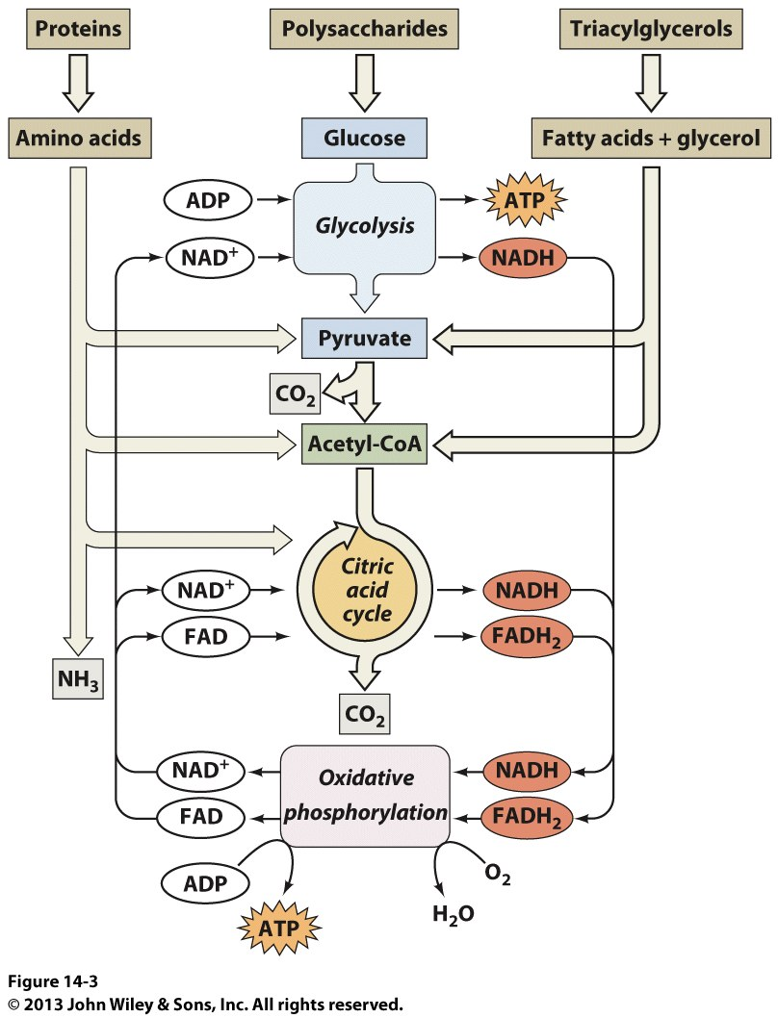

Slide 7
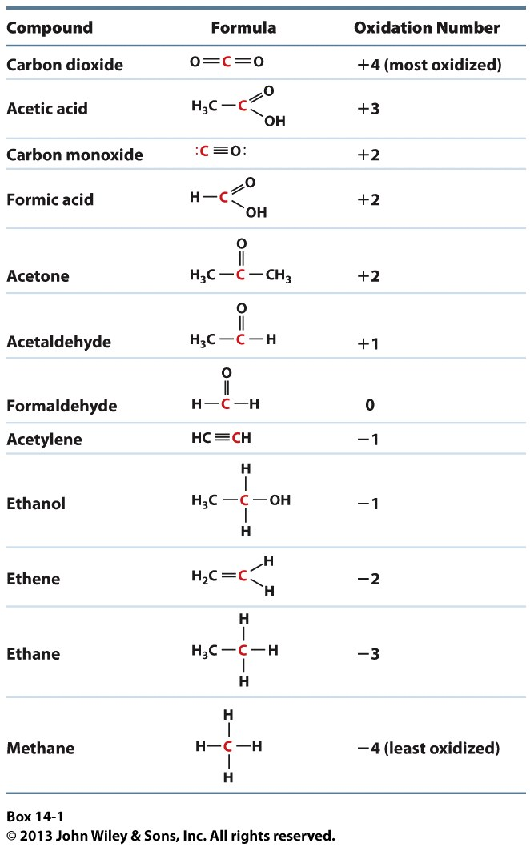

Slide 8
Free Energy of Oxidation of Single-carbon Compounds
Notes:
FIGURE 15.9 Free energy of oxidation of single-carbon compounds.

Slide 9
Reaction Thermodynamics
A reaction can occur spontaneously only if ∆G, the change in free energy, is negative.
∆G for the formation of products C and D from substrates A and B is given by
The ∆G of a reaction depends on the nature of the reactants and products (expressed by the ∆G°′ term, the standard free-energy change) and on their concentrations (expressed by the second term).

Slide 10
A Thermodynamically Unfavorable Reaction Can Be Driven by a Favorable Reaction
To construct a metabolic pathway, two criteria must be met:
The individual reactions must be specific.
The pathway in total must be thermodynamically favorable.
A thermodynamically unfavorable reaction in a pathway can be made to occur by coupling it to a more favorable reaction. In the example below, the two reactions are coupled by their use of the same intermediate “B.”

Slide 11
COUPLING
Cells use Hess’ Law to drive thermodynamically UNFAVORBALE reactions forward by COUPLING them to highly exergonic reactions.
Coupling is critical for many metabolic reactions in the cell
For Example: The 6th reaction of glycolysis is catalyzed by an enzyme called Glyceraldehyde-3-Phosphate Dehydrogenase (GAPDH). The reaction is:
Glyceraldhyde-3-phosphate + P_{i} + NAD⁺ -> 1,3-bisphosphoglycerate + NADH + H⁺
And the ΔG value for the reaction is: +6.7 kJ/mole
Should the reaction proceed spontaneously?

Slide 12
COUPLING
No, it shouldn’t because it has a positive free energy value.
But the next reaction in glycolysis is HIGHLY EXERGONIC
Phosphoglycerate kinase catalyzes the reaction:
1,3-bisphosphoglycerate + ADP -> 3-phosphoglycerate +ATP
ΔG for the reaction is -18.8 kJ/mole
Using Hess’ Law, the next free energy change for the COUPLED reactions is: +6.7 kJ/mole + (-18.8 kJ/mole) = -12.1 kJ/mole
So the reaction pathway continues by coupling one reaction to another

Slide 13
Now back to the Reaction Thermodynamics
∆G for any equilibrium reaction is zero
Cells operate at near equilibrium concentrations of metabolites, so we can use that relationship to come up with a better understanding of reaction pathways
We just saw:
But the ∆G of an equilibrium reaction is zero, so this simplifies to:
∆G°′ = -RTlnK_{eq}

Slide 14
So what?
But the ∆G of an equilibrium reaction is zero, so this simplifies to:
∆G°′ = -RTlnK_{eq}
What does this mean for a cell?
Reactant and product concentrations for nearly all metabolic pathways are at equilibrium values.
We can very easily change the direction of a reaction by a SLIGHT shift in either the reactant or product concentrations
So what?
Metabolic pathways are on a razor’s edge, It doesn’t take much of a change to push a reaction in a different direction.

Slide 15
So what?
For example:
Allosteric effectors changing the rate of an enzyme will change the concentration of products downstream and substrate upstream, affecting other enzymes in the same or other pathways
A mutation in an enzyme in a pathway could alter the affinity or rate of an enzyme, altering the reactant and product concentrations
An excess of products in the cytosol can slow a reaction
A deletion of a gene that imports or exports molecules will alter the cytosolic concentrations and, therefore, rates
Activation of genes that shunt compounds to incorrect pathways

Slide 16
So what?
When reactant or product concentrations become imbalanced, enzymes in a metabolic pathway are forced (by kinetics and thermodynamics) to restore the equilibrium
BECAUSE EVERY ENZYME IN A PATHWAY IS CONNECTED TO EVERY OTHER ENZYME IN THE PATHWAY, and EVEN OTHER PATHWAYS
There is a FLUX of metabolites through a pathway

Slide 17
OK, but still, So What?
Some enzyme catalyzed reactions are so EXERGONIC that they essentially make the pathway IRREVERSIBLE because they don’t operate at equilibrium levels of reactant and product
Remember: Anabolic and Catabolic pathways are separate in cells, you can’t simply run glycolysis in reverse to synthesize glucose
These enzymes control the flux of metabolites through the pathway.
THIS MAKE THESE SPECIFIC ENZYMES PERFECT SITES FOR CONTROL of the entire pathway

Slide 18
The implications of these few exergonic enzymes
The presence of a few enzymes that don’t operate at near equilibrium levels has several implications
Metabolic pathways are irreversible.
If ΔG of the forward reaction is <<0, then you can’t go from product to substrate
An enzyme has an active site that binds substrate effectively (ΔG_{B}) AND adopts a conformation favoring the transition state and immediately releases the product
No affinity for product => No ΔG_{B} => No way to lower the ΔG of the reaction => Irreversible!

Slide 19
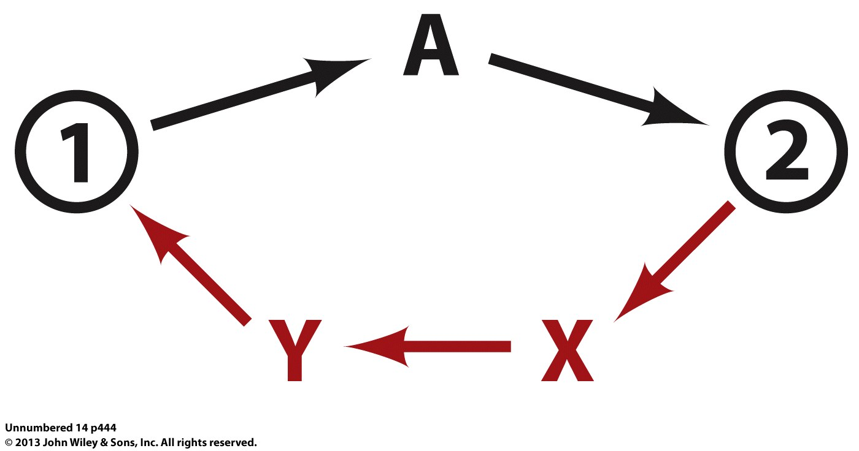
The implications of these few exergonic enzymes
Most pathways have a committed step near the start of the pathway
Controls the flux through the entire pathway
Usually a highly exergonic and irreversible reaction
Anabolic and Catabolic pathways differ
Because of the committed steps, you have to find a new route to get back to 1 from 2

Slide 20
High Energy Compounds
Take the oxidation of glucose or palmitate:
C₆H₁₂O₆ + 6O₂ -> 6CO₂ + 6H₂O ΔG’=-2850 kJ/mole
C1₆H₃₂O₂ + 23O₂ -> 16CO₂ + 16H₂O ΔG’=-9780 kJ/mole
The cell doesn’t get all of that energy at once, it QUANTIZES the energy release into High Energy Bonds
Notes:
FIGURE 15.10 Prominent fuels. Fats are a more efficient fuel source than carbohydrates such as glucose because the carbon in fats is more reduced.

Slide 21
ATP Is the Universal Currency of Free Energy in Biological Systems
Energy derived from fuels or light is converted into adenosine triphosphate (ATP), the cellular energy currency.
Much of the free energy that is derived from the oxidation of food molecules (primarily carbohydrates and fats) is transformed into ATP, which acts as the free-energy donor in most energy-requiring processes such as motion, active transport, and biosynthetic reactions.

Slide 22
ATP Hydrolysis Is Exergonic
The hydrolysis of ATP is highly exergonic because the triphosphate unit contains two phosphoanhydride bonds that are unstable.
The actual ∆G for ATP hydrolysis under cellular conditions depends on many factors, but is approximately −50 kJ mol⁻¹ (−12 kcal mol⁻¹).

Slide 23
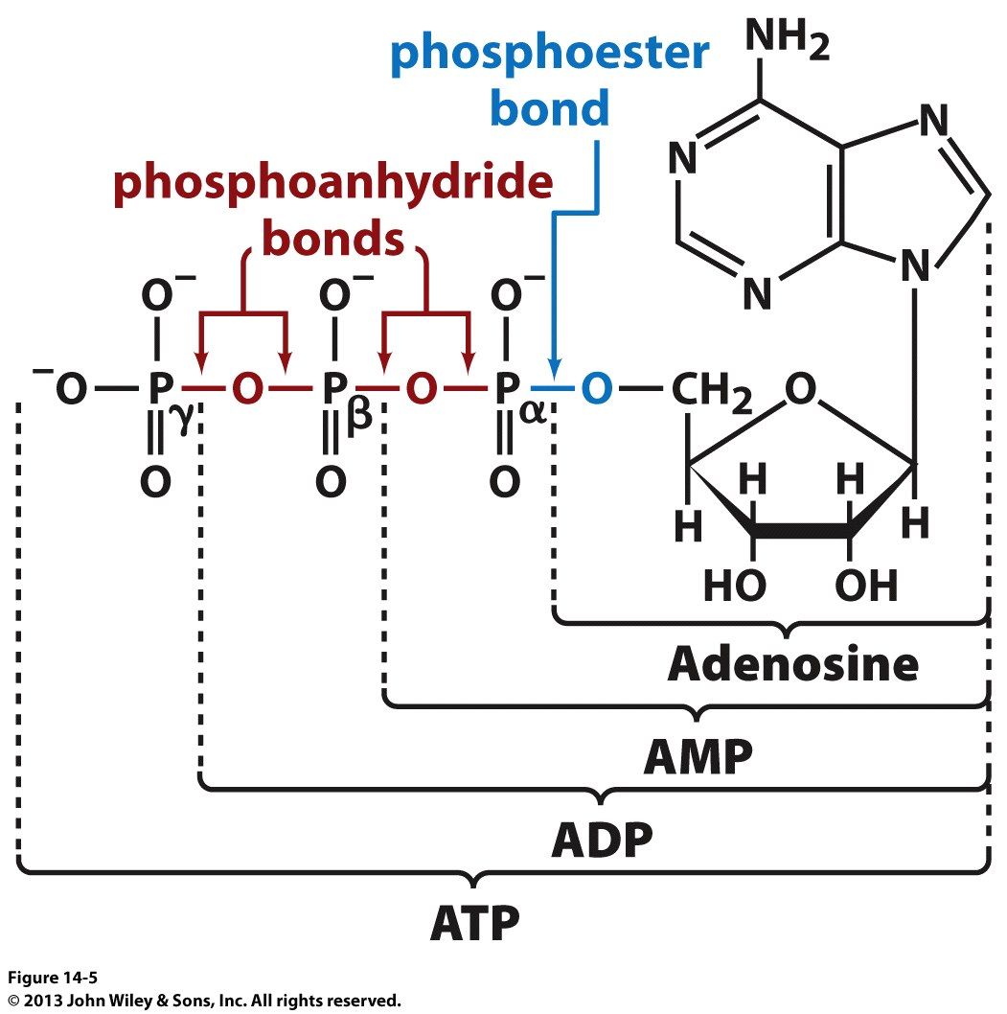

Slide 24
High Energy Bonds
So you already knew that ATP was the energy currency in all life forms, what do we mean by High Energy Bonds?
Any bond with a ΔG◦’ of hydrolysis greater than -25 kJ/mole is considered a high energy bond
Technically all of the phosphoester bonds in ATP are high energy. Why?

Slide 25
The High Phosphoryl Potential of ATP Results from Structural Differences between ATP and its Hydrolysis Products (2/2)
ATP has a high phosphoryl-transfer potential because of four key factors:
Resonance stabilization
Electrostatic repulsion
Increase in entropy
Stabilization by hydration

Slide 26
Resonance Structures of Orthophosphate
Orthophosphate, one of the products of ATP hydrolysis, has greater resonance stabilization than do any of the ATP phosphoryl groups.
Notes:
FIGURE 15.4 Resonance structures of orthophosphate.

Slide 27
Improbable Resonance Structure
An improbable resonance structure for ATP, with two adjacent positive charges. ATP has fewer resonance forms than an orthophosphate does.
Notes:
FIGURE 15.5 Improbable resonance structure. The structure contributes little to the terminal part of ATP, because two positive charges are placed adjacent to each other.

Slide 28
ATP Hydrolysis Drives Metabolism by Shifting the Equilibrium of Coupled Reactions
Consider the following endergonic reaction:
Coupling this reaction with ATP hydrolysis renders the formation of B exergonic.

Slide 29
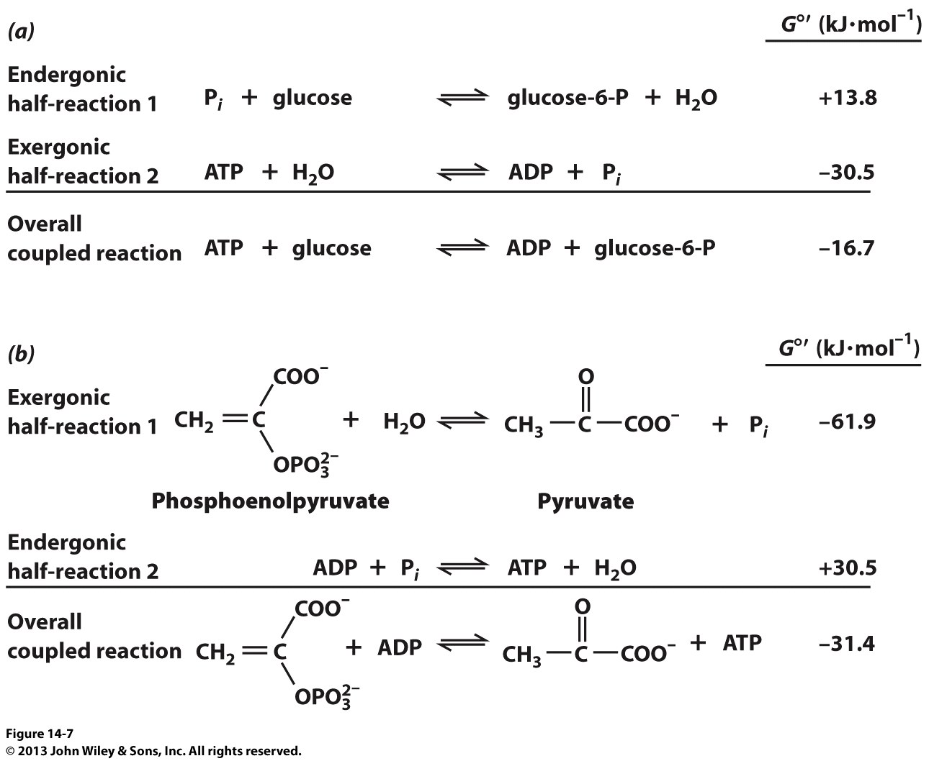
For Example:

Slide 30
Compounds with High Phosphoryl-Transfer Potential
Notes:
FIGURE 15.6 Compounds with high phosphoryl-transfer potential. The role of ATP as the cellular energy currency is illustrated by its relation to other phosphorylated compounds. ATP has a phosphoryl-transfer potential that is intermediate among the biologically important phosphorylated molecules. High-phosphoryl-transfer-potential compounds (1,3-BPG, PEP, and creatine phosphate) derived from the metabolism of fuel molecules are used to power ATP synthesis. In turn, ATP donates a phosphoryl group to other biomolecules to facilitate their metabolism. [Data from D. L. Nelson and M. M. Cox, Lehninger Principles of Biochemistry, 5th ed. (W. H. Freeman and Company, 2009), Fig. 13-19.]

Slide 31
Standard Free Energies of Hydrolysis of Some Phosphorylated Compounds

Slide 32
Section 15.4 Metabolic Pathways Contain Many Recurring Motifs
Activated carriers exemplify the modular design and economy of metabolism.
Example: ATP is an activated carrier of phosphoryl groups.
Other activated carriers are common in biochemistry, and they often are derived from vitamins.

Slide 33
Activated Carriers Exemplify the Modular Design and Economy of Metabolism (1/3)
NADH/NAD⁺ and FADH₂/FAD are activated carriers of electrons for fuel oxidation.
NADH/NAD⁺ participates in reactions such as the following:
FADH2/FAD participates in reactions such as the following:

Slide 34
Structures of the Oxidized Forms of Nicotinamide-derived Electron Carriers
Notes:
FIGURE 15.13 Structures of the oxidized forms of nicotinamide-derived electron carriers. Nicotinamide adenine dinucleotide (NAD⁺) and nicotinamide adenine dinucleotide phosphate (NADP⁺) are prominent carriers of high-energy electrons. In NAD⁺, R = H; in NADP⁺, R = PO₃²⁻.

Slide 35
Structure of the Oxidized Form of Flavin Adenine Dinucleotide (FAD)
Notes:
FIGURE 15.14 Structure of the oxidized form of flavin adenine dinucleotide (FAD). This electron carrier consists of a flavin mononucleotide (FMN) unit (shown in blue) and an AMP unit (shown in black).

Slide 36
Structures of the Reactive Components of FAD and FADH₂
Notes:
FIGURE 15.15 Structures of the reactive components of FAD and FADH₂. The electrons and protons are carried by the isoalloxazine ring component of FAD and FADH₂.

Slide 37
Activated Carriers Exemplify the Modular Design and Economy of Metabolism (2/3)
NADPH/NADP⁺ is most often the electron carrier for reductive biosyntheses.
Example: two molecules of NADPH are required for the reduction of a keto group to a methylene group in fatty acid synthesis.

Slide 38
Coenzyme A (CoA or CoA-SH) is an Activated Carrier of Acyl Groups such as the Acetyl Group
An acetyl group is a two-carbon unit, while an acyl group is a longer unit such as a fatty acid tail.
Acyl groups linked to CoA are important in both
Notes:
FIGURE15.16 Structure of coenzyme A (CoA-SH).

Slide 39
The Transfer of the Acyl Group is Exergonic because the Thioester Is Unstable
The terminal sulfhydryl group in CoA is the reactive site.
Acetyl CoA has a high acetyl-group-transfer potential.

Slide 40
Activated Carriers Exemplify the Modular Design and Economy of Metabolism (3/3)
Two characteristics are common to activated carriers:
The carriers are kinetically stable in the absence of specific catalysts.
The metabolism of activated groups is accomplished with a small number of carriers.

Slide 41
Some Activated Carriers in Metabolism

Slide 42
Key Reactions Are Reiterated throughout Metabolism (1/7)
Although thousands of reactions constitute metabolism, they fall into only six categories.

Slide 43
Key Reactions Are Reiterated throughout Metabolism (2/7)
1. Oxidation–reduction reactions
Two examples from the citric acid cycle:

Slide 44
Key Reactions Are Reiterated throughout Metabolism (3/7)
2. Group transfer reactions
Example: phosphorylation of glucose in the first step of glycolysis

Slide 45
Key Reactions Are Reiterated throughout Metabolism (4/7)
3. Hydrolytic reactions
Example: cleavage of peptide bonds in proteins

Slide 46
Key Reactions Are Reiterated throughout Metabolism (5/7)
4. Carbon bond cleavage by means other than hydrolysis or oxidation, with two substrates yielding one product or vice versa
Examples: cleavage of a hexose in the fourth step of glycolysis and dehydration of 2-phosphoglycerate in the ninth step of glycolysis

Slide 47
Key Reactions Are Reiterated throughout Metabolism (6/7)
5. Isomerization reactions
Example: isomerization of citrate to isocitrate in the citric acid cycle

Slide 48
Key Reactions Are Reiterated throughout Metabolism (7/7)
6. Ligation reactions that form bonds by using free energy from ATP cleavage
Example: the ATP-dependent formation of a carbon–carbon bond to lengthen pyruvate into oxaloacetate; the oxaloacetate can then be used in the citric acid cycle, in gluconeogensis, or in other pathways.

