Slide 1
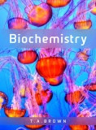
Fig 7.1
Reproduced from: Biochemistry by T.A. Brown, ISBN: 9781907904288 © Scion Publishing Ltd, 2017

Slide 2
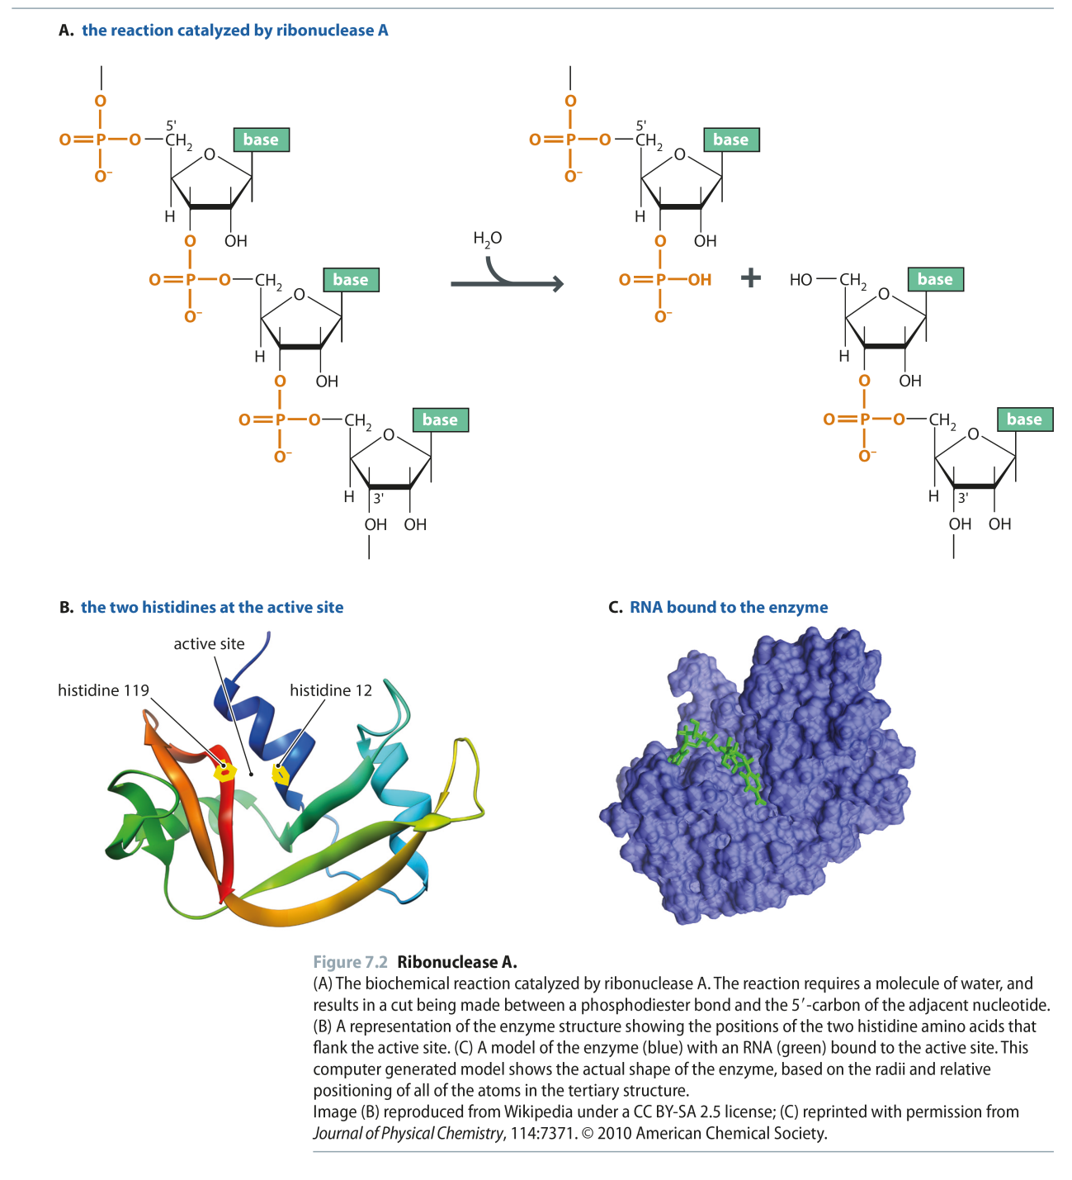
Fig 7.2
Reproduced from: Biochemistry by T.A. Brown, ISBN: 9781907904288 © Scion Publishing Ltd, 2017

Slide 3
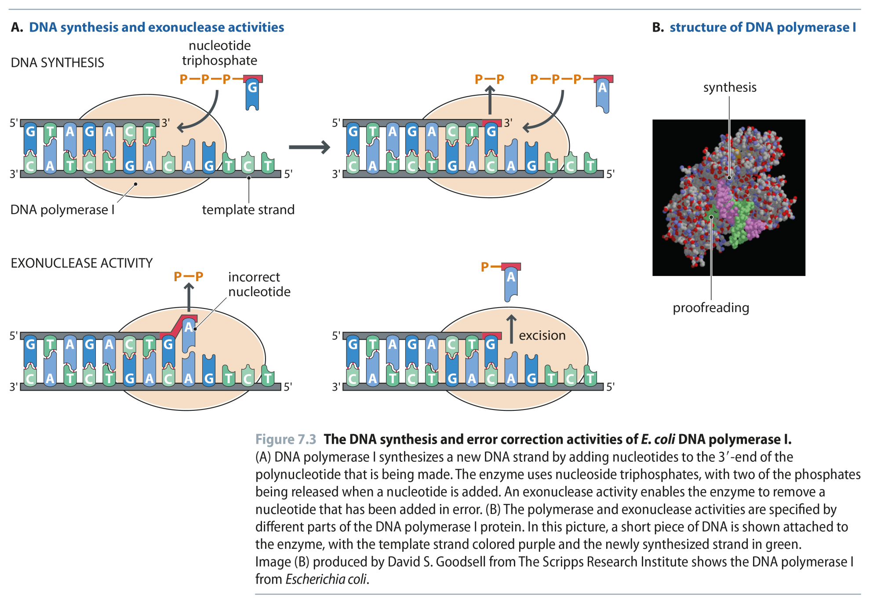
Fig 7.3
Reproduced from: Biochemistry by T.A. Brown, ISBN: 9781907904288 © Scion Publishing Ltd, 2017

Slide 4
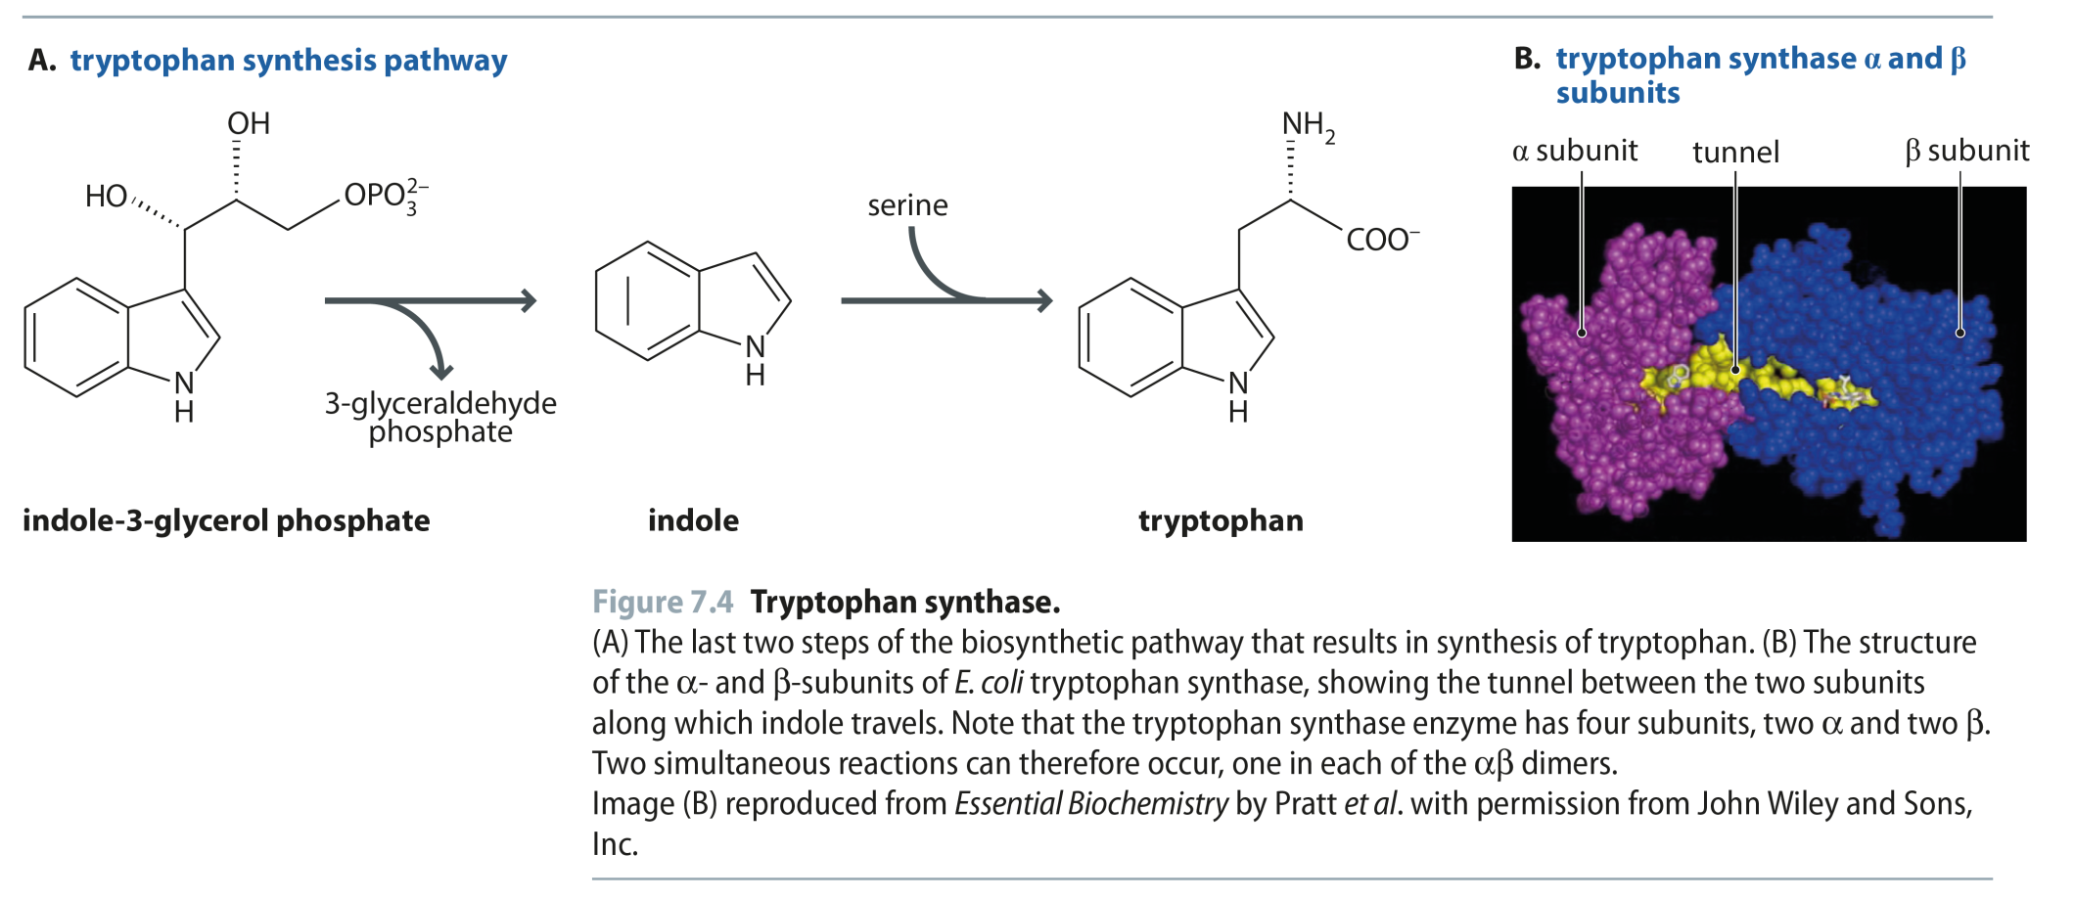
Fig 7.4
Reproduced from: Biochemistry by T.A. Brown, ISBN: 9781907904288 © Scion Publishing Ltd, 2017

Slide 5
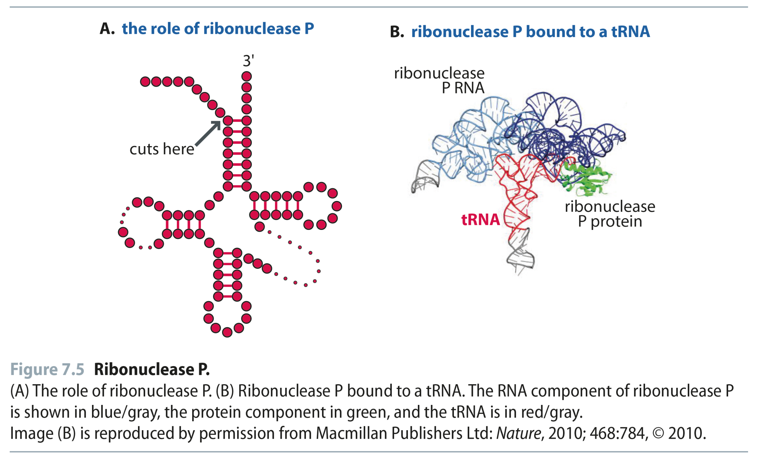
Fig 7.5
Reproduced from: Biochemistry by T.A. Brown, ISBN: 9781907904288 © Scion Publishing Ltd, 2017

Slide 6
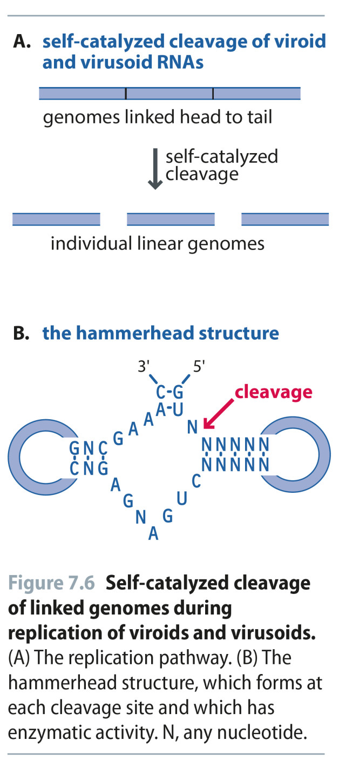
Fig 7.6
Reproduced from: Biochemistry by T.A. Brown, ISBN: 9781907904288 © Scion Publishing Ltd, 2017

Slide 7
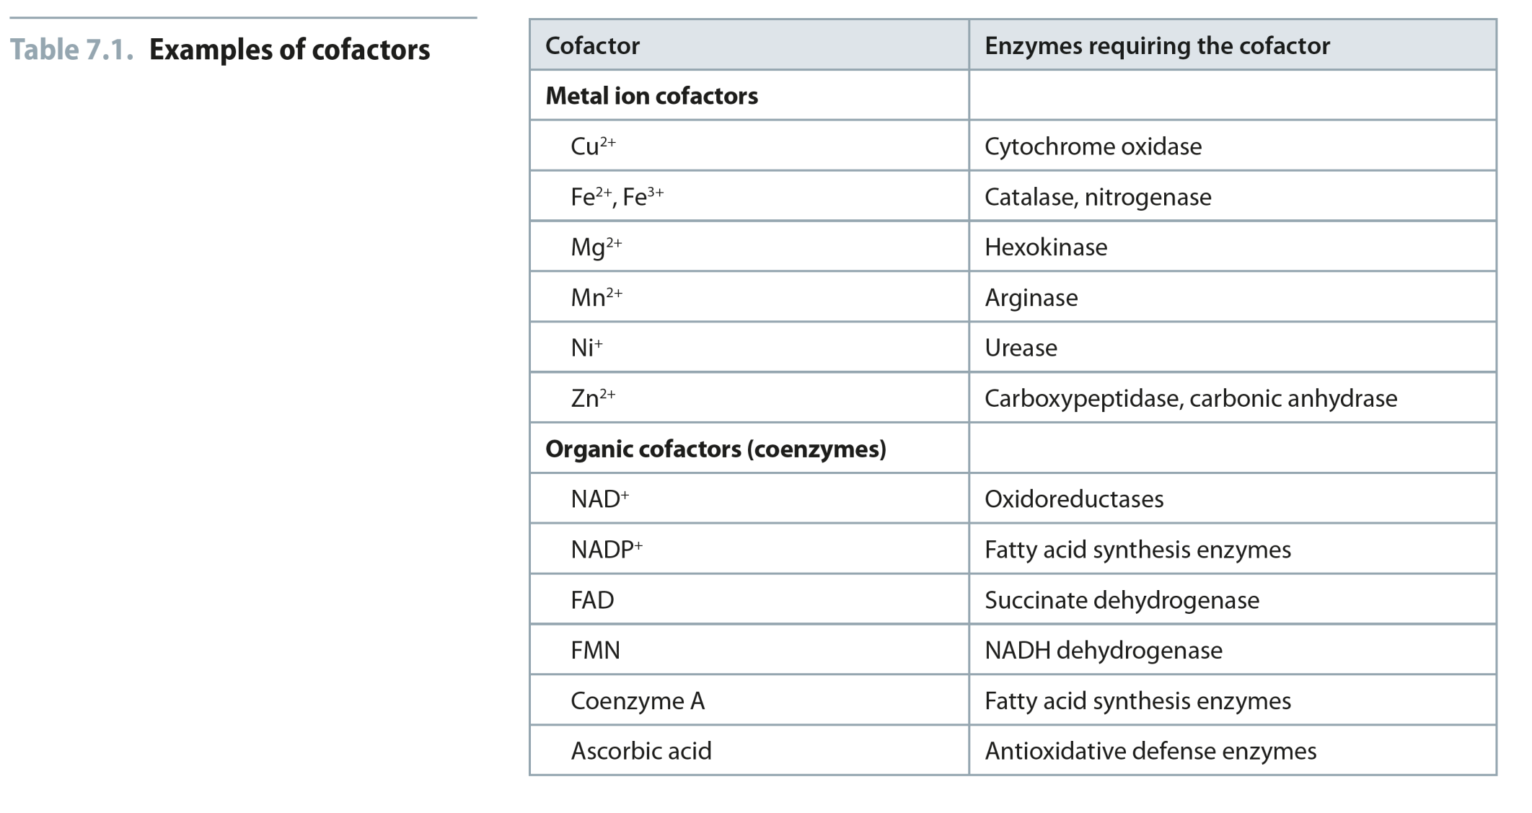
Table 7.1
Reproduced from: Biochemistry by T.A. Brown, ISBN: 9781907904288 © Scion Publishing Ltd, 2017

Slide 8
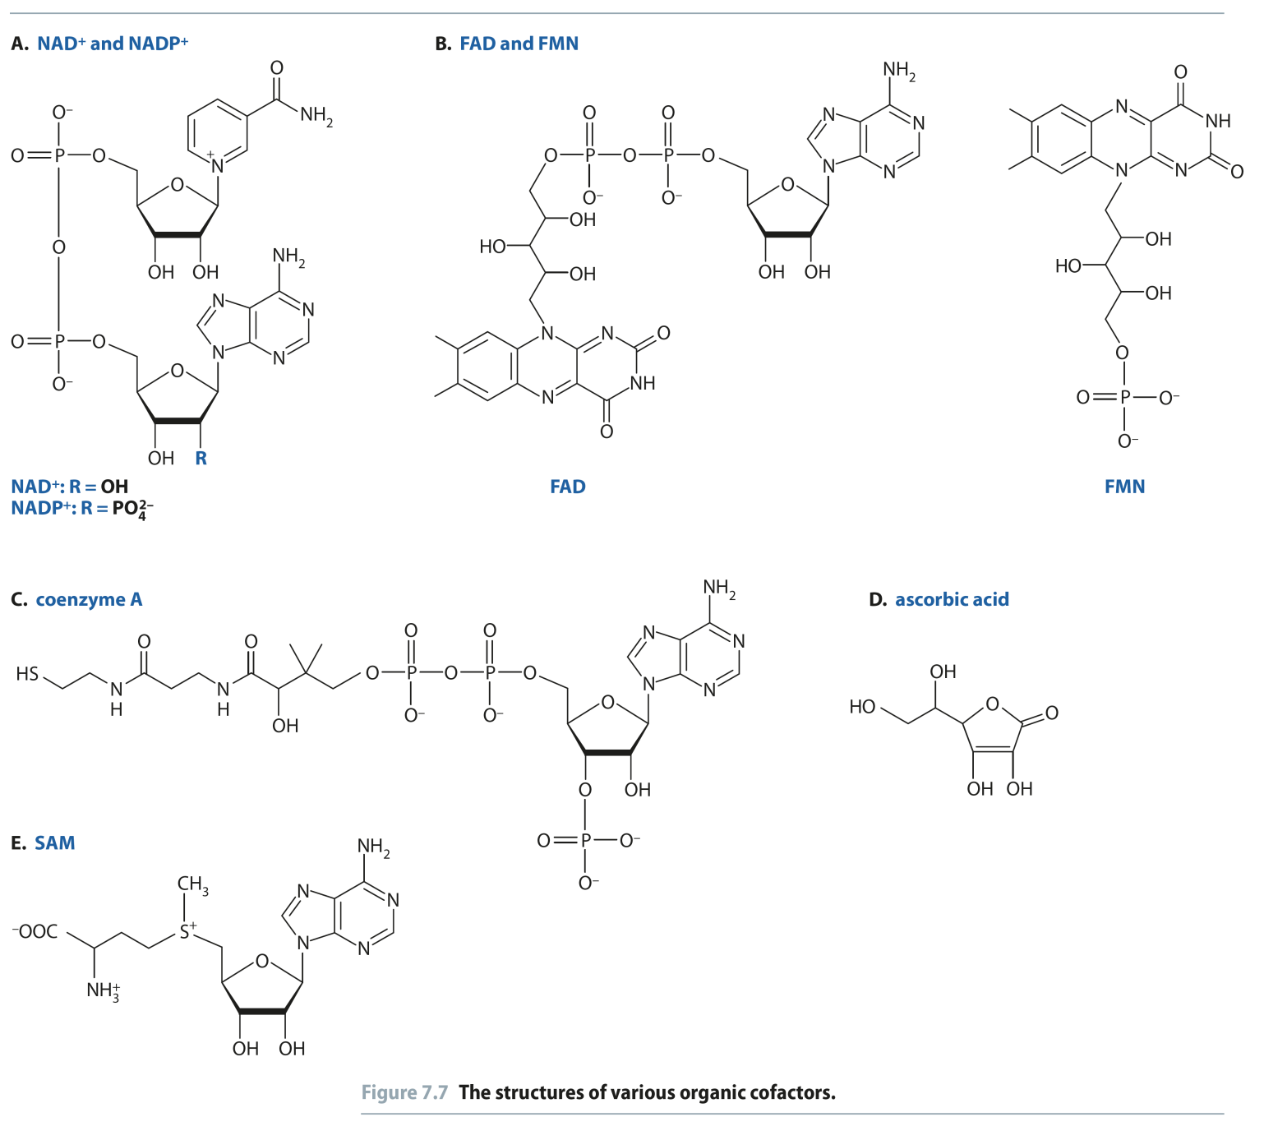
Fig 7.7
Reproduced from: Biochemistry by T.A. Brown, ISBN: 9781907904288 © Scion Publishing Ltd, 2017

Slide 9
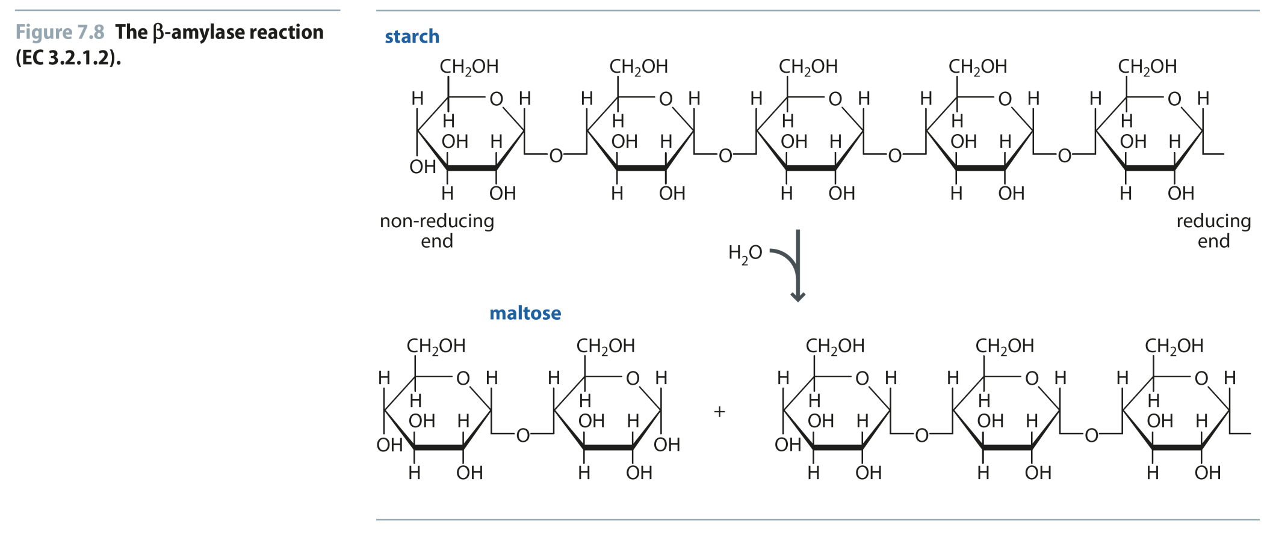
Fig 7.8
Reproduced from: Biochemistry by T.A. Brown, ISBN: 9781907904288 © Scion Publishing Ltd, 2017

Slide 10
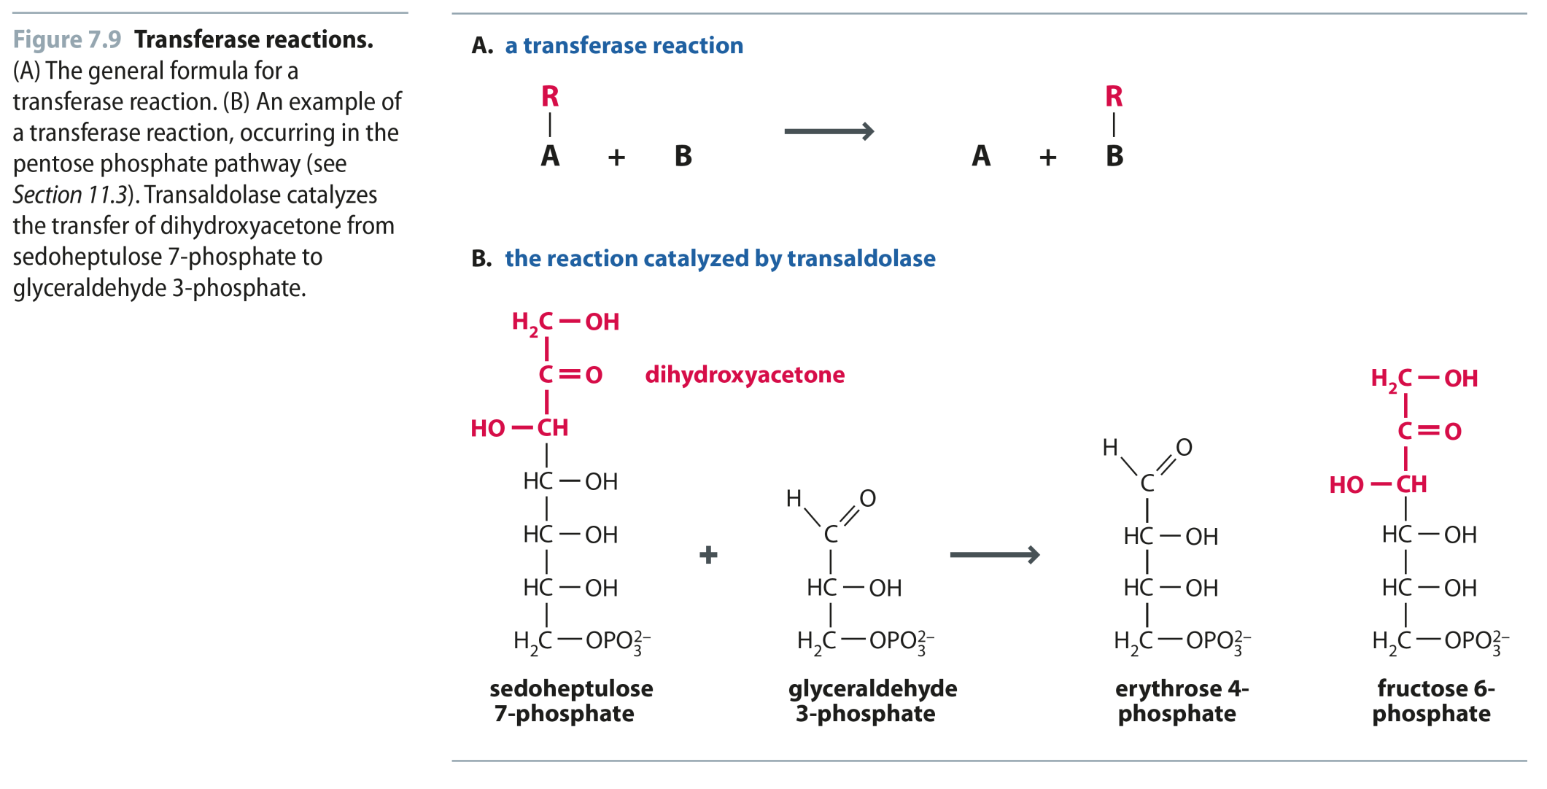
Fig 7.9
Reproduced from: Biochemistry by T.A. Brown, ISBN: 9781907904288 © Scion Publishing Ltd, 2017

Slide 11
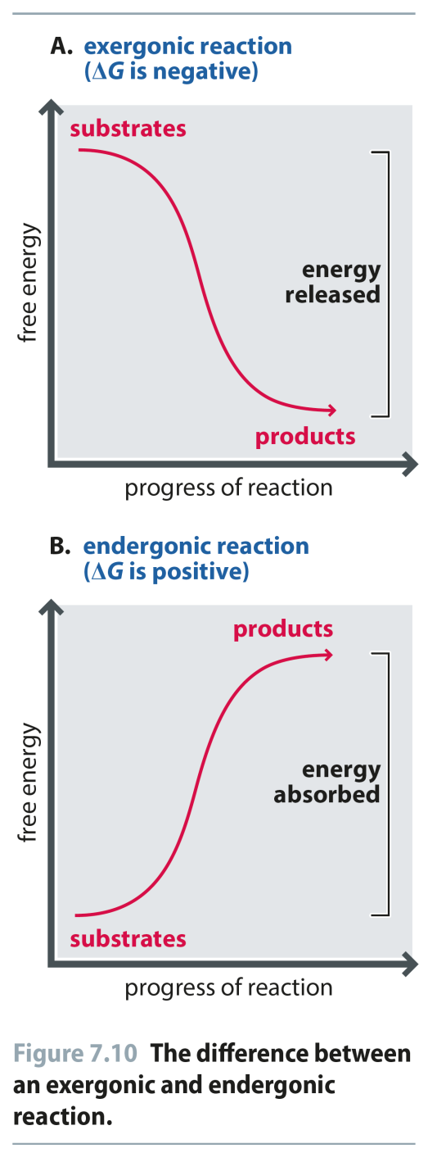
Fig 7.10
Reproduced from: Biochemistry by T.A. Brown, ISBN: 9781907904288 © Scion Publishing Ltd, 2017

Slide 12
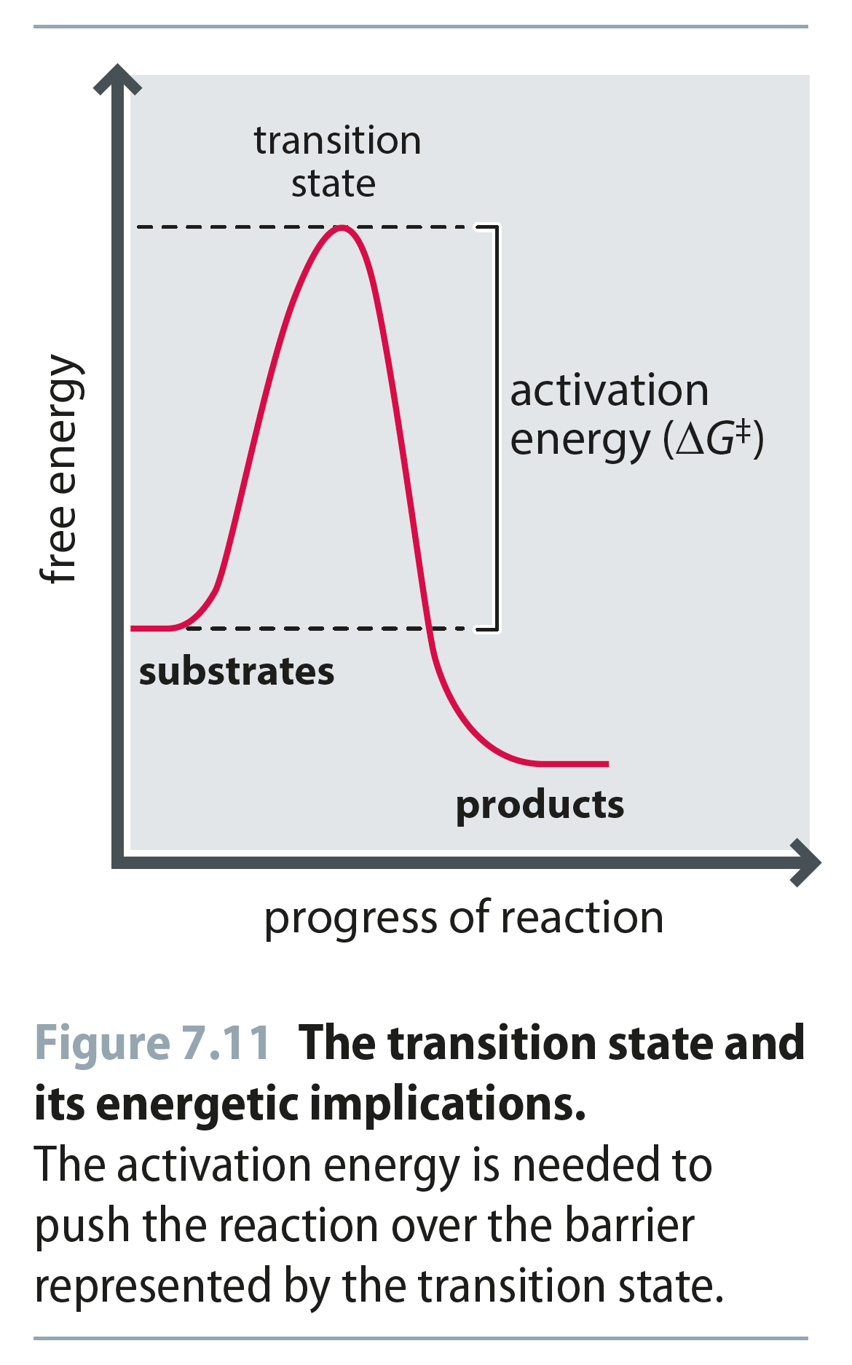
Fig 7.11
Reproduced from: Biochemistry by T.A. Brown, ISBN: 9781907904288 © Scion Publishing Ltd, 2017

Slide 13
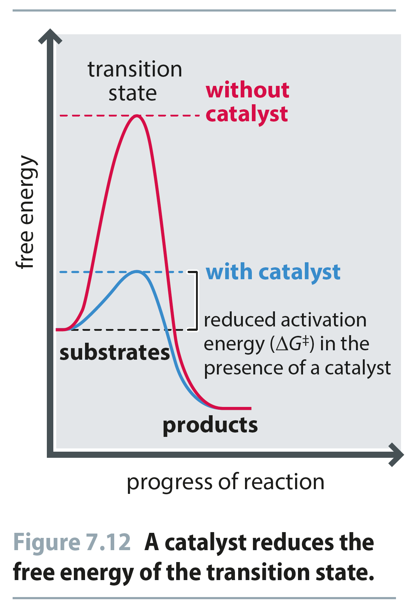
Fig 7.12
Reproduced from: Biochemistry by T.A. Brown, ISBN: 9781907904288 © Scion Publishing Ltd, 2017

Slide 14
Fig 7.13
Reproduced from: Biochemistry by T.A. Brown, ISBN: 9781907904288 © Scion Publishing Ltd, 2017

Slide 15
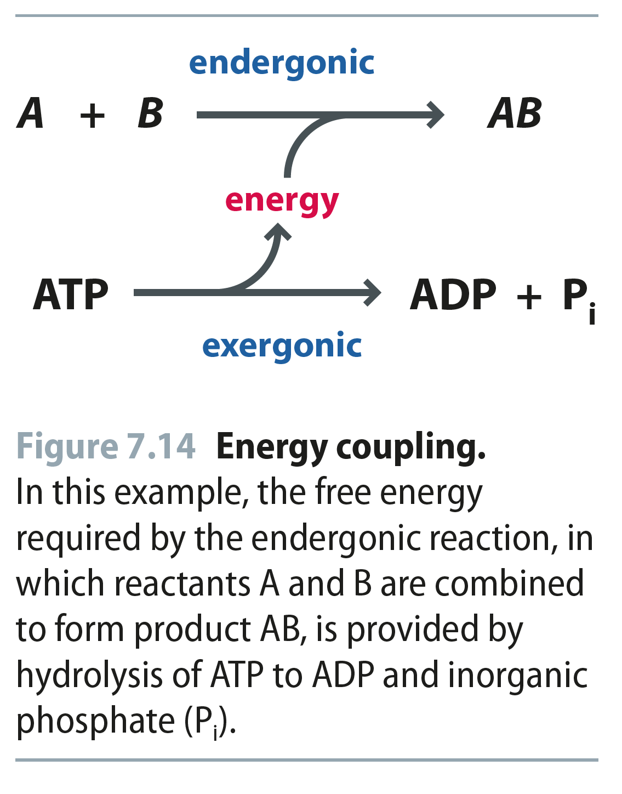
Fig 7.14
Reproduced from: Biochemistry by T.A. Brown, ISBN: 9781907904288 © Scion Publishing Ltd, 2017

Slide 16
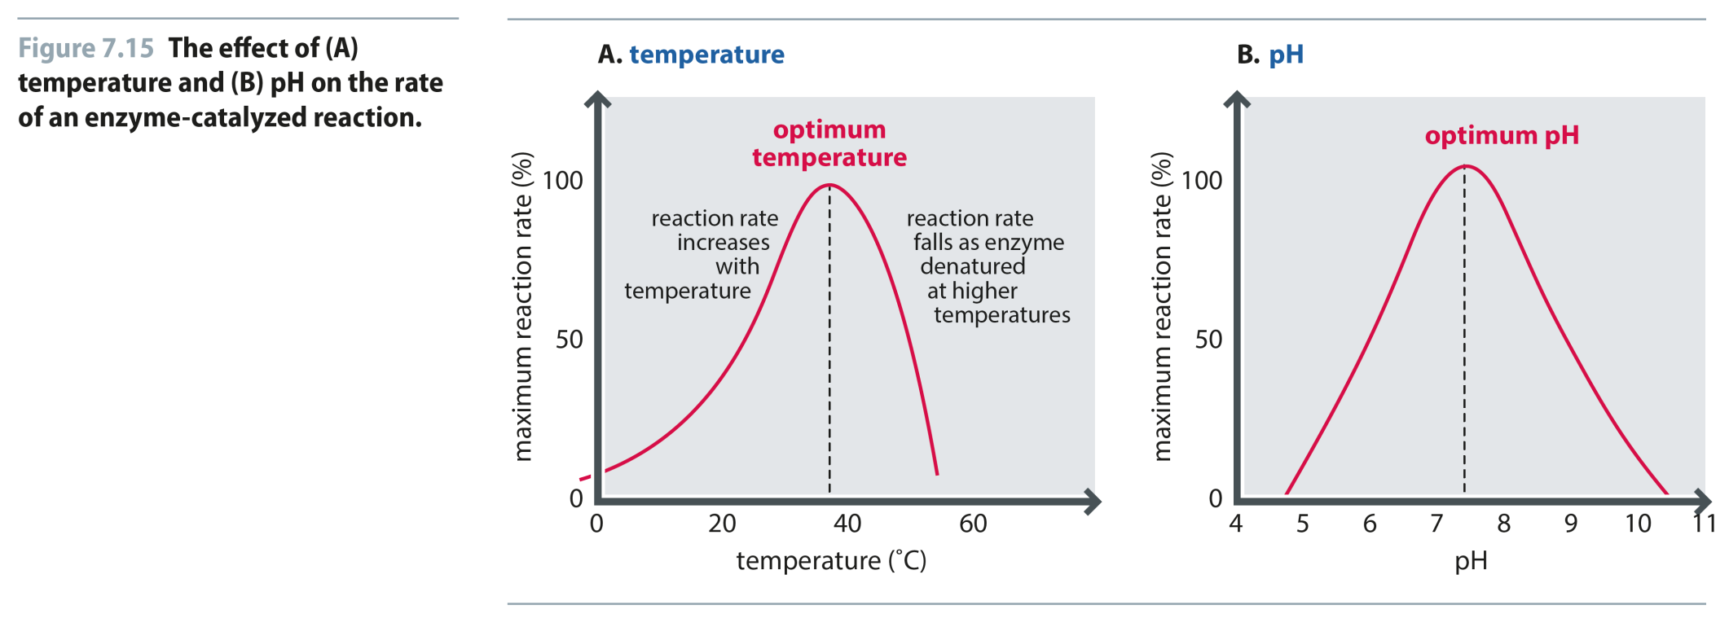
Fig 7.15
Reproduced from: Biochemistry by T.A. Brown, ISBN: 9781907904288 © Scion Publishing Ltd, 2017

Slide 17
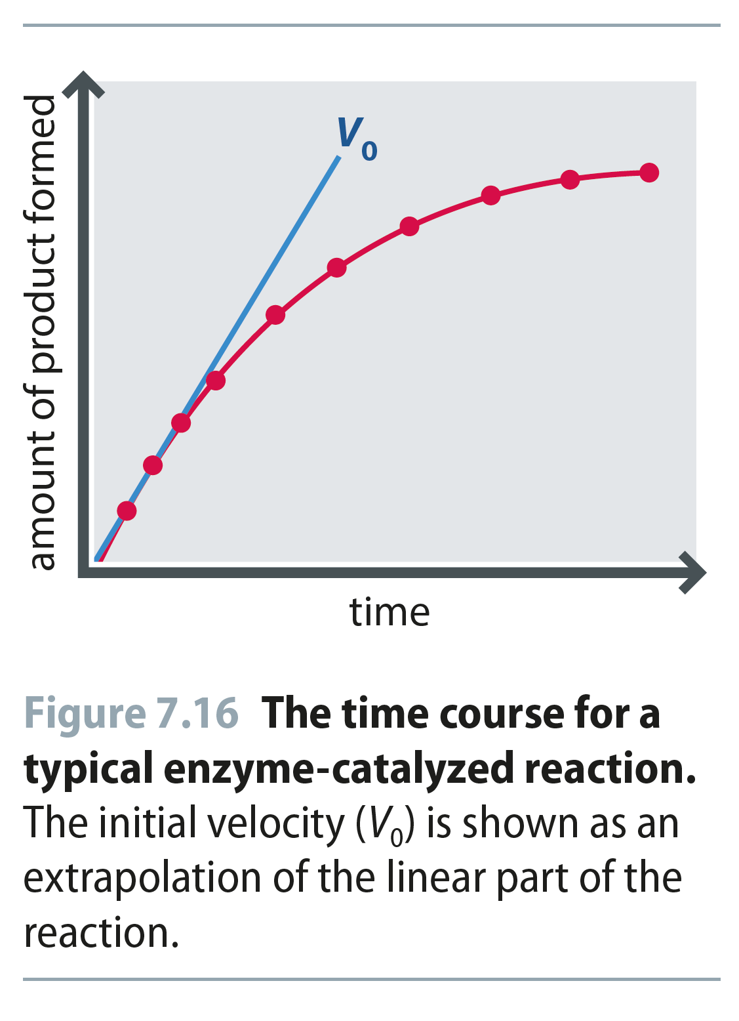
Fig 7.16
Reproduced from: Biochemistry by T.A. Brown, ISBN: 9781907904288 © Scion Publishing Ltd, 2017

Slide 18
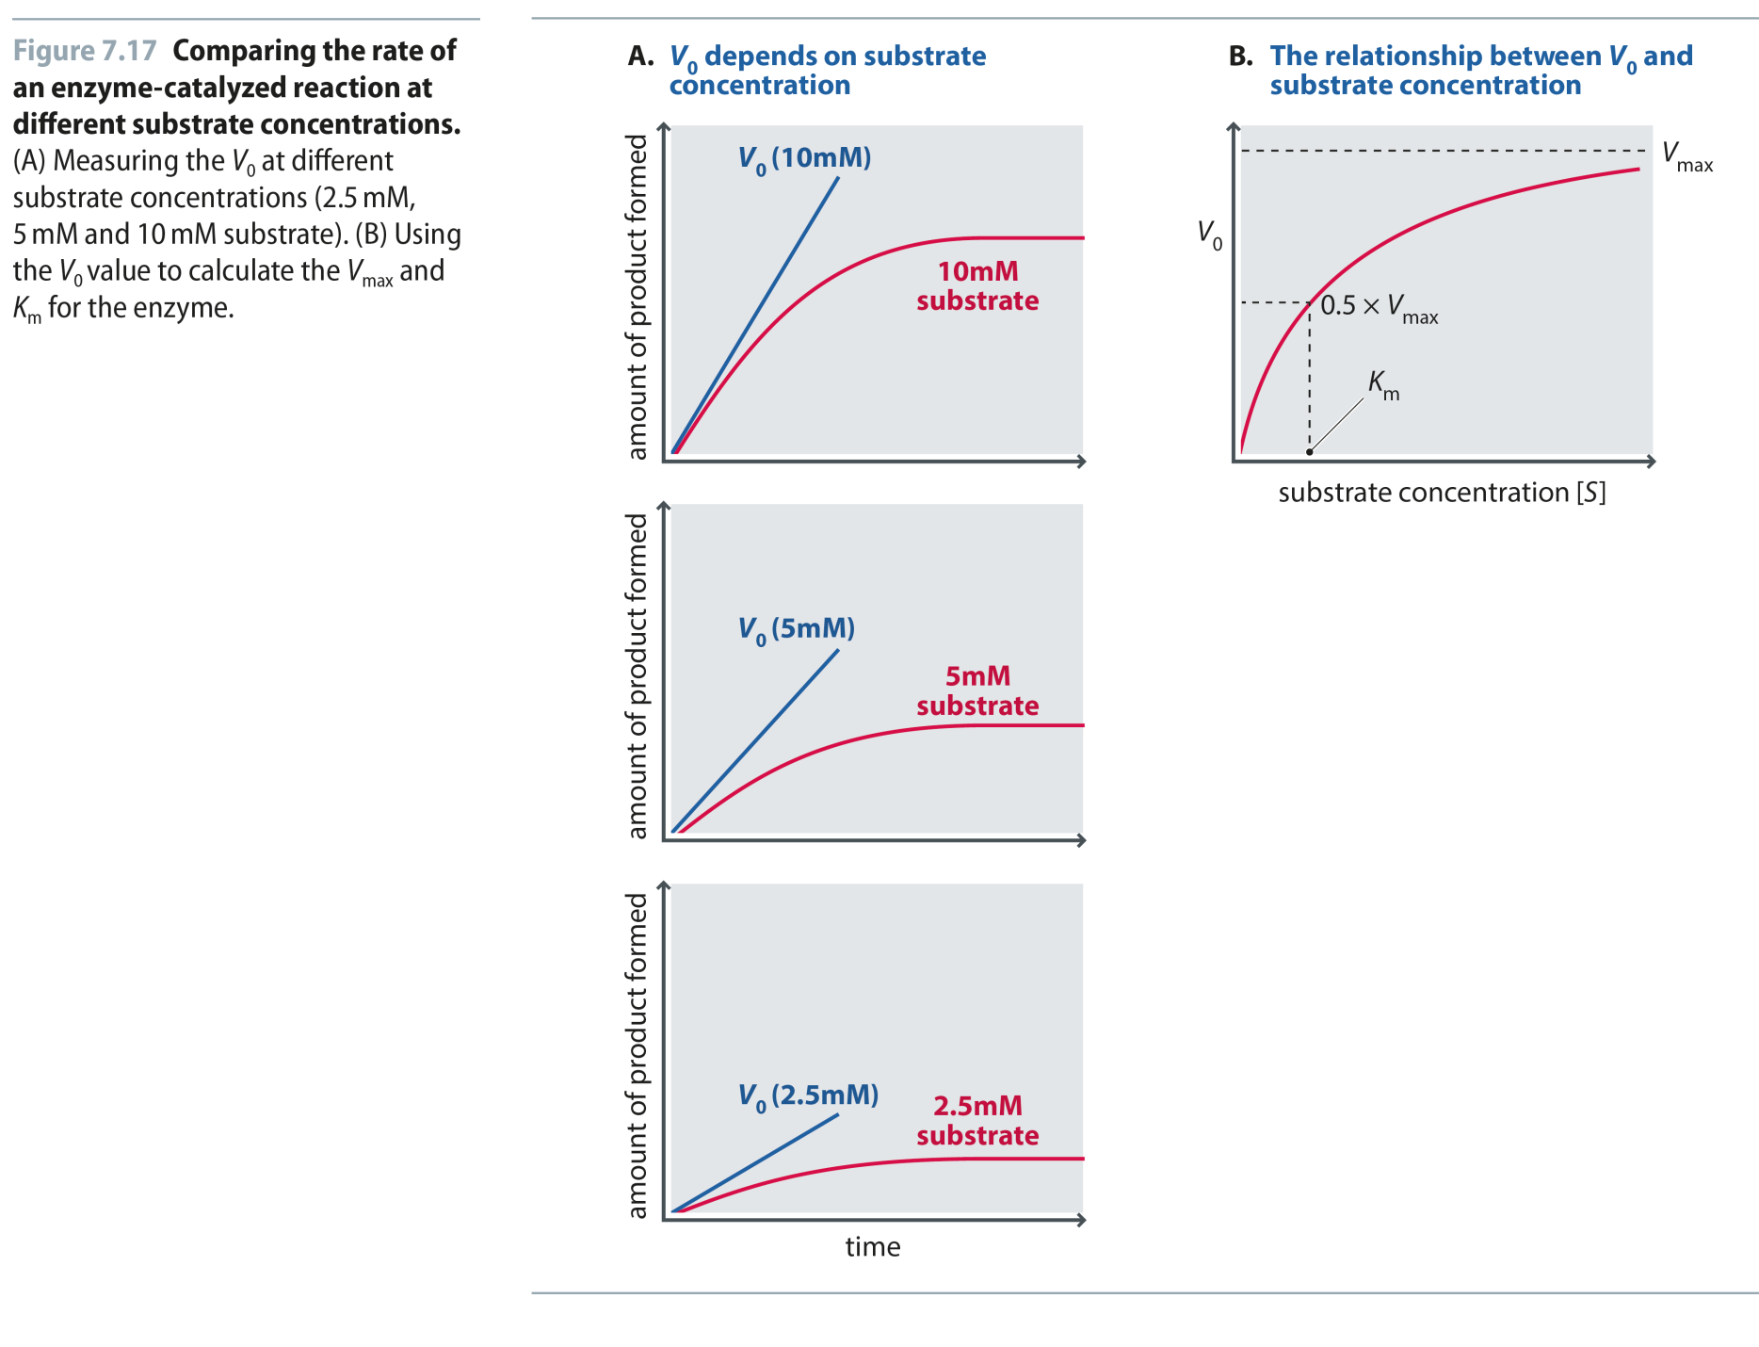
Fig 7.17
Reproduced from: Biochemistry by T.A. Brown, ISBN: 9781907904288 © Scion Publishing Ltd, 2017

Slide 19
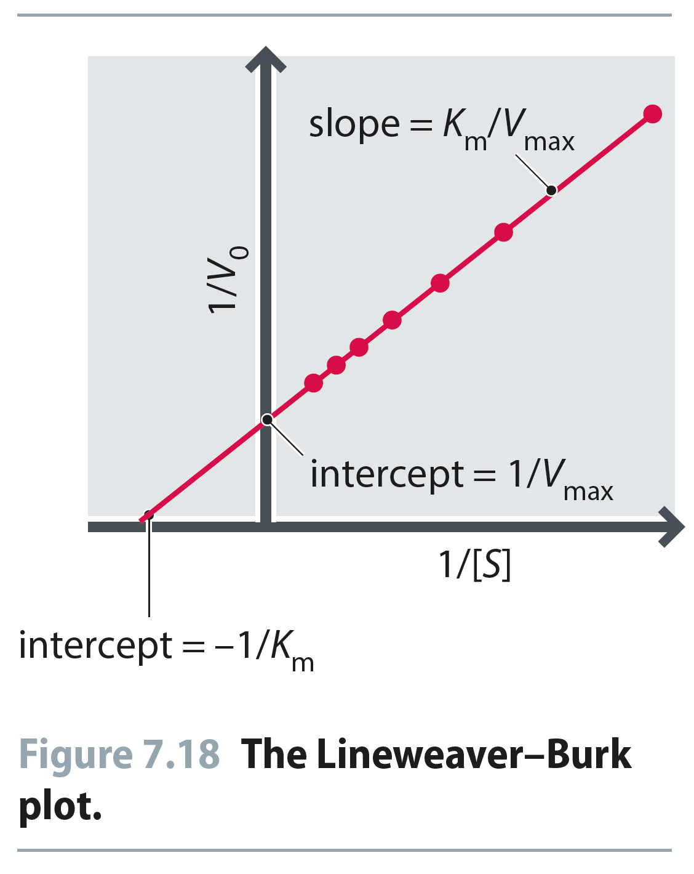
Fig 7.18
Reproduced from: Biochemistry by T.A. Brown, ISBN: 9781907904288 © Scion Publishing Ltd, 2017

Slide 20
Fig 7.19
Reproduced from: Biochemistry by T.A. Brown, ISBN: 9781907904288 © Scion Publishing Ltd, 2017

Slide 21
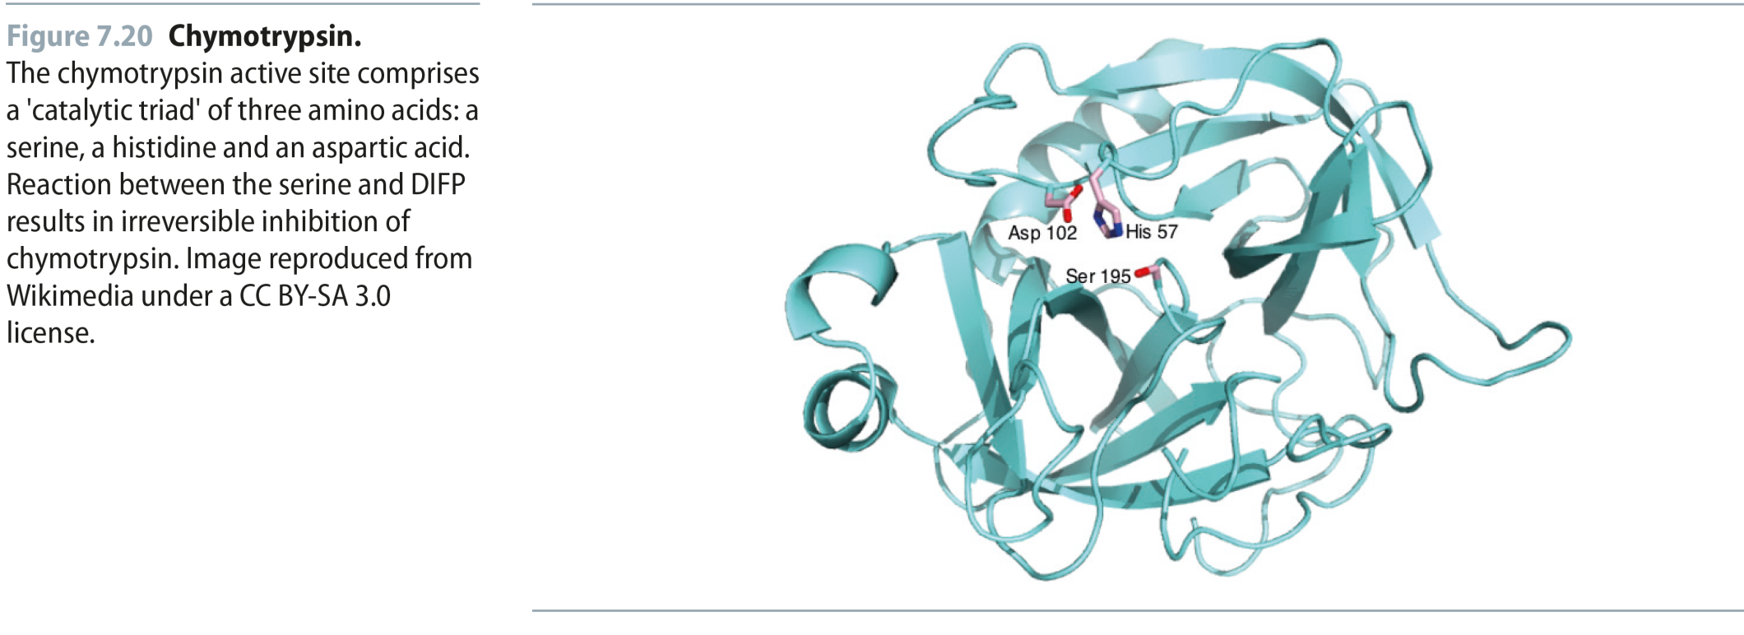
Fig 7.20
Reproduced from: Biochemistry by T.A. Brown, ISBN: 9781907904288 © Scion Publishing Ltd, 2017

Slide 22
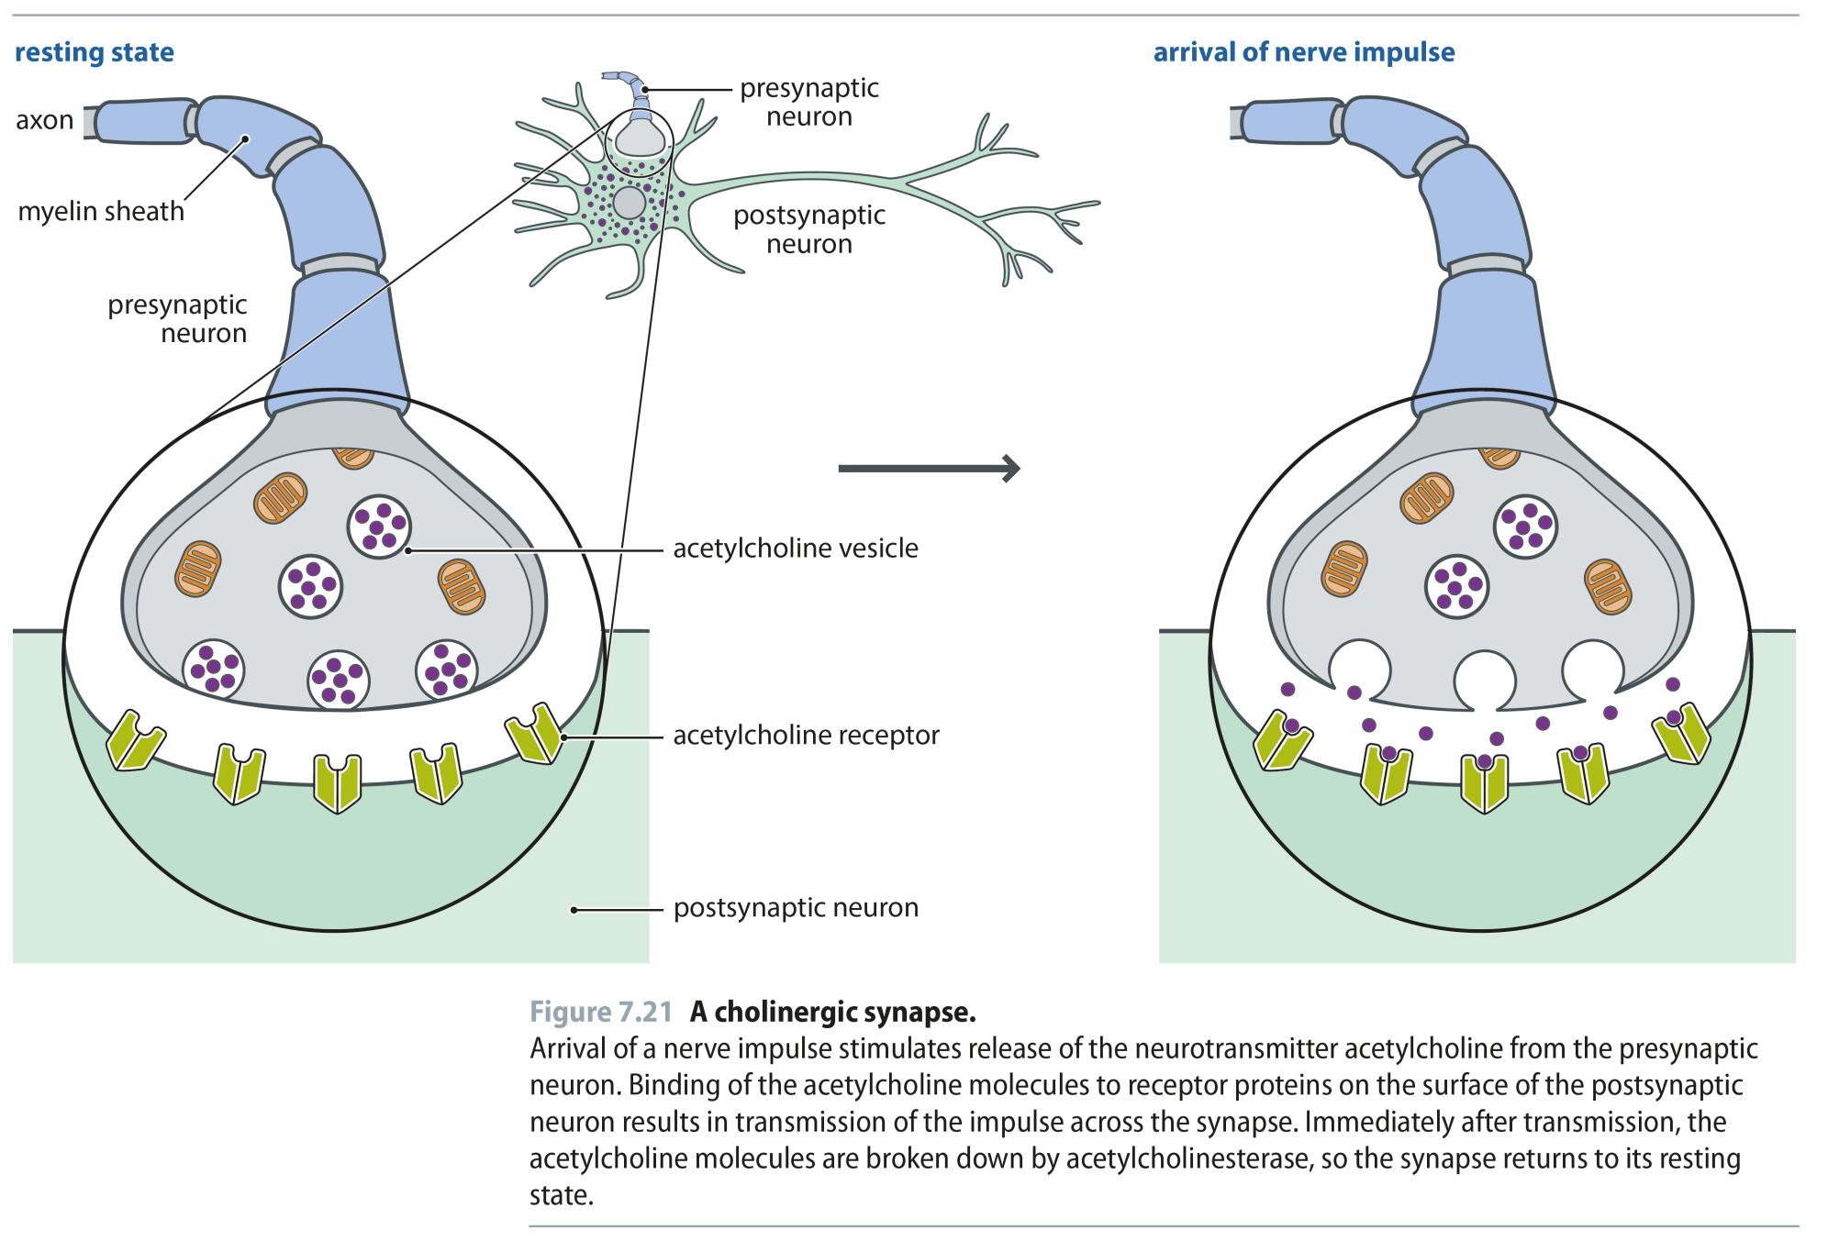
Fig 7.21
Reproduced from: Biochemistry by T.A. Brown, ISBN: 9781907904288 © Scion Publishing Ltd, 2017

Slide 23
Fig 7.22
Reproduced from: Biochemistry by T.A. Brown, ISBN: 9781907904288 © Scion Publishing Ltd, 2017

Slide 24
Fig 7.23
Reproduced from: Biochemistry by T.A. Brown, ISBN: 9781907904288 © Scion Publishing Ltd, 2017

Slide 25
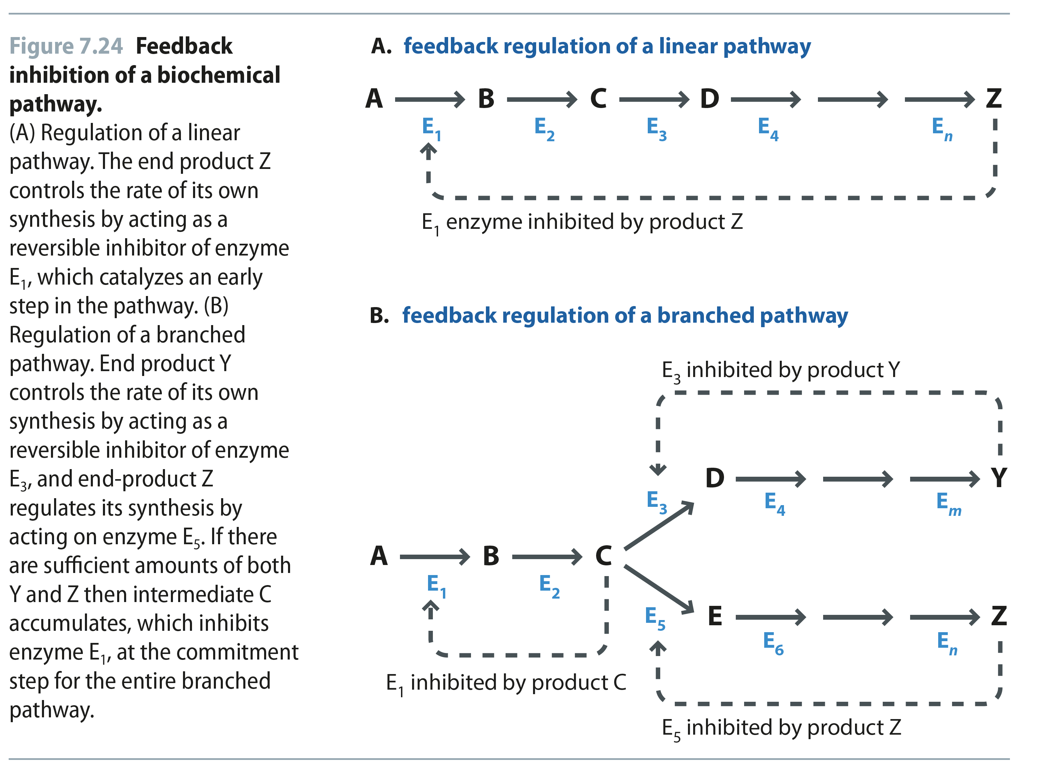
Fig 7.24
Reproduced from: Biochemistry by T.A. Brown, ISBN: 9781907904288 © Scion Publishing Ltd, 2017

