Slide 1
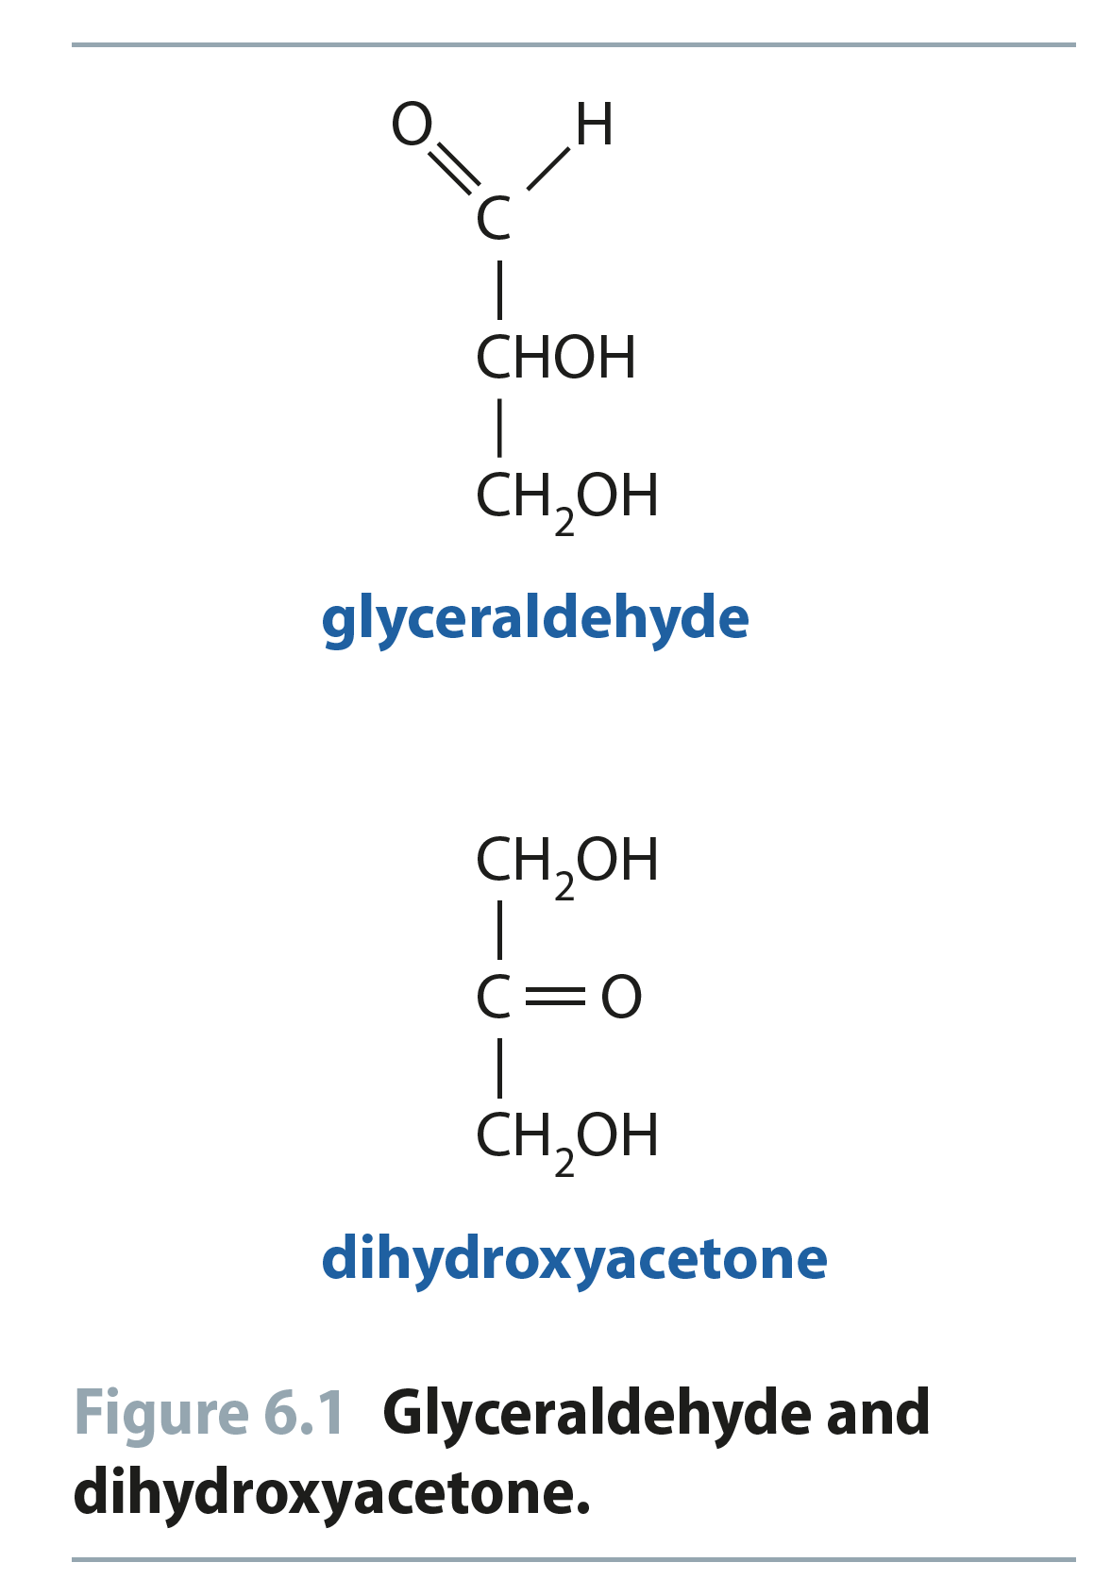
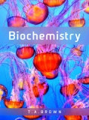
Fig 6.1
Reproduced from: Biochemistry by T.A. Brown, ISBN: 9781907904288 © Scion Publishing Ltd, 2017

Slide 2
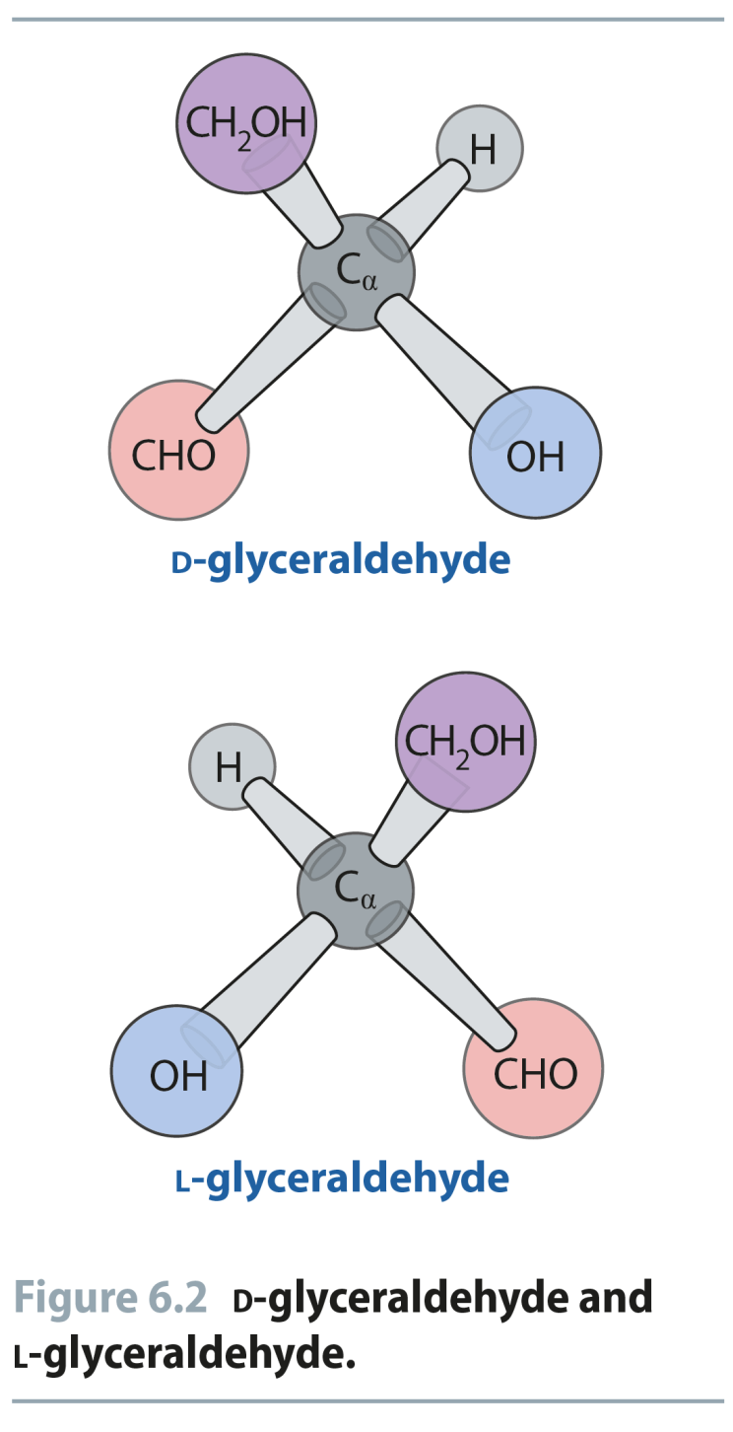
Fig 6.2
Reproduced from: Biochemistry by T.A. Brown, ISBN: 9781907904288 © Scion Publishing Ltd, 2017

Slide 3
Fig 6.3
Reproduced from: Biochemistry by T.A. Brown, ISBN: 9781907904288 © Scion Publishing Ltd, 2017

Slide 4
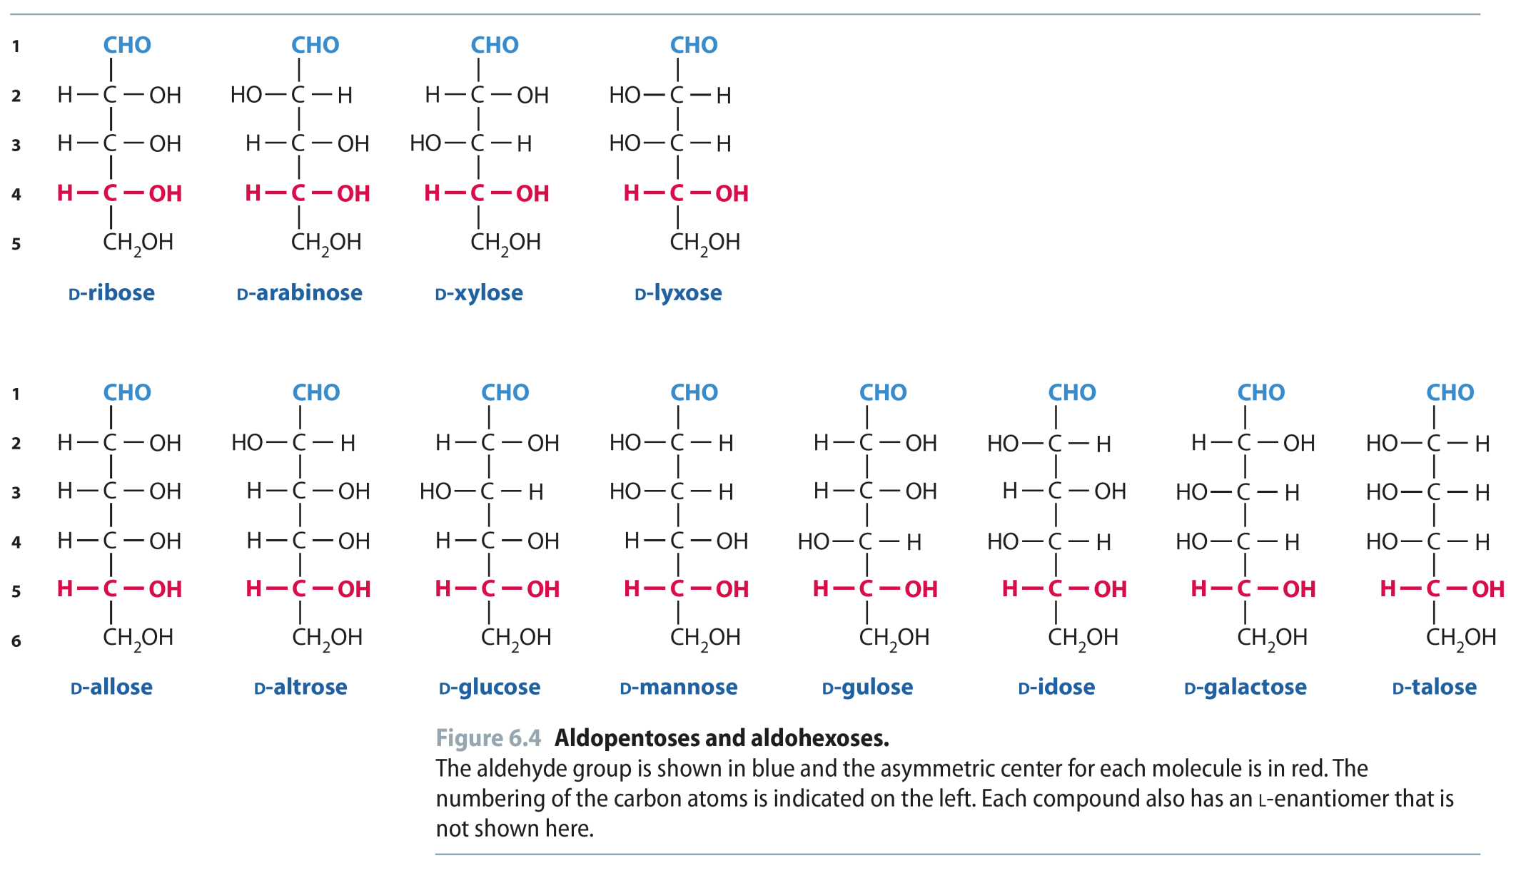
Fig 6.4
Reproduced from: Biochemistry by T.A. Brown, ISBN: 9781907904288 © Scion Publishing Ltd, 2017

Slide 5
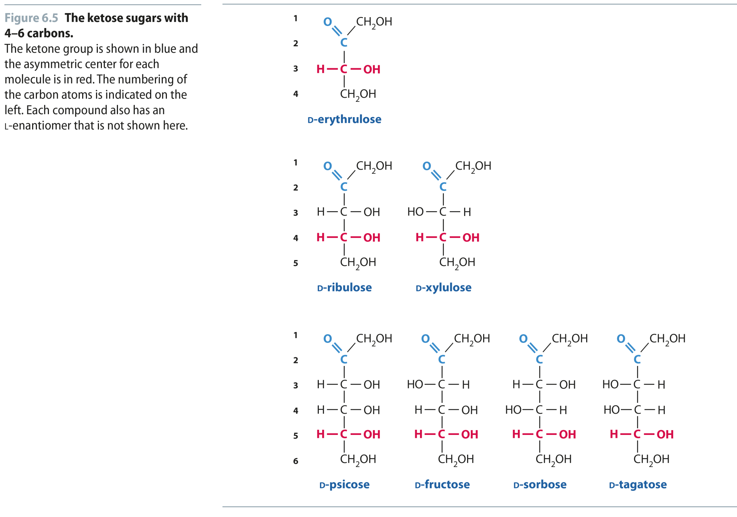
Fig 6.5
Reproduced from: Biochemistry by T.A. Brown, ISBN: 9781907904288 © Scion Publishing Ltd, 2017

Slide 6
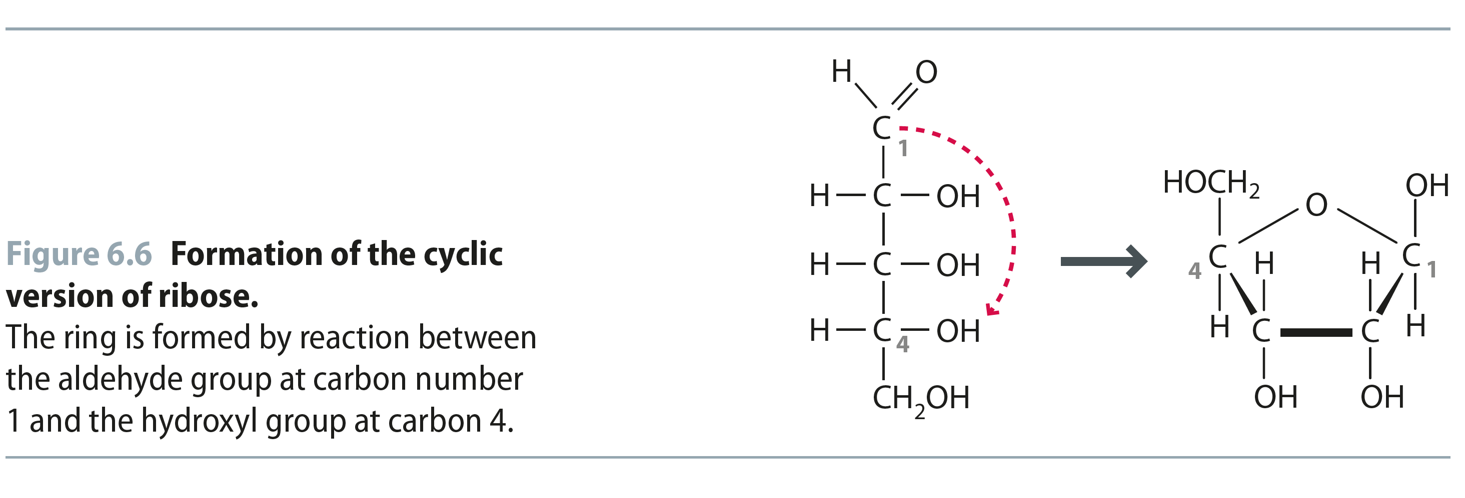
Fig 6.6
Reproduced from: Biochemistry by T.A. Brown, ISBN: 9781907904288 © Scion Publishing Ltd, 2017

Slide 7
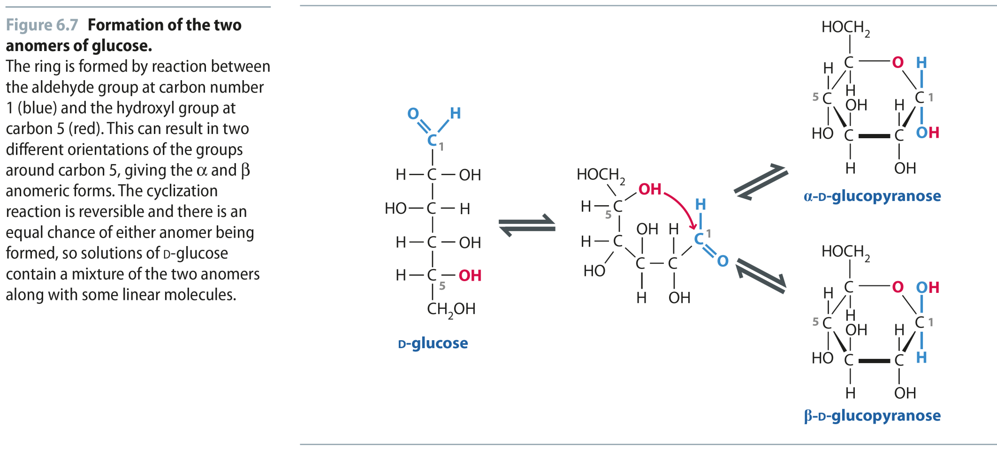
Fig 6.7
Reproduced from: Biochemistry by T.A. Brown, ISBN: 9781907904288 © Scion Publishing Ltd, 2017

Slide 8
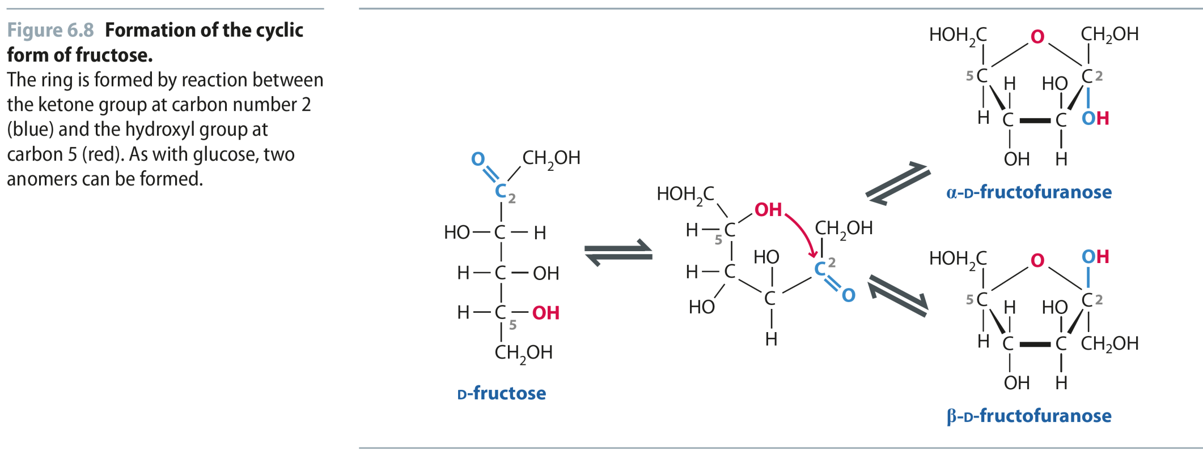
Fig 6.8
Reproduced from: Biochemistry by T.A. Brown, ISBN: 9781907904288 © Scion Publishing Ltd, 2017

Slide 9
Table 6.1
Reproduced from: Biochemistry by T.A. Brown, ISBN: 9781907904288 © Scion Publishing Ltd, 2017

Slide 10
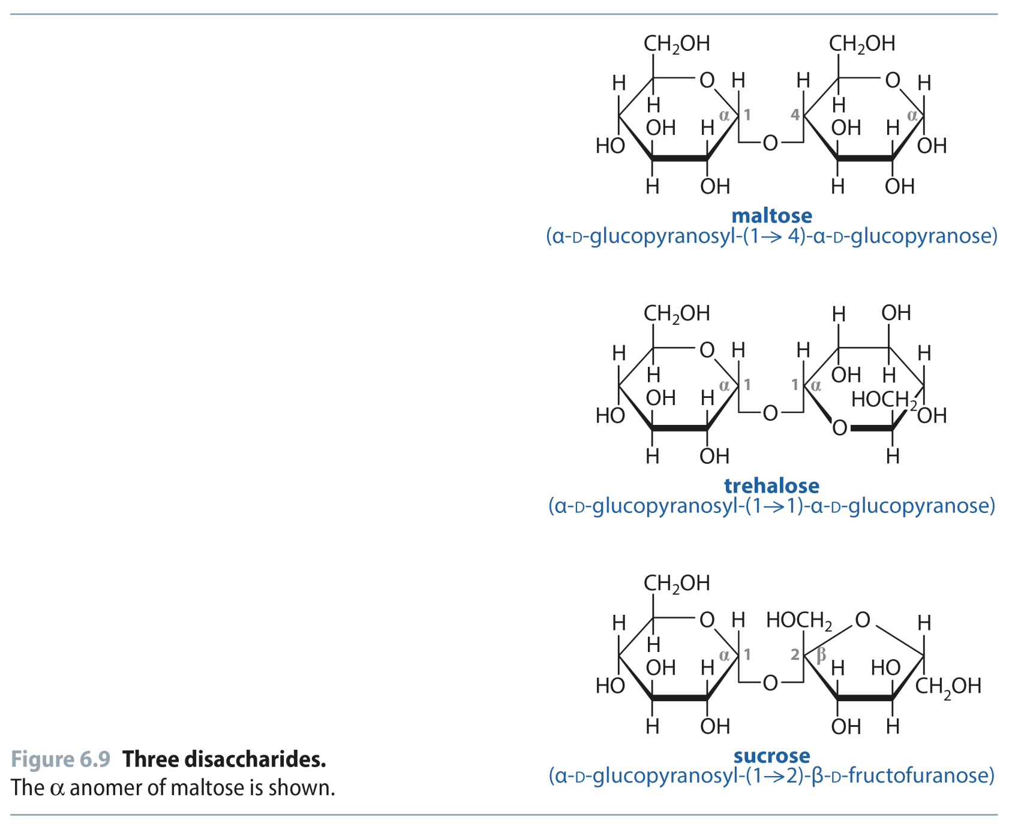
Fig 6.9
Reproduced from: Biochemistry by T.A. Brown, ISBN: 9781907904288 © Scion Publishing Ltd, 2017

Slide 11
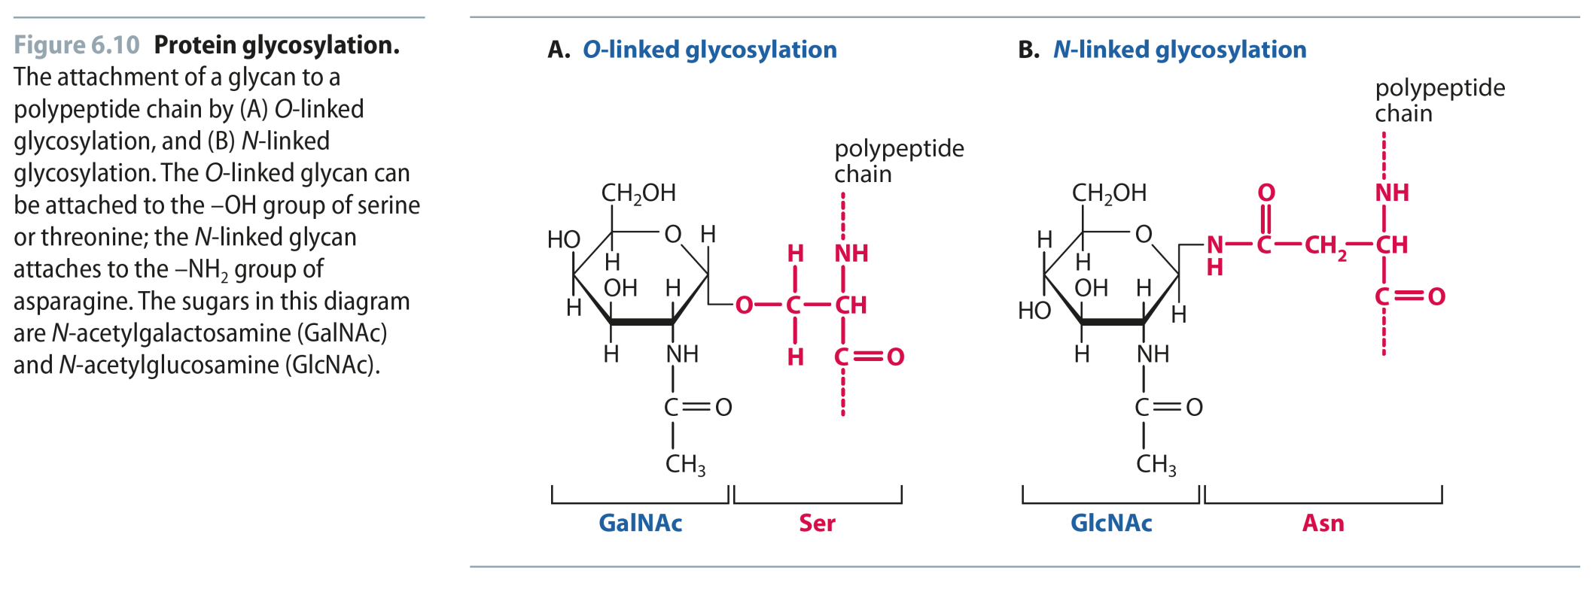
Fig 6.10
Reproduced from: Biochemistry by T.A. Brown, ISBN: 9781907904288 © Scion Publishing Ltd, 2017

Slide 12
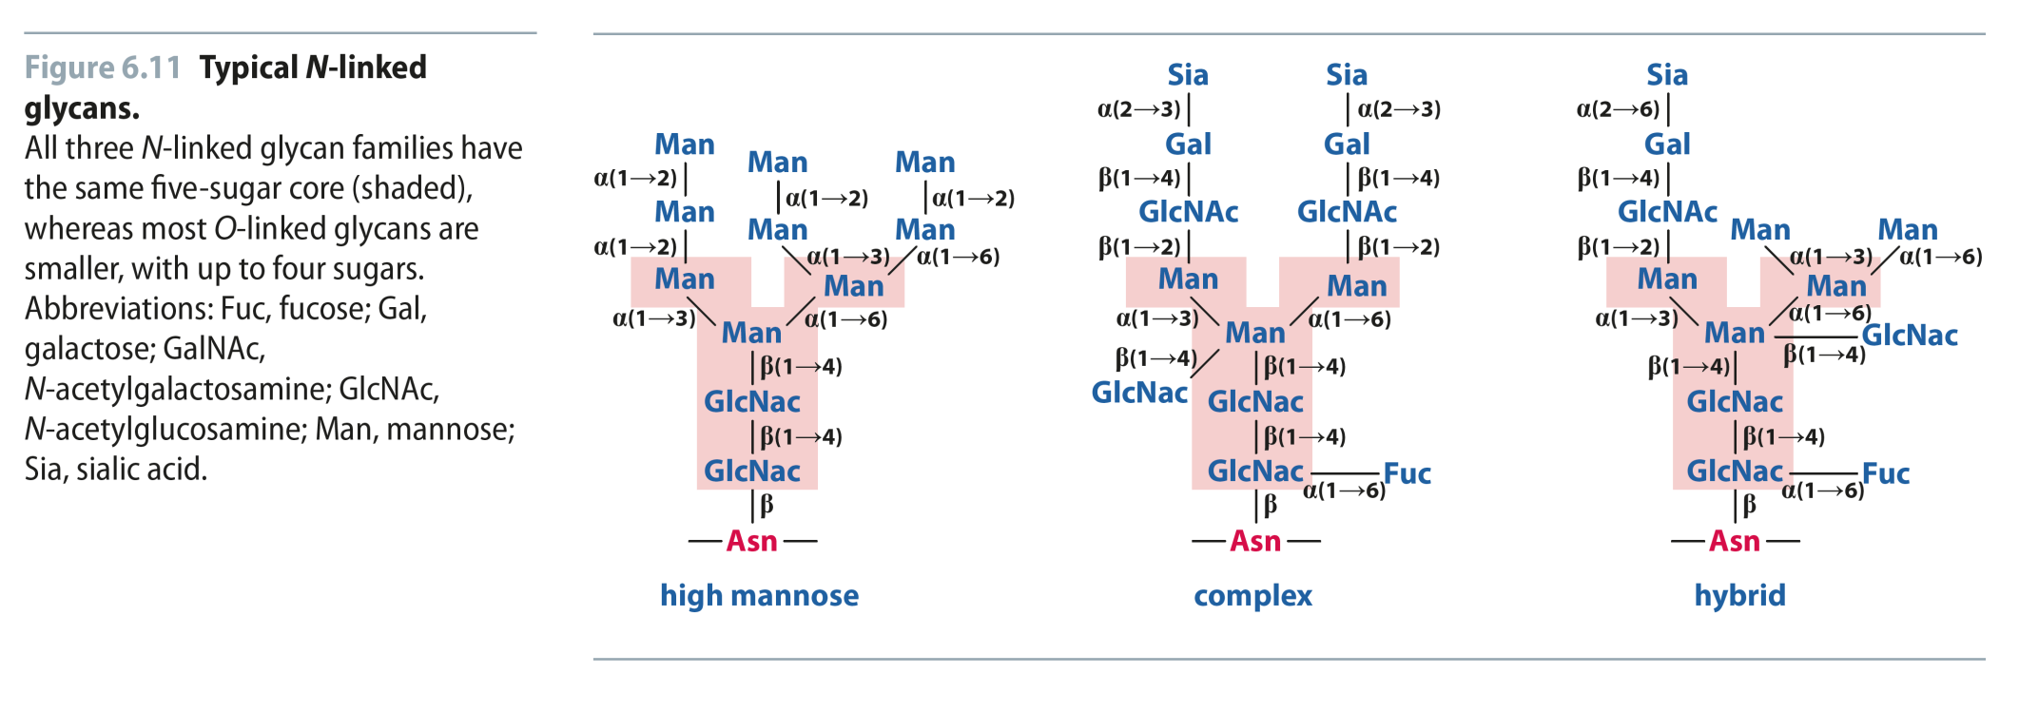
Fig 6.11
Reproduced from: Biochemistry by T.A. Brown, ISBN: 9781907904288 © Scion Publishing Ltd, 2017

Slide 13
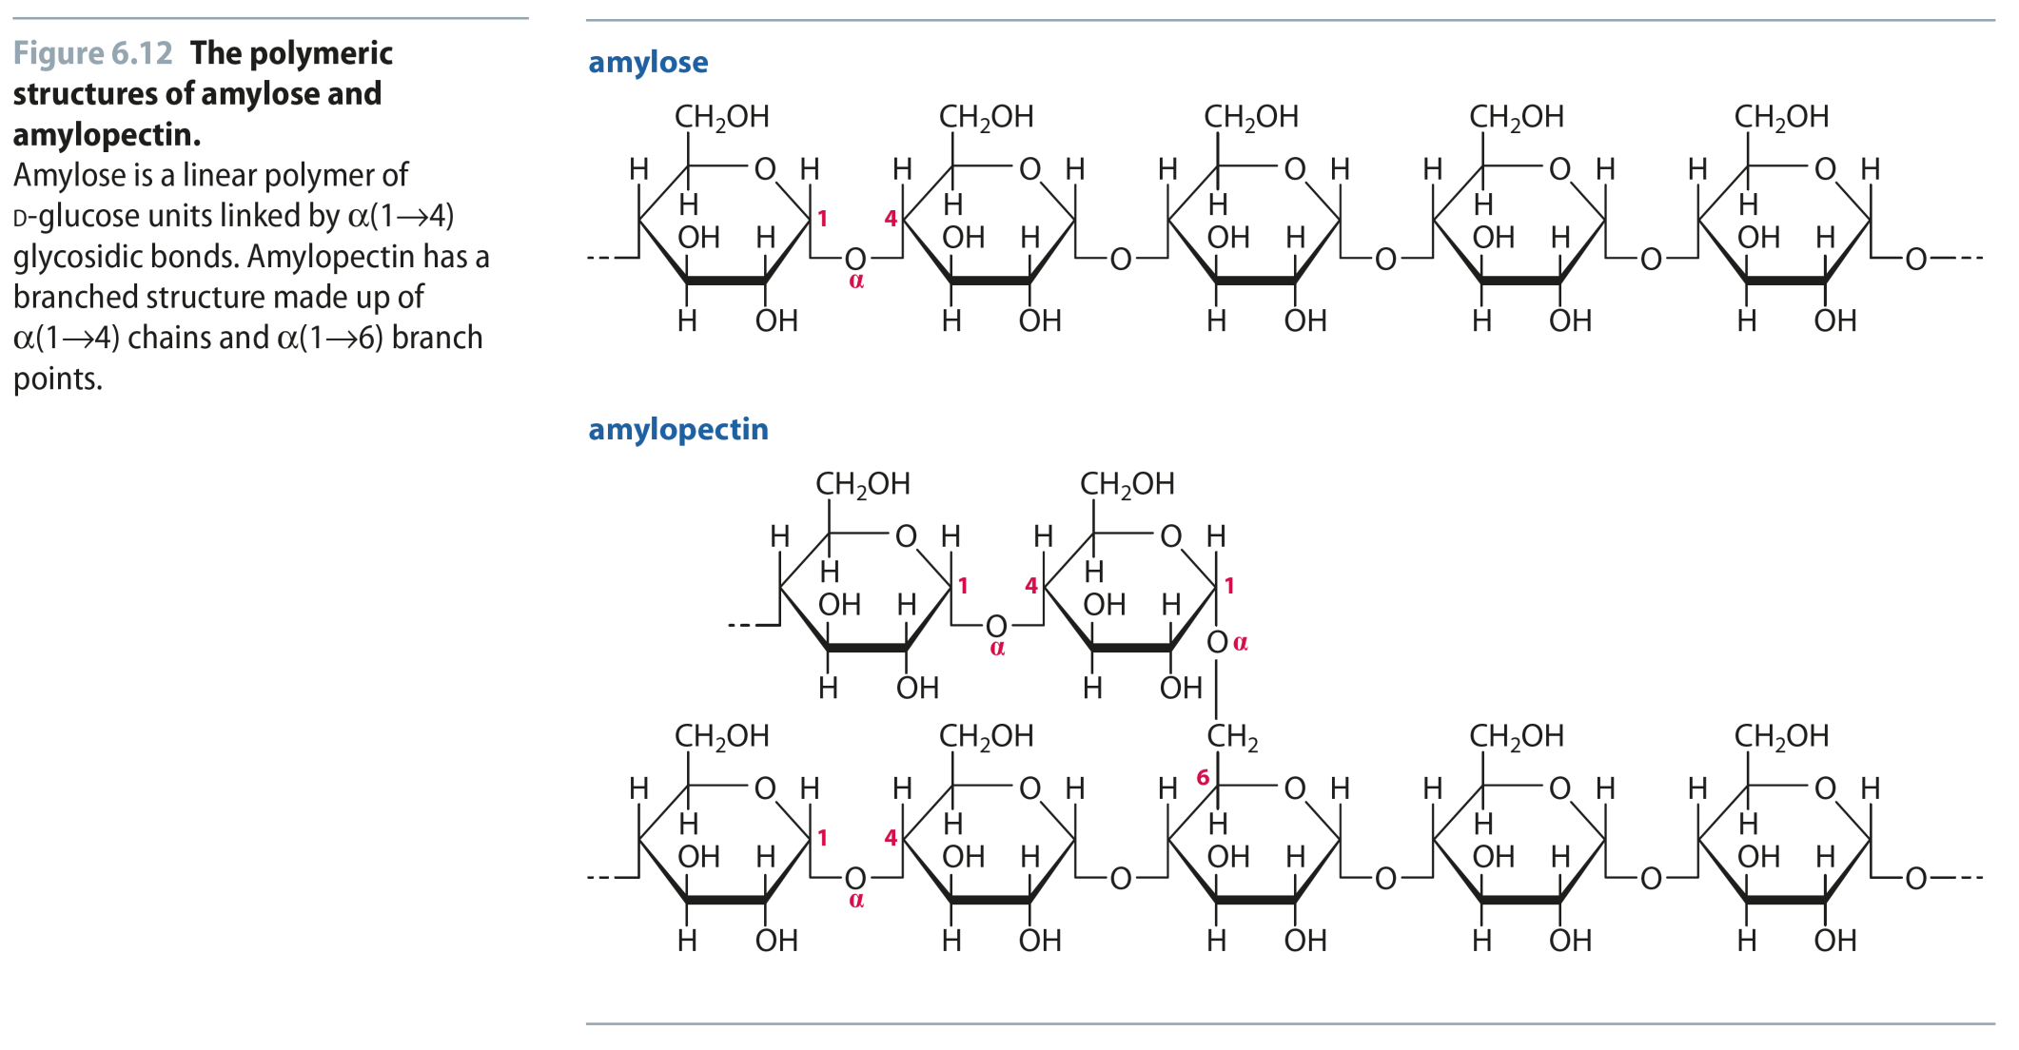
Fig 6.12
Reproduced from: Biochemistry by T.A. Brown, ISBN: 9781907904288 © Scion Publishing Ltd, 2017

Slide 14
Fig 6.13
Reproduced from: Biochemistry by T.A. Brown, ISBN: 9781907904288 © Scion Publishing Ltd, 2017

Slide 15
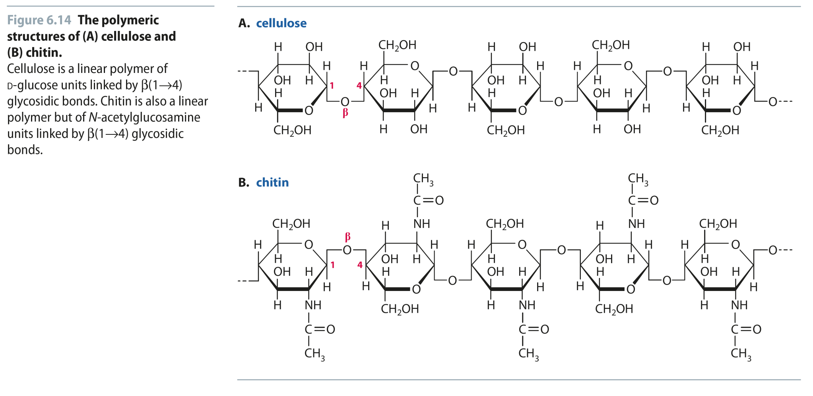
Fig 6.14
Reproduced from: Biochemistry by T.A. Brown, ISBN: 9781907904288 © Scion Publishing Ltd, 2017

Slide 16
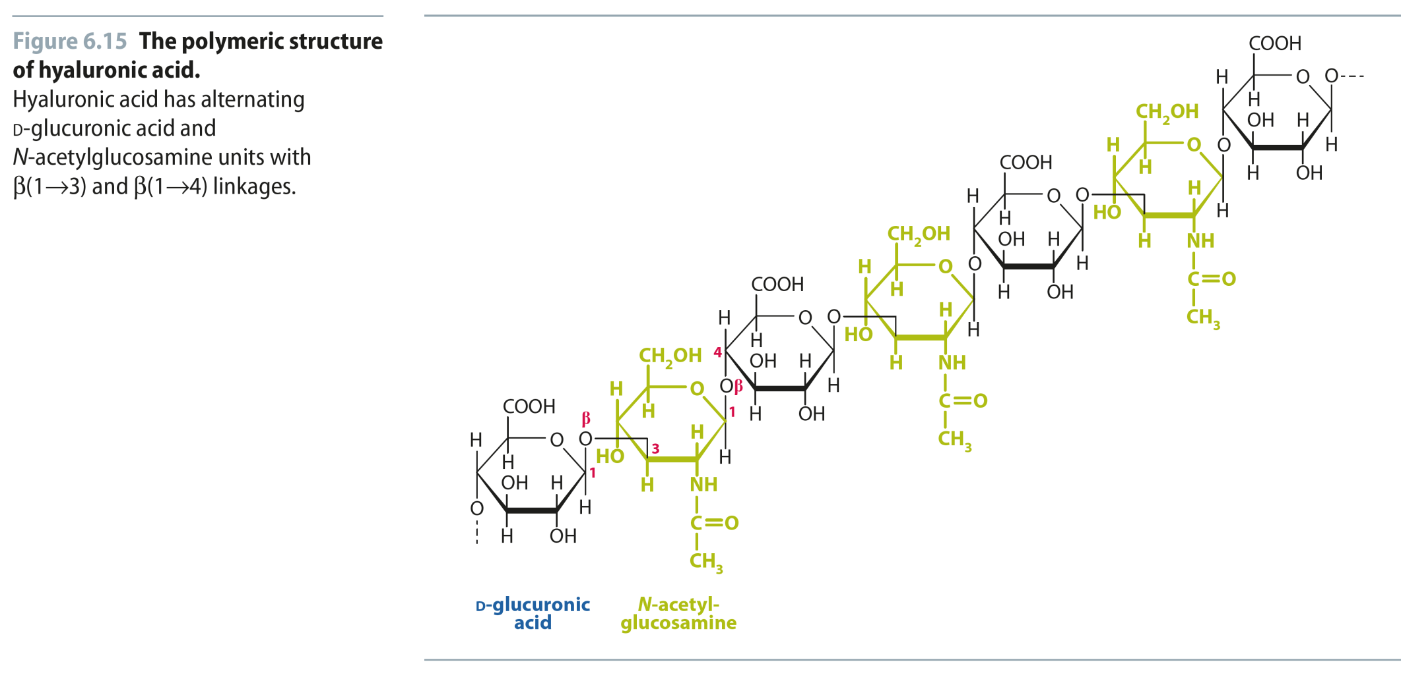
Fig 6.15
Reproduced from: Biochemistry by T.A. Brown, ISBN: 9781907904288 © Scion Publishing Ltd, 2017

Slide 17
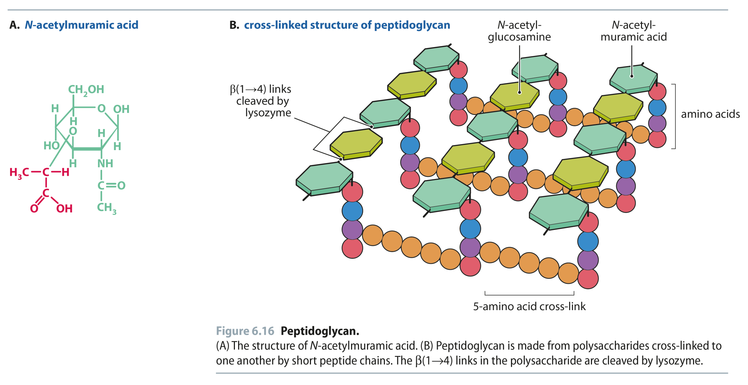
Fig 6.16
Reproduced from: Biochemistry by T.A. Brown, ISBN: 9781907904288 © Scion Publishing Ltd, 2017

