Slide 1
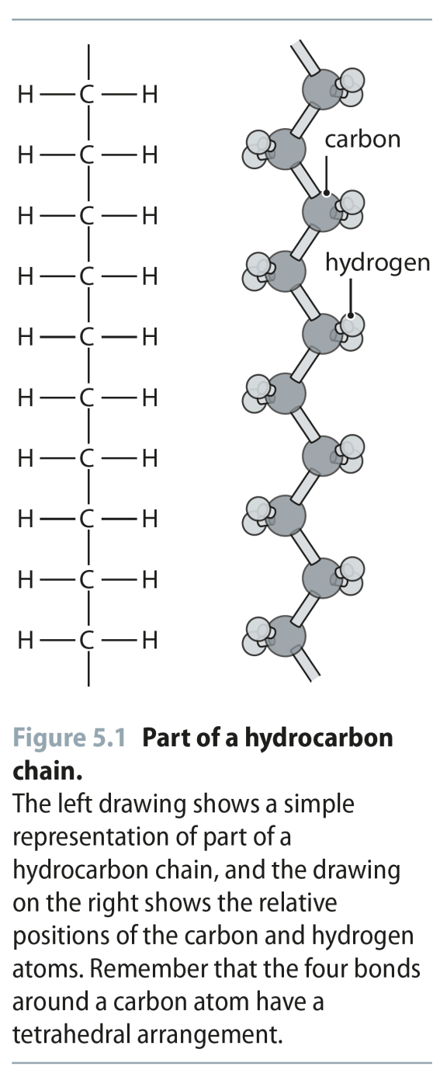
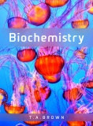
Fig 5.1
Reproduced from: Biochemistry by T.A. Brown, ISBN: 9781907904288 © Scion Publishing Ltd, 2017

Slide 2
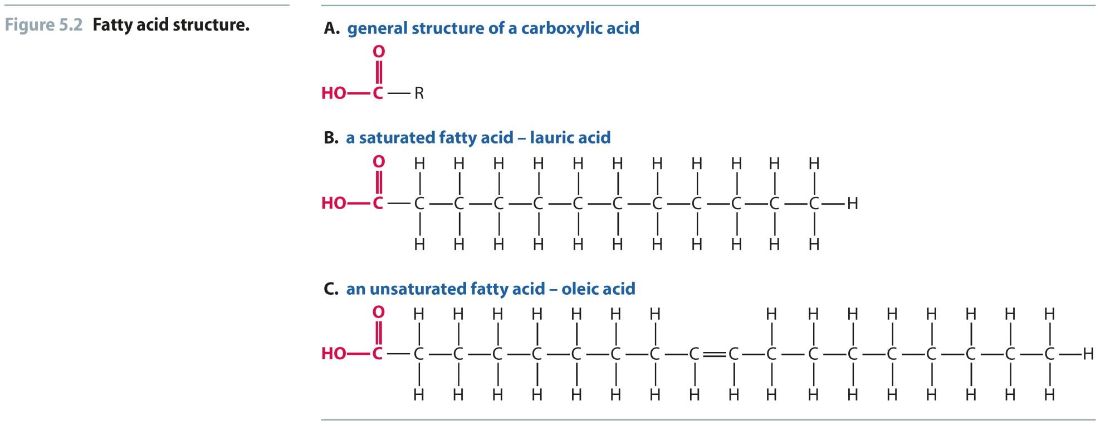
Fig 5.2
Reproduced from: Biochemistry by T.A. Brown, ISBN: 9781907904288 © Scion Publishing Ltd, 2017

Slide 3
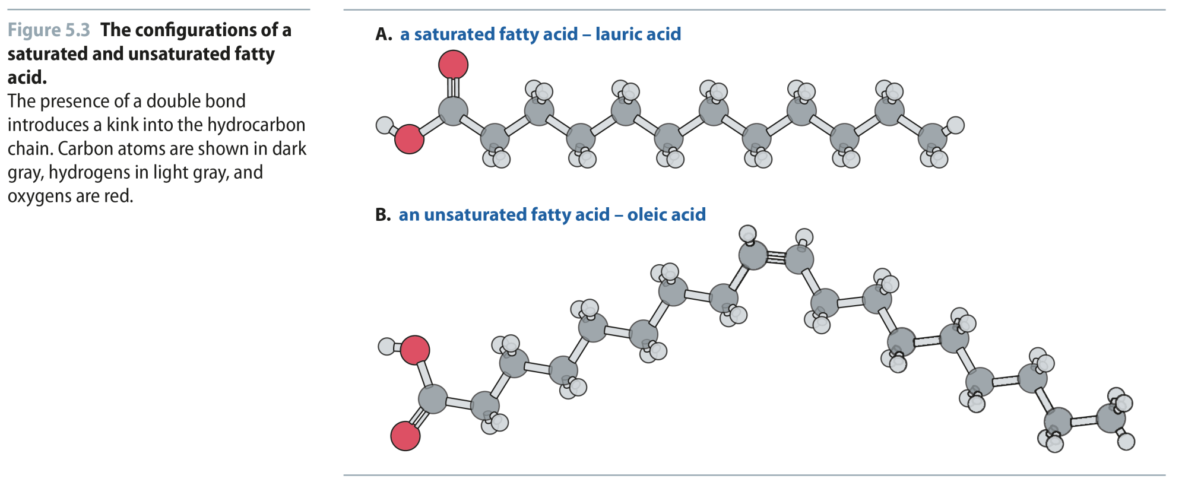
Fig 5.3
Reproduced from: Biochemistry by T.A. Brown, ISBN: 9781907904288 © Scion Publishing Ltd, 2017

Slide 4
Fig 5.4
Reproduced from: Biochemistry by T.A. Brown, ISBN: 9781907904288 © Scion Publishing Ltd, 2017

Slide 5
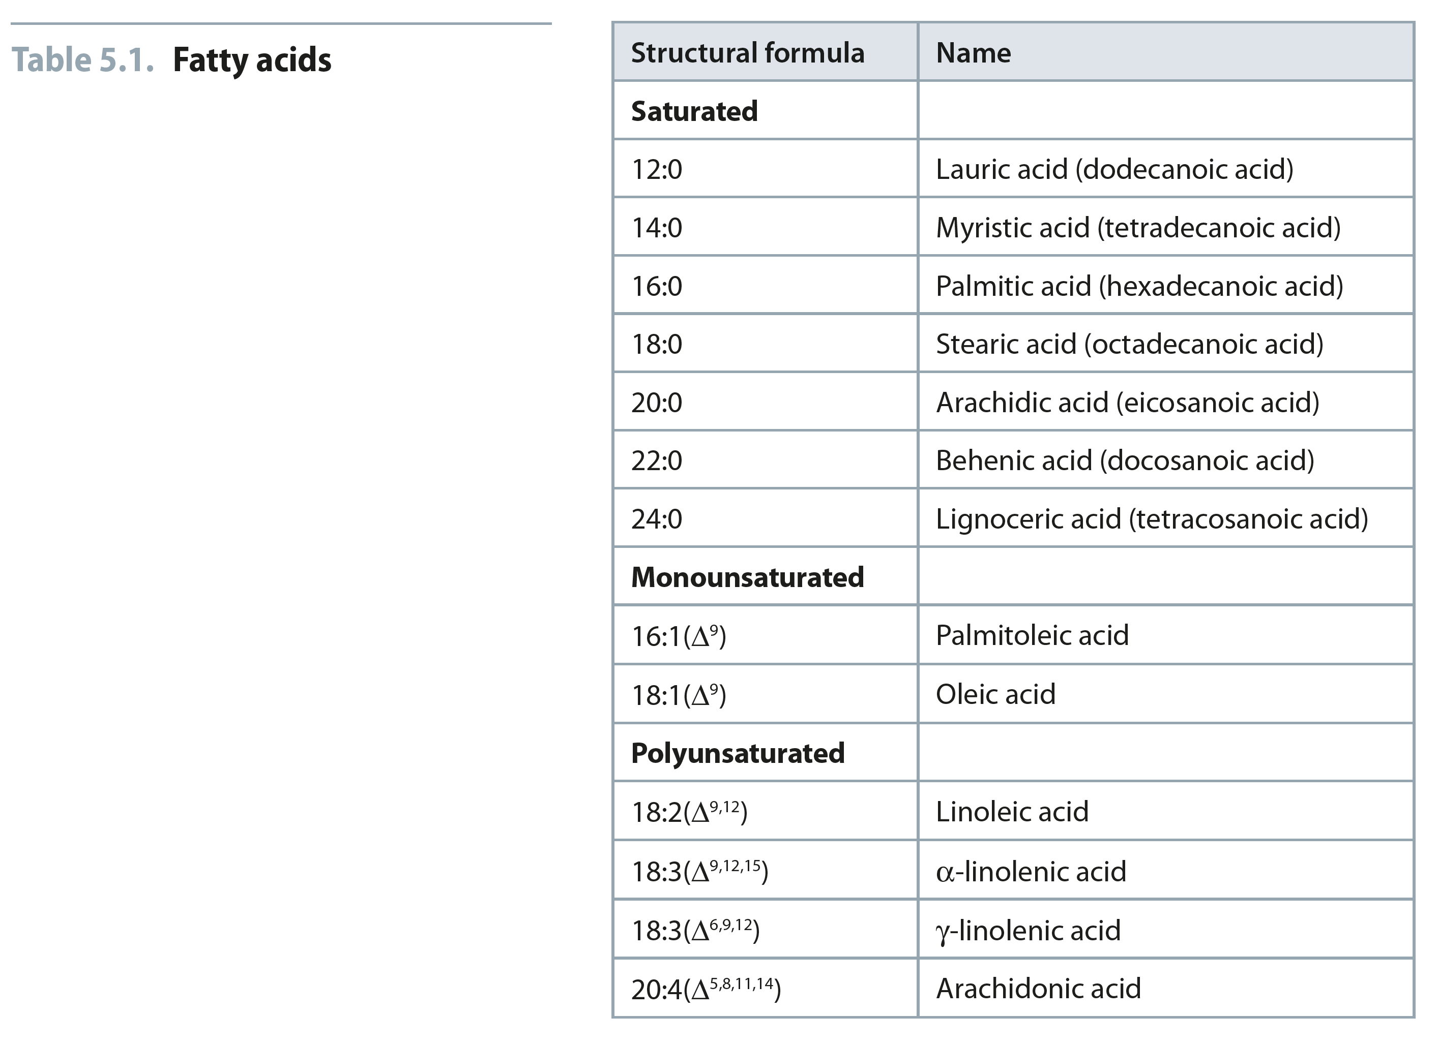
Table 5.1
Reproduced from: Biochemistry by T.A. Brown, ISBN: 9781907904288 © Scion Publishing Ltd, 2017

Slide 6
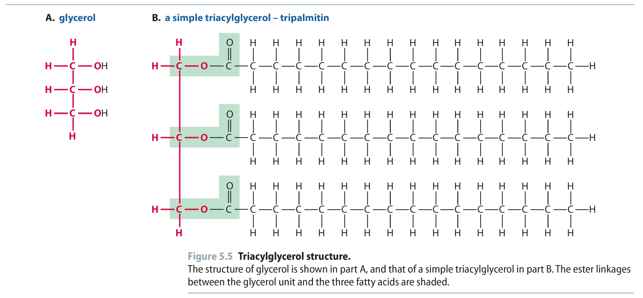
Fig 5.5
Reproduced from: Biochemistry by T.A. Brown, ISBN: 9781907904288 © Scion Publishing Ltd, 2017

Slide 7
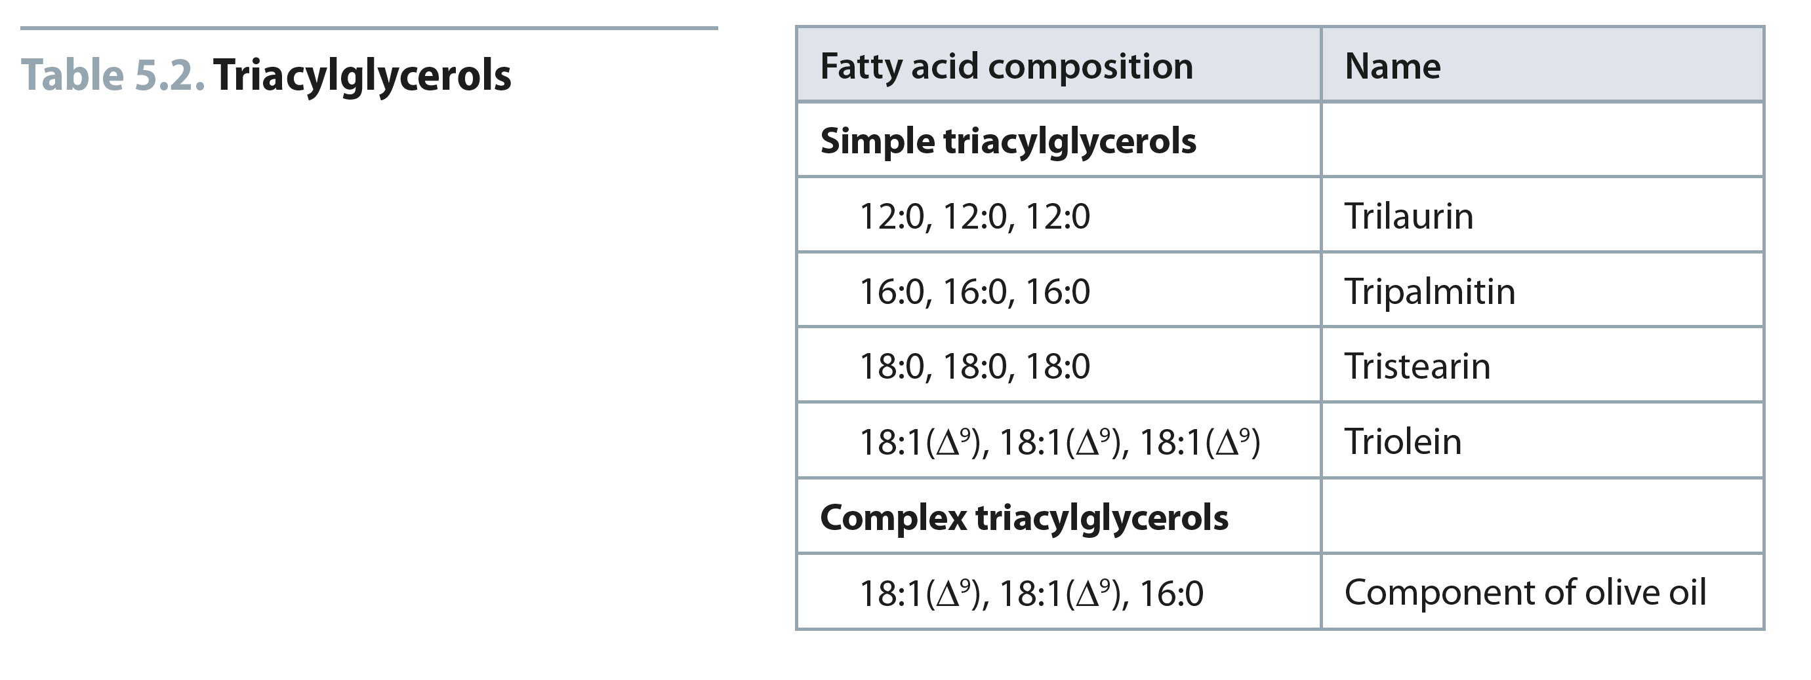
Table 5.2
Reproduced from: Biochemistry by T.A. Brown, ISBN: 9781907904288 © Scion Publishing Ltd, 2017

Slide 8
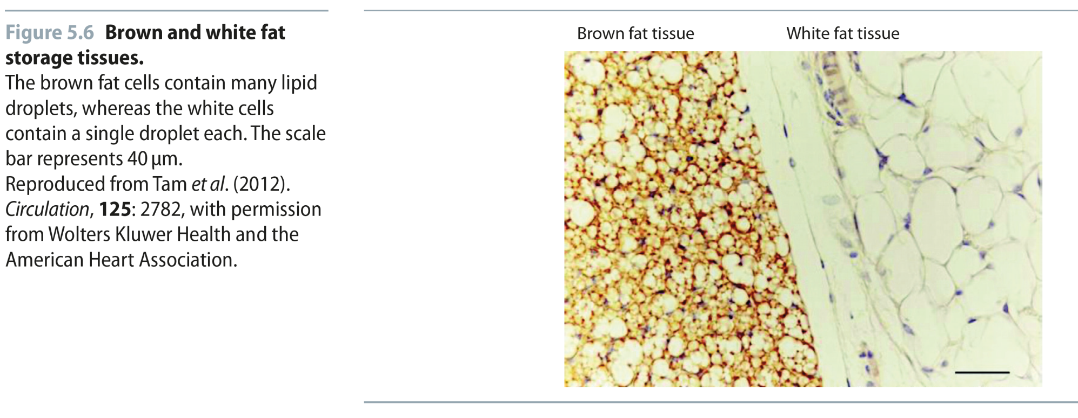
Fig 5.6
Reproduced from: Biochemistry by T.A. Brown, ISBN: 9781907904288 © Scion Publishing Ltd, 2017

Slide 9
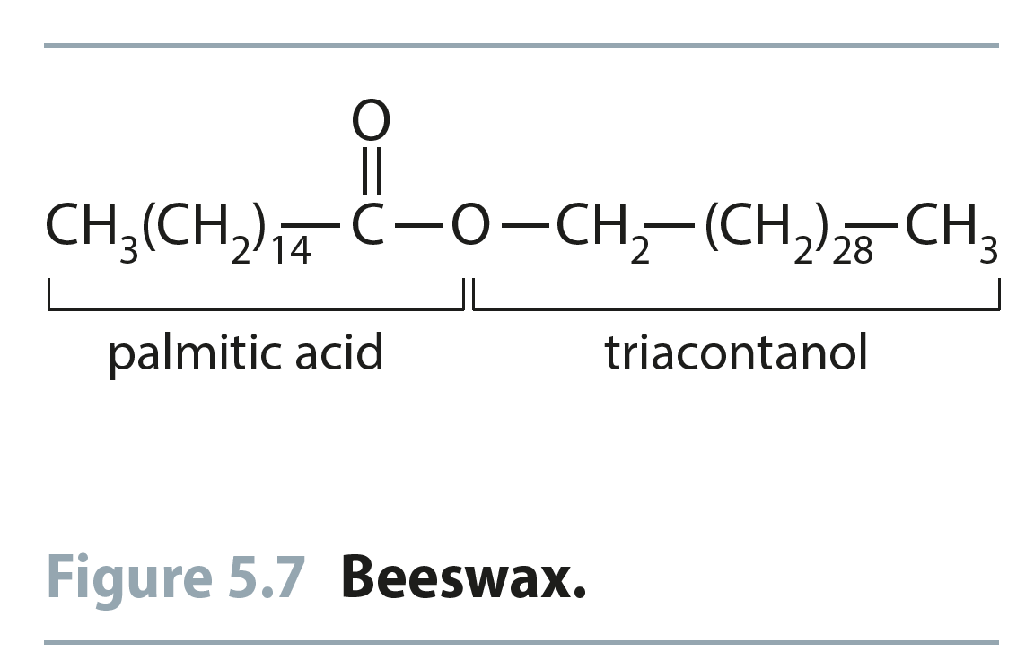
Fig 5.7
Reproduced from: Biochemistry by T.A. Brown, ISBN: 9781907904288 © Scion Publishing Ltd, 2017

Slide 10
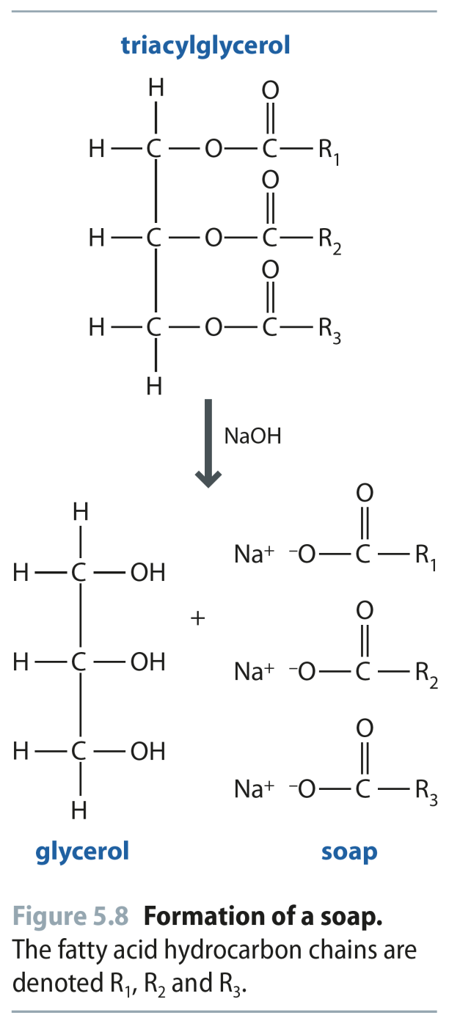
Fig 5.8
Reproduced from: Biochemistry by T.A. Brown, ISBN: 9781907904288 © Scion Publishing Ltd, 2017

Slide 11
Fig 5.9
Reproduced from: Biochemistry by T.A. Brown, ISBN: 9781907904288 © Scion Publishing Ltd, 2017

Slide 12
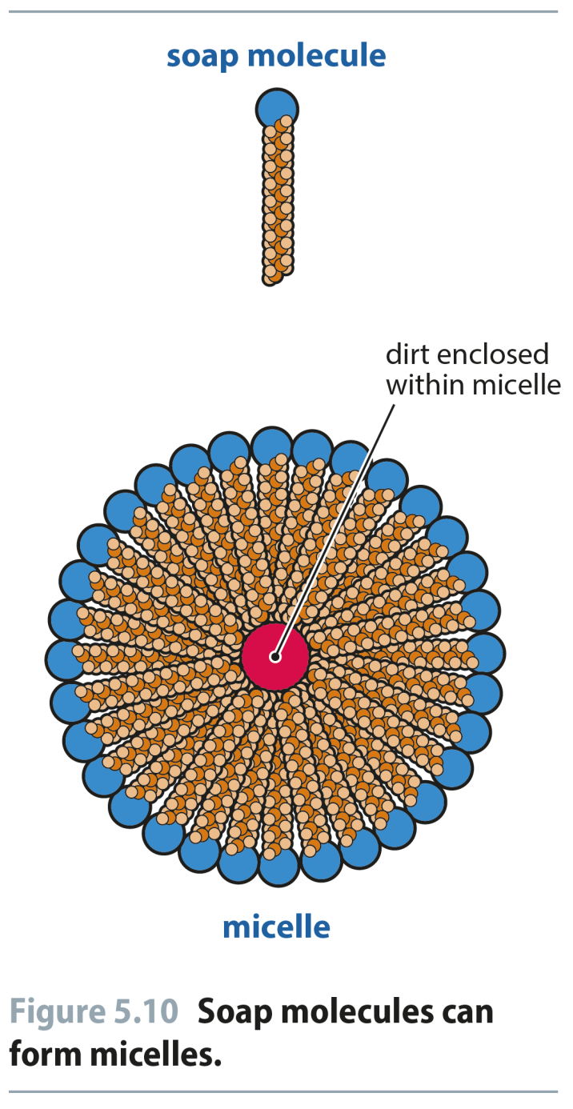
Fig 5.10
Reproduced from: Biochemistry by T.A. Brown, ISBN: 9781907904288 © Scion Publishing Ltd, 2017

Slide 13
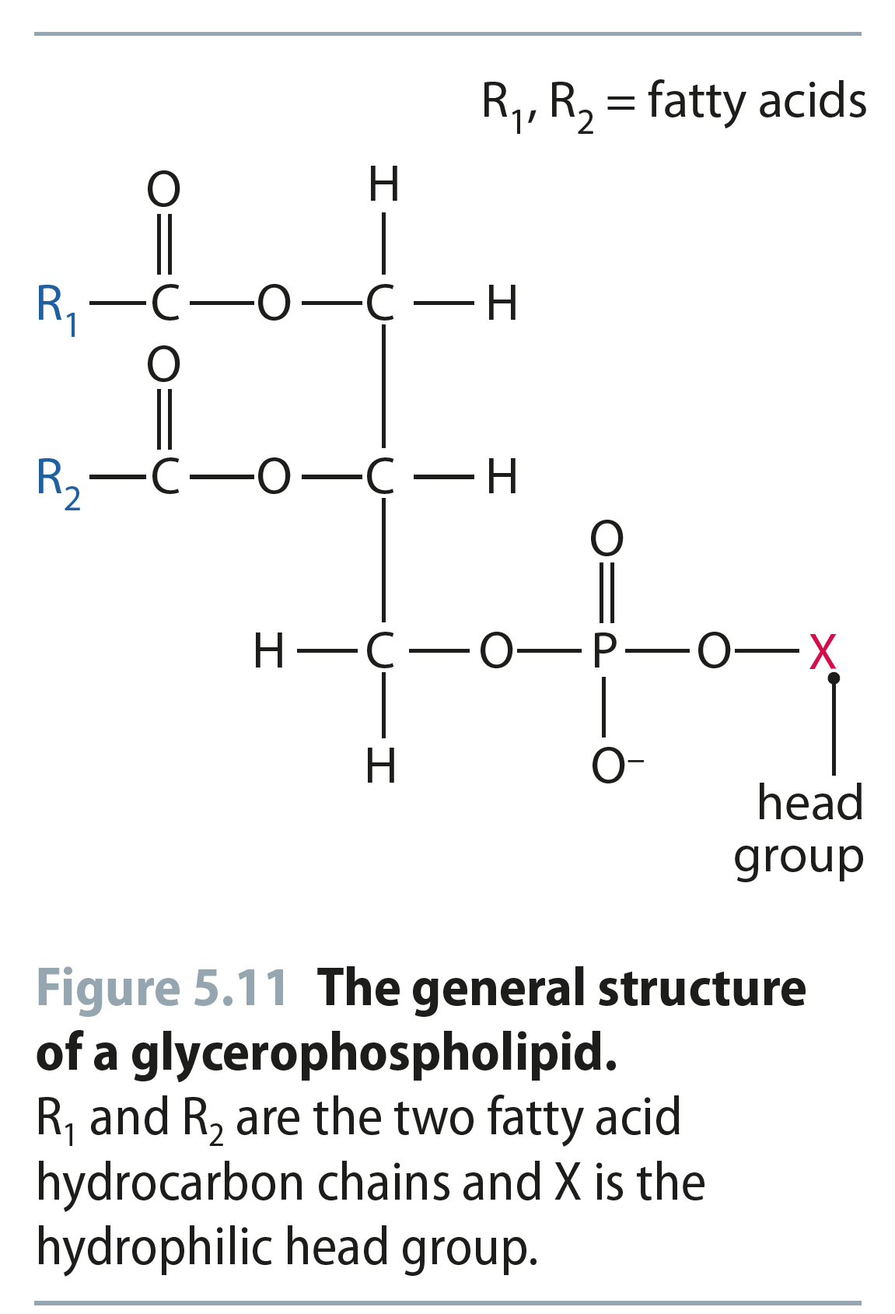
Fig 5.11
Reproduced from: Biochemistry by T.A. Brown, ISBN: 9781907904288 © Scion Publishing Ltd, 2017

Slide 14
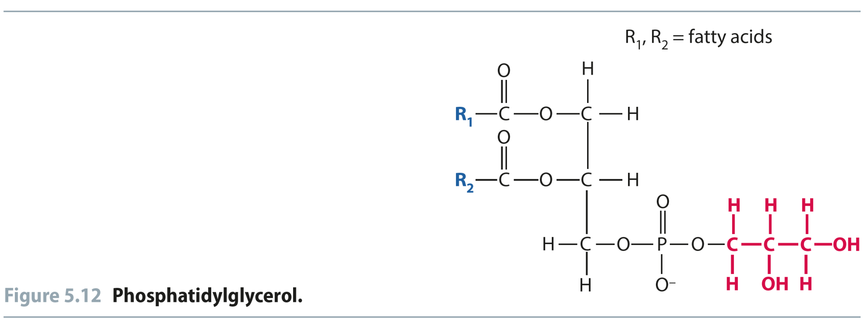
Fig 5.12
Reproduced from: Biochemistry by T.A. Brown, ISBN: 9781907904288 © Scion Publishing Ltd, 2017

Slide 15
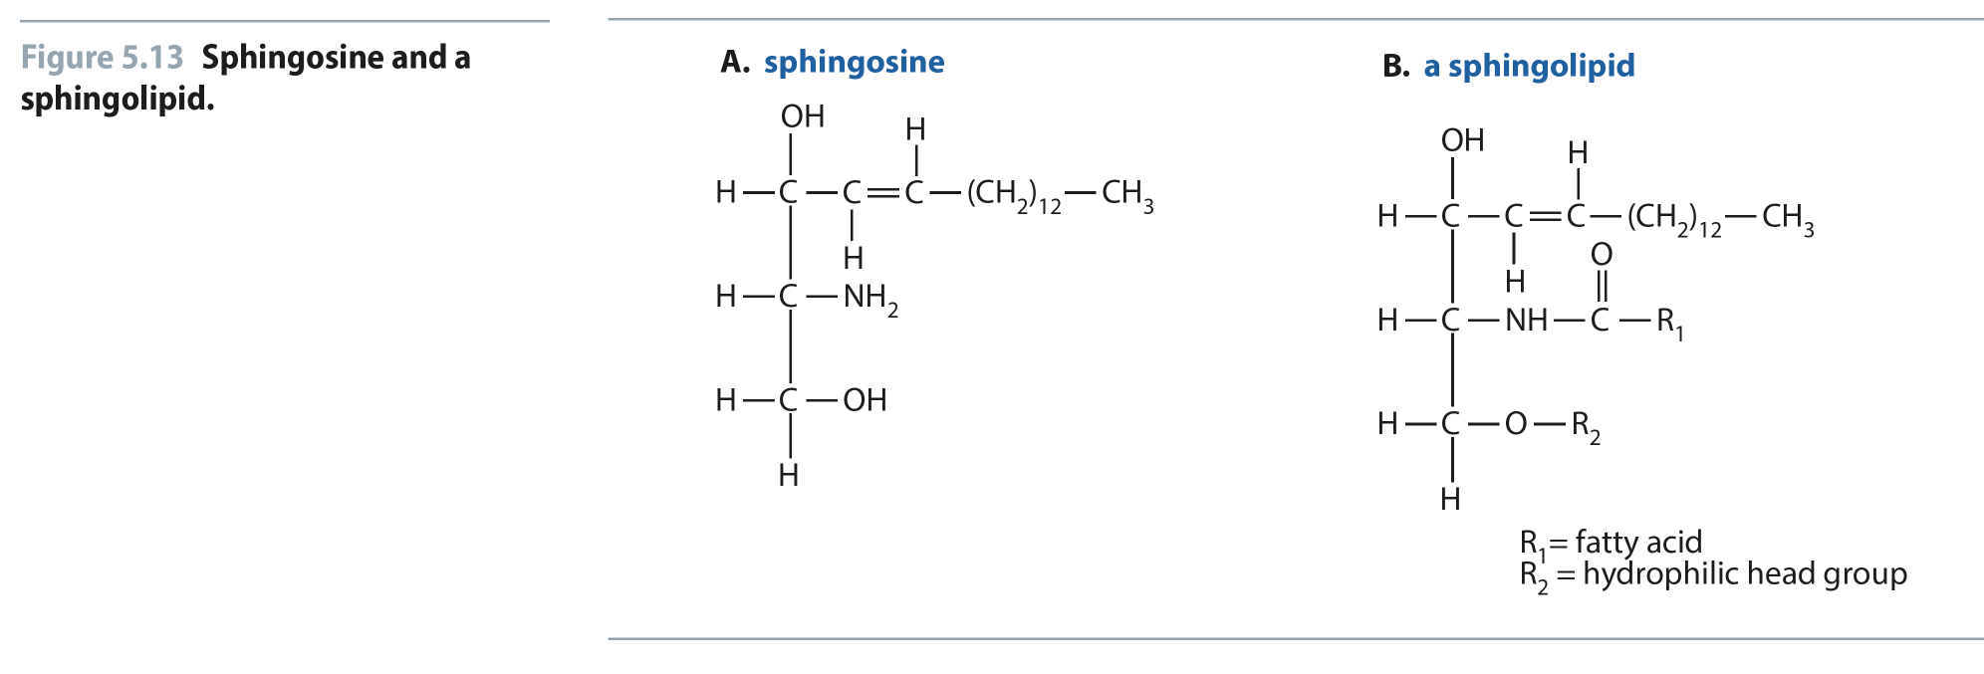
Fig 5.13
Reproduced from: Biochemistry by T.A. Brown, ISBN: 9781907904288 © Scion Publishing Ltd, 2017

Slide 16
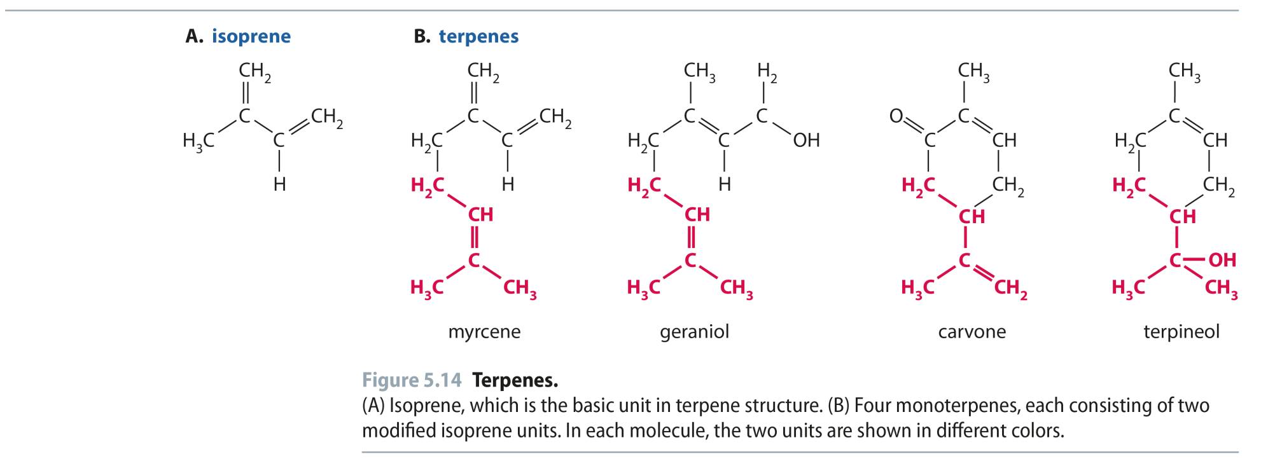
Fig 5.14
Reproduced from: Biochemistry by T.A. Brown, ISBN: 9781907904288 © Scion Publishing Ltd, 2017

Slide 17
Fig 5.15
Reproduced from: Biochemistry by T.A. Brown, ISBN: 9781907904288 © Scion Publishing Ltd, 2017

Slide 18
Fig 5.16
Reproduced from: Biochemistry by T.A. Brown, ISBN: 9781907904288 © Scion Publishing Ltd, 2017

Slide 19
Fig 5.17
Reproduced from: Biochemistry by T.A. Brown, ISBN: 9781907904288 © Scion Publishing Ltd, 2017

Slide 20
Table 5.3
Reproduced from: Biochemistry by T.A. Brown, ISBN: 9781907904288 © Scion Publishing Ltd, 2017

Slide 21
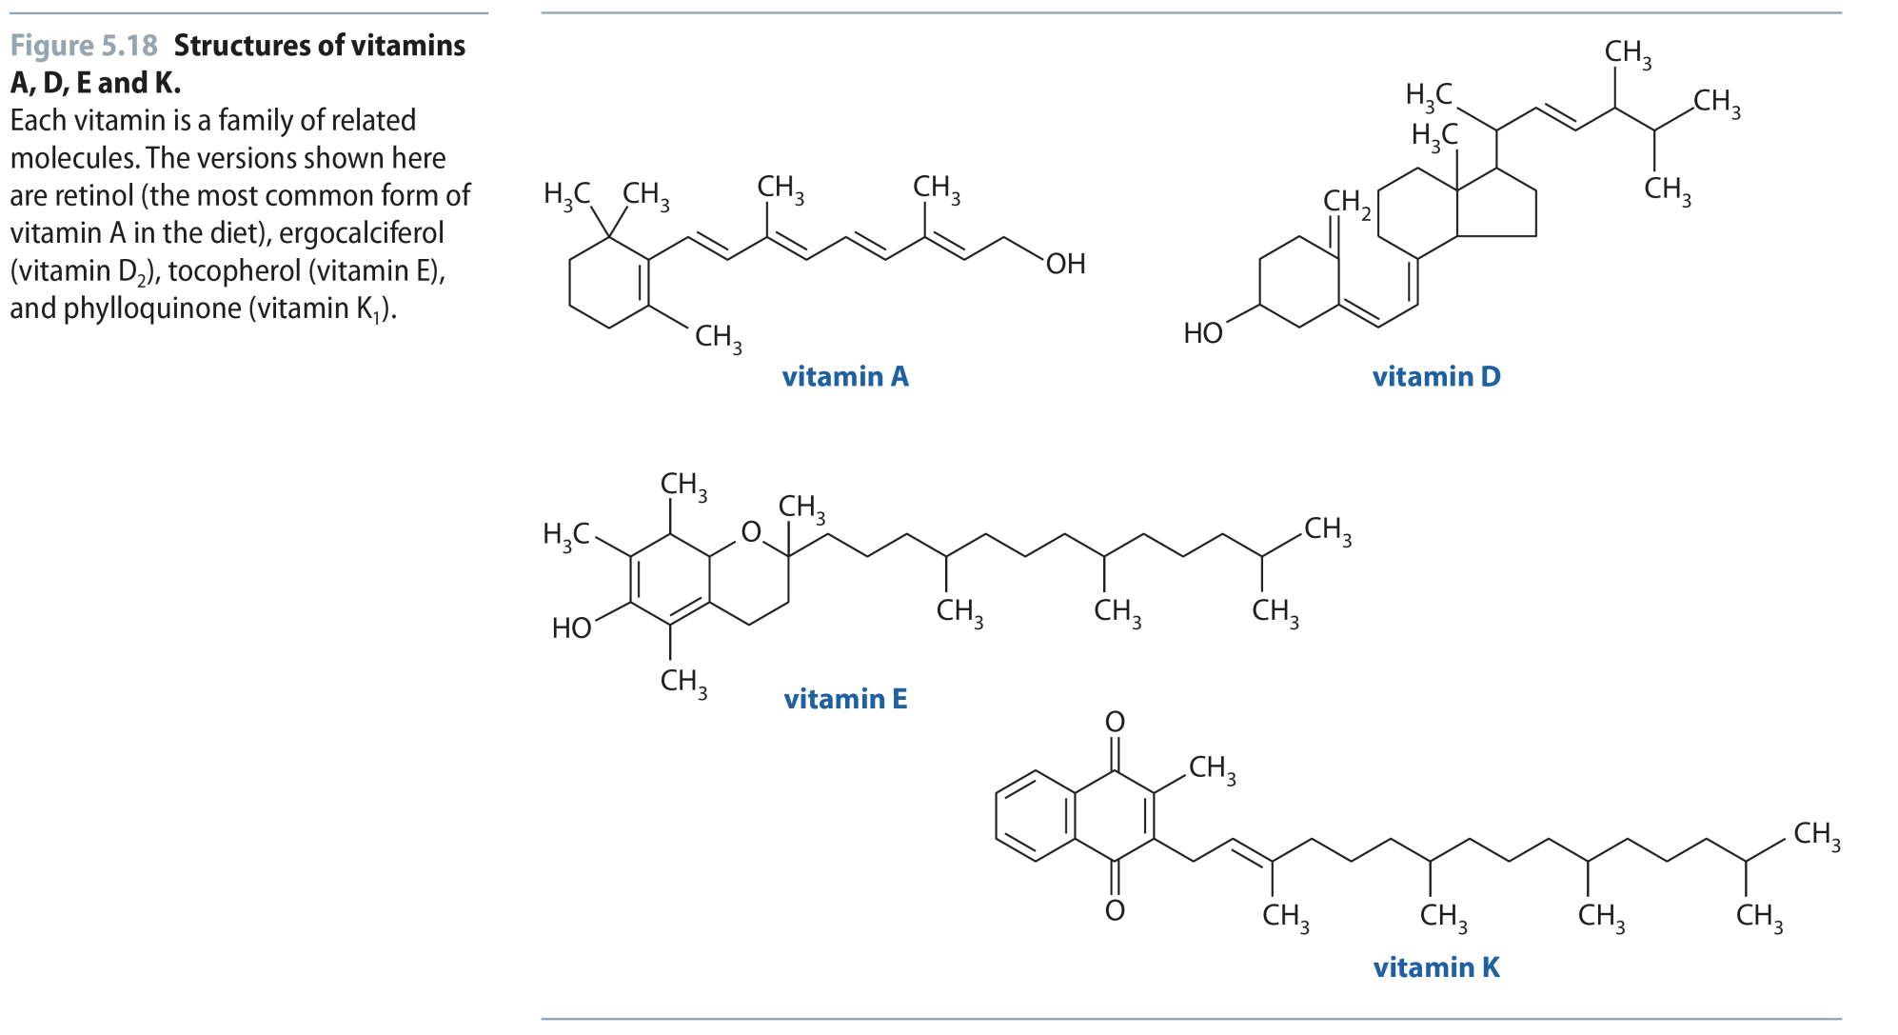
Fig 5.18
Reproduced from: Biochemistry by T.A. Brown, ISBN: 9781907904288 © Scion Publishing Ltd, 2017

Slide 22
Table 5.4
Reproduced from: Biochemistry by T.A. Brown, ISBN: 9781907904288 © Scion Publishing Ltd, 2017

Slide 23
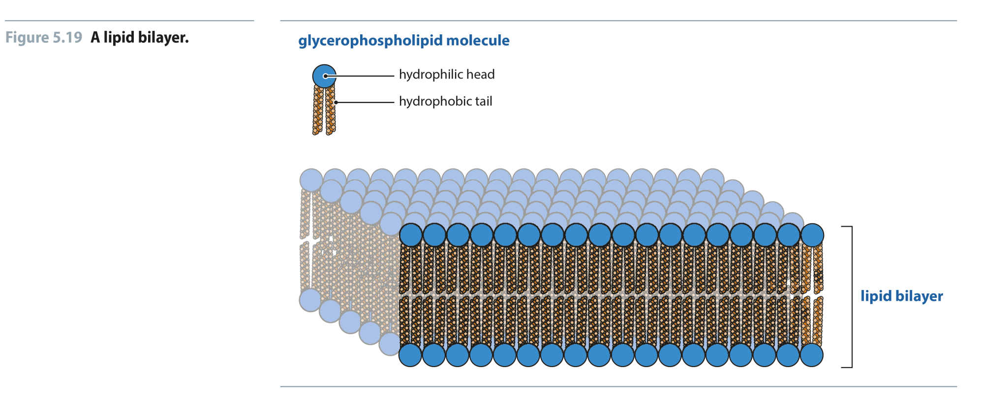
Fig 5.19
Reproduced from: Biochemistry by T.A. Brown, ISBN: 9781907904288 © Scion Publishing Ltd, 2017

Slide 24
Fig 5.20
Reproduced from: Biochemistry by T.A. Brown, ISBN: 9781907904288 © Scion Publishing Ltd, 2017

Slide 25
Fig 5.21
Reproduced from: Biochemistry by T.A. Brown, ISBN: 9781907904288 © Scion Publishing Ltd, 2017

Slide 26
Fig 5.22
Reproduced from: Biochemistry by T.A. Brown, ISBN: 9781907904288 © Scion Publishing Ltd, 2017

Slide 27
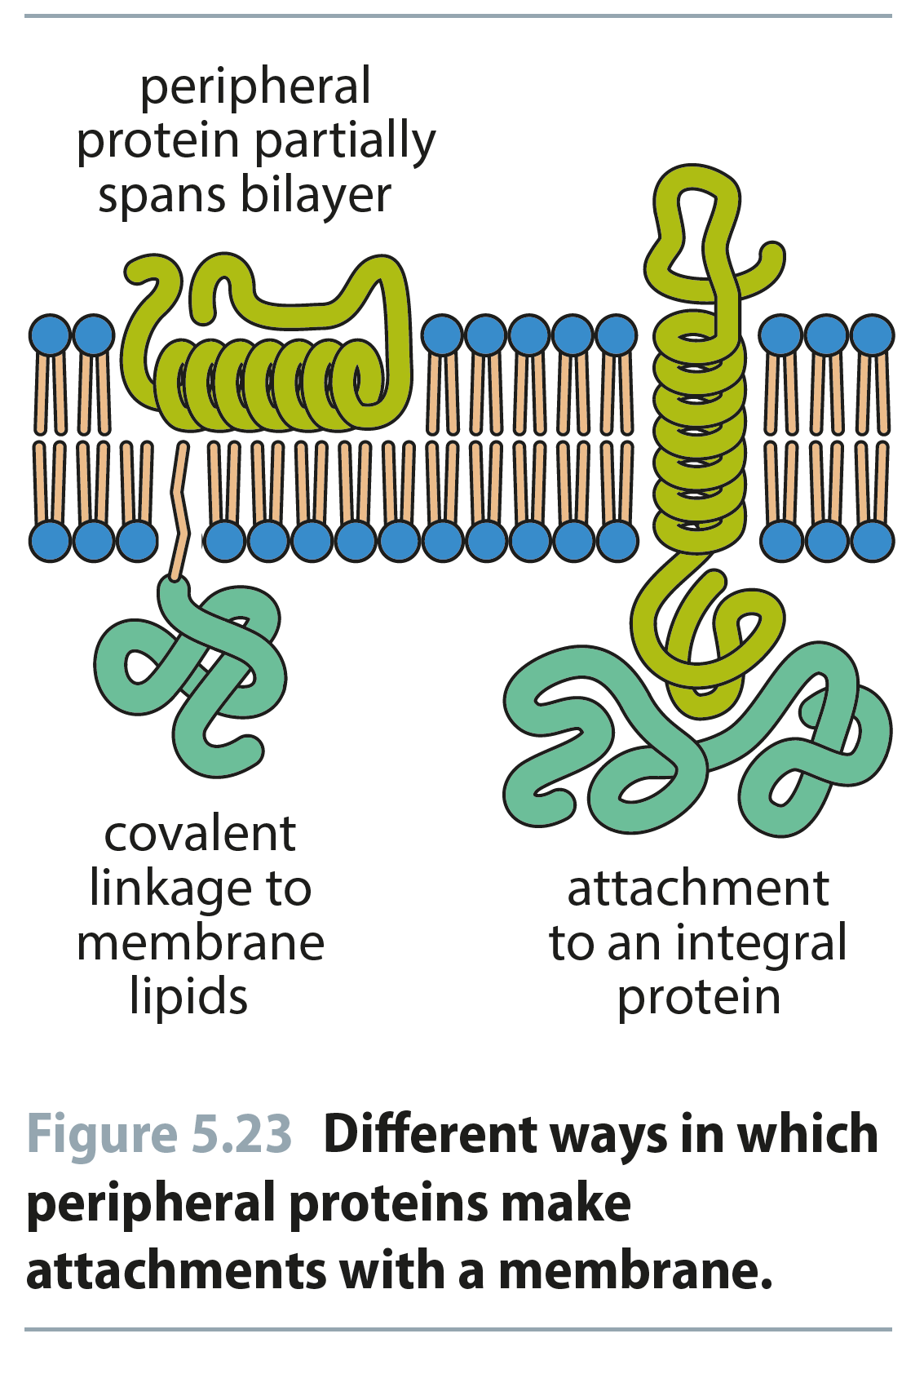
Fig 5.23
Reproduced from: Biochemistry by T.A. Brown, ISBN: 9781907904288 © Scion Publishing Ltd, 2017

Slide 28
Fig 5.24
Reproduced from: Biochemistry by T.A. Brown, ISBN: 9781907904288 © Scion Publishing Ltd, 2017

Slide 29
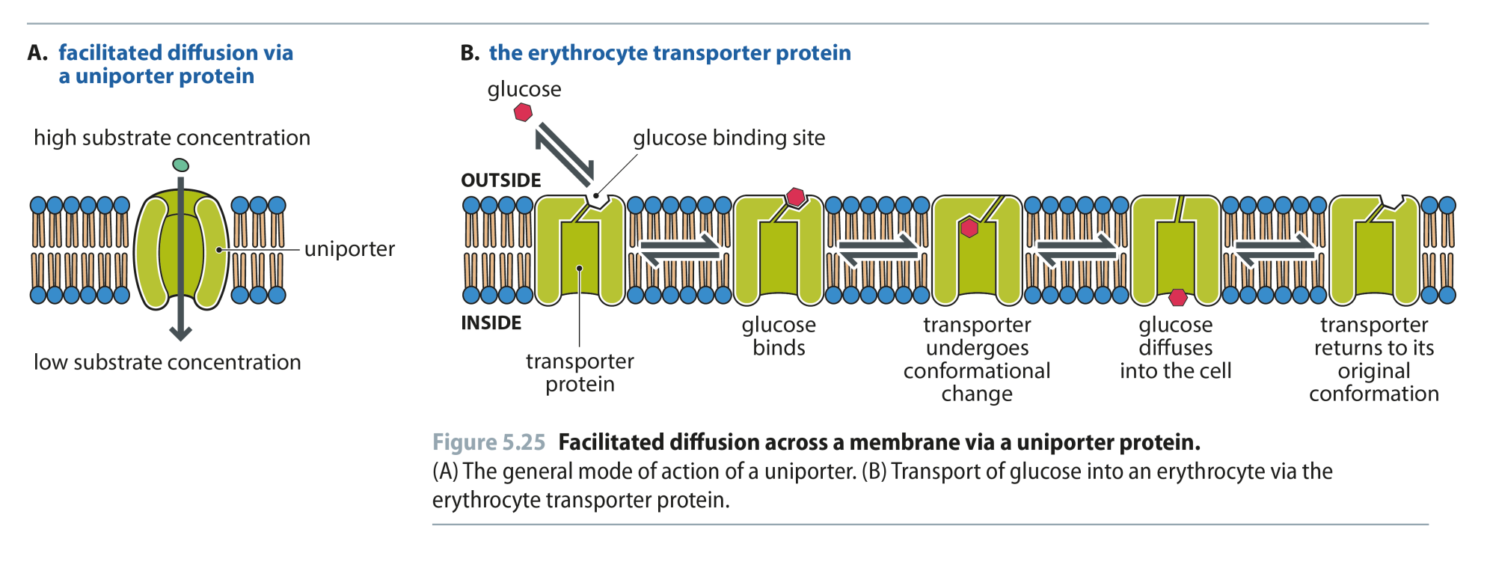
Fig 5.25
Reproduced from: Biochemistry by T.A. Brown, ISBN: 9781907904288 © Scion Publishing Ltd, 2017

Slide 30
Table 5.5
Reproduced from: Biochemistry by T.A. Brown, ISBN: 9781907904288 © Scion Publishing Ltd, 2017

Slide 31
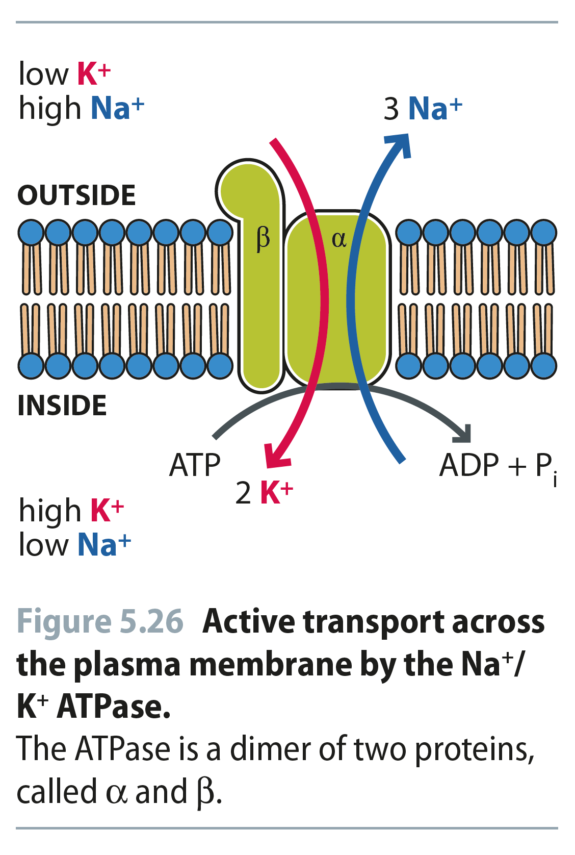
Fig 5.26
Reproduced from: Biochemistry by T.A. Brown, ISBN: 9781907904288 © Scion Publishing Ltd, 2017

Slide 32
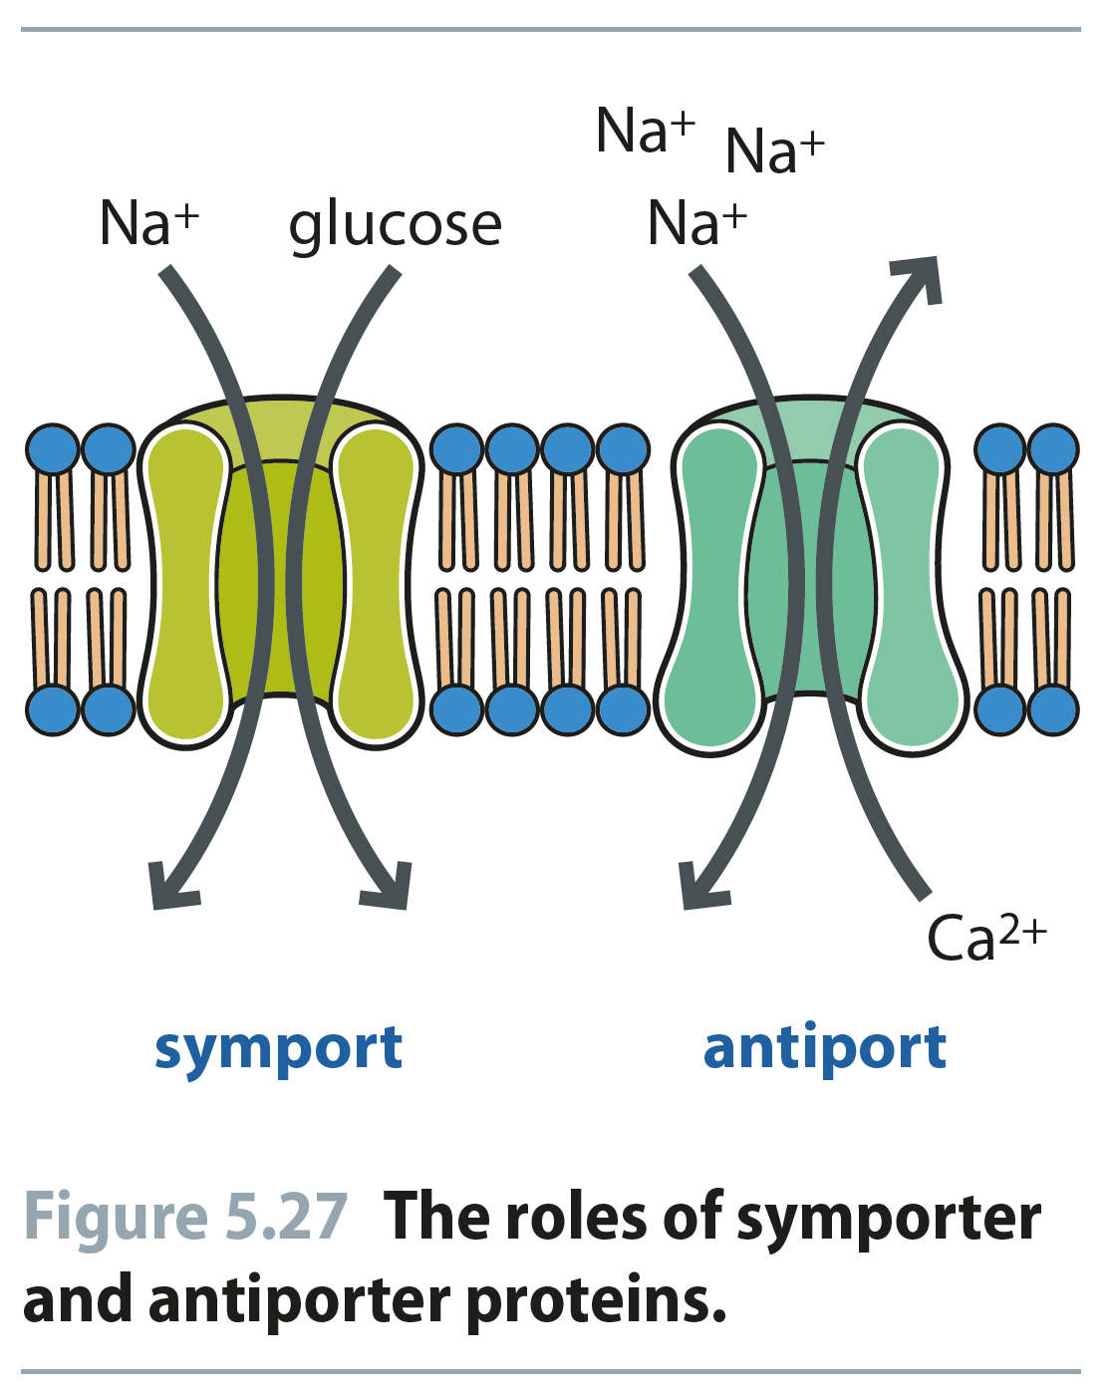
Fig 5.27
Reproduced from: Biochemistry by T.A. Brown, ISBN: 9781907904288 © Scion Publishing Ltd, 2017

Slide 33
Fig 5.28
Reproduced from: Biochemistry by T.A. Brown, ISBN: 9781907904288 © Scion Publishing Ltd, 2017

Slide 34
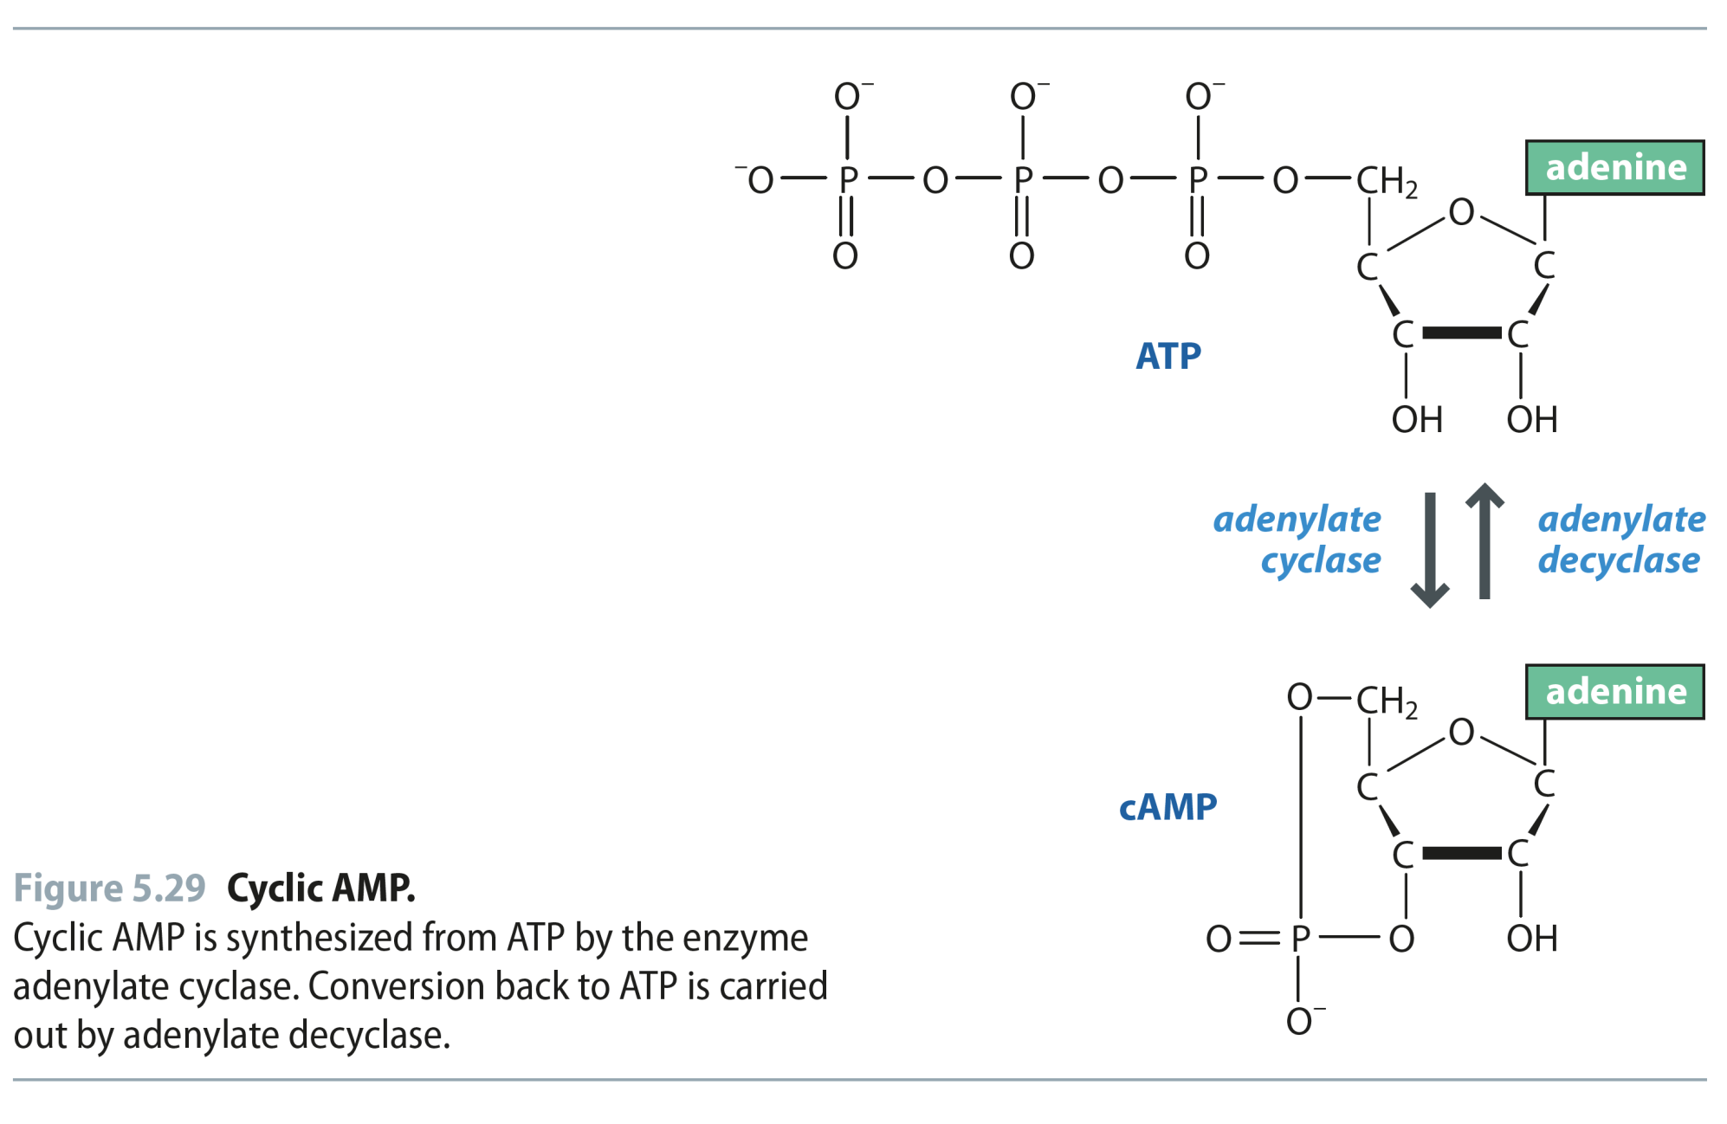
Fig 5.29
Reproduced from: Biochemistry by T.A. Brown, ISBN: 9781907904288 © Scion Publishing Ltd, 2017

Slide 35
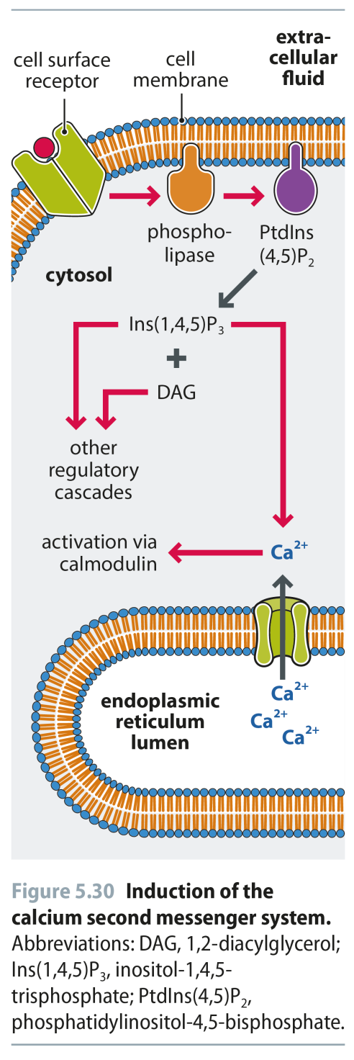
Fig 5.30
Reproduced from: Biochemistry by T.A. Brown, ISBN: 9781907904288 © Scion Publishing Ltd, 2017

